Slide 1
The RCDAC Data Acquisition System
Martin L. Purschke
DAQ manager of sPHENIX
Previous DAQ/Electronics WG co-convener for what is now ePIC
I have been a DAQ (and notably, a calorimeter) guy since my early days at CERN
The new ePIC logo now immortalized at the F&A Grog House, 117 East 3rd St, Bethlehem, PA 18015

Slide 2
What I’ll be talking about today
RCDAQ is DAQ system that has been around since about 2012
It started out as your swiss army knife-type DAQ system to quickly read out whatever you need for your R&D project
It was used in pretty much all R&D campaigns for sPHENIX, but already much earlier in several EIC-themed test beams and other measurements, typically at the Fermilab Test Beam Facility
To the best of my knowledge (some I know, some I learn about when I get questions), it is in use in about 25-30 places around the world
I have step-by-step manuals with examples that seem to work for groups that set up completely autonomously. Just the other day I got a question from an outside group that I didn’t know about. They had been using RDAQ for more than a year and finally had a question.
RCDAQ was chosen to be the main DAQ system of sPHENIX, with several higher-level additions (“Run Control”) that are irrelevant here
I will mostly focus on lab-test / R&D-style / test beam setups today
Go to https://www.phenix.bnl.gov/~purschke/rcdaq for the manuals and sample data files etc

Slide 3
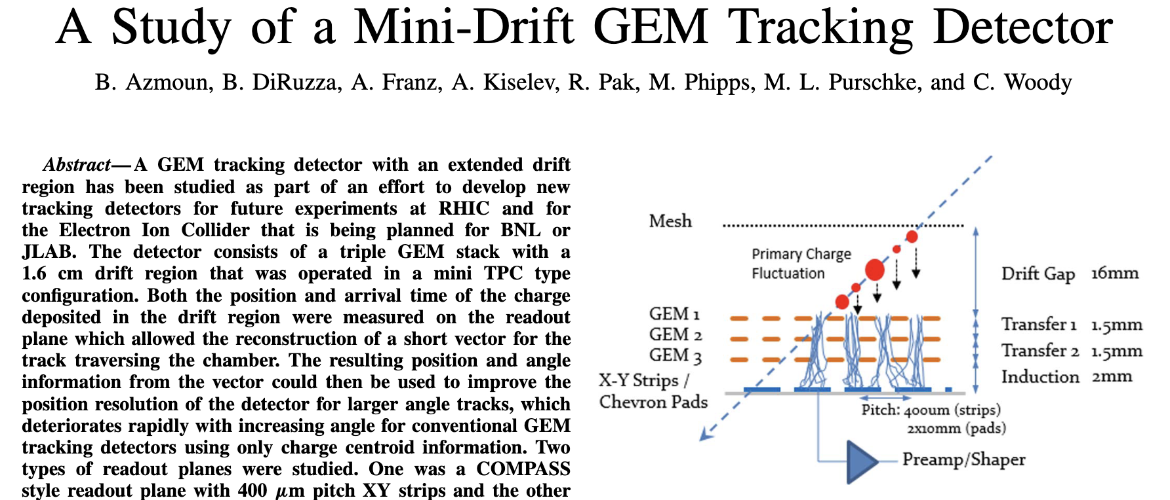
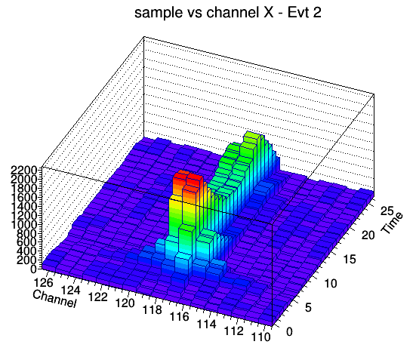
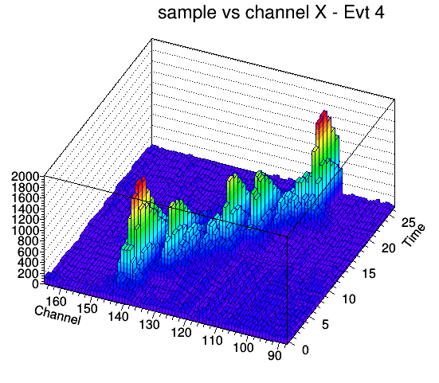
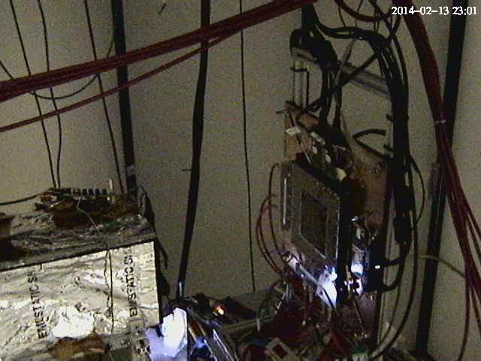
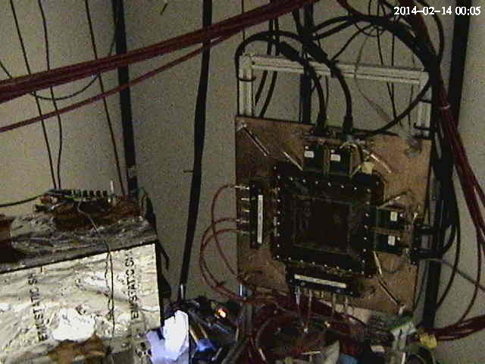
One of the early EIC test beam campaigns with RCDAQ - The Minidrift GEM tracking detector (2014)
IEEE Transactions on Nuclear Science, vol. 63, no. 3, pp. 1768-1776, June 2016
10 years ago!

Slide 4
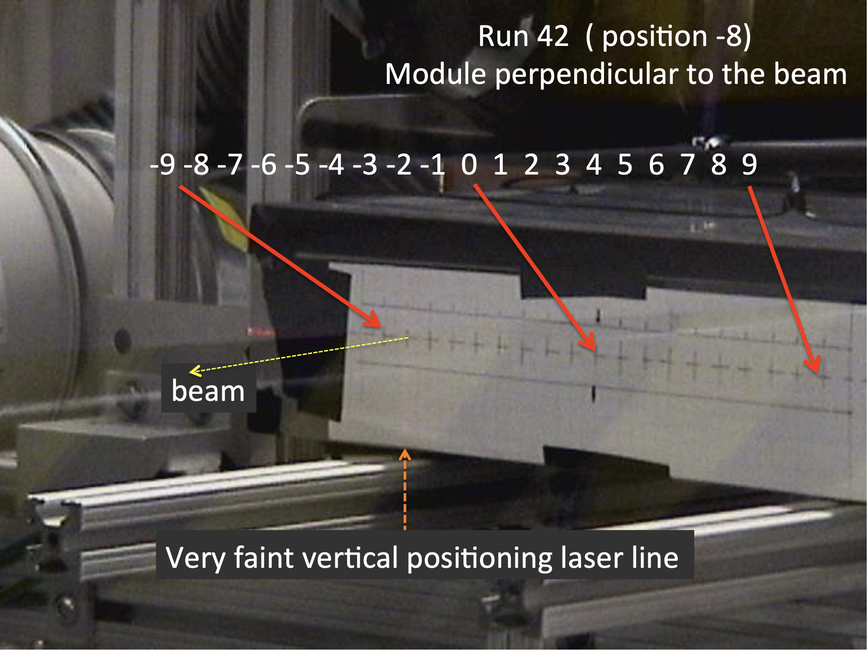
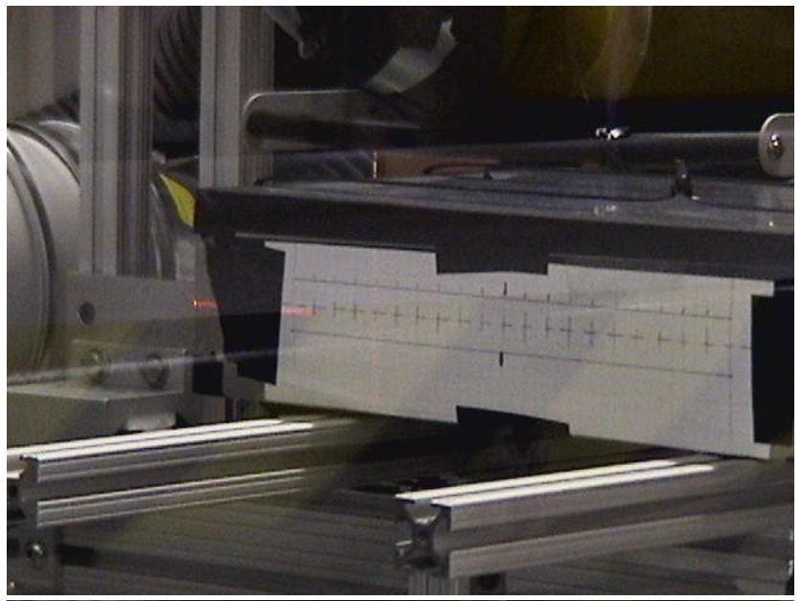
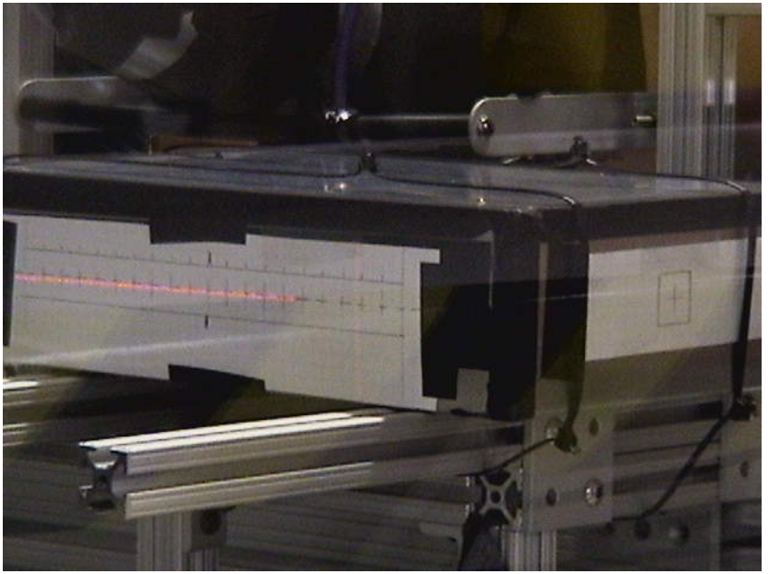
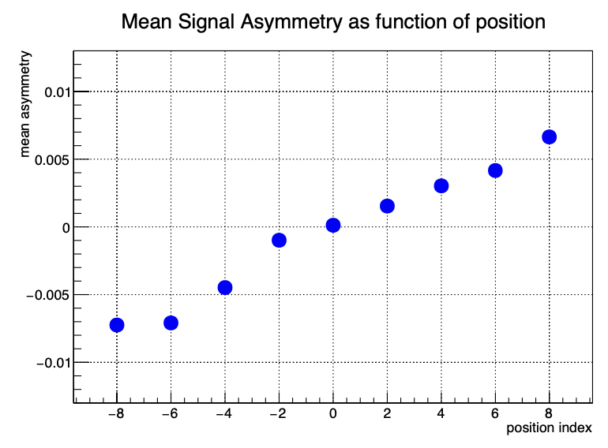
Another one from the EIC calo orbit – Oleg, Craig, myself
”Can we get more calorimeter position information by adding a dual readout and measure time?”
Moving the calorimeter in the beam for “more left” or “more right” incidence
In the end we found that it’s too small an effect to pursue, but it was worth checking!

Slide 5
What does one need?
Pretty much any Linux machine and distro will do. (I do lots of development on a Linux VM on my M2 Mac here)
I’m striving to be distro-agnostic:
RedHat and derivatives (RHEL, Fedora, CentOS, Alma… all good)
Debian and similar (Ubuntu, Mint, …)
Arch Linux
And yes, it does run on a Raspberry Pi – sometimes you want to take a few weeks worth of cosmics with some detector module without tying up a more expensive PC
The main platforms currently at work in sPHENIX are 96-core AMD EPYC PCs.
For practicing/going through the manuals, you can run everything without any actual readout hardware – RCDAQ provides “pretend-devices” that behave like an ADC

Slide 6
RCDAQ - The High Points
Each interaction with RCDAQ is a shell command. There is no “starting an application and issuing internal commands” (think of your interaction with, say, root)
RCDAQ out of the box doesn’t know about any particular hardware. All knowledge how to read out something, say, a FELIX card, comes by way of a plugin that teaches RCDAQ how to do that.
That makes RCDAQ highly portable and also distributable – some sPHENIX FEMs use commercial drivers for the readout; I cannot re-distribute CAEN software, etc etc
RCDAQ has no proprietary configuration files. (huh? In a minute).
Support for different event types
Built-in support for standard online monitoring
Built-in support for electronic logbooks (Stefan Ritt’s Elog)
Network-transparent control interfaces

Slide 7
Everything is a shell command…
One of the most important features. Any command is no different from “ls –l“ or “cat”
Everything is inherently scriptable
You have the full use of the shell’s capabilities for if-then constructs, error handling, loops, automation, cron scheduling, and a myriad of other ways to interact with the system
In that sense, there are no proprietary configuration files – only configuration scripts.
This is quite different from “my DAQ supports scripts”!
I do not want to be trapped within the limited command set of any application!
With shell commands, the DAQ is fully integrated into your existing work environment
(And yes there are GUIs – they usually just trigger the appropriate command)

Slide 8
On Autopilot - Scripts at work
Very often – especially in your R&D days – you want to step through a range of values of a configuration parameter and see what your detector prototype has to say
Bias voltage scans (we characterized gazillions of SiPMs)
Position scans
Temperature scans
And on and on
Such a measurement is best done in a script that reads predetermined positions / voltage settings / what have you and performs the measurement
I picked an example: What is the response uniformity of a calorimeter module when a shower develops in different places? (We were very worried about this)
We were simulating different shower positions by “writing light with a light fiber” on the module front face

Slide 9
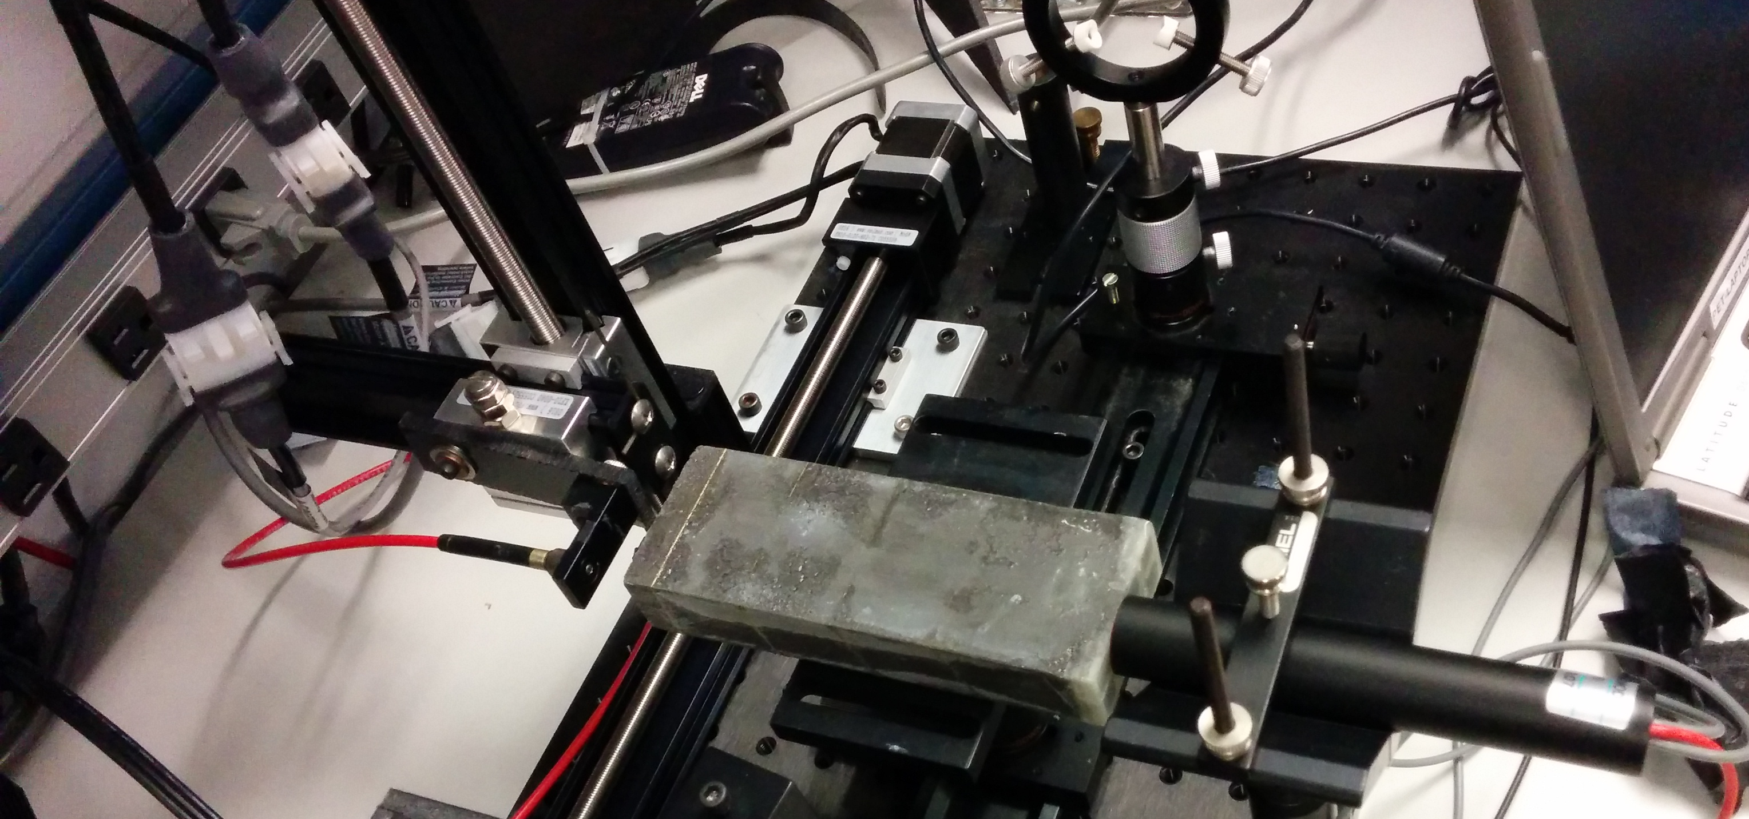
Measurements on autopilot through scripting
Simulate shower incidence positions by moving a light fiber in x and y
take a run for each position w/ 4000 events
50 x 25 = 1250 positions (later we had 60x60, you really want to automate that)
Let it run overnight, come back in the morning, look at the data
X-Y step motor
Calorimeter Module
Light Fiber
PMT
(later SiPM)

Slide 10
The Script
#! /bin/sh
STARTPOSX=0
STARTPOSY=9900
INCREMENTX=200
INCREMENTY=-200
CURRENTPOSY=$STARTPOSY
for posy in $(seq 25) ; do
quickmove.sh $CURRENTPOSY 2
sleep 5
CURRENTPOSY=$( expr $CURRENTPOSY + $INCREMENTY)
CURRENTPOSX=$STARTPOSX
for posx in $(seq 50) ; do
echo "moving to $CURRENTPOSX"
quickmove.sh $CURRENTPOSX 1
sleep 5
CURRENTPOSX=$( expr $CURRENTPOSX + $INCREMENTX)
done
done
The DAQ operation becomes an integral part of your shell environment
25 positions in y
move the Y motor
50 positions in x
move the x motor
next x
next y
Automatic end after 4000 events
start the DAQ
rcdaq_client daq_set_maxevents 4000
rcdaq_client daq_begin
wait_for_run_end.sh

Slide 11
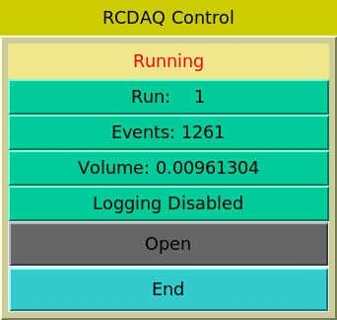
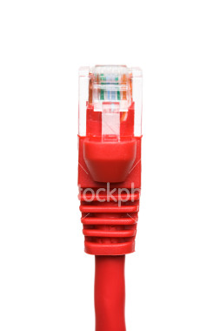
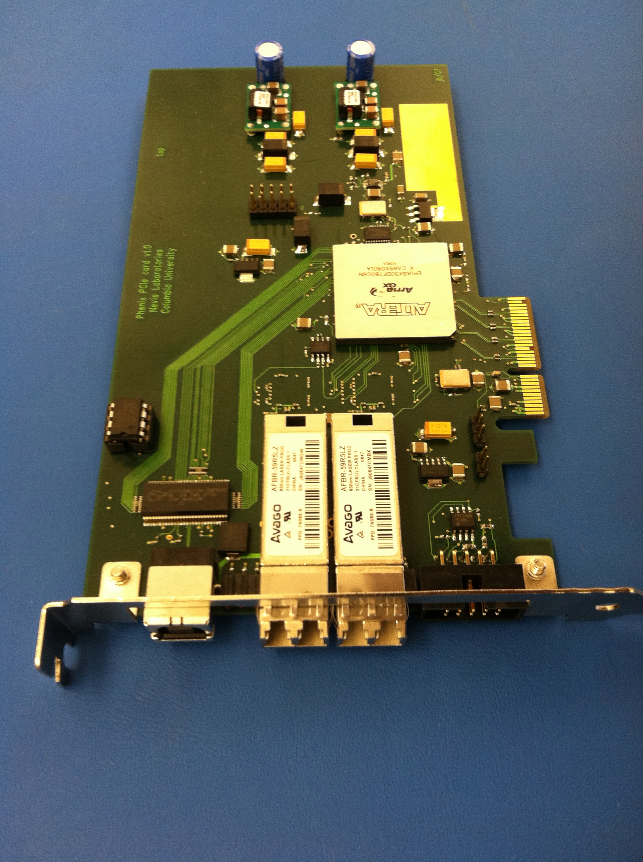
The RCDAQ client-server concept
RCDAQ Client
RCDAQ Client
scripts
Command line
RPC Protocol
RCDAQ Client
Command line
RCDAQ server
This allows an arbitrary number of processes to interact with RCDAQ concurrently
PCIe Network USB
Hardware
Hardware
Hardware
These are the 3 fundamental ways for data to get into a PC –
PCIExpress
Network
USB

Slide 12
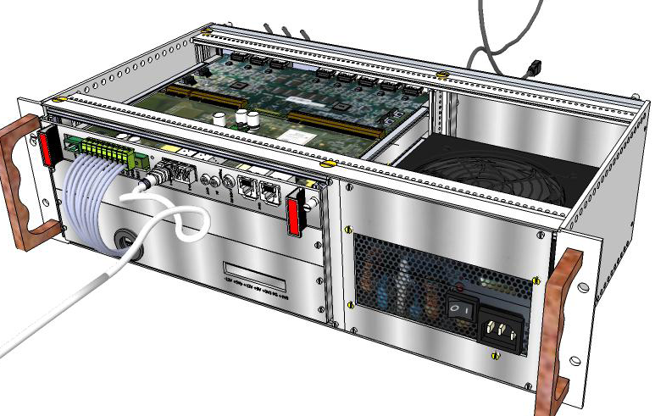
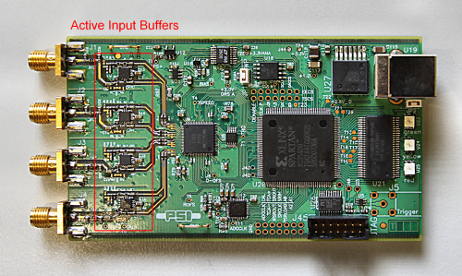
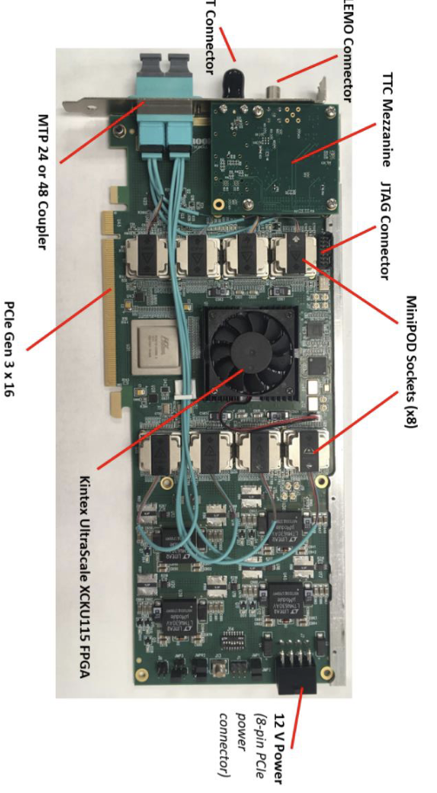
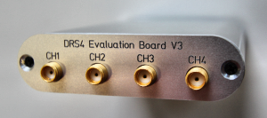
Some workhorse devices implemented in RCDAQ
RCDAQ
PCIe
PCIe
The CERN RD51 SRS System
DRS4 Eval board
“USB Oscilloscope”
The CAEN V1742 waveform digitizer
FELIX Card
There are many more not shown (all told, there are plugins for about 60)
Many devices that you can often find in your institute already, or in the CAEN catalog

Slide 13
Example: reading out a DRS4 Eval board
$ rcdaq_client load librcdaqplugin_drs.so
$ rcdaq_client create_device device_drs -- 1 1001 0x21 -150 negative 140 3
$ daq_open
$ daq_begin
# wait a while…
$ daq_end
You see, each interaction is a separate shell command.

Slide 14
Meta Data Capturing
In the “real” experiment that’s running for a few years (think sPHENIX, ATLAS, what have you) you are embedded in an environment that supports all sorts of record keeping
At a test beam or you in your lab needs a different kind of “record keeping support”
What was the temperature? Was the light on? What was the HV? What was the position of that X-Y positioning table?
We capture this information in the raw data file itself and the data cannot get lost
I often add a webcam picture to the data so we have a visual confirmation that the detector is in the right place, or something
A picture captures everything…
Let me show you how we always capture the RCDAQ setup itself

Slide 15
Reading different things with different Event Types
You would think of the DAQ as “reading out your detector”
Very often, it is necessary to read out different things at different times.
Let’s go to the CERN-SPS (or the Fermilab Test Beam facility) for an example
One needs to read out “meta-info” about each spill for spill-by-spill corrections
acceleration
SPS or AGS
extraction
“spill”
Begin-run event
End-run event
Spill-On event
Read and clear scalers
Flush buffers
Data Events
Read your detector channels, ADCs, TDCs...
Spill-Off event
Read and clear scalers
(allows spill intensity-based corrections)
15
Two more events that are always there – the begin-run and end-run events

Slide 16
Remember this?
This was our typed-in example from before
$ rcdaq_client load librcdaqplugin_drs.so
$ rcdaq_client create_device device_drs -- 1 1001 0x21 -150 negative 140 3
Now you put this into a script so you always get the same setup:
#! /bin/sh
rcdaq_client load librcdaqplugin_drs.so
rcdaq_client create_device device_drs -- 1 1001 0x21 -150 negative 140 3

Slide 17
Capturing the setup script itself for posterity
We add this very setup script file into our begin-run event for posterity
This “device” captures a file as text into a packet
This “9” is the event type of the beg-run
And this refers to the name of the file itself
#! /bin/sh
rcdaq_client create_device device_file 9 900 ”$0”
rcdaq_client load librcdaqplugin_drs.so
rcdaq_client create_device device_drs -- 1 1001 0x21 -150 negative 140 3
So this gets added as packet with id 900 in the begin-run
It’s not quite right yet - $0 is usually just “setup.sh”, so the server may not be able to find it.
Let me show the “end product”:

Slide 18
A typical RCDAQ Setup Script
#! /bin/sh
# this sets up the DRS4 readout with 5GS/s, a negative
# slope trigger in channel 1 with a delay of 140
if ! rcdaq_client daq_status > /dev/null 2>&1 ; then
echo "No rcdaq_server running, starting..."
rcdaq_server > $HOME/rcdaq.log 2>&1 &
sleep 2
fi
MYSELF=$(readlink -f $0)
rcdaq_client daq_clear_readlist
rcdaq_client create_device device_file 9 900 "$MYSELF”
rcdaq_client load librcdaqplugin_drs.so
rcdaq_client create_device device_drs -- 1 1001 0x21 -150 negative 140 3
We comment a lot as a way of documentation
If no server is running, we start one here.
We convert the script filename into a full path
We clear all existing definitions
We load the plugin(s) and define the device(s)

Slide 19
Here is the actual setup script for our FELIX readout
Abridged version, just the essentials
#!/bin/bash
RunType=beam
H=$RCDAQHOST
[ -z "$H" ] && H=$(hostname)
MYSELF=$(readlink -f $0)
rcdaq_client daq_clear_readlist
rcdaq_client create_device device_file 9 900 "$MYSELF"
rcdaq_client load librcdaqplugin_dam.so
rcdaq_client create_device device_dam 1 4${H:4:2}1 1 128
rcdaq_client daq_set_runcontrolmode 1

Slide 20
More about capturing your environment
Sometimes you add meta-info to make the analysis easier, especially in the aforementioned “scanning something” setups - example later
Many times you capture things only “just in case”
I usually add a camera picture to the begin-run, especially when the detector moves in the beam for some position scan
You don’t routinely look at them in your analysis, but it’s good to have that info
If you have some inexplicable feature, you can use the meta-data to do “forensics”
Find out what, if anything, went wrong
The more data you capture, the better this gets
Think of it as “black box” on a plane…

Slide 21
Forensics (FermiLab test beam for the future ePIC HCal)
“It appears that the distributions change for Cherenkov1 at 1,8,12,and 16 GeV compared to the other energies. It seems that the Cherenkov pressures are changed. […] Any help on understanding this would be appreciated.”
Martin: “Look at the info in the data files:”
Among many other things, we capture the most relevant beamline parameters
$ ddump -t 9 -p 923 beam_00002298-0000.prdf
S:MTNRG = -1 GeV
F:MT6SC1 = 5790 Cnts
F:MT6SC2 = 3533 Cnts
F:MT6SC3 = 1780 Cnts
F:MT6SC4 = 0 Cnts
F:MT6SC5 = 73316 Cnts
E:2CH = 1058 mm
E:2CV = 133.1 mm
E:2CMT6T = 73.84 F
E:2CMT6H = 32.86 %Hum
F:MT5CP2 = .4589 Psia
F:MT6CP2 = .6794 Psia
$ ddump -t 9 -p 923 beam_00002268-0000.prdf
S:MTNRG = -2 GeV
F:MT6SC1 = 11846 Cnts
F:MT6SC2 = 7069 Cnts
F:MT6SC3 = 3883 Cnts
F:MT6SC4 = 0 Cnts
F:MT6SC5 = 283048 Cnts
E:2CH = 1058 mm
E:2CV = 133 mm
E:2CMT6T = 74.13 F
E:2CMT6H = 37.26 %Hum
F:MT5CP2 = 12.95 Psia
F:MT6CP2 = 14.03 Psia

Slide 22
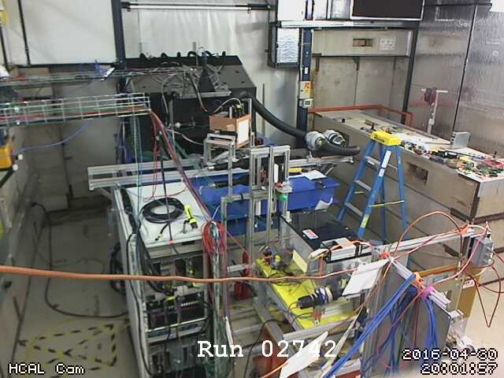
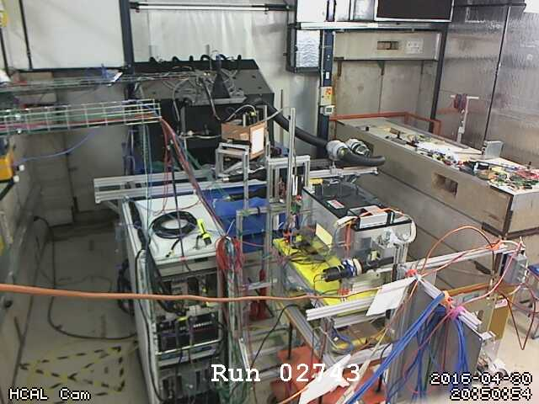
More Forensics (HCal at the Fermilab test beam again…)
“There is a strange effect starting in run 2743. There is a higher fraction of showering than before. I cannot see anything changed in the elog.”
Look at the cam pictures we automatically captured for each run:
$ ddump -t 9 -p 940 beam_00002742-0000.prdf > 2742.jpg
$ ddump -t 9 -p 940 beam_00002743-0000.prdf > 2743.jpg

Slide 23
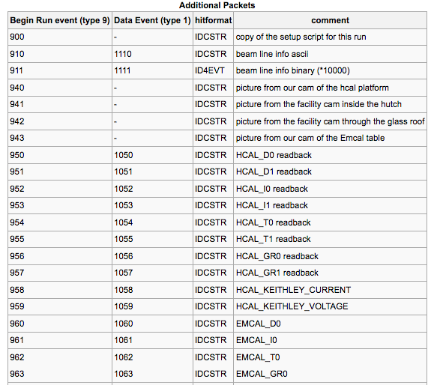
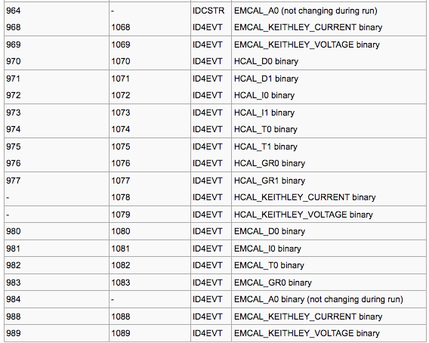
“Meta Data” Packet list from that test beam
More than 72 environment-capturing packets (accelerator params, voltages, currents, temperatures, pictures, …)
Captured at begin-run
Captured again at spill-off

Slide 24
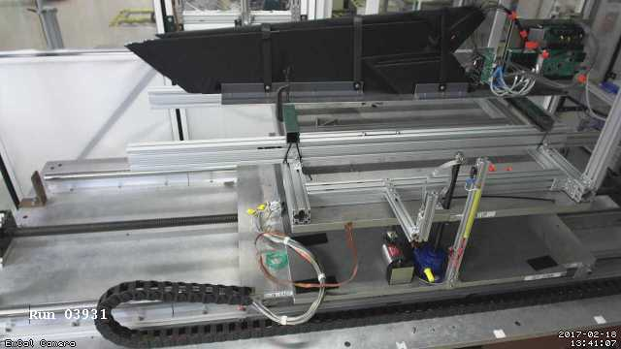
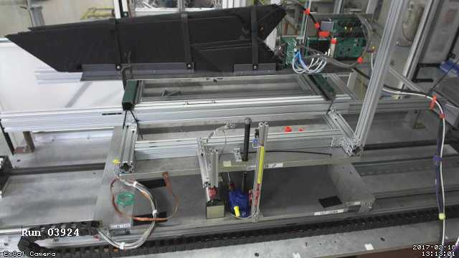
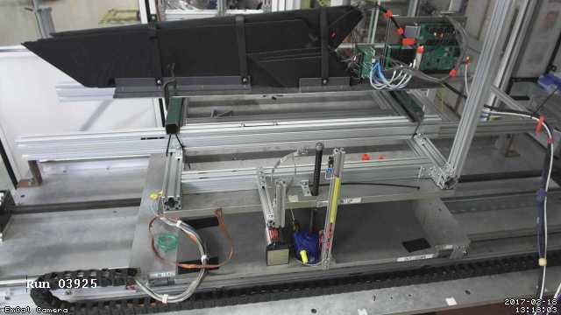
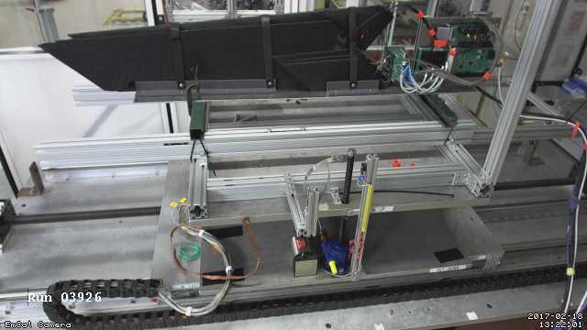
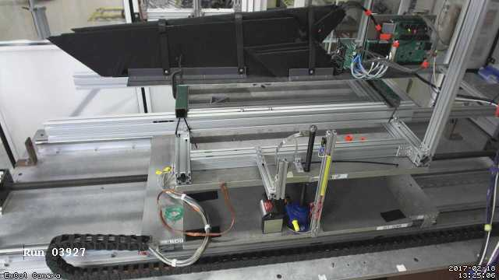
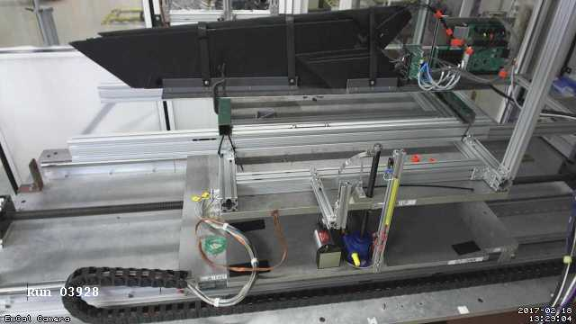
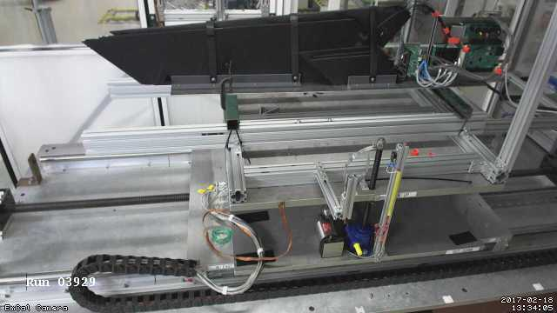
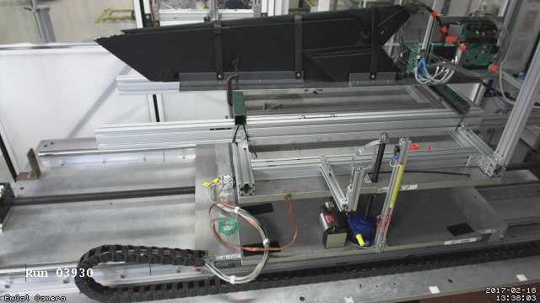
Moving Detector Example: “HCal Tile Mapping” at the Fermi Test Beam Facility
“Tile mapping” refers to mapping the position-dependent response of a hadronic calorimeter tile.
About 200 individual positions of the tile relative to the beam – you’d go nuts doing all that manually, and you are bound to make mistakes
So all is done on autopilot as explained before
And all on camera for feel-good value – does that thing move right when we think it should?
This setup exercises many of the aforementioned features: scripting and reacting to the FTBF spill, network transparency (we cannot access the table positioning from our DAQ machine, but a FTBF-owned machine can control our DAQ)

Slide 25
One last point: Using RCDAC features to streamline your analysis
Going back to the “calo module mapping” for a moment
You are ending up with several thousand individual data files, one per position
In each begin-run event we capture additional information, especially the x/y position this data point is from
RCDAQ has a “command device” that doesn’t read out anything but executes a command when the event is triggered – here we execute “getmotorpositions.sh” at each begin-run
This script reaches out to the positioning system and writes a file “positions.txt” with the two numbers
We then absorb the file into the begin-run event
And we can retrieve this in the analysis (here shown with a command-line utility):
# we add a command to capture the positions to a file
rcdaq_client create_device device_command 9 0 "$HOME/getmotorpositions.sh"
rcdaq_client create_device device_file 9 920 "$HOME/positions.txt"
rcdaq_client create_device device_filenumbers_delete 9 921 "$HOME/positions.txt"
$ ddump -t 9 -p 920 scan10_0000201800-0000.evt
4600
-4400

Slide 26
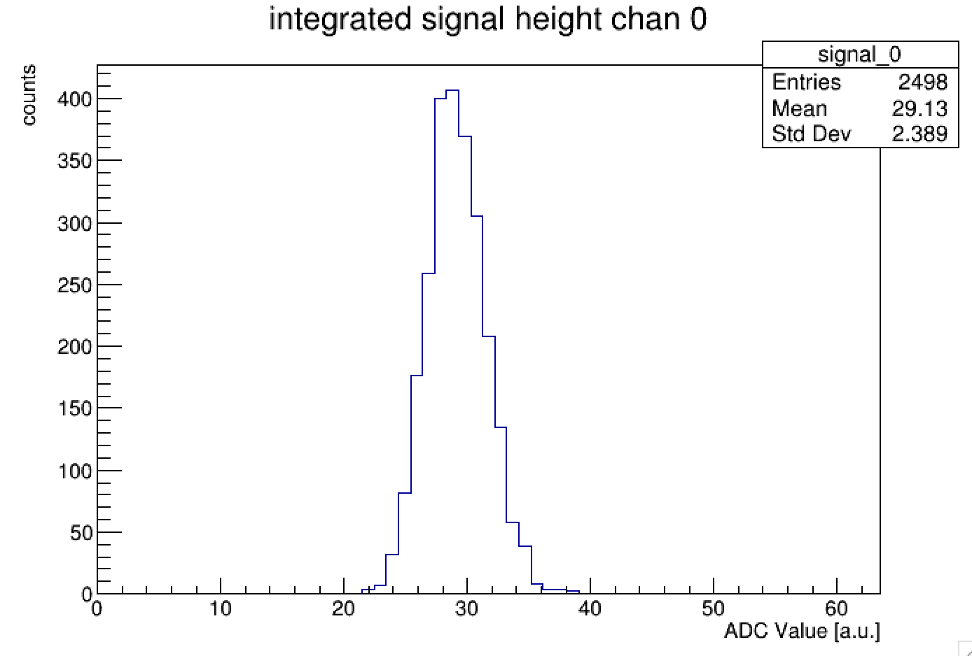
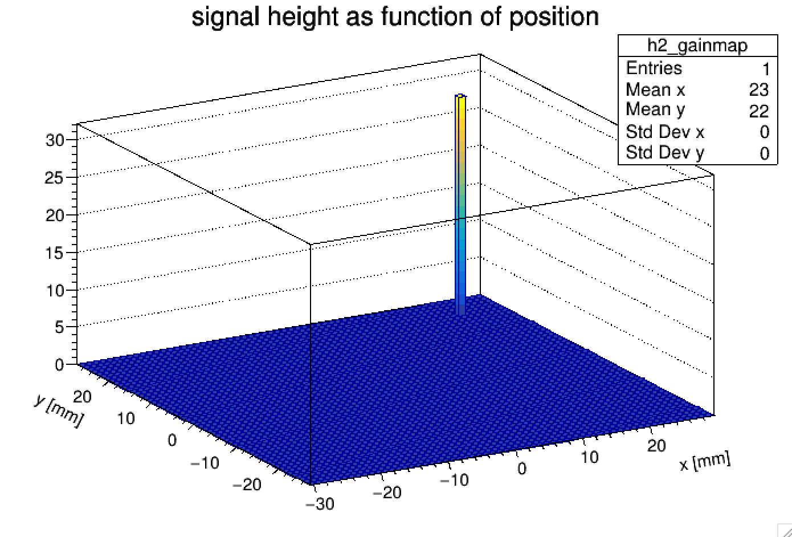
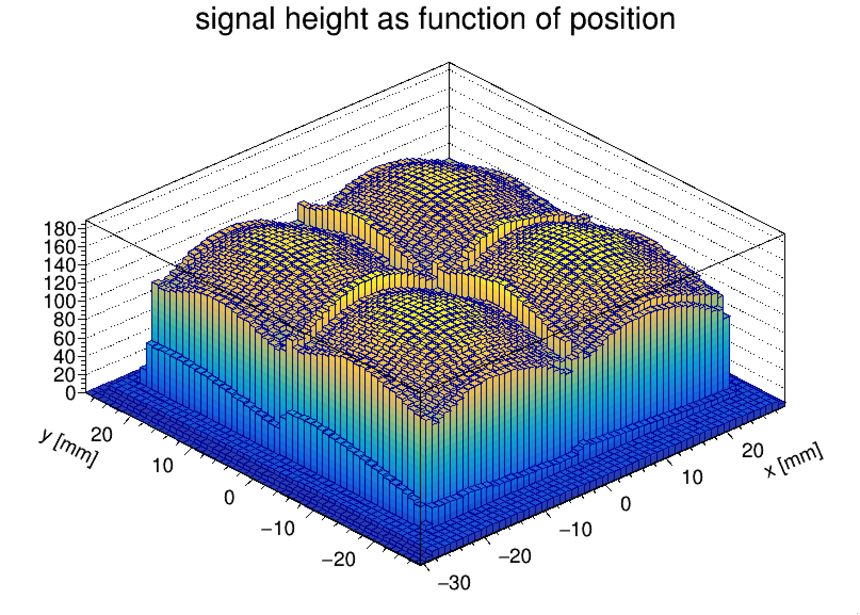
Using RCDAC features to streamline your analysis
Then we make a list of all files that belong to this scan, and throw them all at the at the analysis process
We get the begin-run event and extract and remember the x-y positions
We then histogram the signal with the actual data events
Eventually we hit end end-run event, know that this position is done. Get the mean from the histogram, and fill it in the map at the right position
Run through all files in the set, have a coffee, and see the results:
In this way you can run the analysis without burdensome additional bookkeeping
All you need to analyze the data in one fell swoop is contained in the data themselves

Slide 27
What’s in it for ePIC
I take pride in having one of the easiest-to-use and most versatile DAQ systems out there (from scratch on a brand-new PC to seeing a histogram: one hour)
RCDAQ can read out our detector-specific devices (think FELIX), and many commercial devices that are often used in lab tests (like CAEN V1742, SRS, DRS4, …)
The latest addition is Nalu’s ASocV3 (in progress)
We have been (and are, all BNL/Yale/SBU, test beams) using RCDAQ for our R&D, ample operational experience among ePIC members
Superb support for automated measurements that we will need for many tests
Support for analysis and online monitoring (not enough time today, maybe another time)
(I brought a DRS4 with me if you want a demo in a coffee break)
BTW: We maintain a permanent “bridgehead” at the Fermi FTBF and can spin up a readout system in an hour after you are through the front gate
Notes:
----- Meeting Notes (1/27/16 16:27) -----

Slide 28
There is one thing I haven’t told you yet…
What does “RCDAQ” stand for?
The “Really Cool Data Acquisition”
Thank you!

Slide 29
This page is intentionally left blank

Slide 30
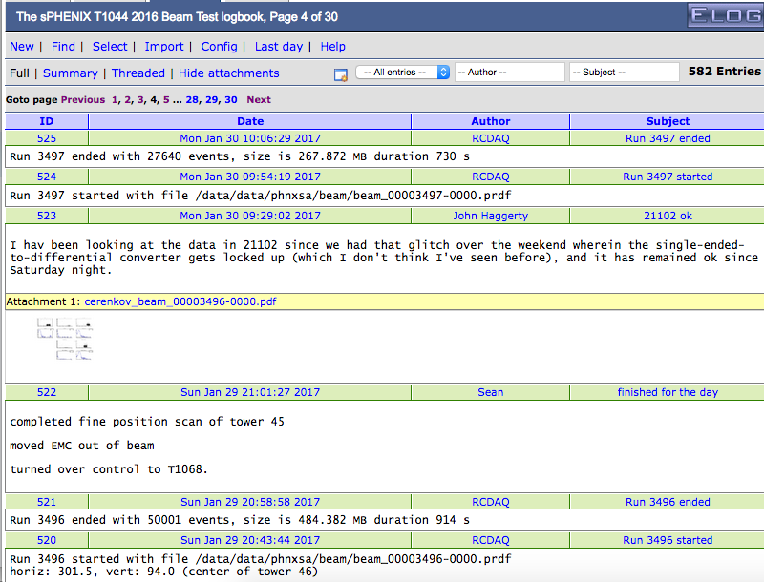
Automated Elog Entries
RCDAQ can make automated entries in your Elog
Of course you can make your own entries, document stuff, edit entries
Gives a nice timeline and log
Notes:
----- Meeting Notes (1/27/16 16:27) -----

Slide 31
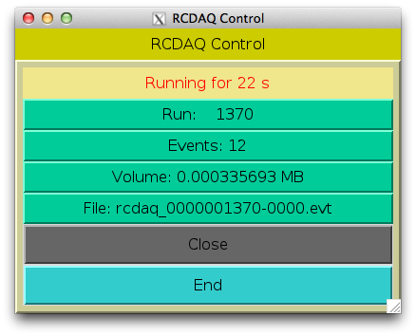
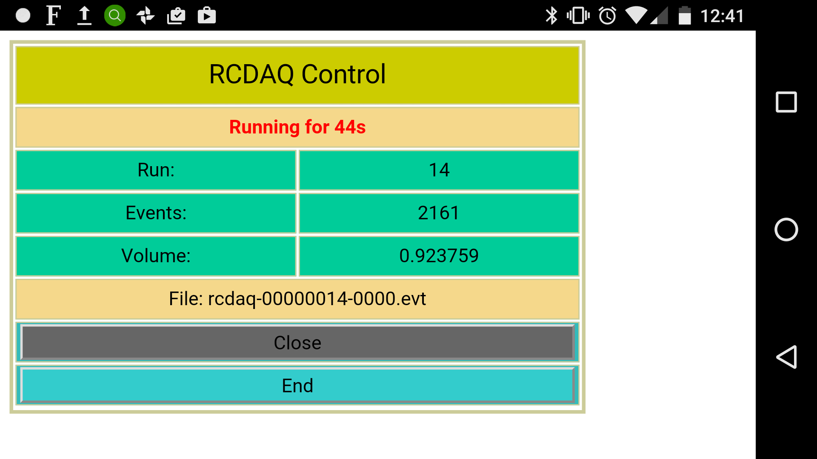
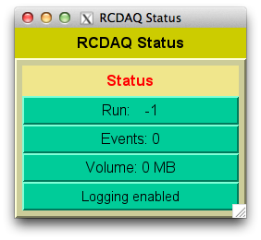
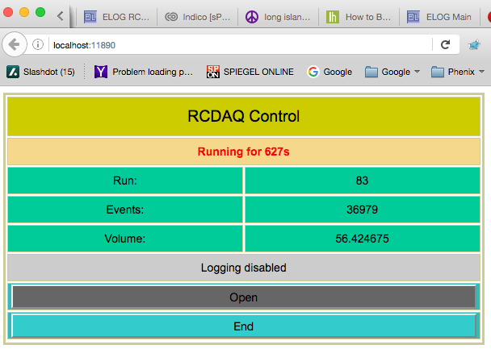
GUIs
On my phone
GUIs must not be stateful!
Statelessness allows to have multiple GUIs at the same time
And allows to mix GUIs with commands (think scripts)
(all state information is kept in the rcdaq server)
My GUI approach is to have perl-TK issue standard commands, parse the output
Slowly transitioning to Web-based controls (web sockets + Javascript)
Perl-TK
Web Browser

Slide 32
Ok, that was a lot about test beams… what about sPHENIX
I harped on lab tests / test beams etc a bit because that’s what ePIC will be busy with for some time
What do we do in sPHENIX?
In short, each detector element connects to a PC that runs its own instance of RCDAQ
It’s all “glued” together with the timing system
And our (in 2023) 52 RCDAQ instances are controlled by a meta-process “RunControl”
The RCDAQs run in a “run control mode” that reduces some of their autonomy so that Run Control is, well, in control
Notes:
----- Meeting Notes (1/27/16 16:27) -----

Slide 33
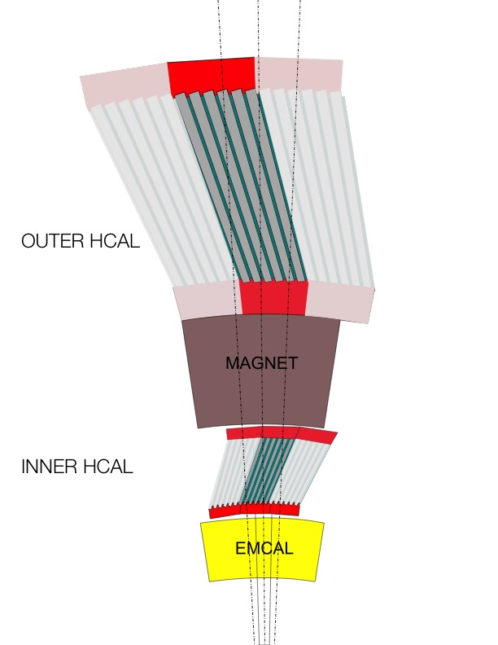
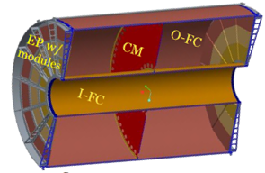
sPHENIX DAQ Bird’s eye view
FEM
100+ Gigabit
Crossbar
Switch
DCM
DCM2
DCM
DCM
DCM
DCM
FEM
DCM
SEB
Buffer Box
DCM
DCM
DCM2
DCM
DCM
DCM
Buffer Box
FEM
DCM
SEB
DCM
To
HPSS (Computing Center)
DCM
DCM
DCM2
DCM
SEB
Buffer Box
DCM
DCM
FEE
Buffer Box
DCM
DCM
FELIX
EBDC
DCM
FEE
Buffer Box
DCM
DCM
FELIX
EBDC
DCM
FEE
Buffer Box
DCM
FELIX
EBDC
DCM
DCM
Data Concentration
On Detector
Rack Room
Rack Room
Rack Room
DCM-2 receives data from digitizer, zero-suppresses and packages
SEB collects data from a DCM group (~20)
EBDC Event Buffer and Data Compressor (~40)
Buffer Box data interim storage before sending to the computing center (6)
Notes:
----- Meeting Notes (1/27/16 16:27) -----

Slide 34
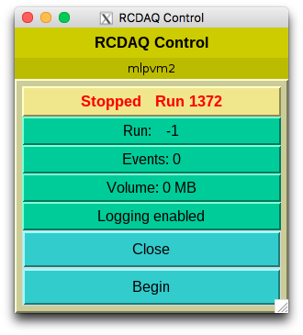
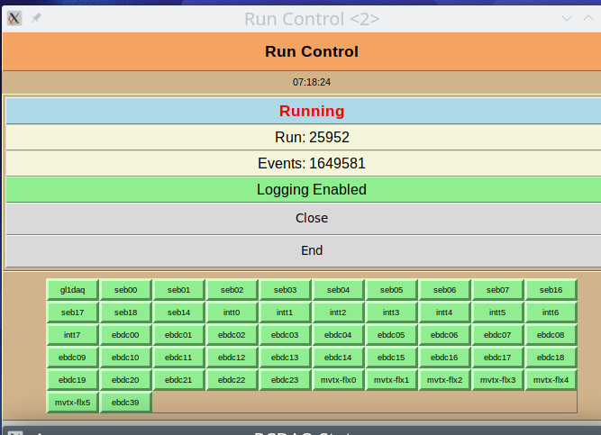
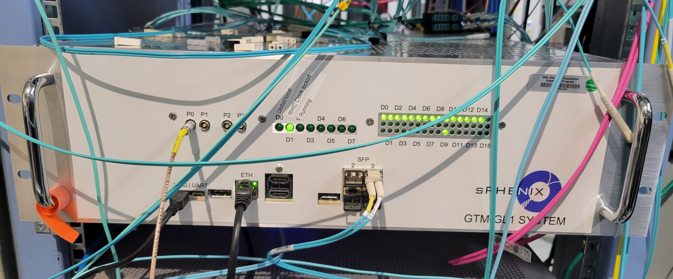
many, many RCDAQs in sPHENIX
FEM
FEE
DCM
DCM2
FEE
DCM
DCM
DCM
DCM
DCM
FELIX
EBDC
DCM
DCM
DCM
FELIX
EBDC
DCM
FEM
DCM
SEB
DCM
FEE
DCM
DCM
DCM
DCM2
FEE
DCM
FELIX
EBDC
DCM
DCM
DCM
DCM
DCM
DCM
FELIX
EBDC
FEM
DCM
SEB
DCM
DCM
FEE
DCM
FEE
DCM
DCM
DCM2
DCM
DCM
FELIX
EBDC
DCM
SEB
DCM
FELIX
EBDC
DCM
DCM
DCM
DCM
FEE
FEE
DCM
DCM
DCM
FELIX
EBDC
FEM
DCM
FELIX
EBDC
DCM
DCM
DCM2
DCM
DCM
DCM
FEE
DCM
DCM
FEE
DCM
DCM
SEB
DCM
DCM
FELIX
EBDC
FEM
DCM
FELIX
EBDC
DCM
DCM
DCM
DCM
DCM2
DCM
DCM
FEE
DCM
FEE
DCM
FEM
DCM
SEB
DCM
DCM
FELIX
EBDC
DCM
DCM
FELIX
EBDC
DCM
DCM
DCM
DCM
DCM2
FEE
DCM
SEB
DCM
DCM
FEE
DCM
DCM
DCM
FELIX
EBDC
DCM
FELIX
EBDC
DCM
FEM
DCM
FEE
DCM
FEE
DCM
DCM
DCM2
DCM
DCM
FELIX
EBDC
DCM
DCM
DCM
FELIX
EBDC
DCM
DCM
DCM
FEM
DCM
SEB
FEE
DCM
FEE
DCM
FELIX
EBDC
DCM
DCM2
DCM
DCM
DCM
DCM
DCM
FELIX
EBDC
DCM
DCM
DCM
FEM
DCM
SEB
FEE
DCM
DCM
DCM
Held together by
Run Control (slow controls - start, stop, etc)
RHIC crossing-by-crossing by the Timing System
DCM
FEE
DCM
FELIX
EBDC
DCM2
DCM
DCM
DCM
DCM
FELIX
EBDC
DCM
SEB
DCM
DCM
FEE
FEE
DCM
DCM
DCM
FELIX
EBDC
DCM
FELIX
EBDC
DCM
FEM
DCM
DCM
DCM2
FEE
DCM
DCM
DCM
DCM
DCM
FEE
DCM
FELIX
EBDC
DCM
SEB
DCM
FELIX
EBDC
DCM
FEM
DCM
DCM
DCM
DCM
DCM2
DCM
DCM
FEE
DCM
FEE
DCM
FEM
DCM
SEB
DCM
DCM
FELIX
EBDC
DCM
DCM
FELIX
EBDC
DCM
DCM
DCM
DCM
DCM2
FEE
DCM
SEB
FEE
DCM
DCM
DCM
DCM
FELIX
EBDC
DCM
DCM
FELIX
EBDC
DCM
DCM
FEE
FEM
FEE
DCM
FELIX
EBDC
DCM
DCM
DCM
DCM
DCM2
DCM
FELIX
EBDC
DCM
DCM
DCM
DCM
DCM
FEM
DCM
SEB
FEE
DCM
FEE
DCM
DCM
DCM2
DCM
DCM
FELIX
EBDC
DCM
DCM
DCM
FELIX
EBDC
DCM
DCM
DCM
FEM
DCM
SEB
FEE
DCM
FEE
DCM
DCM
DCM
DCM
FELIX
EBDC
DCM
DCM2
DCM
FELIX
EBDC
DCM
DCM
SEB
DCM
DCM
FEE
DCM
FEE
DCM
FELIX
EBDC
DCM
DCM
DCM
FELIX
EBDC
DCM
FEM
DCM
DCM
DCM2
FEE
DCM
DCM
DCM
DCM
DCM
FEE
DCM
FELIX
EBDC
DCM
DCM
DCM
SEB
DCM
FELIX
EBDC
FEM
DCM
DCM
DCM
DCM2
FEE
DCM
DCM
FEE
DCM
DCM
DCM
DCM
FELIX
EBDC
FEM
DCM
SEB
DCM
FELIX
EBDC
DCM
DCM
DCM
DCM
FEE
DCM
DCM2
FEE
DCM
FELIX
EBDC
DCM
DCM
DCM
DCM
SEB
DCM
FELIX
EBDC
DCM
DCM
DCM
FEE
FEE
DCM
FEM
DCM
DCM
FELIX
EBDC
DCM
DCM2
DCM
FELIX
EBDC
DCM
DCM
DCM
DCM
DCM
DCM
FEE
DCM
SEB
FEE
DCM
FEM
DCM
DCM
FELIX
EBDC
DCM
DCM
FELIX
EBDC
DCM
DCM
DCM2
DCM
DCM
DCM
DCM
FEE
FEM
DCM
SEB
FEE
DCM
FELIX
EBDC
DCM
DCM
DCM
DCM
DCM
FELIX
EBDC
DCM
DCM
DCM2
DCM
DCM
SEB
DCM
DCM
Trigger/Timing system
Notes:
----- Meeting Notes (1/27/16 16:27) -----

Slide 35
Coming back to the “shell command” feature
For the last 3 minutes, I want to harp some more on the superiority of that “everything is a shell command” approach
Often I’m learning of a new ingenious way to use this aspect for something cool
A real good tool gets used in ways that the designer did not envision… but it works!
A group needed to test a few thousand pads on a plane if they a) work and b) are connected right.
Inject charge into the pads one by one... but you can't take your eyes (or the probe) off the pad plane or you lose your position
They came up with…
Notes:
----- Meeting Notes (1/27/16 16:27) -----

Slide 36
Data Formats in general…
One of the trickiest parts when developing a new application is defining a data format
It can take up easily half of the overall effort – think of Microsoft dreaming up the format to store this very PowerPoint presentation you are seeing in a file. We used to have ppt, now we have pptx – mostly due to limitations in the original format design
A good data format takes design skills, experience, but also the test of time
The tested format usually comes with an already existing toolset to deal with data in the format, and examples – nothing is better than a working example
Case in point: We could easily accommodate the sPHENIX Streaming Readout data in this format, event though no one had ever heard the term when I designed this
I have no time today to talk about the analysis end / online monitoring, etc of this, maybe another time

Slide 37
Modularity and Extensibility
No one can foresee and predict requirements of a data format 20 years into the future.
Must be able to grow, and be extensible
The way I like to look at this:
FedEx (and UPS) cannot possibly know how to ship every possible item under the sun
But they know how to ship a limited set of box formats and types, and assorted weight parameters and limits
Whatever fits into those boxes can be shipped
During transport, they only look at the label on the box, not at what’s inside
We will see a surprisingly large number of similarities with that approach in a minute
“packets”

Slide 38
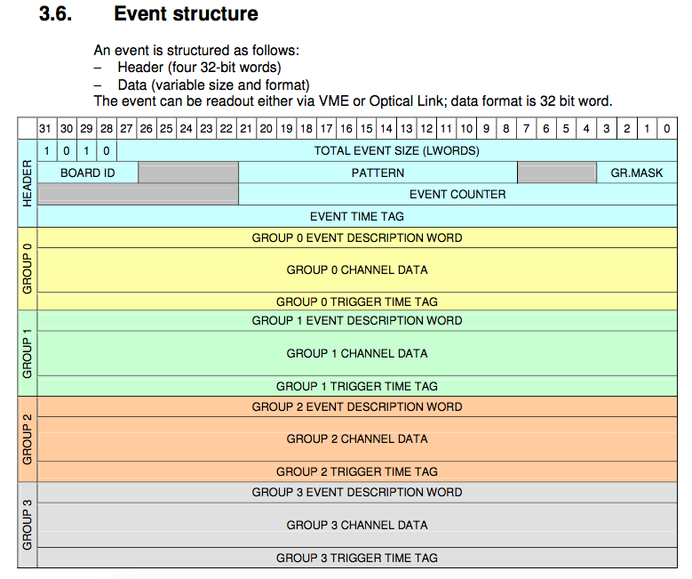
Example: CAEN’s V1742 format
We just take that blob of memory, “put it in a box”, done.
The analysis software takes care of the unpacking and interpretation later
Just grab it. Don’t waste time here.

Slide 39
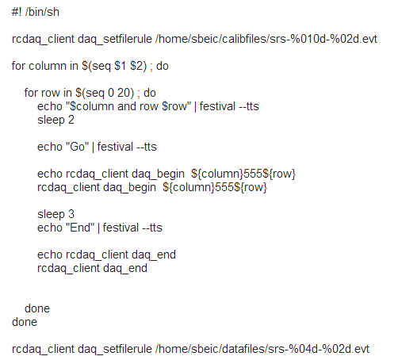
Shell integration
The Speaking DAQ

Slide 40
One more cool thing
Anything that’s capable of issuing a shell command can control the DAQ
I have said (but not shown you yet) that the DAQ can be controlled remotely, through the network
I have a Raspberry Pi connected here that I have set up so it controls RCDAQ running on my Laptop
And you see it has developed some kind of growth on its head… That’s an infrared receiver
We know we can assign arbitrary commands to buttons pressed on virtually any IR remote
I guess you see where this is going…

