Slide 1
A scalable, portable DAQ system design
Martin L. Purschke

Slide 2
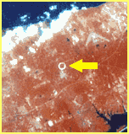
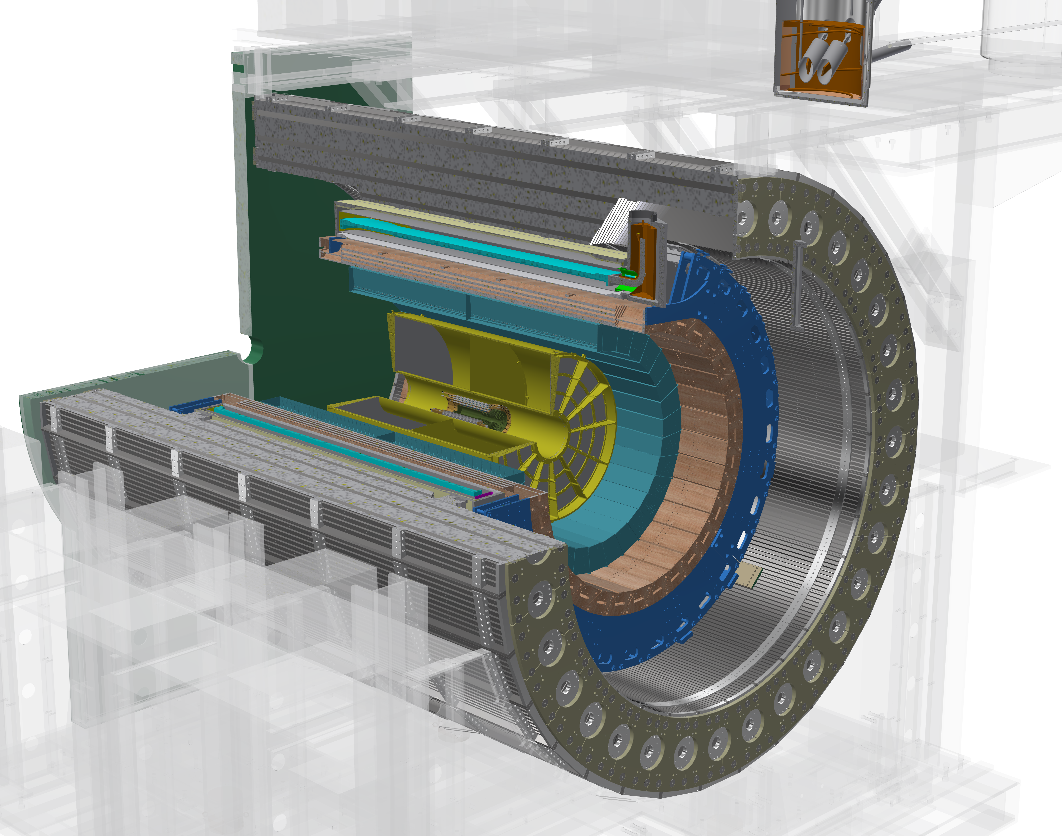
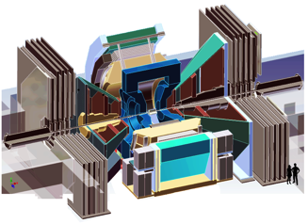
Brookhaven National Laboratory
Home of the Relativistic Heavy Ion Collider…
Manhattan
Long Island, NY
RHIC from space
… and of the new sPHENIX experiment – largest US Nuclear Physics experiment under construction (that’s what I work on)
sPHENIX
PHENIX
2000-2016

Slide 3
What I’ll be talking about today
Over the course of your career, you likely see quite a number of different data acquisition systems
Working at the LHC? Ok, the TDAQ systems are big things with lots of experts.
Later in your career you might ending up being the person to choose and implement the DAQ system
Some systems will be flexible, easy to use, adaptable, fun, others…. not so
I will go through a number of design principles that have served me well
If you ever get to design one, or (more likely) aid in the selection of an existing one, I hope this will be useful
( Obviously, my principles will be biased. Do I think my DAQ systems are great? You bet ☺ ).
I also don’t believe in “Do as I say, not as I do…” – I will show you how I implemented things
I will show you a number of examples to make this more tangible

Slide 4
Design Goals, also known as Buzzwords
Modularity
Data integrity, robustness and resilience
No exposure of analysis code to internals
Binary payload format agnostic
No preferred endianess
Different event types
Set of tools to inspect / display / manipulate files
Online monitoring support
Electronic Logbook support
OS integration
Interface to community analysis tools ( these days: root and 3rd-party frameworks)
It’s gotta be fun to use!
That’s quite a list. Let’s go through and see what all that means

Slide 5
Data Formats in general…
One of the trickiest parts when developing a new application is defining a data format
It can take up easily half of the overall effort – think of Microsoft dreaming up the format to store this very PowerPoint presentation you are seeing in a file. We used to have ppt, now we have pptx – mostly due to limitations in the original format design
A good data format takes design skills, experience, but also the test of time
The tested format usually comes with an already existing toolset to deal with data in the format, and examples – nothing is better than a working example
Case in point: Parts of the PHENIX Raw Data Format (PRDF) have their roots at the CERN-SPS, and the Bevalac Plastic Ball experiment in the 80’s – that’s a solid “test of time”

Slide 6
Resilience and error recovery
Imagine a data format where one bit error, or one error in some length field, in the data renders the entire file unreadable
Obviously not a good design – you will have such errors, corrupt tapes, recovered disk files, and you cannot allow to lose a significant portion of your statistics
Corrupt data is far more common than you think!
Data can be corrupted by the storage medium
Data structures can also be corrupt from the get-go by some bug in the DAQ
“Resilience in depth” – any corrupt entity must be able to be skipped, the remainder of the data recovered
You must also be able to account for what was lost
“You must be able to erroneously feed your mail file to your analysis. It shouldn’t find events, but it shouldn’t crash, either.”

Slide 7
How did we implement this?
This is a storage-level layer, usually invisible
A variable number of Events per buffer
Data structures from individual detectors
The error recovery works on the smallest corrupted entity, a packet, an event, or a buffer.

Slide 8
Error Recovery
A good amount of the physical storage concept is derived from what was the main storage medium back in the 80’s and 90’s – tapes
Of course, in 2018 , we still write the majority of our data to tapes, just not directly
Useful leftovers from the days of direct tape reading:
Our Buffers are a multiple of 8Kb “records” – tape drives used to write physical chunks of 8Kb
Got a corrupt data? Skip 8Kb records until you find the start of a new buffer. It must start on a record (8Kb) boundary. Without that constraint, you have no chance to find that.
Inside buffers, parts of the data of an event can be corrupt but the “outer” structure intact – skip event
Inside an event, the data structure from a detector can be corrupt – skip this and take a (user) decision whether or not to accept the event
At any time, you are in charge of dealing with the situation in a manner that suits your analysis.

Slide 9
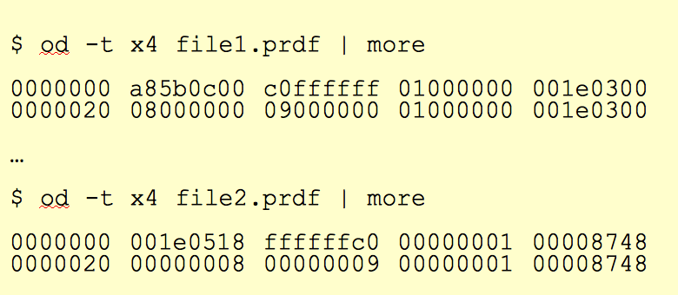
No Preferred Endianess – what does that mean?
This is less of an issue today as it was 10 years ago when we had a lot of VME-based stuff and Motorola 68K and PowerPC CPUs in front-ends (all big-endian) and Intel/AMD for analysis (all little-endian)
Endianess – the order how a 2 or 4-byte variable is stored
int i = -64 -> 0x FF FF FF C0
Little Endian – least significant bit is at lowest address
Memory location | Little-endian | Big-endian
Offset +0 | C0 | FF
+1 | FF | FF
+2 | FF | FF
+3 | FF | C0
Files with different endianess with a
“-64 1” sequence Variables from files with the wrong endianess need to be byte-swapped
That can be time-consuming!
Have the DAQ write in its native endianess and let the analysis software do the byte-swapping as needed. Don’t waste time with that in the DAQ!

Slide 10
Modularity and Extensibility
No one can foresee and predict requirements of a data format 20 years into the future.
Must be able to grow, and be extensible
The way I like to look at this:
FedEx (and UPS) cannot possibly know how to ship every possible item under the sun
But they know how to ship a limited set of box formats and types, and assorted weight parameters
Whatever fits into those boxes can be shipped
During transport, they only look at the label on the box, not at what’s inside
We will see a surprisingly large number of similarities with that approach in a minute
“packets”

Slide 11
“Binary payload agnostic” – what is that?
Most of the “devices” we read out provide their data in some pre-made (and usually quite good) compact binary format already. Usually done in some FPGA.
Actual formatting/packing/zero-suppression in the CPU is rare these days
All you want to do is to grab the blob of data, stick it into a packet, put a label (packet header) on that says what’s in it, done.
That is literally all we do to the data
From that point forward, the DAQ does not care. The “FedEx” approach – they ship boxes, we ship packets.
More generally: Usually we store data from our readout devices, but we must be able to store literally anything in our data stream.
Want to store an Excel spreadsheet? A text file? A jpeg image? Shouldn’t cause a problem.
If you think ”why would one want to do that!”, just wait a few minutes.

Slide 12
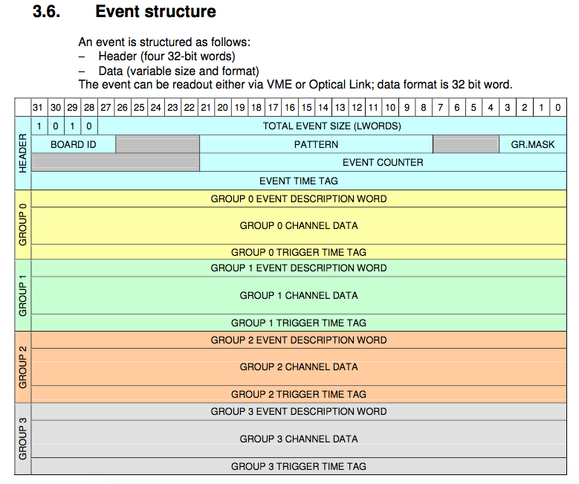
Example: CAEN’s V1742 format
We just take that blob of memory, “put it in a box”, done.
The analysis software takes care of the unpacking and interpretation later
Just grab it. Don’t waste time here.

Slide 13
How do we accomplish that?
The “box” / packet has what I call “envelope information” – a header describing what’s inside
The hitformat is an enumerated value that determines how the data needs to be unpacked
I have about 400 such formats defined
The packet id uniquely identifies what piece of a given detector this packet holds, or the data from which device
Word | 16 bit | 16 bit
0 | Length
1 | Packet id | Swap unit
2 | Hitformat | Padding size
3 | Reserved | reserved
4 + | DATA
n+4 | padding
The order of the packets within an event is irrelevant – a “mini database” – allows to change the read order without breaking anything
Padding – we pad the packet as needed to remain 64- or 128-bit aligned

Slide 14
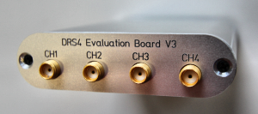
A packet header example (the DRS4 board you see here)
$ $ od -j 163888 -t d2 -N 16 beam_0000000042-0000.evt 0500060 5126 0 1001 4 81 1 0 0
$ dlist beam_0000000042-0000.evt Packet 1001 5126 -1 (ONCS Packet) 81 (IDDRS4V1)
Word | 16 bit | 16 bit
0 | Length 5126
1 | Packet id 1001 | Swap unit 4
2 | Hitformat 81 | Padding size 1
3 | Reserved 0 | Reserved 0
4 + | DATA
n+4 | padding
This packet says:
I contain data in the hitformat 81 (DRS4 version1 format)
That determines how the data are to be interpreted and decoded later

Slide 15
Data Encapsulation
The unpacker/decoder selected through the hitformat shields the user code from the changing internals of the encoding
The only constant is that the same channels – usually a readout board that we call FEM, Front-End Module – feeds its data into a packet with a never-changing packet id
The packet id identifies a FEM, and a piece of detector “real estate”
We often refer to a given FEM by its packet id (“we had a problem with 4033 last night”)
But: how the data are encoded changes over time.
We do not want our analysis code to break because of that!
The packet id tells you what is stored in the packet
The hitformat says how it is encoded
I can change the encoding for a more efficient one at any time; I just tag it with a new hitfomat (and implement the new decoder acting on that format)
No user software will break!

Slide 16
A real PHENIX event…
This is an actual PHENIX event with the full detector
3827 packets in total in this event
$ dlist /a/eventdata/EVENTDATA_P00-0000459344-0000.PRDFF
Packet 14001 52 0 (Unformatted) 714 (IDGL1)
Packet 14007 10 0 (Unformatted) 716 (IDNTCZDC_LL1)
Packet 14002 9 0 (Unformatted) 701 (IDBBC_LL1)
Packet 14009 14 0 (Unformatted) 717 (IDGL1_EVCLOCK)
Packet 14011 13 0 (Unformatted) 914 (IDGL1PSUM)
Packet 8180 21 0 (Unformatted) 1508 (IDEMC_FPGA3WORDS0SUP)
Packet 8165 42 0 (Unformatted) 1508 (IDEMC_FPGA3WORDS0SUP)
Packet 8166 48 0 (Unformatted) 1508 (IDEMC_FPGA3WORDS0SUP)
. . .
Packet 25121 83 0 (Unformatted) 425 (IDFVTX_DCM0)
Packet 25122 198 0 (Unformatted) 425 (IDFVTX_DCM0)
Packet 25123 99 0 (Unformatted) 425 (IDFVTX_DCM0)
Packet 25124 46 0 (Unformatted) 425 (IDFVTX_DCM0)
Packet 21351 356 0 (Unformatted) 1121 (IDMPCEXTEST_FPGA0SUP)
Packet 21352 319 0 (Unformatted) 1121 (IDMPCEXTEST_FPGA0SUP)
Packet 21353 238 0 (Unformatted) 1121 (IDMPCEXTEST_FPGA0SUP)
Packet 21354 323 0 (Unformatted) 1121 (IDMPCEXTEST_FPGA0SUP)
Notes:
----- Meeting Notes (1/27/16 16:27) -----

Slide 17
I haven’t really mentioned the word “DAQ” yet…
I want to introduce you to my portable DAQ system, “rcdaq” (“really cool data acquisition” – I have a way with names)
What’s so cool about it?
Our “real” DAQ occupies a space about the size of a squash court -- rcdaq is highly portable, lightweight, etc etc – good for ~ 50,000 channels or so, not millions
We use it for R&D, detector commissioning, test beams, teaching at the ISOTDAQ ☺, what have you
It writes data in the PHENIX format, so the data you take can be analyzed like the real thing
It’s a godsend for our students, who usually start out with some test beam data, or work on a detector - the same data format makes for a smooth transition to physics data later
Rcdaq is way more flexible than the big real DAQ and runs on far less demanding hardware
It actually runs on a Raspberry Pi (you can read out the DRS4 evaluation board and some other USB devices)

Slide 18
Example Applications
We are in the middle of upgrading to a new experiment “sPHENIX” – virtually all R&D takes place using RCDAQ as the workhorse DAQ (Stony Brook, Yale, UIUC, BNL…)
The DAQ of the BNL / Stony Brook / UPenn Medical Imaging Groups
A lot of R&D efforts in the Electron-Ion Collider orbit use RCDAQ
One of the DAQ systems available to CERN RD51 collaboration members
Workhorse DAQ at several FermiLab Test Beam setups
Even used in ATLAS for the recent ZDC calorimeter calibration
Medial Department at U of Texas, Arlington

Slide 19
RCDAQ
First off, there are many fine DAQ systems around, some made by people at this school
I’m using mine to show how I implemented the aforementioned principles and some other points
Let me start by asserting that something that just “reads out your detector” does not qualify as a data acquisition system yet – it lives and dies by the amenities it has to offer to really help with your needs.
So what did I implement?

Slide 20
The High Points
Each interaction with RCDAQ is a shell command. There is no “starting an application and issuing internal commands” (think of your interaction with, say, root)
RCDAQ out of the box doesn’t know about any particular hardware. All knowledge how to read out something, say, the DRS4 eval board, comes by way of a plugin that teaches RCDAQ how to do that.
That makes RCDAQ highly portable and also distributable – PHENIX FEMs need commercial drivers for the readout; I couldn’t re-distribute CAEN software, etc etc
RCDAQ has no configuration files. (huh? In a minute).
Support for different event types ( one of the more important features)
Built-in support for standard online monitoring
Built-in support for an electronic logbook (Stefan Ritt’s Elog)
Network-transparent control interfaces

Slide 21
Everything is a shell command…
One of the most important features. Any command is no different from “ls –l“ or “cat”
That makes everything inherently scriptable, and you have the full use of the shell’s capabilities for if-then constructs, error handling, loops, automation, cron scheduling, and a myriad of other ways to interact with the system
Nothing beats the shell in flexibility and parsing capabilities (of course you also have GUIs)
You can type in a full RCDAQ configuration on your terminal interactively, command by command (although you usually want to write a script to do that)
In that sense, there are no configuration files – only configuration scripts.
This is quite different from “my DAQ supports scripts”!
I do not want to be trapped within the limited command set of any application!
As shell commands, the DAQ is fully integrated into your existing work environment

Slide 22
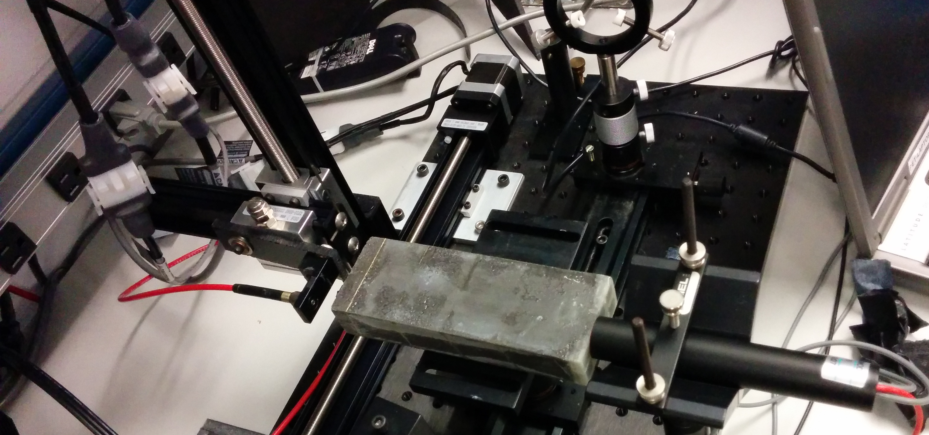
Measurements on autopilot through scripting
You want to run measurements where you step through some values of a parameter completely on autopilot
Here: Move a light fiber with 2 step motors, take a run for each position w/ 4000 events
50 x 25 = 1250 positions (you really want to automate that)
Let it run overnight, come back in the morning, look at the data
X-Y step motor
Calorimeter Module
Light Fiber
PMT

Slide 23
The Script
#! /bin/sh
STARTPOSX=0
STARTPOSY=9900
INCREMENTX=200
INCREMENTY=-200
CURRENTPOSY=$STARTPOSY
for posy in $(seq 25) ; do
quickmove.sh $CURRENTPOSY 2
sleep 5
CURRENTPOSY=$( expr $CURRENTPOSY + $INCREMENTY)
CURRENTPOSX=$STARTPOSX
for posx in $(seq 50) ; do
echo "moving to $CURRENTPOSX"
quickmove.sh $CURRENTPOSX 1
sleep 5
CURRENTPOSX=$( expr $CURRENTPOSX + $INCREMENTX)
done
done
The DAQ operation becomes an integral part of your shell environment
25 positions in y
move the Y motor
50 positions in x
move the x motor
next x
next y
Automatic end after 4000 events
start the DAQ
rcdaq_client daq_set_maxevents 4000
rcdaq_client daq_begin
wait_for_run_end.sh

Slide 24
Client-Server Interaction
Think of your session when you use the root package for your analysis
You give commands, use GUIs, and it does what you want
However, you have the exclusive access to your session. No one else (or you in another terminal) can interact with the same root session.
In a DAQ, this is not what one usually wants!
You want more than one “entity” to be able to control your DAQ. Think GUIs, the command line, cron jobs, you name it
Short of control, you want other processes to be able to extract information – extract and display the event rate, the run number, the open file name, etc etc
You want a way for more than one process to be able to connect to your DAQ concurrently
The technology I chose is the Remote Procedure Call, RPC

Slide 25
RPC
Let me first say that there is no shortage of client-server protocols
CORBA, PVM, there are many others
The Remote Procedure Call is, in my book, the easiest to use and available everywhere
Widely established open standard (RFC 1831) for remote execution of code from a client
Makes it look like a local function call, but the function executes on a server
Originally meant for off-loading time-consuming functions to a beefy server. We use it to set values and trigger actions in the server.
The ubiquitous NFS (network file system) is based on RPC, it is available virtually everywhere. Linux. MacOS. Android. Windows. Everything.
It is a network protocol, so client and server don't have to be on the same machine, can have DAQ and control machine in different rooms (or as far apart as you like as long as the connection traverses the firewalls).

Slide 26
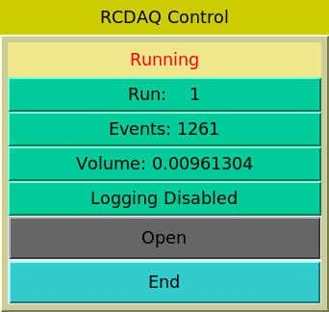
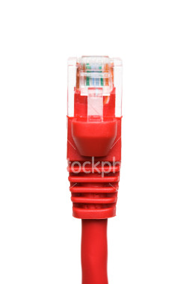
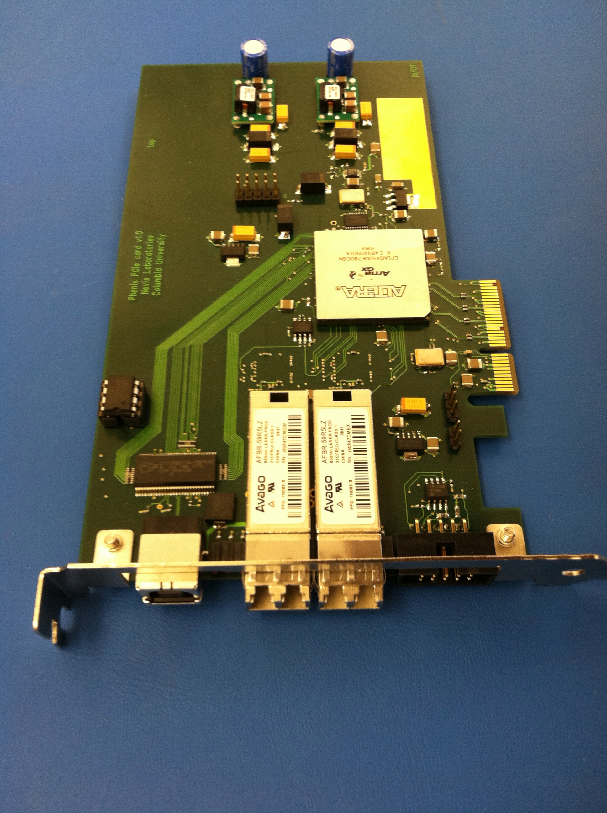
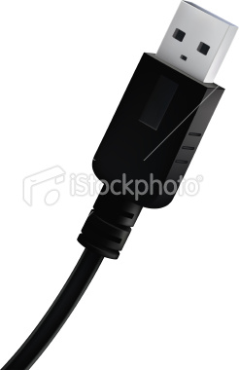
The RCDAQ client-server concept
RCDAQ Client
RCDAQ Client
scripts
Command line
RPC Protocol
RCDAQ Client
Command line
RCDAQ server
Network USB PCIe
This allows an arbitrary number of processes to interact with RCDAQ concurrently
Hardware
Hardware
Hardware
The RCDAQ server does not accept any input from the terminal. All interaction is through the clients.
$ rcdaq_client load librcdaqplugin_drs.so

Slide 27
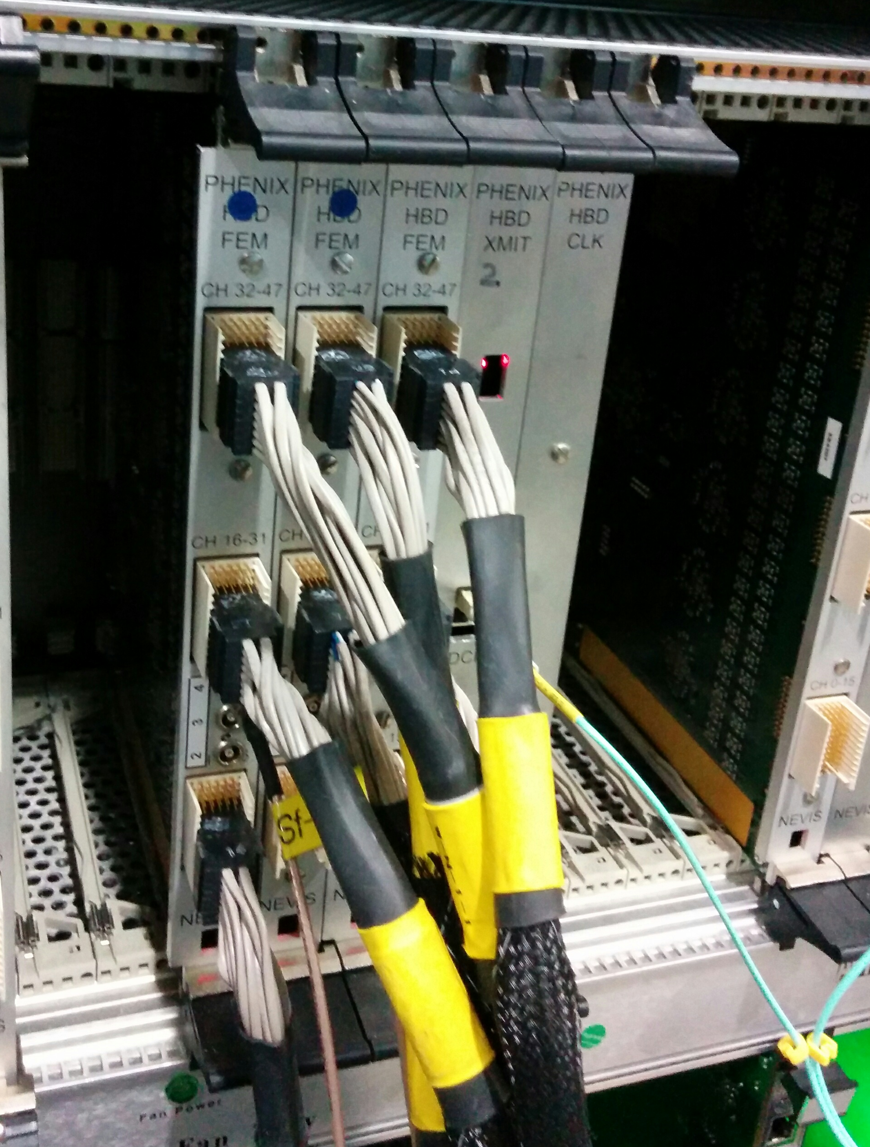
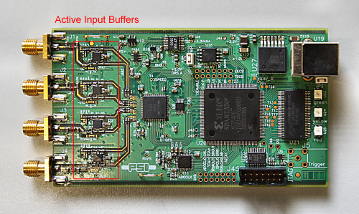
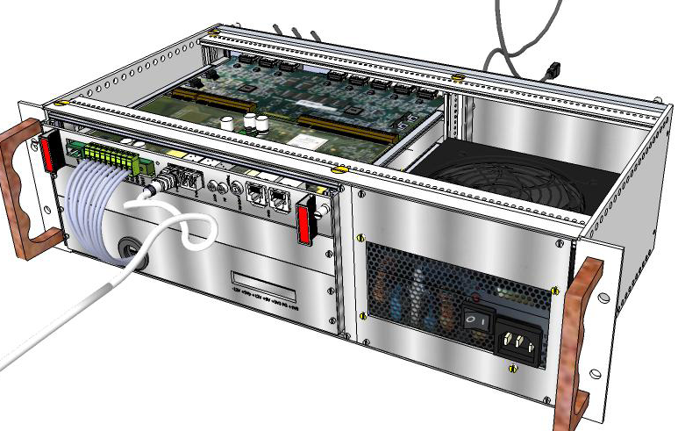
Some standard devices implemented in RCDAQ
RCDAQ
PCIe
PCIe
PCIe
The CERN RD51 SRS System
PHENIX Digitizer
new sPHENIX digitizer prototype
DRS4 Eval board
“USB Oscilloscope”
The CAEN V1742 waveform digitizer
There are many more not shown…

Slide 28
Setting up and reading out a DRS4 Eval board
$ rcdaq_client load librcdaqplugin_drs.so
$ rcdaq_client create_device device_drs -- 1 1001 0x21 -150 negative 140 3
$ daq_open
$ daq_begin
# wait a while…
$ daq_end
BTW, this double-dash is shell standard for “stop processing command line options”
Else the later “-150” would be interpreted as -1 -5 -0 options like “ls –ltr”.
Try to delete a file named “-I”…
You see, each interaction is a separate shell command!

Slide 29
Remember we are talking about a “portable” DAQ here…
Think of a test beam setup (or your Lab setup) for a moment
In the “real” experiment that’s running for a few years (think PHENIX, ATLAS, what have you) you are embedded in an environment that supports all sorts of record keeping
We have the PHENIX run database as an example – we log “everything”, AND there’s infrastructure and support so most people know how to get at it.
I’m not disputing the need for a database, I’m saying that a test beam or your test lab needs a different kind of “record keeping support”
What was the temperature? Was the light on? What was the HV? What was the position of that X-Y positioning table?
A database allows you to search for runs with certain properties. But capturing this information in the raw data file is more flexible and the data cannot get lost
I often add a webcam picture to the data so we have a visual confirmation that the detector is in the right place, or something
A picture captures everything…
Remember our concept of being payload agnostic?

Slide 30
Reading different things with different Event Types
You would think of the DAQ as “reading your detector”
Very often, it is necessary to read different things at different times.
Let’s go to the CERN-SPS (or the BNL AGS) for an example:
acceleration
SPS or AGS
extraction
“spill”
Begin-run event
End-run event
Spill-On event
Read and clear scalers
Flush buffers
Data Events
Read your detector channels, ADCs, TDCs...
Spill-Off event
Read and clear scalers
(allows spill intensity-based corrections)
30
In addition to your data, you need information about the spill itself – each one is different
You need to make intensity-dependent corrections on a spill-by-spill basis
So you put some signals on scalers and get an idea about the intensity, dead times, microstructures, etc

Slide 31
Remember this?
This was our typed-in example from before
$ rcdaq_client load librcdaqplugin_drs.so
$ rcdaq_client create_device device_drs -- 1 1001 0x21 -150 negative 140 3

Slide 32
A Setup Script
Now you got yourself a setup script as I advertised before, call it, say,
“setup.sh”
#! /bin/sh
rcdaq_client load librcdaqplugin_drs.so
rcdaq_client create_device device_drs -- 1 1001 0x21 -150 negative 140 3
Make it executable and you can re-initialize your DAQ each time the same way

Slide 33
Capturing the setup script for posterity
We add this very setup script file into our begin-run event for posterity
This “device” captures a file as text into a packet
This “9” is the event type of the beg-run
And this refers to the name of the file itself
#! /bin/sh
rcdaq_client create_device device_file 9 900 ”$0”
rcdaq_client load librcdaqplugin_drs.so
rcdaq_client create_device device_drs -- 1 1001 0x21 -150 negative 140 3
So this gets added as packet with id 900 in the begin-run
It’s not quite right yet - $0 is usually just “setup.sh”, so the server may not be able to find it.
We need the name with a full path!

Slide 34
Expanding the $0 to a full filename
The 3 lines expand the file to a full filename
#! /bin/sh
D=`dirname "$0"`
B=`basename "$0"`
MYSELF="`cd \"$D\" 2>/dev/null && pwd || echo \"$D\"`/$B”
rcdaq_client create_device device_file 9 900 "$MYSELF”
rcdaq_client load librcdaqplugin_drs.so
rcdaq_client create_device device_drs -- 1 1001 0x21 -150 negative 140 3
Almost there…

Slide 35
… one more thing …
We clear out any pre-existing device definitions first. We also add some comments as documentation what we are doing here
#! /bin/sh
# this sets up the DRS4 readout with 5GS/s, a negative
# slope trigger in channel 1 with a delay of 140
D=`dirname "$0"`
B=`basename "$0"`
MYSELF="`cd \"$D\" 2>/dev/null && pwd || echo \"$D\"`/$B”
rcdaq_client daq_clear_readlist
rcdaq_client create_device device_file 9 900 "$MYSELF”
rcdaq_client load librcdaqplugin_drs.so
rcdaq_client create_device device_drs -- 1 1001 0x21 -150 negative 140 3

Slide 36
… and the final touch
If no server is running, we start one here.
#! /bin/sh
# this sets up the DRS4 readout with 5GS/s, a negative
# slope trigger in channel 1 with a delay of 140
if ! rcdaq_client daq_status > /dev/null 2>&1 ; then
echo "No rcdaq_server running, starting..."
rcdaq_server > $HOME/rcdaq.log 2>&1 &
sleep 2
fi
D=`dirname "$0"`
B=`basename "$0"`
MYSELF="`cd \"$D\" 2>/dev/null && pwd || echo \"$D\"`/$B”
. . .

Slide 37
More special devices
We have seen the device_file, which captures the contents of a file into a packet. What else is there?
device_filenumbers – the “file” saves the contents as text, which is not always easy to work with. Device_filenumbers looks for lines with numbers by themselves on a line, and stores them as numbers. In your analysis, it’s much easier to work with
device_command - no packet generated, but an arbitrary command gets executed. (This is one of the most powerful concepts).
device_file_delete – as device_file, but the file gets deleted after inclusion
device_filenumbers_delete – you get the idea

Slide 38
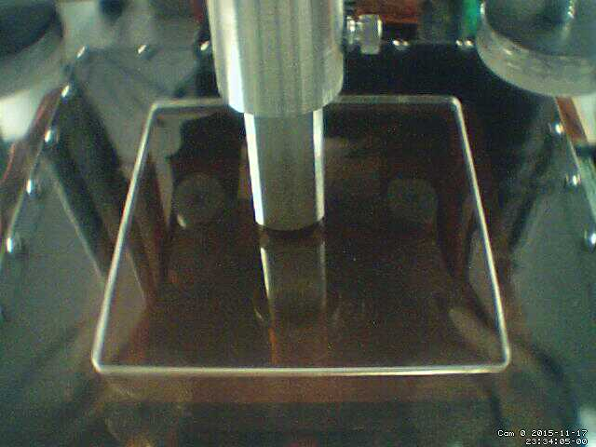
More things from a previous setup
Here you see two scripts executed which reach out to the positioning system and reads back the motor positions, and capture an image from a webcam
eicdaq2 ~ $ ddump -O -p 910 -t 9 ZZ48_0000001600-0000.evt
8031
8377
eicdaq2 ~ $ ddump -O -p 910 -t 9 ZZ48_0000001601-0000.evt
8031
8393
eicdaq2 ~ $ ddump -O -p 910 -t 9 ZZ48_0000001602-0000.evt
8031
8409
eicdaq2 ~ $ ddump -O -p 910 -t 9 ZZ48_0000001603-0000.evt
8031
8425
This makes the analysis a snap – throw all 4900 files at your analysis process. Each file contains the x/y position – making the x-y gain map here is totally easy!
We are scanning in y direction here
We include the generated “positions.txt” files both as text as as numbers in 910 and 911
#add the position information
rcdaq_client create_device device_command 9 0 /home/eic/struck/getmotorpositions.sh
rcdaq_client create_device device_file 9 910 /home/eic/struck/positions.txt
rcdaq_client create_device device_filenumbers_delete 9 911 /home/eic/struck/positions.txt
# add the camera picture
rcdaq_client create_device device_command 9 0 "/home/eic/capture_picture.sh /home/eic/struck/cam_picture.jpg"
rcdaq_client create_device device_file_delete 9 940 /home/eic/struck/cam_picture.jpg
8031
8377

Slide 39
More about capturing your environment
Many times you capture things only “just in case”
You don’t routinely look at them in your analysis (such as cam pictures shown before)
But if you have some inexplicable feature, you can use the data to do “forensics”
Find out what, if anything, went wrong
The more data you capture, the better this gets
Think of it as “black box” on a plane…

Slide 40
Forensics
“It appears that the distributions change for Cherenkov1 at 1,8,12,and 16 GeV compared to the other energies. It seems that the Cherenkov pressures are changed. […] Any help on understanding this would be appreciated.”
Martin: “Look at the info in the data files:”
$ ddump -t 9 -p 923 beam_00002298-0000.prdf
S:MTNRG = -1 GeV
F:MT6SC1 = 5790 Cnts
F:MT6SC2 = 3533 Cnts
F:MT6SC3 = 1780 Cnts
F:MT6SC4 = 0 Cnts
F:MT6SC5 = 73316 Cnts
E:2CH = 1058 mm
E:2CV = 133.1 mm
E:2CMT6T = 73.84 F
E:2CMT6H = 32.86 %Hum
F:MT5CP2 = .4589 Psia
F:MT6CP2 = .6794 Psia
$ ddump -t 9 -p 923 beam_00002268-0000.prdf
S:MTNRG = -2 GeV
F:MT6SC1 = 11846 Cnts
F:MT6SC2 = 7069 Cnts
F:MT6SC3 = 3883 Cnts
F:MT6SC4 = 0 Cnts
F:MT6SC5 = 283048 Cnts
E:2CH = 1058 mm
E:2CV = 133 mm
E:2CMT6T = 74.13 F
E:2CMT6H = 37.26 %Hum
F:MT5CP2 = 12.95 Psia
F:MT6CP2 = 14.03 Psia

Slide 41
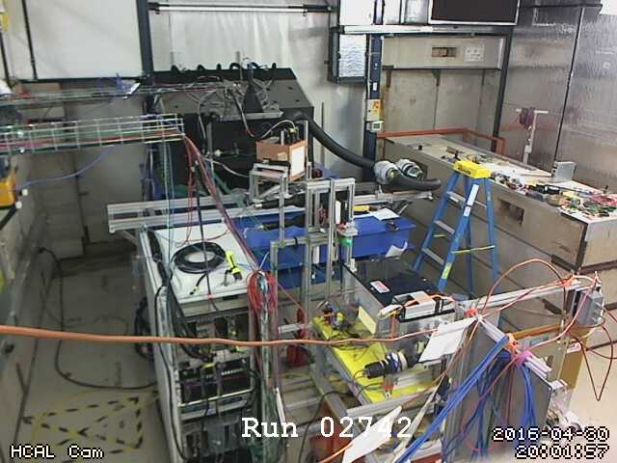
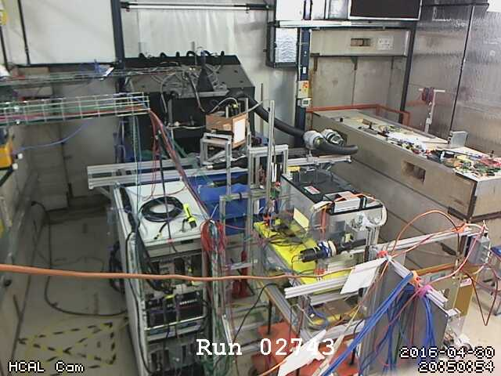
More Forensics (my poster child why this is so useful…)
“There is a strange effect starting in run 2743. There is a higher fraction of showering than before. I cannot see anything changed in the elog.”
Look at the cam pictures we automatically captured for each run:
$ ddump -t 9 -p 940 beam_00002742-0000.prdf > 2742.jpg
$ ddump -t 9 -p 940 beam_00002743-0000.prdf > 2743.jpg

Slide 42
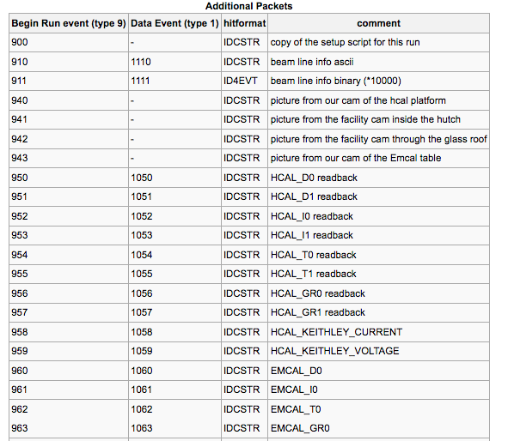
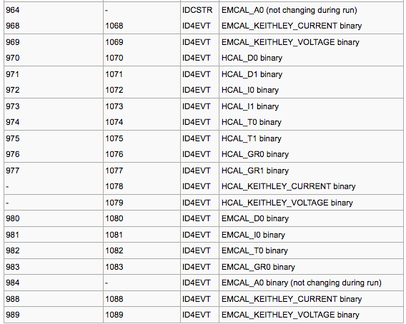
“Meta Data” Packet list from a recent test beam
More than 72 environment-capturing packets (accelerator params, voltages, currents, temperatures, pictures, …)
Captured at begin-run
Captured again at spill-off

Slide 43
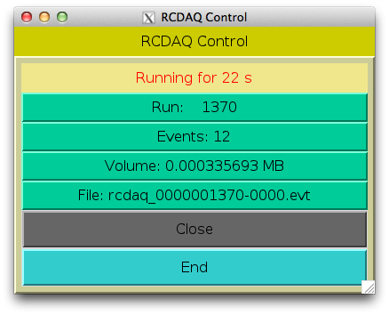
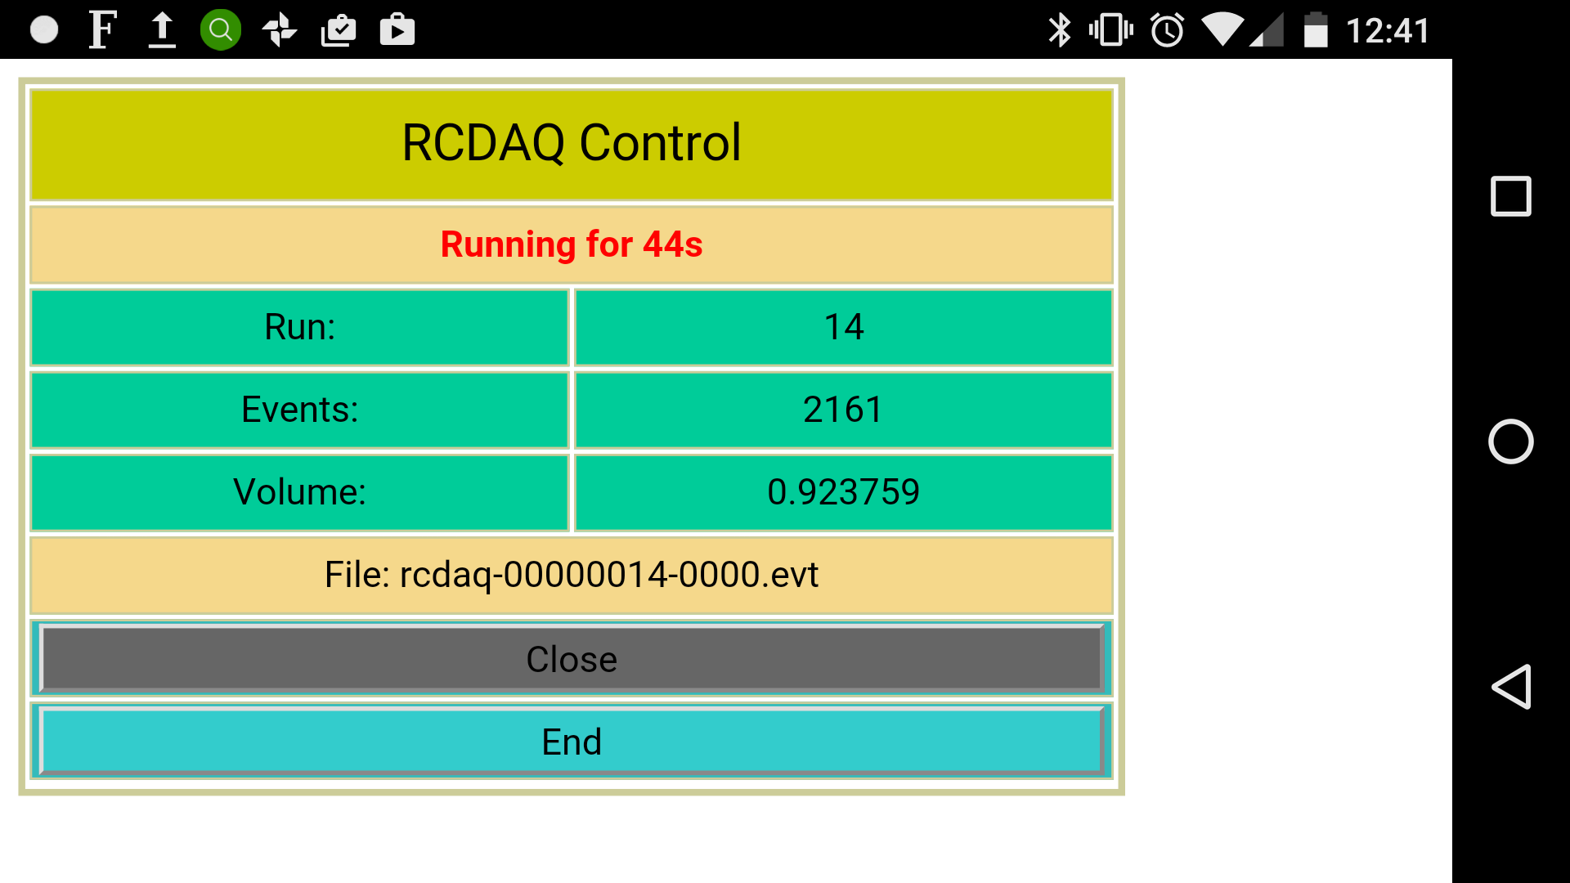
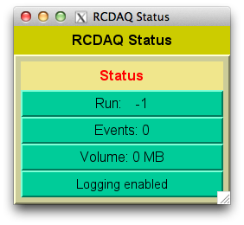
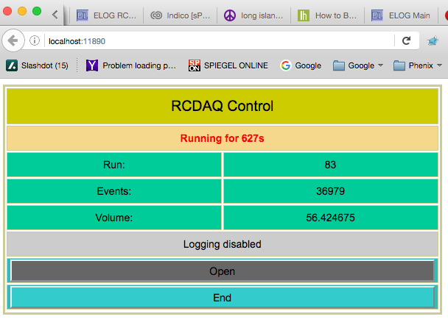
GUIs
On my phone
GUIs must not be stateful!
Statelessness allows to have multiple GUIs at the same time
And allows to mix GUIs with commands (think scripts)
(all state information is kept in the rcdaq server)
My GUI approach is to have perl-TK issue standard commands, parse the output
Slowly transitioning to Web-based controls (web sockets + Javascript)
Perl-TK
Web Browser

Slide 44
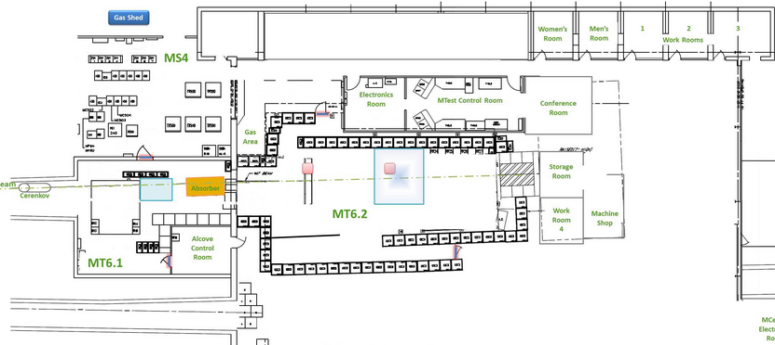
Why stateless GUIs (and controls in general)
They allow you to run any number of GUIs that show the same thing
You can enter RCDAQ commands from any terminal that can reach the DAQ machine
Say you fix something at your setup – you can control the remote DAQ from your laptop that you brought with you for the access
Also remember that the controls travel through the network
This is the FermiLab Test Beam Facility. It took us about 10 minutes each time to access our setup. The ability to control the DAQ from the hut and see that everything works is really important. By the time you end the access, you know everything is ok.

Slide 45
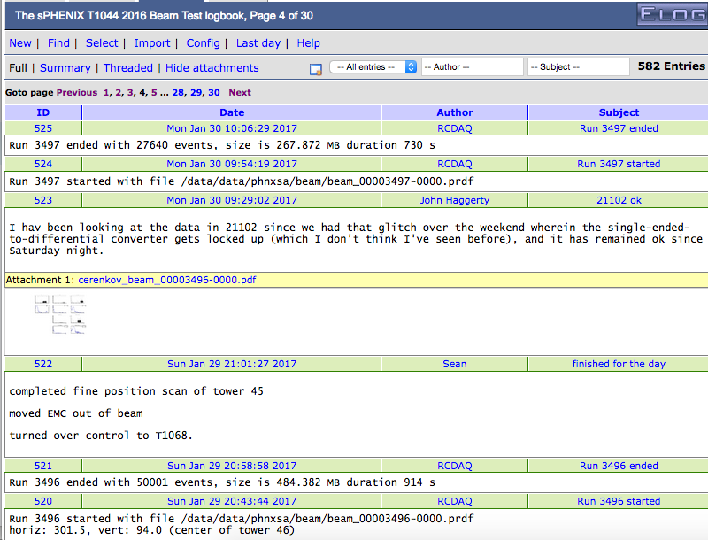
Automated Elog Entries
RCDAQ can make automated entries in your Elog
Of course you can make your own entries, document stuff, edit entries
Gives a nice timeline and log
Notes:
----- Meeting Notes (1/27/16 16:27) -----

Slide 46
Coming back to the “shell command” feature
For the last 3 minutes, I want to harp some more on the superiority of that “everything is a shell command” approach
Often I’m learning of a new ingenious way to use this aspect for something cool
A real good tool gets used in ways that the designer did not envision… but it works!
A group needed to test a few thousand pads on a plane if they a) work and b) are connected right.
Inject charge into the pads one by one... but you can't take your eyes (or the probe) off the pad plane or you lose your position
They came up with…
Notes:
----- Meeting Notes (1/27/16 16:27) -----

Slide 47
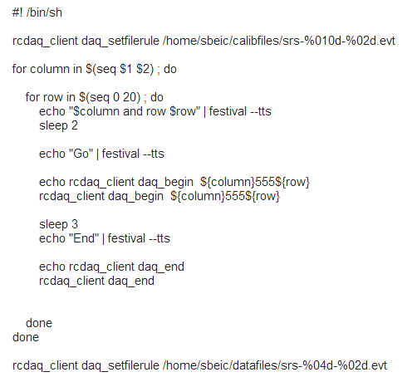
Shell integration
The Speaking DAQ

Slide 48
One more cool thing
Anything that’s capable of issuing a shell command can control the DAQ
I have said (but not shown you yet) that the DAQ can be controlled remotely, through the network
I have a Raspberry Pi connected here that I have set up so it controls RCDAQ running on my Laptop
And you see it has developed some kind of growth on its head… That’s an infrared receiver
We know we can assign arbitrary commands to buttons pressed on virtually any IR remote
I guess you see where this is going…

Slide 49
Summary
I used RCDAQ to show some design principles
I want to re-iterate that there are many fine DAQ systems “out there”
We have seen the virtues of shell-command only interactions
Learned about Event Types for different cool things, especially the begin-run
We learned why we want stateless GUIs and commands, and be network-transparent
We didn’t have time to talk about the online monitoring, but it’s there
Also, there’s still quality time during the school
A portable DAQ system – in a minute you will see me carry it back to my seat.
Thank You!

Slide 50
Shameless advertising…
My DAQ group at BNL is (soon, like in 2 weeks) looking for an online software person. Want to be part of the next big thing?
The sPHENIX experiment, presently under construction, is a major upgrade to the PHENIX detector at RHIC which will begin operation in early 2023. The data acquisition, trigger, and control system software is under development, and requires an experienced application developer who can work with custom hardware and software to support detector operation. The candidate should be an experienced Linux application developer capable of designing, implementing, and maintaining a distributed system of clients and servers with high speed Ethernet networking. ….

Slide 51
This page is intentionally left blank

Slide 52
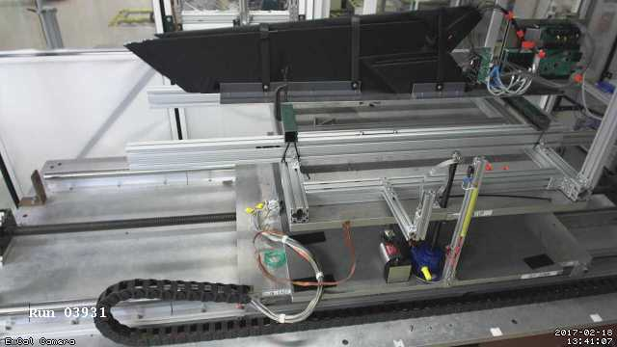
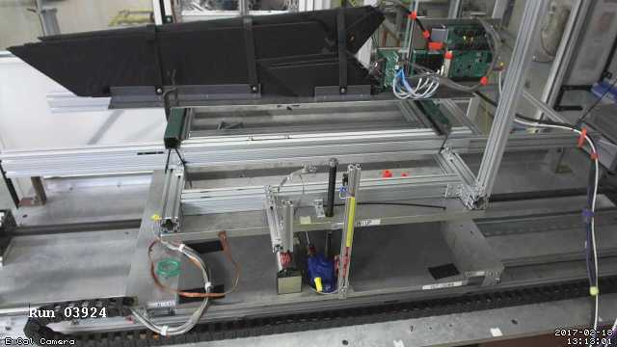
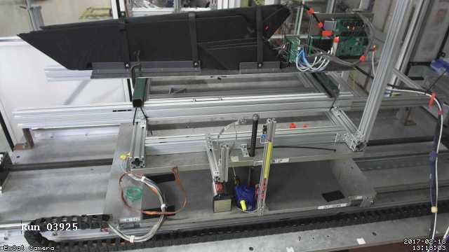
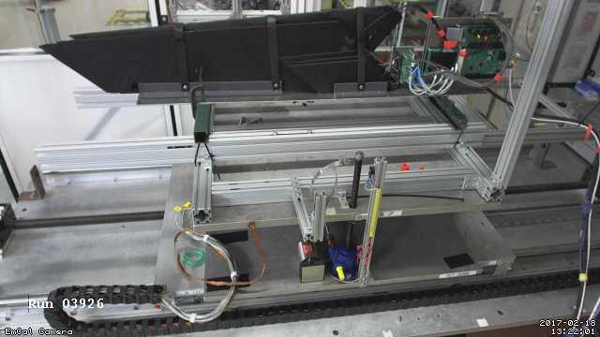
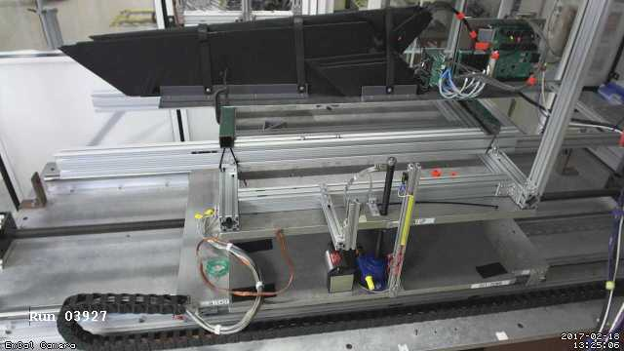
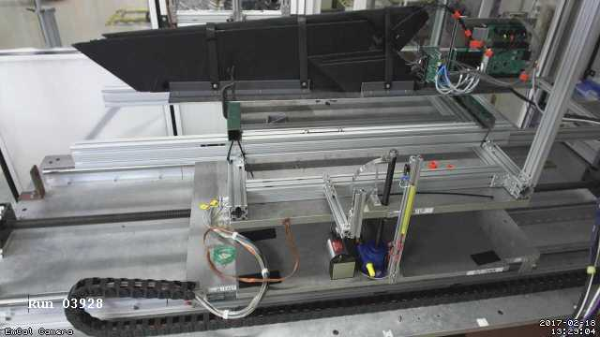
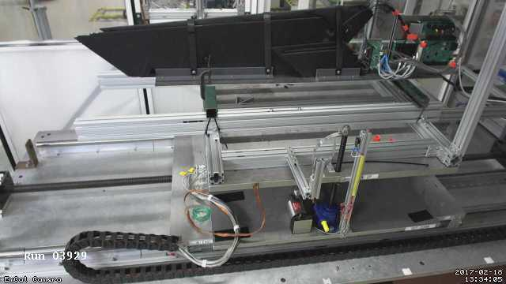
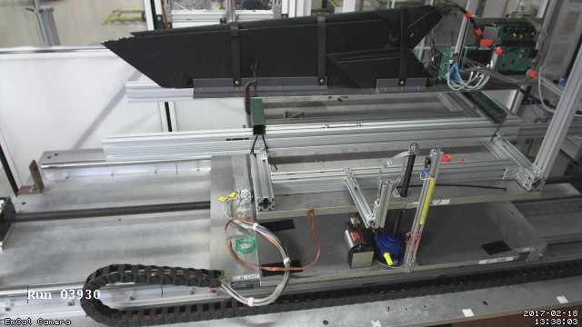
Autopilot example: “Tile Mapping” at the Fermi Test Beam Facility
“Tile mapping” refers to mapping the position-dependent response of a hadronic calorimeter tile.
About 200 individual positions of the tile relative to the beam – you’d go nuts doing all that manually, and you are bound to make mistakes
The FTBF M2.6 table is controlled via the accelerator controls (ACNET) – some caution required
This setup exercises most of the aforementioned features: scripting and reacting to the FTBF spill, network transparency (we cannot access ACNET from the DAQ machine, but an ACNET-enabled machine can control our DAQ)
I told you about my cameras, right?

