Slide 1
Anders Kirleis
The Design Of A Detector For The Electron Ion Collider
Stony Brook University

Slide 2
Motivation
Simulate e-p collisions within detector environment.
Observe detector data.
Analyze obtained resolutions .
Modify detector design, maximize acceptance.

Slide 3
Software Used
Geant 3 –
Detector description and simulation tool.
Written at CERN in 1993.
ESIM –
Framework for Geant 3.
Written by Pavel Nevski (BNL).
Simplifies geometry construction.
Same at ATLSIM (used for ATLAS).
Pythia –
Monte Carlo used to generate 4x100 GeV Proton Events.
Rapgap –
Monte Carlo used to generate 10x250 GeV Electron Events.

Slide 4
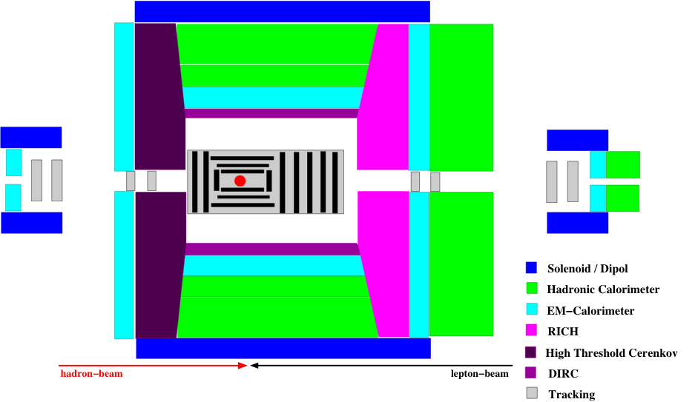
The Detector
Solenoid (4T)
Dipole
3Tm
Dipole
3Tm
FPD
FED
//
//
ZDC
Dipoles needed to have good forward momentum resolution
Solenoid no magnetic field @ r ~ 0
DIRC, RICH hadron identification → π, K, p
high-threshold Cerenkov → fast trigger for scattered lepton
radiation length very critical → low lepton energies

Slide 5
The Detector

Slide 6
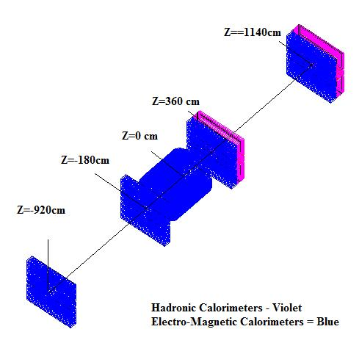
Calorimetry

Slide 7
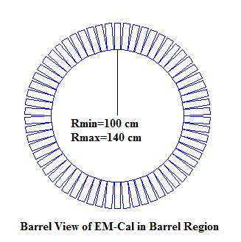
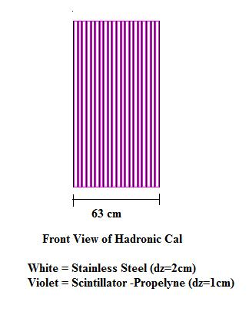
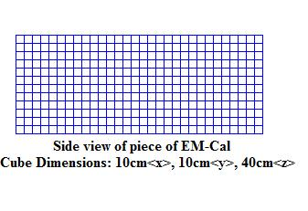
Calorimetry (cont.)
EM Materials: Lead Glass
HD Materials: Stainless Steel & Propylene sandwiched

Slide 8
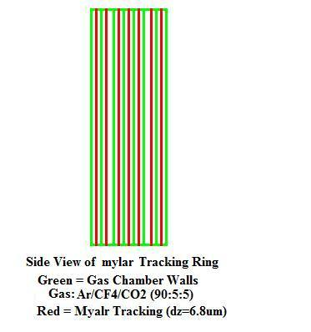
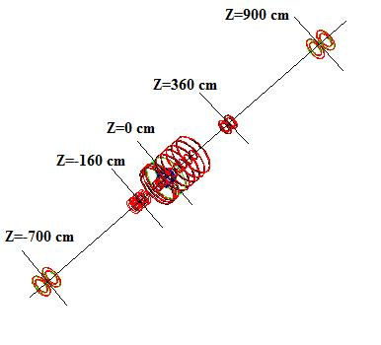
Particle Tracking
Side View of Wire Chamber
Green: Gas Chamber Enclosure
Gas: Ar/CF4/C02 (90:5:5)
Red: Mylar Sheets

Slide 9
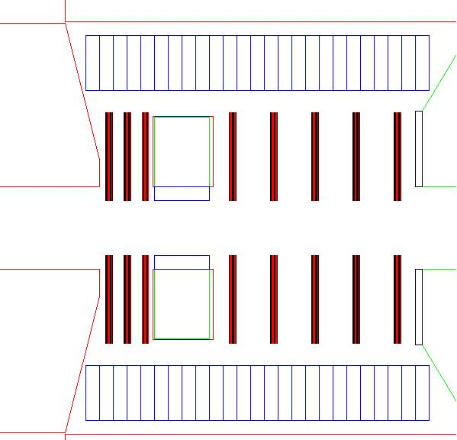
Particle Tracking (cont.)
Gas Chamber: Green
Rmin:30cm
Rmax:80cm
Z:40cm
Gas: Helium:Isobutane (80:20)
Silicon Tracking: Blue
Rmin:20cm
Rmax:30cm
Z:40cm

Slide 10
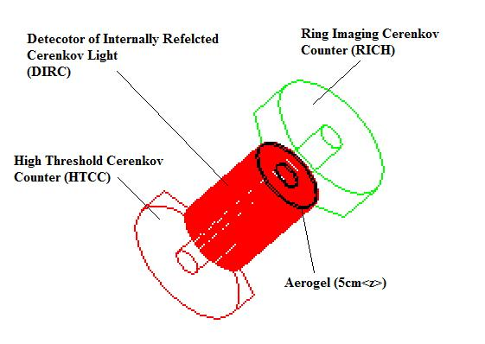
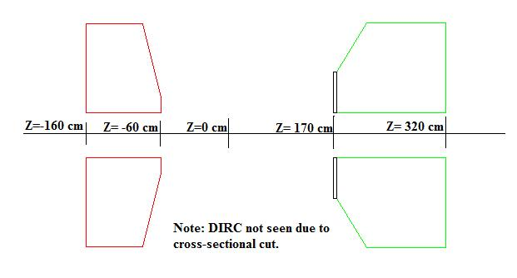
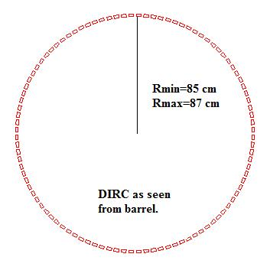
Particle Identification
DIRC <z>: 120 cm
DIRC Materials: Fused Silicia (SiO2)
Inner Radius of HTCC: 30cm
Outer Radius of HTCC: 150cm
HTCC Materials: CO2
Inner Radius of RICH: 30cm
Outer Radius of RICH: 150cm
RICH Materials: C4F10

Slide 11
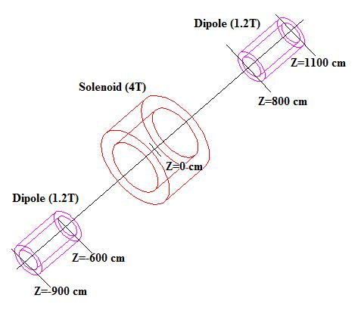
Magnets

Slide 12
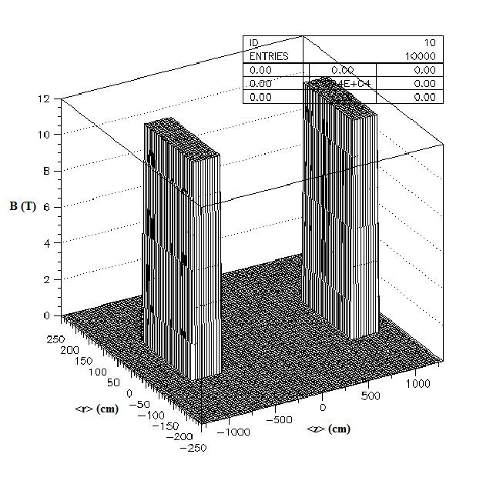
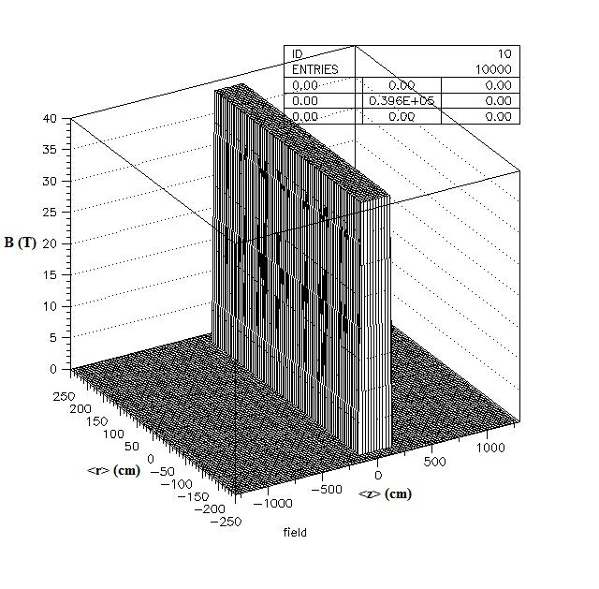
Magnetic Fields
DIPOLE B<y>
SOELNOID B<z>

Slide 13
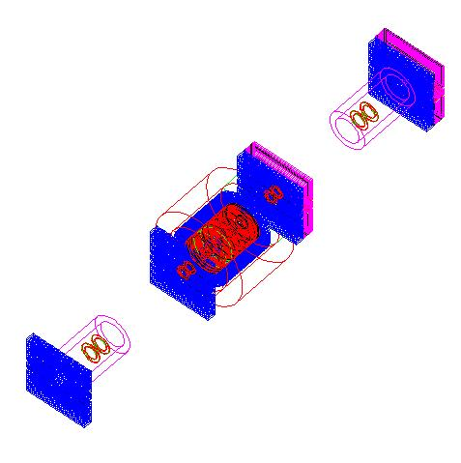
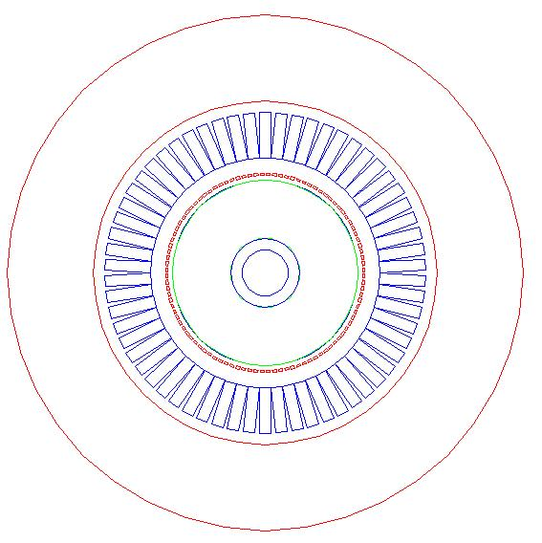
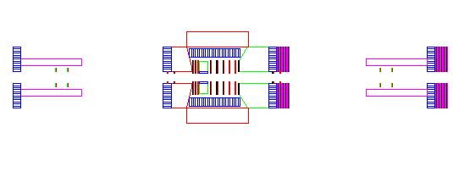
Full Detector

Slide 14
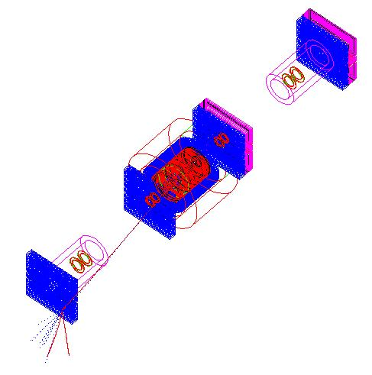
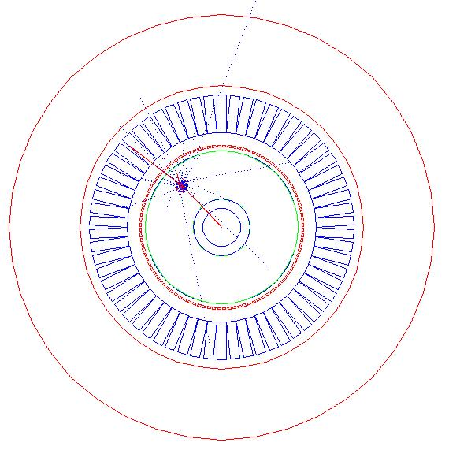
Events

Slide 15
Events (cont.)
All volumes are sensitive with the exception of magnets.
Data received includes:
global position (x,y,z) momentum (px,py,pz), mass, energy, energy lost, theta, phi, particle id

Slide 16
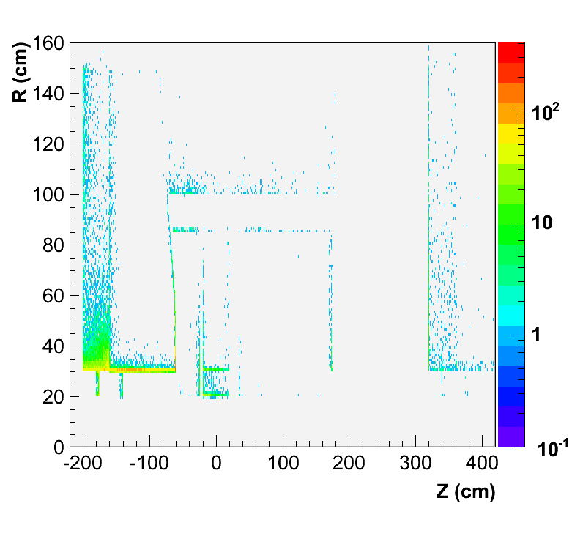
Electron Hits in Solenoid Region Data Shown Includes First Electron Hit In Each Individual Detector
DIRC
EM Calorimeters
EM Calorimeter
HTCC
Silicon Tracking
Tracking
Wire Chamber

Slide 17
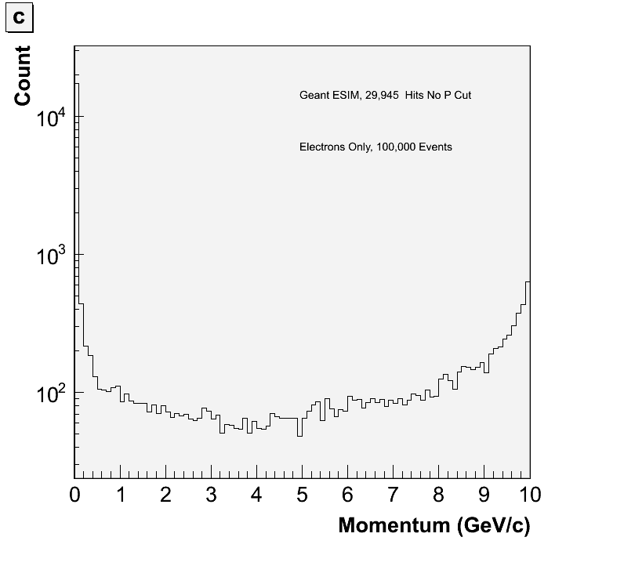
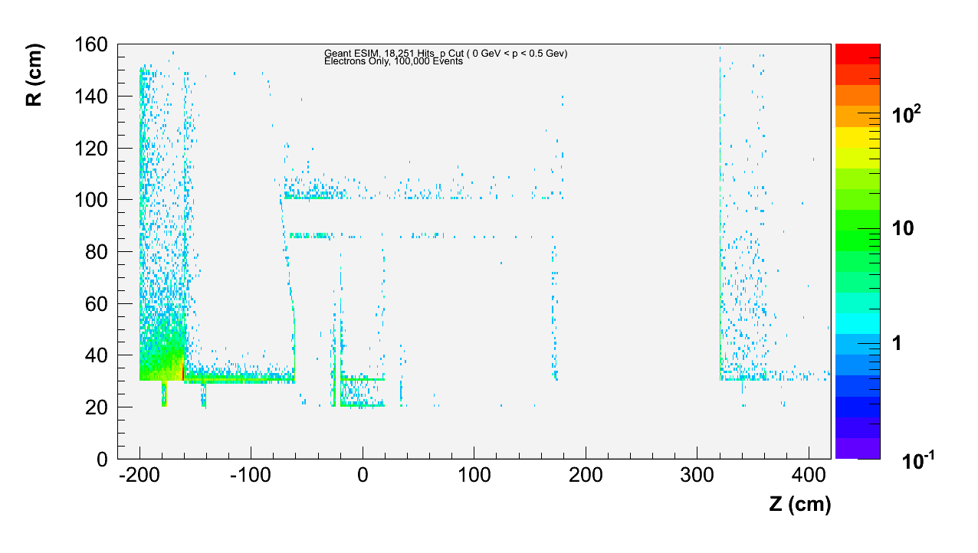
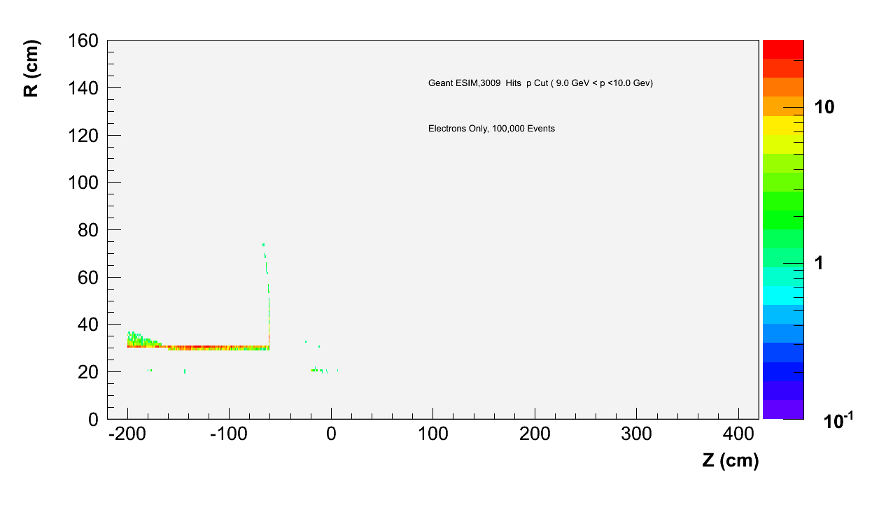
Electron hits in Solenoid Region (cont.) Data Shown Includes First Electron Hit In Each Individual Detector
Momentum in Solenoid Region
Momentum Cut
(0 < p <= 0.5)
Momentum Cut
(9.0 < p <= 10.0)

Slide 18
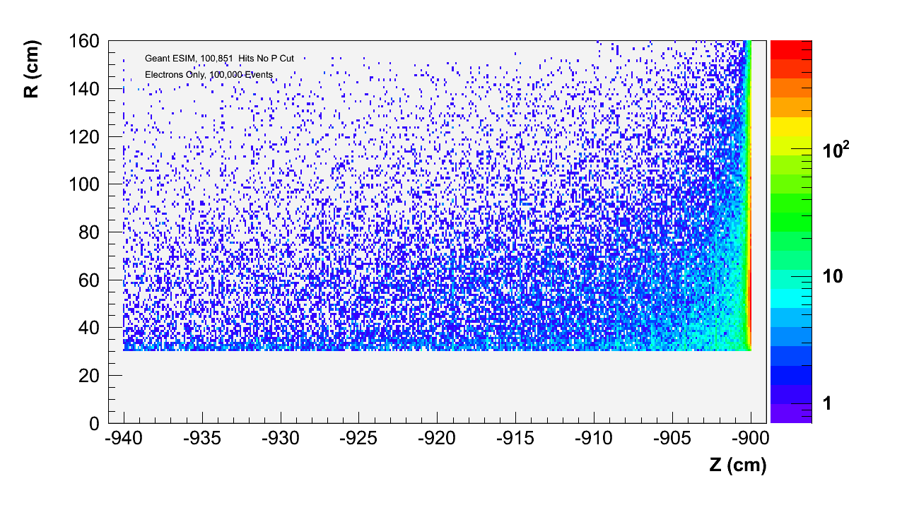
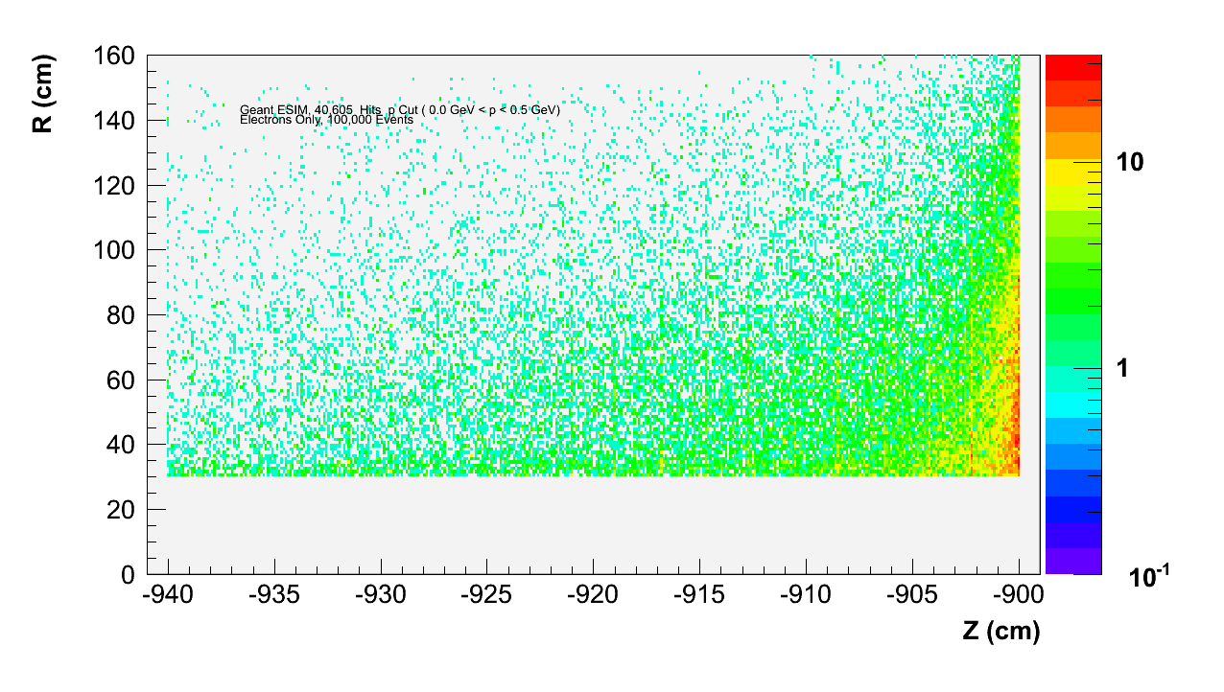
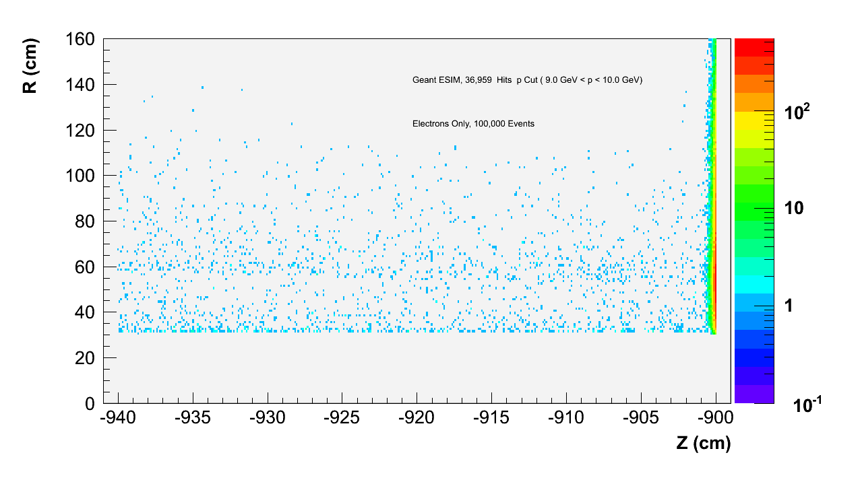
Electron Hits in Dipole Region EM Calorimeter
Momentum in Dipole EM Calorimeter
Hits in Dipole EM Calorimeter
Hits P Cut (0 < p < 0.5)
Hits P Cut (9.0 <p<10)

Slide 19
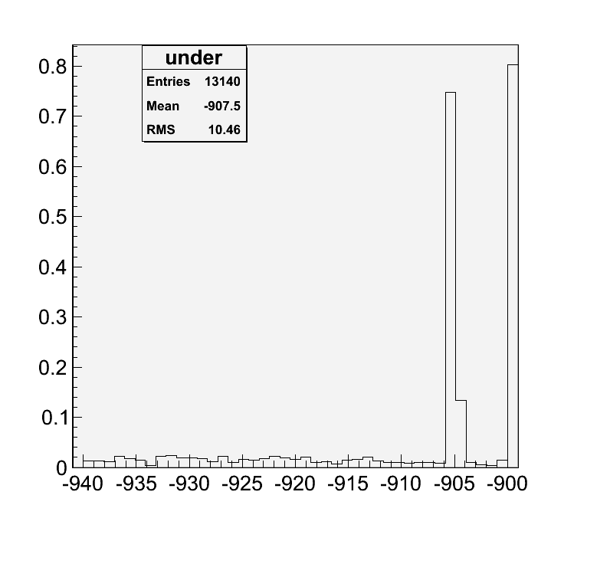
How many electrons do we miss? Data shown here includes a Tungsten Wall With 30cm Radius in Dipole Field
Hit Total With Wall: 120,971 Electrons
Miss Total: 13,140 Electrons
Hits w/ r < 30cm
Total Hits
<z> (cm)

Slide 20
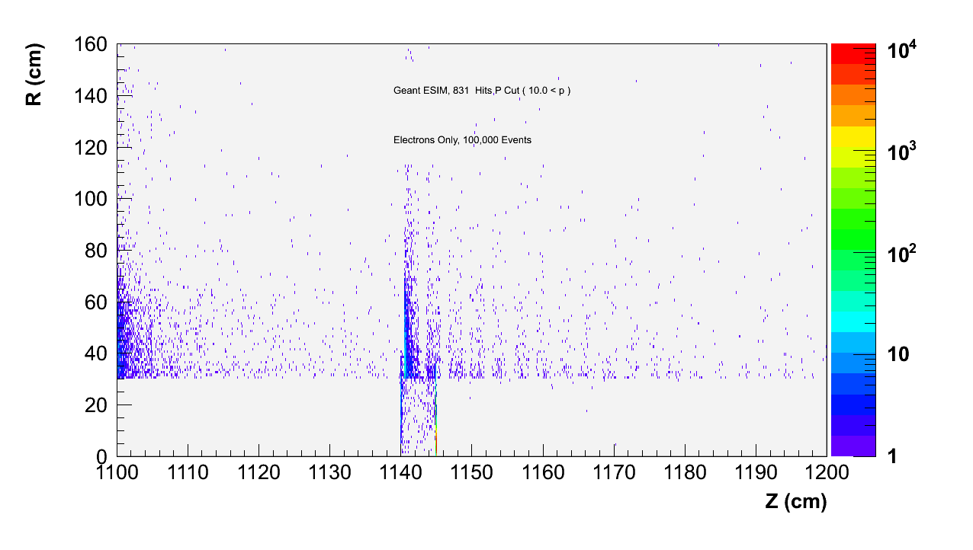
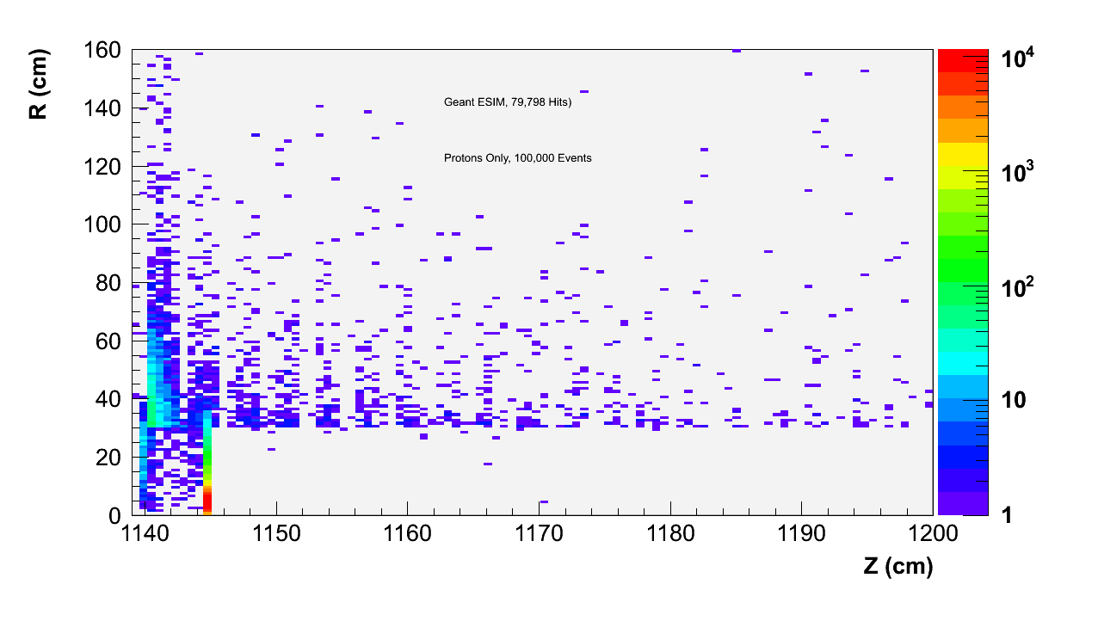
Proton Hits In Dipole Region
Data includes a Tungsten wall at the Hadronic Calorimeter

Slide 21
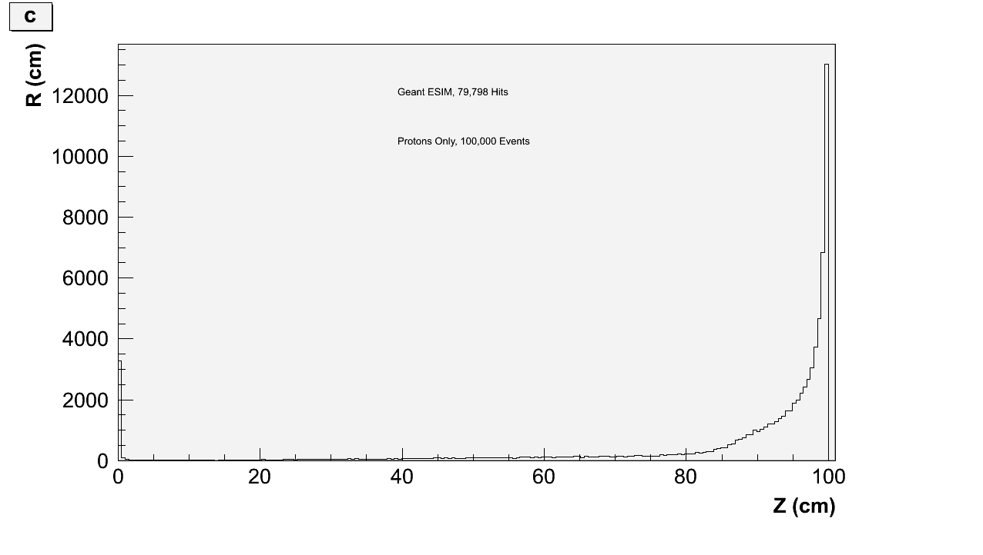
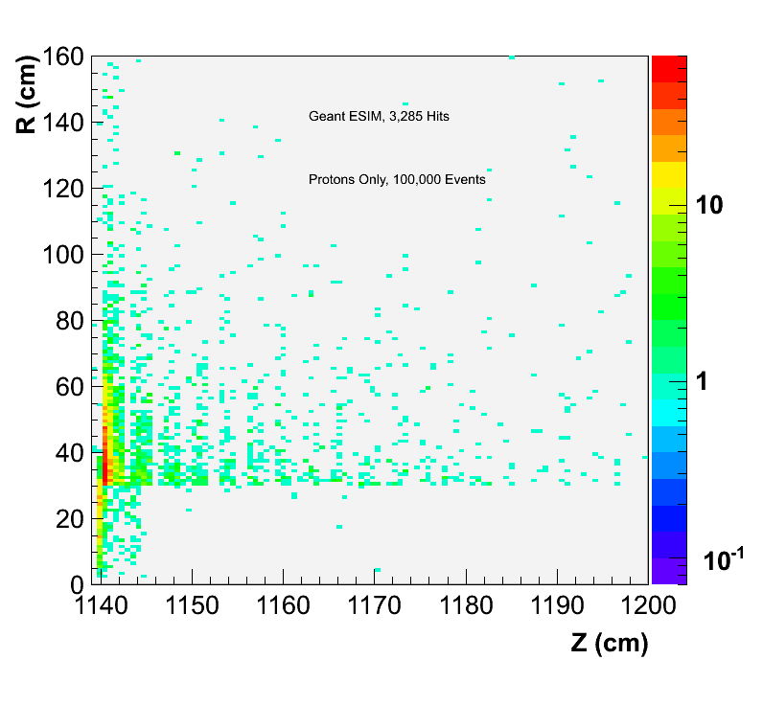
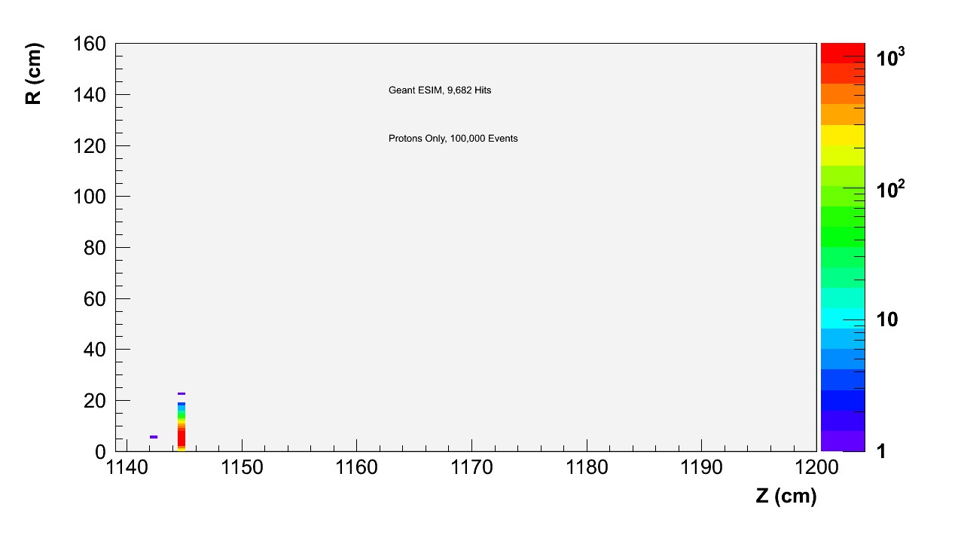
Proton Hits In Hadronic Calorimeter in Dipole
Momentum of Protons in Hadronic Calorimeter
Hits in Hadronic Calorimeter with cut (0 < p < 0.5)
Hits in Hadronic Calorimeter with cut (80 < p < 90)
Hits in Hadronic Calorimeter with cut (90 < p < 100)

Slide 22
Future Plans
Study effects of different magnetic fields.
Study different events DIS vs Diffractive
Study momentum and angular resolutions of particles.
Simulate e-A events
Release source code
Optimize geometry (bring detectors closer to beam pipes d~10cm)
…………….

