Slide 1
Gluons and the quark sea at high energies: distributions, polarization, tomography
September 13 to November 19, 2010
Organizers: Daniel Boer, Markus Diehl, Richard Milner,
Raju Venugopalan, and Werner Vogelsang
Complete information at:
http://www.int.washington.edu/PROGRAMS/10-3/
The announcement has been mailed to prospective attendees
If interested in attending, please fill out the application form and submit it
At most 22 participants at any time (office space)
Most of the invitations will be sent in March 2010
Seminar planning will start in June 2010
The goal is to develop a high level science case for EIC
INT has agreed to publish a summary volume

Slide 2
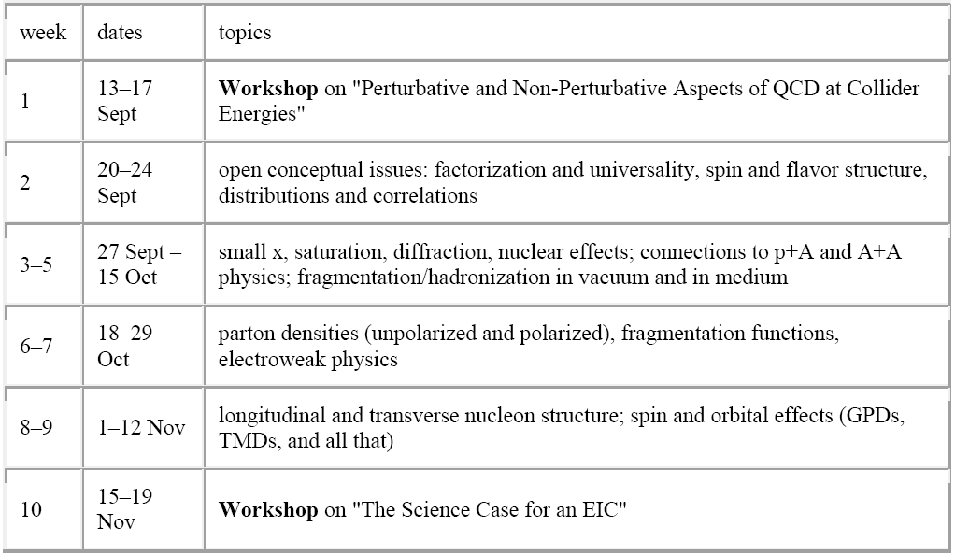
Gluons and the quark sea at high energies: distributions, polarization, tomography
September 13 to November 19, 2010

Slide 3
Advice from EICAC
The [Fall 2010] INT Program should be used to articulate the theoretical motivation, but also to compare those goals with reality by examining the sensitivities of simulated experiments. An outcome should be the science / machine matrix discussed earlier. At the conclusion of the INT program, we can anticipate some follow-up event(s) in 2011 where the joint community agrees on the theme of a final White Paper.
[At Fall 2020 INT Workshop]: i) For each of the two directions, it would be very useful to prepare a concrete list of the requested measurements (including the scientific motivation, kinematic region, required accuracy etc.); and/or ii) each of the two groups should investigate to what extent their scientific goals could be reached by the other machine (i.e. 'proton imaging' etc by the BNL design, 'saturation' etc by the JLab version).
We need to make sure that we are not missing elements (individual workshops) and that what we have is coherent (INT??)

