Slide 1
Beam-Beam effects in MeRHIC and eRHIC
Yue Hao
Collider-Accelerator Department
Brookhaven National Laboratory
Jan 10, 2009 EIC Meeting at Stony Brook

Slide 2
Outline
Beam-beam effect on the Electron beam
Beam distribution disruption
Mismatch with the design lattice
Pinch effect
Beam-beam effect on the Proton/Ion beam
Kink Instability
Possible feedback scheme as countermeasures

Slide 3
Disruption Effect (MeRHIC No cooling)
Np | 2e11
Ne | 0.31e11
Energy p/e (GeV) | 250/4
Bunch number | 111
Emit. p/e [nm-rad] | 9.4/9.4
β* p/e [m] | 0.5/0.5
Proton bunch length [m] | 0.2
ξp / De | 1.5e-3/3.1
Lumi.[cm-2s-1] | 1.1e32

Slide 4
Disruption Effect (MeRHIC with CEC)
Np | 2e11
Ne | 0.31e11
Energy p/e (GeV) | 250/4
Bunch number | 111
Emit. p/e [nm-rad] | 0.94/0.94
β* p/e [m] | 0.5/0.5
Proton bunch length [m] | 0.2
ξp / De | 1.5e-2/31
Lumi.[cm-2s-1] | 1.4e33
In working progress

Slide 5
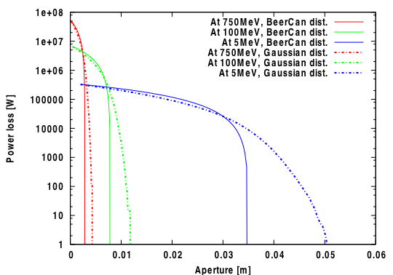
Power (Beam) loss requirements on aperture, MeRHIC w/o cooling

Slide 6
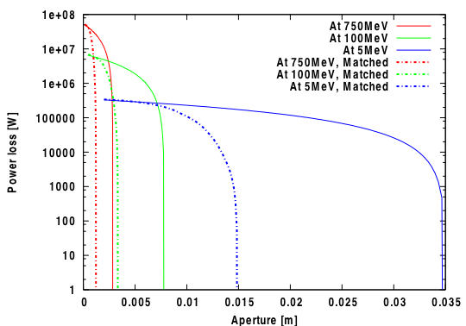
Mismatch compensation
If aperture is an issue, the mismatch between the beam distribution and design optics can be compensated, since it is mainly an linear effect.
Possible schemes: fast quadrupole, electron lens

Slide 7
Disruption for eRHIC Optimization
β*= 1m
Emittance:
1nm-rad
β*= 0.2m
Emittance:
5nm-rad

Slide 8
Kink Instability
One turn map for two particle with kick between two particles leads to the matrix over one synchrotron oscillation is:
The stability condition is just to keep the Eigen value of T as imaginary number, which requires
The proton beam sees the opposing electron beam as wake field. The wake field can be calculated by simulation. It depends on the position of both leading and trailing particles.
Define:

Slide 9
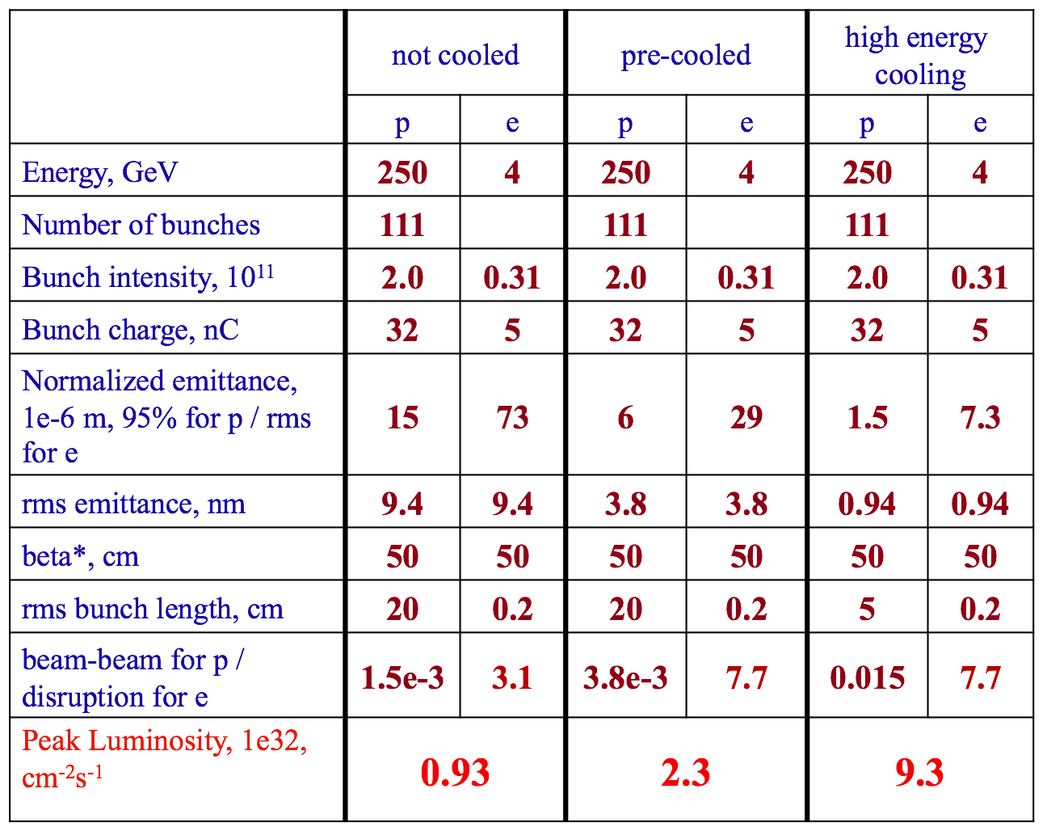
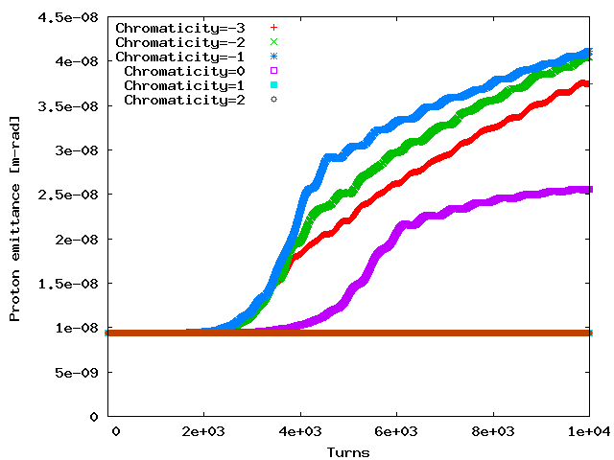
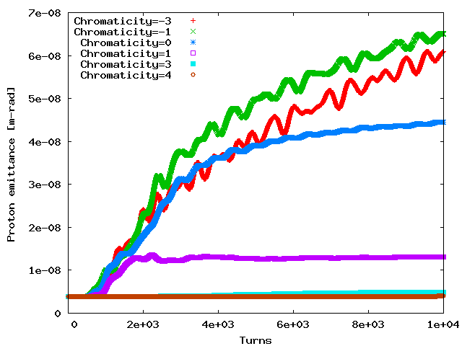
Kink Instability is curable Example: MeRHIC
Not Cooled case
Chromaticity=1 is needed
Pre Cooled case
Chromaticity=4 is needed
Assuming the rms energy spread is 5e-4
For the parameters beyond threshold, use Landau damping to suppress the beam emittance growth. For eRHIC, larger chromaticity is needed (5-7 unit).

Slide 10
Feedback stabilization is possible
Kink instability can be stabilized by landau damping by introduce certain amount of chromaticity. However, large chromaticity is unpleasant in real machine operation.
Under this motivation, a feedback scheme is being carried out to stabilize the instability by measuring the electron bunch info after beam-beam interaction.
ERL
BPM
Feedback kicker
IP
RHIC
The info from the previous electron bunch is amplified by certain factor A and feed through the next opposing electron bunch for the same specific proton bunch.
The factor A is determined by proton transverse tune, the position of BPM and kicker. It can also related to the noise level and how frequently the feedback is added.

Slide 11
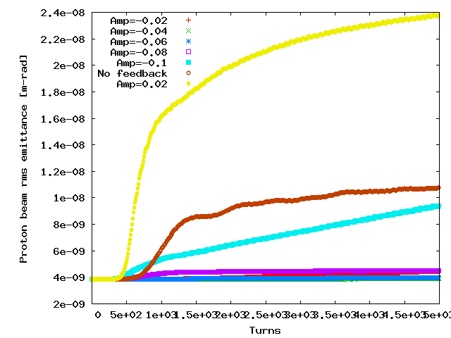
A preliminary state-of-art illustration
Use eRHIC parameters, to replace required 5-7 chromaticity, feedback loop is introduced.
We measure the transverse offset of the electron bunch after beam-beam collision, multiply a factor ‘Amp’ and apply this offset to next electron bunch with respect to same proton bunch.

Slide 12
Summary
We need to fight with electron disruption and mismatch effects to minimize the beam loss after the interaction.
For both eRHIC and MeRHIC, the effects are studied and no showstoppers are found
The kink instability can be suppressed by chromaticity.
A possible feedback scheme can also bring the system stable without unpleasant large chromaticity.
The electron beam noise issue has been discussed in M. Blaskiewicz’s talk.

Slide 13
Disruption with different beam-beam strength
Use the MeRHIC with CEC parameters.
Vary the proton beam intensity from 0 to 2e11
The disruption after collision is shown.

Slide 14
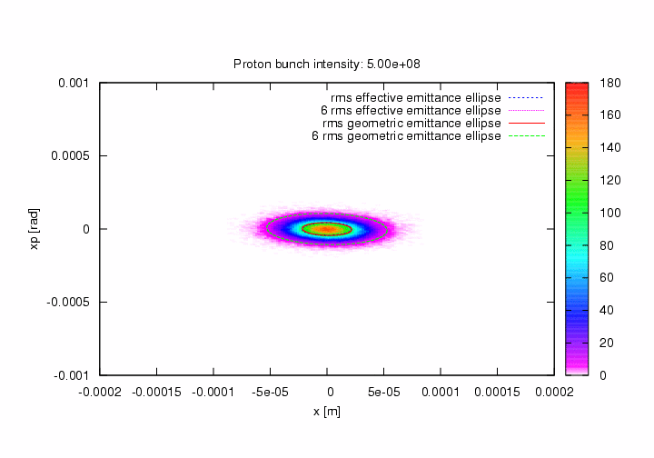
Disruption with different beam-beam strength

Slide 16
Beam-Beam Effects
Beam-Beam effect is caused by interaction between the two beams at the interaction region.
At interaction region, a particle in one beam is experiencing the electromagnetic force generated by both opposing beam and the beam itself.
The former force is called beam-beam force, while the latter is called space charge force.
Possible Countermeasures: (ring-ring, ERL-ring)
Proper working point (Hold the tune spread due to nonlinear force)
Electron lens (apply another force which has same form but opposite sign)
Low-beta* electron optics
Fight with collective effects in ion beam
Electron beam is pinched by ion beam

Slide 17
Accelerator Keywords
Transverse Motion (x,x’,y,y’)
Transverse Tune
Emittance
One Turn Map Matrix
Longitudinal Motion(Synchrotron Motion)
The synchrotron motion is much slower tan transverse motion. The tune for synchrotron motion in eRHIC design is 0.0043. The motion is nonlinear if oscillation amplitude is large.
Luminosity for two Gaussian beams:

Slide 18
Beam-Beam Field
For a transverse Gaussian distribution,
(+/-4 sigma cut-off)
Bassetti-Erskine formular
For round beam case, the field have simple form
Near axis, the field is linear.

Slide 19
Beam-Beam In ERL Based eRHIC
Proton Beam
Fresh Electron Beam
Electron Effects:
Disruption
- Nonlinear b-b force
Mismatch
- Mainly Linear effect
Proton Effects:
Kink Instability
Pinch Effect
Noise
Continually rotate in RHIC
To energy recovery path

Slide 20
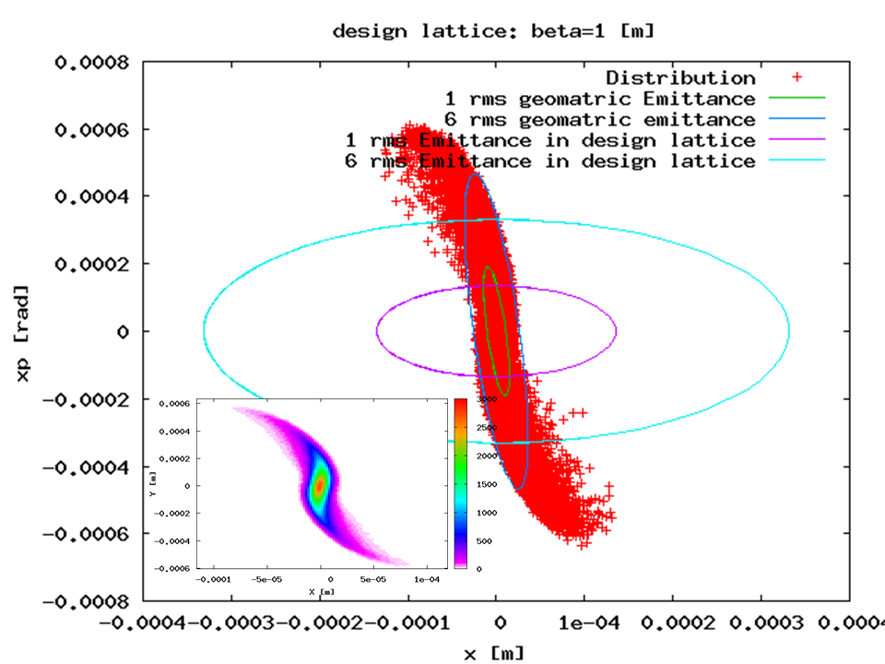
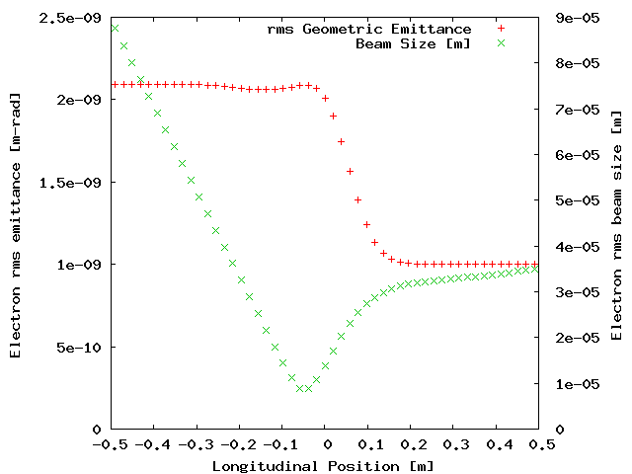
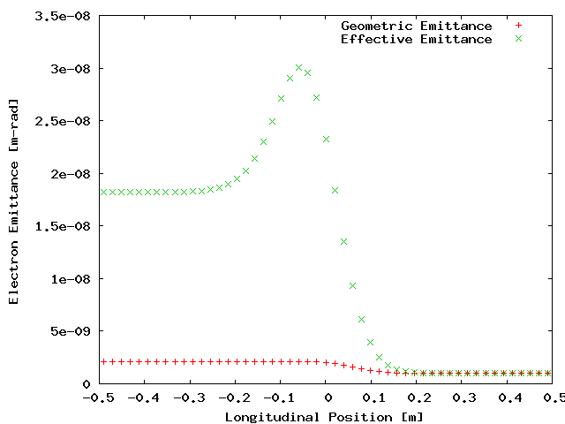
Electron Disruption Effect in eRHIC(β* = 1m)
Electron beam travels from positive longitudinal position to negative.
The nonlinear beam-beam force will cause the electron beam geometric emittance growth.

Slide 21
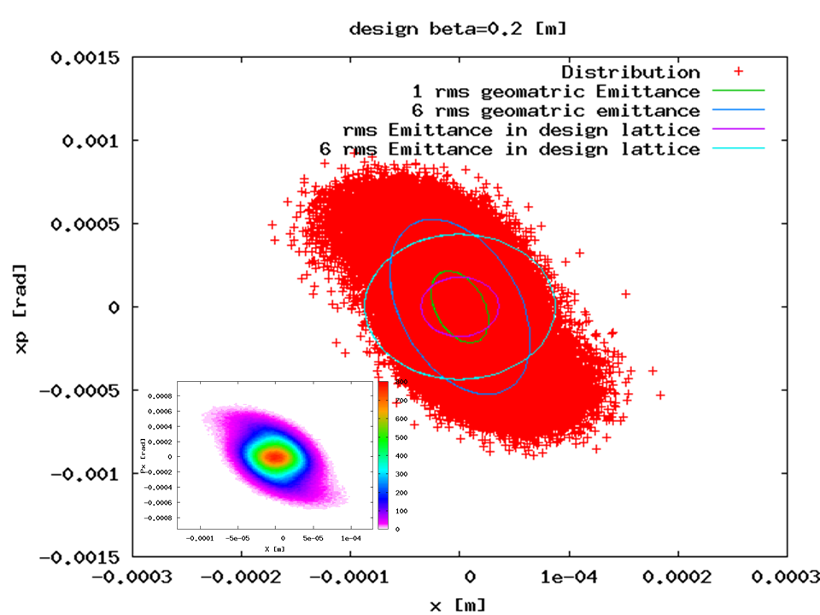
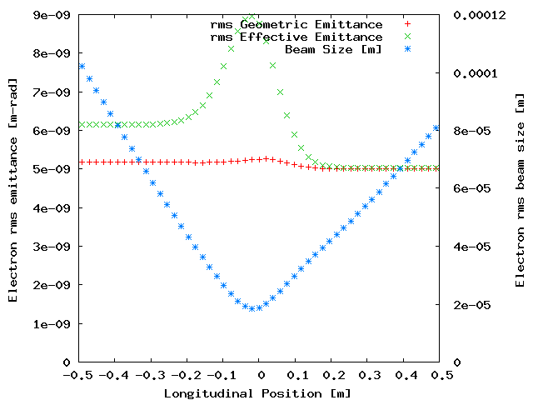
Electron Disruption Effect in eRHIC(β* = 0.2m)
Mismatch effect is much smaller, from the discrepancy of geometric emittance and effective emittance.
Pinch effects also smaller! (Minimum electron size ~20 microns, compared with ~8 microns)

Slide 22
The beam loss at different position
(Not-Cool case)
(Use beta=5m everywhere, easily scale later)
For both initial Beer-Can and Gaussian (4-σ cutoff) Distribution
Position | Energy | Aperture Beer-Can | Aperture Gaussian
Lowest Energy at arc | 750 MeV | 2.9 mm | 4mm
The exit of main linac | 100 MeV | 7.8 mm | 10mm
Entrance of Beam dump | 5 MeV (Dump All) | 35 mm | 53mm

Slide 23
Kink Instability of Proton Beam
Use 2-Particle model to illustrate kink instability, The two particles have same synchrotron amplitude but opposite phase. Let T be the synchrotron period.
p
p
p
e
p
e
p
p
p
e
p
e
e
p
e
p
p
p
e
p
e
p
p
p
After T/2, the head and tail exchange there positions
Unstable
p
Stable
p
p
e
p
e

Slide 24
Threshold (Two-particle model)
One turn map for two particle:
Kick from the leading particle to trailing one.
The total matrix for one synchrotron oscillation gives:
Threshold:

Slide 25
Electron Pinch Effect
Electron pinch effect is very harmful for proton/ion beam. It enhance the proton/ion beam-beam parameter up to factor of 60!!
Can be cured by lower the electron beta*.

Slide 26
Conclusions
MeRHIC will deliver 10³² cm⁻²s⁻¹ level luminosity, eRHIC reaches at least 10 times higher.
MeRHIC white paper and cost estimation are being prepared.
Staging plan leads us to the exciting full energy eRHIC with smooth transitions, 90% of equipment in MeRHIC will be reused in eRHIC.
New accelerator physics and technology are being discovered and learned during design the machine. The difficulties are being overcome!

