Slide 1
MeRHIC Design
V.Ptitsyn
on behalf of MeRHIC Design team:
M. Bai, J. Beebe-Wang, I. Ben-Zvi, M. Blaskiewicz, A. Burrill, R. Calaga, X. Chang, A. Fedotov, H. Hahn, Y. Hao, L. Hammons, D. Kayran, V. N. Litvinenko, G. Mahler, B. Parker, E. Pozdeyev, T. Roser, A. Pendzick, S. Plate, T. Rao, S. Tepikian, D. Trbojevic, E.Tsentalovich, N. Tsoupas, J. Tuozzolo, G. Wang

Slide 2
Talk Outline
MeRHIC layout and general description
Design beam parameters and luminosity
Design components:
  Electron linac
  Recirculation passes
  Interaction region
  Injector
Summary

Slide 3



RHIC and MeRHIC
  MeRHIC – Medium energy eRHIC .
  First stage of the electron-ion collider at BNL.
  Electron acceleration is based on energy-recovery linacs.
  Electrons collide with protons and ions from RHIC Blue ring. Only minimal modifications of existing RHIC rings at IR region.
  Polarized electron and proton beams. Longitudinal polarization orientation at the collision point for both beams.
  Parallel operation with the p-p (or ion-ion) collisions at PHENIX and STAR detectors.
80-250 GeV
protons
4 GeV
electrons
p
e⁻
100 GeV/u
Au ions
Up to 63 GeV center mass energy
PHENIX
STAR

Slide 4
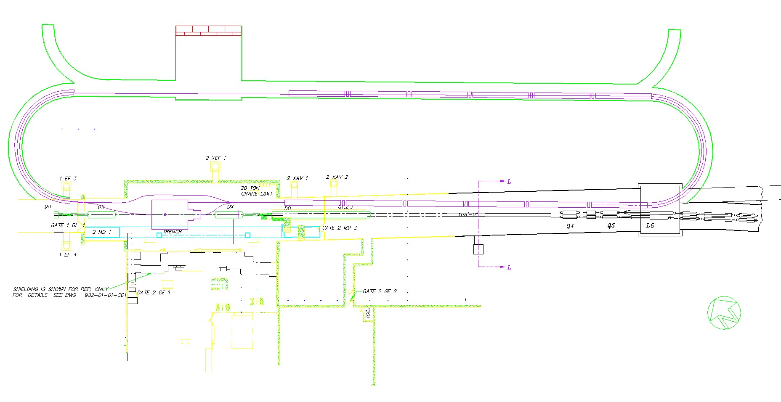
MeRHIC at IR2 region
Pre-accelerator 90 MeV ERL
Electron gun
Beam dump
Linac 1
e⁻
2nd harmonic
cavities
0.1 GeV
Fundamental cavity on 4 Gev pass
Main ERLs; 36 cavities x 18 Mev/cav = 0.65 GeV per linac
0.1, 1.4, 2.7 GeV
0.75, 2.05, 3.35 GeV
Linac 2
4 GeV
p
IR2 region features:
- asymmetric detector hall (appropriate for asymmetric detector for e-p collisions)
- long wide (7.3m) tunnel on one side from the IR (enough space to place energy recovery linac(s))
Main components:
100 MeV injector on the basis of polarized electron gun (50 mA) and pre-accelerator ERL.
-Two main ERLs (one of them in the RHIC tunnel) with maximum 0.65 GeV energy gain per linac.
-Recirculation passes: warm magnets, acceptable synchrotron radiation power.
(April 09)

Slide 5
Proton and ion beam for MeRHIC
Goal: modifications for proton (ion) beam have to be minimal
IR design: use of existing triplets and D0 magnets, removal of IR2 DX magnets, addition of warm dipole magnets.
Addition of two spin rotators in Blue ring.
Required proton beam parameters are either already achieved or planned to be achieved in 2-3 years for RHIC operation.
MeRHIC will take advantages of planned improvements in RHIC (for RHIC operation): 56 MHz SRF, stochastic cooling (for ions) …

Slide 6
MeRHIC parameters for e-p collisions
 | Baseline design (no cooling) |  | Pre-cooled at the injection energy |  | With high energy cooling (CEC)
 | p | e | p | e | p | e
Energy, GeV | 250 | 4 | 250 | 4 | 250 | 4
Bunch repetition time, ns | 105 | 105 | 105 | 105 | 105 | 105
Bunch intensity, 10¹¹ | 2.0 | 0.31 | 2.0 | 0.31 | 2.0 | 0.31
Bunch charge, nC | 32 | 5 | 32 | 5 | 32 | 5
Normalized emittance, 1e-6 m, 95% for p / rms for e | 15 | 73 | 6 | 29 | 1.5 | 7.3
rms emittance, nm | 9.4 | 9.4 | 3.8 | 3.8 | 0.94 | 0.94
beta*, cm | 50 | 50 | 50 | 50 | 50 | 50
rms bunch length, cm | 20 | 0.2 | 20 | 0.2 | 5/20 | 0.2
beam-beam for p /disruption for e | 1.5e-3 | 3.1 | 3.8e-3 | 7.7 | 0.015 | 7.7/30
Peak Luminosity, 1e32, cm⁻²s⁻¹ | 0.93 |  | 2.3 |  | 9.3

Slide 7
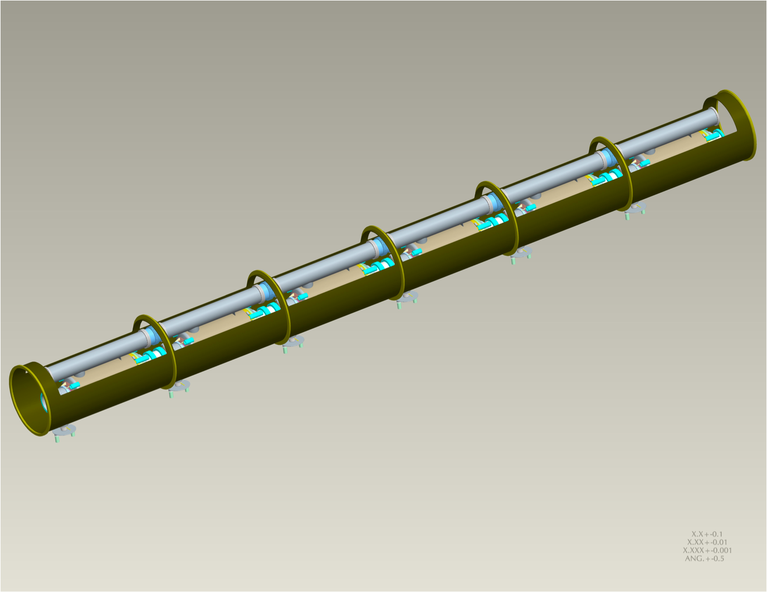
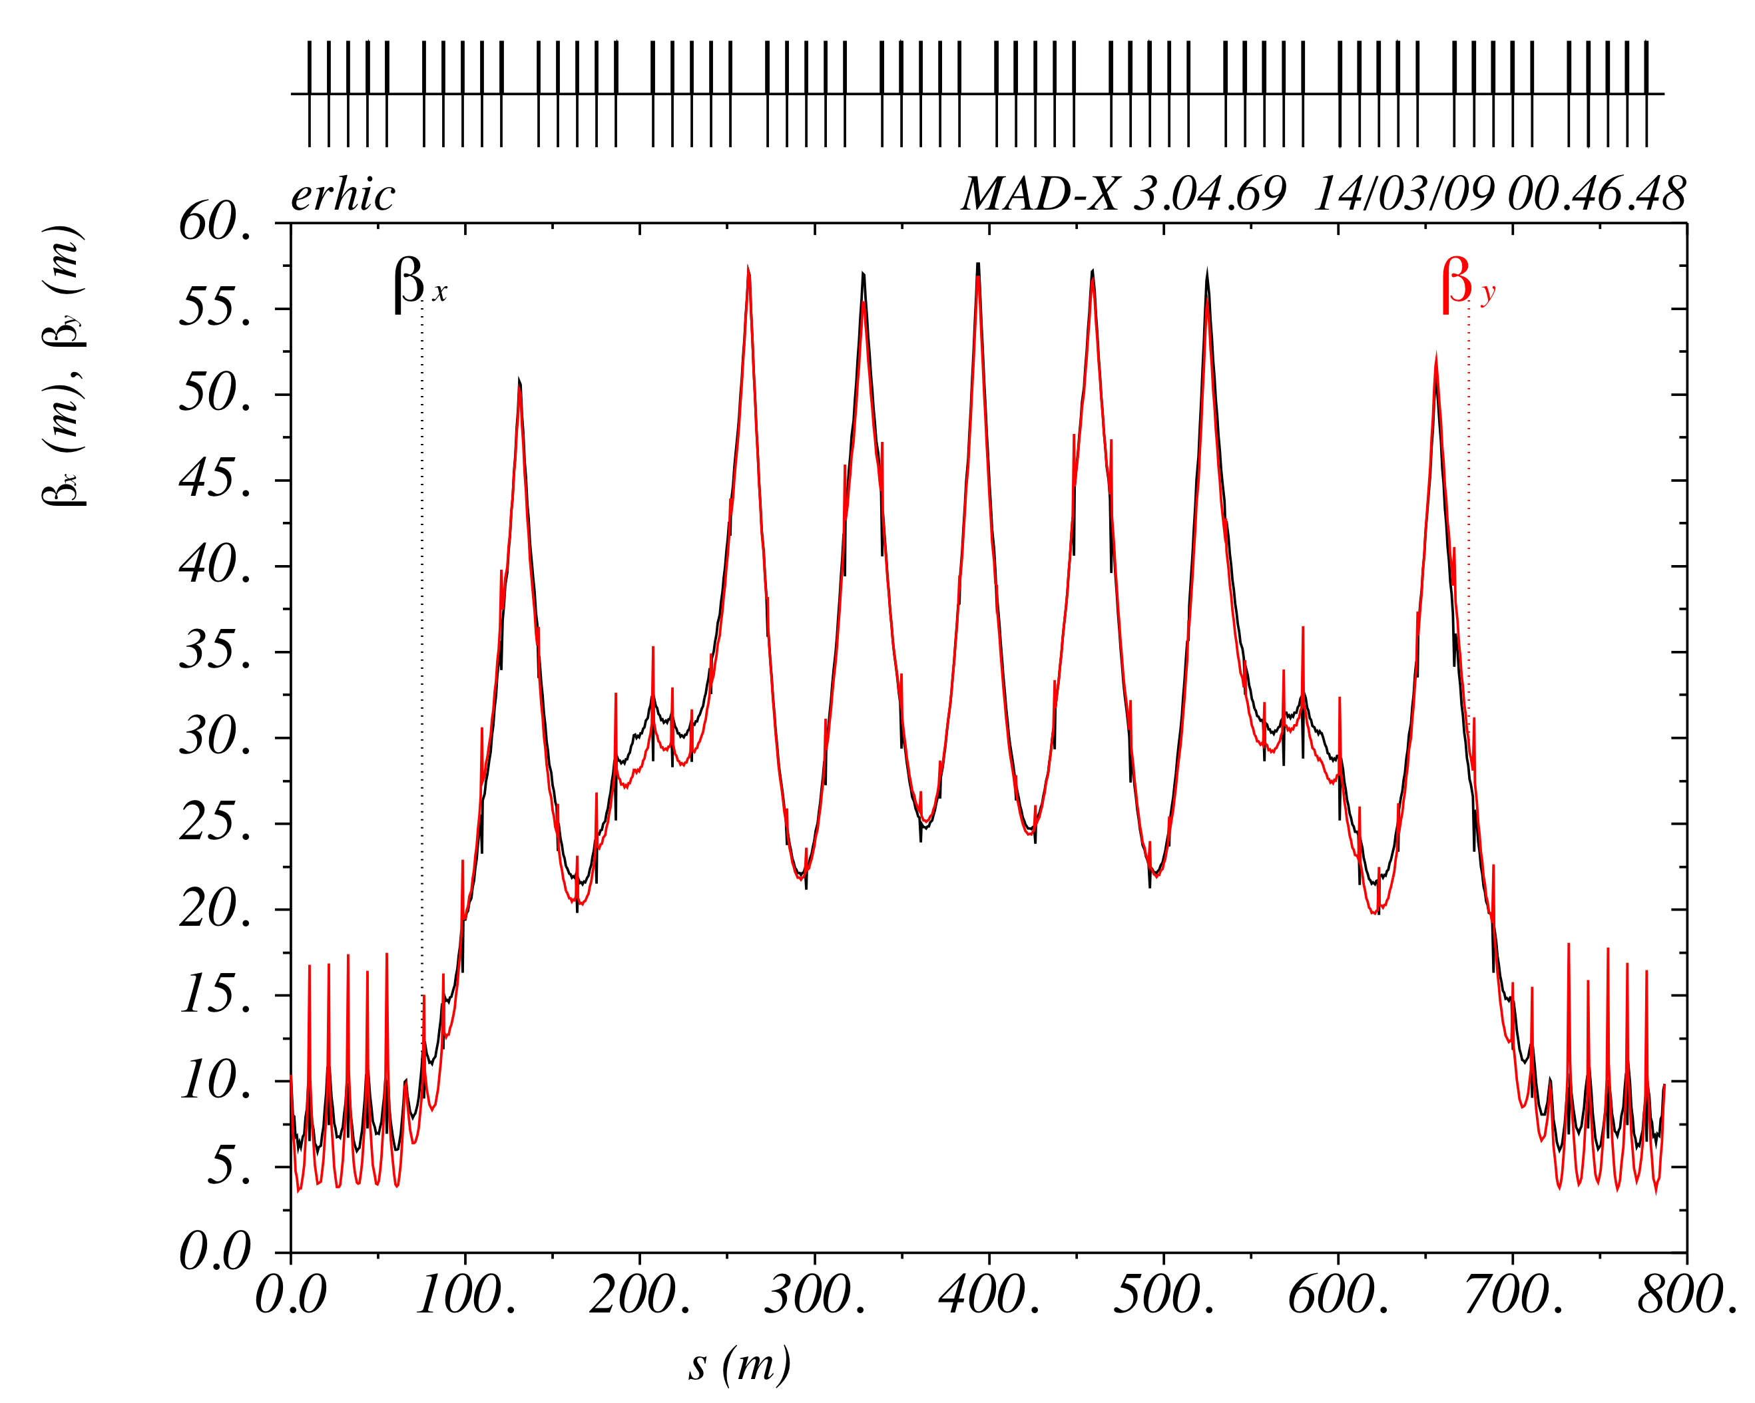
MeRHIC Linac Design
65m total linac length
All cold: no warm-to-cold transition
703.75 MHz
1.6 m long
Drift
1.5 m long
Based on BNL SRF cavity with fully suppressed HOMs
Critical for high current multi-pass ERL
100 MeV
4 GeV
100 MeV
Current breakdown of the linac
N cavities = 6 (per module)
N modules per linac = 6
N linacs = 2
L module = 9.6m
L period = 10.6 m
E_{f} = 18.0 MeV/m
⟨dE/ds⟩ = 10.2 MeV/m
Modular structure
I. Ben-Zvi
E.Pozdeyev

Slide 8
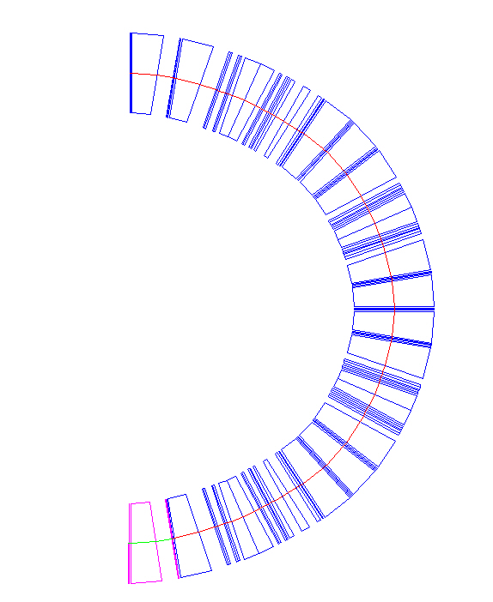
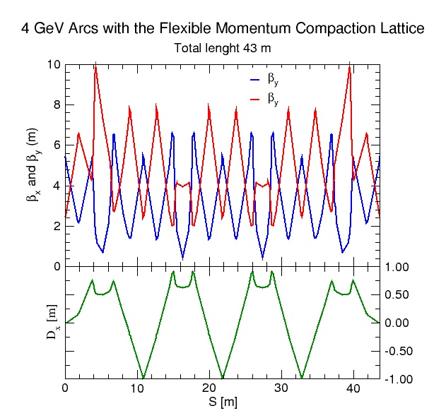
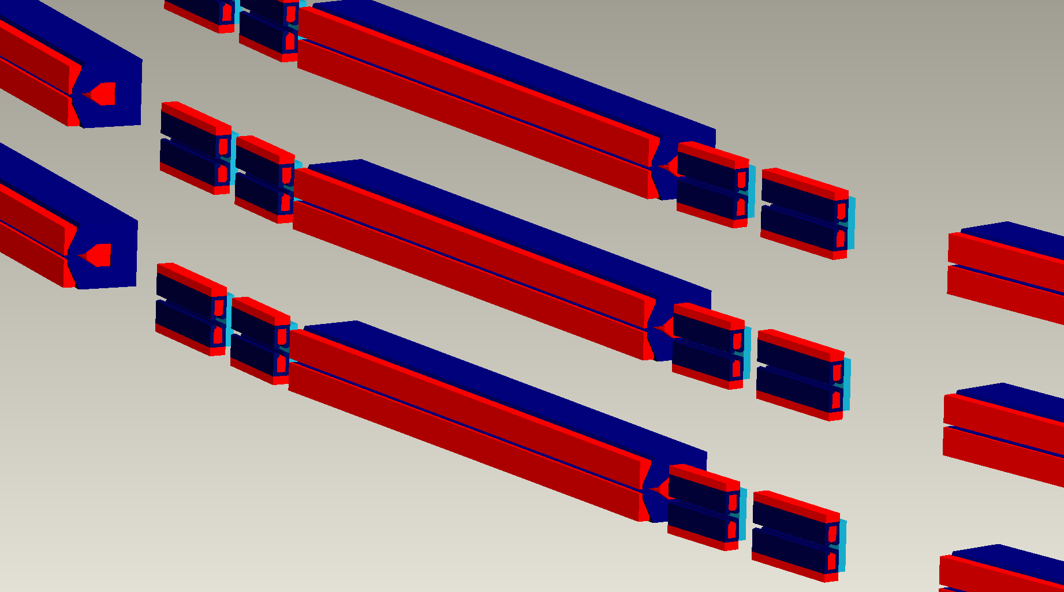
Recirculation pass lattice
Achromatic and isochronous arc design
Flexible Momentum Compaction Lattice-> adjustable M₅₆ parameter
Large dipole filling factor (64%) -> reduced synchrotron radiation (< 2kW/m)
Initial dipole and quadrupole magnet design has been developed
D. Trbojevic, N. Tsoupas
Vertical arrangement
of recirculation passes
27.8m

Slide 9
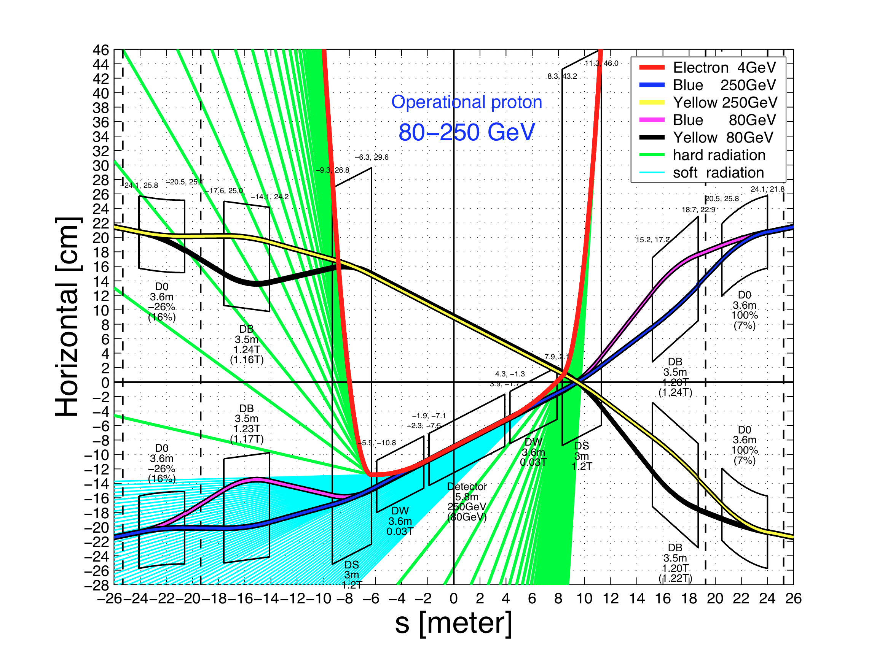
IR Design Features
© J.Bebee-Wang
Provides the integration of detector dipole magnets into the beam separation scheme
Provides the ability to vary the proton beam energy from 80 to 250 GeV at constant electron beam energy.
Provides effective SR protection:
soft bend (~0.05T) is used for final bending of electron beam
Focusing elements are located far from the IP (first electron quad at 11m)
1T,3m
dipole
Soft
dipole
Soft
dipole
1T,3m
dipole
e
p, Au
Solenoid, 4 T
40 m

Slide 10
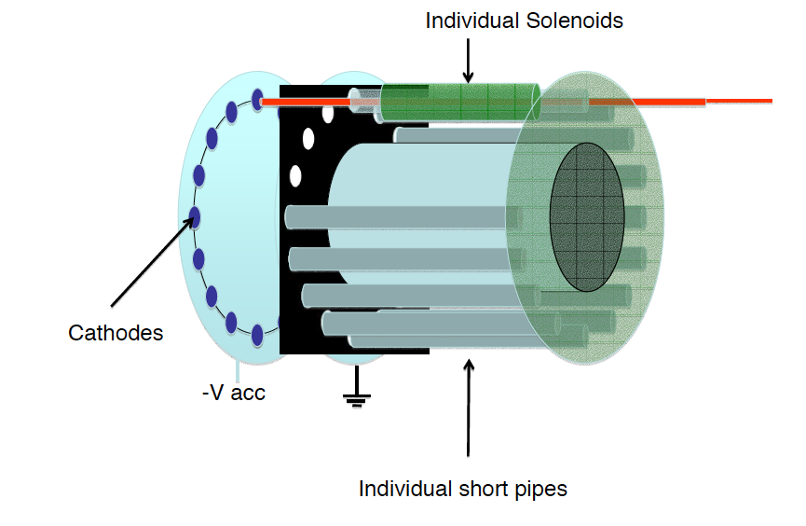
Injector and Pre-accelerator Design
X. Chang and D. Kayran
Injector Parameters:
Polarized Gun (200kV)
Cathode GaAs,
Laser 780nm
Emax= 10 MeV
Iavr =50 mA,
Q per bunch =5nC
Design realizes bunch compression and spin direction control
Pre-accelerator linac:
Standard MeRHIC linac cryomodule (~10m) with 5x703 MHz 5-cell cavities and one 3rd harmonic 2.11 GHz inside.
Two transition sections (0.5 m each) attached from both ends
Energy gain 90 MeV
Output beam parameters :
E=100 MeV
Iavr=50 mA
Ipeak=500 A
Reprate = 9.8 MHz
Emittance =70 mm-mrad
Bunch length = 2-3 mm
dE/E = 1E-3
10 MeV Injector
90 MeV Linac
10 MeV x 50 mA
0.5 MW Beam Dump
11 m
11 m
Gatling Gun (Ek=200keV)
10 MeV Booster Linac
to MeRHIC vertical combiner
from MeRHIC
arcs
1.4, 2.7, 4 GeV
30 m

Slide 11
Summary: MeRHIC Design Status
The lattices of all machine components (injector, recirculation passes, linac, interaction region, mergers/splitters) have been developed. (D. Trbojevic’s and D.Kayran’s talks)
The interaction region with the detector fully integrated into the accelerator environment has been designed. (J. Beebe-Wang’s talk)
The most important beam dynamics effects, defining achievable beam parameters, machine luminosity and polarization have been studied. (M.Blaskiewicz’s, M.Bai’s amd Y.Hao’s talks)
No show-stoppers had been found.
Design development of high current polarized electron gun is underway. (X.Chang’s talk)
Conceptual designs of superconducting linac and its cryomodule have been done.
(I. Ben-Zvi’s talk)
Engineering realization of various design aspects and accelerator system (magnets, vacuum, civil construction …) has been considered. (J. Tuozzolo’s talk)
Detailed cost estimate of MeRHIC has been completed, including all machine systems, civil construction and utilities. In early October 2009, an Internal BNL Committee reviewed the MeRHIC cost estimate. The cost came to ~$350mln (without the detector).

