Slide 1
Polarization in ELIC
Yaroslav Derbenev
Center for Advanced Study of Accelerators
Jefferson Laboratory
EIC Collaboiration Meeting , January 10-12, 2010
Stony Brook, Long Island

Slide 2
Outline
Polarization of Ions (protons, deuterons, ³He)
Polarization of Electrons
Polarization of Positrons

Slide 3
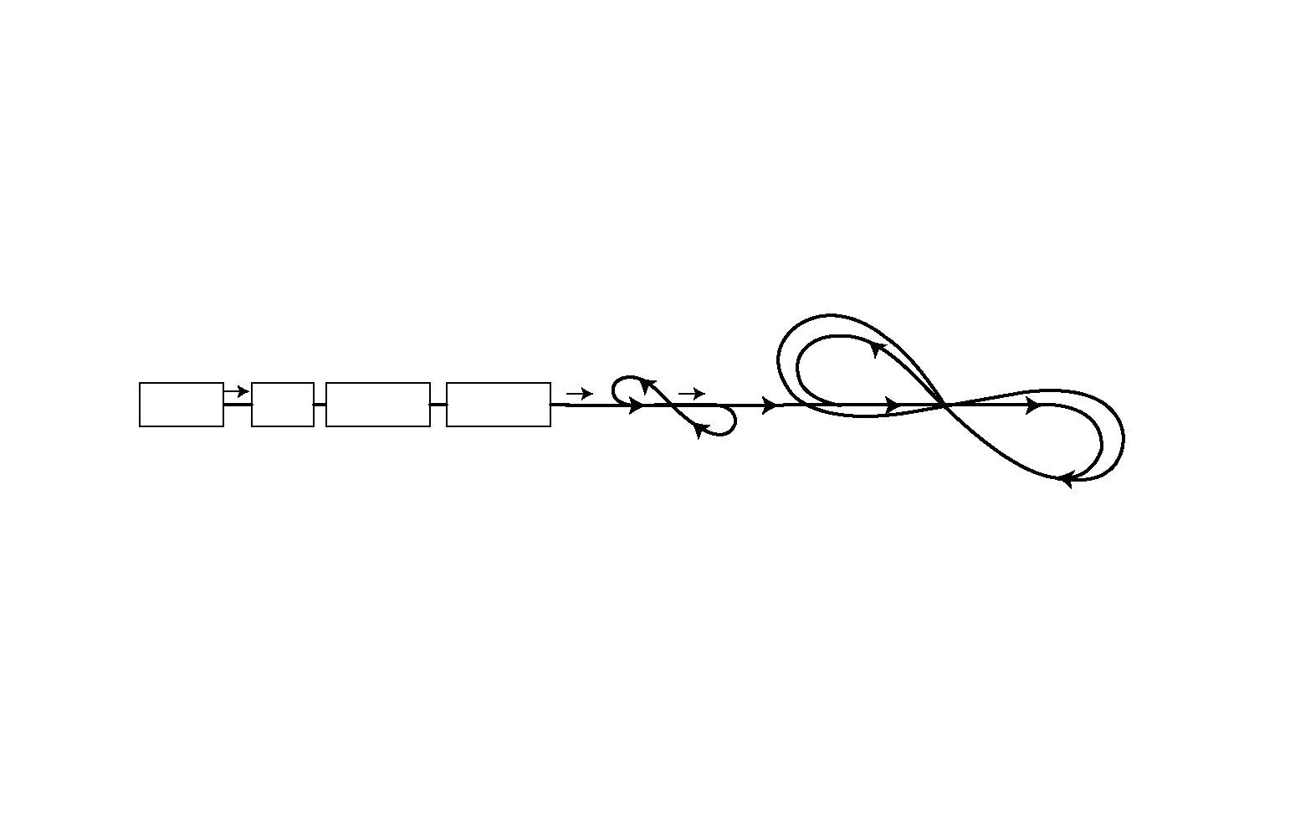
Ion Polarization
“Figure-8” boosters and storage rings
Zero spin tune avoids intrinsic spin resonances.
No spin rotators required around the IR.
Ensure longitudinal polarization for deuterons at 2 IP’s simultaneously, at all energies.
Ion Collider Ring
Linac 200 MeV
Source
Pre-Booster
3 GeV/c
C~75-100 m
Ion Large Booster 20 GeV
(Electron Storage Ring)

Slide 4
Snakes for p and He++
Protons and ³He
Solenoid
Deuterons
collision point
collision point
d
collision point
collision point
e
Protons and ³He
P, He3
Protons and ³He: 4 IP’s (along straight section) with simultaneous longitudinal polarization with no rotators.
Two snakes are required to ensure longitudinal polarization at 4 IP’s simultaneously.
Deuterons: Two IP’s with simultaneous longitudinal polarization with no snakes (can be switched between two cross-straights).
Solenoid (or snake for protons and He) to stabilize spin near longitudinal direction for all species.

Slide 5
Polarization of Electrons
spin rotator
spin rotator with 90º solenoid snake
spin rotator
collision points
collision points
spin rotator with 90º solenoid snake
spin rotator
spin rotator
Spin injected vertical in arcs (using Wien filter).
Self-polarization in arcs to maintain injected polarization.
Spin rotators matched with the cross bends of IPs.

Slide 6
Electron Spin Matching at the IR
spin rotator
Spin tune solenoid
spin tune solenoid
spin rotator
spin
e
e
collision point
collision point
i
i
90º
90º
spin tune solenoid
spin tune solenoid
snake solenoid
Rotation of spin from vertical in arcs to longitudinal at IP:
- Beam crossing bend causing energy-dependent spin rotation, together with
- Energy-independent orbit spin rotators [two SC solenoids with bend in the middle] in the arc and after the arc.

Slide 7
Polarization for Positrons
spin rotator
spin rotator with 90º solenoid snake
spin rotator
collision points
collision points
spin rotator with 90º solenoid snake
spin rotator
spin rotator
Sokolov-Ternov polarization for positrons
Vertical spin in arcs
4 IP’s with longitudinal spin
Polarization time is 2 hrs at 7 GeV – varies as E⁻⁵ (can be accelerated by introduction of wigglers or polarizing at maximum energy).
Quantum depolarization in spin rotators ->Equilibrium polarization ≤ 90%

Slide 8
e⁻ / e⁺ Polarization Parameters
*One e-folding. Time can be shortened using high field wigglers.
**Ideal max equilibrium polarization is 92.4%. Degradation is due
to radiation in spin rotators.

Slide 9
On bunch-to-bunch errors
In ELIC, forming the ion beam via re-bunching
(acceleration by normal RF, coasting,
final bunching by SC HV RF)
eliminates variation of beam parameters over bunches.
Ion bunch may collide with many e-bunches (even with all of them)

Slide 10
Beam-beam depolarization
We are well familiar with the beam- beam forces impact to polarization (read old papers by A. Kondratenko and J. Buon)
Spin tune spread due to b-b) can be suppressed by snakes or twist of figure 8
Low vertical emittance achieved with cooling will help
Very large synchrotron tune (ELIC) allows one to select a good tune position to avoid dangerous beam-beam spin resonances
In addition, b-b impact could be compensated by organizing interference with quadrupole lattice, if needed (theory by A. Kondratenko, proposal by J. Buon)
There is no doubt that the b-b depolarization can be prevented in both ELIC and eRHIC designs

Slide 11
Open issues
Transverse ion spin at IPs in figure 8 ring
Flipping spin
Polarimetry

Slide 12
Conclusions
ELIC design offers very robust and efficient acceleration, maintenance and operation of all species polarized beams
Beam- beam depolarization is well understood and will be prevented by the well-known measures
Collision systematic errors is not a matter of ELIC design
There still be questions to be solved or designed (transverse ion spin, flipping spin, polarimetry…)

Slide 13
Thank you!

