Slide 1

ELIC Luminosity and Electron Cooling
Ya. Derbenev and Y. Zhang
EIC Collaboration Meeting
Stony Brook University, January 10 to 12, 2010

Slide 2
Outline
Introduction
ELIC Luminosity Concept
Forming and Cooling of Ion Beams
Conceptual Design of ERL Circulator Cooler
Key Enabling Technologies and R&D
Summary

Slide 3
1. Introduction

Slide 4
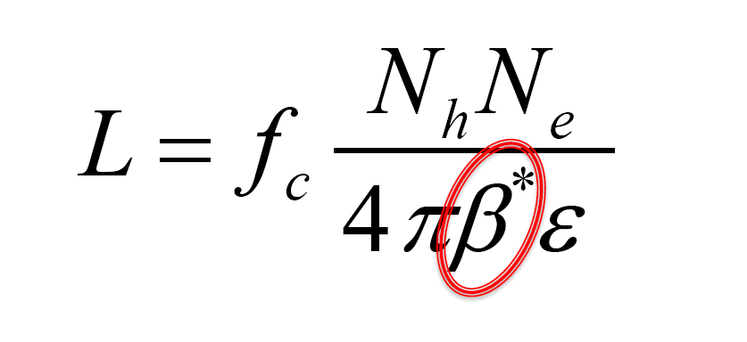
Introduction: ELIC Luminosity
It is true that ELIC β*=5 mm is a factor of 25 to 50 smaller than other hadron colliders
However this is not whole story
Bunch repetition rate f_{c} and bunch charges N_{h}, N_{e} also play very important role in ELIC design

Slide 5
Introduction
From the beginning, ELIC design effort has been focused on achieving very high luminosity, above 10³⁴ /cm²/s, over a wide range of center-of-mass energy.
ELIC design concept is based on
  very high bunch repetition rate (for hadron colliders),
  very small beam spot sizes at collision points (β*=5 mm)
  very short ion bunch (~5 mm RMS)
  All proven in existing (lepton) colliders
Staged electron cooling is essential for such luminosity concept.
The design is optimized for taking maximum advantages of
  CEBAF high repetition CW electron beam
  a new facility of ion complex.
For electron cooling, all technology issues are either already solved or have promising concepts

Slide 6
2. ELIC Luminosity Concept

Slide 7
B-Factories’ Success As A Role Model
B-factories (PEPII & KEKB, etc)
  Asymmetric high energy lepton colliders (energy and beam current)
  Pioneered a class of new technologies (crab cavity, etc.)
  Highly succeed interaction region design
  Unprecedented high luminosity, already over 2x10³⁴ /cm²/s, the present world record
  Planning for upgrade (Super-B factory) for reaching luminosity above 10³⁶ /cm²/s, with more technology innovations (crab waist, etc.)

Slide 8
Key Factors for B-Factories’ Unprecedented High Luminosity
Very high bunch repetition rate (~ 500 MHz)
Very small β* (~6 mm) to reach very small spot sizes at collision points
Very short bunch length (σ_{z}~ β*) to avoid luminosity loss due to hour-glass effect (unless other mitigation schemes are used)
Very small bunch charge for making very short bunch possible
High bunch repetition restores high average beam current and luminosity
Nature provides a very powerful helping hand -- synchrotron radiation damping,

Slide 9
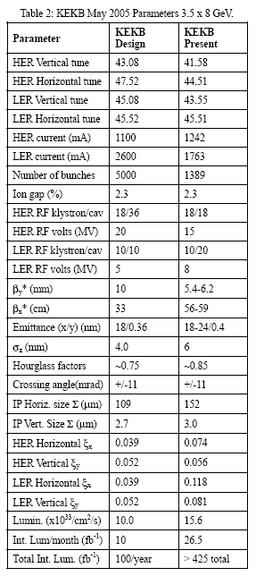
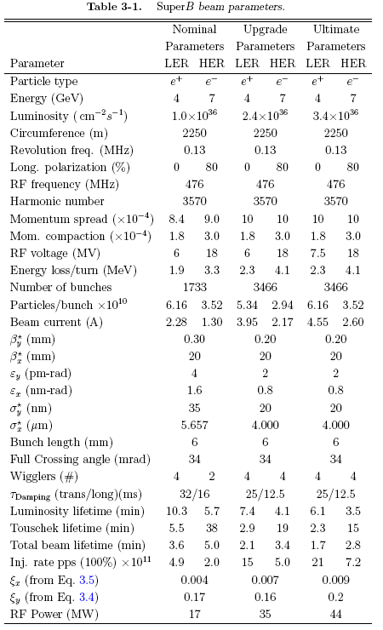
B Factories and Super-B Factories
A factor of 30 reduction

Slide 10
How to Repeat B-Factories’ Success for Electron-ion Collision ELIC?
Do exactly the same things for electron/ion beams
Very high bunch repetition (~499 MHz up to 1.5 GHz)
Very small β* for reaching very small bunch spot at collision points
Fortunately, we are able to make this happen
Electron beam from CEBAF is already a high repetition CW beam (up 1.5 GHz)
Proton/ion beams from a new ion complex, which allows us to specially design to deliver same high repetition beams
But very unfortunately,
Nature does not provide a radiation damping to ion beam in our desired energy range, we must introduce one

Slide 11
Choice of Short Ion Bunch with Small Charge
ELIC design choice (with a very small β*)
  A very short bunch length (same as β*) to minimize luminosity loss due to hour-glass effect
  A small bunch charge to keep relatively small charge density for avoiding bad beam instability
  Achieve high average beam current through high bunch repetition with relative small bunch charge
A short ion bunch with high charge (and high charge density) can lead to many bad things such as increasing single bunch instabilities, hard to form & cool, and heat-up by strong IBS .
A long bunch, though can hold high charge, needs additional mitigations such as traveling final focusing, an unnecessary technical complication.

Slide 12
ELIC Design Parameters
Beam Energy | GeV | 250/10 | 150/7 | 60/5 | 60/3 | 12/3
Collision freq. | MHz | 499
Particles/bunch | 10¹⁰ | 1.1/3.1 | 0.5/3.25 | 0.74/2.9 | 1.1/6 | 0.47/2.3
Beam current | A | 0.9/2.5 | 0.4/2.6 | 0.59/2.3 | 0.86/4.8 | 0.37/2.7
Energy spread | 10⁻⁴ | ~ 3
RMS bunch length | mm | 5 | 5 | 5 | 5 | 50
Horz. emit., norm. | μm | 0.7/51 | 0.5/43 | 0.56/85 | 0.8/75 | 0.18/80
Vert. emit. Norm. | μm | 0.03/2 | 0.03/2.87 | 0.11/17 | 0.8/75 | 0.18/80
Horizontal beta-star | mm | 125 | 75 | 25 | 25 | 5
Vertical beta-star | mm | 5
Vert. b-b tuneshift/IP |  | 0.01/0.1 | 0.015/.05 | 0.01/0.03 | .015/.08 | .015/.013
Laslett tune shift | p-beam | 0.1 | 0.1 | 0.1 | 0.054 | 0.1
Peak Lumi/IP, 10³⁴ | cm⁻²s⁻¹ | 11 | 4.1 | 1.9 | 4.0 | 0.59
High energy
Medium energy
Low energy
Current focus

Slide 13
Comparison of ELIC & eRHIC Ion beams
ELIC protons/bunch adjusted appropriately
 |  | ELIC |  | eRHIC |  | Factors | KEK B | SuperB
Coherent electron cooling |  |  |  |  | Yes |  | (2005)
Luminosity (10³⁴) | 1/cm²/s | ~4 | ~4 | 0.01 | 0.3 |  | 2.1 | >100
Bunch repetition | MHz | 500 | 1500 | 8.7 | 13 | 38 to 115 | 509 | 476
Bunch Charge | nC | 1.7 | 0.57 | 32 | 32 | 1/19 to 1/57 | 3.2 / 2.3 | 4.6 / 2.6
proton/bunch | 10¹⁰ | 1.1 | 0.37 | 20 | 20 | 1/19 to 1/57 | 2 / 1.5 | 6.2 / 3.5
Bunch length | mm | 5 | 5 | 200 | 49 | 1/40 to 1/10 | 6 | 6
Particle linear density | 10¹³ /m | 0.22 | 0.07 | 0.1 | 0.5 | 2 to 1/7 | 0.3 | 1 / 0.7
Horizontal & vertical β* | mm | 5/25 | 5/25 | 500 | 250 |  | 5.9 / 120 | 0.2 / 20
With a smaller charge density, ELIC ion beam formation/cooling & dynamics should not be significantly different, if not better.
Similar or smaller charge density
  ELIC
  High repetition rate
  Small bunch charge
  Short bunch length
  Small β*
  eRHIC
  Low repetition rate
  Super bunch charge
  Long bunch length,
  Large β*
  Bottom line:
  VS.

Slide 14
Achieving High Luminosity
ELIC design luminosity
L~ 10³⁵ cm⁻² s⁻¹ for high energy (250 GeV x 10 GeV)
L~ 4x10³⁴ cm⁻² s⁻¹ for medium energy (60 GeV x 3 GeV)
ELIC luminosity Concepts
  High bunch collision frequency (0.5 GHz, can be up to 1.5 GHz)
  Short ion bunches (σ_{z} ~ 5 mm) (also much smaller bunch charge)
  Relative long bunch (comparing to beta-star) for very low ion energy
  Strong final focusing (β*_{y} ~ 5 mm)
  Large beam-beam parameters (~0.01/0.1, 0.025/.1 largest achieved)
  Need electron cooling of ion beams
  Need crab crossing colliding beams
  Large synchrotron tunes to suppress synchrotron-betatron resonances
  Equal (fractional) betatron phase advance between IPs

Slide 15
Special Considerations for ELIC
Electron and ion beams are still quite different
    Electron/positron beams have (radiation) damping, ion beams don’t (achieving & preserving the beam quality)
    Electron/positron beams have full energy injection, ion beams don’t (forming a stored beam)
B-factories and EIC are also different
    Distance between the final focusing magnets and a collision point in EIC is much larger than the B-factory, so chromaticity is huge.
Electron Cooling
SRF Linac, Staged Cooling
Chromatic Compensation

Slide 16
3. Forming and Cooling of ELIC Ion Beams

Slide 17
Forming Ion Beams With Cooling
SRF Linac
cooling
source
pre-booster-Accumulator ring
To high energy ion collider ring
(for Full Energy EIC@JLab)
Booster-low energy collider ring
Medium energy ion collider ring
 | Length (m) | Max. Energy (GeV/c) | Cooling Scheme | Electron Energy (MeV) | Process
Source/SRF linac |  | 0.2 |  |  | Full stripping
Pre-booster (Accumulator Ring) | ~100 | 3 | DC electron | 0.1 | Stacking/accumulating Energy boosting
Low energy ring (booster) | ~640 | 12 | Electron (ERL) | 1.6 & 6.5 | Fill ring/Energy boosting RF bunching (for collision)
Medium energy ring | ~640 | 60 | Electron (ERL) | 6.5 & 33 | Energy boosting RF bunching (for collision)
Mature or state-of-art, except this

Slide 18
Stacking/cooling Ion Beam in Pre-booster/Accumulator Ring
Accumulation of 1 A coasted beam in pre-booster
    Polarized p, d: stripping injection from negative ion source after linac
    Other ions: must use DC electron cooling
  Multi-turn (~10) pulse injection from linac
  Damping/cooling of injected pulse
  Accumulating beam at space charge limited emittance
Accelerating to 3 GeV/c
Fill large booster/low energy collider ring, then accelerate
Switch to collider ring for energy booster,
RF bunching and initial/continuous cooing
Pre-booster/Accumulator-ring
An advanced concept
Overcoming space charge by accumulating low temperature, large area beam in ring with circular betatron modes
Circumference | M | ~80
Arc radius | M | ~3
Crossing straight length | M | 2 x 15
Energy/u | GeV | 0.2 -0.4
Electron current | A | 1
Electron energy | MeV | 0.1 - 0.2
Cooling time for protons | ms | 10
Stacked ion current | A | 1
Norm. emit. After stacking | µm | 16
Notes:
An advanced stacking/cooling concept:
Overcoming space charge, by accumulating low temperature, large area beam in ring with circular betatron modes

Slide 19
Initial, Final & Continuous Cooling of Ion Beam in ELIC Collider Ring
 | GeV/MeV | Initial Cooling | after boost & bunching | Colliding Mode
Momentum | GeV/MeV | 12 / 6.55 | 60 / 32.67 | 60 / 32.67
Beam current | A | 0.6 / 3 | 0.6 / 3 | 0.6/ 3
Particles/Bunch | 10¹⁰ | 0.74 / 3.75 | 0.74 / 3.75 | 0.74 / 3.75
Bunch length | mm | 200 / 200 (coasted) | 10 / 30 | 5 / 15
Momentum spread | 10⁻⁴ | 5 / 1 | 5 / 1 | 3 / 1
Horizontal emittance, norm. | µm | 4 | 1 | 0.56
Vertical emittance, norm. | µm | 4 | 1 | 0.11
Laslett’s tune shift (proton) |  | 0.002 | 0.006 | 0.1
Cooling length/circumference | m/m | 15 / 640 | 15 / 640 | 15 / 640
Cooling time | s | 92 | 162 | 0.2
IBS growth time (longitudinal) | s |  |  | 0.9

Slide 20
4. Conceptual Design of ERL Circulator Electron Cooler

Slide 21
Design Choice of ELIC e-Cooler
Design Requirements and Challenges
  Electron beam current
    up to 3 A CW beam at 499 MHz repetition rate
    About 5 nC bunch charge (possible space charge issue at low energy)
    About 260 kC/day from source/injector (state-of-art is 0.2 kC/day)
  Energy of cooling electron beam
      up to 6.7 MeV for cooling low energy (12 GeV/c) ELIC
      up to 33 MeV for cooling medium energy (60 GeV/c) ELIC
  Beam power
    Need 100 to 400 MW for cooling 60 to 250 GeV/c ELIC
Design Choice: ERL Circulator Cooler (ERL-CC)
Energy Recovery SRF Linac (ERL) to solve RF power problem
Circulator-cooler ring for reducing average current from source/ERL
  ERL-CC can provide the required high cooling current while consuming low RF power!
High Current & Lifetime of injector
High RF Power

Slide 22
ERL Based Circulator e-Cooler
solenoid
ion bunch
electron bunch
Electron circulator ring
Cooling section
Fast beam kicker
Circulator ring by-pass
Fast beam kicker
Path length adjustment
(synchronization)
energy recovery path
SRF Linac
electron injector
dump

Slide 23
ELIC Cooler Design Parameters
Number of turns in circulator cooler ring is determined by degradation of electron beam quality caused by inter/intra beam heating up and space charge effect.
Space charge effect could be a leading issue when electron beam energy is low.
It is estimated that beam quality (as well as cooling efficiency) is still good enough after 100 to 300 turns in circulator ring.
This leads directly to a 100 to 300 times saving of electron currents from the source/injector and ERL.
Max/min energy of e-beam | MeV | 33/8
Electrons/bunch | 10¹⁰ | 3.75
bunch revolutions in CCR |  | ~300
Current in CCR/ERL | A | 3/0.01
Bunch repetition in CCR/ERL | MHz | 500/1.67
CCR circumference | m | 80
Cooling section length | m | 15
Circulation duration | μs | 27
Bunch length | cm | 1-3
Energy spread | 10⁻⁴ | 1-3
Solenoid field in cooling section | T | 2
Beam radius in solenoid | mm | ~1
Beta-function | m | 0.5
Thermal cyclotron radius | μm | 2
Beam radius at cathode | mm | 3
Solenoid field at cathode | KG | 2
Laslett’s tune shift @60 MeV |  | 0.07
Longitudinal inter/intra beam heating | μs | 200

Slide 24
5. Key Technologies and Critical R&D

Slide 25
Enabling Technologies and R&D
Making of a cooling electron beam
  A high bunch-charge and high repetition source/injector
  Energy recovery linac
  Fast kicker
Stability of cooling beam in a circulator ring
  Single (electron) & coupled (electron-ion) instabilities
  Long term space charge effect & beam quality degradation
  Beam heat-up by IBS
Efficiency of cooling at medium ion energy
Cooling rate as a function of energy (state-of-art is 4 MeV at Fermilab)
Cooling efficiency as a function of turns in the circulator ring
Staged cooling (at injection & final energy, during collision)
New Concepts and Schemes
Flat-to-round beam transform and reduction of space charge effect

Slide 26
Electron Source/Injector
ELIC CCR driving injector
  10 mA@1.667 MHz, up to 33 (125) MeV energy
  5 nC bunch charge, magnetized
Challenges
  Source life time: 0.86 kC/day (state-of-art is 0.2 kC/day)
  → source R&D, & exploiting possibility of increasing evolutions in CCR
Conceptual design
  High current/brightness source/injector is a key issue of ERL based light source applications, much R&D has been done
  We adopt light source injector as a baseline design of CCR driving injector
Beam qualities should satisfy electron cooling requirements (based on previous computer simulations/optimization)
Bunch compression may be needed.
solenoids
SRF modules
300keV DC gun
buncher
quads

Slide 27
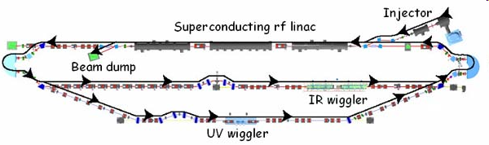
Energy Recovery Linac
JLab is world leader in ERL technology !
JLab FEL Program
Energy Recovery
Energy | MeV | 80-200
Charge/bunch | pC | 135
Average current | mA | 10
Peak current | A | 270
Beam power | MW | 2
Energy spread | % | 0.5
Normalized emittance | µm-rad | <30
SRF ERL based FEL
High average power, up to14 kW (world record)
mid-infrared spectral region
Extension to 250 nm in the UV is planned
Photocathode DC injector, 10 mA class CW beam, sub-nC bunch charge
Beam energy up to 200 MeV, energy recovery
Next proposal: 100kW average power, 100 mA CW beam. ERL, nC-class bunch charge

Slide 28
Test Facility for Circulator Cooling Ring
A test facility for an ERL circulator cooler utilizing JLab FEL facility is under consideration. Additional hardware cost is moderate.
Focusing of this test facility will be studies of
  Dynamics of electron beam in the circulator ring (space charge effect, single bunch instabilities, IBS heating up, etc.)
  Lifetime of electron source/injector
  test of fast kicker.
Diagnostic elements
Transverse focusing lattice
Using JLab FEL ERL facility or a new SRF module
fast kicker

Slide 29
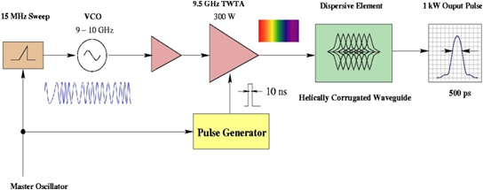
Ultra Fast RF Kicker
Goal: Development of a sub-ns pulse of 20 kW &15 MHz to drive a RF kicker
Leading candidate of a technical solution:
State-of-Art RF chirp technique is able to produce ~2 ns, 11 kW RF pulses at a 12 MHz repetition rate, very close to ELIC requirement.
Helically-corrugated waveguide (HCW) serves to further compress the output pulse without excessive loss. Up to 10 kW power have been created
Development plans include studies of HCW, optimization of chirp techniques, and generation of 1-2 kW peak output powers as proof of concept.
Beam energy | MeV | 125
Kick angle | 10⁻⁴ | 3
Integrated BdL | Gm | 1.25
Frequency BW | GHz | 2
Kicker Aperture | Cm | 2
Peak kicker field | G | 3
Kicker Repetition Rate | MHz | 15
Peak power/cell | KW | 10
Average power/cell | W | 15
Number of cells | 20 | 20
(J. Musson, JLab, EE)

Slide 30
Ultra-Fast Beam-Beam Kicker
A short (1~ 3 cm) target electron bunch passes through a long (15 ~ 50 cm) low-energy flat bunch at a very close distance, receiving a transverse kick
The kicking force is
integrating it over whole kicking bunching gives the total transverse momentum kick
Proof-of-principle test of this fast kicker idea can be planned. Simulation studies will be initiated.
F
surface charge density
v≈c
D
h
σ_{c}
kicking beam
v₀
L
Circulating beam energy | MeV | 33
Kicking beam energy | MeV | ~0.3
Repetition frequency | MHz | 5 -15
Kicking angle | mrad | 0.2
Kinking bunch length | cm | 15~50
Kinking bunch width | cm | 0.5
Bunch charge | nC | 2
V. Shiltsev, NIM 1996

Slide 31
Advanced Cooling Concepts
Staged cooling
  Start (longitudinal) electron cooling at injection energy in collider ring
  Continue electron cooling after acceleration to high energy
Sweep cooling
  After transverse stochastic cooling, ion beam has a small transverse temperature but large longitudinal one.
  Use sweep cooling to gain a factor of longitudinal cooling time
Dispersive cooling
  compensates for lack of transverse cooling rate at high energies due to large transverse velocity spread compared to the longitudinal (in rest frame) caused by IBS
Flat beam cooling (for high energies)
  based on flattening ion beam by reduction of coupling around the ring
  IBS rate at equilibrium reduced compared to cooling rate
Matched cooling (low energies)
  based on use of circular modes optics of ions matched with solenoid of cooling section
  separates cooling of beam temperature from cooling (round) beam area
  results in removal temperature limit due to space charge (strong reduction of achievable 4D emittance)
Notes:
Matched cooling

Slide 32
Flat-to-Round Beam Transform & Reduction of Space Charge Effect
Flat colliding ion beam and space charge
  Colliding ion beam should be flat at interaction point in order to match flat electron beam (due to synchrotron radiation)
  Space charge tune shift is a leading limiting factor for low energy ion beam, and it further effect luminosity of the collider
  Flat beam enhances space charge tune-shift . i.e., Laslett tune-shift is determined by smaller transverse dimension
Luminosity optimization: flat-to-round transform
if colliding ion beam can be arranged as
  flat at interaction point ➔ matching flat electron beam
  Round in the storage ➔ maintaining large transverse beam area for overcoming space charge
Technical feasibility
  circular (100% coupled) optics (ring) under matched cooling
  Special adapters to converting round beam to flat beam and back to round beam at collision point

Slide 33
Summary
ELIC Luminosity should be able to reach 4x10³⁴ cm⁻²s⁻¹ at medium energy range (60x3~5 GeV²) for e-p collisions, achieved through
  high repetition CW electron and ion beam
  very strong vertical final focusing (β*=5 mm)
  very short bunch length (~5 mm)
Electron cooling is essential for forming (through stacking and accumulating) and cooling of the ion beam for ELIC.
Conceptual design of an ERL circulator cooler has been proposed to provide a high average current (3 A) cooling beam with energy up to 33 MeV.
Key enabling technologies includes electron source/injector, ERL, and ultra-fast kicker, either already existing or having promising conceptual designs. Thus cooler design is technical feasible.
Beam dynamics of circulating electron beam, cooling efficiency and design optimization are main R&D issues.

Slide 34
Backup Slides

Slide 35
ELIC Study Group
A. Afanasev, A. Bogacz, J. Benesch, P. Brindza, A. Bruell, L. Cardman, Y. Chao, S. Chattopadhyay, E. Chudakov, P. Degtiarenko, J. Delayen, Ya. Derbenev, R. Ent, P. Evtushenko, A. Freyberger, D. Gaskell, J. Grames, L. Harwood, T. Horn, A. Hutton, C. Hyde, R. Kazimi, F. Klein, G. A. Krafft, R. Li, L. Merminga, J. Musson, A. Nadel-Turonski, M. Poelker, R. Rimmer, C. Tengsirivattana, A. Thomas, M. Tiefenback, H. Wang, C. Weiss, B. Wojtsekhowski, B. Yunn, Y. Zhang - Jefferson Laboratory staffs and users
W. Fischer, C. Montag - Brookhaven National Laboratory
V. Danilov - Oak Ridge National Laboratory
V. Dudnikov - Brookhaven Technology Group
P. Ostroumov - Argonne National Laboratory
V. Derenchuk - Indiana University Cyclotron Facility
A. Belov - Institute of Nuclear Research, Moscow, Rssia
V. Shemelin - Cornell University

Slide 36
ELIC Design Goals
Energy
  Wide CM energy range between 10 GeV and 100 GeV
  High energy: up to 10 GeV e on 250 GeV p or 100 GeV/n ion
  Medium energy: up to 11 GeV e on 60 GeV p or 30 GeV/n ion
  Low energy: 3 to 10 GeV e on 3 to 12 GeV/c p (and ion)
Luminosity
  10³³ up to 10³⁵ cm⁻² s⁻¹ per interaction point
  Multiple interaction points
Ion Species
  Polarized H, D, ³He, possibly Li
  Up to heavy ion A = 208, all striped
Polarization
  Longitudinal at the IP for both beams, transverse of ions
  Spin-flip of both beams
  All polarizations >70% desirable
Positron Beam desirable

Slide 37
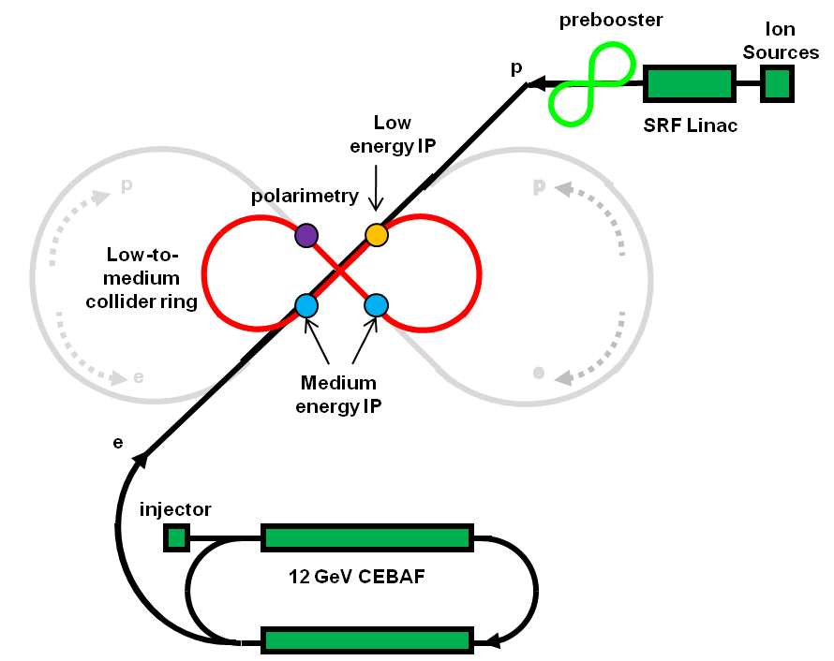
EIC@JLab: Low to Medium Energy
Three compact rings:
3 to 11 GeV electron
Up to 12 GeV/c proton (worm)
Up to 60 GeV/c proton (cold)

Slide 38
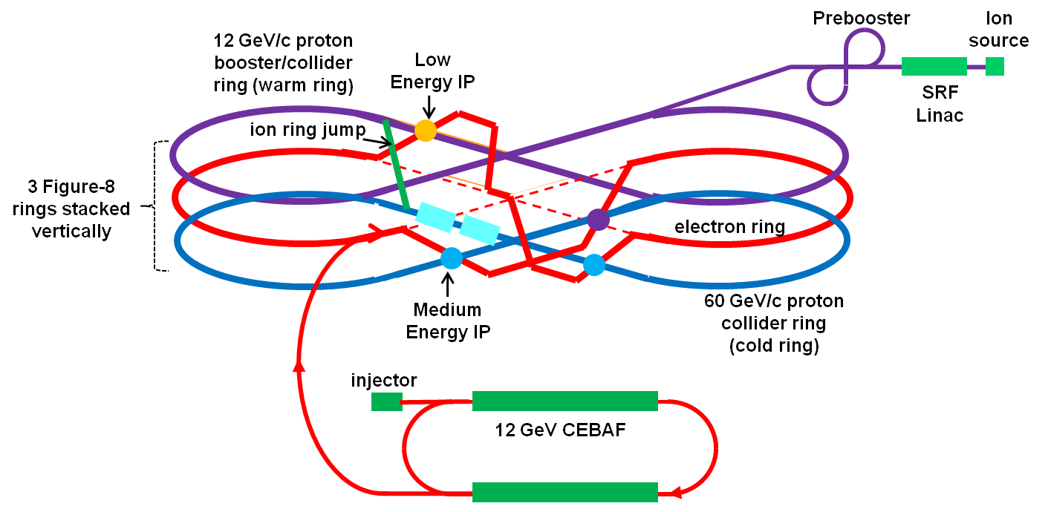
EIC@JLAB: Low to Medium Energy
polarimetry

Slide 39
ELIC Ring-Ring Design Features
Unprecedented high luminosity
Electron cooling is an essential part of ELIC
Up to four IPs (detectors) for high science productivity
“Figure-8” ion and lepton storage rings
  Ensure spin preservation and ease of spin manipulation
  No spin sensitivity to energy for all species.
Present CEBAF injector meets storage-ring requirements
12 GeV CEBAF can serve as a full energy injector to electron ring
Simultaneous operation of collider & CEBAF fixed target program.
Experiments with polarized positron beam are possible.

Slide 40
Circulator Ring & Synchronization
Transverse focusing lattice
Bunch In/out kicking
An ultra fast kicker switches electron bunches in and out circulator ring.
Deflecting angle should be large enough to separate outgoing bunches from circulating bunches and be further deflected by a dipole
Duration of kicking should be less than bunch spacing (~1/500MHz = 2 ns)
Synchronization
Bunch spacing depends on beam energy. There is about 1.8 mm difference when energy is boosted from 12 to 60 GeV/c
A 10m dog-lag lattice or loops in arc must be introduced to ensure electron-ion synchronization at cooling section.
Maximum deflecting angle is 13º, providing total 26cm path length adjustment.
Kicker Parameter
energy | MeV | 33
Kick angle |  | 0.04
Integrated BDL | GM | 400
Frequency BW | GHz | 2
Kicker aperture | cm | 2
Repetition Rate | MHz | 1.67
Power | kW | 13

