Slide 1
Advances in collider concepts
Yaroslav Derbenev
Center for Advanced Study of Accelerators
Jefferson Laboratory
EIC Workshop 2010
Stony Brook, Long Island,
January 10 – 12

Slide 2
Outline
Achromatic IP theory
Dispersive crabbing
Overcoming space charge in low energy EIC
Matched Electron Cooling
Kicker-beam for EC circulator ring

Slide 3
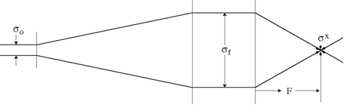

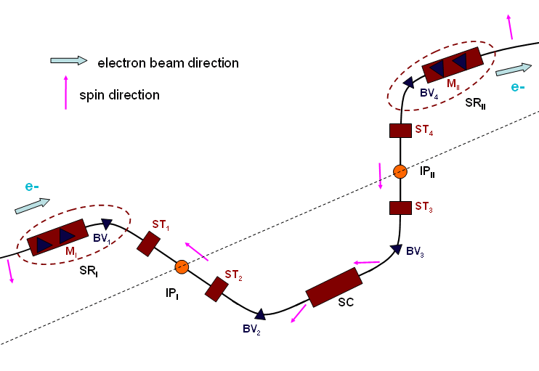
Interaction Region constraints
ELIC luminosity concept:
Low emittance, short bunches
Extreme low beta
Low charge/bunch
High repetition rate
Crab-crossing beams
Use HV, HF SC cavities
Large size (beta) of extended beam:
Large chromatic spread:
requires compensation
Radiation impact to e-beam emittance
Crab- crossing beams
Short bunches make crab-crossing feasible
1.5 GHz SRF deflectors have to be developed
EIC crossing angle is large (30 mrad)
Rotators for electron spin
Fixed orbit desirable
Need space
Notes:
Short bunches make crab-crossing feasible
SRF deflectors at 1.5 GHz has to be developed
EIC crossing angle is large (30 mrad)

Slide 4


Asymmetric low beta for flat beams
Design
Why? And when?
Necessary for low emittance flat beams, at
Instead of increasing emittances, one increases , e.g. decreases .
There are important reductions in:
1) cure for dynamical aperture;
2 ) radiation recoil impact in bends of chromatic compensator;
3) radiation from final quadrupoles
Note, however: this measure been applied, while maintaining current, does not benefit one with luminosity, but , in contrary:
- stresses the issues connected to charge/bunch (electron cloud, wakefields)
- complicates implementation of crab crossing.
Notes:
;

Slide 5
Achromatic low beta problem
There is long, difficult history…
with many good names
It continues to go on…
To be exhausted some day?
We hope so - but may be never?...
But solution has arrived.

Slide 6
Achromatic low beta solution
After 2 years search for a solution for MC and EIC, concept of achromatic low beta IP (5mm or even shorter), while maintaining large dynamical aperture, has arrived.
It suggests a receipt for EIC, MC, and other colliding beams of new generation.
Optics concept is based on symmetry formulation for bends and linear lattice of specific compensation block .
Sextupole compensation is then easy to design (only two conditions to satisfy). It provides a precision chromaticity suppression and returns luminosity and particle stability.
Octupole magnets introduced to compensate for sextupole and dispersion impact on dynamical aperture. Formulation is especially simple (two conditions) for flat beams (low vertical emittance).
For equal emittances, reduction to two conditions is achieved by imposing a coupling resonance around the ring.
A complete theory, formulation and estimates have been done. Justifying simulation underway.

Slide 7

CCD (Collider Chromo-Dynamics)
Ideal design ( neglecting chromatic spread):
;
;
;
;
;
Perturbations due to chromatic spread + sextupoles and octupoles for compensation:
Requirements at star point:
Iterations:
Sextupole compensation:
Octupole compensation for flat beams ( ) :

Slide 8
Symmetry formulation of Achromatic IP
(Standart Model)
“Canonical” conditions (compensation for original chromatic terms )
;
Conditions connected to the betatron and 2nd order dispersion beam sizes:
;
;
These 3 conditions on sextupoles can be satisfied “automatically”, if to implement symmetry to the compensating block: symmetric and , while symmetry of and is opposite to symmetry of .
What is achieved with this compensation:
Suppression of tune chromatic spread (usual)
Suppression of intrinsic chromatic and sextupole 3d smear of beam core at star point (new)
What may not have been achieved: maintaining the dynamical aperture
Notes:
What is achieved with sextupole compensation:
Suppression of tune spread
Suppression of sextupole smear of beam core
What my not been achieved: maintain the dynamical aperture

Slide 9
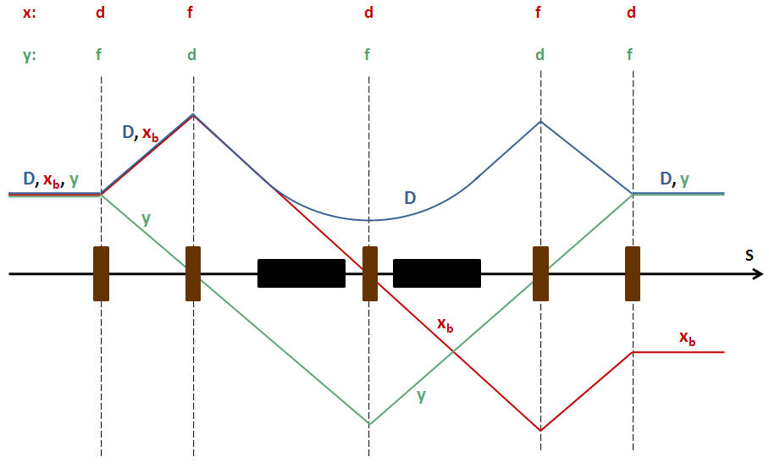
Achromatic Interaction Point Design
Yaroslav Derbenev , Guimei Wang, Alex Bogacz, Pavel Chevtsov (PAC 2009)
CCB: Preventive chromatic compensation block
installed before the final focusing
CCB with symmetric dispersion pattern
Blue: dispersion
Red: horizontal betatron trajectory
Green: vertical trajectory
Upper: dispersion and beta functions.
Lower: betatron part of beam trajectory.
Notes:
CCB: Preventive chromatic compensation block installed before the final focusing

Slide 10
Bent chromatic compensator
Recent an adjustment dream
y₀
x₀, y₀
y₀
x₀
Dipole
Dipole
D
x₀
Dispersion compensated to the end of arc
Dipoles of CCB continue beam bend between arcs (space economy)
No dispersion in the focusing block
Dispersion does not change sign after the IP area – this
naturally helps with the further going octupole compensation
Notes:
Dipoles continue beam bend between arcs (space economy)
Dispersion does not change sign after the IP area – this naturally helps with furthergoing octupole compensation

Slide 11
Dynamical Aperture
What is the DA?
Particles get scattered by IBS and quantum radiation well beyond the beam core
At large amplitudes, dynamics is polluted by non-linear resonances of sextupoles field
At amplitudes above some critical (non-linear tune shift approaches ½ ) particles quickly get lost
The Criterion: 1) DA must frequently exceed the beam size (achieved with compensation for the smear); 2) While cooling, time of scattering to critical amplitudes should exceed shift time…

Slide 12

Taking care of Dynamical Aperture
Octupole compensation for the 3d power terms over IP
Using symmetry over IP (here s=0 is the star point):
;
;
;
Taking into account flat beams, compensation conditions
have been reduced to only two:
With figure 8 ring, one can also use symmetry over two IP:
restored, while changes sign.
Notes:
With figure 8 ring, one can also use symmetry over two IP

Slide 13


Taking care of Dynamical Aperture ( cont-d)
Estimated DA (confinement…) and lumi lifetime
With sextupole only compensation:
After quadrupole cleaning:
Important for electrons because of radiation recoil:
octupole compensation allows one to reduce dispersion in bends of CCB, while using stronger sextupoles and octupoles.
IBS (Touschek effect) from IR is insignificant (large beam area)
e-beam can be quickly (in 10 seconds) refreshed every a few minutes, if needed
Touschek vs Electron Cooling lumi lifetime of ions exceeds shift time (estimated earlier)

Slide 14



Electron emittance due to radiation in IR
;
;
Radiation recoil impact to emittance is critical due to low transverse temperature of extended beam
Courant-Snyder invariant:
Quantum scatter :
Criterion for radiation in bends of IR to be insignificant:
;

Slide 15
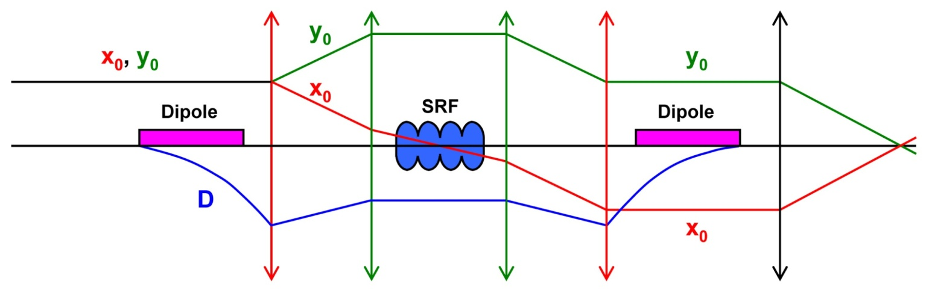
Preliminary IP layout for ion beam
CCB with inserted SRF for bunching and dispersive crabbing
Dipoles bending the beam in addition to arcs
Inserted SRF resonators are sufficient for required
bunching and dispersive crabbing
Notes:
Dipoles are bending the beam in addition to arcs

Slide 16
Dispersive Crab Crossing for ion beam by use of bunching SRF cavities
Solution for ELIC/MEIC feasible today !
Conventional bunching SRF cavities being installed in sections with dispersion before final focus can at the same time be used to tilt proton bunches for crabbing.
How it works? Phase-correlated energy kick causes transverse oscillation. After the kick, the dispersion is compensated at star-point, but the excited deviation stands. In rest, the tilt mechanism is the same as at kick by a deflecting cavity.
Crab tilt is compensated over two IPs
(we have 4 IP in EIC design).
Parameters sample for p-beam
Energy, GeV 250
Number of IP 4
Number of cryomodules 4
MV /cryomodule 80
RF field strength MV/m 20
Frequency, GHz 1.5
Required dispersion, m 1.5
Dispersion-prime 0.17
IP focal parameter, m 9
Crossing angle, mrad 30
Notes:
Solution feasible right now

Slide 17
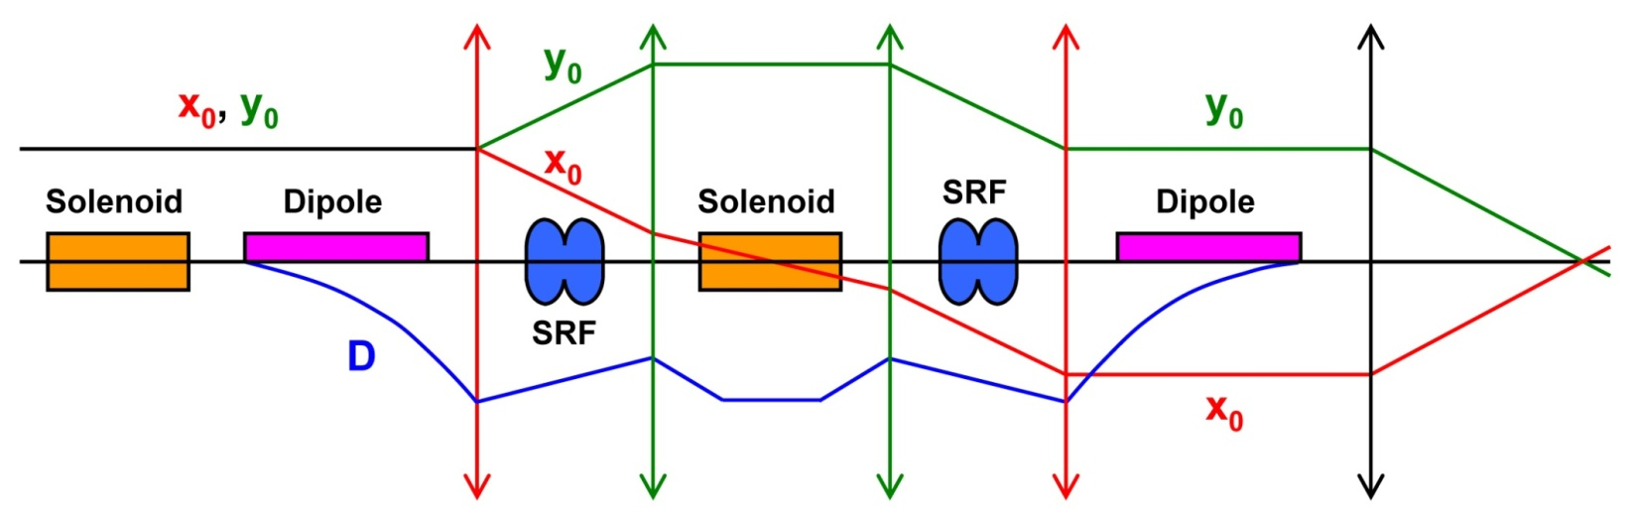
Preliminary IP layout for e-beam
CCB with inserted SRF for acceleration/bunching/dispersive crabbing, and solenoids for spin rotation
Two solenoids in conjunction with two dipoles perform spin rotation
from vertical to longitudinal for all energies at fixed orbit
Notes:
Two solenoids in conjunction with two dipoles perform spin rotation from vertical to the longitudinal

Slide 18
Dispersive Crab Crossing for e-beam
High SRF voltage (10-30 MV) is needed to compensate for SR energy losses (10 MWt for e-current 1-3 A).
Even higher voltage (~100 MV) is needed for bunching (energy spread about 0.1%, bunch length 5 mm.)
These resonators can be used for dispersive crabbing, as well
Crab for e-beam is ease, since energy is low (3-9 Gev).
Dispersion can be used for chromatic compensation, as well.
Parameters sample for e-beam
Energy, GeV 10
Number of IP 4
Number of cryomodules 4
MV /cryomodule 25
RF field strength MV/m 20
Frequency, GHz 1.5
Dispersion, m 0.2
Dispersion-prime 0.025
IP focal parameter, m 9
Crossing angle, mrad 30

Slide 19
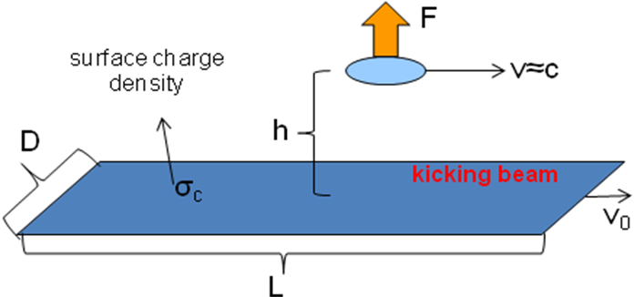

Kicker-beam for circulator-cooler ring
( P. Evtushenko for ELIC, 2009; V. Shiltsev for TESLA, 1995)
Kicker beam is not accelerated after the DC gun
Both beams are flat in the kick section
Flat beams can be obtained from magnetized sources (grid operated).
Circulating beam energy | MeV | 33
Kicking beam energy | MeV | ~0.3
repetition frequency | MHz | 5 – 15
angle | mrad | 0.2
bunch length | cm | 15 – 50
bunch width | cm | 0.5
bunch charge | nC | 2
Kicker beam is maintained in solenoid. It can be
flatten by imposing constant quadrupole field
Flat cooling beam is obtained applying round-to-
flat beam adapters
Notes:
(V. Shiltsev for TESLA, 1995; P.Evtushenko for ELIC, 2009)
Kicker beam is maintained in solenoid

Slide 20
Overcoming ion space charge at low energies
There is a concept under study as follows:
  Create ion beam with very uneven transverse emittances (large aspect ratio).
  Make the beam flat at IP but round-rotating after the focusing triplet, by use of beam adapters.
  Space charge then has no impact to beam temperature, since the temperature is connected to the small emittance (rotating beam state, associated with circular mode of large emittance).
  Such beam can be created and maintained by matched electron cooling.

Slide 21
Matched Electron Cooling
Application of an old idea (NIM, 2000)
Cooling of nucleon beams at energies below 30 GeV of protons may present an issue of ion space charge. This problem can be alleviated with help of round-to-flat ion beam and matched electron cooling techniques
What is matched electron cooling:
  Rotation of one of two circular modes of ion beam is stopped in solenoid of cooling section
  Other mode then is transformed to cyclotron rotation in solenoid
  Only the cyclotron mode has the intrinsic cooling effect in the accompanying e-beam
  Cooling of this mode cannot be stopped by the ion space charge, so its equilibrium emittance can reach a very small value
  Cooling of the stopped mode (limited by the ion space charge) can be provided by cooling redistribution mechanism

Slide 22
Conclusions
Development of low emittance, low beta, high repetition rate CEBAF based ring-ring EIC concept of luminosity level is finalizing.
The concept is based on the familiar beam physics and advanced accelerator technology elements (CW sources, SRF, ERL).
Achromatic low beta concept has been established. Analytical stage finished. 5 mm and shorter beta star looks real.
Crab crossing solved and is feasible today.
That short e-and-i bunches (low charge/bunch!)are real based on Electron Cooling and HF SC resonators.
High energy, high current CW Electron Cooling based on low current ERL injector solved as a consistent concept. It can be proposed for experimental realization.
Simulations underway. Need more manpower.
Compact detectors capable operate at 1.5 GHz and above repetition rate should be designed. NP consortium shall be called.
Explorations of possibilities to overcome space charge limitations of low and medium energy, high luminosity EIC (MEIC) has started. Need more manpower for conceptual realization and simulation.

Slide 23
Thank You!

Slide 24
Backup slides

Slide 25





Interaction Region constraints
;
;

Slide 26
Octupole compensation for the 3d power effects
Flat beams with symmetric low beta

Slide 27



Octupole cleaning the star point

Slide 28
Taking care of Dynamical Aperture
Equations for flat beams:

