Slide 1
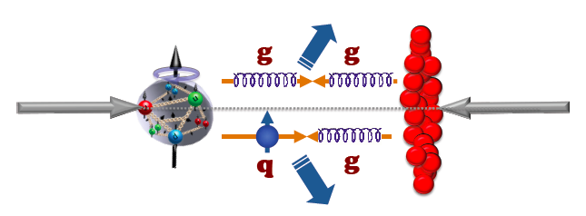
p⬆A@RHIC Path Forward

Slide 2
We’ve learned in the past few days:
p⬆A@RHIC
RHIC machine can deliver it.
Uniqueness for RHIC. Complementary to pA@LHC.
Exciting new physics observables.
…

Slide 3
We agree that:
p⬆+A should do be a major part of the RHIC physics program.
Polarized proton beam should be in the BLUE ring.
… and we will follow up with detailed technical studies to make it happen for measurements with STAR and PHENIX.

