Slide 1

The MPC-EX, pA observables with an eye to future
Richard Seto
University of California, Riverside
Riken-BNL pA workshop
Jan 7-9, 2012
Acknowledgements to MPC-EX group

Slide 2
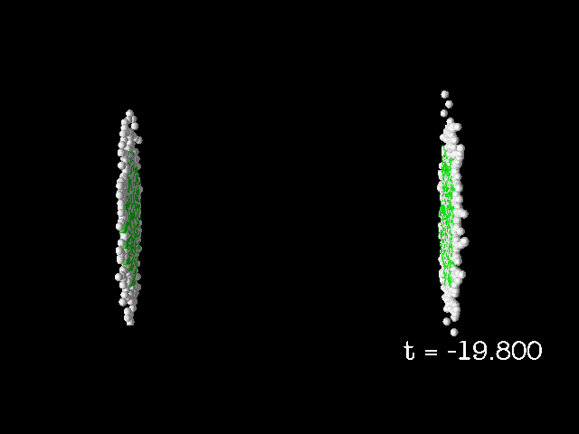



pA: the questions
Questions
  The sQGP – How is it born?
    Answering this question is crucial to understanding the sQGP
    Source of bulk @RHIC is from low x below 10⁻² LHC is factor 10 to 100 less
  Can we understand Cold Nuclear Matter?
  How are probes affected?
Competing pictures
  One nice picture
    CGC → Glasma →sQGP (hydro)
  Modified structure functions (together with a Glauber picture for centrality dependence)
  pQCD shadowing
    Higher twist
    Coherence
  Initial state energy loss
  Absorption
  …
CGC
Glasma
sQGP

Slide 3

pA: Competing pictures : equivalent descriptions
d+A Suppression
At low-x two universal gluon distributions G⁽¹⁾ and G⁽²⁾ show up in cross section calculations
  Equivalent distributions derived in TMD framework and CGC framework
Two pictures
  Higher Twist shadowing
  CGC
p+p TMD
e.g. jet jet
d+A TMD (k_{T})
Low-x
d+A
Higher Twist
shadowing
Dominguez
Marquet
Bo-Wen Xiao
Yuan
PRD 83, 105005
????
Are some of the other
Competing processes
(e.g. energy loss and the CGC)
also equivalent?
CGC
Low-x gluons
(k_{T})
A+A
Initial condition sQGP

Slide 4
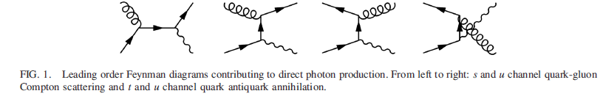
pA: Where to look?
To study the precursor state of sQGP → pT ~ 1 GeV
    E.g. multiplicity distributions
    Pion correlations at low p_{T}
  Problem: dependent on FF and/or gluon multiplication factor ( CGC)
Can we use “hard probes”, something that comes directly from the vertex?
Direct photons
  “low” Q² p_{T}> 3 GeV
  Forward region to probe “low-x” gluons
LO Direct Photon Diagrams:
Add direct photon capability to the MPC

Slide 5
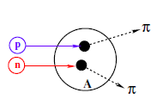
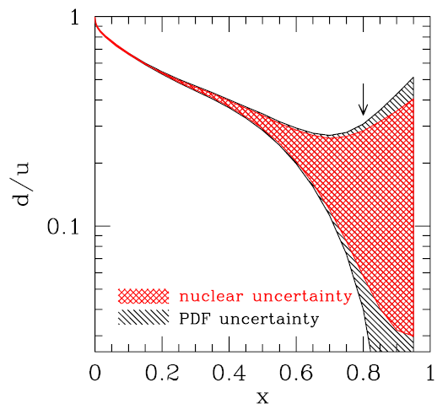
Why p+A instead of d+A?
Multi-parton interactions not present in pA can contribute to the suppression of the away-side correlation strength.
M. Strikman, 1112.3834
Phys. Rev. D 84 014008 (2011)
Forward rapidity corresponds to high-x in the projectile nucleon (d or p). Nuclear corrections at high-x are large for the deuteron
…and you can’t polarize the deuteron at RHIC…

Slide 6
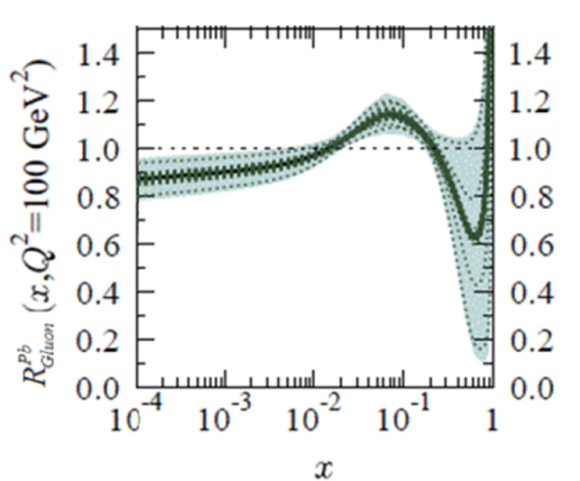
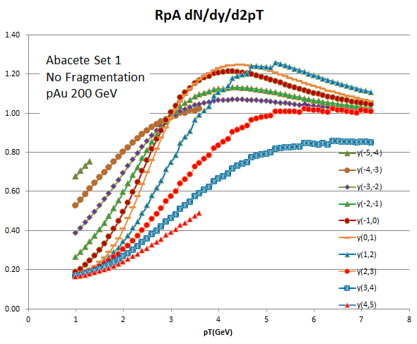
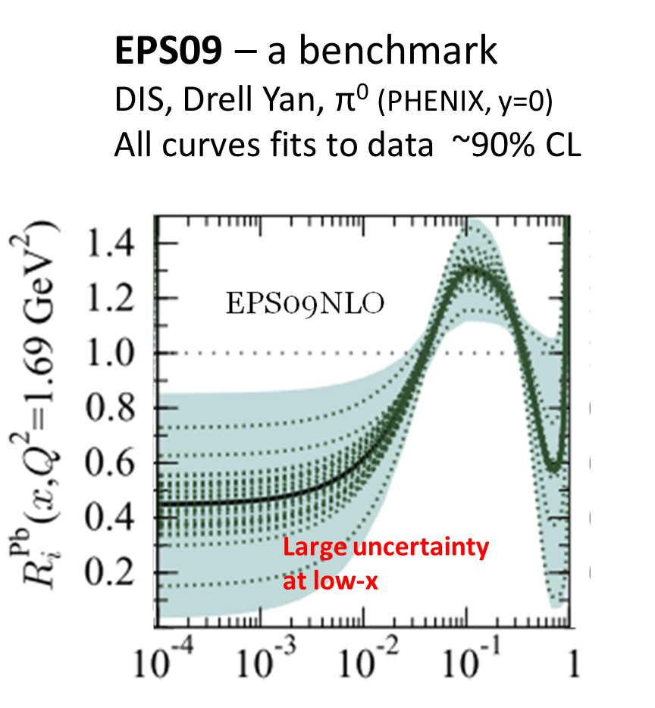

Where to look – from the CGC
Y=3-4
Minimal
Suppression at
High Q²
$$R_{pA}^{gluons}$$
CGC MCKT
No Fragmentation
p_{T} (GeV)
(Note: this is a user generated plot)
Use EPS09 as a Benchmark
Go to
Y=3-4
Low Q²

Slide 7
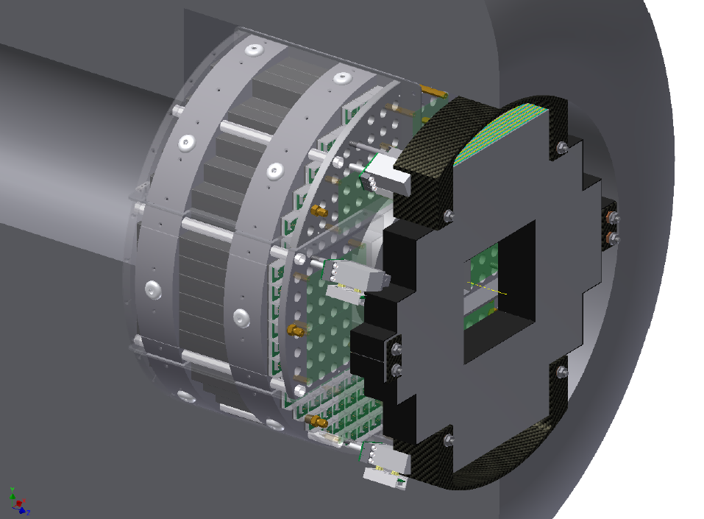
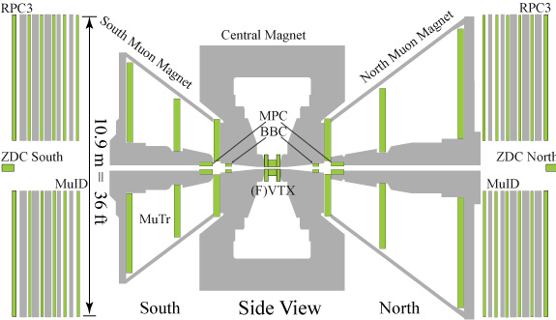
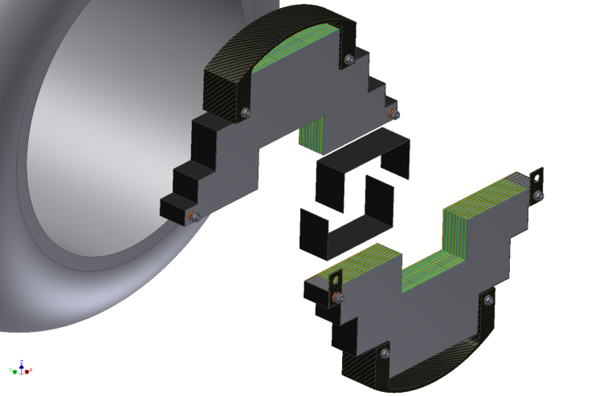
The PHENIX MPC-EX Detector
A combined charged particle tracker and EM preshower detector – dual gain readout allows sensitivity to MIPs and full energy EM showers.
π⁰ rejection for direct photons
π⁰ reconstruction out to >80GeV
Charged track identification
3.1<η<3.8
Approved by BNL/DOE - will be ready for Run-15 (earliest p+Au run)

Slide 8


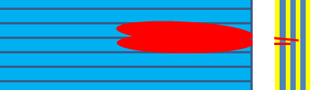
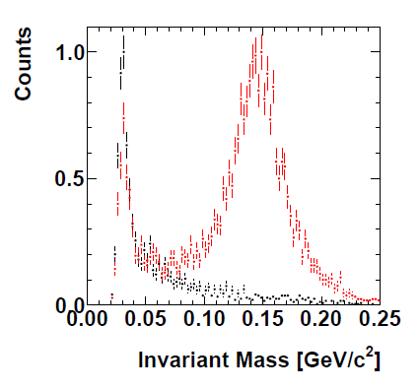
How it works
MPC-EX
1.8mm x 15mm “minipad” sensors
Interleaved with 2mm Tungsten
4 layers in x and 4 in y
π⁰ →
(Cartoon)
40<E<45 GeV

Slide 9
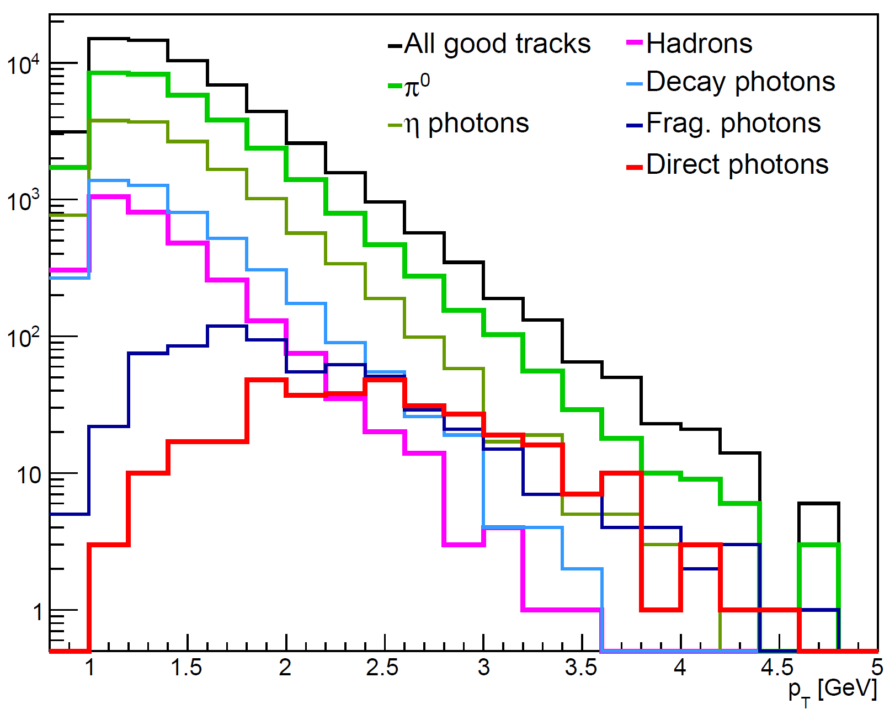
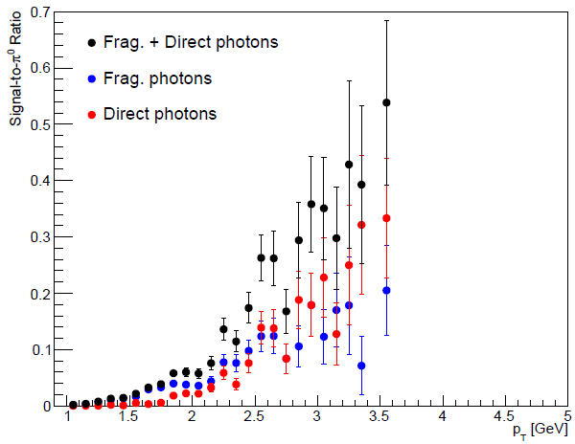
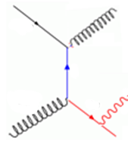
Direct Photon Simulations (π⁰ cuts)
Basic cuts: remove π⁰,η, charged hadrons
For p_{T}>3 GeV:
2.9% efficiency for π⁰
31.2% efficiency for direct ___photons
dir/(frag+dir) = 57.4%
Counts in simulation
π⁰ photons
Frag photons
Direct photons
Frag photons
350 nb⁻¹ sampled:
1.4 x 10⁴ prompt photons
p_{T}>3 GeV/c after cuts
Simulation: 868M pythia MB events

Slide 10
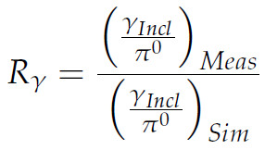
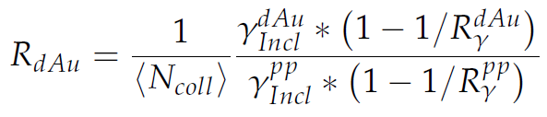
Extracting prompt photons
measure inclusive γ and π⁰
simulate hadronic sources of γ
R_{γ} >1 ⇨ prompt γ
γ_{prompt} = γ _{incl} *(1-1/R_{γ})
Advantage: many sources of systematic error cancel
in particular the energy scale

Slide 11
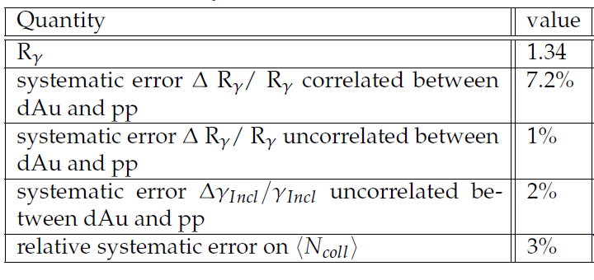
Systematic errors
from knowledge of π⁰ Cross section
Residual error from energy scale
Residual error from energy scale

Slide 12
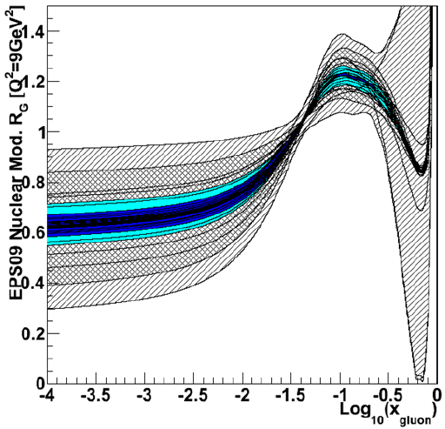
EPS09 Limits from Prompt Photons
  Weight events in x,Q² (direct, frag) according to EPS09 to generate R_{dAu} for each curve
  Assume the R_{dAu} value we measure corresponds to the EPS09 baseline
  Vary R^{pp}_{γ}, R^{dAu}_{γ}, γ^{dAu}_{incl} and γ^{pp}_{incl} within 3σ systematic errors
  Evaluate EPS09 curves to see which are consistent within 90% C.L.
MPC-EX
350nb⁻¹ d+Au
49pb⁻¹ p+p
90% C.L.
Prompt photons in MPC-EX → Precise Measurement of the Nuclear Gluon PDF
I would like to use a CGC model to estimate sensitivity to Q_{S}

Slide 13
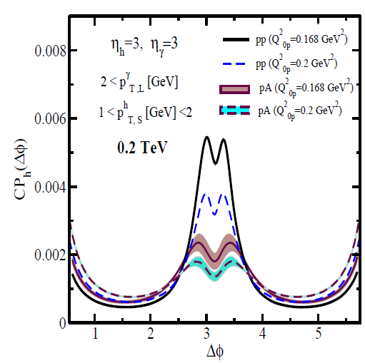
Additional Measurements γ+hadrons
Pick p_{T} of photon, measure hadron correlation in bins of Δθ, and p_{T} of hadron
Sensitive to Q_{Sat}
pp
pA
Resaein (1209.0478)

Slide 14
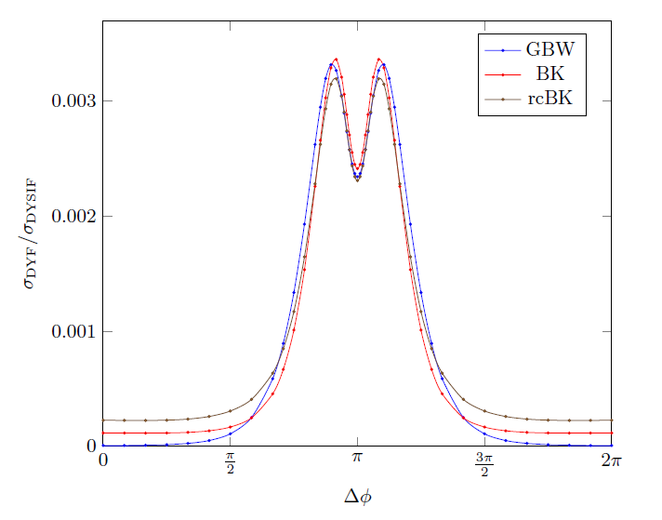
The future? DY hadron correlations
Xiao, Stasto et al
Double hump structure (preponderance of signatures)
Rate??? Possible at RHIC in pCu?

Slide 15
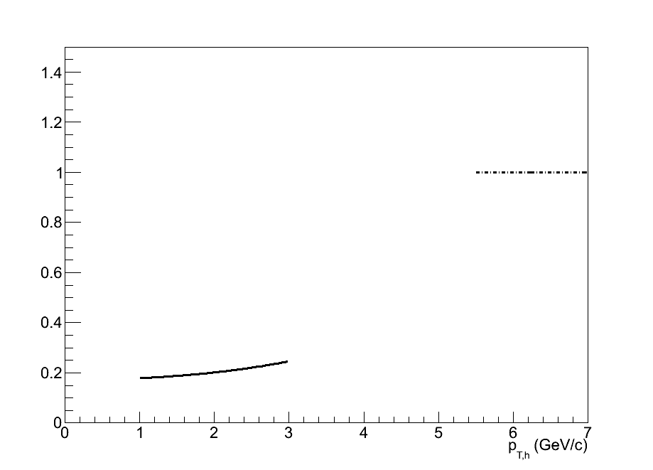
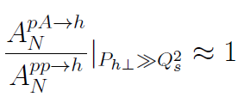
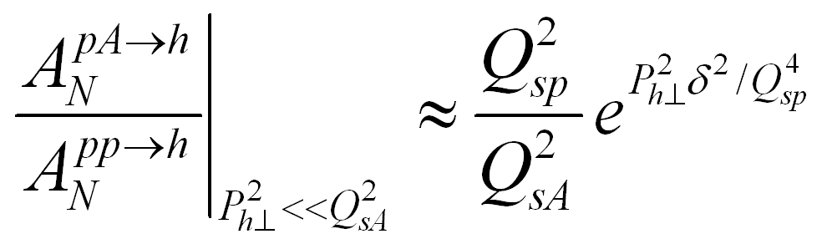
Polarized p+A Collisions
Kang, Yuan: PRD 84, 034019 (2011)
Left
A
Q_{sp}² = (1.0 GeV)²
Q_{sA}² = (2.5 GeV)²
δ = 0.16 GeV
p
Right
Approximate error in ratio
assuming δA_{N}/A_{N} ~ 0.1
Single spin asymmetries (Sivers, Collins,…)
can act as a probe of the saturation scale.
Dependence of Q_{sA} on A
Combined with other measurements this can estimate Q_{sp}
A unique capability of RHIC!

Slide 16
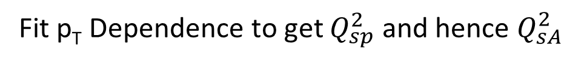

A Strategy
δ = 0.16 GeV
Measure A_{N} π⁰ in p+p, p+Au, and e.g. p+Cu
Intermediate p_{T} dependence being worked out (Zhongbo Kang)
Measure A_{N} γ to get change proportion of Sivers to Collins as a check of understanding of mechanism
$Q_{sA}^{2}$ $∝$ $A^{⅓}$ $Q_{sp}^{2}$
Fit p_{T} Dependence to get $Q_{sp}^{2}$ and hence $Q_{sA}^{2}$

Slide 17
To Conclude: Some theoretical help
A better understanding of the equivalence if there is one between different pictures so we don’t chase “smoking guns” only to be told that the smoking gun is not discriminatory – maybe it’s because the picture are in some way equivalent (which of course may be good, but make it difficult when setting up experimental strategy)
Easy access to CGC MC generator as there are for pp and heavy ions (control of parameters and final states
  ala, EPS09, pythia, AMPT, HIJING….
  MCKT is a nice start

Slide 18
To Conclude
MPC-EX, a plan into the future (fsPHENIX), and a plan for pA
  Direct photons
  Pion-pion correlation (as begun in the MPC) to higher p_{T}, look at multiplicity dependence
  Direct photons-pion correlations
  Polarized pA A_{N} (direct photon to look at Sivers ala Yuri K?)
  Centrality Selection
    PHENIX will need to use a larger coverage detector for centrality selection
    Probably will still need to run several nuclear species however
Is it worth thinking about a lower energy?
Can pA help get a handle of the “Glasma”. Signatures? (more than ridge?)
It is crucial to understand the initial state and themalization phase of a heavy ion collisions to understand the sQGP
  Only unified picture that I know
  CGC→Glasma→sQGP (hydro)
The hope is to use the various signatures to “box” in the phenomena to yield
the correct theoretical description of
1) initial state of sQGP 2) CNM 3) themalization stage of sQGP
Parameters extracted from different measurements should be “universal”

Slide 19
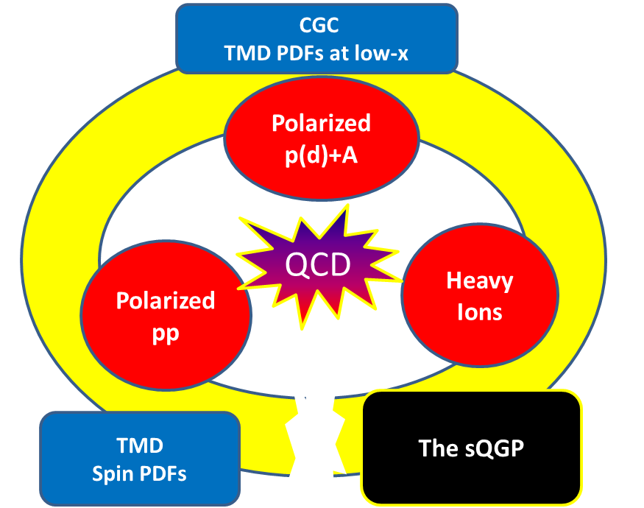
Perturbative
Non-
Perturbative
Non-equilibrium?

