Slide 1
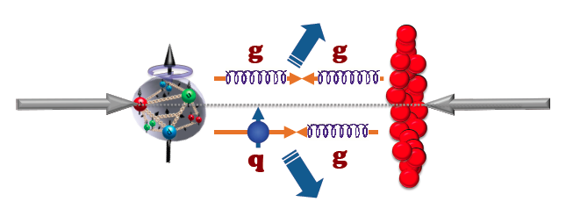
Physics opportunities with Di-muon analysis at PHENIX - Drell-Yan and quarkonia
Kwangbok Lee
Los Alamos National Laboratory
pA workshop, 1/9/2013

Slide 2
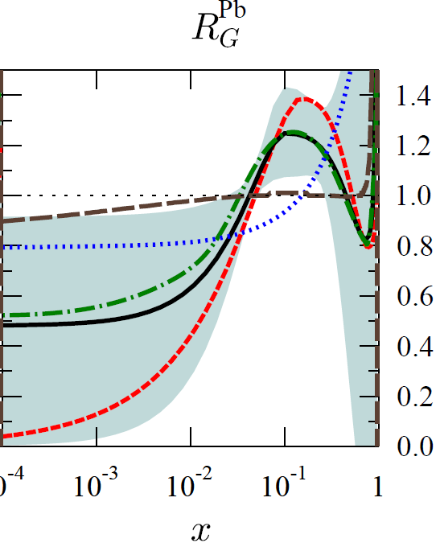
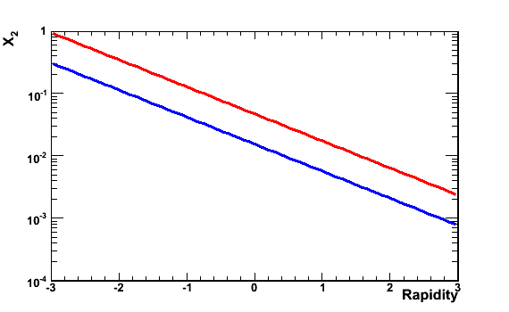
Quarkonia for Heavy Ion phyiscs
Quarkonia are produced mostly by
gluon fusion and good probes to explore
gluon distribution in nucleus.
Nuclear absorption (final)
Initial state parton energy loss.
<- disentangle effects seen at hot
nuclear collision.
R_{G}^{Pb}
Q² = 1.69 GeV²
antishadowing
nDS
HKN07
EKS98
EPS09
shadowing
EPS08
J/ψ
Υ_{1S}
X₂
Υ_{1S}
arXiv:0902.4154
J/ψ
Gluon density in different x
low x
high x
Rapidity

Slide 3
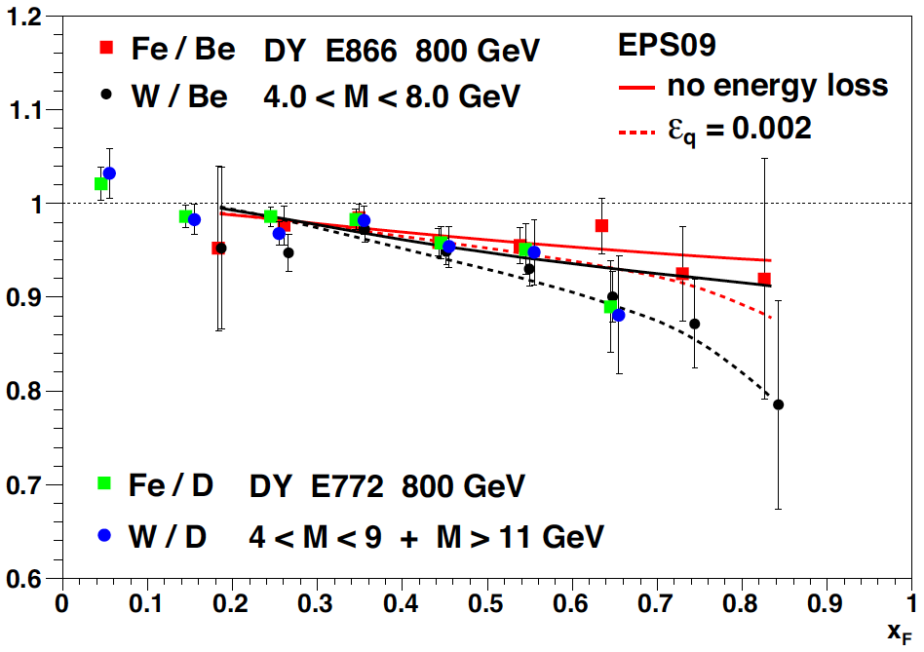
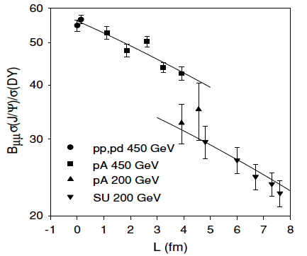
Drell-Yan for Heavy Ion phyiscs
Quarkonia measurements are not enough to
disentangle the cold nuclear effects.
The leptons from Drell-Yan process
(qq -> γ* -> l⁺l⁻, qg->qγ*) does not interact
with the nuclear medium.
Ideally suited to separate the initial-state
parton energy loss and parton modification,
given the absence of final-state effects.
EPS09 only
EPS09 + energy loss
j.nuclphysbps.2011.03.064
The NA50 experimental ratio of the total
J/ψ cross sections and Drell-Yan cross sections
as a function of the nuclear length L
arXiv:nucl-th/0212046

Slide 4
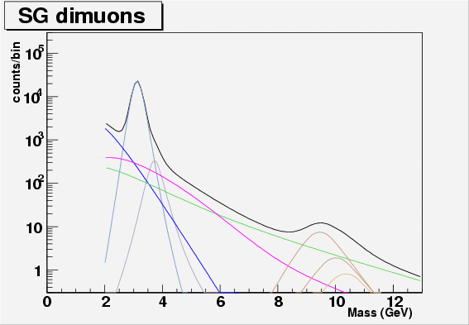
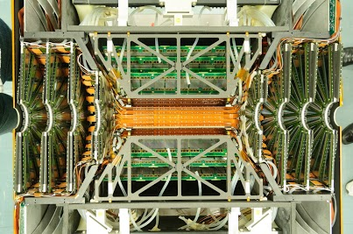
Backgrounds under Drell-Yan and control with FVTX/VTX
VTX
FVTX (S)
FVTX (N)
BEAM LINE
Correlated DD
Drell-Yan
_
_
Correlated BB
VTX
√s = 200 GeV simulation, p+p pythia
FVTX/VTX have been successfully installed
and working since 2012/2011.
Between 4 GeV/c² and 8 GeV/c² is thought to be dominated by
Drell-Yan process and correlated BB.
We would separate Drell-Yan process and correlated BB which have different decay lengths,
using silicon vertex detector, (F)VTX between 4 and 8 GeV/c².
We would get order of five thousand events for each arm with FVTX with
300 pb⁻¹ (p+p equivalent), current muon arm configuration, efficiencies included.
_
_

Slide 5
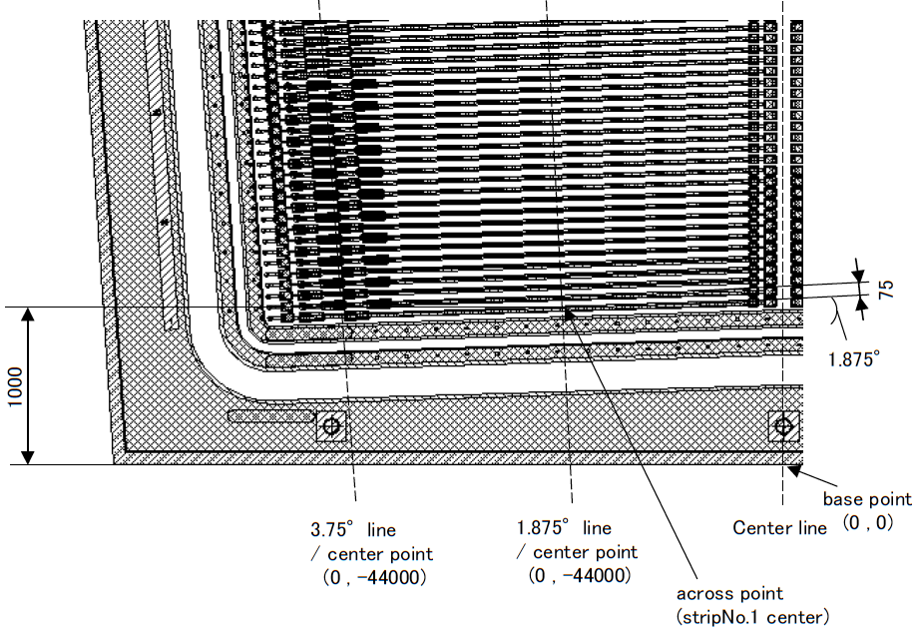
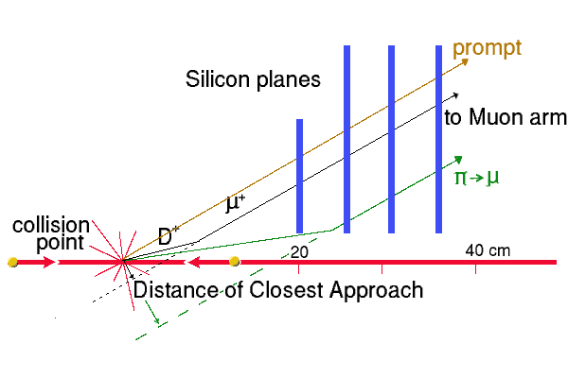
FVTX operation
75 μm pitch strips in radial directon, r and
3.75° along Φ direction.
Cover same pseudorapidity, |η| of 1.2
to 2.4(2.2) with Muon arm.
-> Sample momentum fraction, x₂, order of
10⁻³ to 10⁻² for the Drell-Yan.
Match track with Muon arm +(F)VTX.
-> Improve mass resolution.
Measure the primary vertex and
secondary decay.
-> Extract dimuon vertices, DCAs,
to distinguish Drell-Yan and heavy flavor
decay background.
75 μm
3.75°
Center line
FVTX wedge
Silicon plane
Decay length of Drell-Yan : none
Decay length of B meson : ~ 500 μm
pA workshop, 1/9/2013

Slide 6
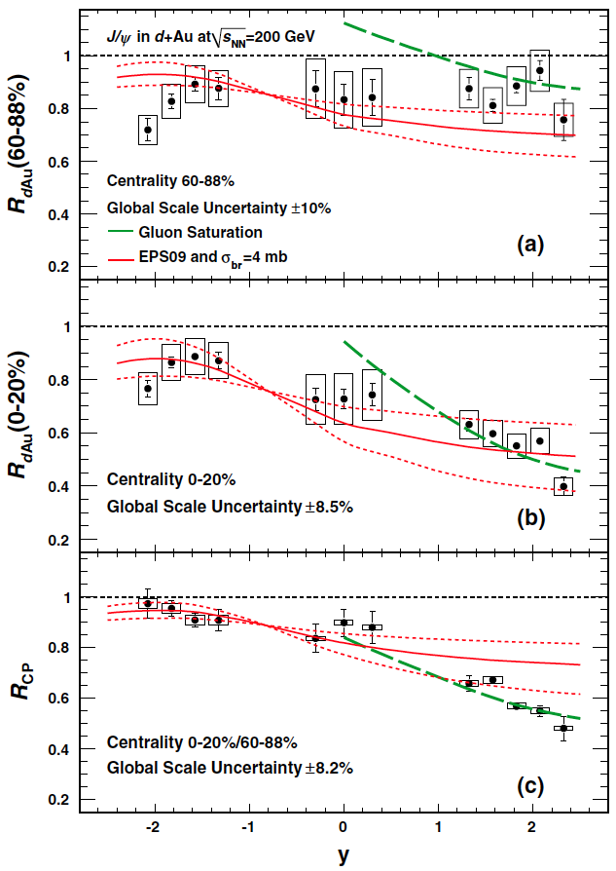
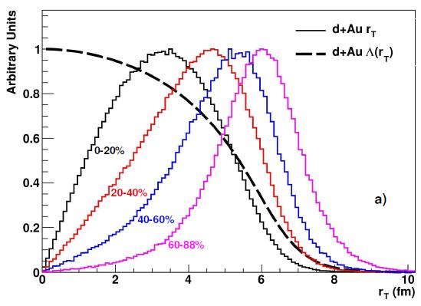
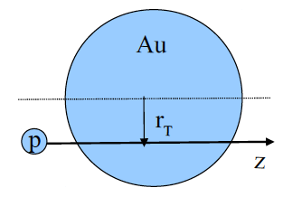
PHENIX J/ψ R_{dAu} measurement
Tried to fit the data with shadowing model, EPS09
+ breakup cross section.
The centrality dependence of these J/ψ
suppression results at forward rapidity is not well
described quantitatively by nuclear-shadowing
models that include final-state breakup effects.
Phys. Rev. Lett. 107, 142301 (2011)
-> See Cesar’s talk for more detail

Slide 7
χ_{c} at mid rapidity
cc
bb
state | J/ψ (1S) | χ_{c} (1P) | Υ (1S) | Υ (2S) | Υ (3S)
mass [GeV] | 3.10 | 3.53 | 9.46 | 10.02 | 10.36
radius [fm] | 0.25 | 0.36 | 0.14 | 0.28 | 0.39
T_{d}/T_{c} | 2.10 | 1.16 | > 4.0 | 1.60 | 1.17
Higher charmonium state(1P) than J/ψ(1S).
There are three states of chi_c.
Radiative decay channel χ_{c} -> J/ψ + γ -> μ⁺μ⁻(e⁺e⁻) + γ.
R_{χc} = (χ_{c} -> J/ψ + γ ) / (Inclusive J/ψ).
Decouple the fraction of decay J/ψ and direct J/ψ and check the production
mechanism.
χ_{c} has weak binding energy than other quarkonia, rather easily break up.
hep-ph/0609197v1 H. Satz

Slide 8
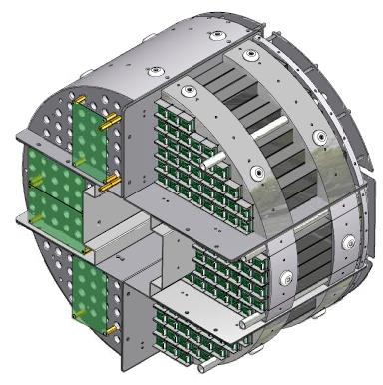
χ_{c} at forward rapidity
γ
d
Au
μ⁺
μ⁻
Forward E.M. Calorimeter
(MPC)
3.1 < |η| < 3.9
South
North
MPC, 3.1 < |η| < 3.9
Muon arm, 1.2 < |η| < 2.4
pA workshop, 1/9/2013

Slide 9
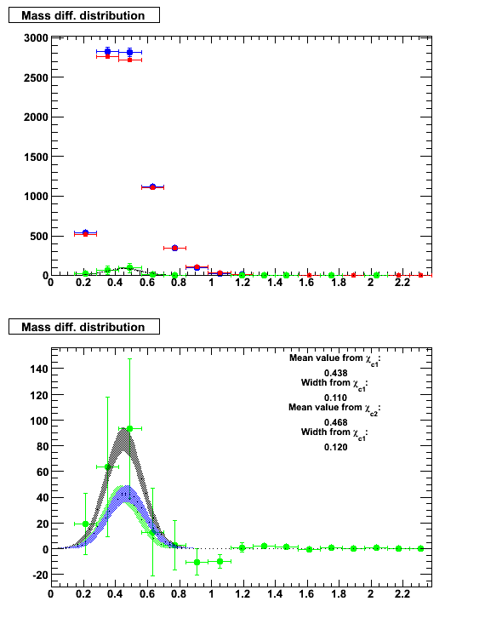
χ_{c} at forward rapidity
A.U.
Foreground event
Scaled mixed event
Signal(Foreground – Mixed)
We saw the peak, but large uncertainties due to
the large backgrounds from low energy photon
mess up the χ_{c} signal.
Future upgrade with Calorimeter will
improve χ_{c} measurement at forward/mid rapidities.
χ_{c} – J/ψ mass
A.U.
χ_{c} – J/ψ mass
√s_{NN} = 200GeV, dAu North
pA workshop, 1/9/2013

Slide 10
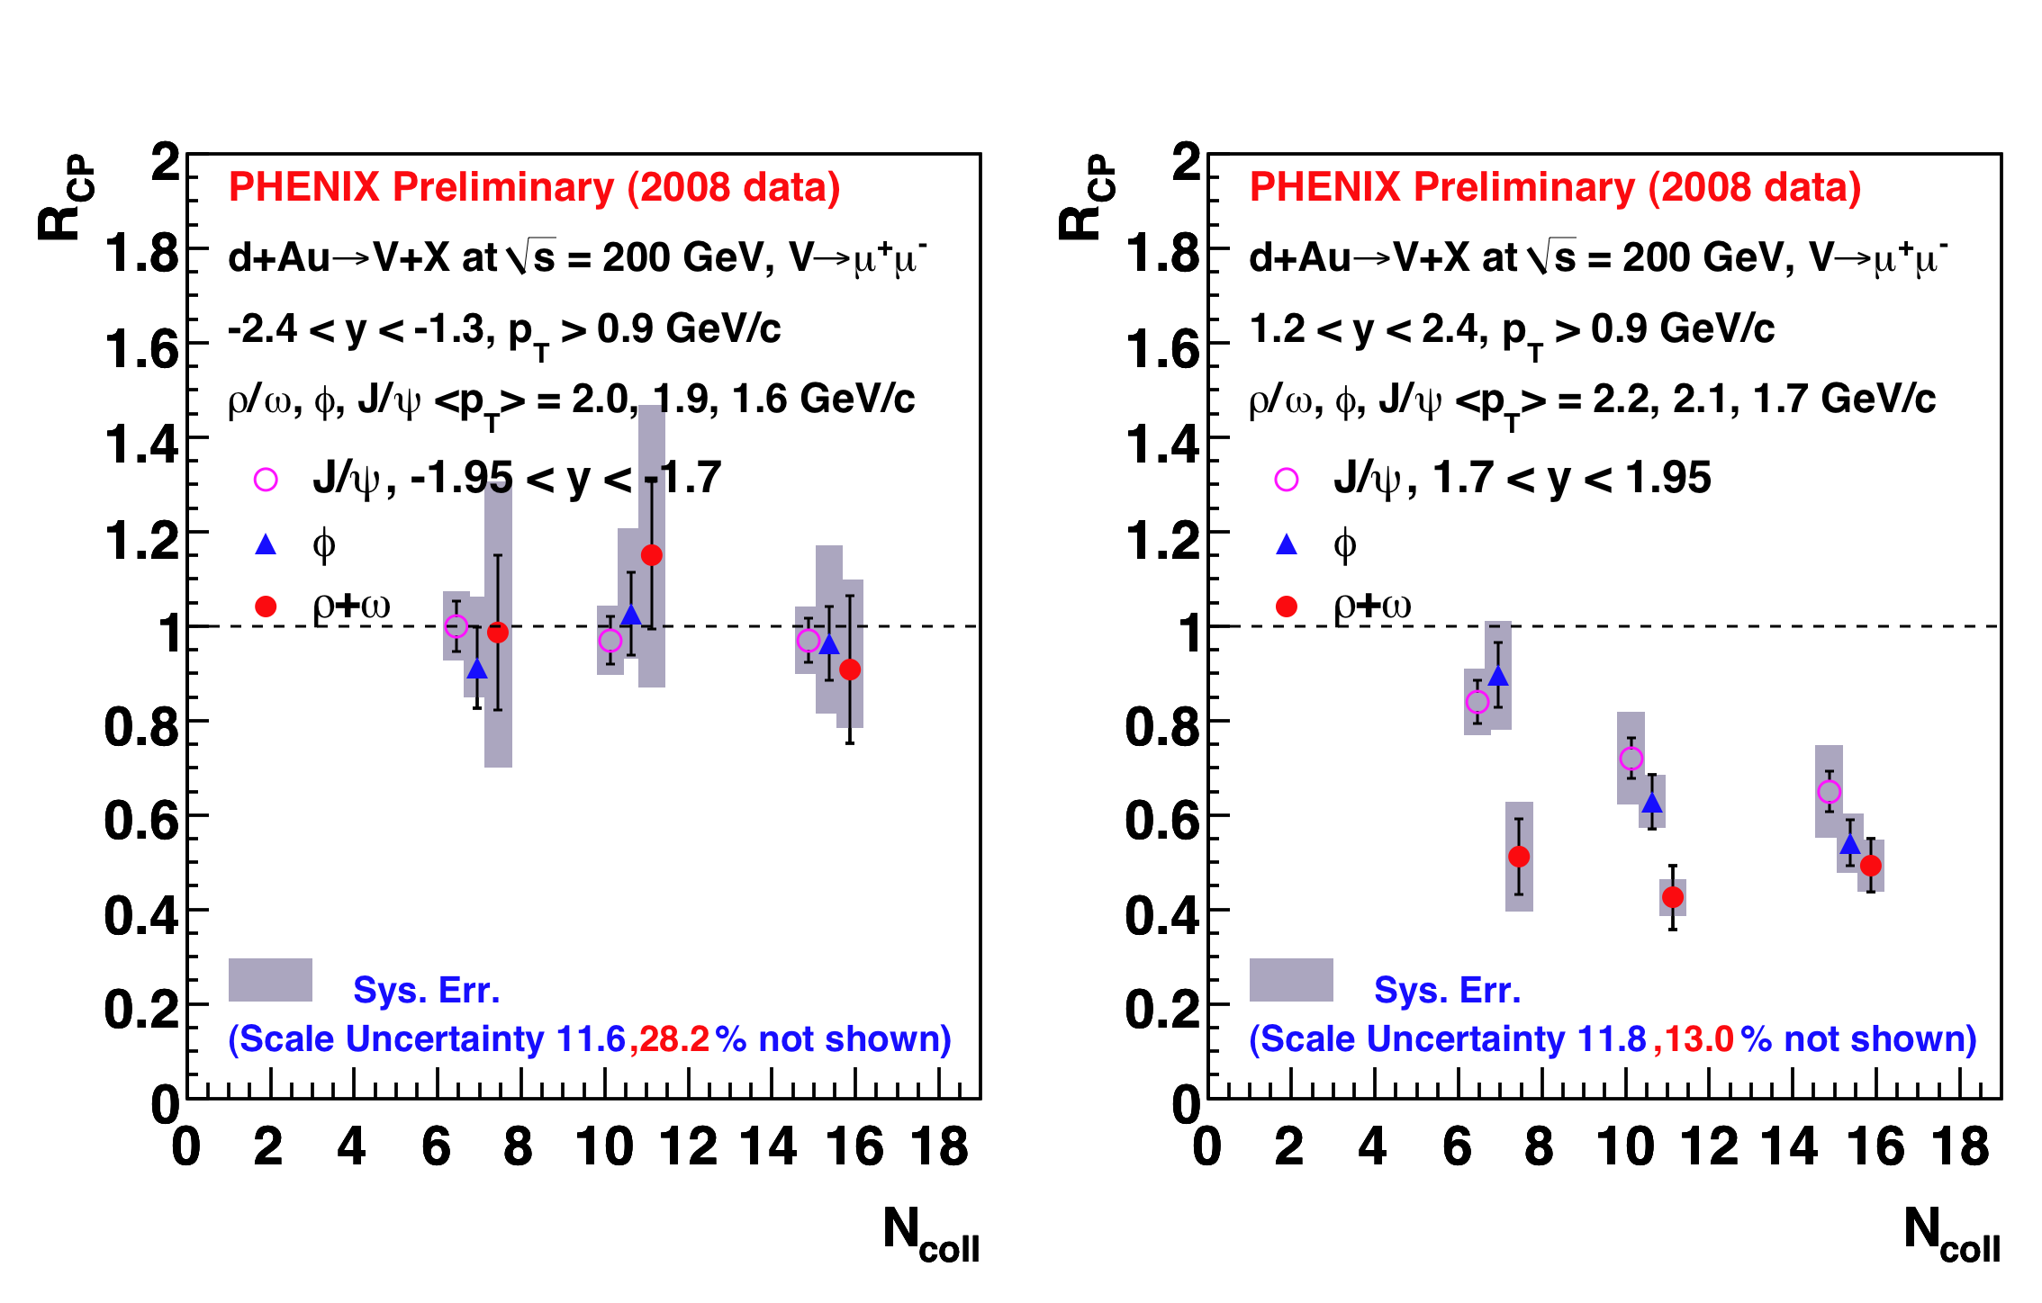
Light Vector Mesons R_{cp}
Gold(Au) going, y<0
Deuteron(d) going, y>0
Nuclear modification factor, R_{CP} measurement for low mass vector mesons
Significant suppression at deuteron going direction.
Stronger suppression for ρ/ω than φ and J/Ψ.
pA workshop, 1/9/2013

Slide 11
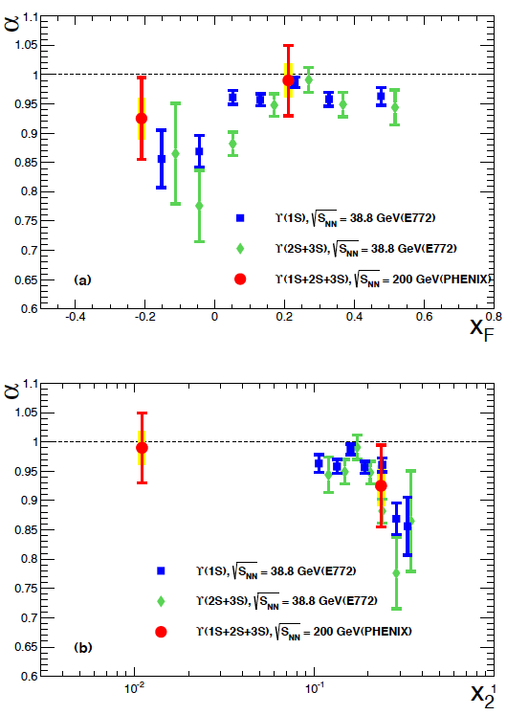
PHENIX Upsilon R_{dAu} measurement
arXiv:1208.1293
nPDF(EPS09) + breakup σ
Comparison to lower energy pA results(E772)
The rapidity dependence of the observed suppression at forward and backward
rapidities are compatible with lower energy results and a NLO theoretical calculation.
Expect to separate out ϒ of the ground state and the exited states with
the future upgrade.

Slide 12
Summary
Drell-Yan measurement at pA collision is interesting to test initial-state quark modification and parton energy loss at nucleus.
Ratio of J/ψ / DY and P_{T} broadening would be interesting to test nuclear modification/absorption.
(F)VTX can help to separate open HF correlation from Drell-Yan and quarkonia measurement at dimuon channel.
Future upgrade and (F)VTX would help to improve mass resolution and separate ψ’ and excited states of upsilon as well as χ_{c}.
See Cesar, John, Joe more for the upgrade.
pA workshop, 1/9/2013

Slide 13
Back up
pA workshop, 1/9/2013

Slide 14
Introduction
Review the PHENIX dimuon/other previous measurements.
Check the possible improvements/physics.
This talk is focused on cold nuclear matter physics, not on the spin measurement.
pA workshop, 1/9/2013

Slide 15
Yield Extraction Examples
Fitting function: Two Gaussian (φ/ω) + One Relativistc BW (ρ) +Background (Defined by estimated shape)
φ yields stable when fitting procedure changes
ρ+ω yields using background subtraction (large uncertainty)
y>0, Centrality: 40-60
y>0, Centrality: 40-60
Estimated background
ρ φ
ω
ρ φ
ω
Smaller fitting range:0.5-2.5 GeV
Larger parameter range
Larger fitting range:0.4-2.6GeV
Smaller parameter range
pA workshop, 1/9/2013

Slide 16
Background Estimation Challenge
y<0, Centrality: 20-40
Correlated background
2.2e-03 , 1.2e-02
6.6e-02, 3.6e-01
A new data-driven background estimation method developed
Use di-muon pairs with large χ2_{vtx} to estimate the background
Addresses the issue of correlated hadrons that decays to μ^{+/−}
Achieved good background description at all mass range
pA workshop, 1/9/2013

Slide 17
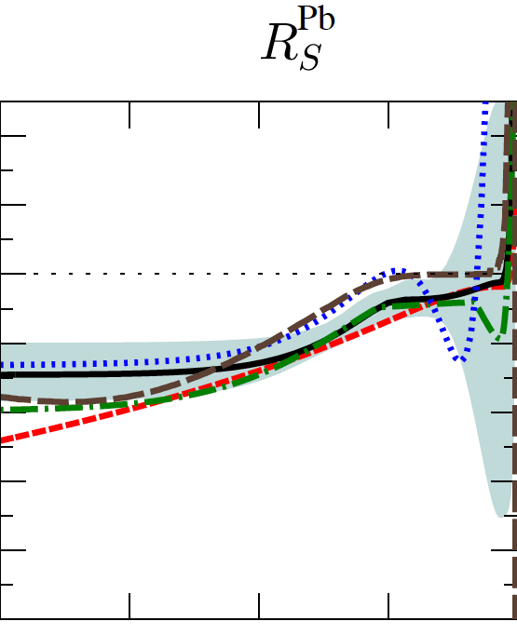
Drell-Yan for Heavy Ion phyiscs
R_{S}^{Pb}: sea quark modification
1.4
_
Drell-Yan process (qq -> γ* -> l⁺l⁻) is a good
probe to study the quark modification in
nucleus and initial-state parton energy loss.
Ideally suited to isolate the initial-state
parton energy loss, given the absence of final-
state effects on the produced dimuon.
Q² = 1.69 GeV²
1.2
R_{S}^{Pb}
nDS
1.0
HKN07
0.8
EPS09
EKS98
0.6
EPS08
0.4
0.2
0.0
EPS09 only
10⁻⁴
10⁻³
10⁻²
10⁻¹
1
arXiv:0902.4154
x coverage of PHENIX Drell-Yan in nucleus
at √s = 200 GeV (1.2 < y < 2.2)
EPS09 + energy loss
j.nuclphysbps.2011.03.064

Slide 18
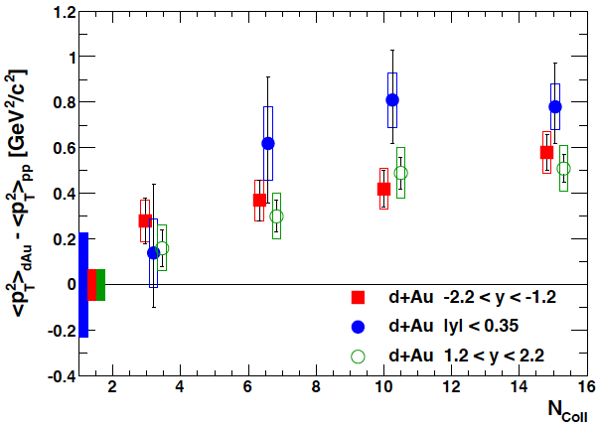
Ratio of J/ψ over DY and P_{T} broadening
arXiv:1204.0777
arXiv:nucl-th/0212046
The NA50 experimental ratio of the total
J/ψ cross sections and Drell-Yan cross sections
as a function of the nuclear length L
PHENIX √s_{NN} = 200GeV
NA50 data are fit with the QCD based nuclear absorption model.
PHENIX J/ψ data show P_{T} broadening due to the multiple scattering

