Slide 1
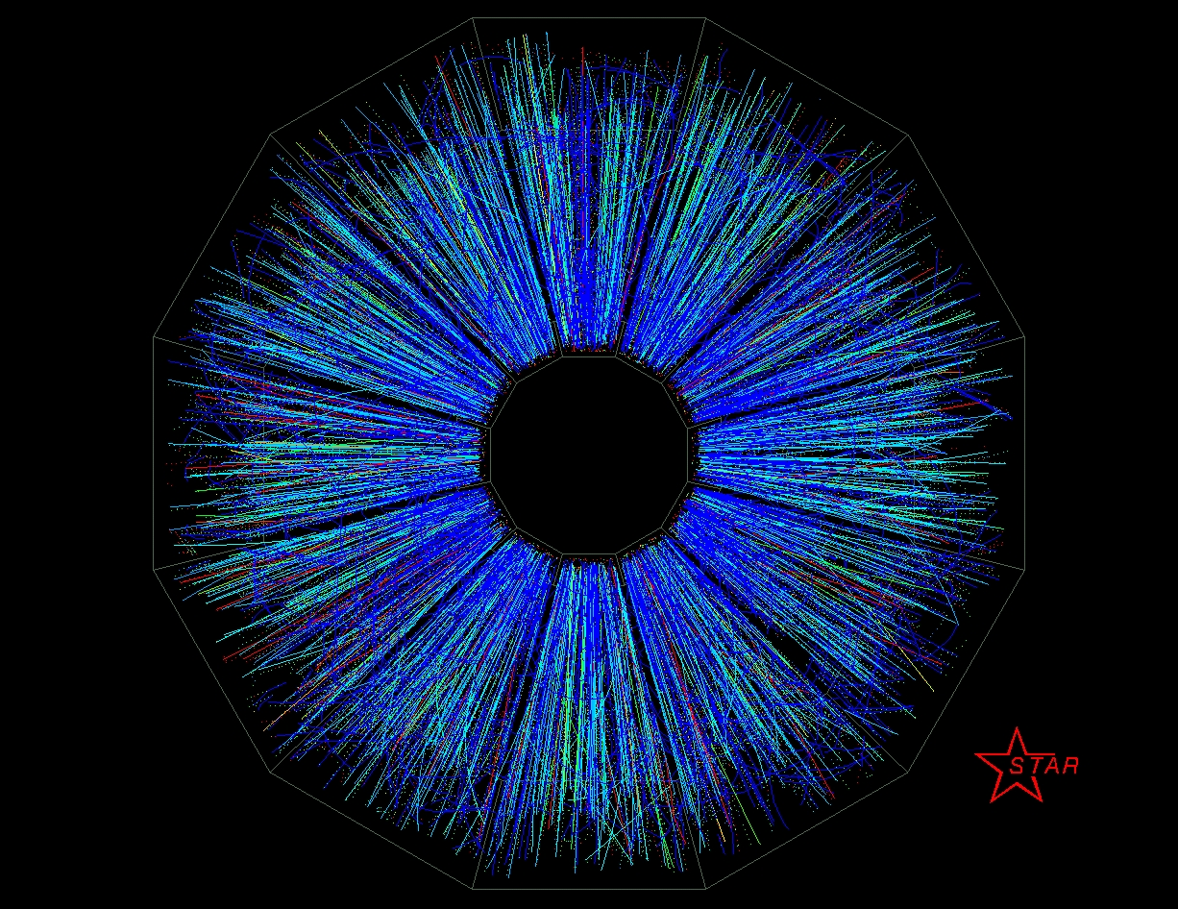
STAR Decadal Plan
James Dunlop for the STAR Collaboration

Slide 2
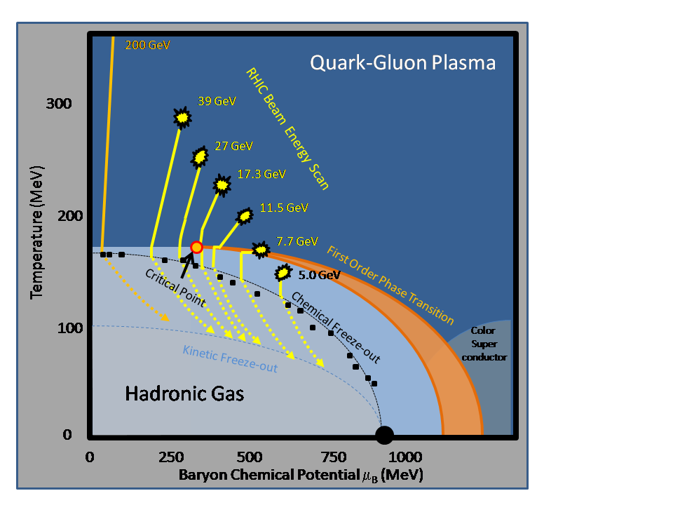
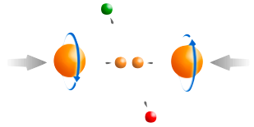
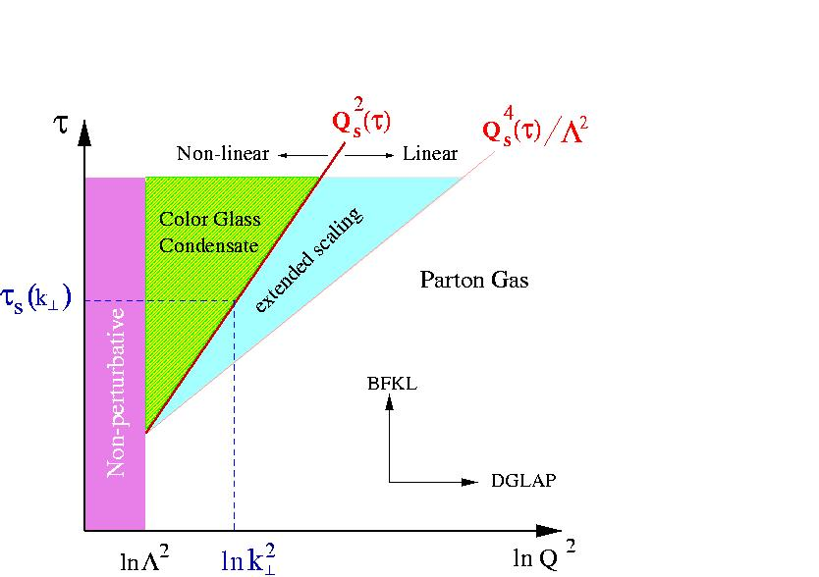
RHIC: Exploring QCD in detail
Hot QCD Matter
Partonic structure
Spin structure of the nucleon
How to go beyond leading twist and
colinear factorization?
Properties of the sQGP in detail
Mechanism of Energy Loss:
weak or strong coupling?
Is there a critical point, and if so, where?
Novel symmetry properties
Exotic particles
What are the properties of
cold nuclear matter?

Slide 3
How to explore QCD: from hot to cold
Hot QCD matter: high luminosity RHIC II (fb⁻¹ equivalent)
  Heavy Flavor Tracker: precision charm and beauty
  Muon Telescope Detector: e+μ and μ+μ at mid-rapidity
  Trigger and DAQ upgrades to make full use of luminosity
  Tools: jets combined with precision particle identification
Phase structure of QCD matter: Energy Scan Phase II
  Fixed Target to access lowest energy at high luminosity
  Low energy electron cooling to boost luminosity for √s_{NN}<20 GeV
  Inner TPC Upgrade to extend η coverage, improve PID
Cold QCD matter: high precision p+A, followed by e+A
  Major upgrade of capabilities in forward direction
  Existing mid-rapidity detectors well suited for portions of e+A program

Slide 4
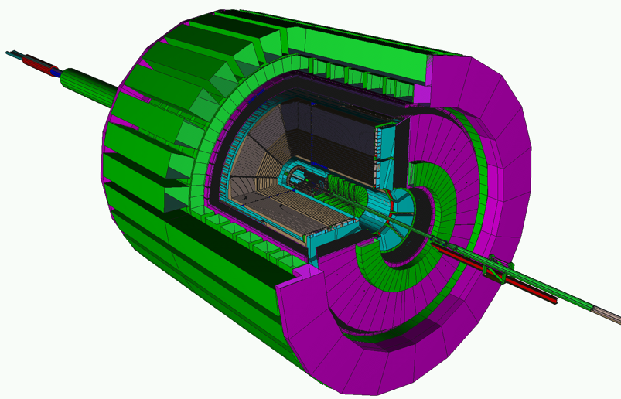
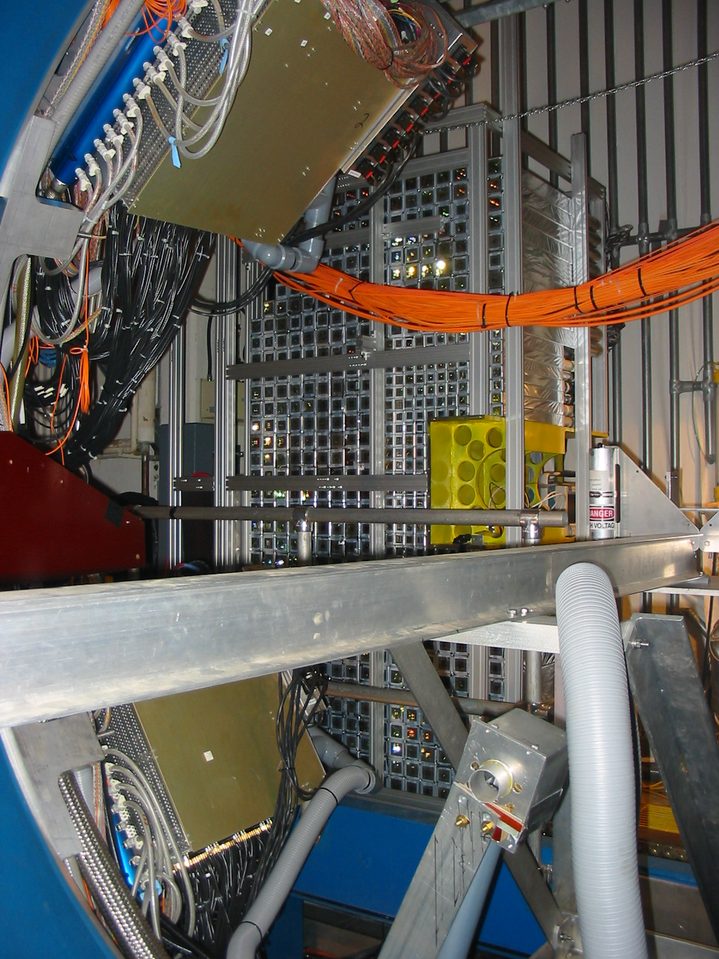
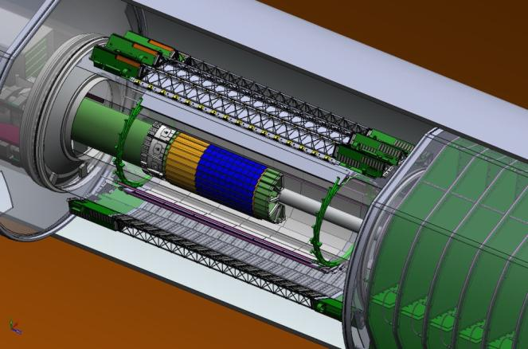
STAR: A Correlation Machine
Tracking: TPC
Particle ID: TOF
Electromagnetic Calorimetry:
BEMC+EEMC+FMS
(-1 ≤ η ≤ 4)
Recent upgrades:
DAQ1000
TOF
Plus upgrades to
Trigger and DAQ
Muon Telescope Detector (runs 13/14)
Heavy Flavor Tracker (run 14)
Forward GEM Tracker (runs 12/13)
Full azimuthal particle identification
over a broad range in pseudorapidity

Slide 5
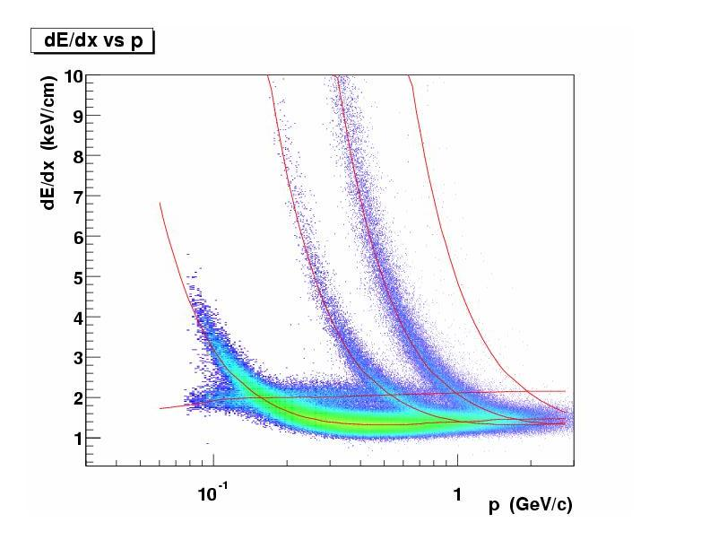
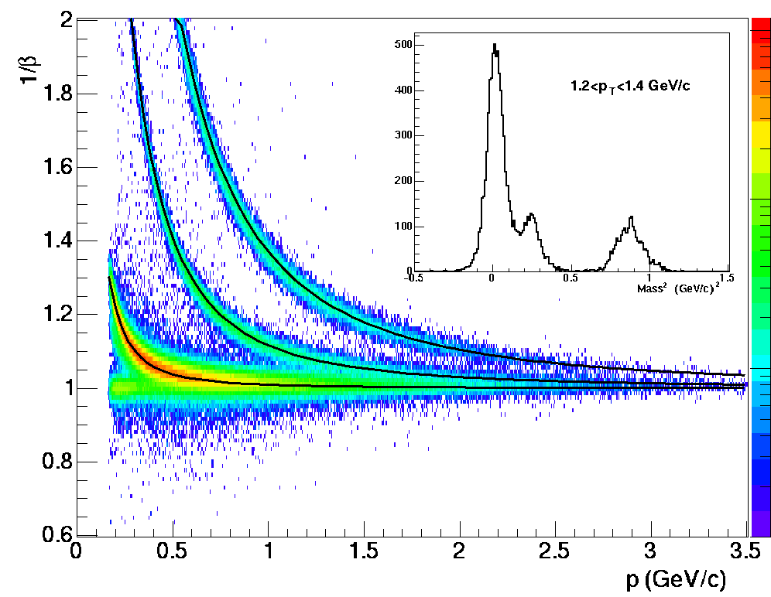
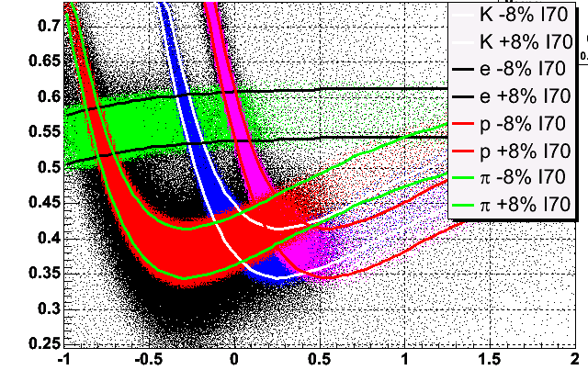
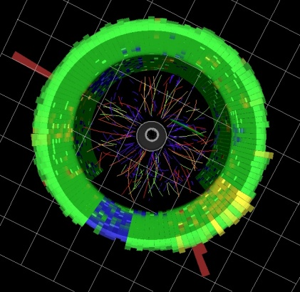
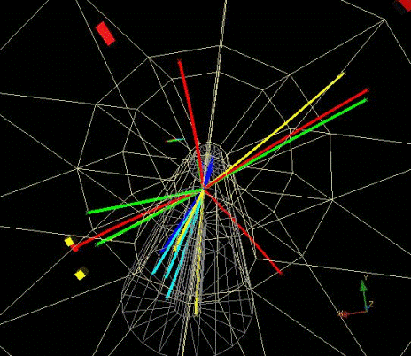
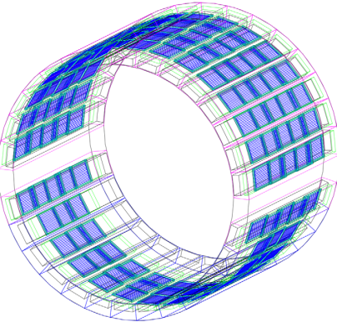
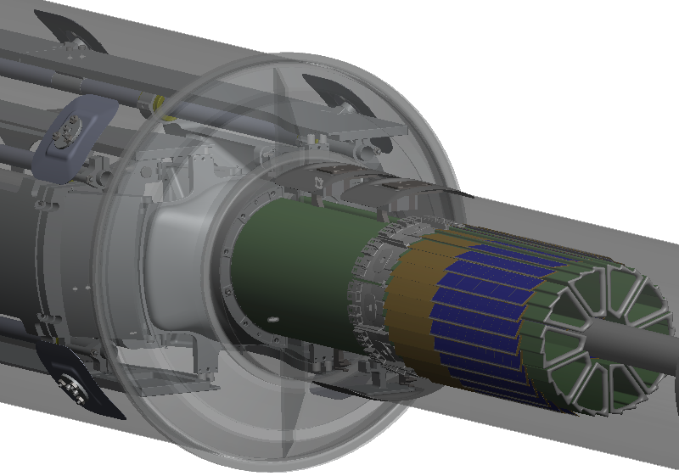
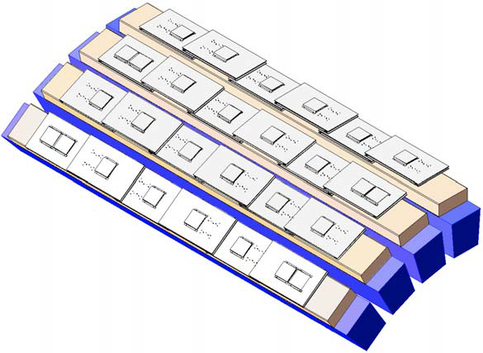
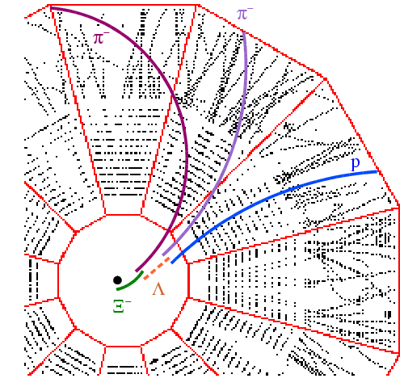
Particle Identification in STAR
TPC TOF TPC
TPC
K p d
π
e, μ
TOF
Log₁₀(p)
Charged hadrons
Hyperons & Hyper-nuclei
MTD
HFT
EMC
Jets
Neutral particles
Jets & Correlations
High p_{T} muons
Heavy-flavor hadrons
Multiple-fold correlations among the identified particles!
Nearly perfect coverage at mid-rapidity

Slide 6
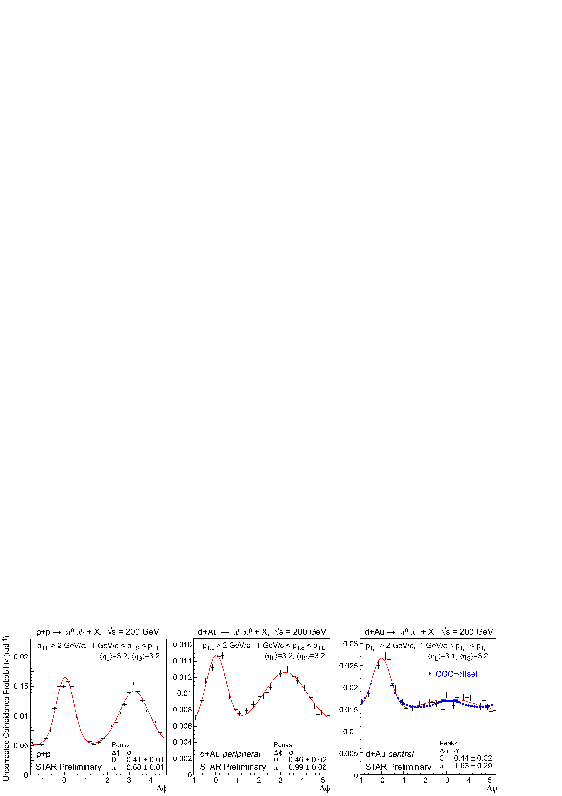
  What are the properties of cold nuclear matter?
  Is there evidence for saturation of the gluon density?
PHENIX, Phys. Rev. Lett. 107, 172301 (2011)
STAR
preliminary
RHIC may provide unique access to the onset of saturation
  Complementarity: LHC likely probes deeply saturated regime
Future questions for p+A
  What is the gluon density in the (x,Q²) range relevant at RHIC?
  What role does saturation of gluon densities play at RHIC?
  What is Q_{s} at RHIC, and how does it scale with A and x?
  What is the impact parameter dependence of the gluon density?
Upgrades to both STAR and PHENIX to extend observables (focus on EM)
  Timescale: medium-term (~2017+)

Slide 7
p+A: Where to measure?
Most promising at
RHIC energies:
y ~ 3-4
Q² ~ few GeV²
N.B. Lines only
schematic, kinematic control limited in p+A
From 2->2 parton scattering, many sources of smearing
LHC mid-y
~ RHIC y=4

Slide 8
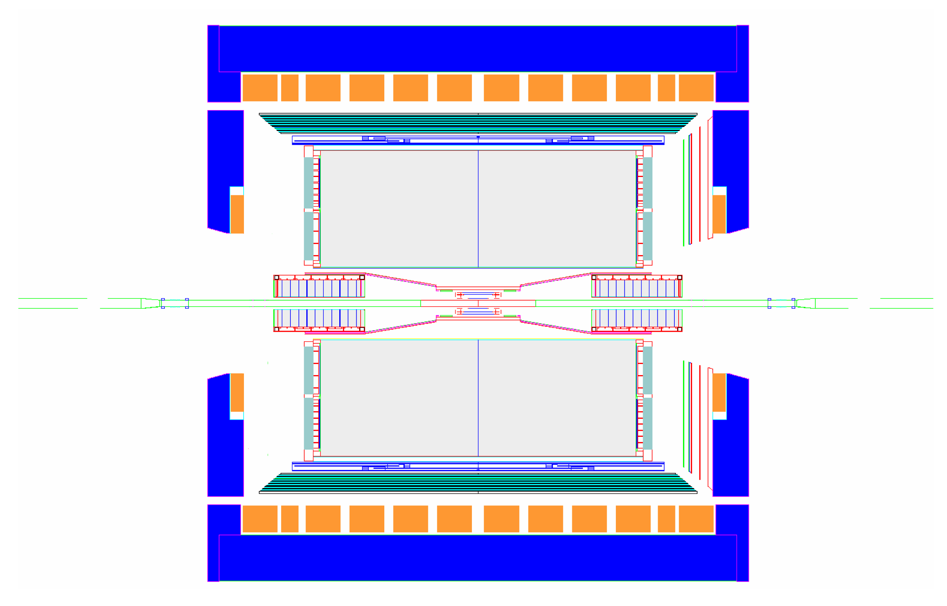
STAR Experiment as of 2014
MRPC ToF Barrel
MTD
EMC Barrel
EMC End Cap
FMS
BBC
FPD
TPC
Roman Pots
Phase 2
DAQ1000
COMPLETE
Trigger and DAQ
Upgrades
FGT
HFT
R&D/Ongoing

Slide 9
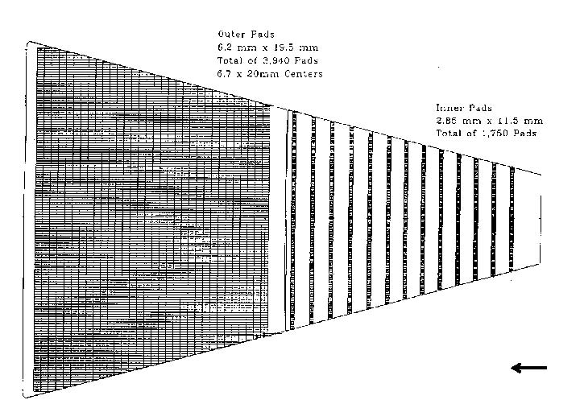
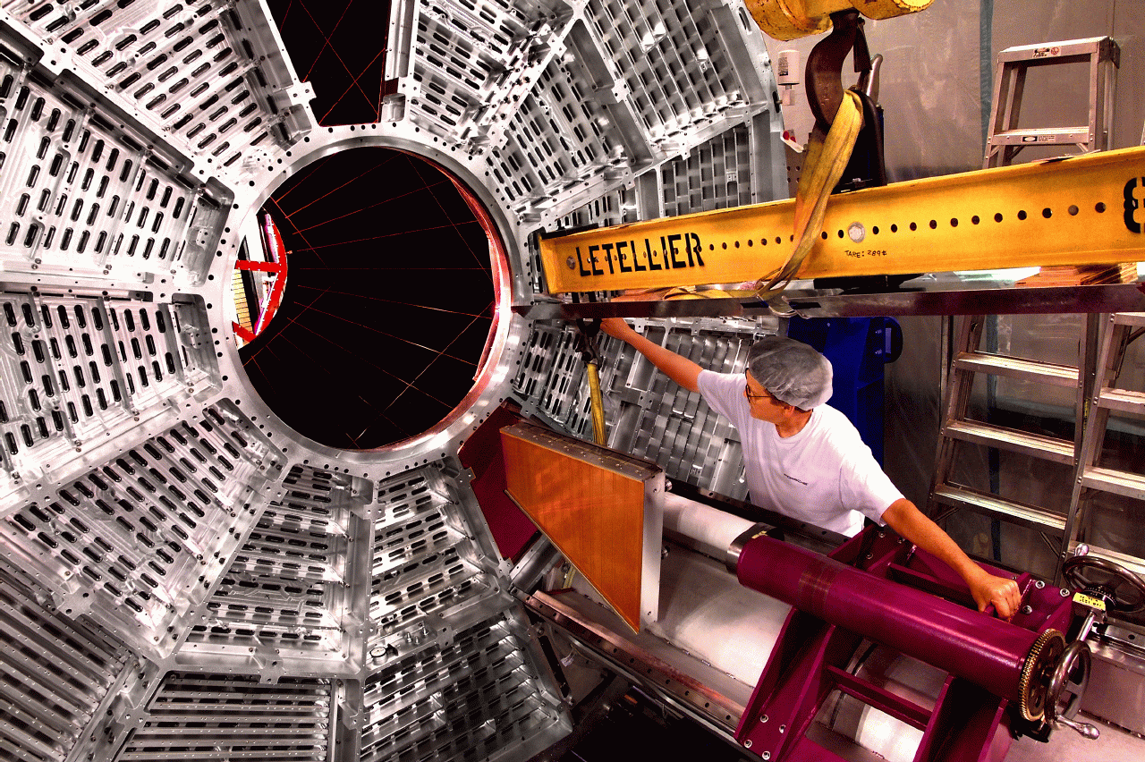
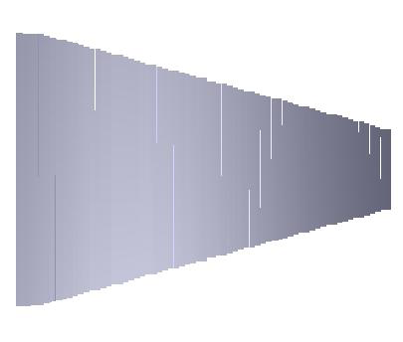
Inner TPC Upgrade
Better tracking and dE/dx PID capability
η 1.0-1.7 region -- broad physics impact on
transverse spin physics program
hyperon and exotic particle searches
high p_{T} identified particles
BES Phase II+
Not as forward as most useful for p+A, but useful for ridge studies

Slide 10
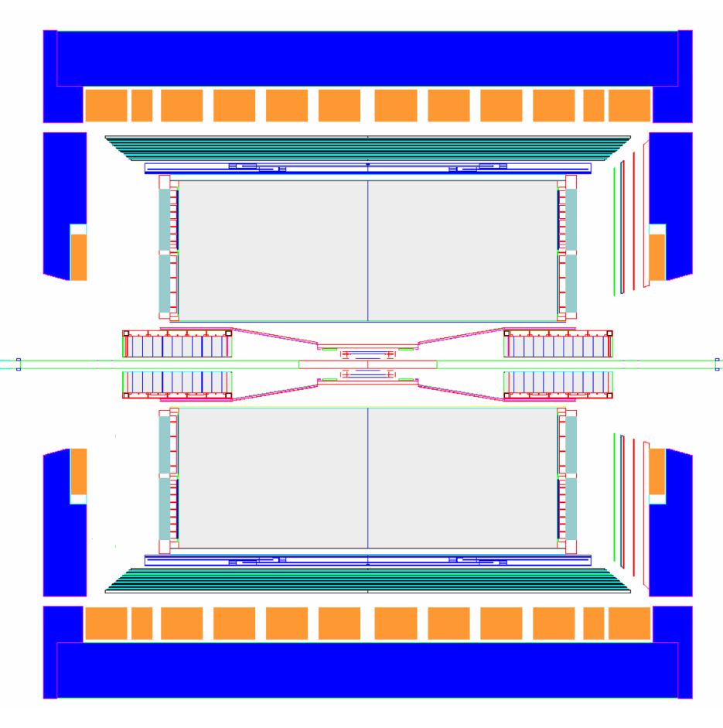
Forward Instrumentation Upgrade
proton
nucleus
~ 6 GEM disks
Tracking: 2.5 < η < 4
2017+
Forward Calorimeter System (FCS)
FHC (E864)
Pb-Sc HCal
FHC (E864)
W-Powder EMCal
RICH/Threshold
Baryon/meson separation
Forward instrumentation optimized for p+A and transverse spin physics
  Charged-particle tracking
  e/h and γ/π⁰ discrimination
  Possibly Baryon/meson separation

Slide 11
Some planned p+A measurements
Nuclear modifications of the gluon PDF
  Correlated charm production
Gluon saturation
  Forward-forward correlations (extension of existing π⁰-π⁰)
    h-h
    π⁰-π⁰
    γ-h
    γ-π⁰
  Drell-Yan
    Able to reconstruct x₁, x₂, Q² event-by-event
    Can be compared directly to nuclear DIS
    True 2 → 1 provides model-independent access to x₂ < 0.001
What more might we learn by scattering polarized protons off nuclei?
Forward-forward correlations and Drell-Yan are also very powerful tools to unravel the dynamics of forward transverse spin asymmetries – Collins vs Sivers effects, TMDs or Twist-3, …
Easier to measure
Easier to interpret

Slide 12
Plans for Forward Upgrade
Calorimeter:
  EM: Pb-glass (FMS) augmented by Tungsten SPACAL
    Smaller Moliere radius for better 2-γ separation
    Keep high E resolution
  Hadron calorimetry for e/h discrim., jet reconstruction
Very Forward GEM Tracker (VFGT)
  Likely GEM-based
  Details of the design depend on experience with FGT
Particle Identification
  RICH problematic with accessible p_{T} resolution
  Threshold Cerenkov detector under consideration
  Detector will not be included in initial upgrade
Schedule: proposal this year, construction start 2015+
Ready for data 2017 at the earliest

Slide 13
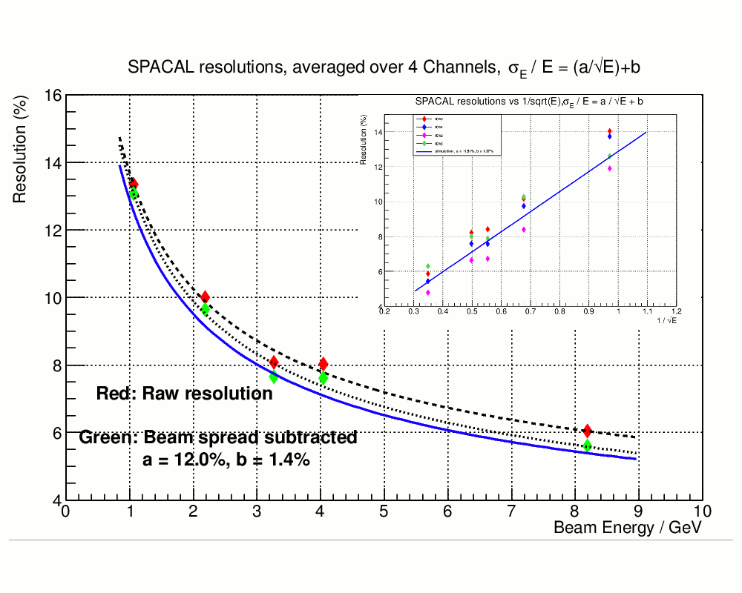
Calorimeter: SPACAL works
Also measured:
1.Uniformity of response across the towers.
2. Energy resolution with and
without mirror.
3. Perform scans along the towers with electrons and muons.
4. Estimated effects of attenuation and towers non-uniformities on resolution.
Viable EMC detector technology developed through EIC R&D
A prototype hadron calorimeter module will be built in 2013

Slide 14
Tracking: proof of principle
P_{t} Resolution in STAR Forward TPC
Charged hadron R_{cp} at |η|~3.1
J. Putschke, Thesis
nucl-ex/0703016
|η|~3.1
STAR magnetic field allows for moderate p_{T} resolution in forward direction
e.g. FTPC, position resolution ~100 μm
Some added momentum resolution can be garnered from radial magnetic field at poletip
Likely insufficient for RICH particle identification, but sufficient for charge sign discrimination in Drell-Yan: detailed simulations underway

Slide 15
Summary
Major upgrade of capabilities in forward direction envisioned
Full calorimetry (EM+Hadronic)
Modern tracking technology to make most of existing magnetic field
Timescale: 2017+
(BTW: Roman Pots Phase 2 have program in p+A, so engineering needs to take this into account)
Strong set of measurements to be made, complementary to and supporting those at a future EIC
From this workshop: what specific measurements should we optimize for in design?

Slide 16
Backup

