Slide 1

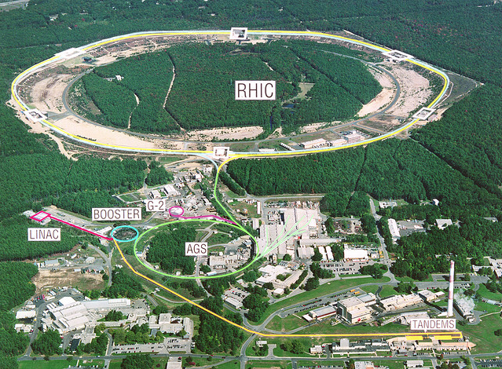

The STAR FGT upgrade program
STAR
Xuan Li for the STAR Collaboration
Temple University

Slide 2
Outline
Motivation
  Forward GEM Tracker (FGT) physics program
FGT overview
  Assembly and installation
  Cosmic ray results for RHIC Run 13
FGT upgrade and open discussion for p+A collisions
Summary

Slide 3
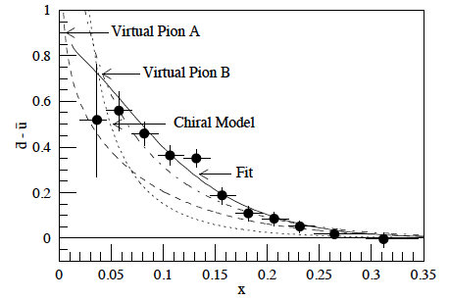
Motivation
Asymmetry of unpolarized sea quark distribution function had been found in Drell-Yan process (p+N μ⁺μ⁻).
T.C.Awes et al.,
Phys.Rev.D58:092004,1998
Other channels?
How about polarized sea quark distribution?

Slide 4
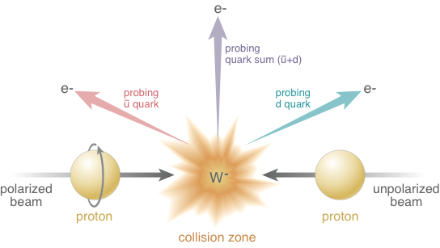
W production – unique new probe to measure quark polarization
Probing polarized quark distribution via W production.

Slide 5
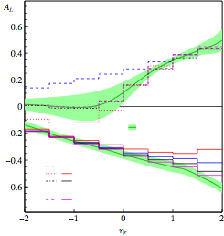
W measurement at STAR
STAR A_{L} results and projection.

Slide 6
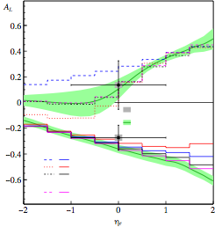
W measurement at STAR
STAR A_{L} results and projection.
Measured asymmetries (Run 9) are in agreement with theory evaluations using polarized pdf’s (DSSV) constrained by polarized DIS data
⇒ Universality of helicity distr. functions!

Slide 7
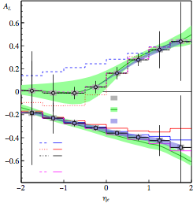
W measurement at STAR
STAR A_{L} results and projection.
Measured asymmetries (Run 9) are in agreement with theory evaluations using polarized pdf’s (DSSV) constrained by polarized DIS data
⇒ Universality of helicity distr. functions!
Critical: Measurement of W⁺ and W⁻ asymmetries as a function ηe

Slide 8
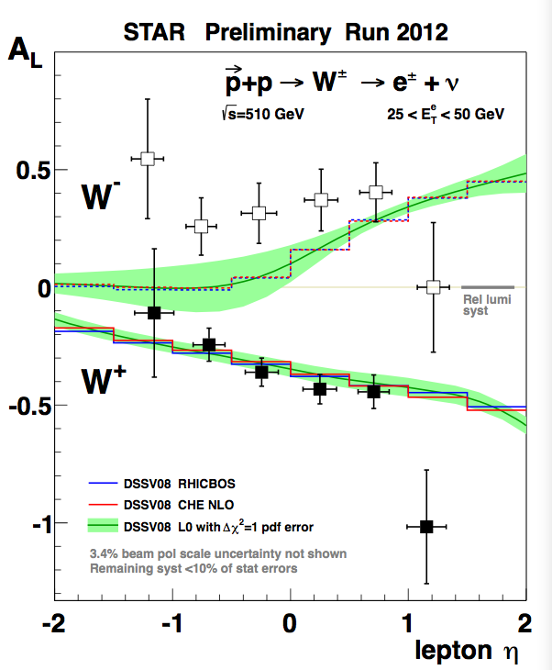
W measurement at STAR
STAR A_{L} results and projection.
Measured asymmetries (Run 9) are in agreement with theory evaluations using polarized pdf’s (DSSV) constrained by polarized DIS data
⇒ Universality of helicity distr. functions!
Critical: Measurement of W⁺ and W⁻ asymmetries as a function ηe
Extension of backward / forward ηe acceptance enhances sensitivity to anti-u / anti-d quark polarization
⇒ STAR Forward GEM Tracker (1<|ηe|<2)

Slide 9
W measurement at STAR
STAR A_{L} results and projection.
Measured asymmetries (Run 9) are in agreement with theory evaluations using polarized pdf’s (DSSV) constrained by polarized DIS data
⇒ Universality of helicity distr. functions!
Critical: Measurement of W⁺ and W⁻ asymmetries as a function ηe
Extension of backward / forward ηe acceptance enhances sensitivity to anti-u / anti-d quark polarization
⇒ STAR Forward GEM Tracker (1<|ηe|<2)

Slide 10
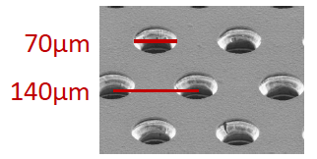
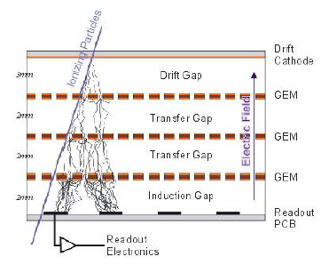
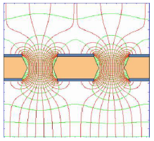
GEM technology
Gas Electron Multiplier technology used for its high resolution capabilities at a very low mass.
GEMs use a high electric field in the holes of a copper coated foil to amplify very small signals produced by ionizing particles.
Hole diameter:
Ionizing particles pass through Triple GEM
Pitch:
Single GEM
in electic field

Slide 11
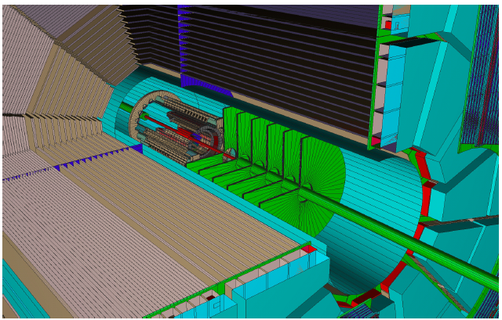
FGT overview - design
Design constraints
  Low mass which is important being close to interaction region.
  Size limited by GEM foil production technology.
  High rate – around 0.5MHz/cm², very radiation tolerant.
FGT installed inside STAR

Slide 12
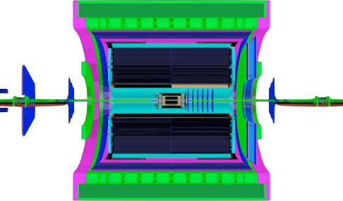

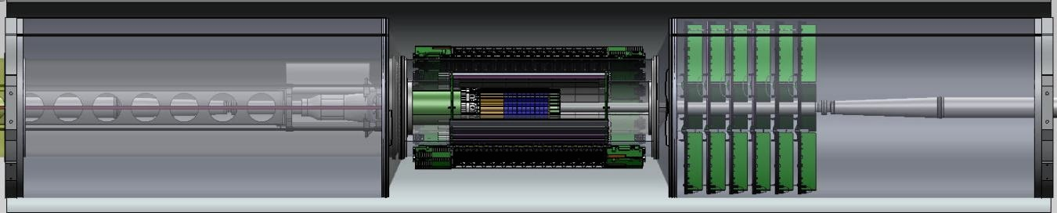
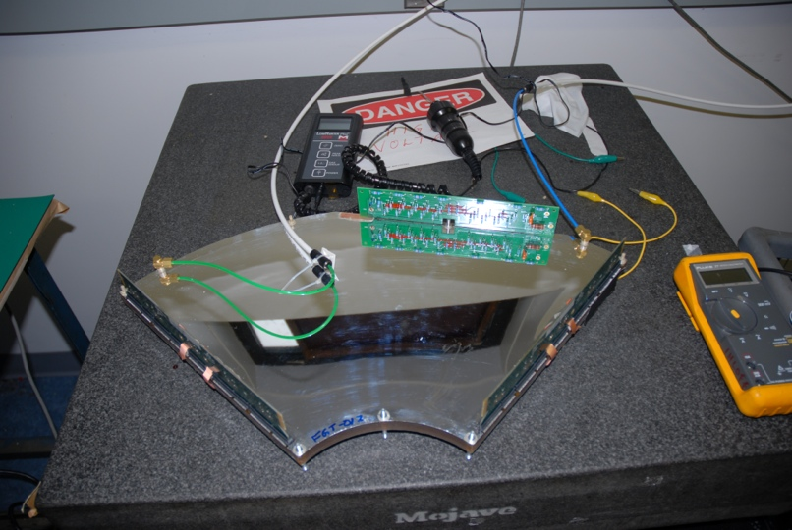
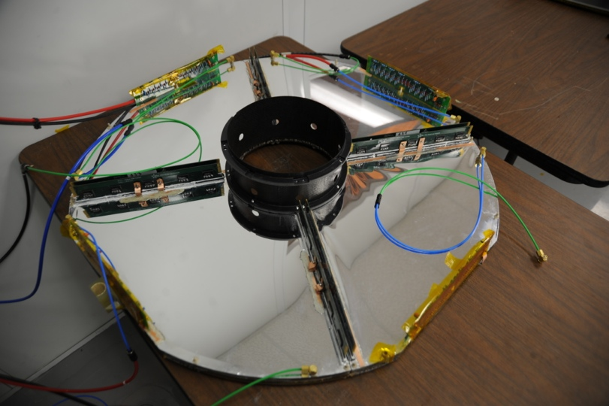
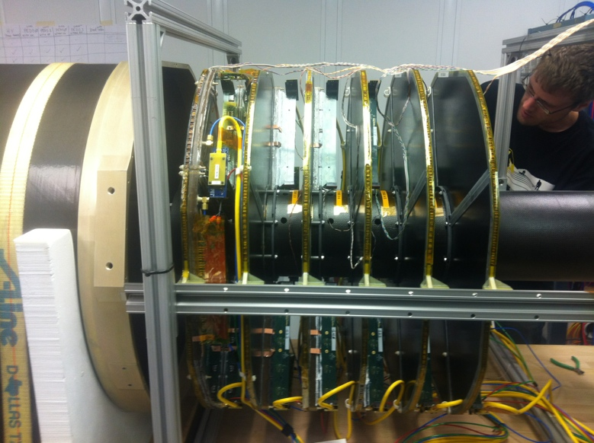
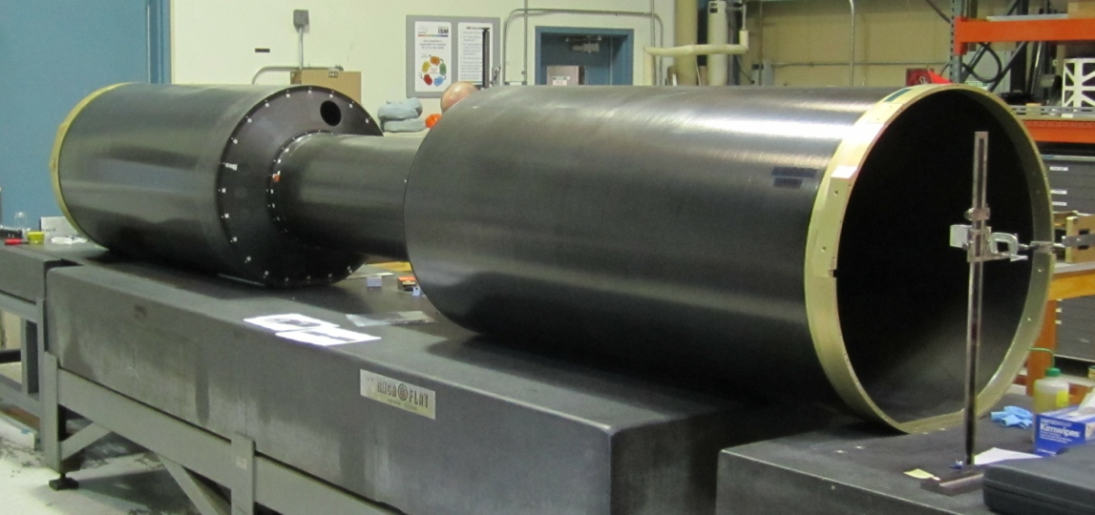
FGT overview - construction
Forward GEM Tracker - layout
The FGT has been
fully installed in STAR
for RHIC Run 13.
Quarter section
Disk
FGT consists of 6 disks
West Support Cylinder (WSC)
for FGT

Slide 13
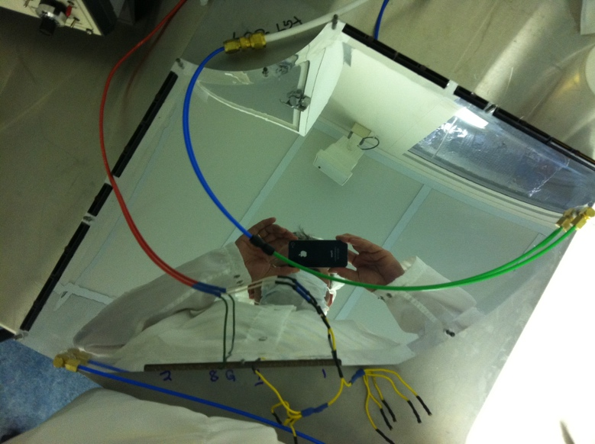
Look inside FGT quadrant
FGT quarter section - layout
Read out R, φ
value to determine
hit position
Read out φ
Read out R
Long Octant
Short Octant

Slide 14
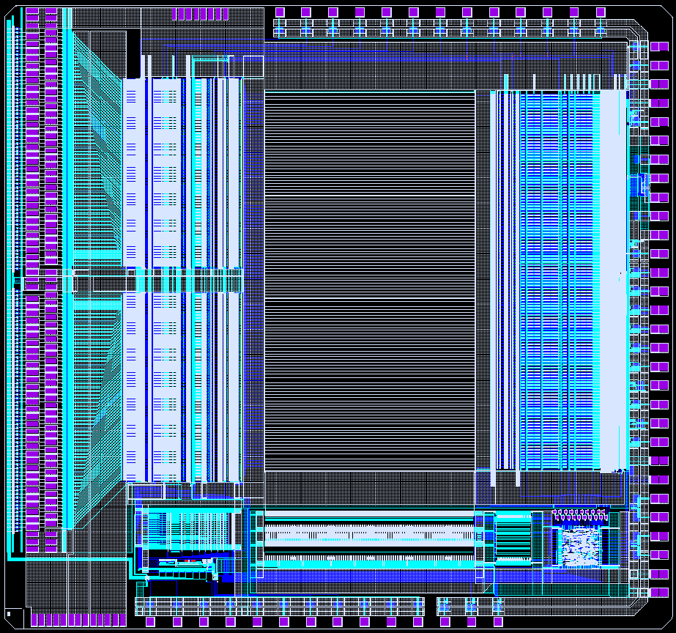
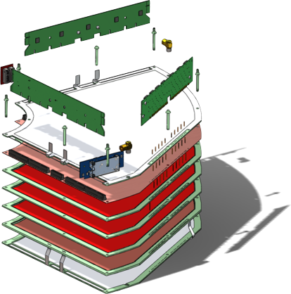
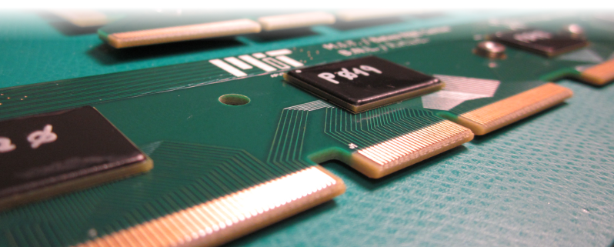
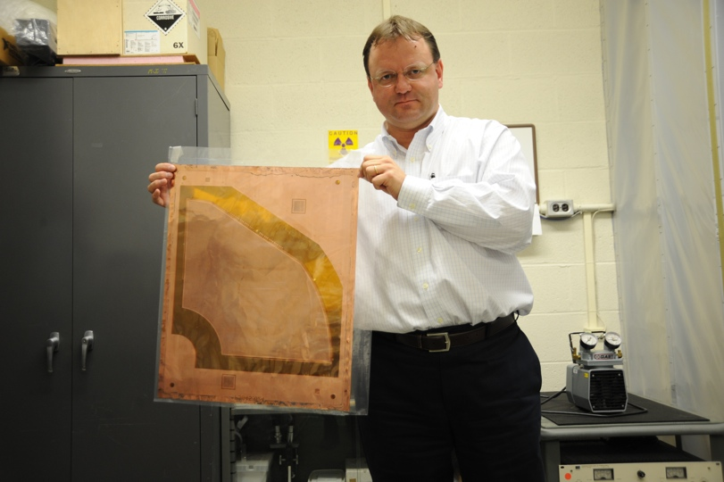
Look inside FGT quadrant
FGT quarter section - layout
Readout module
APV chip
Pressure volume
HV board
2D readout board
Interconnect board
Pressure volume
HV layer

Slide 15
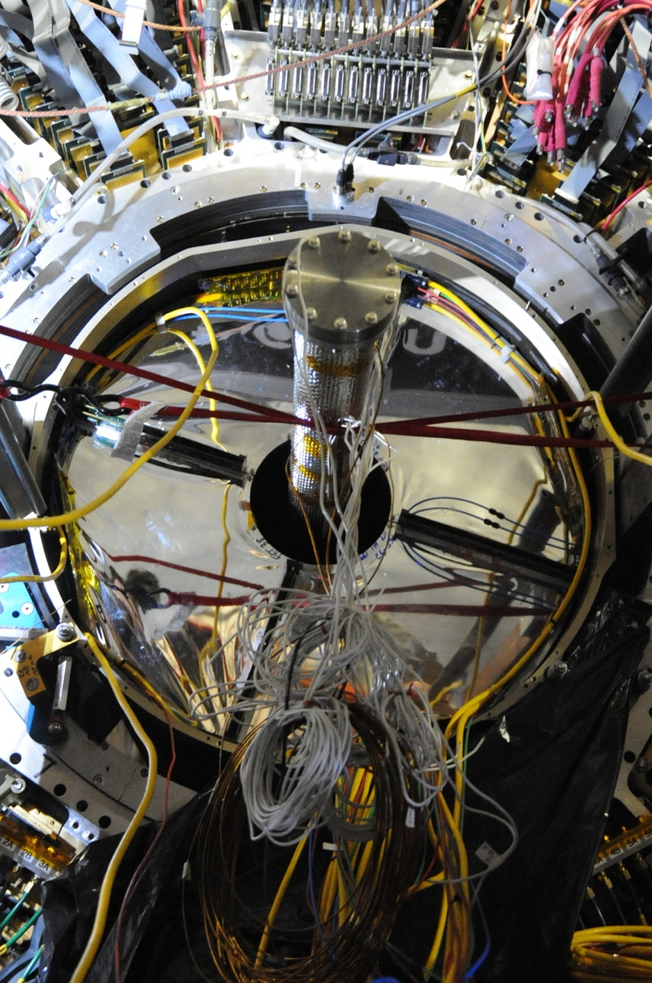
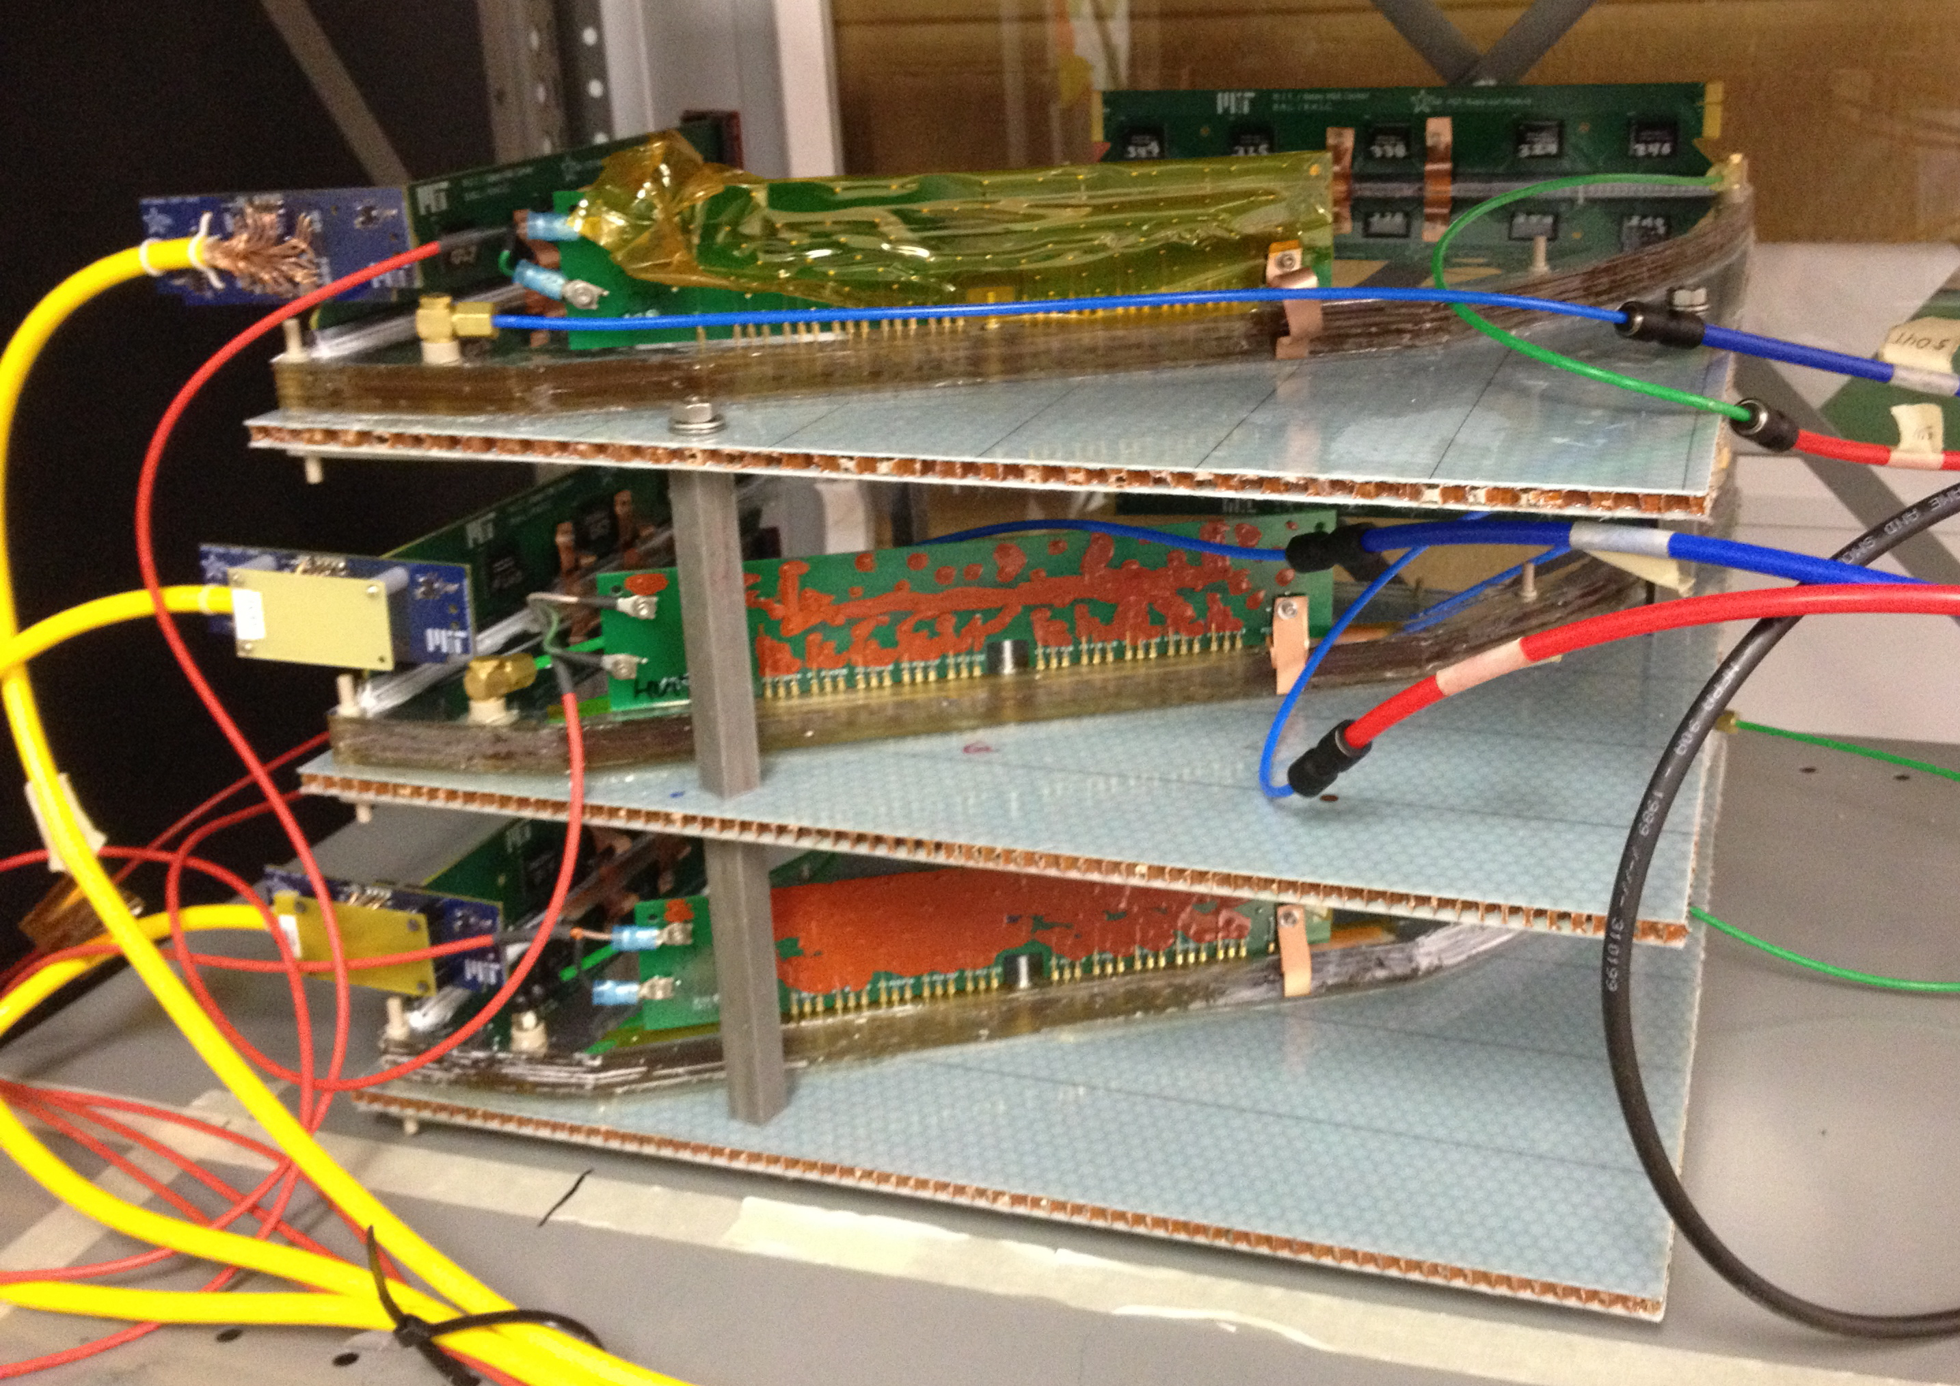
FGT installation and calibration
FGT has been fully installed in STAR for RHIC run13.
Tune HV and APV parameters with three layers of FGT quadrants in cosmic ray test.
Trigger scintillating counters not shown in this picture located above and below the FGT cosmic ray setup.

Slide 16
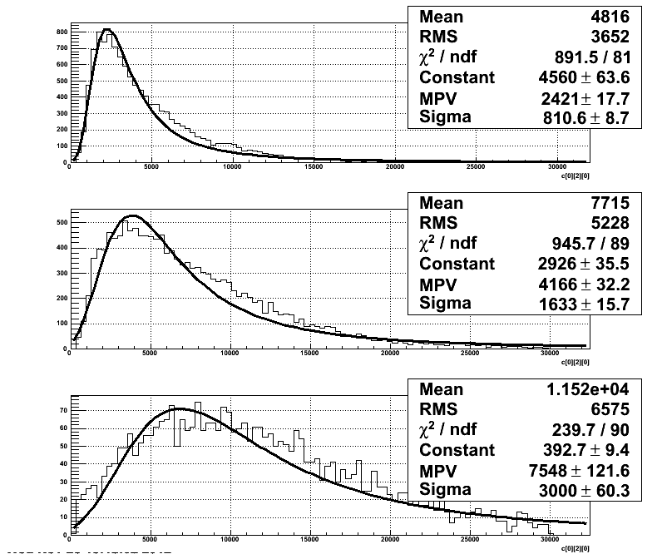
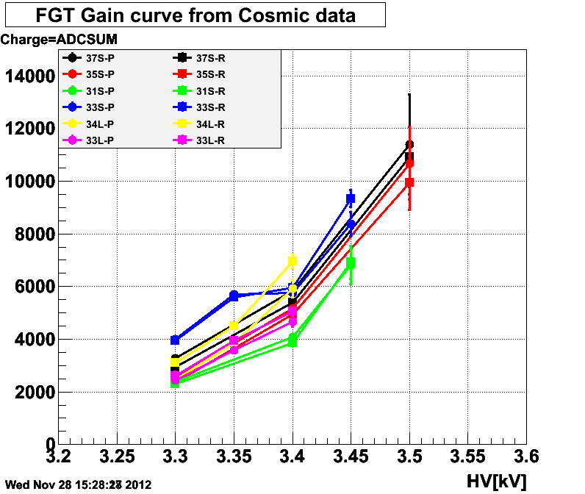
FGT cosmic ray – Gain curve
Gain VS HV
3.3kV
3.4kV
3.5kV
Cluster threshold = 4*PedRMS(~40)*3timebin ~ 500
ADC saturate at peak time-bin of peak strip for
~10% of pulses at 3.4kV
~50% of pulses at 3.5kV (but no visible effect on residual yet)

Slide 17
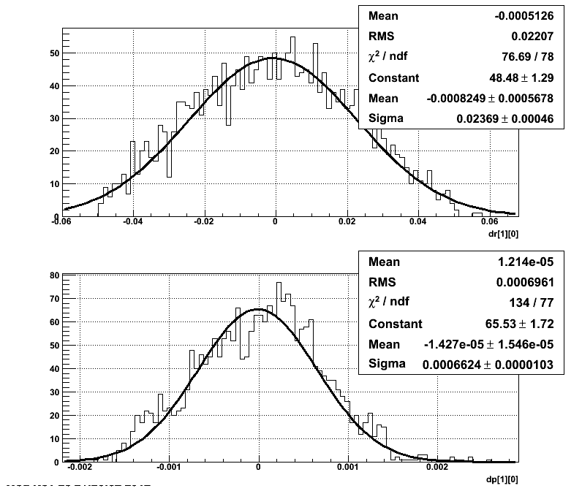
FGT cosmic ray - residual
Use the top and bottom quadrants to determine the projected value for the middle quadrant.
R
Sigma = 240um
ϕ
Sigma = 0.6mrad
=> 180um @ R=30cm
Assuming all quadrants have same resolution:
Single detector position resolution = Residual at middle quad/1.22 (from simple geometry)
180um residual @ Middle => 150um resolution at each detector

Slide 18
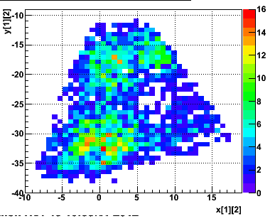
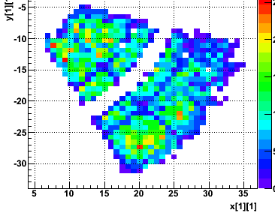
FGT cosmic ray - efficiency
“Good event”: with clean one cluster in R&ϕ of two quadrants and calculate efficiency for third quadrant within good trigger area.
Sensitive to noise at higher HV & low Threshold.
Top-Short “Golden event” Hit Map
Reading the short octant
 | Top | Middle | Bottom
3.3kV | 73% | 83% | 81% → higher thr 76%
3.4kV | 83% | 88% | 78% → higher thr 86%
3.5kV | 87% | 95% | 61% → higher thr 86%
Efficiency calculated in this area only
Default Thr= 4*PedRMS(~40)*3timebin ~ 500
Higher Thr = 7 * PedRMS(~40)*3timebin ~ 850
Middle-Long “Golden event” Hit Map
 | Top | Middle | Bottom
3.4kV | 72% | 60% | 70%
Efficiency calculated in whole octant
Use the cosmic ray results to decide which quadrant for final installation.
Dead HV sector 4

Slide 19
FGT related measurements
The FGT will enhance the tracking capability of STAR in pseudorapidity range 1<η<2.
The primary FGT design is for W measurements in p+p collisions. But, together with other STAR detectors the following measurements may be possible.
  J/ψ e⁺e⁻, heavy flavor via electron decay channel.
  Charged hadron, i.g. π⁺π⁻.
  Drell-Yan?
  Jets?
Do we need larger GEM detectors?

Slide 20
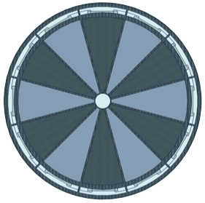
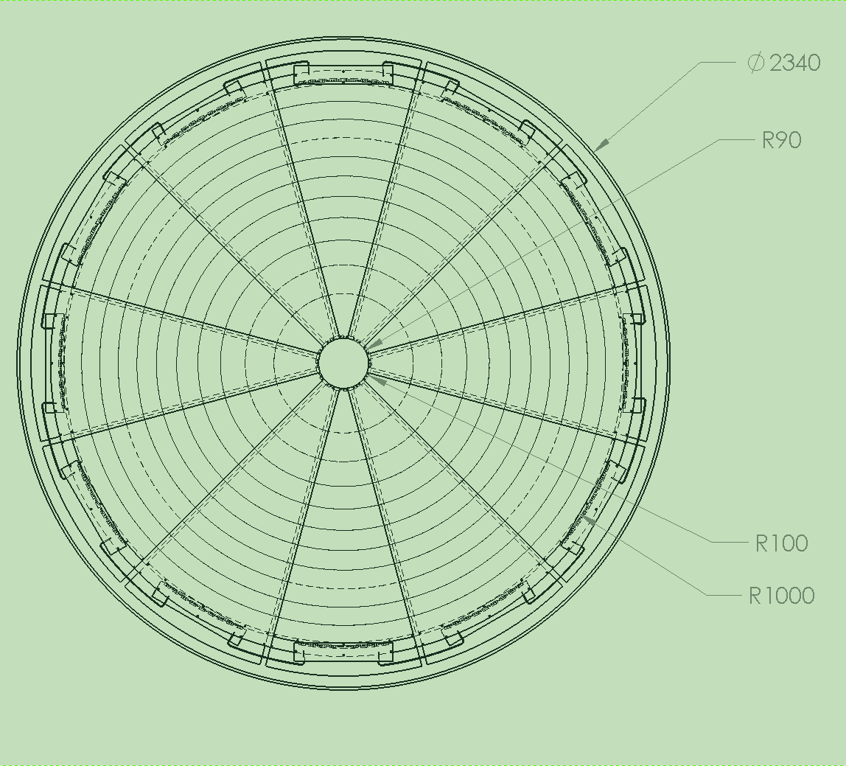
Forward Large Triple-GEM design at Temple University (I)
Supported by EIC R&D program.
The active area of Large Triple-GEM detectors is 10cm<R<100cm.
Each detector covers 30° azimuthal angle and use separate 2D readout.
12 GEM detectors are mounted on light-weight support structure
Schematics of the large GEM detector
GEM segmented side of the large GEM detector

Slide 21
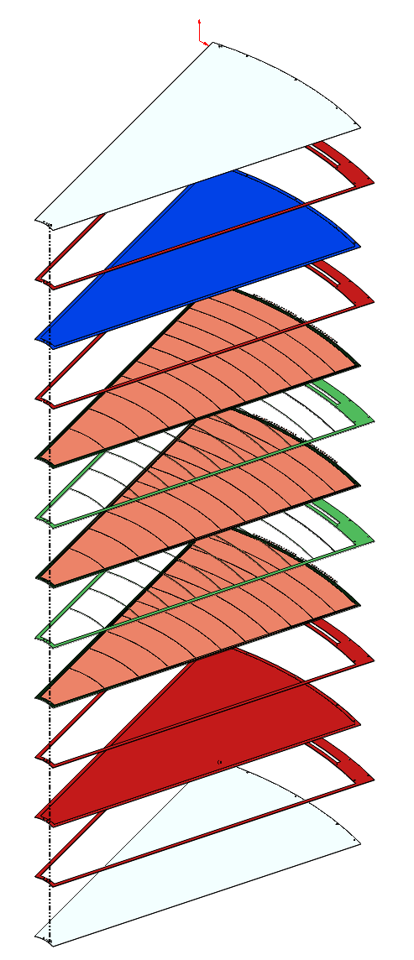
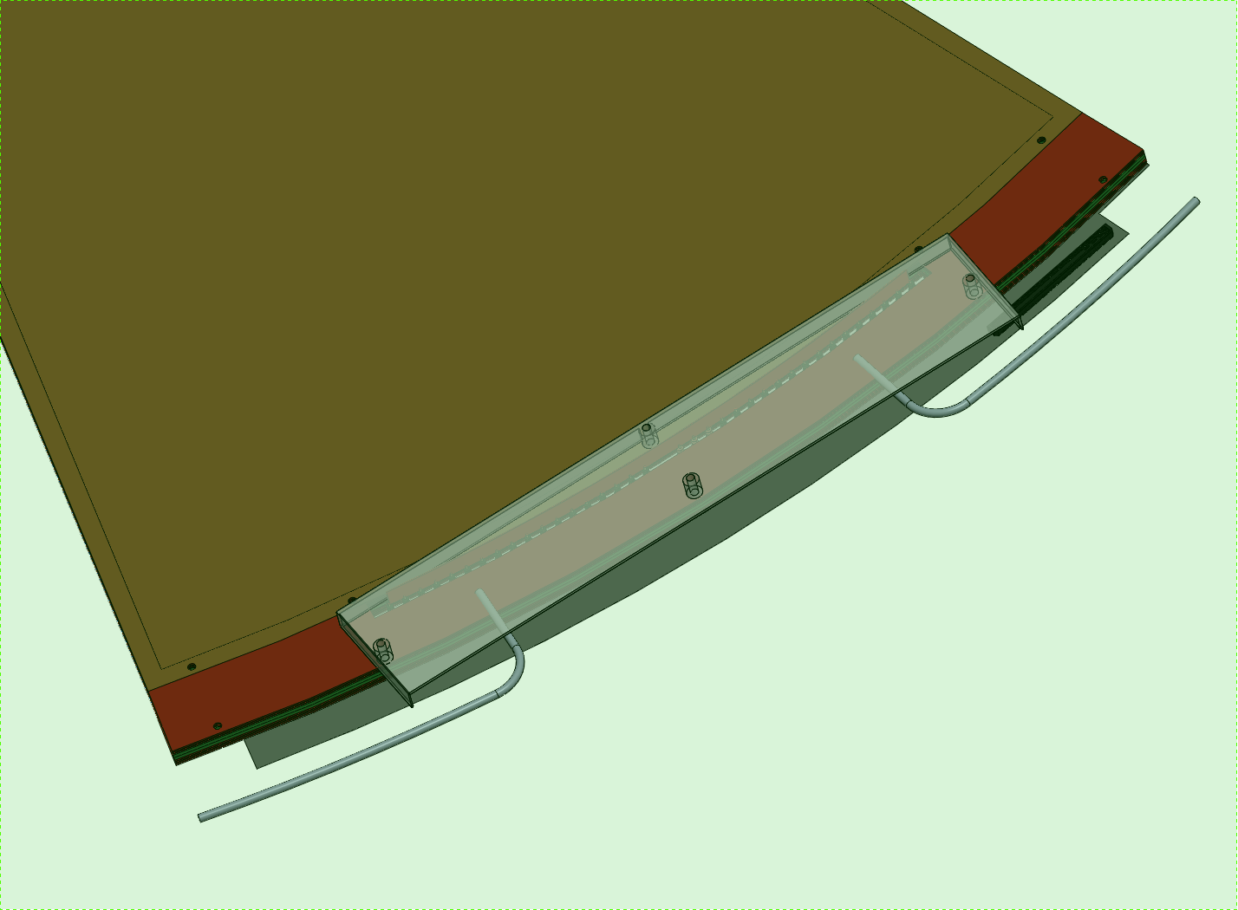
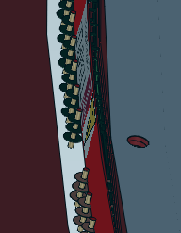
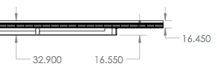
Forward Large Triple-GEM design at Temple University (II)
Mylar foils plus spacer
Cathode (HV)
3 mm spacer (Drift volume)
3 x GEM foils + 2mm spacer grid
2mm spacer (Induction gap)
Readout electrode
spacer + Mylar foil
Large Triple GEM layout
Gas, HV, and readout connections
16.45 mm thick
+ service box
Exploded view of the GEM detector
Lightweight (<1% X0 in active area)

Slide 22
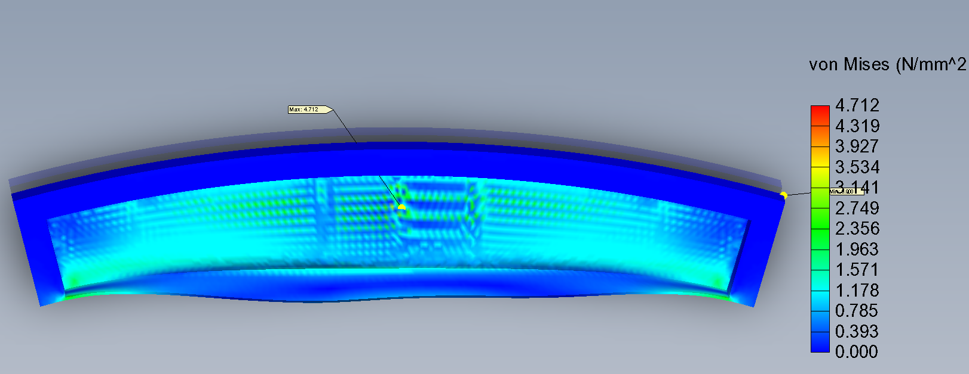
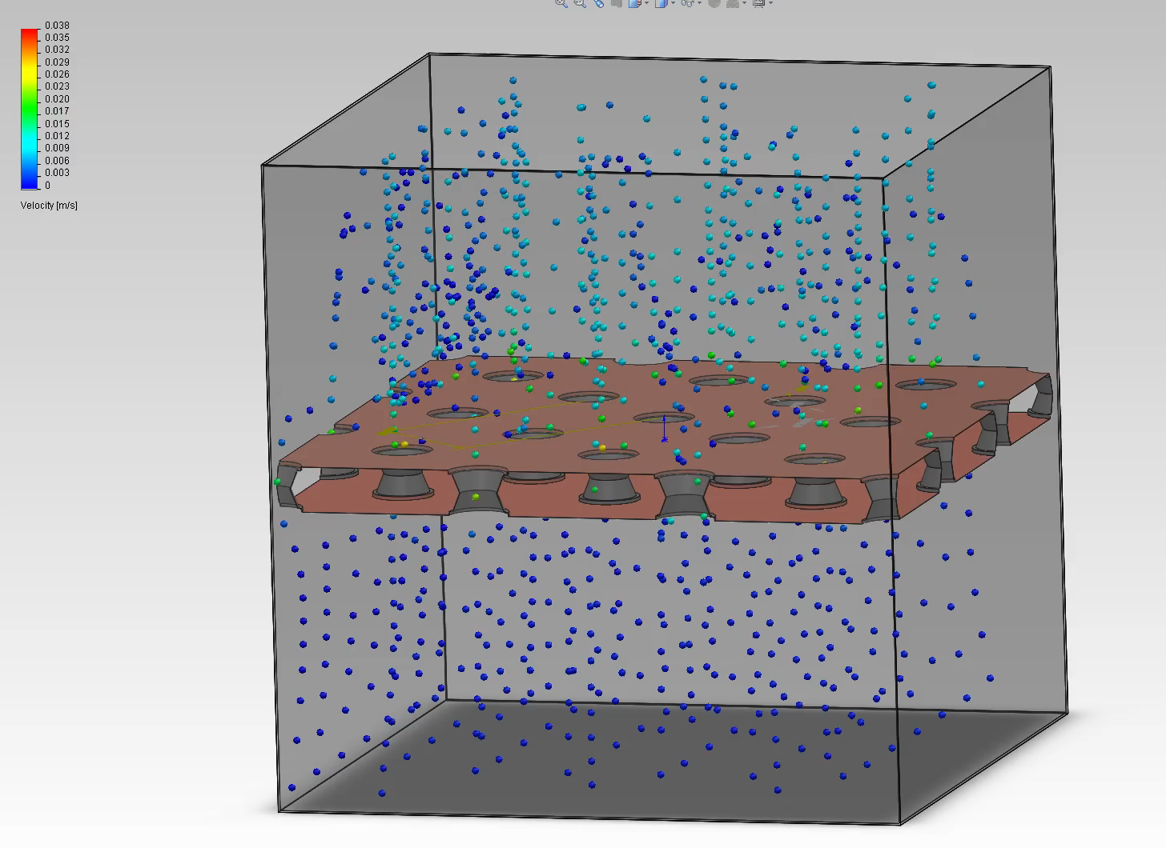
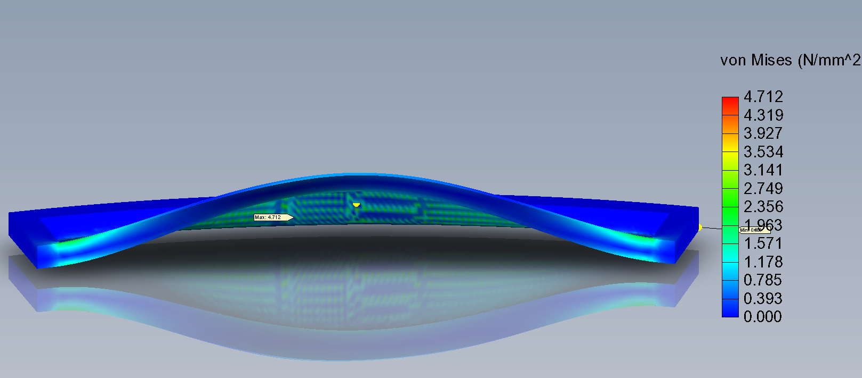
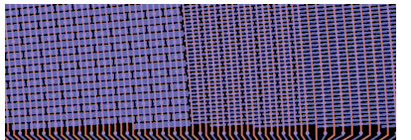
Forward Large Triple-GEM design at Temple University (III)
Study the mechanical deformation.
Study the gas diffusion inside the detector.
Low E field
High E field
Cathode
Triple GEM
amplification
with diff HV conf.
GEM
GEM
GEM
Optimization of the signal size vs. electrode pitch
Readout PCB

Slide 23
Can GEM detectors be used for p+A collisions?
Question 1: Which measurements? For example, J/ψ production or di-hadron correlations to study gluon saturation in p+A.
Question 2: Will the higher multiplicity in p+A collisions (compare to p+p collisions) impact the resolution of GEM detectors?
Question 3: What kind of design of the GEM 2D readout board for p+A collisions? Strip only, strips plus pads, pad only or others?
All these questions should be answered by simulations first to study the feasibility.

Slide 24
Summary
The STAR FGT has been fully installed for RHIC Run 13. Cosmic ray results provide the first stage calibration for the FGT.
Large Triple GEM detector R&D at Temple University is ongoing.
The application of GEM detector in p+A collisions need simulation studies.
Suggestions or comments on how to use GEM detectors in p+A collisions are very welcome!

Slide 25
Thanks for your attention!
Thanks for the hard work of the STAR FGT group and Temple large GEM working group.
Special thanks
  Bernd Surrow, Maxence Vandenbroucke from Temple University,
  Akio Ogawa, Ramiro Debbe from BNL.
  Jason Bessuille, Ross Corliss, Gerrit van Nieuwenhuizen and Ben Buck from MIT.

Slide 26
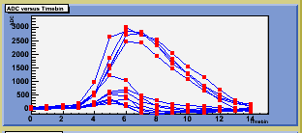
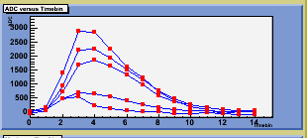
Backup
The FGT has 15 time bins.
One time-bin = 107nsec/4 = 27nsec
All strips with ADC sum 3 sigma above ped in a quadrant from 1 event are shown / panel
Timing moves 4 time-bin event by event due to cosmic system trigger only at RHIC clock

