Slide 1


Prompt Photon A_{N} with the PHENIX MPC-EX Detector
J. Lajoie
Iowa State University
for the PHENIX MPC-EX group

Slide 2
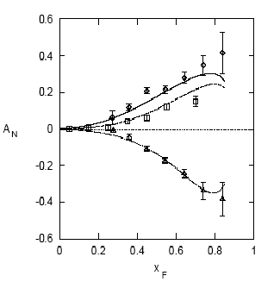
Single Transverse Spin Asymmetries
A_{N} difference in cross-section between particles produced to the left and right
Left
Right
E704: Left-right
asymmetries
A_{N} for pions:
π⁺
Theory Expectation:
Small asymmetries at high energies
(Kane, Pumplin, Repko, PRL 41, 1689–1692 (1978) )
π⁰
A_{N}
A_{N} O(10⁻⁴) Theory
π⁻
Experiment:
(E704, Fermi National Laboratory, 1991)
A_{N} O(10⁻¹) Measured
x_{F}

Slide 3
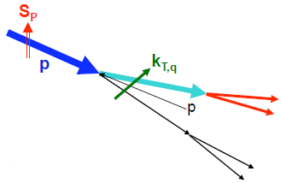
Sources of Transverse SSA’s
  “Sivers effect”
  TMD: Correlation between nucleon spin and parton k_{T}.
  Twist-3: Quark-gluon correlations in polarized hadron
  “Collins effect”
  TMD: Transversity distributions + Spin dependent fragmentation functions
  Twist-3: Transversity combined with twist-3
  quark-gluon fragmentation function
Phys. Rev. D 41, 83 (1990) Phys. Rev. D 43, 261, (1991)
Sivers distribution
Phys. Rev. D 59, 014004 (1998)
Nucl. Phys. B 396, 161 (1993)
Transversity
Collins FF

Slide 4
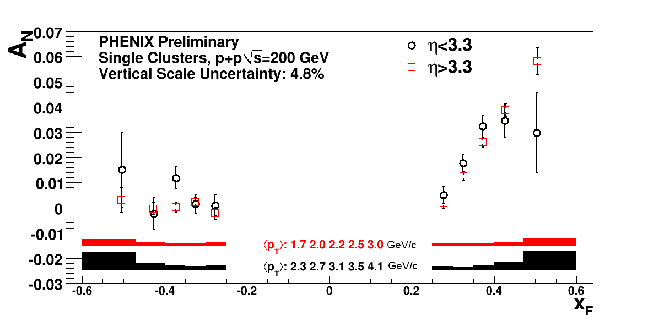
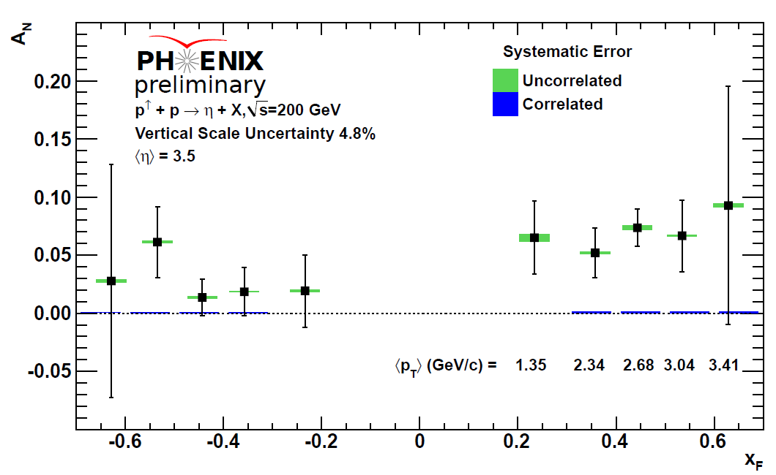
Single Spin Asymmetries in PHENIX MPC
Neutral Clusters
Identified η mesons
Current measurements cannot address the source of these asymmetries
  Need more targeted measurements

Slide 5
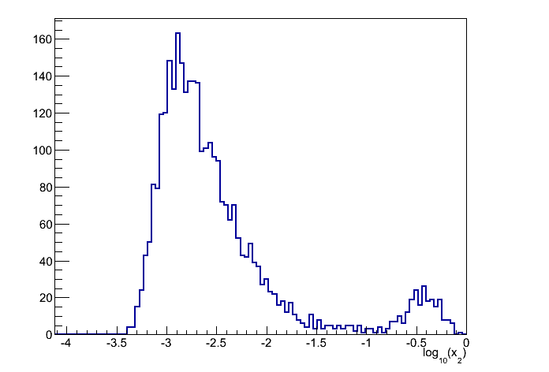
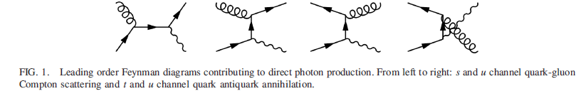
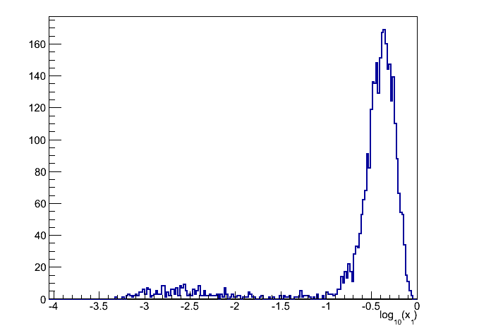
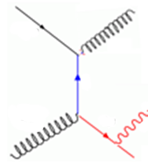
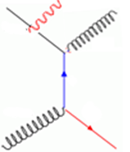
Prompt Photons at Forward Rapidity
Direct Photons
Dominated by gluon Compton at forward rapidites
Same level of production in pythia and NLO calculations (within factor of ~2)
x₂
3.1<η<3.8
log(x₂)
Fragmentation Photons
Comparable between pythia and NLO calculations
QED Radiation (initial state)
Production over-estimated in
Pythia (Included in direct in NLO )
x₁
3.1<η<3.8
(+ other diagrams)
(+ other diagrams)
log(x₁)
p↑+p : high-x quarks
p+A : low-x gluons

Slide 6
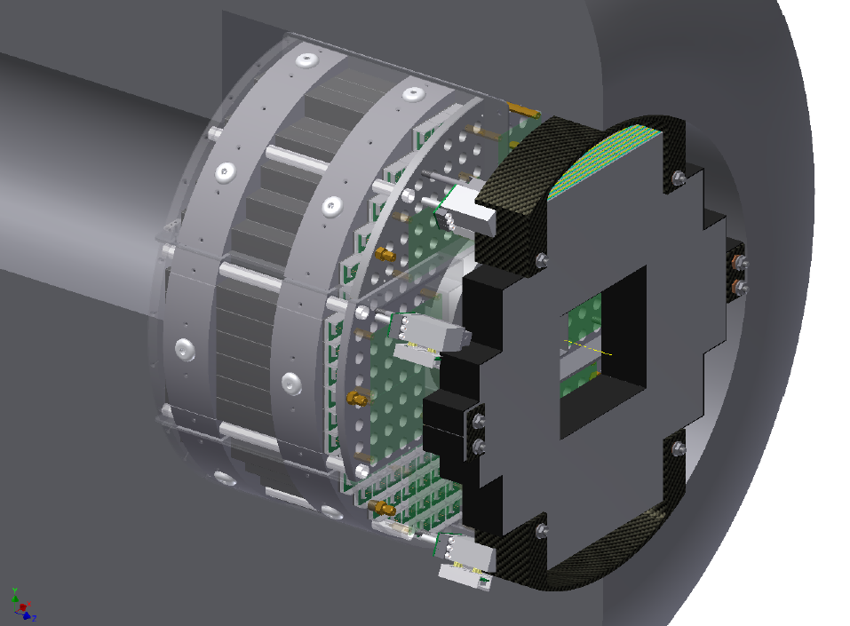
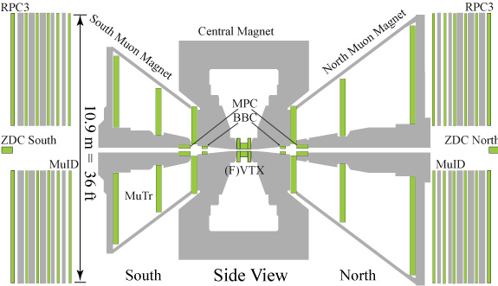
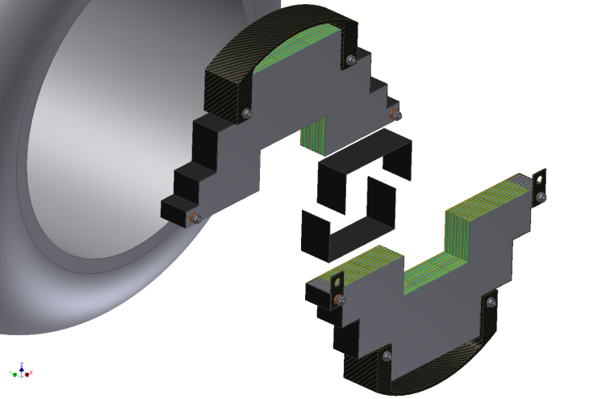
The MPC-EX Detector
A combined charged particle tracker and EM preshower detector – dual gain readout allows sensitivity to MIPs and full energy EM showers.
π⁰ rejection (direct photons)
π⁰ reconstruction out to >80GeV
Charged track identification
3.1<η<3.8
Approved by BNL and DOE - will be ready for Run-15 (earliest p+Au run)

Slide 7
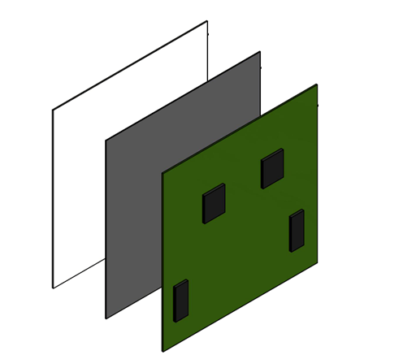
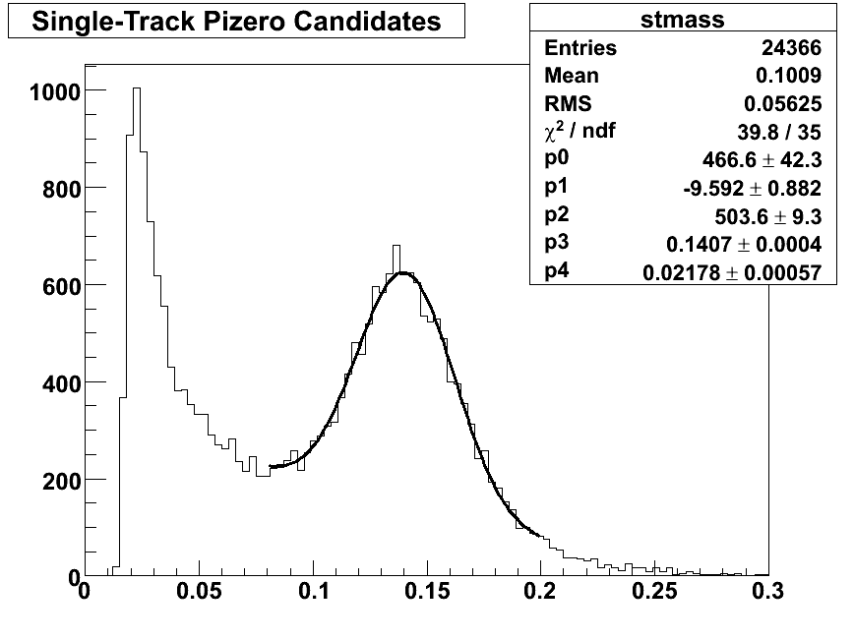
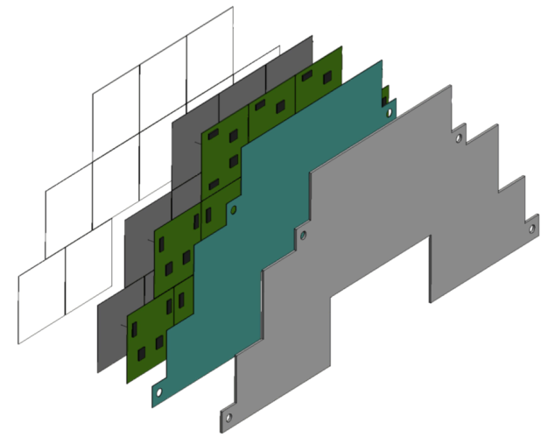
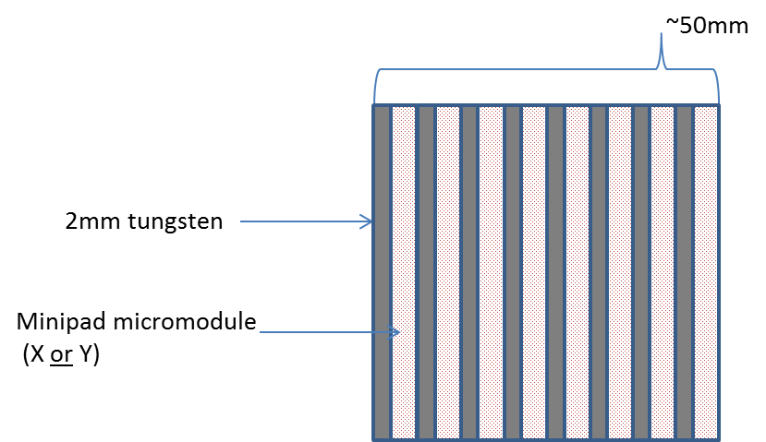
Minipad Sensors
1.8mm x 15mm “minipad” sensor
Detector elements are Si “minipad” detectors, one layer per tungsten gap, oriented in X and Y (alternating layers).
π⁰ mesons reconstructed
in p+p jet events (E>20GeV)
Dual SVX-4 Readout Card
Cross-Section View:
mass (GeV/c²)

Slide 8
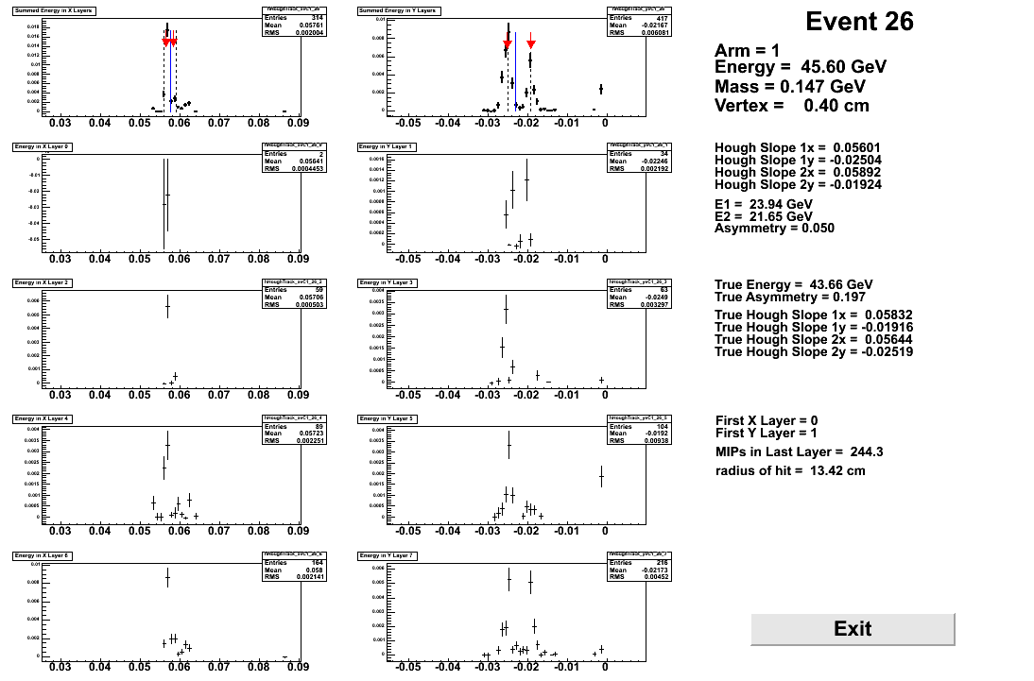
MPC-EX Event Reconstruction
Layer
Sum
X
Y
Layer 1
Layer 2
Layer 3
Layer 4

Slide 9
The MPC-EX Physics Program
The Gluon Distribution in Cold Nuclear Matter
at Low-x:
  Single π⁰ production
  π⁰ pairs
  Prompt Photons
Source of A_{N} in p↑+p Collisions:
  Prompt Photon A_{N}
  π⁰ correlations with jet-like clusters
    “pioneering” measurement
  Jet A_{N}
Extended kinematic range for existing measurements
(p_{T}>1 GeV/c, E>20GeV)

Slide 10
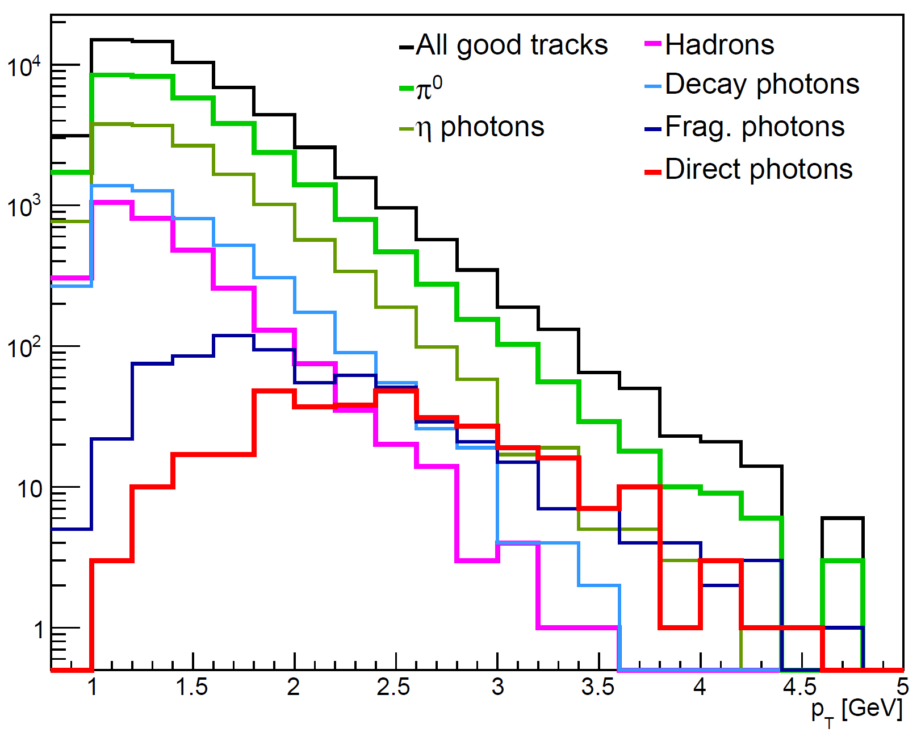
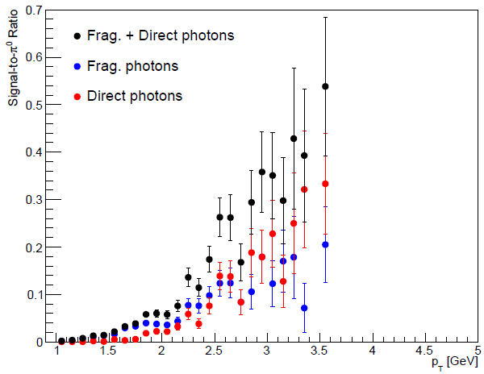
Prompt Photon Simulations (π⁰ cuts)
868M pythia MB+direct photon events (200GeV)
Signal to π⁰ ratio
simulation yield
p_{T} (GeV)
For p_{T}>3 GeV:
2.9% efficiency for π⁰
31.2% efficiency for direct photons
dir/(frag+dir): 57.4%
Basic cuts designed to remove π⁰, charged hadrons and other backgrounds.

Slide 11
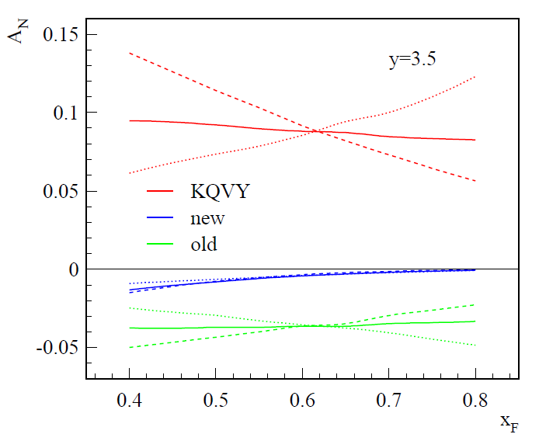
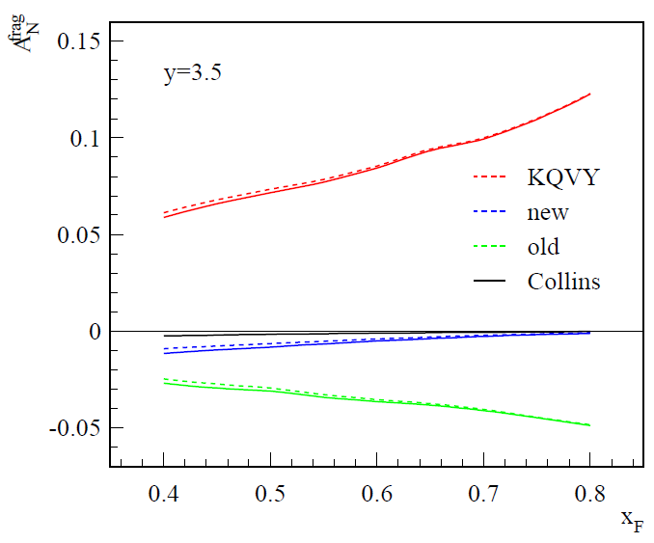
Direct and Frag. Photon A_{N} (x_{F}>0)
Gamberg and Kang, arXiv 1208.1962v1 (2012)
A_{N}^{Direct} falls with x_{F}, while A_{N}^{Frag} rises with x_{F}.
Direct
Frag.

Slide 12
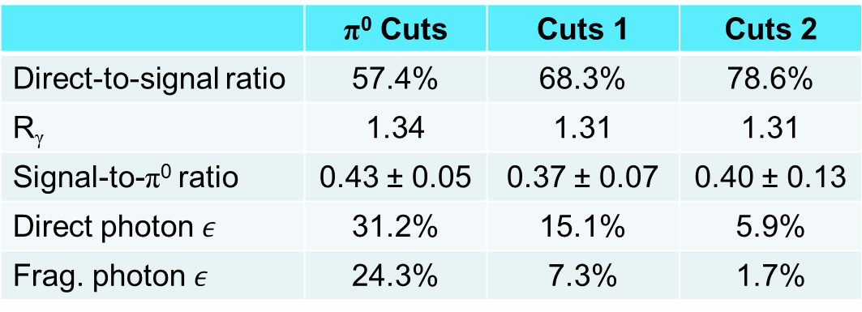
Separating Direct and Frag. Photons
Gamberg and Kang, arXiv 1208.1962v1 (2012)
Direct
Can control the direct/frag ratio with
tightened isolation cuts in the MPC/MPC-EX
Frag.
Tightening cuts
 | π⁰ Cuts | Cuts 1 | Cuts 2
Direct-to-signal ratio | 57.4% | 68.3% | 78.6%
R_{γ} | 1.34 | 1.31 | 1.31
Signal-to-π⁰ ratio | 43 ± 5 % | 37 ± 7 % | 40 ±13 %
 | 31.2% | 15.1% | 5.9%
 | 24.3% | 7.3% | 1.7%

Slide 13
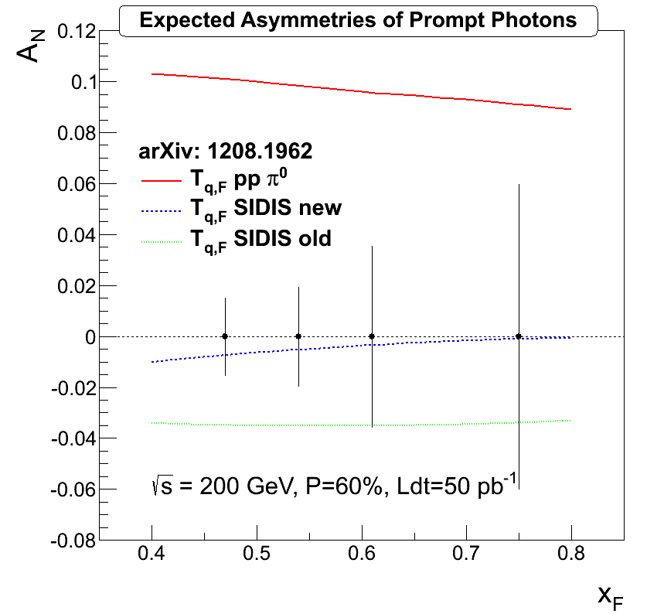
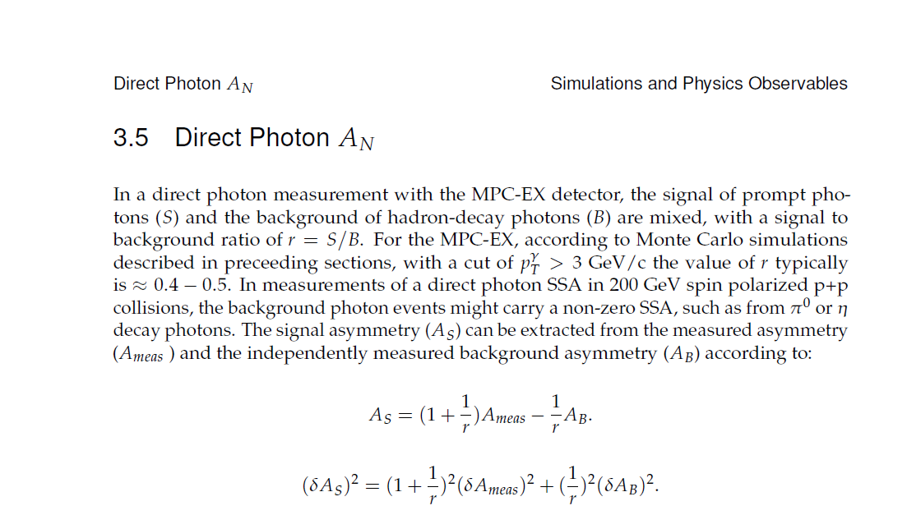
Prompt Photon A_{N} (x_{F}>0)
Kang, Qiu, Vogelsang and Yua, Phys Rev. D 83 094001 (2011)
Gamberg and Kang, arXiv 1208.1962v1 (2012)
r= S/B = 0.34
Prompt Photon A_{N}
  Projected error bars assume statistical errors, subtraction of π⁰ and η photon asymmetry, and 60% polarization
  Test of theoretical frameworks
  Measure of quark Sivers
Prompt photon measurements with MPC-EX will resolve the issue.

Slide 14
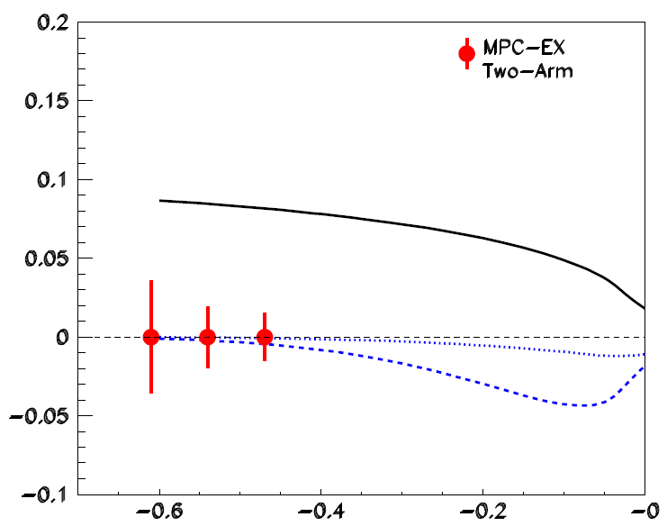
Prompt Photon A_{N} (x_{F}<0)
Koike and Yoshida Phys Rev. D 85 034030 (2012)
x_{F}<0 samples the gluon distribution
in the polarized proton
50pb⁻¹, P=0.6
A_{N}
Two different tri-gluon correlation
functions: O(x) and N(x)
Models:
Parameters constrained by open heavy flavor production at RHIC.
(c)
(b)
(a)
x_{F}
A_{N} for x_{F}<0 carries information about the tri-gluon correlation function.

Slide 15
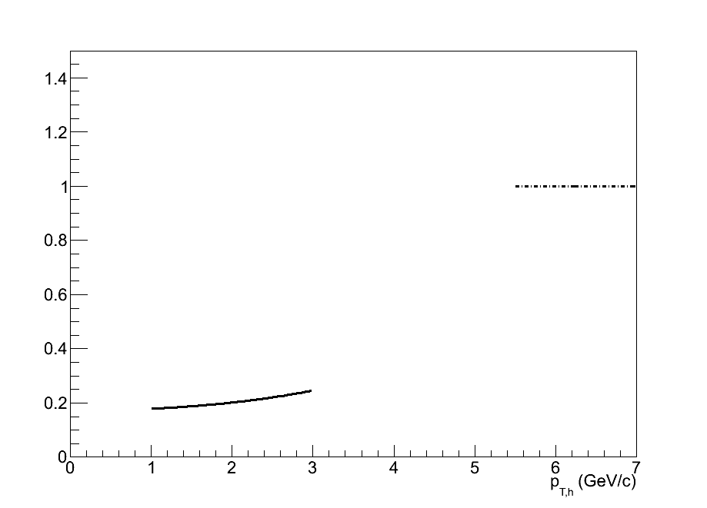
Polarized p+A Collisions
Kang and Yaun, PRD 84, 034019 (2011) (asymmetries modeled as Collins)
Left
Q_{sp}² = (1.0 GeV)²
Q_{sA}² = (2.5 GeV)²
δ = 0.16 GeV
Right
Approximate error in ratio
assuming δA_{N}/A_{N} ~ 0.1
Single spin asymmetries can act as
a probe of the saturation scale.
Dependence of Q_{sA} on A
Combined with other measurements this can estimate Q_{sp}
A unique capability of RHIC!

Slide 16
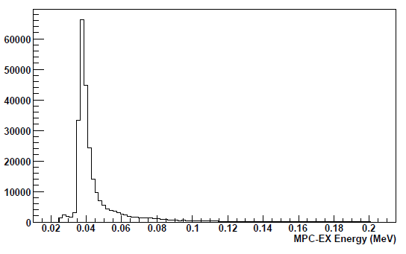
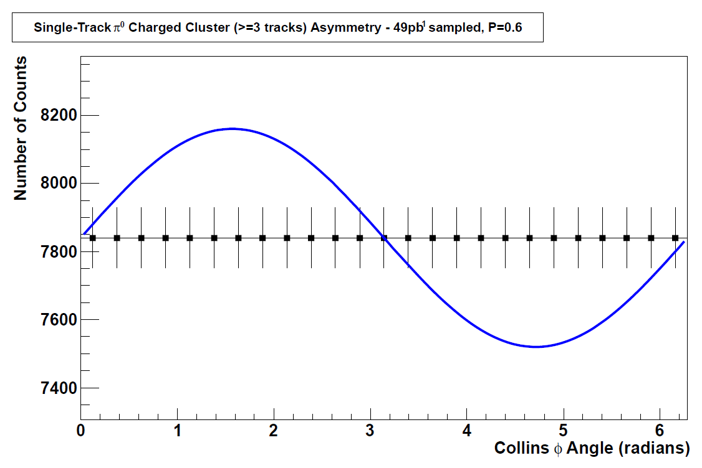
Collins Asymmetry in Jets
charged
cluster axis
MIP ~ 36 MeV
Charged Tracks:
All layers hit
Energy deposit < 70MeV
R=1.0
All tracks given equal weight
Select the cluster with highest number of tracks
φ
50pb⁻¹, P=0.6
cluster axis
spin
π⁰
(E>20GeV)
Charged clusters with >=3 tracks, single-track π⁰’s

Slide 17
Summary
The MPC-EX is a novel detector that offers exciting new physics opportunities:
  Separate the sources of SSA’s measured in 200GeV transversely polarized p+p collisions
    Deepen understanding of hadron structure
    Enable continued progress in the application of fundamental QCD to p+p collisions
  Measurement of the gluon distribution in cold nuclear matter
    Further understanding saturation, shadowing, …
    Set initial conditions for HI collisions at RHIC and LHC
Exciting new physics output from RHIC!

Slide 18

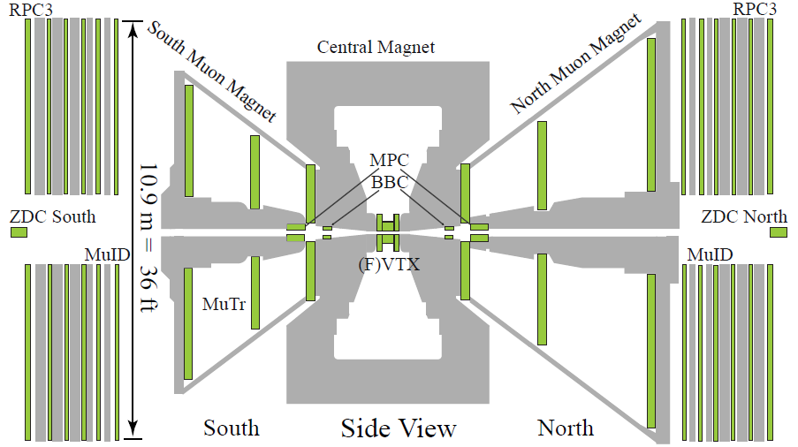
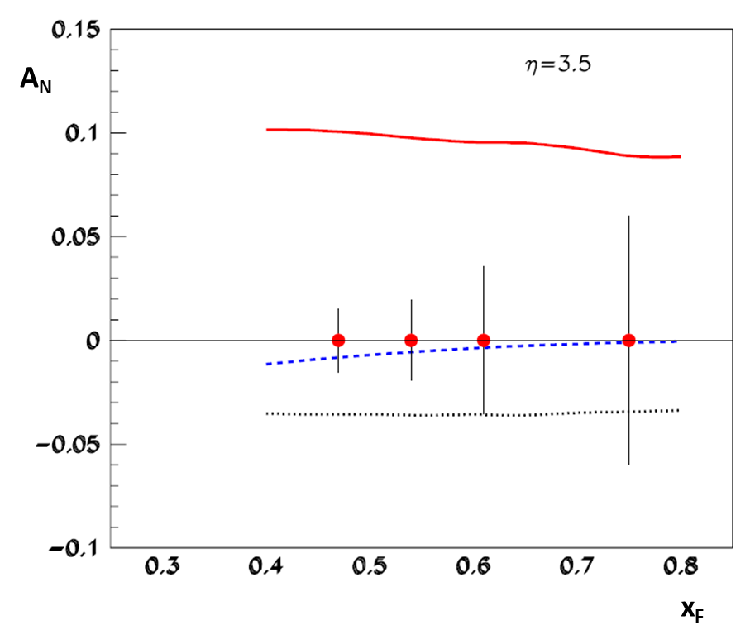
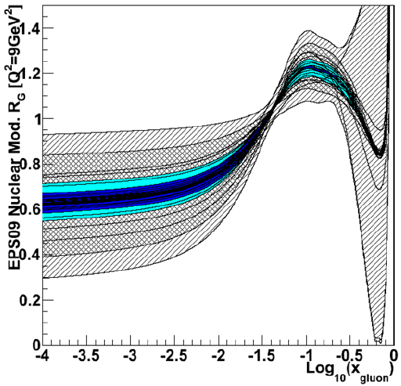
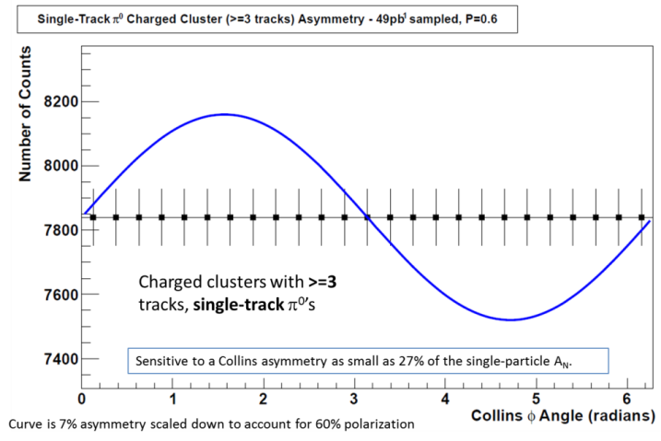
The PHENIX Muon Piston Calorimeter Extension (MPC-EX)
MPC-EX
MPC
Colored band = range with MPC-EX direct photon data
d+Au: Gluons in Nuclei
49pb⁻¹, P=0.6
pol. protons:
Origin of A_{N}
MPC-EX
350nb⁻¹ d+Au
49pb⁻¹ p+p
ESP09 extents

Slide 19
BACKUP

Slide 20
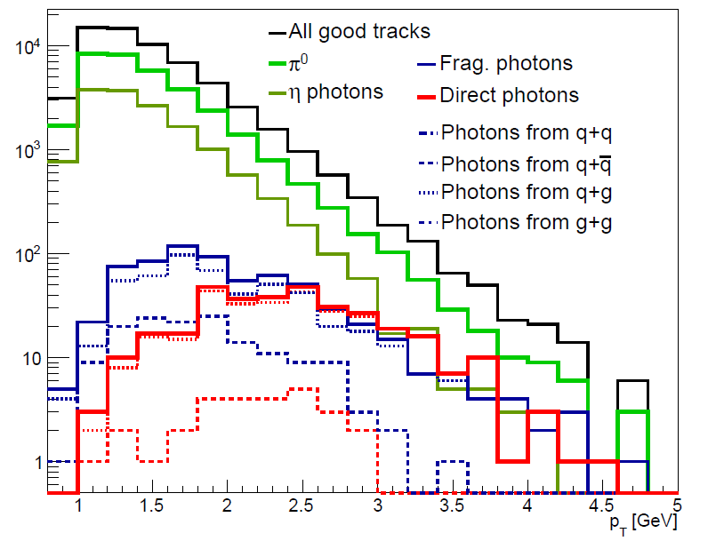
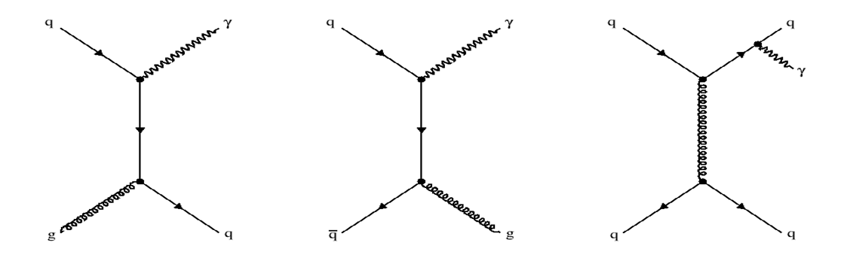

Process Breakdown
Direct photons
Simulated Counts
Frag. photons
Direct photons 100% q+g for p_{T}>3GeV
Fragmentation photons 93% q+g, 7% q+qbar for p_{T}>3GeV

Slide 21
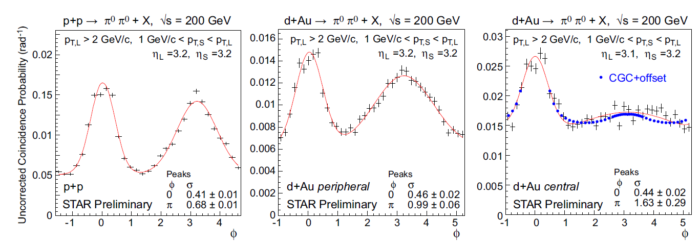
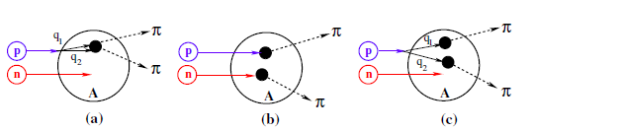
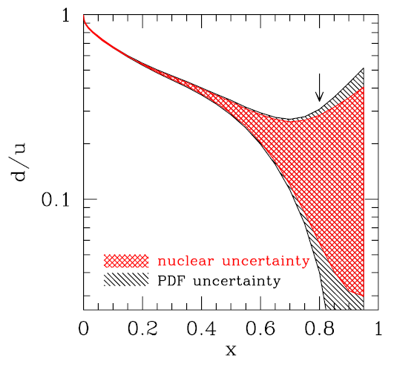
Why p+A instead of d+A?
Multi-parton interactions can contribute to the suppression of the away-side correlation strength.
Phys. Rev. D 84 014008 (2011)
Forward rapidity corresponds to high-x in the projectile nucleon (d or p). Nuclear corrections at high-x are large for the deuteron, which may necessitate d+p running for proper comparison.
…and you can’t polarize the deuteron at RHIC…

Slide 22
SSA’s in polarized p+A Collisions
Kang and Yuan, PRD 84, 034019
A systematic study of SSA’s in spin-polarized p+A collisions would allow us to study the gluon saturation scale.

Slide 23
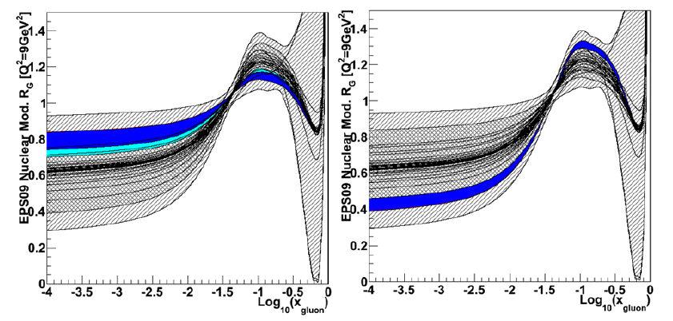
EPS09 Limits from Direct Photons
assuming EPS09 upper curve
assuming EPS09 lower curve
Ultimate sensitivity depends on the measurement and a full NLO fit.

Slide 24
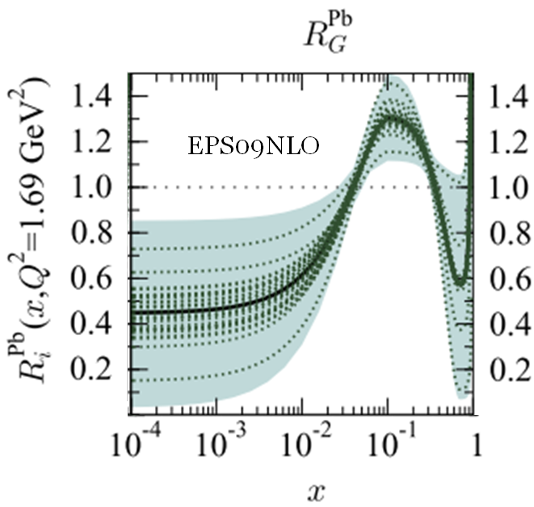
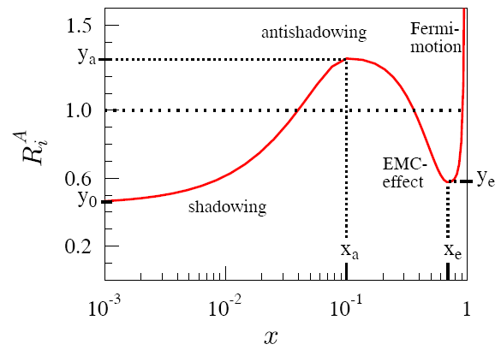
Gluons in Nuclei
shadowing/saturation in nuclei
Fit data on nuclei:
SLAC, NMC, EMC
DIS+DY+PHENIX
midrapidty π⁰
Lack of data
⇨large uncertainly
in gluon pdf
at low-x
gluons
Large uncertainty
At low-x
x
Eskola , Paukkunen, Salgado, JHP04 (2009)065
Large uncertainties in low-x gluons in nuclei!
Important for fundamental understand of partonic processes in nuclei, as well as for the initial conditions at RHIC and the LHC.
Use EPS09 as a baseline for comparison.
The MPC-EX measurement will directly address any model of low-x gluons.

Slide 25
EPS09 Limits from Prompt Photons
  Weight events in x,Q² according to EPS09 to generate R_{dAu} for each curve
  Assume the R_{dAu} value we measure corresponds to the EPS09 baseline
  Vary R^{pp}_{γ}, R^{dAu}_{γ}, γ^{dAu}_{incl} and γ^{pp}_{incl} within 3-sigma systematic errors
  Evaluate EPS09 curves to see which are consistent within 90% C.L.
MPC-EX
350nb⁻¹ d+Au
49pb⁻¹ p+p
90% C.L.
Prompt photons in MPC-EX -> Precise Measurement of Gluons at Low-x

Slide 26
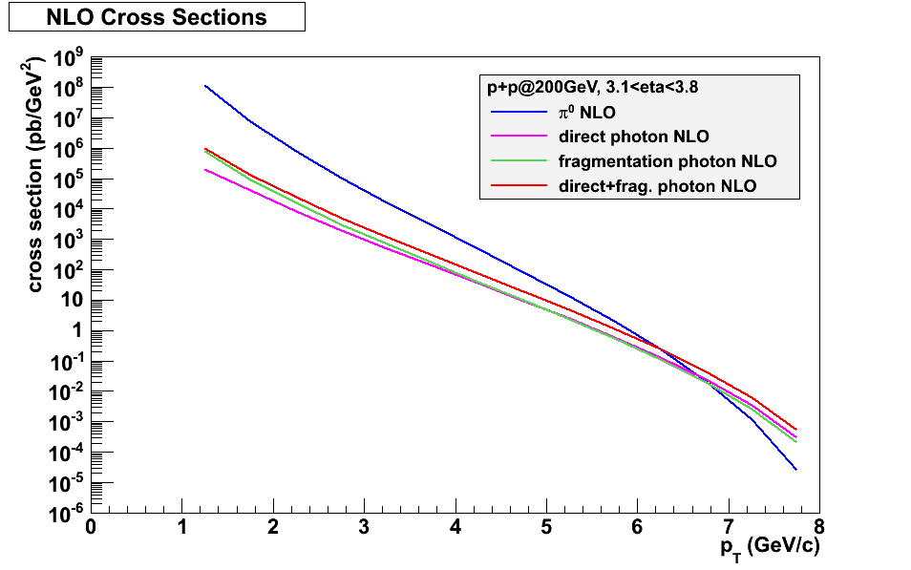
Direct Photon NLO Cross Sections
NLO calculations from Werner Vogelsang

Slide 27
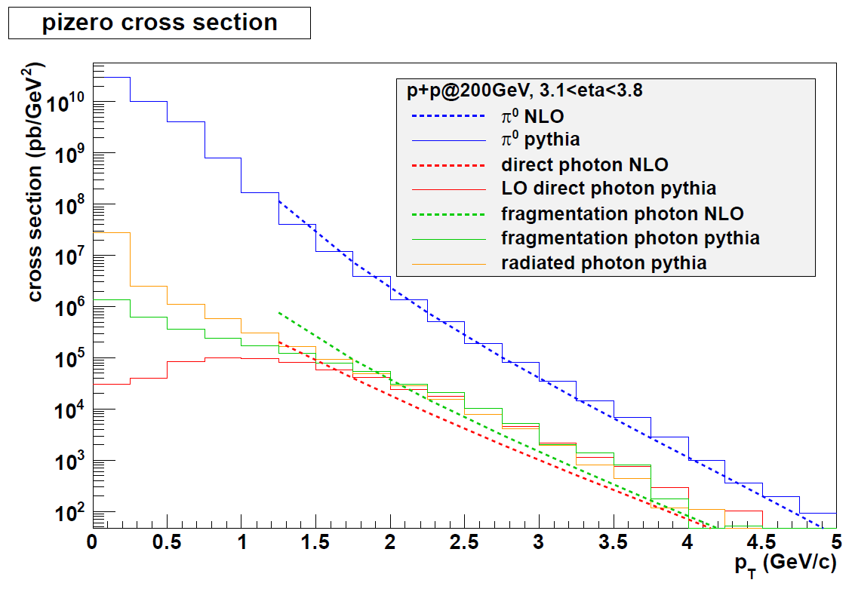
Direct Photons in Pythia

