Slide 1
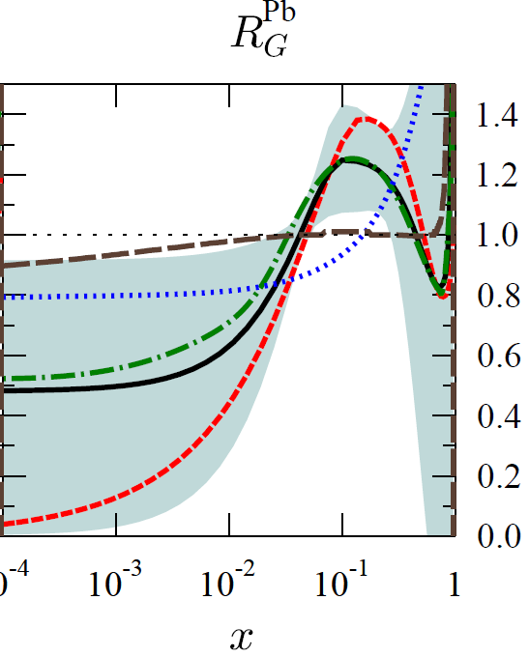
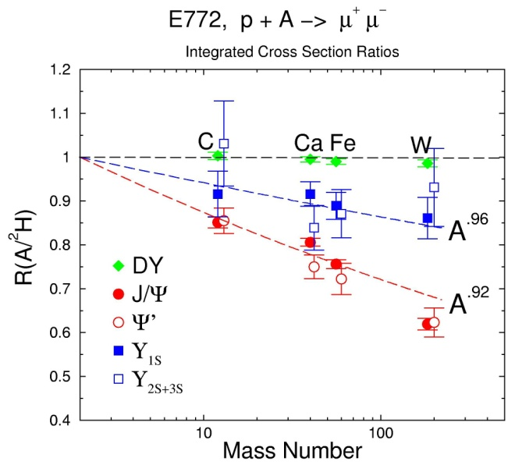
A Summary of Earlier p+A Experiments' Physics & Results
Workshop on the Physics of p+A Collisions at RHIC
BNL, Jan 7-9, 2013
Mike Leitch, LANL Retired Fellow
Cold Nuclear Matter (CNM) physics
Lessons & Clues from the data:
shadowing
initial-state vs final-state
absorption
dE/dx from Drell-Yan
p_{T} broadening
Intrinsic Charm
very small-x shadowing (E665)
FNAL E772/789/866; SPS NA38/50/60; FNAL E665 (DIS); Cronin expt, …
R_{G}^{Pb}
Q² = 1.69 GeV²
nDS
HKN07
EKS98
EPS09
EPS08
x

Slide 2
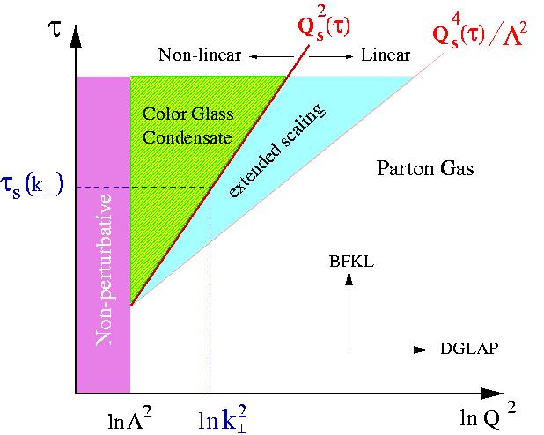
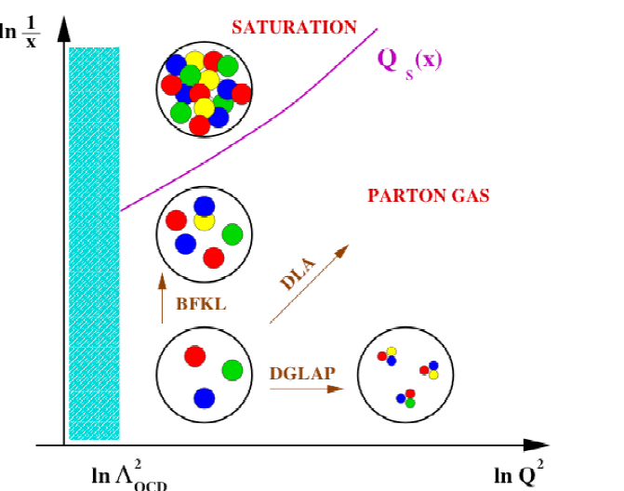
Saturation of Small-x Gluons or Shadowing
Leading twist gluon shadowing, e.g.:
EPS09 - phenomenological fit to DIS & DY data with large uncertainties, Eskola, Paukkunen, Salgado, JHEP 0904:065,2009
Also coherence models & higher-twist (HT) shadowing, e.g. Vitev
Q² = 1.69 GeV²
R_{G}^{Pb}
nDS
HKN07
EKS98
EPS09
EPS08
x
Small-x gluon saturation or Color Glass Condensate (CGC)
At low-x there are so many gluons that 2→ 1 diagrams become important and deplete the low-x region
Nuclear amplification: x_{A}G(x_{A}) = A^{1/3}x_{p}G(x_{p}), i.e. gluon density is ~6x higher in Gold than the nucleon
Iancu and Venugopalan hep-ph/0303204

Slide 3
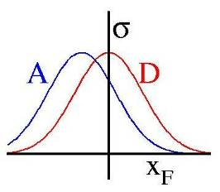
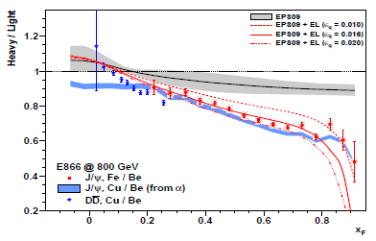
Energy Loss of Partons in Nuclei
Initial-state energy loss
E866/NuSea, 800 GeV, J/Ψ p+W / p+Be ratio
R(W/Be)
EPS09 shadowing
R(A/p)
R=1
With various
amounts of
energy loss
x_{F}
x_{F}
R. Vogt – Jan. 2011

Slide 4
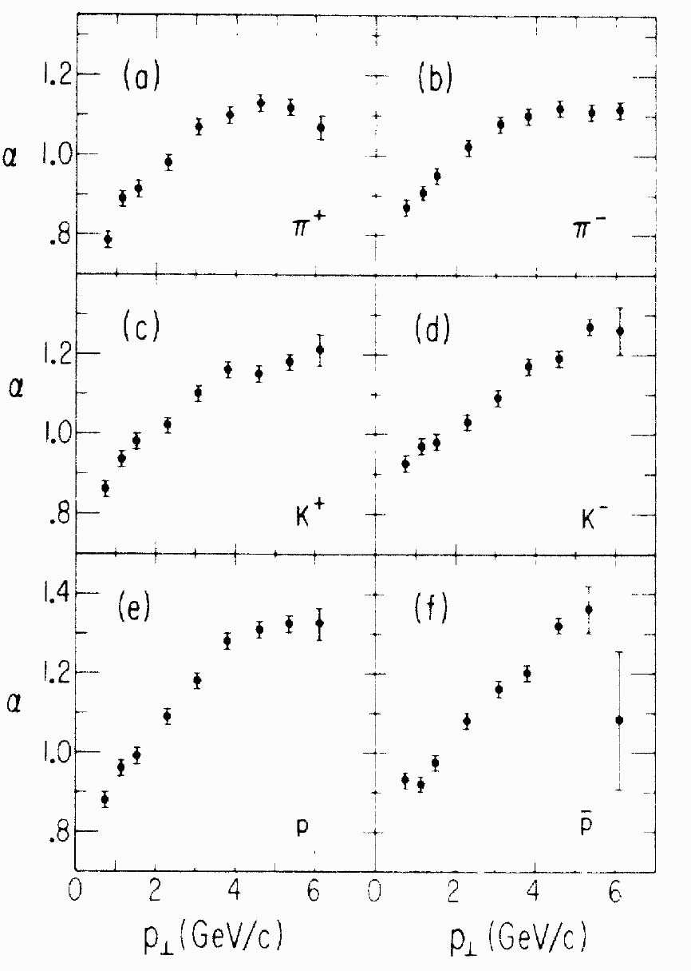
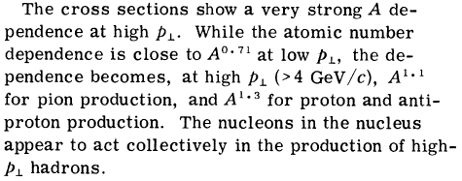
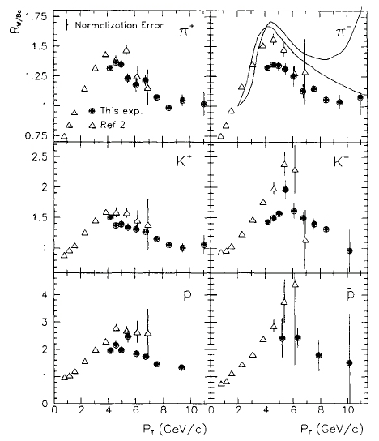
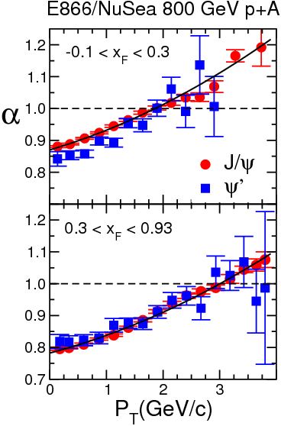
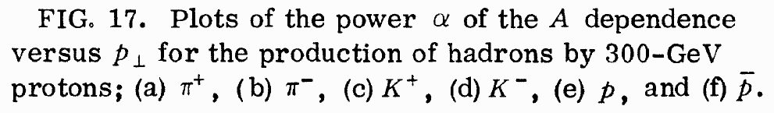
Cronin effect, or p_{T} broadening from soft initial-state pre-hard-interaction scatterings
Cronin et al., PRD 11, 3105(1975)
P.B Straub,PRL 68, 452(1992)
π⁺
π⁻
K⁺
K⁻
27 GeV
p
38 GeV
pbar
PRL 84, 3256 (2000)

Slide 5
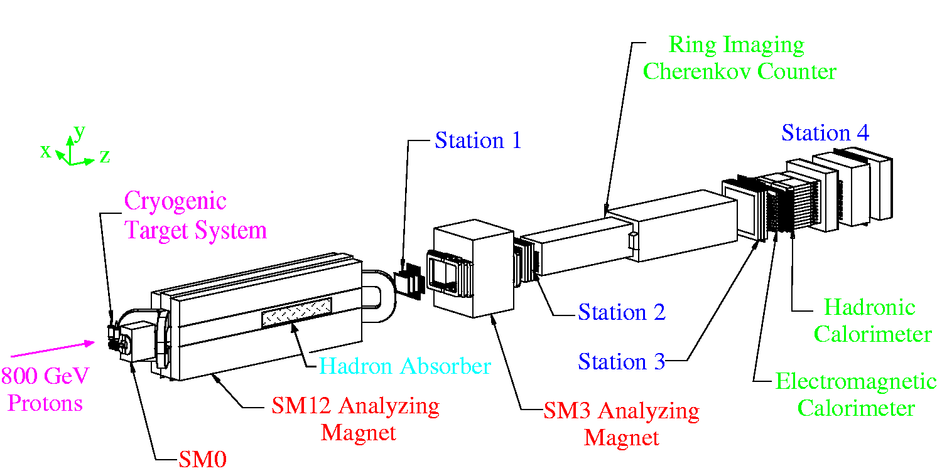
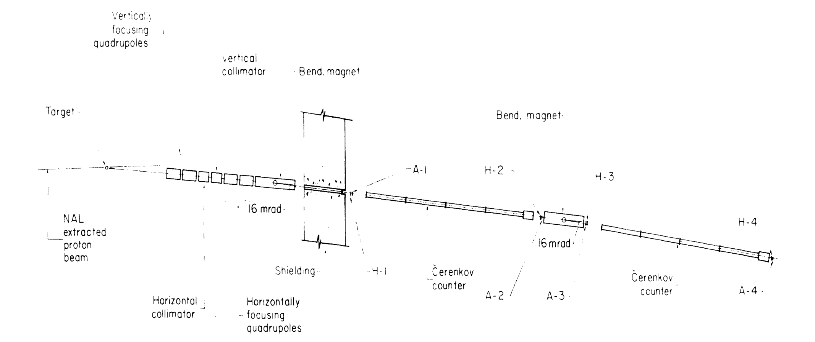
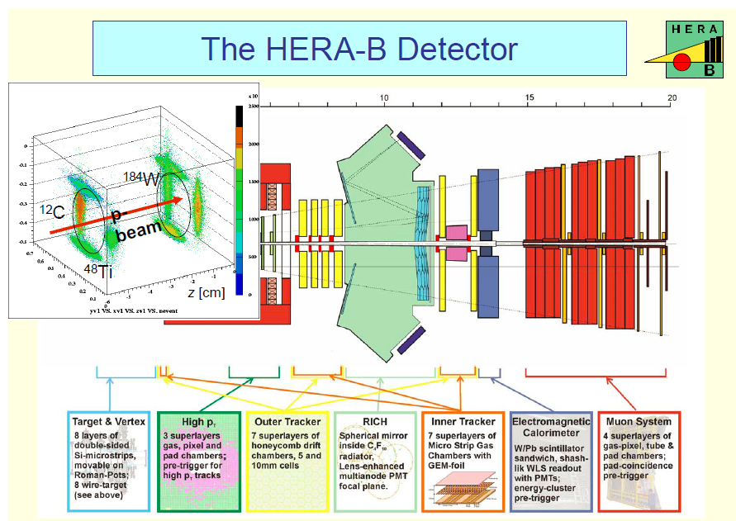
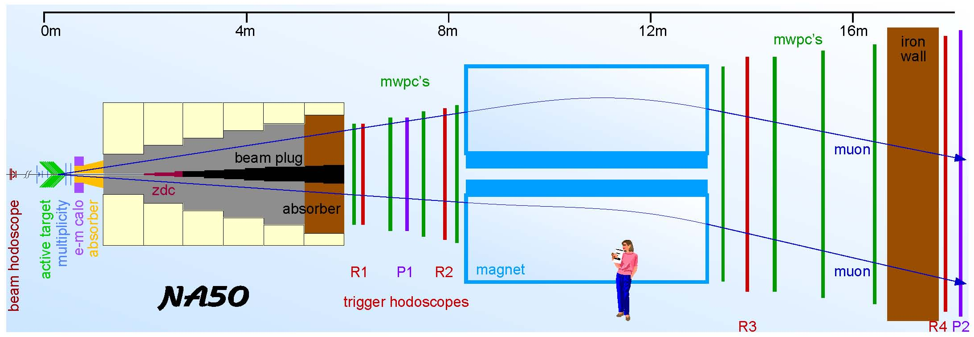
Lessons and Clues from the Data
Cronin expt.
E866/NuSea
NA50
HERA-B

Slide 6
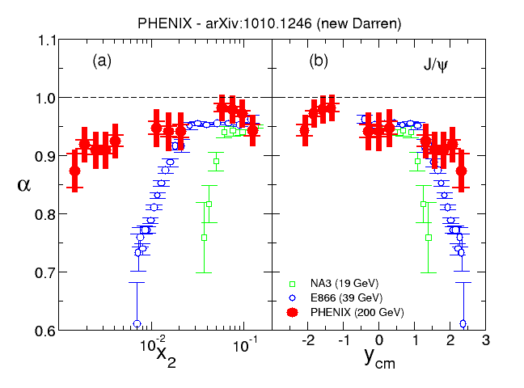

Suppression Not Universal vs x₂ as Expected for Shadowing
R_{G}^{Pb}
Q² = 1.69 GeV²
PHENIX, E866, NA3 J/ψ Comparison
nDS
HKN07
EKS98
EPS09
EPS08
Phys. Rev. Lett. 107, 142301 (2011)
Closer to scaling with x_{F} or rapidity
initial-state gluon energy loss?
200 GeV
Energy loss of incident gluon shifts effective x_{F} and produces nuclear suppression which increases with x_{F}
19 GeV
or gluon saturation?
39 GeV
Gluon saturation from non-linear gluon interactions for the high density at small x; amplified in a nucleus.
= X₁ – X₂
low x
high x
(x₂ is x in the nucleus)

Slide 7
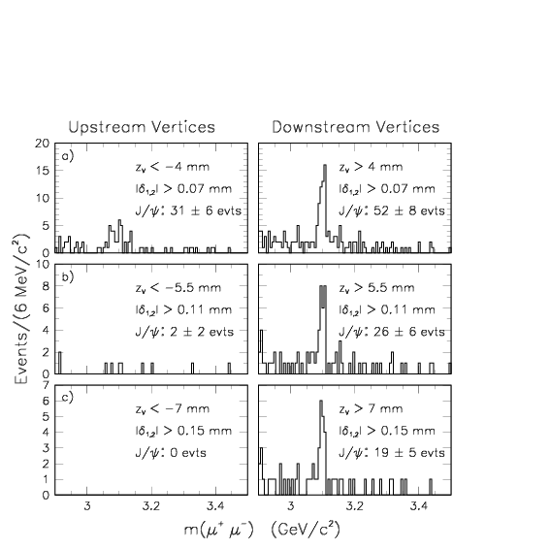
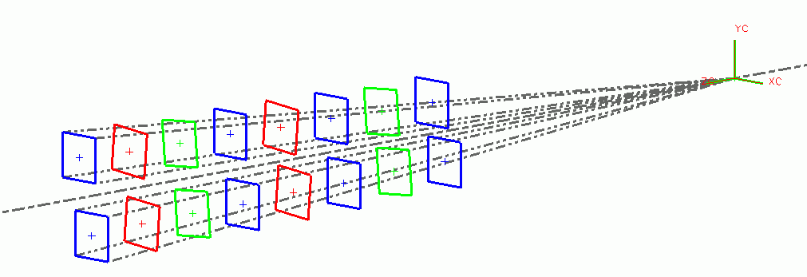
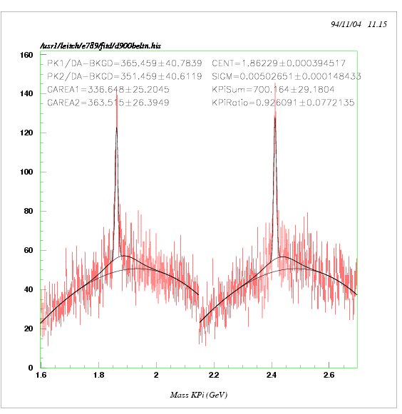
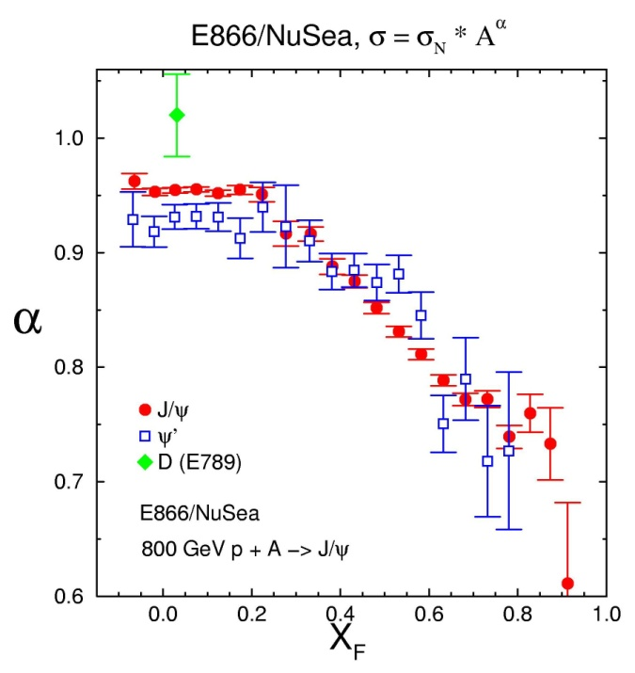
Fermilab E789: D⁰ → Kπ and B → J/ψ X
(charm & beauty using silicon vertex detector)
upstream
downstream
Dimuon spectrometer
+
B -> J/ψ + X
Phys. Rev. Lett. 74, 3118 (1995)
16-plane, 50μm pitch/8.5k strip silicon vertex detector
Phys. Rev. Lett. 72, 2542 (1994)
D⁰ -> Kπ
Compare closed and open charm to isolate initial-state CNM effects
K⁻π⁺
K⁺π⁻
Mass (GeV/c²)

Slide 8
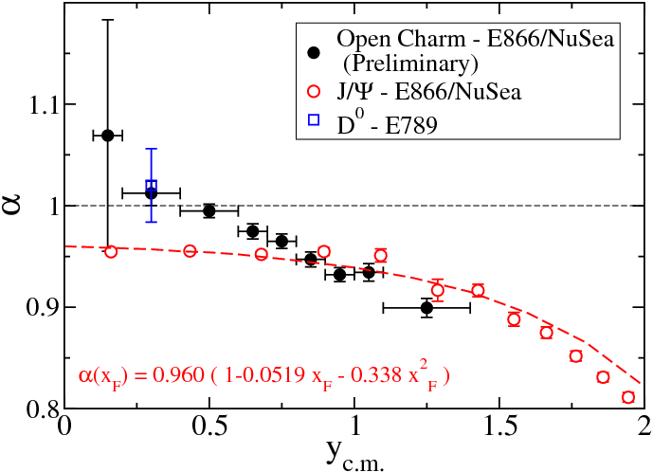
Comparing Open & Closed Charm
Isolating Initial-state Effects
E866/NuSea 800 GeV p+A
Open-charm p+A nuclear dependence (single-μ p_{T} > 1 GeV/c) – very similar to that of J/Ψ:
implies that dominant effects are in the initial state
  e.g. dE/dx, CGC (since shadowing disfavored by lack of x₂ scaling)
weaker open-charm suppression at y=0 attributed to lack of absorption for open charm
follow this example at RHIC

Slide 9
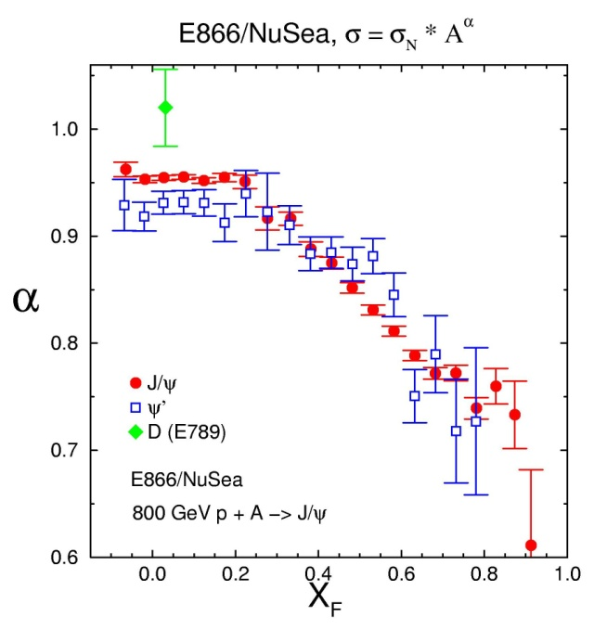
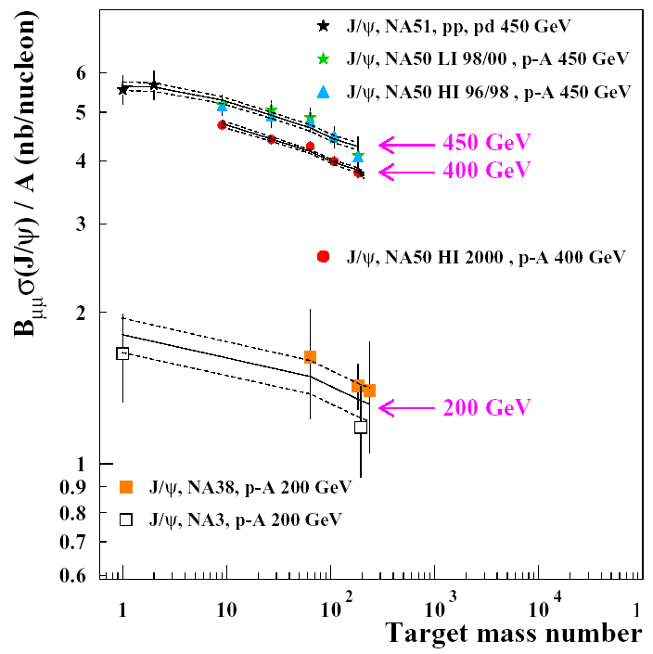
Absorption at mid-rapidity, J/ψ & ψ’ in Fixed Target Measurements
PRL 84, 3258
(2000)
Absorption (or dissociation) of J/ψ or pre-J/ψ ( ) as they exit nucleus into two D mesons, by nucleus or co-movers
Power law parameterization σ = σ _{N} * A^{α}
α = 0.954 ± 0.003 E866/NuSea @ x_{F}=0
α = 0.941 ± 0.004 NA50, QM04
Absorption model parameterization (from pA)
  σ_{J/ψ} = 4.18 ± 0.35 mb NA50 QM05
  σ _{ψ’} = 7.6 ± 1.1 mb

Slide 10
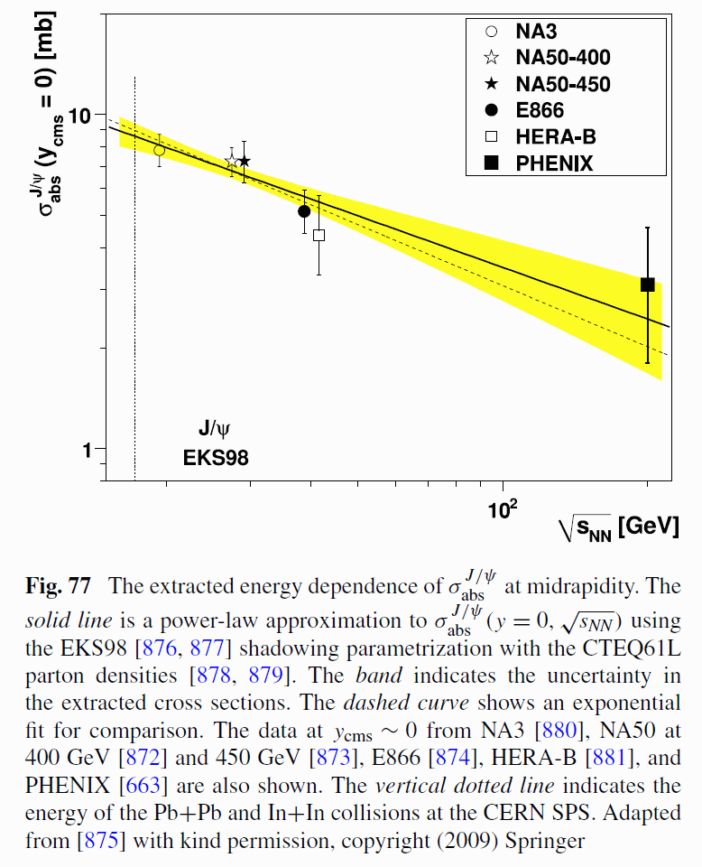
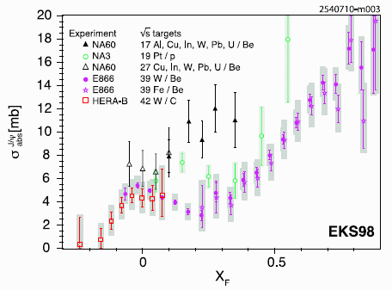
Absorption or Dissociation of J/ψ after correcting for shadowing
Energy Dependence; after corrections for EKS98 shadowing
Apparent absorption vs x_{F}; after EKS98 shadowing is removed
Eur. Phys. J. C (2011) 71: 1534
Eur. Phys. J. C (2011) 71: 1534

Slide 11
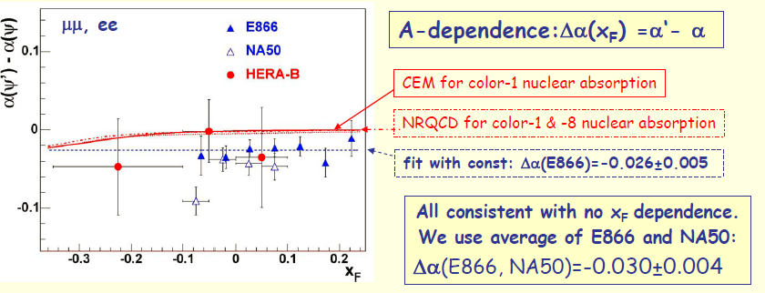
ψ’ absorbed more than J/ψ near x_{F} = 0
Meson | M(GeV) | R(Fm) | BE (MeV)
J/Ψ | 3.1 | .45 | ~640
Ψ΄ | 3.7 | .88 | ~52

Slide 12
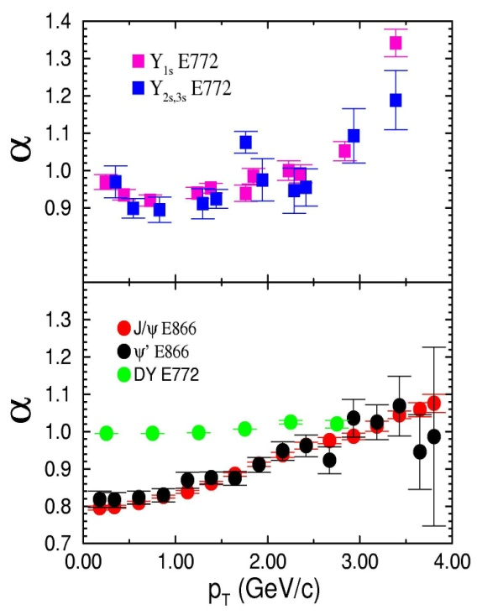
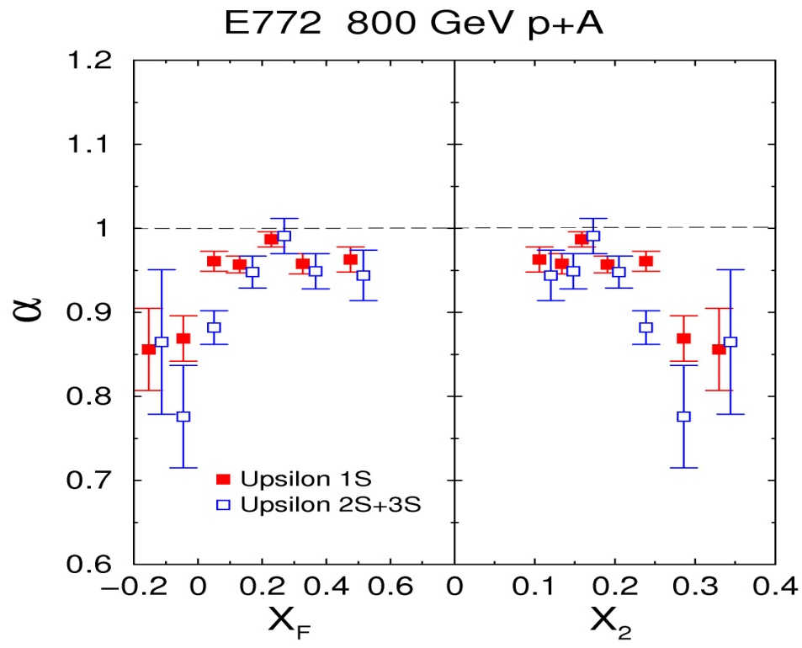
Contrasting ϒ’s with J/ψ’s
√S =39 GeV (E772 & E866)
less absorption
not in shadowing region (large x₂)
similar p_{T} broadening
ϒ_{1S} ϒ_{2S+3S}
But careful: ϒ suppression is from data for x_{F} < 0 or x₂ > 0.2 (in the EMC region)
Upsilons
Drell-Yan
J/Ψ
& Ψ’

Slide 13
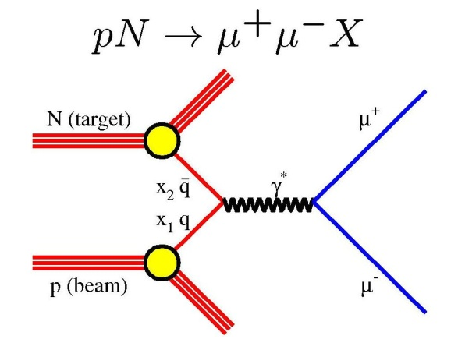
Drell-Yan

Slide 14
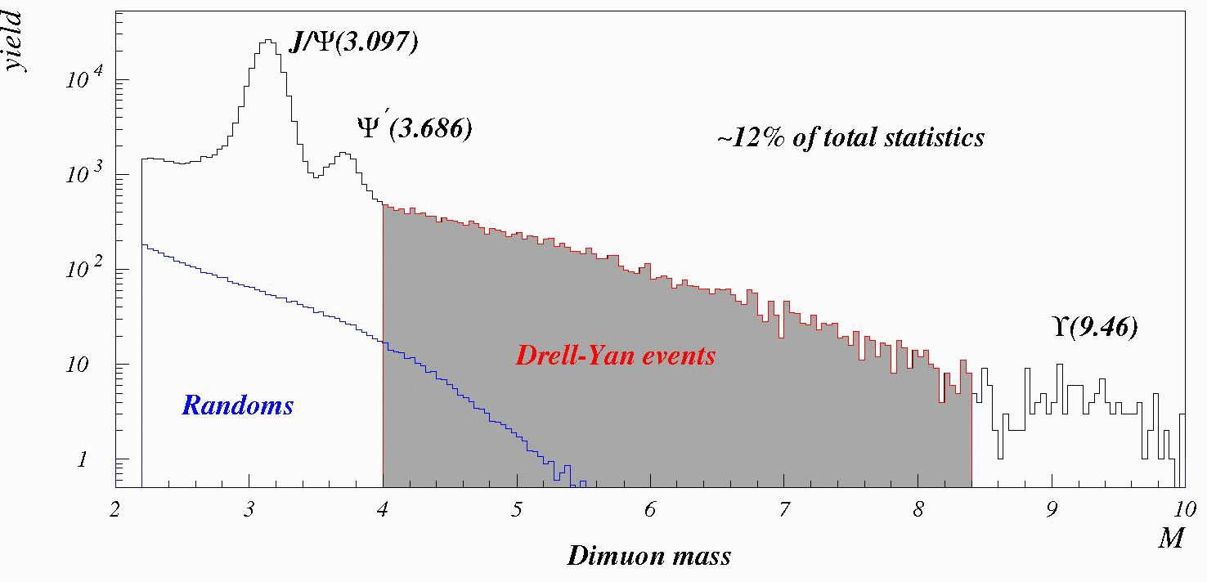
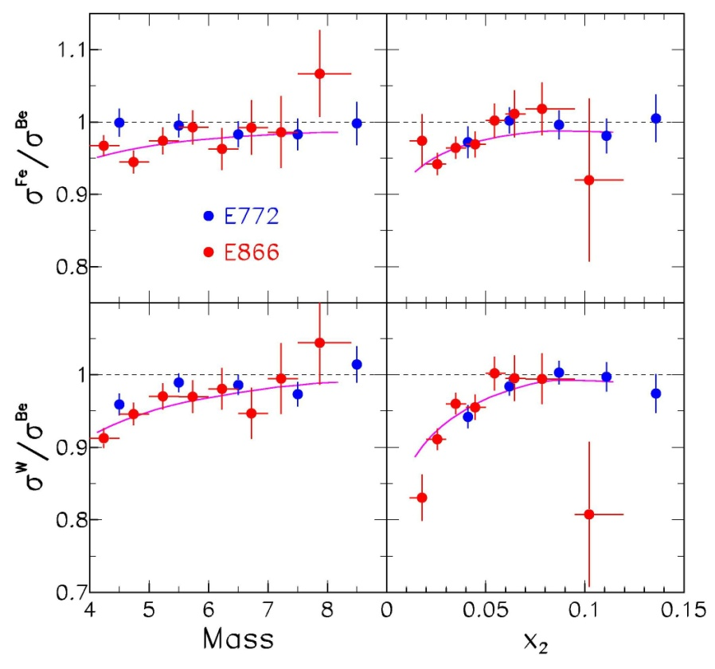
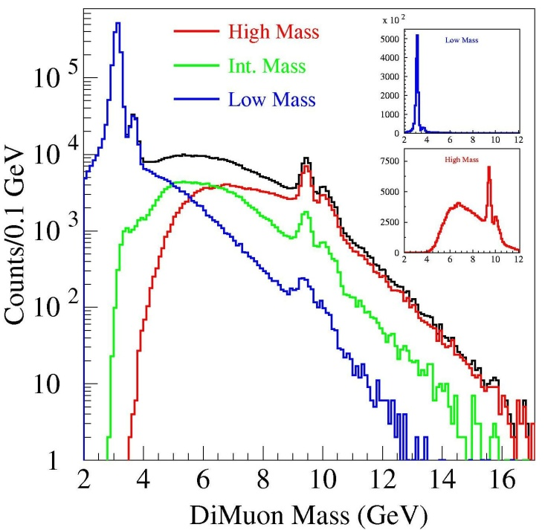
Drell-Yan from E772/E789/E866 at Fermilab
Phys. Rev. Lett. 83, 2304 (1999)

Slide 15
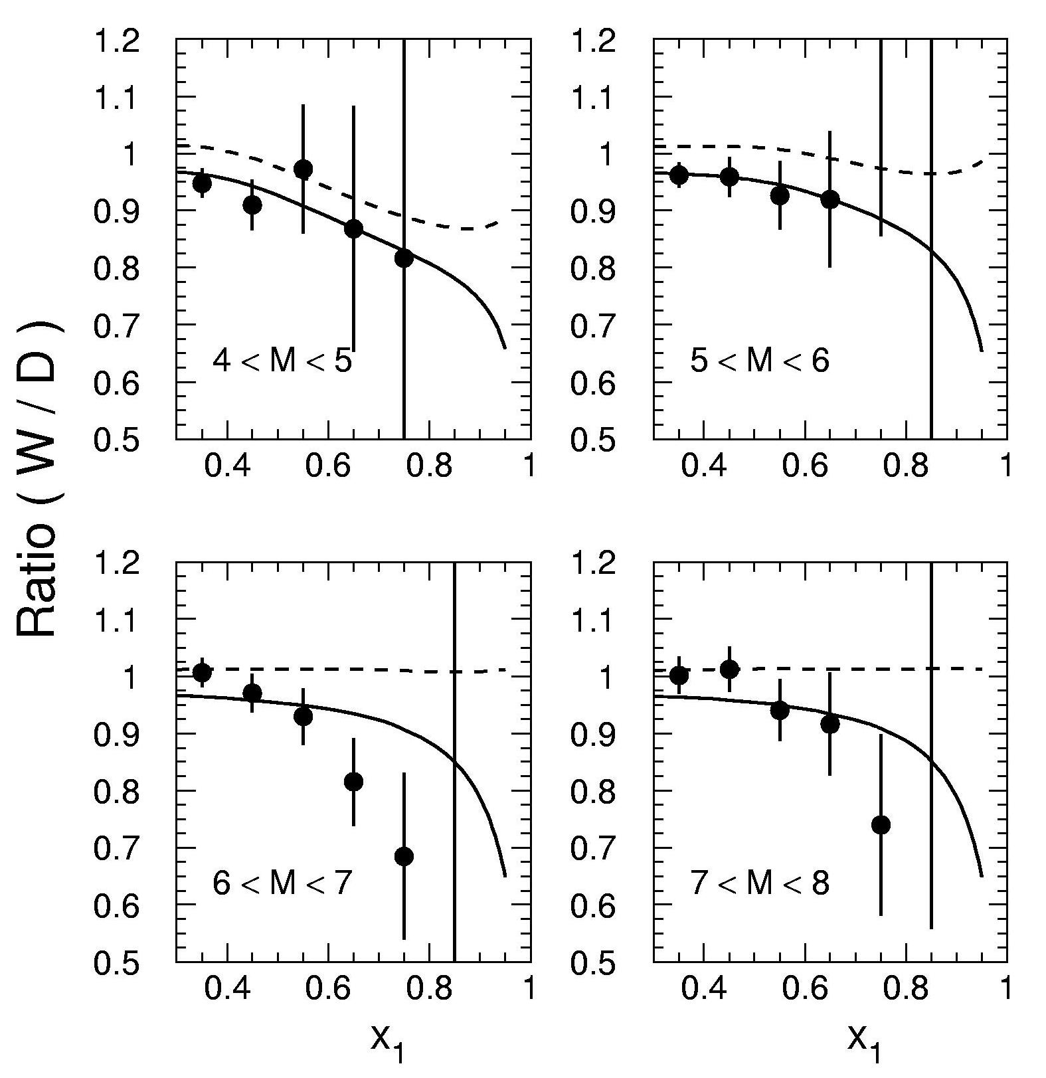
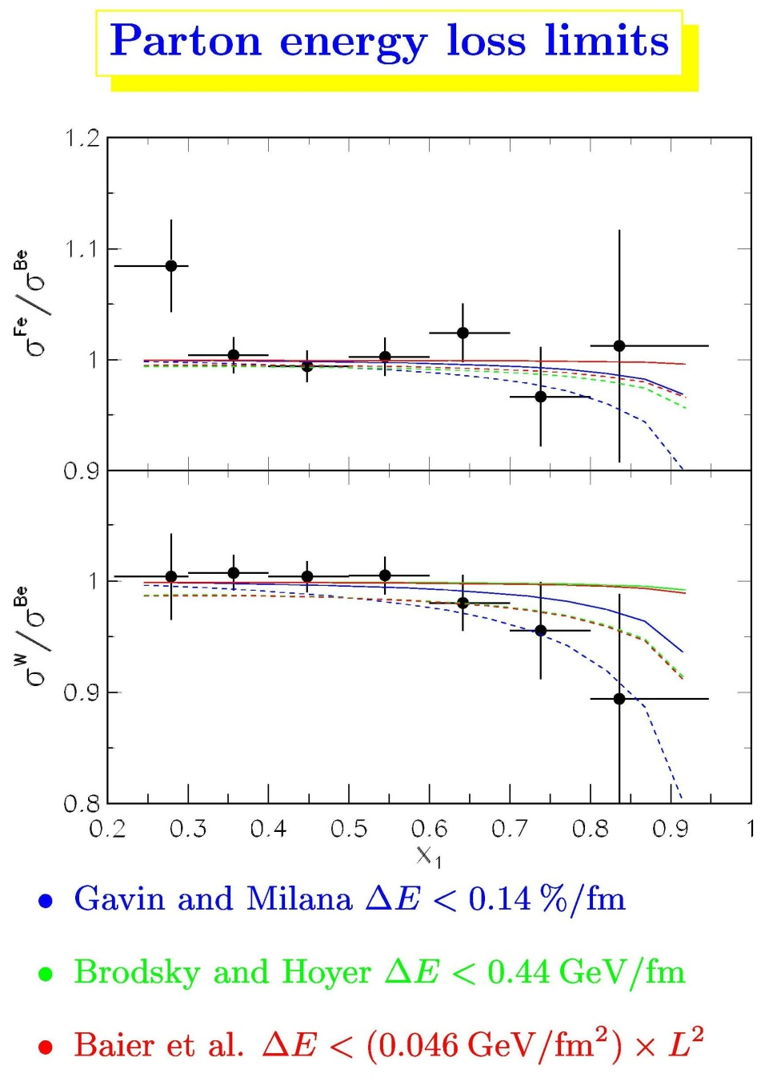
Quark Energy Loss from Drell-Yan data
Two ways
assuming EKS Shadowing
assuming Kopeliovich Shadowing
Johnson, Kopeliovich et al., PRL 86, 4483 (2001)
Phys. Rev. Lett. 83, 2304 (1999)
Shadowing
dE/dx
+ Shadowing
Analysis of our p-A Drell-Yan data using the Kopeliovich model.
dE/dx = 2.32 ± 0.52 ± 0.5 GeV/fm
Confusion due to having both shadowing and dE/dx contributing to Drell-Yan suppression for measurements at this energy

Slide 16
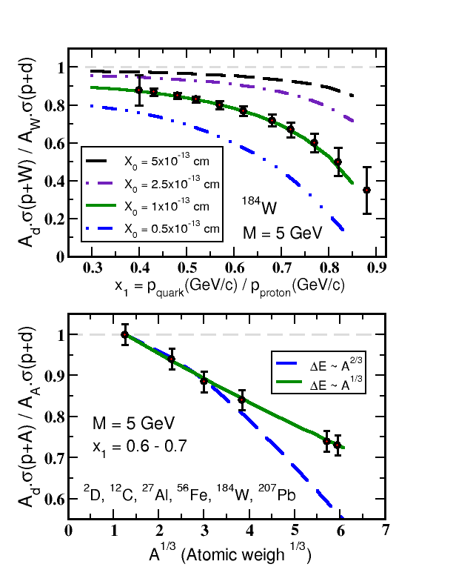
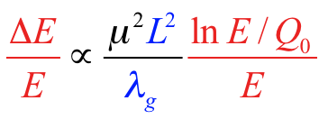
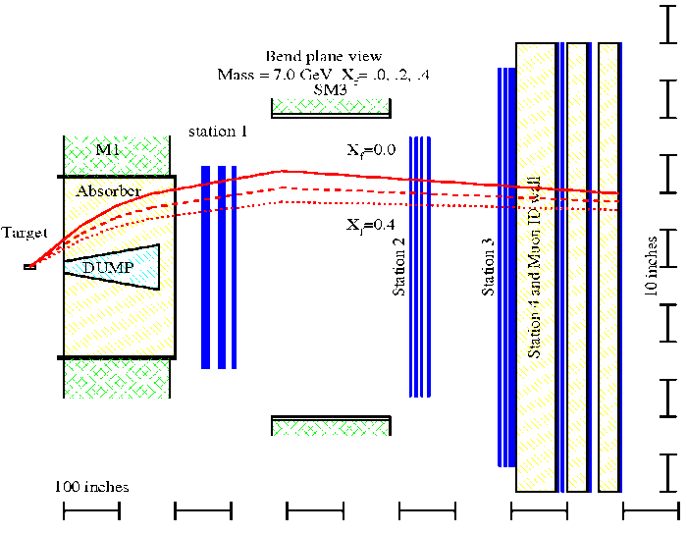
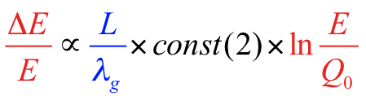
Drell-Yan to constrain parton energy loss in CNM
FNAL E906/Seaquest – Drell-Yan
Drell-Yan
In E906 at 120 GeV, nuclear suppression in Drell-Yan should only be from dE/dx (x₂ > 0.1)
Vitev
Distinguish radiative from collisional (L² vs L)
See Paul Reimer’s talk

Slide 17
Transverse Momentum Broadening

Slide 18
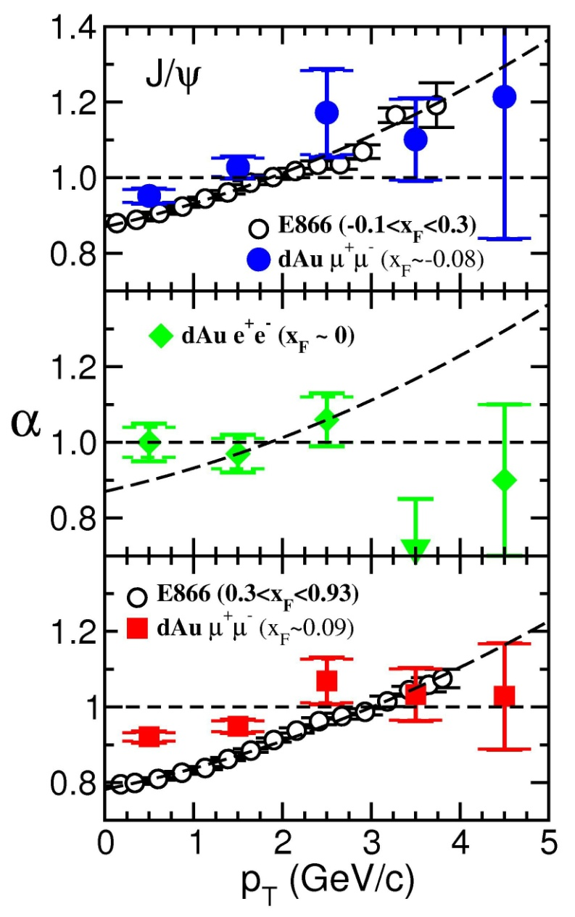
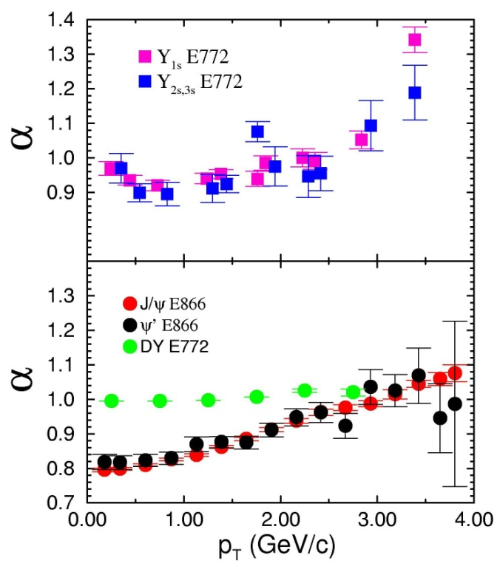
Transverse Momentum Broadening – DY, J/ψ, Upsilon
PRL 96, 012304 (2006)
High x₂
~ 0.09
Initial-state gluon multiple scattering causes p_{T} broadening (or Cronin effect)
PHENIX 200 GeV results show p_{T} broadening comparable to that at lower energy (√s=39 GeV in E866/NuSea)
Upsilons
Low x₂
~ 0.003
Drell-Yan
J/Ψ & Ψ’

Slide 19
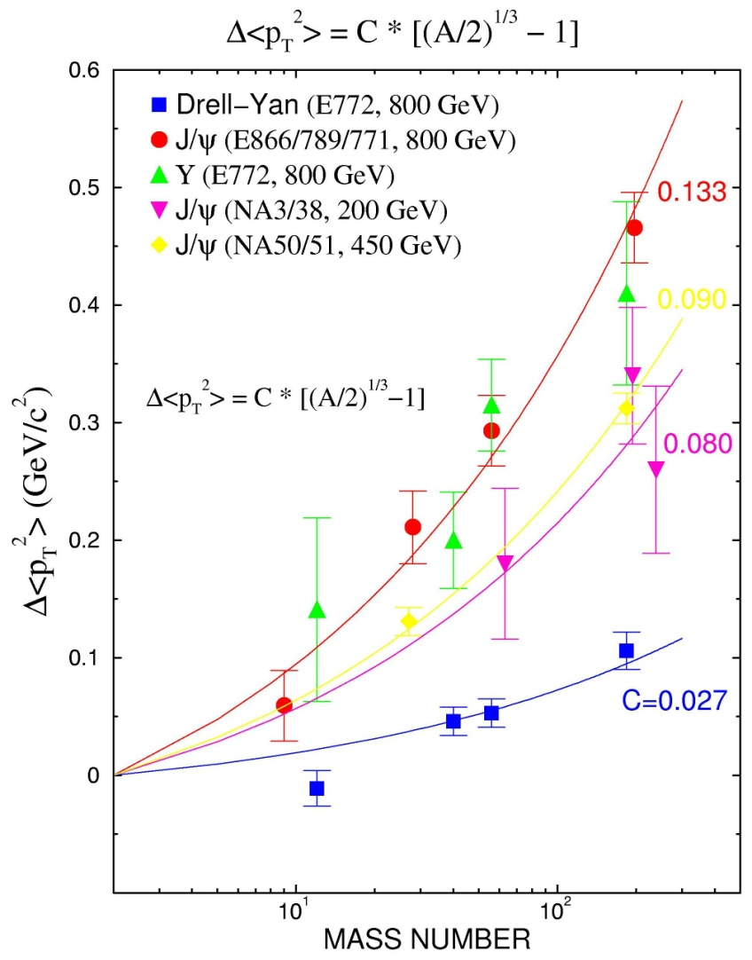
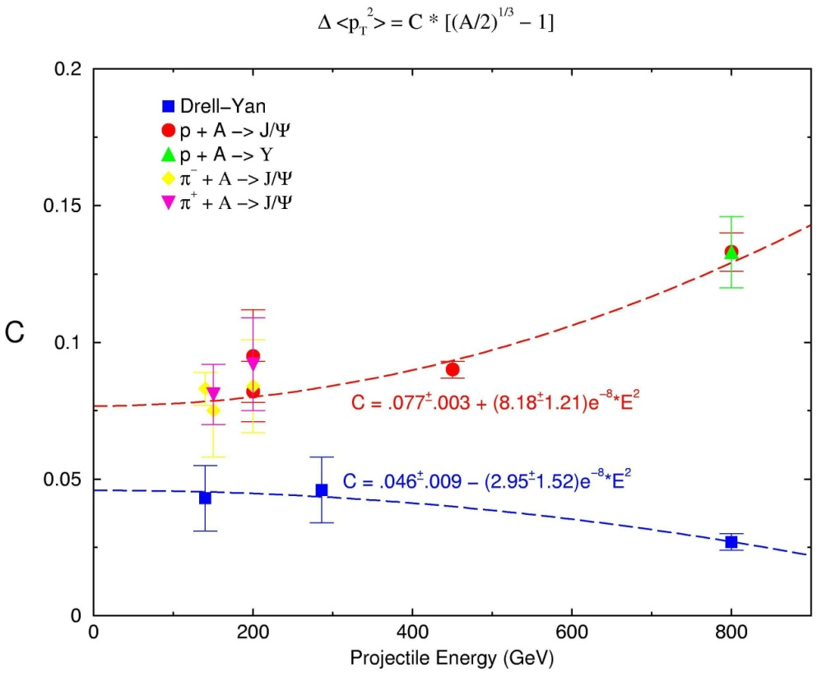
Systematics of P_{T} Broadening
E866/NuSea

Slide 20
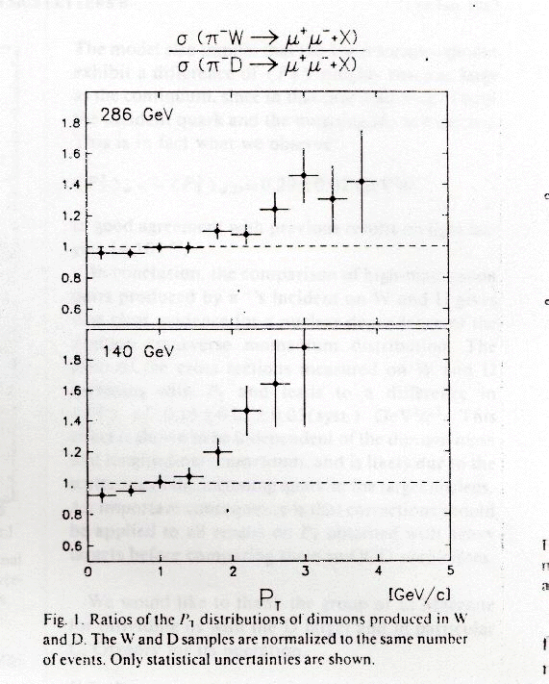
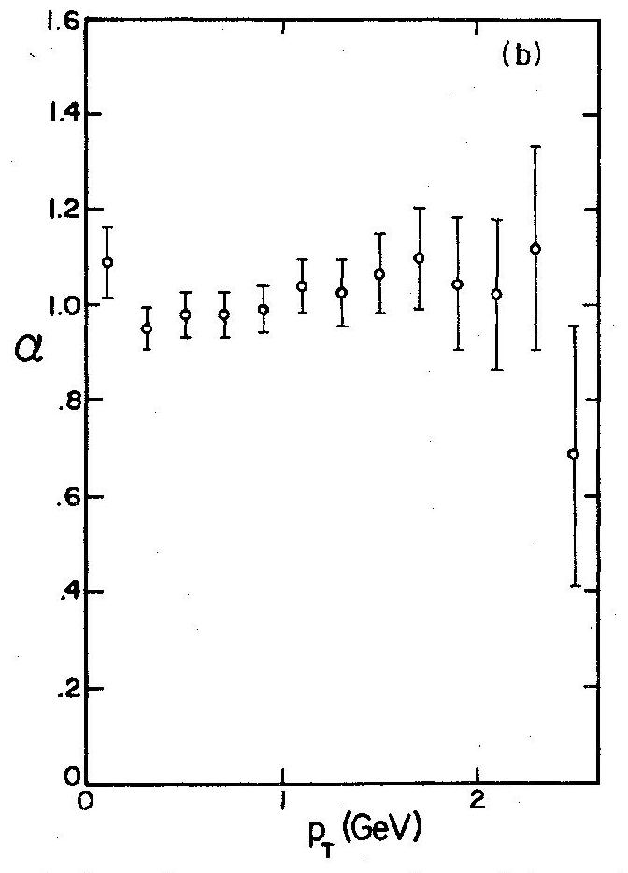
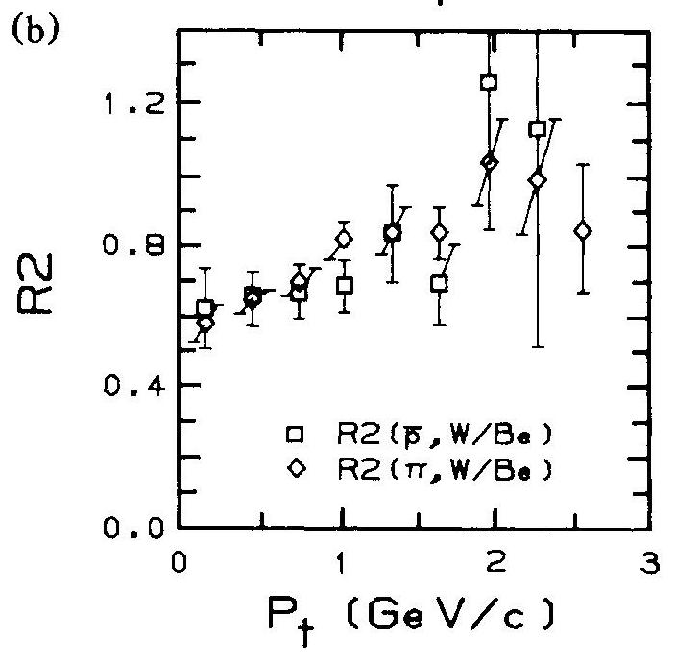
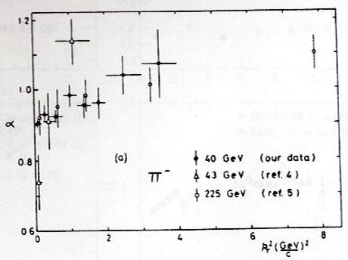
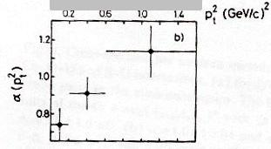
P_{T} Broadening for different energies and probes – other data
E537: 125 GeV pbar,π⁻ J/ψ
PRL 60, 2121 (1988)
E288 400 GeV p DY
PRD 23, 604 (1981)
NA10: 140,286 GeV π⁻ DY
PLB 193, 368 (1987)
Omega: 39.5 GeV π⁻ J/ψ
PL110B, 415 (1982)
Antipov: 43 GeV π⁻ J/ψ
PL76B, 235 (1978)

Slide 21
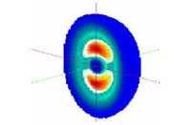
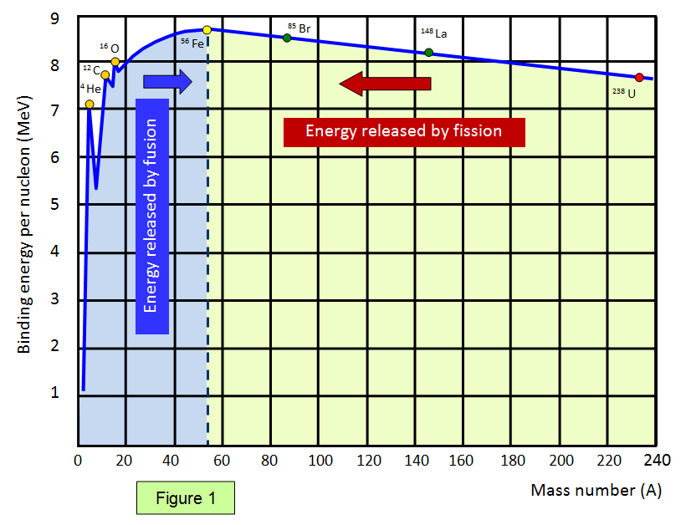
Deuteron vs the Proton
Deuteron is very weakly bound & not a typical nucleus in terms of CNM effects
Binding energies:
  D – 2.22 MeV
  Alpha – 28.3 MeV

Slide 22
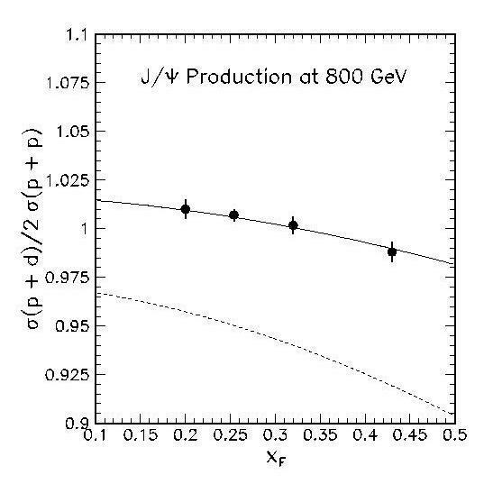

J/ψ Nuclear dependence weaker than expected for Deuterium/Hydrogen !
E866/NuSea
Preliminary
A_{eff} = 1.2
A_{eff} = 1.35
A = 2
A = 2
E866/NuSea
Preliminary
Nuclear dependence in deuterium seems to follow the systematics of larger nuclei, but with an effective, A_{eff,} smaller than the A=2 of deuterium
From fits to E866/NuSea
p + Be, Fe, W data: σ_{pA}~ σ_{pp}A^{α}

Slide 23
Intrinsic Charm
Intrinsic charm components of incident proton produce J/ψ at large x_{F}. A^{2/3} dependence from surface stripping of proton’s light quarks (Brodsky)

Slide 24


Intrinsic charm contribution to Quarkonia
At large x_{F} (≥ 0.5) intrinsic cc components of the projectile proton can dominate the production of charm pairs
A^{2/3} dependence via surface stripping of light quarks to free charm pair component
no I.C.
J/ψ
with
I.C.
Vogt, Brodsky, Hoyer, NP B360, 67 (1991)
(also includes absorption and shadowing)
2.0% IC
0.57%
No conclusive evidence for IC:
“IC constrained to be from zero (no IC) to a level 2-3 times larger than previous model estimates”
CTEQ6 best fit
Pumplin, Lai, Tung, PRD 75, 054029 (2007)

Slide 25

Flattening of shadowing at very small x?
F₂ structure functions (q & qbar) may show leveling out of shadowing at smallest x values probed by DIS on nuclear targets (E665)
hep-ph/0506039
J. Phys. G35, 115010 (2008)
Kopeliovich – color transparency & coherence effects
Vitev – higher-twist shadowing
e.g. probe qbar with very-forward Drell-Yan on nuclear targets

Slide 26
DY shows shadowing or dE/dx
Drell-Yan
Summary p-A data lessons
suppression of vector mesons
Open vs closed charm isolates initial state
J/ψ
J/ψ suppression doesn’t scale like shadowing
200 GeV
19 GeV
everything has p_{T} broadening
39 GeV
p+d J/ψ suppression is weak
Shadowing may flatten for x<10⁻³?
E866/NuSea
Preliminary
Vitev
A_{eff} = 1.35
A = 2

Slide 27
Backups

Slide 28



Solving the J/ψ Puzzle
MJL – 4/3/12
E906 & √s-dep. of DY
separate dE/dx from shadowing
Theory: q vs gluon dE/dx
diff. Screening for diff. quarkonia states
quark dE/dx
initial state gluon dE/dx
quarkonia vs open-heavy
Screening in QGP
isolates I.S. from breakup
breakup
J/ψ vs √s
CNM
diff. x ranges for shadowing
gluon shadowing
Regeneration
J/ψ vs ϒ
q
Theory: EPS09; coherence models; gluon saturation
large regen.
@ LHC?
Theory for RHIC regen.
γ
direct-γ
vs HQ
vs DY
g
predict small regen. @ RHIC?
g
jet
path length dep. of CNM
c
p_{T} of R_{AA} from regen.: diagonal or random?
c
g
d+Au vs d+Cu & centrality dep.
q
l ⁺
q or g in deuteron – dE/dx
q or g in nucleus – shadowing
2 unknowns, 3 measurements
flat or rising R_{AA} as b→0?
q
l ⁻

Slide 29

HERA-B - J/ψ A dependence
A. Zoccoli (HERA-B) – talk @ Hard Probes 2004
Preliminary
Vogt – hep-ph-/9907317
Gavin, Milana dE/dx
Brodsky, Hoyer
(minimum) dE/dx
Boreskov, Kaidalov
hep-ph/0303033
Previous result of FNAL E866 extended to x_{F} = –0.35
Result from 15% of full μ⁺ μ– sample, statistical uncertainties only, similar results for e⁺e⁻
Work on systematics ongoing. Complete the analysis on the full data sample.

Slide 30



Open Charm Nuclear Dependence : x_{F} Dependence?
E769 250 GeV π± PRL 70,722 (1993)
WA82 340 GeV π⁻ PRB 284,453 (1992)
Vogt et al., NP 383,643 (1992)
E769 250 GeV π⁻
WA78 320 GeV π⁻ (Beam dump)

Slide 31



Slide 32



Slide 33


Slide 34



EMC – Theoretical Models
(Ericson & Thomas
Bickerstaff & Thomas
Berger & Coester)
Nuclear Binding & Fermi Motion
Excess pions (nuclear binding)
Loss of valence quark momentum & enhanced sea (pions)
Pions have valence (large x) anti-quarks so anti-quark momentum is enhanced
Fermi motion
Spreads quark momentum near x=1
Rescaling (Close et al.; Jaffe)
~15% phenomological increase in confinement scale
Overlapping nucleons (6-quark clusters, Close, Jaffe,…)
Loss of valence quark momentum
Multi-quark Clusters (Pirner & Vary; Carlson & Havens)
Loss of valence quark momentum
relative enhancement at x~1 (one quark can have > nucleon momentum)
Notes:
Ericson, Thomas PL 148B, 191 (1984)
Bickerstaff, Thomas, PRL 53, 2531 (1984)
Berger, Coester PRD 32, 1071 (1985)
Close, Jaffe, Roberts, Ross, PRD 31, 1004 (1985)
Pirner, Vary PRL 46, 1376 (1981)
Carlson, Havens PRL 51, 261 (1983)

Slide 35
Sudakov suppression
Kopeliovich hep-ph/0501260
π,p,K,Λ,ρ,Ξ data
describes universal suppression vs x_{F} for low energy data
Universal suppression at large x_{F} seen in data for various reactions:
forward light hadrons, Drell-Yan, heavy flavor
often attributed to shadowing since x₂ is small
But this common suppression mechanism can also be viewed as Sudakov suppression :
no particles produced as x_{F} → 1 due to energy conservation
more multiple interactions make the effect larger in nuclei
x_{F}
J/ψ
Sudakov
suppression
Close to 800 GeV J/ψ suppression vs x₁ (x₁≈x_{F})
+ higher twist
shadowing
x₁
and Brahms forward rapidity (η=3.2) hadrons
30-50%
0-20% (central)
Notes:
or Enhanced resolution of higher Fock states by nuclei (Brodsky) emphasize higher multi-parton Fock states which fall more steeply toward xF = 1
An effective dE/dx that rises linearly with energy also results from this picture
And also that coherence effects at small x2 vanish as x1 → 1

Slide 36
Fermilab E866/NuSea Detector
60m x 3m x 3m
Forward x_{F}, high mass μ-pair spectrometer
Liquid hydrogen and deuterium targets
Two acceptance defining magnets (SM0, SM12)
Beam dump (4.3m Cu)
Hadronic absorber (13.4 I₀-Cu, C, CH₂)
Momentum analyzing magnet (SM3)
Three tracking stations
Muon identifier wall & 4th tracking

Slide 37
NA38/NA50
Luminosity monitor
EmCAL, ZDC, Si-strip multiplicity detector for centrality determination
Toroidal analyzing magnet
Lots of absorber material
Segmented active target
MWPCs, hodoscopes for tracking/triggering
Note benefits of a fixed target experiment:
Lots of luminosity.
Boost in lab frame gives very high momentum particles, so resolution is improved and background can be greatly reduced by many meters of absorber.
Notes:
The NA38/NA50 apparatus is a classic muon spectrometer. The beam enters from the left. There’s a luminosity monitor, several detectors to measure the collision centrality, lot’s of material to absorb everything but the relatively rare muons, and detectors and magnets for measurement of the particle’s trajectory and momentum and for triggering.

Slide 38


Slide 40
Production of hadrons at large transverse momentum
at 200, 300 and 400 GeV at Fermilab
J.W. Cronin et al., PRD 11, 3105 (1975)

Slide 41

slide from R. Vogt – Jan. 2011

Slide 42

Quark Energy Loss from Drell-Yan data assuming EKS Shadowing
Data corrected for EKS shadowing
Phys. Rev. Lett. 83, 2304 (1999)

Slide 43
Quark Energy Loss from Drell-Yan data
assuming Kopeliovich Shadowing
Johnson, Kopeliovich et al., PRL 86, 4483 (2001)
data from
E772 - PRL 64, 2479 (1990)
Shadowing
dE/dx
+ Shadowing
Analysis of our p-A Drell-Yan data using the Kopeliovich model. Dashed lines with shadowing only; solid lines with parton energy loss of
dE/dx = 2.32 ± 0.52 ± 0.5 GeV/fm
Confusion due to having both shadowing and dE/dx
contributing to Drell-Yan suppression for measurements at this energy

Slide 44

Intrinsic charm contribution to Quarkonia
At large x_{F} (≥ 0.5) intrinsic cc components of the projectile proton can dominate the production of charm pairs
A^{2/3} dependence via surface stripping of light quarks to free charm pair component
no I.C.
J/ψ
with
I.C.
Vogt, Brodsky, Hoyer, NP B360, 67 (1991)
(also includes absorption and shadowing)
E789, PRL 72, 1318 (1994)
Predictions w/o I.C.
But E789 set limit on I.C. contribution via shape of cross section vs x_{F}
< 2.3 x 10⁻³ nb/nucleon (1.8 nb/nucleon predicted)

Slide 45

Slide from JCP

Slide 46
Slide from JC Peng

