Slide 1
Single-Spin Asymmetry in Polarized p+A Collisions
Yuri Kovchegov
The Ohio State University
based on arXiv:1201.5890 [hep-ph] and more recent work with Matthew Sievert
(special thanks to Michael Lisa)

Slide 2
Outline
Introduction (STSAs, saturation/CGC)
Calculation of STSA in CGC
  New mechanism: odderon exchange with the unpolarized nucleus
  Sivers effect: including it into the CGC framework
Conclusions and outlook

Slide 3
Introduction

Slide 4
Single Transverse Spin Asymmetry
Consider polarized proton scattering on an unpolarized proton or nucleus.
Single Transverse Spin Asymmetry (STSA) is defined by

Slide 5
STSA: the data
The asymmetry is non-zero, and is an increasing function of Feynman-x of the polarized proton:
Fermilab
E581 & E704
collaborations
1991

Slide 6
STSA: a more recent data

Slide 7
STSA: the data
STSA is also a non-monotonic function of transverse momentum p_{T}, which has zeroes (nodes), where its sign changes:
RHIC,
STAR collaboration
2008

Slide 8
STSA: a more recent data

Slide 9
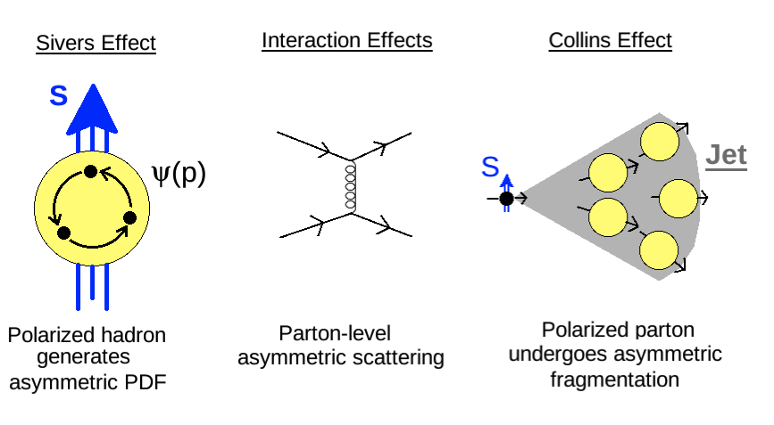
Theoretical Explanations
The origin of STSA (in the collinear/TMD factorization framework) is in
polarized PDF (Sivers effect)
polarized fragmentation (Collins effect)
hard scattering

Slide 10
Need to understand STSAs in the saturation/CGC framework
At RHIC, even in p⬆+p collisions reach small values of x in the unpolarized proton → saturation effects may be present
For p⬆+A scattering, nuclear target would further enhance saturtion/CGC effects, making understanding the role of saturation in STSA a priority
Spin-dependent probes may provide new independent tests of saturation/CGC physics.

Slide 11
High Energy QCD: saturation physics
Saturation physics is based on the existence of a large internal momentum scale Q_{S} which grows with both energy s and nuclear atomic number A
such that
and we can calculate total cross sections, particle spectra and multiplicities, etc, from first principles.
Bottom line: everything is considered perturbative.

Slide 12
Map of High Energy QCD
Saturation physics allows us
to study regions of high
parton density in the small
coupling regime, where
calculations are still
under control!
(or p_{T}²)
Transition to saturation region is
characterized by the saturation scale

Slide 13
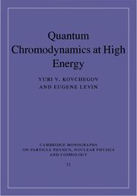
A reference
Published in September 2012
by Cambridge U Press

Slide 14
Calculation of STSA in CGC

Slide 15
What generates STSA
To obtain STSA need
  transverse polarization dependence
  (comes with a factor of “i”)
  a phase difference by “i” between the amplitude and cc amplitude to cancel the “i” from above (cross section and STSA are real)
  (from Qiu and Sterman, early 90’s)

Slide 16
(i) Shooting spin through Color Glass

Slide 17
Forward quark production
It is easier to work in transverse coordinate space:
The quark (transverse) coordinates are different on two sides of the cut!

Slide 18
Forward quark production
The eikonal quark propagator is given by the Wilson line
with the light cone coordinates

Slide 19
Forward quark production
Dumitru, Jalilian ‘02
The amplitude squared is
The quark dipole scattering amplitude is
Hence quark production is related to the dipole amplitude! Valid both in the quasi-classical Glauber-Mueller/McLerran-Venugopalan multiple-rescattering approximation and for the LLA small-x evolution (BFKL/BK/JIMWLK).

Slide 20
Dipole Amplitude
Dipole scattering amplitude is a universal degree of freedom in CGC.
It describes the DIS cross section and structure functions:
It also describes single inclusive quark (shown above) and gluon production cross section in DIS and in pA.
Even works for diffraction in DIS and pA.
For correlations need also qudrupoles, etc. (J.Jalilian-Marian, Yu.K. ‘04)

Slide 21
Spin-dependent quark production
The eikonal quark production is indeed spin-independent, and hence can not generate STSA.
Simple recoil, while spin-dependent, is suppressed by 1/s:

Slide 22
Spin-dependent quark production
The only way to include spin dependence without 1/s suppression
is through the splitting in the projectile before or after
the collision with the target:
Let’s calculate the corresponding quark production cross section,
find its spin-dependent part, and see if it gives an STSA.

Slide 23
Production Cross Section
Squaring the amplitude we get the following diagrams
contributing to the production cross section:

Slide 24
Extracting STSA
STSA can be thought of as the term proportional to
To get a k_{T}-odd part of the cross section
we need the anti-symmetric part of the integrand.
This may either come from the wave function squared or from the interaction with the target.
Our LO wave function is symmetric: need to find the anti-symmetric interaction!

Slide 25
C-even and C-odd dipoles
To find the anti-symmetric interaction we decompose the dipole amplitude into real symmetric (C-even) and imaginary anti-symmetric (C-odd) parts:
The symmetric part is
The anti-symmetric part is
As interchanges quark and antiquark, it is C-parity!

Slide 26
C-even and C-odd dipoles
S_{xy} is the usual C-even dipole amplitude, to be found from the BK/JIMWLK equations: describes DIS, unpolarized quark and gluon production
O_{xy} is the C-odd odderon exchange amplitude, obeying a different evolution equation (Yu.K., Szymanowski, Wallon ’03; Hatta et al ‘05)
At LO the odderon is a 3-gluon exchange:
The intercept of the odderon is zero (Bartels, Lipatov, Vacca ’99):
In our setup, odderon naturally generates STSA.

Slide 27
STSA in high energy QCD
When the dust settles, the spin-dependent part of the production cross section is
with the C-odd interaction with the target
Note that the interaction contains nonlinear terms: only those survive in the end.
The expression for the interaction at any N_{c} is known.
spin-dependence
phase

Slide 28
Properties of the obtained STSA contribution

Slide 29
Odderon STSA properties
Our odderon STSA is a non-monotonic function of transverse
momentum and an increasing function of Feynman-x:
Warning: very crude approximation of the formula. (Q_{s}=1 GeV)
Curves are for (Feynman-x) α =0.9 (dash-dotted), 0.7 (solid),
0.6 (dashed), 0.5 (dotted).

Slide 30
Dependence on density gradient
Our STSA is proportional to the square of the gradient of the nuclear profile function T(b):
The asymmetry is larger for peripheral collisions, and is dominated by edge effects.
It is also smaller for nuclei (p⬆+A) than for the proton target (p⬆+p).

Slide 31
Odderon STSA properties
To illustrate this we plot A_{N} with a different large-b (IR) cutoff:
Warning: very crude approximation of the formula. (Q_{s}=1 GeV)
Curves are for (Feynman-x) α =0.9 (dash-dotted), 0.7 (solid),
0.6 (dashed), 0.5 (dotted).

Slide 32
Odderon STSA at high-p_{T}
The odderon STSA is a steeply-falling function of p_{T}:
However, the suppression at high transverse momentum is gone for p_{T} ~ Q_{s} (from one to a few GeV).

Slide 33
Nuclear (unpolarized) target
Target radius is R=1 fm (top curve), R=1.4 fm (middle curve),
R=2 fm (bottom curve): strong suppression of odderon STSA
in nuclei. Warning: crude approximation of the exact formula!

Slide 34
Gluon STSA
is also found along the same lines:
Properties TBD,
likely similar to
quark STSA

Slide 35
Prompt photon STSA
is zero (in this mechanism).
The photon asymmetry originated in the following spin-dependent production cross-section
with the interaction with the target linear in the odderon exchange
This cross section is zero since
for any odd function

Slide 36
(ii) Sivers effect in Color Glass

Slide 37
Sivers vs Odderon
In the above STSA mechanism the spin-dependence came from the polarized wave function, while the phase was generated in the interaction. (The wave function was too simple to contain a phase.)
The phase may also arise in the polarized wave function – this is Sivers effect.
How does it come into CGC? Is it leading or subleading to the above effect?

Slide 38
Sivers effect in CGC
We have explored the case of C-even wave function squared and C-odd interactions.
One also needs to look into the case of C-odd wave function squared and C-even interaction with the target:
This is the analogue of the works by Brodsky, Hwang, Schmidt ’02 and Collins ’02 in our saturation language.
As O_{xy} ~ α_{S} S_{xy} this is of the same order as the odderon STSA.

Slide 39
Sivers effect in CGC
Both the phase and spin-dependence come from the top of the diagram. The phase is denoted by a cut (Im part = Cutkosky rules).
However, the extra rescattering generating the phase can only be in the final state as shown (no phase arising in the initial state that we could find).
Interaction with the target is C-even: no odderons!

Slide 40
Sivers effect in CGC
This is still work in progress (YK, M. Sievert).
The answer should look like
Very hard to calculate amplitude A in coordinate space (not eikonal, no simplifications, may also need term where spin-dependence is in A).
phase
spin-dependence

Slide 41
Sivers effect in CGC
May be lower-twist than the odderon STSA,
but the two may be comparable for k_{T} ~ Q_{s}.
Would lead to non-zero STSA for prompt photons!
Perhaps the odderon STSA contribution can be found by subtracting photon STSA from the hadron STSA, though there is also the Collins mechanism for hadron STSA.
Sivers STSA in CGC in p⬆+A scattering is also likely suppressed compared to p⬆+p, but more work is needed to check this.

Slide 42
Conclusions
It seems STSA in p⬆+A collisions can be generated by three possible mechanisms: Sivers, Collins, and odderon-mediated.
Odderon mechanism has right qualitative features of STSA, but falls off fast at high p_{T} . It is much smaller in p⬆+A than in p⬆+p. Predicts zero photon/DY STSA.
Sivers effects is leading at high-p_{T} (compared to the odderon), and probably is also suppressed in p⬆+A vs p⬆+p, but this needs to be confirmed. Photon/DY STSA is non-zero.
I do not have much to say about Collins effect in p⬆+A, but fragmentation function may be modified by nuclear environment, possibly modifying the effect.

