Slide 1
First two-particle correlation results in proton-lead collisions from CMS
Wei Li (Rice University)
for the CMS collaboration

Slide 2
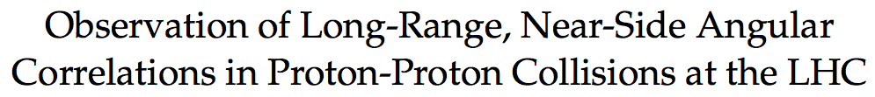
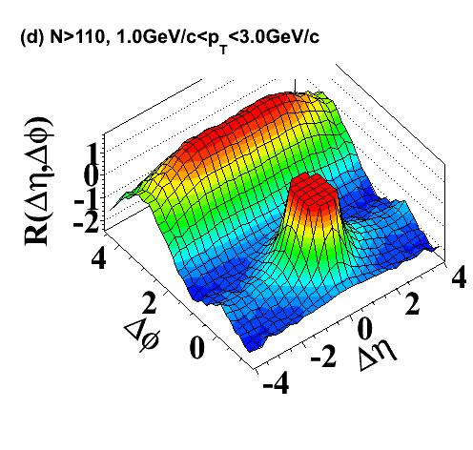
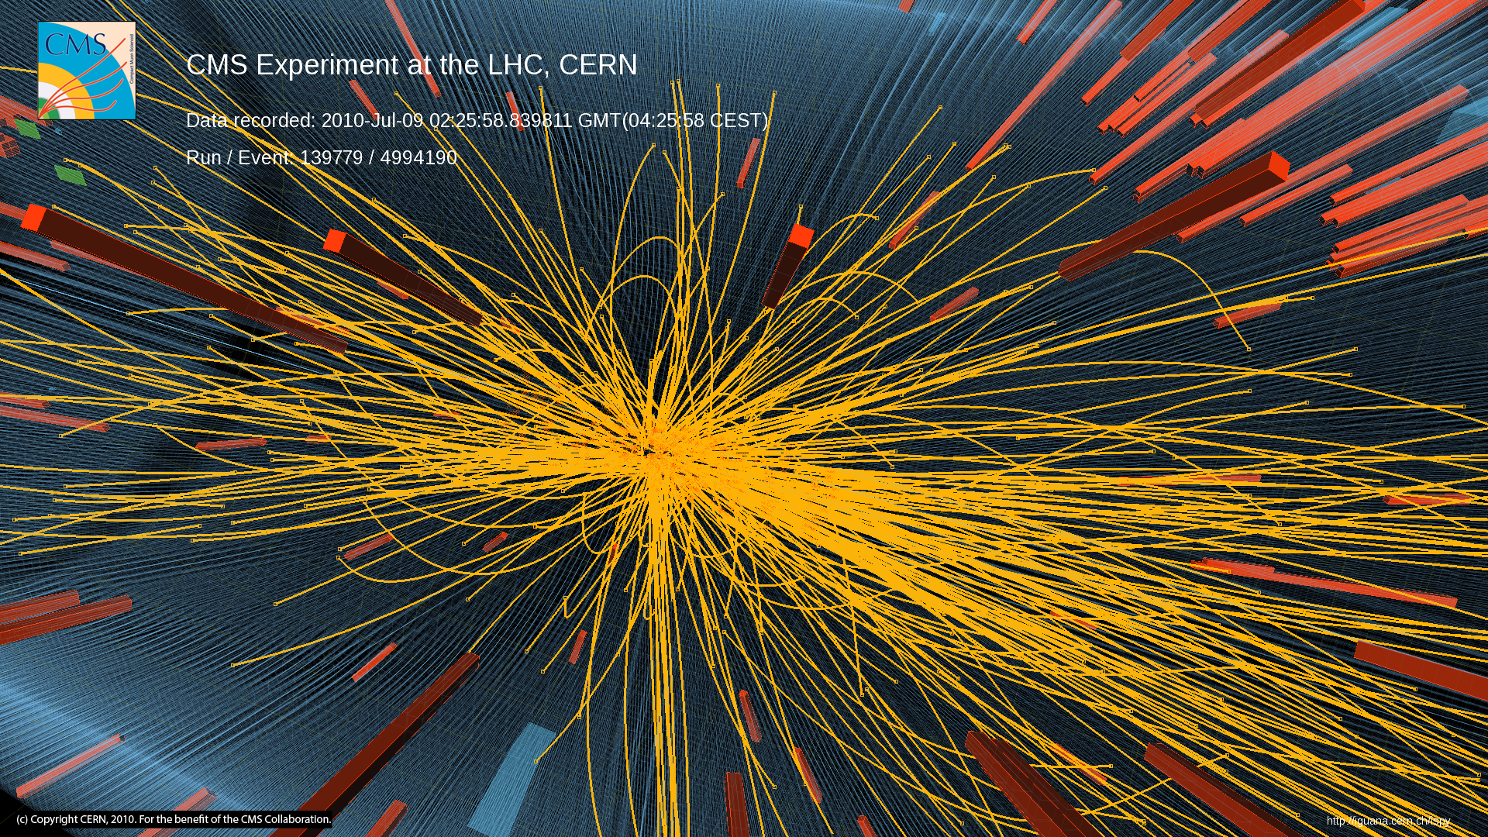
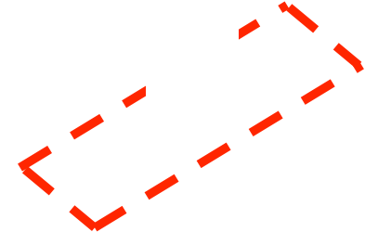
The “ridge” in pp collisions
p
p
CMS collaboration, JHEP 09 (2010) 091
pp N>110, 1<p_{T}<3 GeV/c
Event with more than 200 charged particles
A surprise: near-side (Δϕ~0) “ridge” in high multiplicity pp!

Slide 3
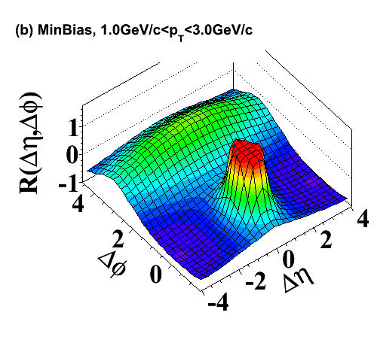
The “ridge” in pp collisions
CMS collaboration, JHEP 09 (2010) 091
pp <N>~15, 1<p_{T}<3 GeV/c
pp N>110, 1<p_{T}<3 GeV/c
No ridge observed in minimum bias pp or any pp MC generators

Slide 4
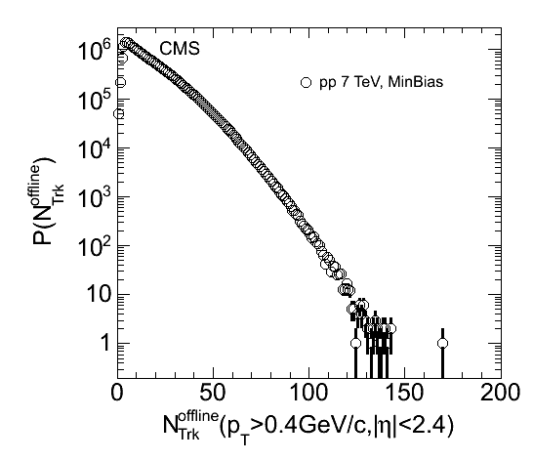
Very high multiplicity pp collisions
Very high-multiplicity pp events are rare in nature
Very exotic
pp events
10⁻⁵ – 10⁻⁶ prob.
Raw counts of tracks!

Slide 5

proton-proton and nucleus-nucleus collisions
Pb
Pb
p
p

Slide 6
The “ridge” in pp and AA collisions
Pb
Pb
p
p
pp 7 TeV, N>110
PbPb 2.76 TeV
arXiv:1201.3158
JHEP 09 (2010) 091
JHEP 07 (2011) 076
EPJC 72 (2012) 2012

Slide 7
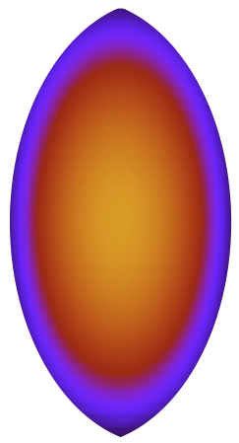
The “ridge” in pp and AA collisions
Pb
Pb
p
p
pp 7 TeV, N>110
PbPb 2.76 TeV
elliptic flow:
cos(2Δϕ)
arXiv:1201.3158
JHEP 09 (2010) 091
JHEP 07 (2011) 076
EPJC 72 (2012) 2012
Initial-state geometry
+
collective expansion
“Smoking gun” of a strongly
interacting QGP liquid!

Slide 8
The “ridge” in pp and AA collisions
Pb
Pb
p
p
pp 7 TeV, N>110
PbPb 2.76 TeV
elliptic flow:
cos(2Δϕ)
arXiv:1201.3158
JHEP 09 (2010) 091
JHEP 07 (2011) 076
EPJC 72 (2012) 2012
Physical origin of pp ridge is
still not completely explained
Initial-state geometry
+
collective expansion
“Smoking gun” of a strongly
interacting QGP liquid!

Slide 9
The “ridge” in pp, pA and AA collisions?
p
Pb
Pb
Pb
p
p
pp 7 TeV, N>110
PbPb 2.76 TeV
?
arXiv:1201.3158
JHEP 09 (2010) 091
JHEP 07 (2011) 076
EPJC 72 (2012) 2012
What if colliding a proton and a nucleus?
Is there a ridge and how big is it?

Slide 10

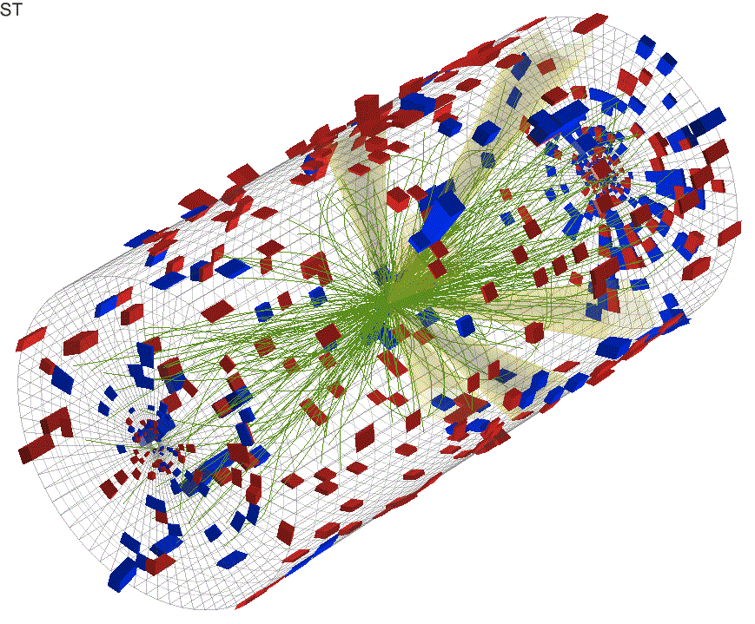
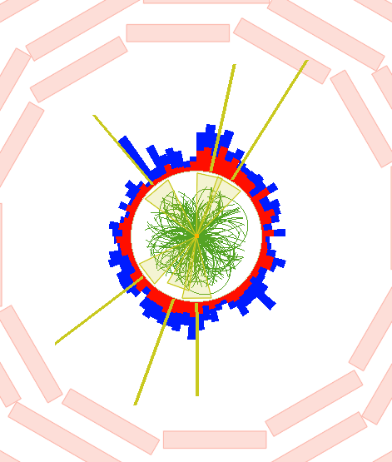
Proton-nucleus collisions at the LHC
Pb: 1.58 TeV/nucleon
Proton: 4 TeV
pPb pilot run at the LHC on September 13, for ~ 8 hours
z
y_{cm}=0.46
Center-of-mass energy:
√s_{NN} = 5.02 TeV

Slide 11
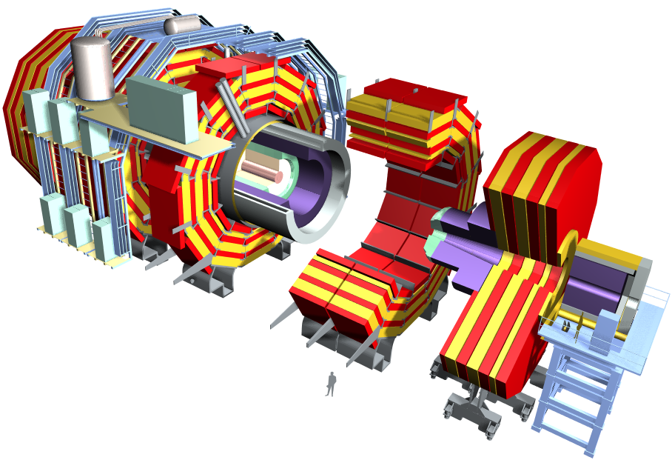
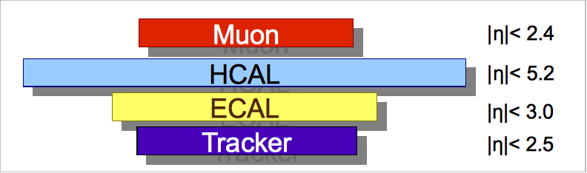
CMS experiment at the LHC
Hadron Calorimeter (HCAL)
EM Calorimeter (ECAL)
Beam Scintillator Counters (BSC)
Forward
Calorimeter
(HF)
Tracker
(Pixels and Strips)
Muon System
Unprecedented kinematic range and acceptance

Slide 12
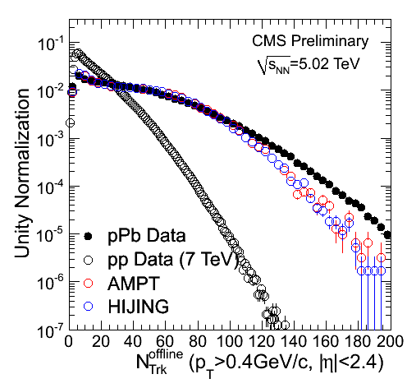
Multiplicity distribution in pPb
~ 2 million minimum bias pPb events were collected (1 μb⁻¹)
Much easier to reach high multiplicity in pPb, as expected

Slide 13
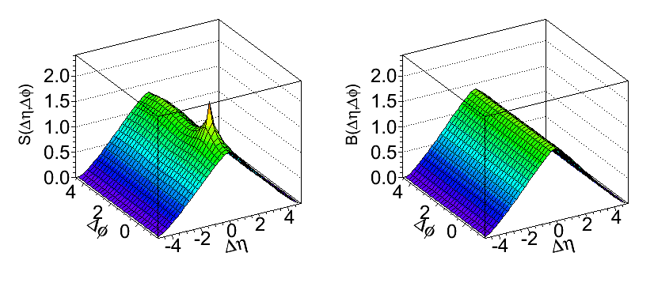
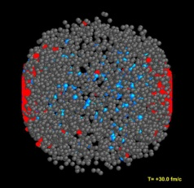
Two-particle correlations at CMS
Pair of two primary reconstructed tracks within |η|<2.4
Trigger particle from a p_{T}^{trig} interval
Associated particle from a p_{T}^{assoc} interval
Signal-pair distribution
Background-pair distribution
Triangular shape in Δη
due to limited acceptance
η=-2.4
η=0.0
η=2.4
z
Δη = η^{assoc} – η^{trig}
Δφ = φ^{assoc} – φ^{trig}
Same-event pairs
Mixed-event pairs
(similar z_{vtx})
Event 1:
Event 2:

Slide 14
Two-particle correlations at CMS
Pair of two primary reconstructed tracks within |η|<2.4
Trigger particle from a p_{T}^{trig} interval
Associated particle from a p_{T}^{assoc} interval
Signal-pair distribution
Background-pair distribution
Triangular shape in Δη
due to limited acceptance
η=-2.4
η=0.0
η=2.4
z
Δη = η^{assoc} – η^{trig}
Δφ = φ^{assoc} – φ^{trig}
Pair yield per trigger particle:

Slide 15
Two-particle correlations at CMS
Pair of two primary reconstructed tracks within |η|<2.4
Trigger particle from a p_{T}^{trig} interval
Associated particle from a p_{T}^{assoc} interval
Signal-pair distribution
Background-pair distribution
Triangular shape in Δη
due to limited acceptance
η=-2.4
η=0.0
η=2.4
z
Δη = η^{assoc} – η^{trig}
Δφ = φ^{assoc} – φ^{trig}
Pair yield per trigger particle:
acceptance
correction

Slide 16
First two-particle correlation result in pPb
p
Pb
for both p_{T}^{trig}, p_{T}^{assoc}
PLB718 (2013) 795
A significant near-side ridge in high multiplicity pPb!

Slide 17
First two-particle correlation result in pPb
p
Pb
ALICE (arXiv:1212.2001)
for both p_{T}^{trig}, p_{T}^{assoc}
ATLAS (arXiv:1212.5198)
PLB718 (2013) 795
A significant near-side ridge in high multiplicity pPb!

Slide 18

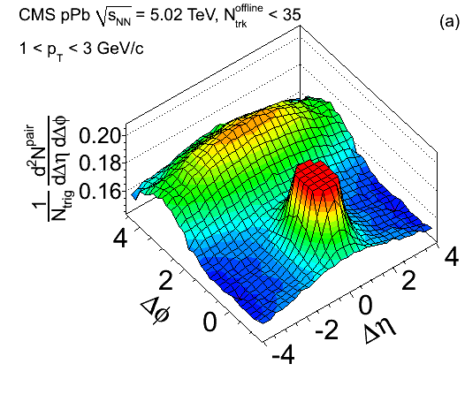
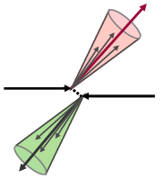
First two-particle correlation result in pPb
p
Pb
Fraction of cross section: 50.4%
Dijet-like correlations in low multiplicity (or peripheral) pPb!

Slide 19
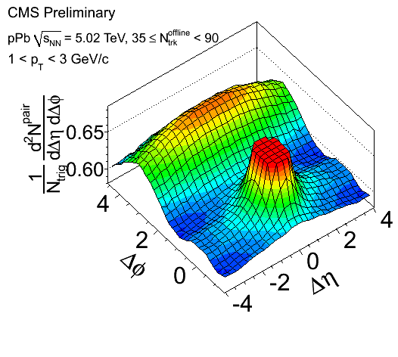
First two-particle correlation result in pPb
p
Pb
Fraction of cross section: 41.9%
Near-side (Δϕ~0) ridge structure turns on as multiplicity increases

Slide 20
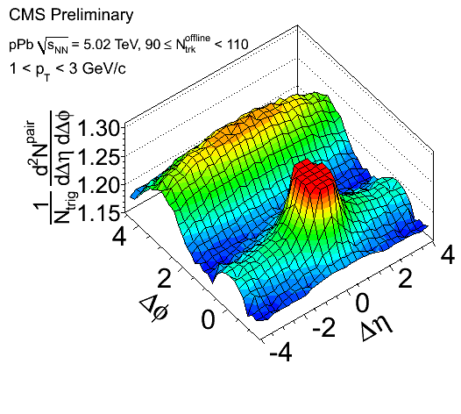
First two-particle correlation result in pPb
p
Pb
Fraction of cross section: 4.6%
Near-side (Δϕ~0) ridge structure turns on as multiplicity increases

Slide 21

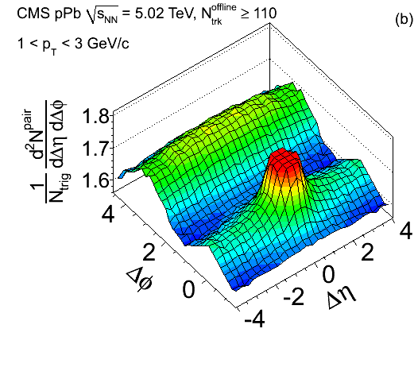
First two-particle correlation result in pPb
p
Pb
Fraction of cross section: 3.1%
Near-side (Δϕ~0) ridge structure turns on as multiplicity increases

Slide 22
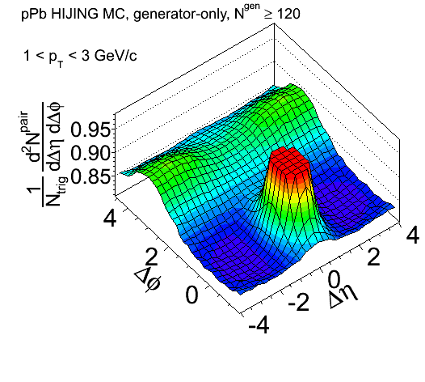
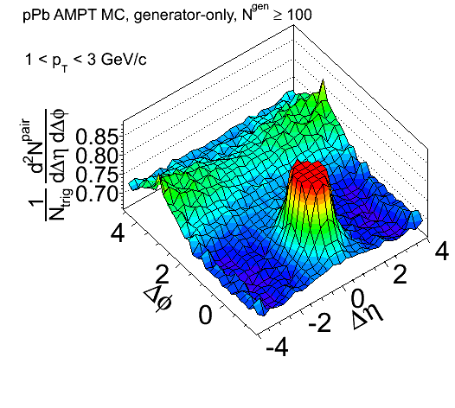
No ridge in pPb MC models
pPb HIJING, N>120
pPb data
pPb AMPT, N>100
Ridge is not predicted by common pPb
MC event generators, as in pp!
AMPT shows the ridge in AA collisions

Slide 23
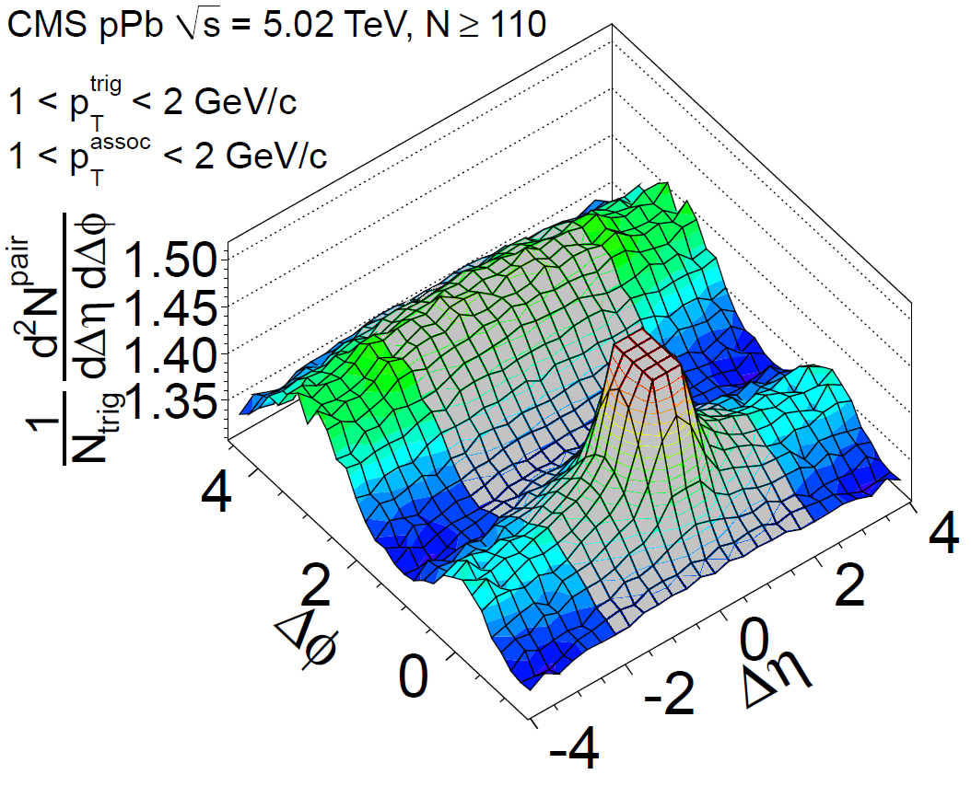
Quantify the ridge correlations
1 < p_{T} < 2 GeV/c
1 < p_{T} < 2 GeV/c
Average over
ridge region
(2<|Δη|<4)
2 < |Δη| < 4

Slide 24
Quantify the ridge correlations
1 < p_{T} < 2 GeV/c
1 < p_{T} < 2 GeV/c
Average over
ridge region
(2<|Δη|<4)
2 < |Δη| < 4
Shift the distribution to Zero Yield At Minimum (ZYAM)
N>=110
pPb 5.02 TeV
pp 7 TeV

Slide 25
Quantify the ridge correlations
1 < p_{T} < 2 GeV/c
1 < p_{T} < 2 GeV/c
Average over
ridge region
(2<|Δη|<4)
2 < |Δη| < 4
Shift the distribution to Zero Yield At Minimum (ZYAM)
N>=110
pPb 5.02 TeV
pp 7 TeV
Ridge in pPb is significantly
stronger than in pp at similar N

Slide 26
Quantify the ridge correlations
1 < p_{T} < 2 GeV/c
1 < p_{T} < 2 GeV/c
Average over
ridge region
(2<|Δη|<4)
2 < |Δη| < 4
Shift the distribution to Zero Yield At Minimum (ZYAM)
N>=110
pPb 5.02 TeV
pp 7 TeV

Slide 27
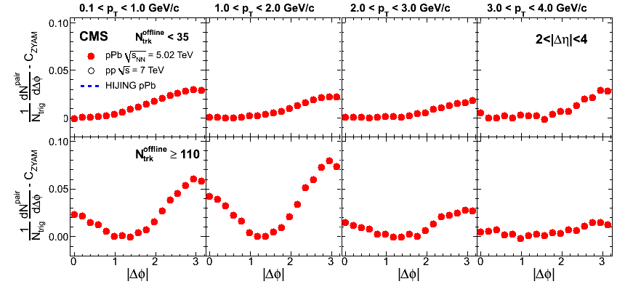
Quantify the ridge correlations
p_{T}
PLB718 (2013) 795

Slide 28
Quantify the ridge correlations
p_{T}
PLB718 (2013) 795
Ridge most prominently at:
high multiplicity, N >= 110
intermediate p_{T} ~ 1 GeV/c

Slide 29
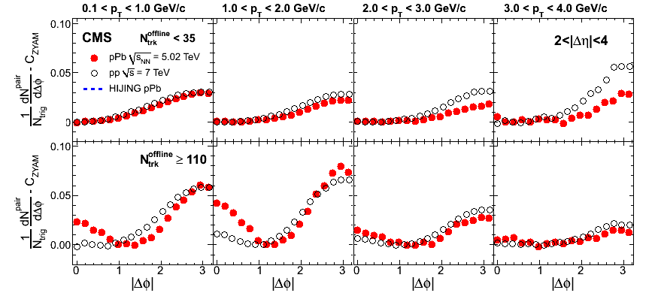
Quantify the ridge correlations
p_{T}
PLB718 (2013) 795
Ridge most prominently at:
high multiplicity, N >= 110
intermediate p_{T} ~ 1 GeV/c
Stronger ridge in pPb than in pp at similar N!

Slide 30
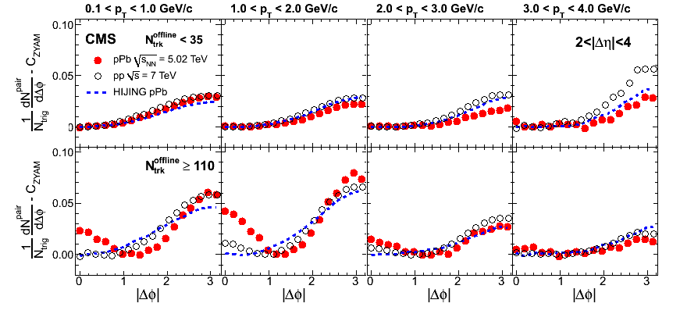
Quantify the ridge correlations
p_{T}
PLB718 (2013) 795
Ridge most prominently at:
high multiplicity, N >= 110
intermediate p_{T} ~ 1 GeV/c
Stronger ridge in pPb than in pp at similar N!
HIJING does not show any
near-side ridge in all bins

Slide 31
Quantify the ridge correlations
p_{T} and multiplicity dependence of ridge yield
Quantify the ridge
PLB718 (2013) 795
“Rise and Fall” as a function of p_{T}, similar to pp (even PbPb)!

Slide 32
Quantify the ridge correlations
p_{T} and multiplicity dependence of ridge yield
Quantify the ridge
PLB718 (2013) 795
“Rise and Fall” as a function of p_{T}, similar to pp (even PbPb)!
Become significant at N ~ 40 and linearly increases, similar to pp!

Slide 33
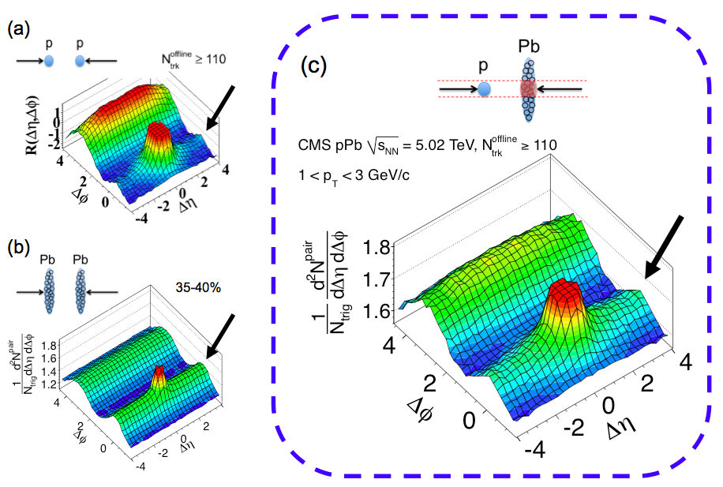
A complete picture of ridge correlations
Is there a common origin of the ridge in all systems?
Flow-like effect similar to PbPb? Final-state effect seen in pPb?
Other QCD mechanisms in smaller systems?

Slide 34
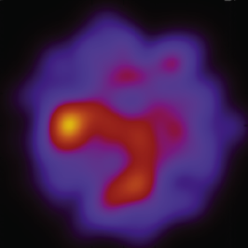
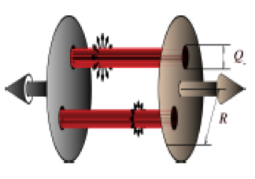
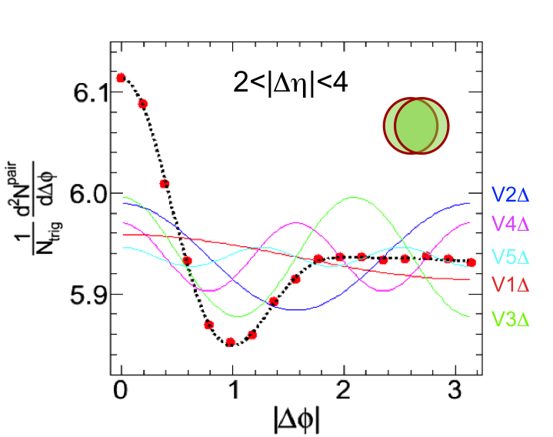
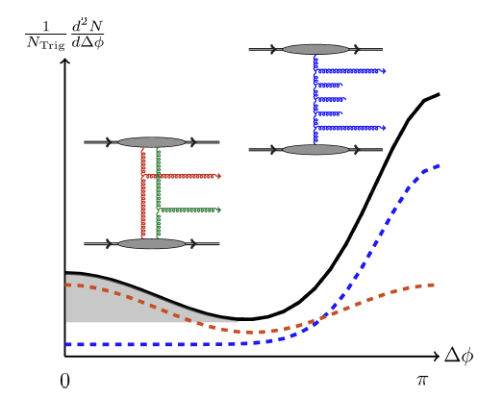
Understanding the origin of ridge
Hydrodynamics/final-state interactions
Intrinsic collimated gluon emission
from glasma diagram (CGC)
Initial-state asymmetry
K. Dusling, R. Venugopalan:
arXiv:1210.3890
BFKL Mini-jet
0-5% central PbPb
Glasma graphs

Slide 35
Understanding the origin of ridge
Hydrodynamics/final-state interactions
Intrinsic collimated gluon emission
from glasma diagram (CGC)
Initial-state asymmetry
K. Dusling, R. Venugopalan:
arXiv:1210.3890
BFKL Mini-jet
0-5% central PbPb
Glasma graphs
Key difference: initial-state “geometry” driven or not!

Slide 36
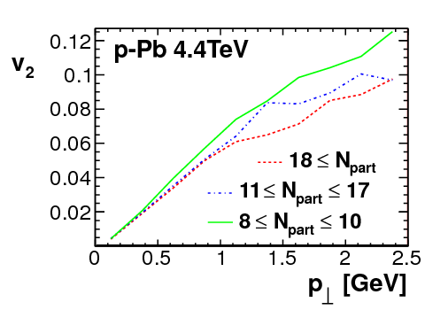
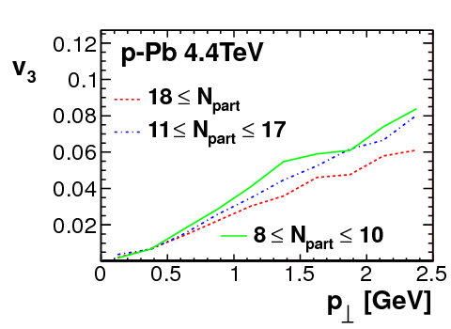
Hydrodynamics in pp and pA?
Viscous hydro calculation in pPb
P. Bozek, Phys.Rev. C85 (2012) 014911
v₂
v₃

Slide 37
Hydrodynamics in pp and pA?
Viscous hydro calculation in pPb
P. Bozek, Phys.Rev. C85 (2012) 014911
v₂
v₃

Slide 38
Hydrodynamics in pp and pA?
Viscous hydro calculation in pPb
P. Bozek, Phys.Rev. C85 (2012) 014911
v₂
v₃
Is hydro still valid for such small system size
and lifetime? Where is the limit?

Slide 39
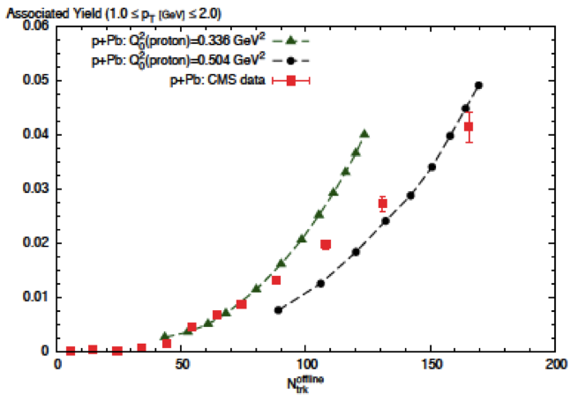
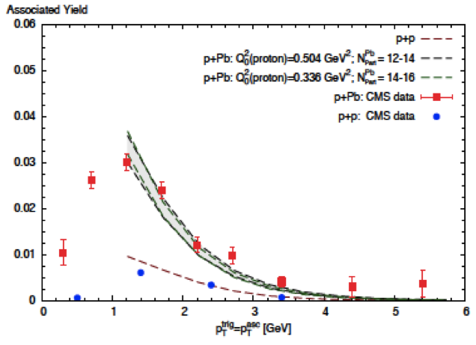
Ridge arising from gluon saturation
Calculations of ridge in pp and pPb from glasma mechanism
K. Dusling, R. Venugopalan: arXiv:1211.3701
Integrated associated yield
Correlation functions
Good description of the data
No need of asymmetric initial geometry
Need qualitatively different predictions from two scenarios!

Slide 40
Summary
First observation of a long-range near-side correlation (“ridge”) in high multiplicity (central) pPb collisions at 5.02 TeV
  much stronger than in pp
  not in common pPb MC models
Multiplicity and p_{T} dependence of the ridge in pPb have been investigated in detail:
  turns on slightly above average MB multiplicity
  rises and falls with p_{T}, similar trend as observed in PbPb and pp
N>=110
pPb 5.02 TeV
pp 7 TeV

Slide 41
Outlook
Observation of the ridge in pp and pPb opens up a new testing ground of high-density, strongly interacting QCD system
  Probing proton structure at very early timescale
  Final-state effect also seen in pA?
  Smoking gun of gluon saturation?
30000-fold increase in luminosity (30 nb⁻¹)
is expected in the nominal pPb run.
  Much wider reach in multiplicity
  Access to a variety of observables
  Direct comparison of pp, pPb, PbPb with
  drastically different system size, geometry
With ~ 250 nb⁻¹ projected luminosity, a pA program at RHIC can probe the same exciting physics and provide a new handle in the collision energy dependence
Stay tuned!
O(10⁴)

Slide 42
Outlook
Observation of the ridge in pp and pPb opens up a new testing ground of high-density, strongly interacting QCD system
  Probing proton structure at very early timescale
  Final-state effect also seen in pA?
  Smoking gun of gluon saturation?
30,000-fold increase in luminosity (30 nb⁻¹)
is expected in the nominal pPb run
  Much wider reach in multiplicity
  Access to a variety of observables
  Direct comparison of pp, pPb, PbPb with
  drastically different system size, geometry
With ~ 250 nb⁻¹ projected luminosity, a pA program at RHIC can probe the same exciting physics and provide a new handle in the collision energy dependence
O(10⁴)

Slide 43
Outlook
Observation of the ridge in pp and pPb opens up a new testing ground of high-density, strongly interacting QCD system
  Probing proton structure at very early timescale
  Final-state effect also seen in pA?
  Smoking gun of gluon saturation?
30,000-fold increase in luminosity (30 nb⁻¹)
is expected in the nominal pPb run
  Much wider reach in multiplicity
  Access to a variety of observables
  Direct comparison of pp, pPb, PbPb with
  drastically different system size, geometry
With ~ 250 nb⁻¹ projected luminosity, a pA program at RHIC can probe the same exciting physics and provide a new handle in the collision energy dependence
Stay tuned!
O(10⁴)

Slide 44
Outlook
Observation of the ridge in pp and pPb opens up a new testing ground of high-density, strongly interacting QCD system
  Probing proton structure at very early timescale
  Final-state effect also seen in pA?
  Smoking gun of gluon saturation?
30,000-fold increase in luminosity (30 nb⁻¹)
is expected in the nominal pPb run
  Much wider reach in multiplicity
  Access to a variety of observables
  Direct comparison of pp, pPb, PbPb with
  drastically different system size, geometry
With ~ 250 nb⁻¹ projected luminosity, a pA program at RHIC can probe the same exciting physics and provide a new handle in the collision energy dependence
Stay tuned!
O(10⁴)

Slide 45
Backups

Slide 46
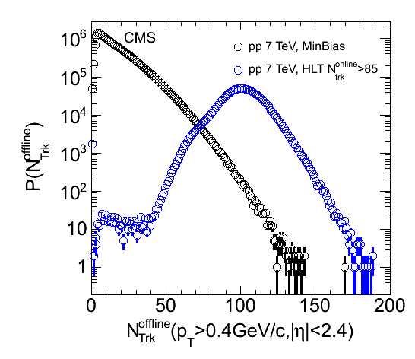
Very high multiplicity pp collisions
Dedicated online selection of high multiplicity events

Slide 47
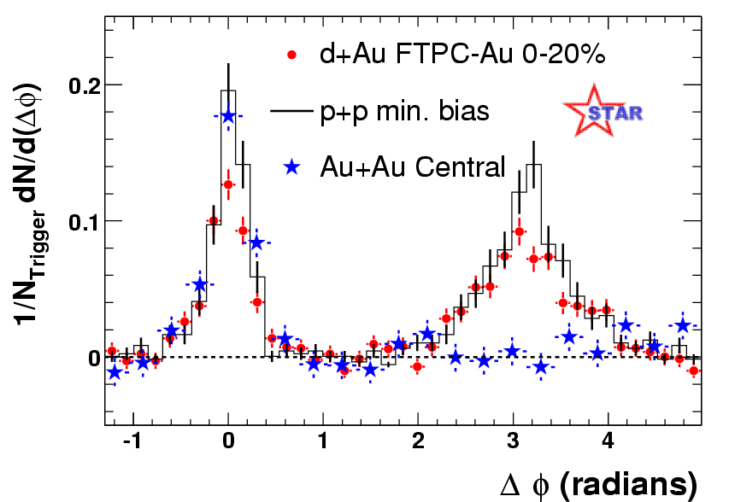
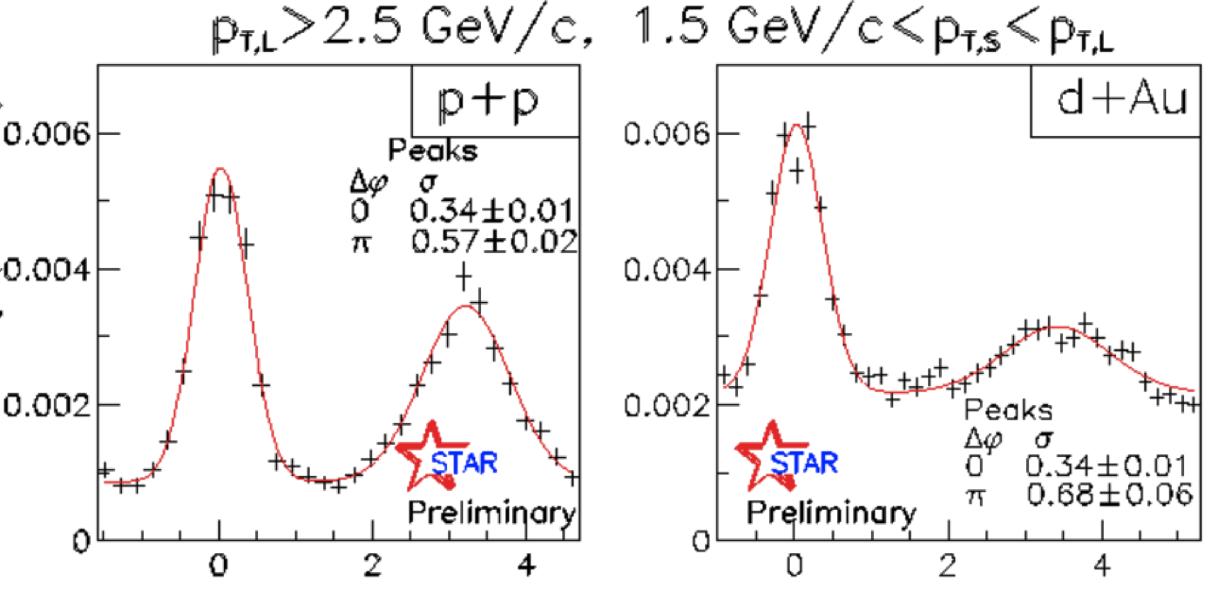
Why studying pA collisions?
Reference for nucleus-nucleus collisions: to address the issue of cold nuclear matter effects
Observation of jet quenching
in AuAu but not in pp or dAu
➔Final-state effect
Probe nucleus structure at extremely small-x regime
Modification of away side
In dAu at forward rapidity
➔Saturation of small-x gluons?

