Slide 1
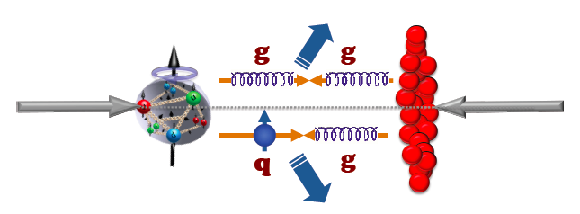


p-A Collisions at RHIC
T. Ludlam
January 7, 2013
Brookhaven Science Associates
U.S. Department of Energy

Slide 2
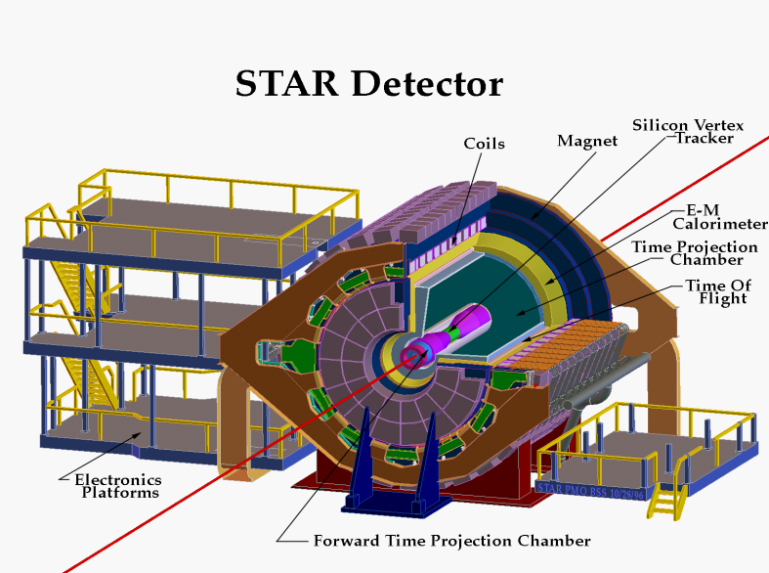
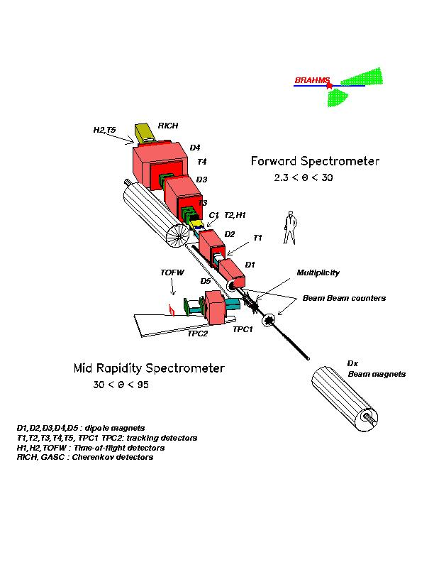
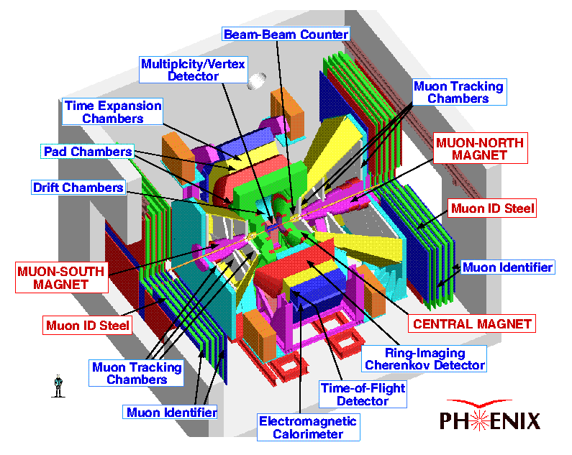

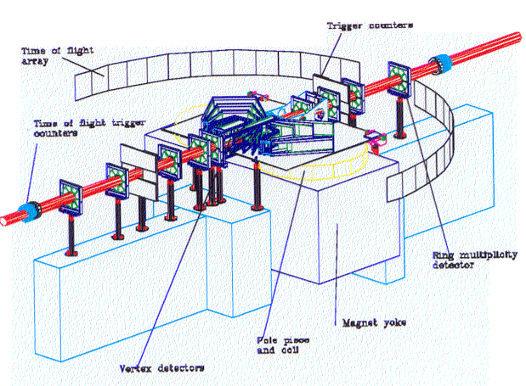
In the Beginning:
RHIC experiments configured to focus on hot nuclear matter in the central region
Little attention to the study of cold matter in nuclei-- interest primarily as a “baseline”
PHOBOS
STAR
Not much detector coverage in the forward direction.
Provision for asymmetric beams in the RHIC rings was designed in, but not as a forefront capability.

Slide 3
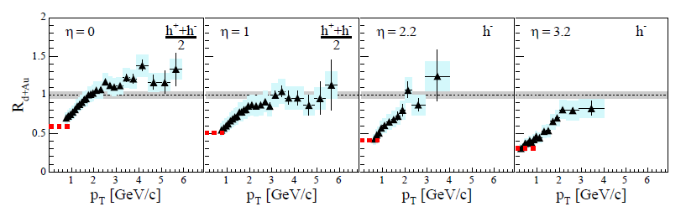
Early surprises with probes of Cold Nuclear Matter at RHIC
BRAHMS result from 2003 d + Au Run
Color Glass Condensate?
High Pt hadrons are suppressed at very forward angles in d-Au collisions:
hint of initial-state gluon saturation .
Transverse Single Spin asymmetries are large at RHIC energies:
New experimental probe of color interactions; potential to distinguish initial and final state effects.

Slide 4
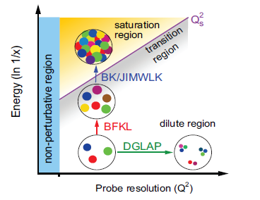
QCD at extreme parton densities
Attention has now turned to the fundamental importance of the saturated gluon state.
p – A collisions provide a smaller, simpler probe.
Enhanced RHIC II luminosity
p-A collisions at LHC
Science goals for an Electron Ion Collider
Renewed focus on forward kinematics at RHIC:
Scattering of high-x valence quark off low-x gluon.
New idea:
Scattering a polarized probe on saturated gluon matter. Transverse Single Spin asymmetry may provide a further experimental test of effective theory for gluon saturation, e.g. test CGC predictions.
Need forward upgrades to the detectors

Slide 5
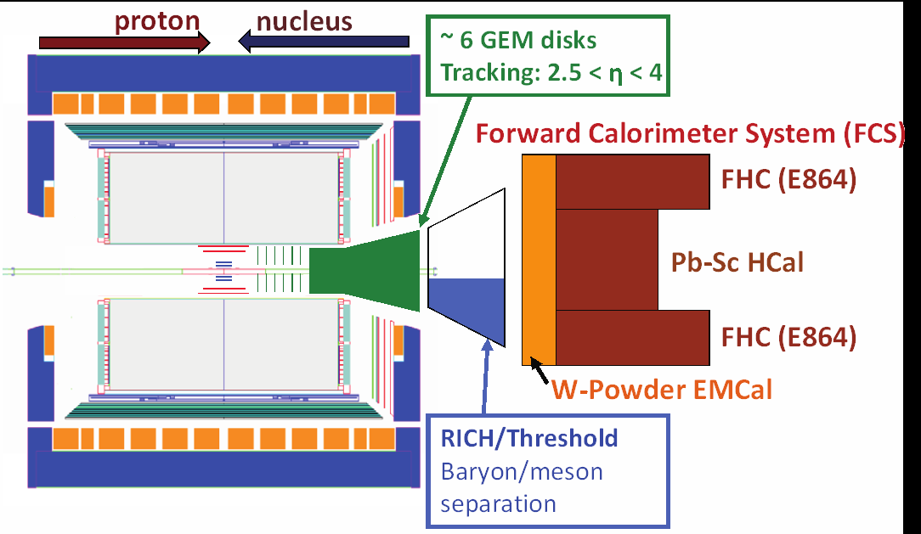
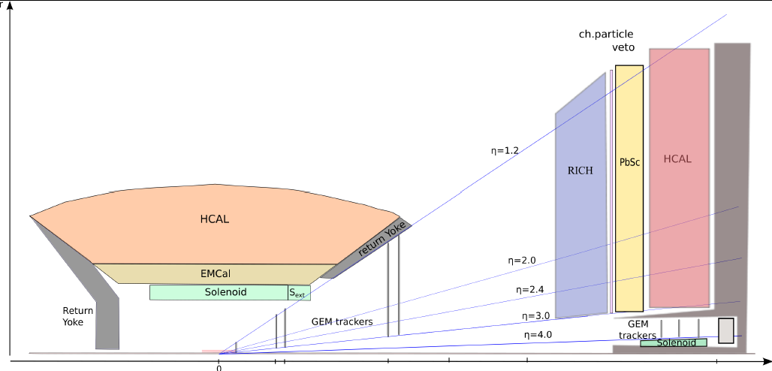
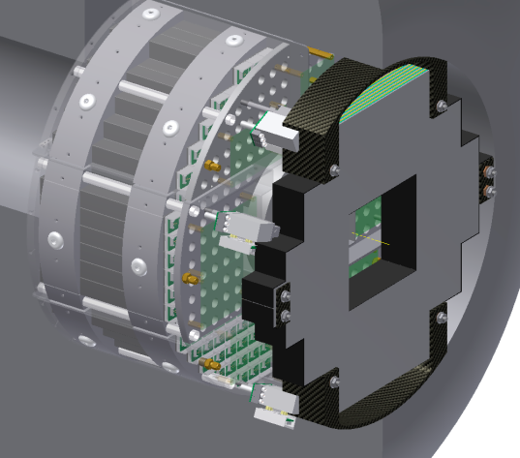
Forward Upgrades
STAR and PHENIX
STAR Forward Upgrades
sPHENIX Forward Upgrades
PHENIX MPC-EX

Slide 6
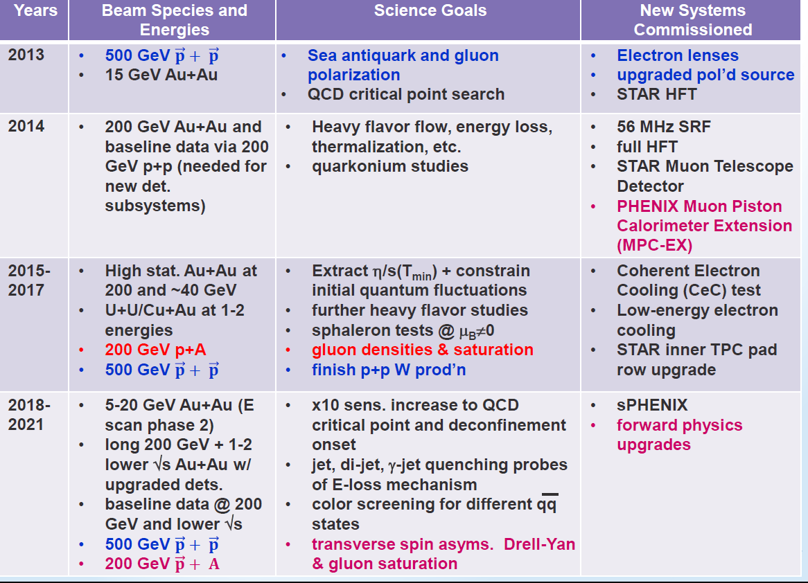
RHIC Timeline for the next Decade
From the White Paper “The Case for Continuing RHIC Operations”

