Slide 1
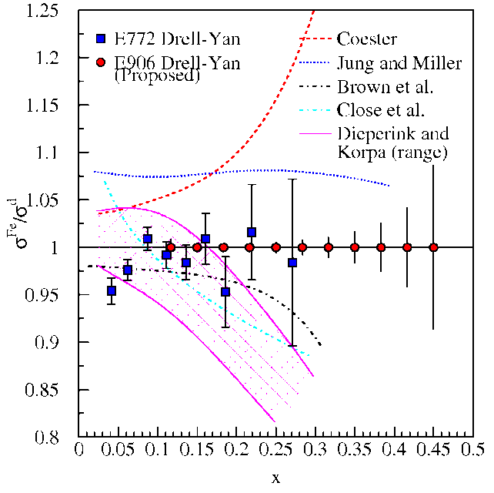

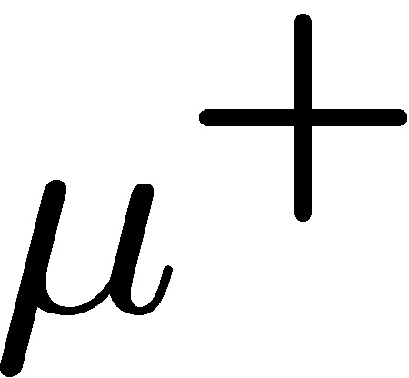

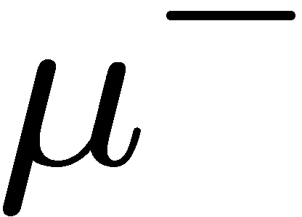
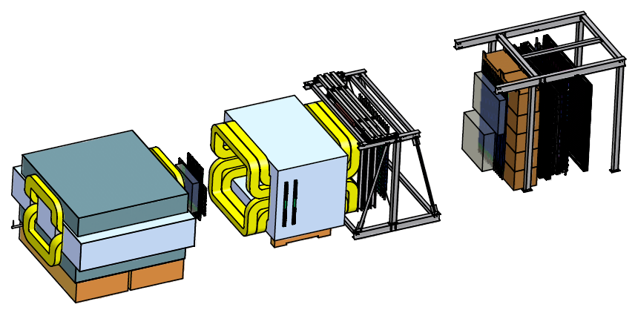
Fermilab E-906/SeaQuest: Measurements of pA Spin Independent Drell-Yan
Paul E. Reimer
Physics Division
Argonne National Laboratory
7 January 2013
The Big Picutre--Drell-Yan
EMC effect
Partonic Energy Loss
This work is supported in part by the U.S. Department of Energy, Office of Nuclear Physics, under Contract No. DE-AC02-06CH11357.

Slide 2
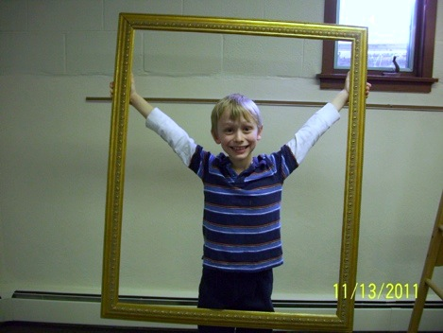
The Big Picture

Slide 3
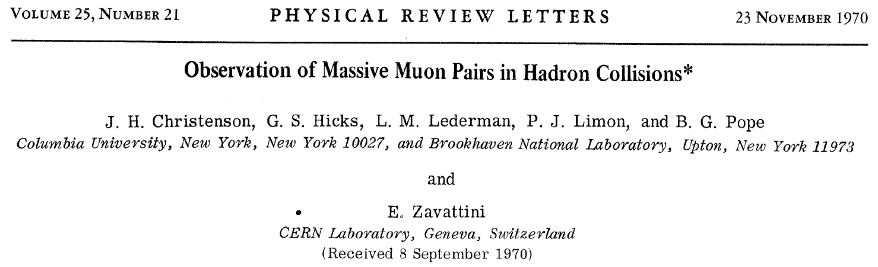
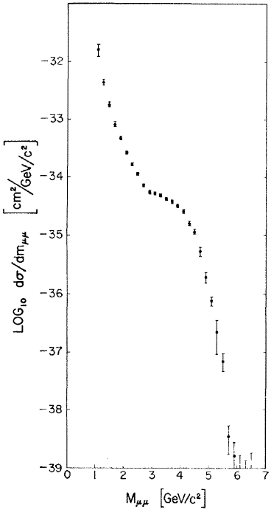
Early Muon Pair Data—soon to be called Drell-Yan
Muon Pairs in the mass range 1 < m_{μμ} < 6.7 GeV/c² have been observed in collisions of high-energy protons with uranium nuclei. At an incident energy of 29 GeV, the cross section varies smoothly as dσ/dm_{μμ} ≈ 10⁻³² / m_{μμ}⁵ cm² (GeV/c)⁻² and exhibits no resonant structure. The total cross section increases by a factor of 5 as the proton energy rises from 22 to 29.5 GeV.

Slide 4
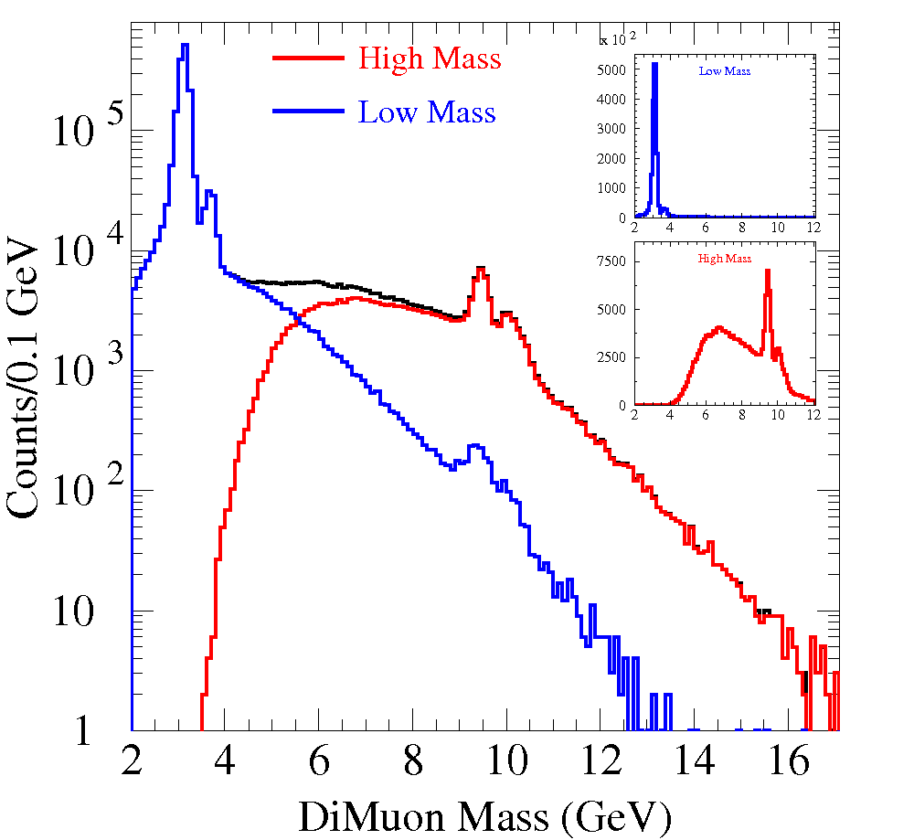
Early Muon Pair Data—soon to be called Drell-Yan

Slide 5
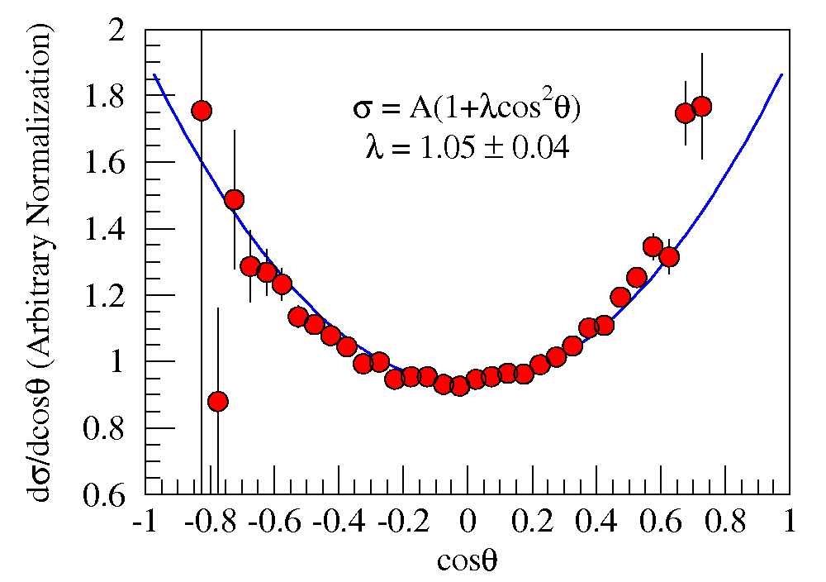
Drell and Yan’s explanation
Also predicted
λ(1+cos²θ)
angular distributions.
Fermilab E-866/NuSea
unpublished

Slide 6
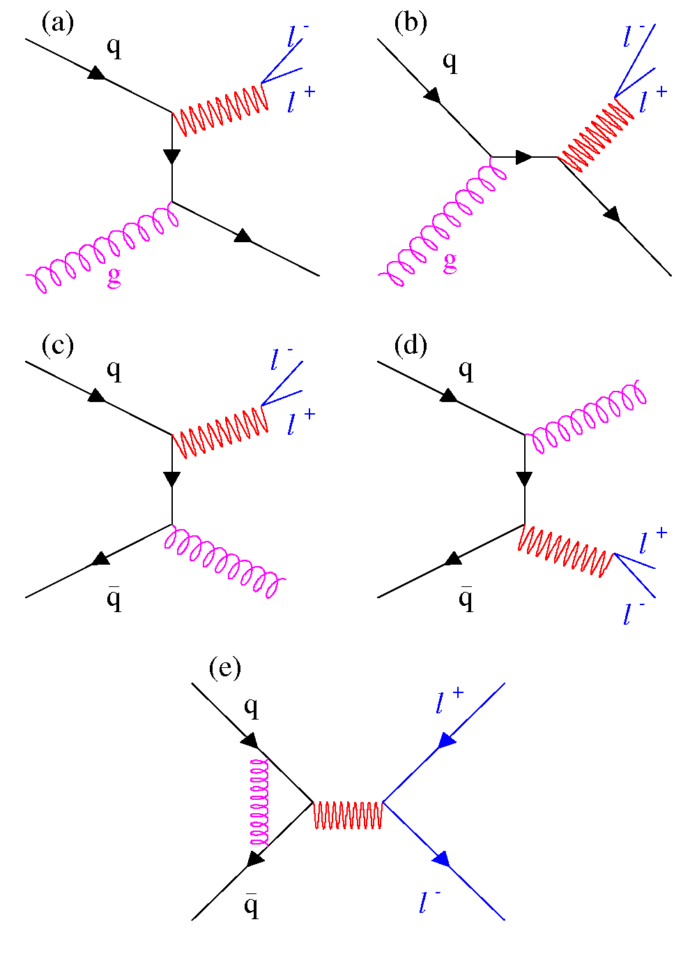
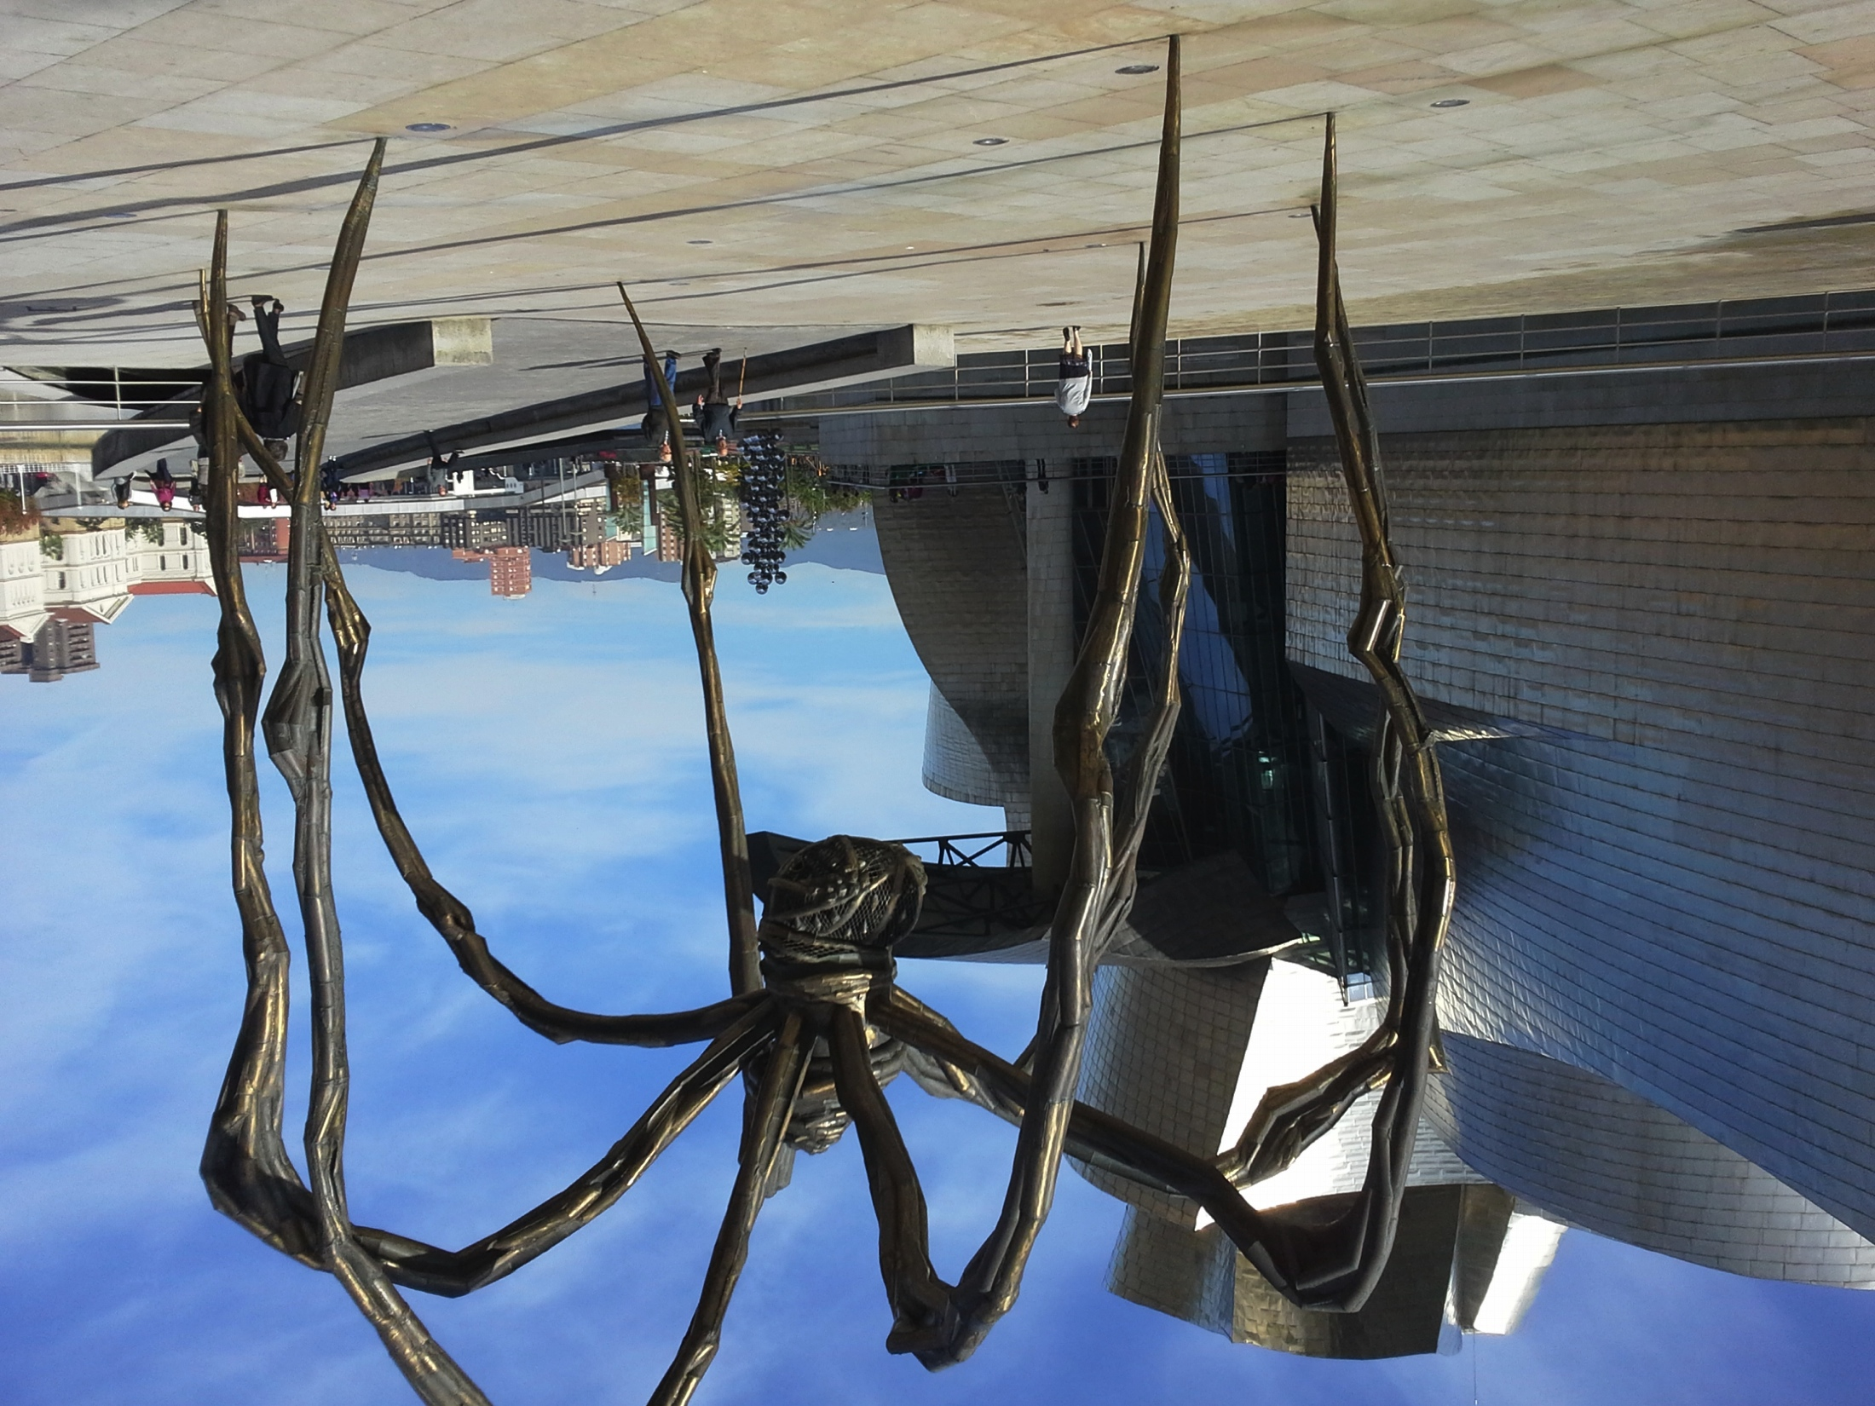
Drell-Yan Cross Section
Next-to-Leading Order
These diagrams are responsible for up to 50% of the measured cross section
Parton distributions are Universal!
Intrinsic transverse momentum of quarks (although a small effect, λ > 0.8)
Soft gluon resummation at all orders
Angular Distributions
Higher Twist??

Slide 7
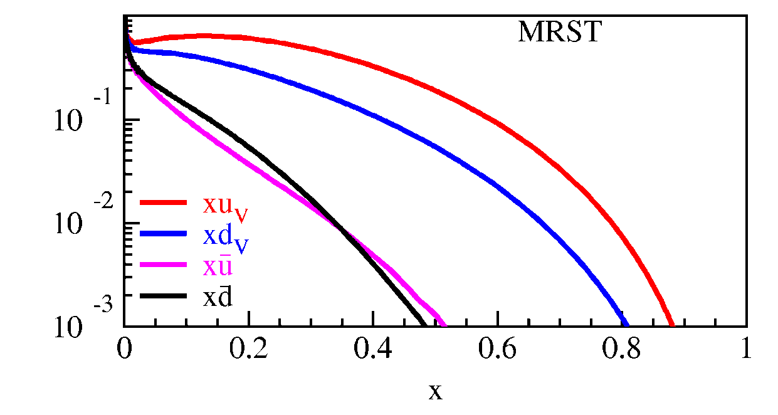
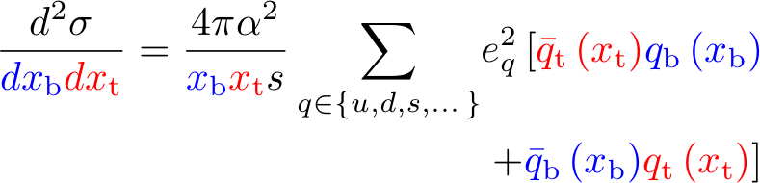
Drell-Yan Cross Section
Measured cross section is a convolution of beam and target parton distributions
Proton Beam
  Target antiquarks and beam
u-quark dominance
  (2/3)² vs. (1/3)²
x_{target}
x_{beam}

Slide 8
Drell-Yan Cross Section
Measured cross section is a convolution of beam and target parton distributions
Proton Beam
  Target antiquarks and beam
u-quark dominance
  (2/3)² vs. (1/3)²
x_{target}
x_{beam}
π⁻ beam
  Valence beam anti-u quark and u target quark
Acceptance limited
Beam | Target | Experiment
Hadron | Beam valence quarks target antiquarks | Fermilab E-906, RHIC (forward acpt.) J-PARC
Anti-Hadron | Beam val. antiquarks Target valence quarks | GSI-FAIR Fermilab Collider
Meson | Beam val. antiquarks Target valence quarks | COMPASS
Valence × Valence
Valence-sea ×¼
Sea-Sea

Slide 9
What can Drell-Yan tell us about the EMC effect?

Slide 10
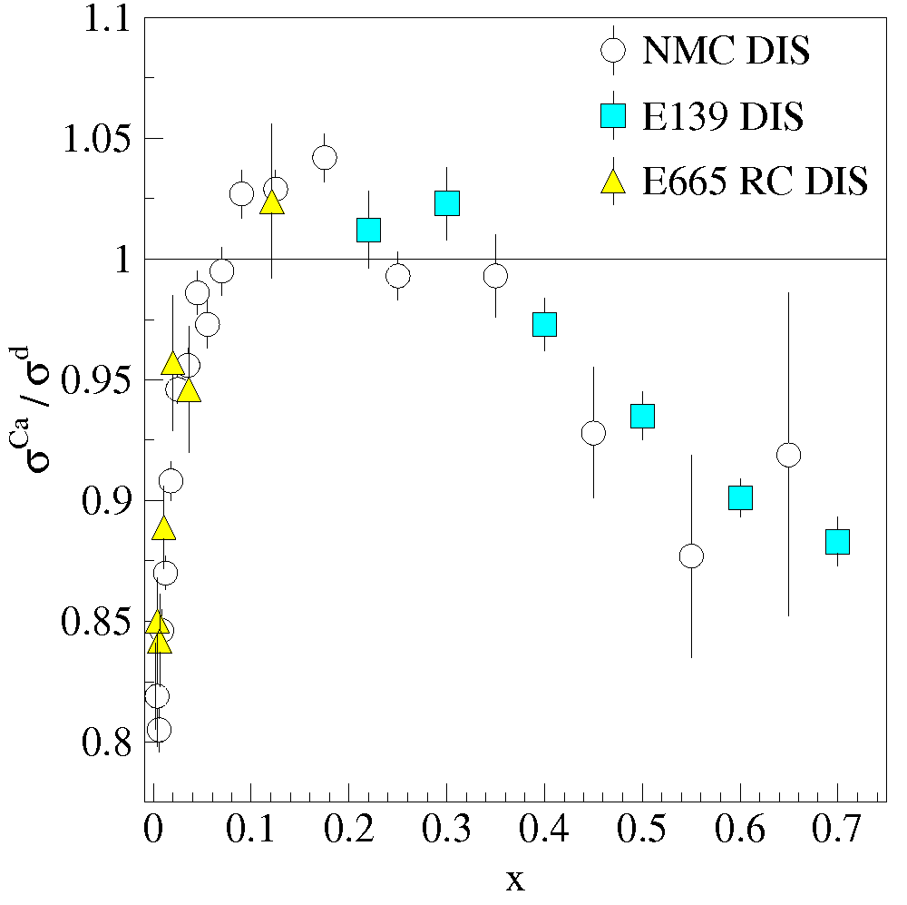
Structure of nucleonic matter:
The EMC effect
Comparison with
Deep Inelastic Scattering (DIS)
EMC: Parton distributions of bound and free nucleons are different.
Nuclear binding effects distributions of quarks within the nucleons

Slide 11
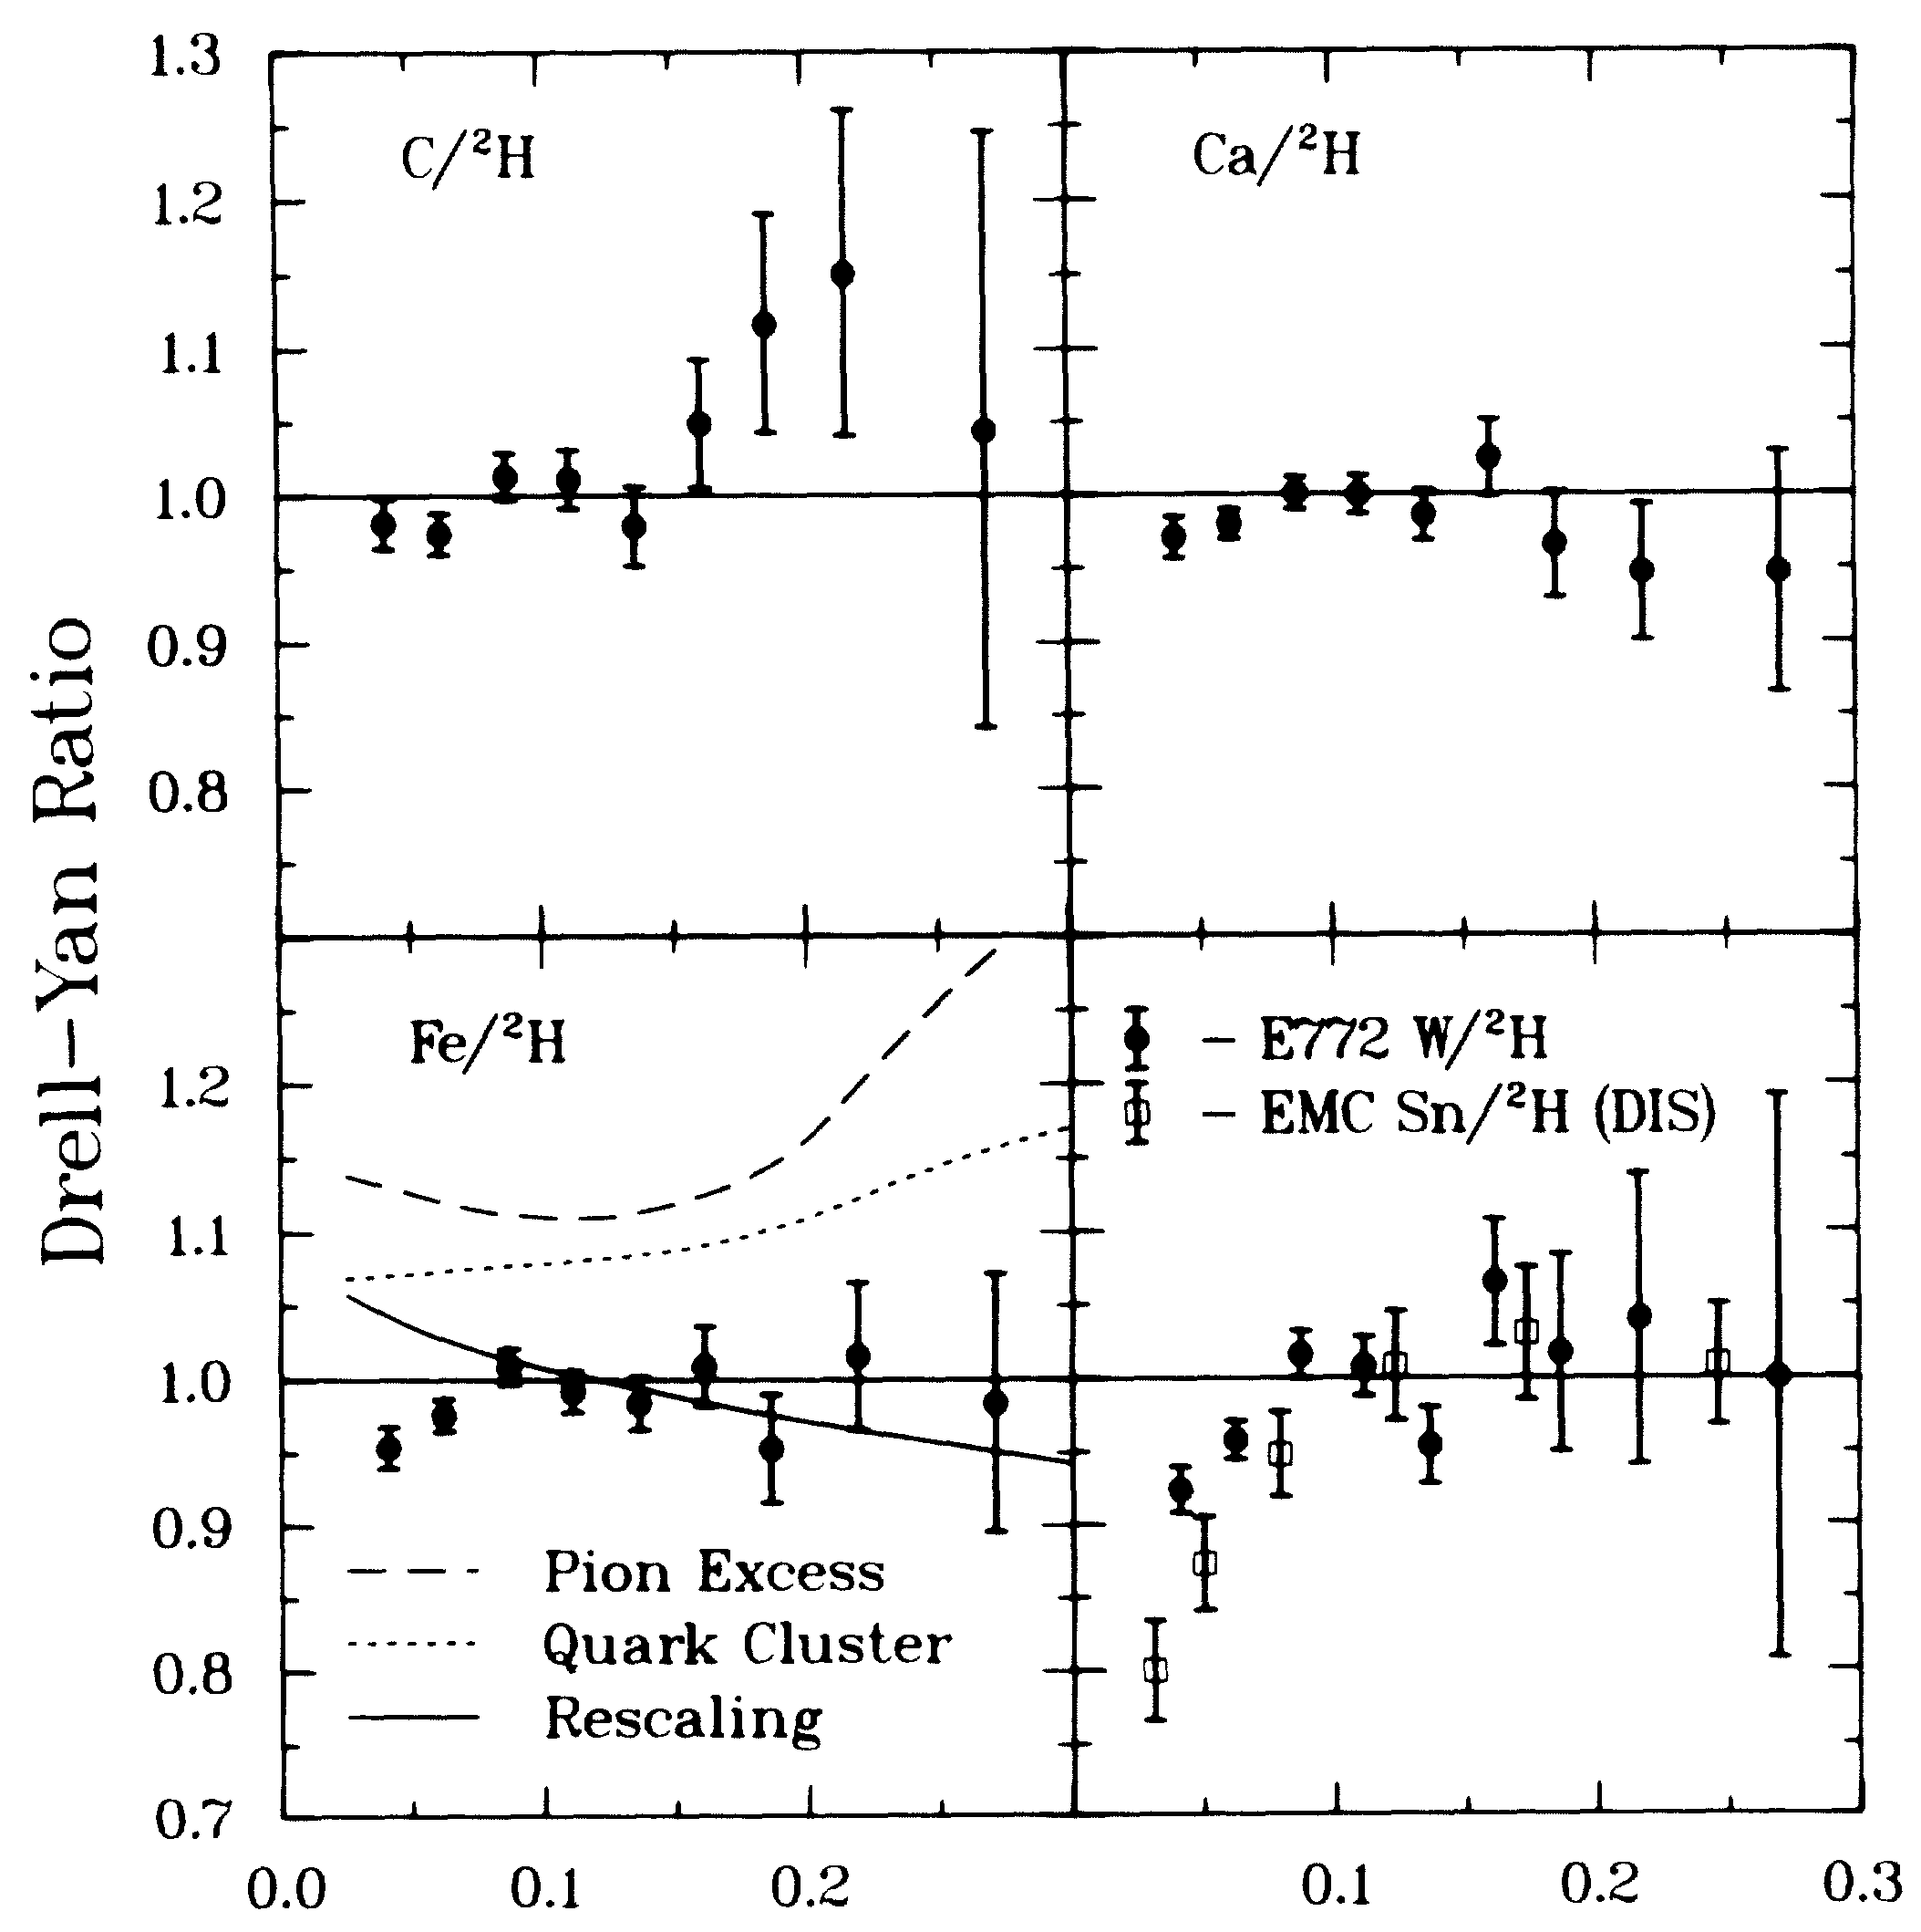
Structure of nucleonic matter:
How do DIS and Drell-Yan data compare?
Shadowing present in Drell-Yan
Antishadowing not seen in Drell-Yan—Valence only effect
Alde et al (Fermilab E772) Phys. Rev. Lett. 64 2479 (1990)

Slide 12
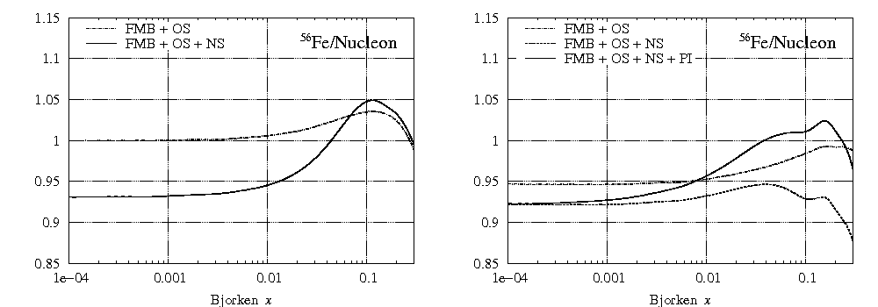
Kulagin and Petti sea vs. valence nuclear effects
Valence
Sea
Nuclear Physics A 765 (2006) 126–187

Slide 13
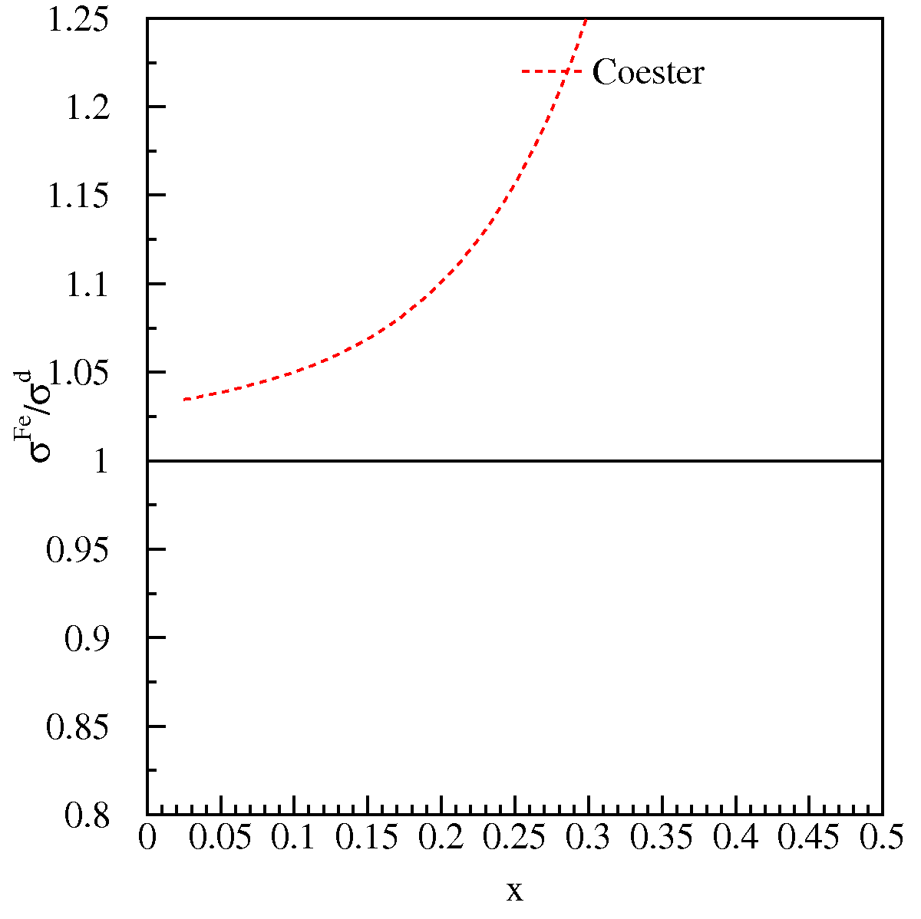
Structure of nucleonic matter: Where are the nuclear pions?
The binding of nucleons in a nucleus is expected to be governed by the exchange of virtual “Nuclear” mesons.
Notes:
George Bertsch in Science: Where are the nuclear pions? Answers in terms of Gluonic fields
Berger and Coester: Standard nuclear convolution:
F_2^A = \int dy f_N^A(y) F_2^N(x/y) + \int dy f_\pi^A(y) F_2^\pi(x/y)
where the F_2’s are the DIS structure functions of the nucleus, nucleon and pion and f_N/\pi^A are the nucleon/pion distribution
functions. Other baryons are added as well and all is subject to conservation rules on baryon number and small f’s have total momentum conservation rules
Jung and Miller: Start with Berger and Coester, but uses different pionic distribution function in nucleus from Ericson and Thomas—points out that Berger and
Coester should have used a light cone rather that instant-(time) form nuclear wave function.
Brown et al.: Brown, Rho rescaling—inside a nuclear environment masses of hadron composed of light quarks all decrease with density (at the same rate—see
eqn 2.23). The rescaling is based on a partial restoration of Chiral Symmetry. This the also effects the coupling strengths. Based on this, one obtains a
modified pion density distribution and follows the convolution model of Berger and Coester.
Dieperink and Korpa: First, range of curves is for various Migdal parameters. Looks at real and imaginary parts of particle-hole (nucleon-hole?) and \Delta-hole
contributions. Also look at the self-energy of the pion propagator. The dressed pion propagator included nucleon and \Delta terms. These affect the pion
distribution function (f_pi)

Slide 14
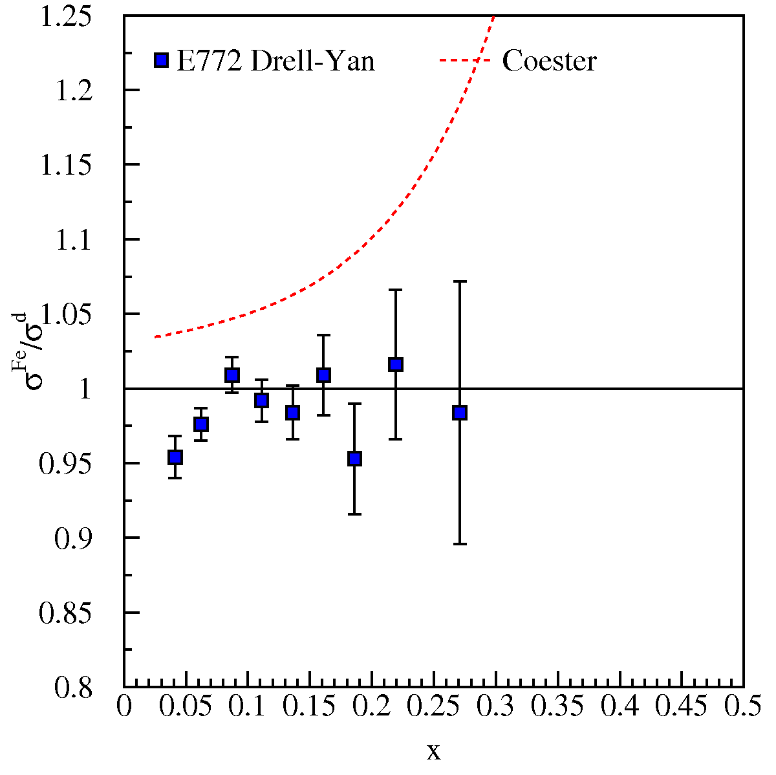
Structure of nucleonic matter: Where are the nuclear pions?
The binding of nucleons in a nucleus is expected to be governed by the exchange of virtual “Nuclear” mesons.
No antiquark enhancement seen in Drell-Yan (Fermilab E772) data.
Notes:
George Bertsch in Science: Where are the nuclear pions? Answers in terms of Gluonic fields
Berger and Coester: Standard nuclear convolution:
F_2^A = \int dy f_N^A(y) F_2^N(x/y) + \int dy f_\pi^A(y) F_2^\pi(x/y)
where the F_2’s are the DIS structure functions of the nucleus, nucleon and pion and f_N/\pi^A are the nucleon/pion distribution functions. Other baryons are added as well and all is subject to conservation rules on baryon number and small f’s have total momentum conservation rules
Jung and Miller: Start with Berger and Coester, but uses different pionic distribution function in nucleus from Ericson and Thomas—points out that Berger and Coester should have used a light cone rather that instant-(time) form nuclear wave function.
Brown et al.: Brown, Rho rescaling—inside a nuclear environment masses of hadron composed of light quarks all decrease with density (at the same rate—see eqn 2.23). The rescaling is based on a partial restoration of Chiral Symmetry. This the also effects the coupling strengths. Based on this, one obtains a modified pion density distribution and follows the convolution model of Berger and Coester.
Dieperink and Korpa: First, range of curves is for various Migdal parameters. Looks at real and imaginary parts of particle-hole (nucleon-hole?) and \Delta-hole contributions. Also look at the self-energy of the pion propagator. The dressed pion propagator included nucleon and \Delta terms. These affect the pion distribution function (f_pi)

Slide 15
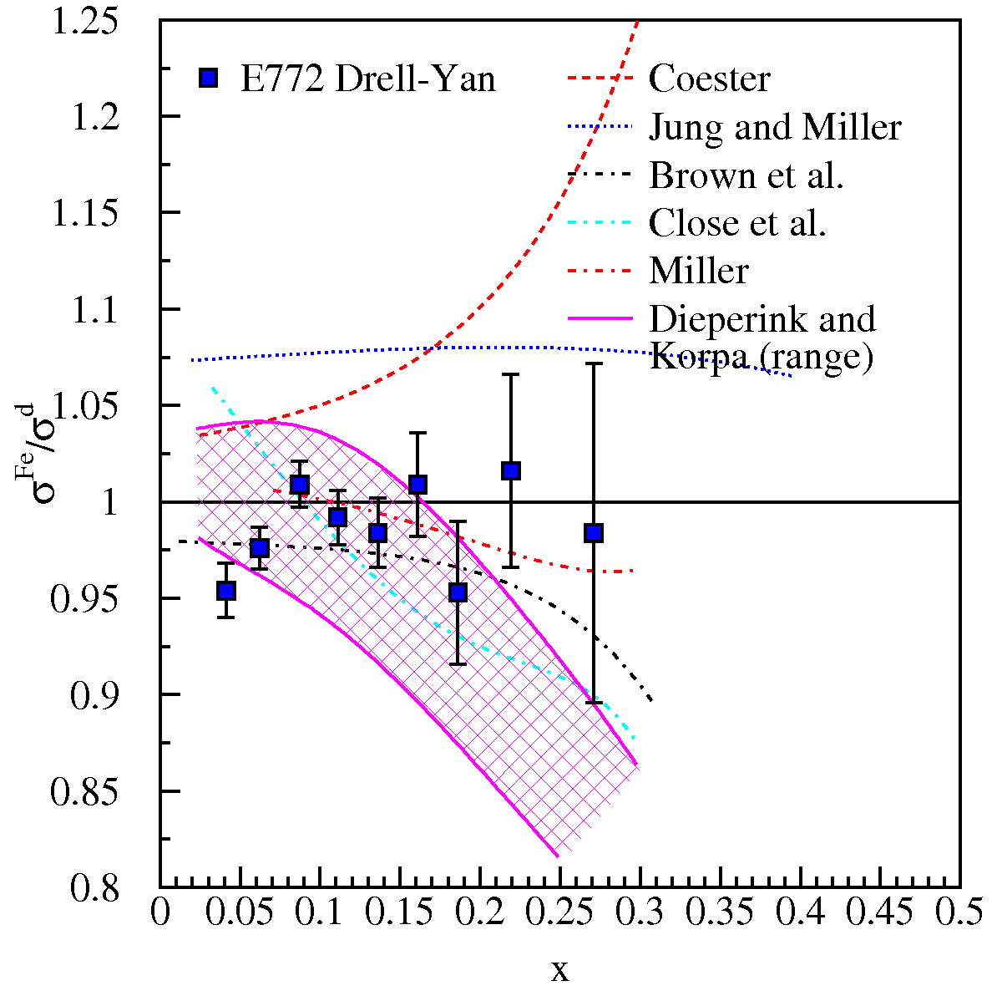
Structure of nucleonic matter: Where are the nuclear pions?
The binding of nucleons in a nucleus is expected to be governed by the exchange of virtual “Nuclear” mesons.
No antiquark enhancement seen in Drell-Yan (Fermilab E772) data.
Contemporary models predict large effects to antiquark distributions as x increases.
Models must explain both DIS-EMC effect and Drell-Yan
Notes:
George Bertsch in Science: Where are the nuclear pions? Answers in terms of Gluonic fields
Berger and Coester: Standard nuclear convolution:
F_2^A = \int dy f_N^A(y) F_2^N(x/y) + \int dy f_\pi^A(y) F_2^\pi(x/y)
where the F_2’s are the DIS structure functions of the nucleus, nucleon and pion and f_N/\pi^A are the nucleon/pion distribution functions. Other baryons are added as well and all is subject to conservation rules on baryon number and small f’s have total momentum conservation rules
Jung and Miller: Start with Berger and Coester, but uses different pionic distribution function in nucleus from Ericson and Thomas—points out that Berger and Coester should have used a light cone rather that instant-(time) form nuclear wave function.
Brown et al.: Brown, Rho rescaling—inside a nuclear environment masses of hadron composed of light quarks all decrease with density (at the same rate—see eqn 2.23). The rescaling is based on a partial restoration of Chiral Symmetry. This the also effects the coupling strengths. Based on this, one obtains a modified pion density distribution and follows the convolution model of Berger and Coester.
Dieperink and Korpa: First, range of curves is for various Migdal parameters. Looks at real and imaginary parts of particle-hole (nucleon-hole?) and \Delta-hole contributions. Also look at the self-energy of the pion propagator. The dressed pion propagator included nucleon and \Delta terms. These affect the pion distribution function (f_pi)

Slide 16
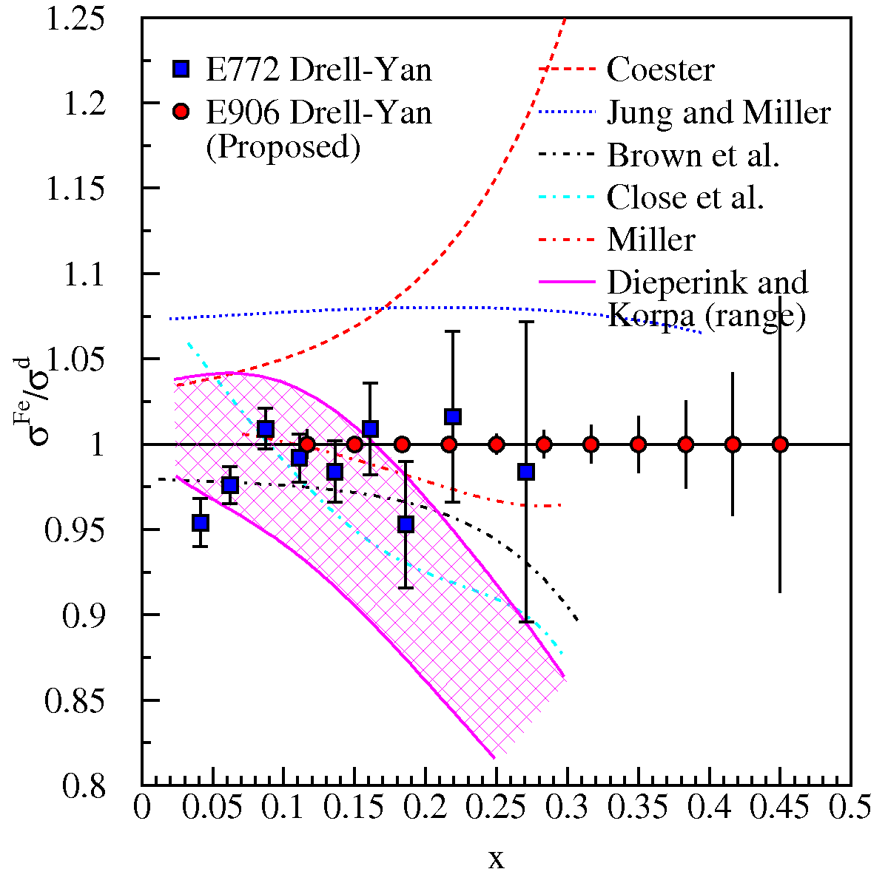
Structure of nucleonic matter: Where are the nuclear pions?
The binding of nucleons in a nucleus is expected to be governed by the exchange of virtual “Nuclear” mesons.
No antiquark enhancement seen in Drell-Yan (Fermilab E772) data.
Contemporary models predict large effects to antiquark distributions as x increases.
Models must explain both DIS-EMC effect and Drell-Yan
Notes:
George Bertsch in Science: Where are the nuclear pions? Answers in terms of Gluonic fields
Berger and Coester: Standard nuclear convolution:
F_2^A = \int dy f_N^A(y) F_2^N(x/y) + \int dy f_\pi^A(y) F_2^\pi(x/y)
where the F_2’s are the DIS structure functions of the nucleus, nucleon and pion and f_N/\pi^A are the nucleon/pion distribution functions. Other baryons are added as well and all is subject to conservation rules on baryon number and small f’s have total momentum conservation rules
Jung and Miller: Start with Berger and Coester, but uses different pionic distribution function in nucleus from Ericson and Thomas—points out that Berger and Coester should have used a light cone rather that instant-(time) form nuclear wave function.
Brown et al.: Brown, Rho rescaling—inside a nuclear environment masses of hadron composed of light quarks all decrease with density (at the same rate—see eqn 2.23). The rescaling is based on a partial restoration of Chiral Symmetry. This the also effects the coupling strengths. Based on this, one obtains a modified pion density distribution and follows the convolution model of Berger and Coester.
Dieperink and Korpa: First, range of curves is for various Migdal parameters. Looks at real and imaginary parts of particle-hole (nucleon-hole?) and \Delta-hole contributions. Also look at the self-energy of the pion propagator. The dressed pion propagator included nucleon and \Delta terms. These affect the pion distribution function (f_pi)

Slide 17
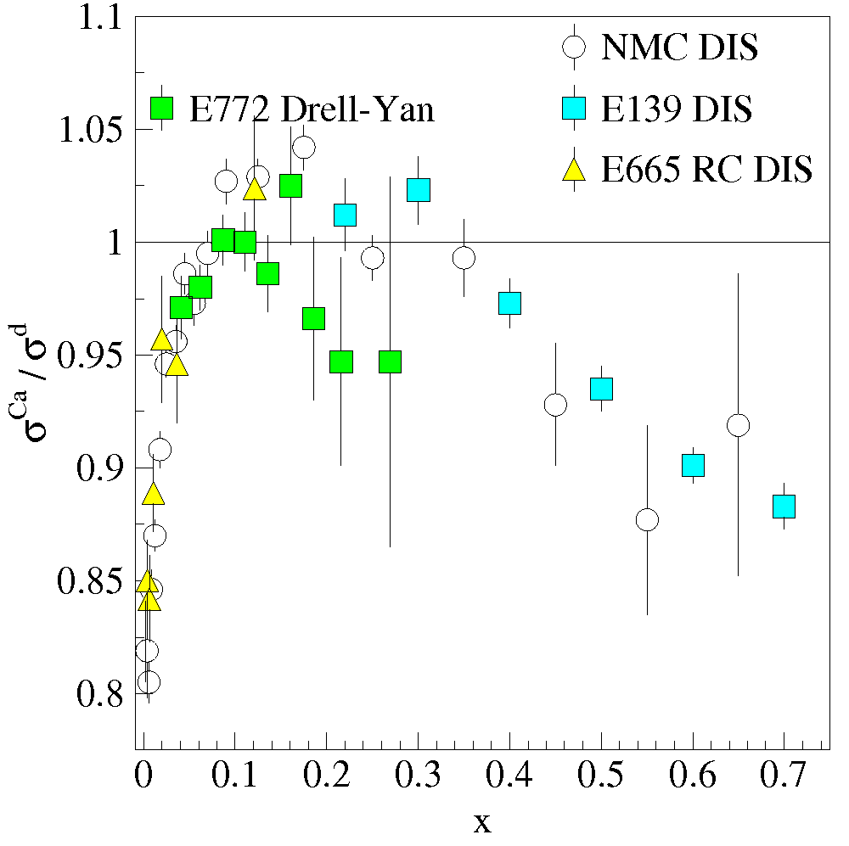
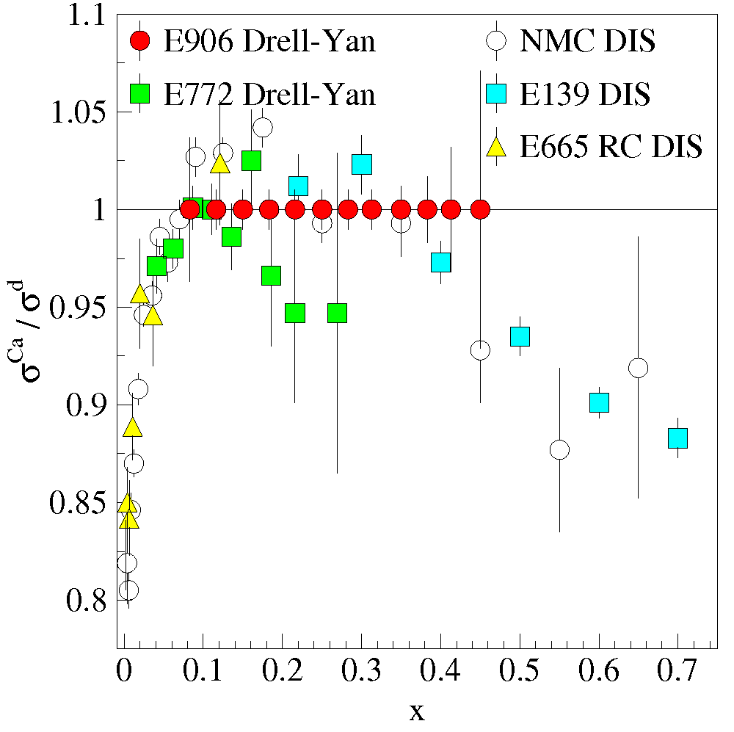
Structure of nucleonic matter:
How do sea quark distributions differ in a nucleus?
Intermediate-x sea PDF’s
ν-DIS on iron—Are nuclear effects with the weak interaction the same as electromagnetic?
Are nuclear effects the same for sea and valence distributions

Slide 18
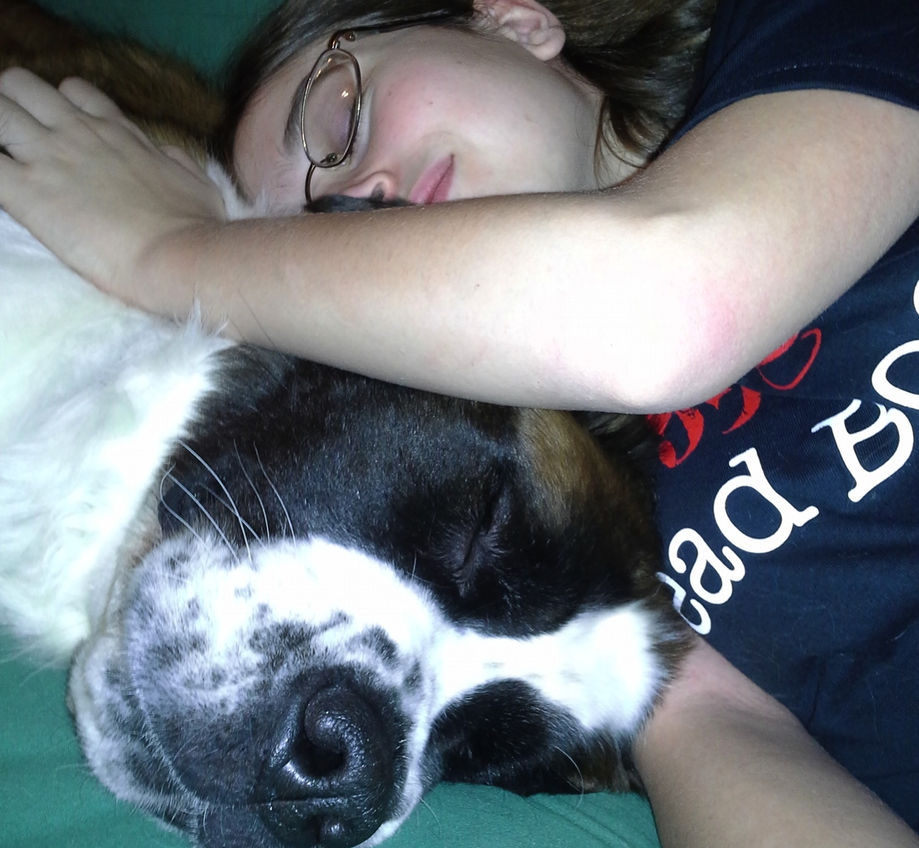
Partonic energy loss in Cold Nuclear Matter

Slide 19
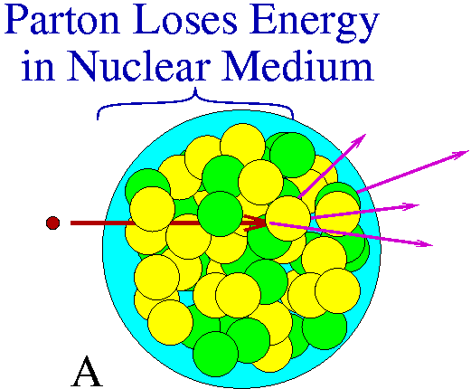
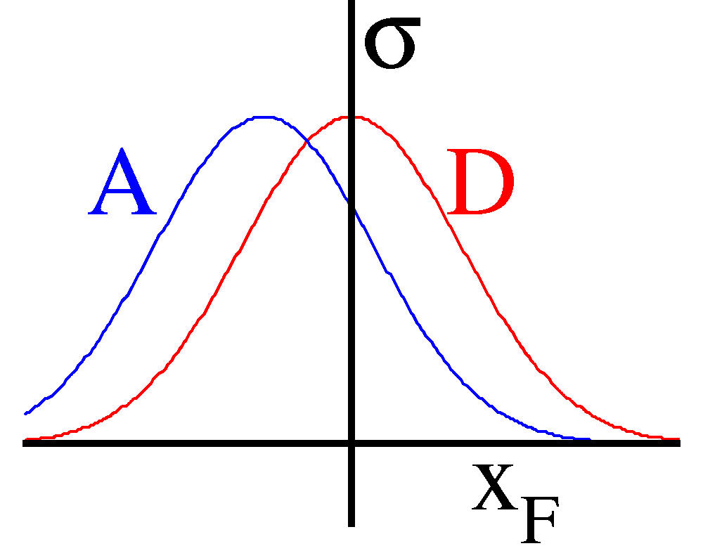
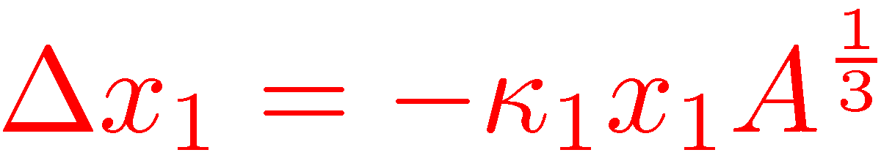
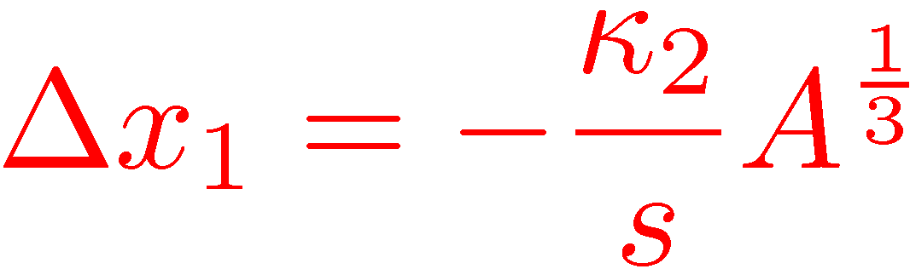
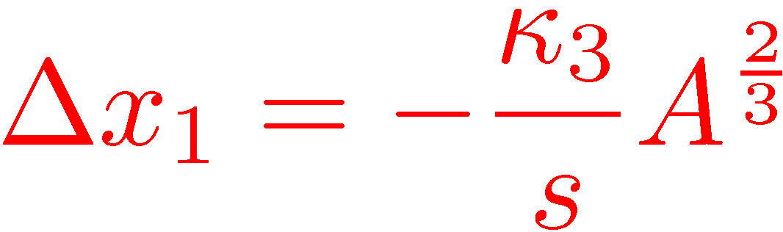
Partonic Energy Loss
Pre-interaction parton moves through cold nuclear matter and looses energy.
Apparent (reconstructed) kinematic values (x₁ or x_{F}) are shifted
Fit shift in x₁ relative to deuterium
Models:
  Galvin and Milana
  Brodsky and Hoyer
  Baier et al.
X₁
R(A/p)
R=1
X₁

Slide 20

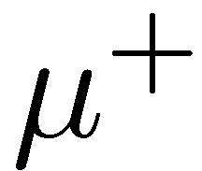

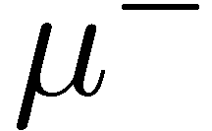
Event Reconstruction
We measure
  Direction of particles
  Absolute momentum of particles
We assume
  Particles are muons
momentum vector
Relativistic energy-momentum vector P
Add 4-vectors of muons to get 4-vectors of virtual photon P
  Now we know everything

Slide 21
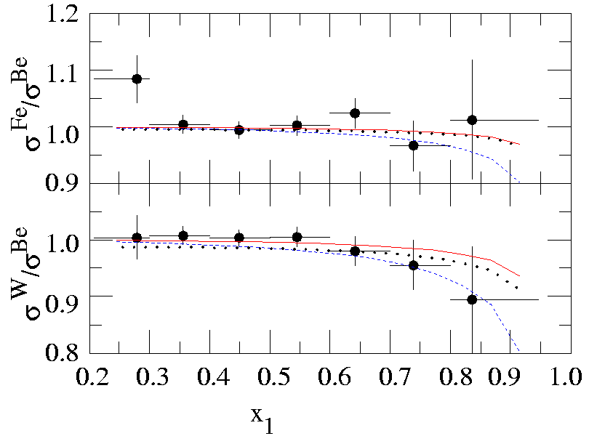
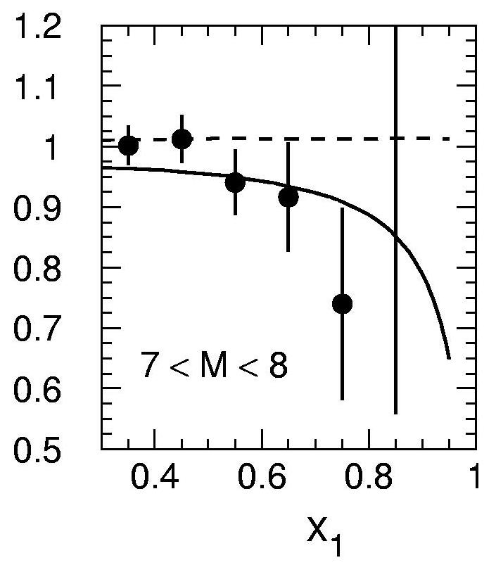
Partonic Energy Loss
E866/NuSea
E866 data are consistent with NO partonic energy loss for all three models
Caveat: A correction must be made for shadowing because of x₁—x₂ correlations
  E866 used an empirical correction based on EKS fit do DIS and Drell-Yan.
Treatment of parton propagation length and shadowing are critical
  Analysis of our p-A Drell-Yan data using the Kopeliovich model.
  dE/dx = 2.32 ± 0.52 ± 0.5 GeV/fm
  Same data with different shadowing correction and propagation length
Better data outside of shadowing region are necessary.
Drell-Yan p_{T} broadening also will yield information
Johnson, Kopeliovich et al., PRL 86, 4483 (2001)
Shadowing
dE/dx
+ Shadowing

Slide 22
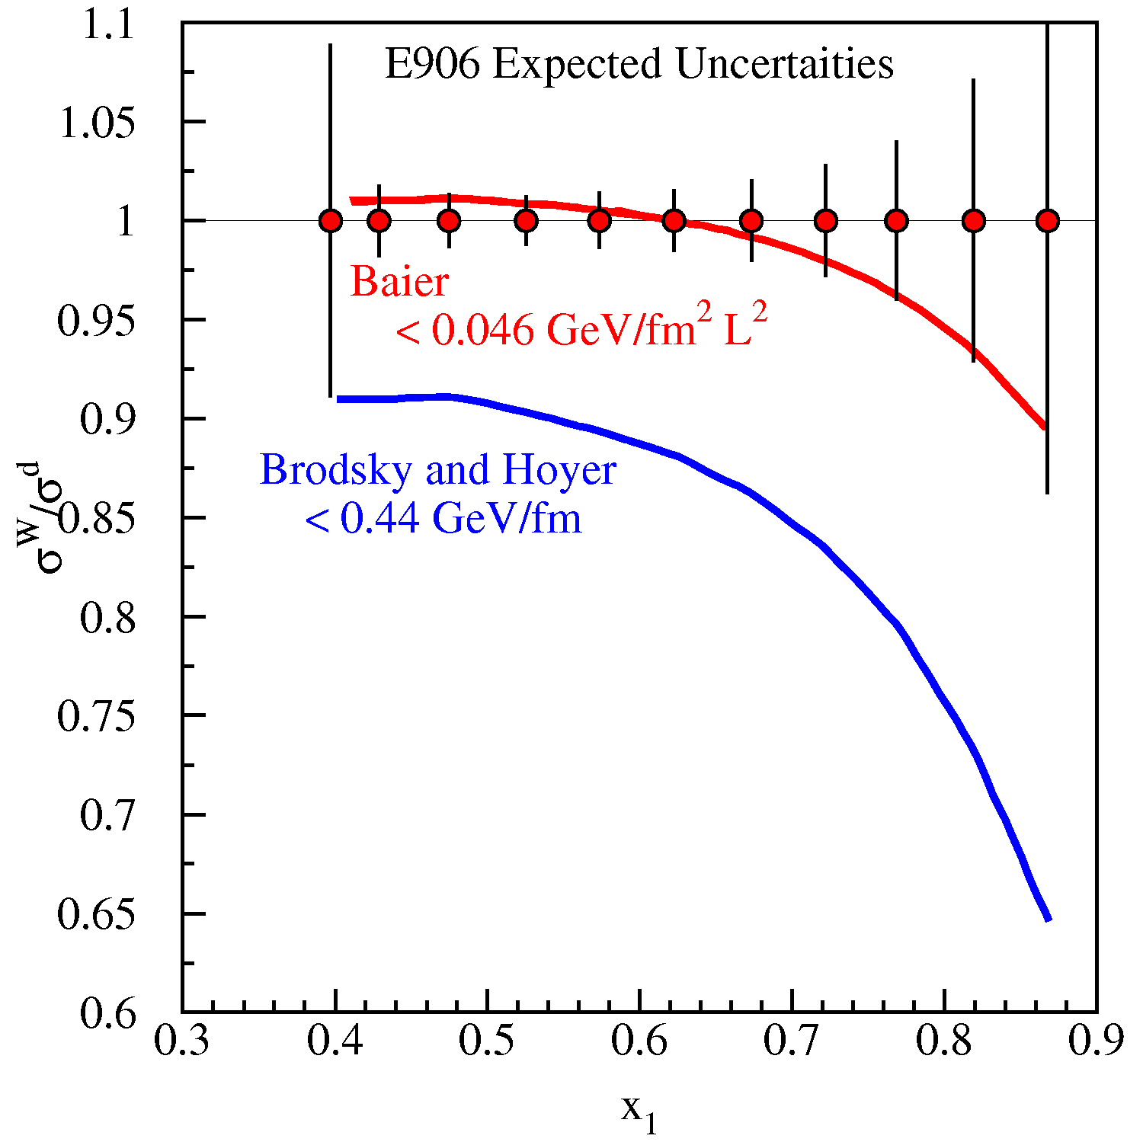
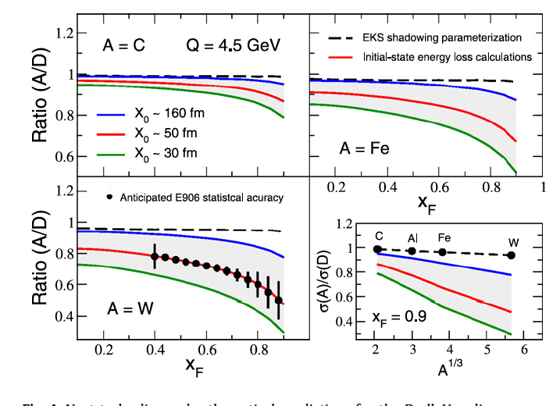
Parton Energy Loss
E906 expected uncertainties
Shadowing region removed
Shift in Δx / 1/s
  larger at 120 GeV
Ability to distinguish between models
Measurements rather than upper limits
E906 will have sufficient statistical precision to allow events within the shadowing region, x₂ < 0.1, to be removed from the data sample
Energy loss upper limits based on E866 Drell-Yan measurement
Shadowing vs. initial state energy loss
  R.B. Neufeld et al. Physics Letters B 704 (2011) 590–595
Possible to distinguish between A^{1/3} (collisional) and A^{2/3} (radiative) dependence?
Would like data at different s
Notes:
Brodsky and Hoyer: Gluon Bremsstrahlung process (A^1/3 / s)
Baier: Build on Brodsky. Energy loss depends on characteristic scattering length (A^1/3) and on squared p_T (A^1/3) giving a total A^2/3 / s effect. Also make predictions for both hot and cold nuclear matter.
Johnson et al.: 2.2 GeV/fm Different treatment of shadowing and parton propagation length

Slide 23
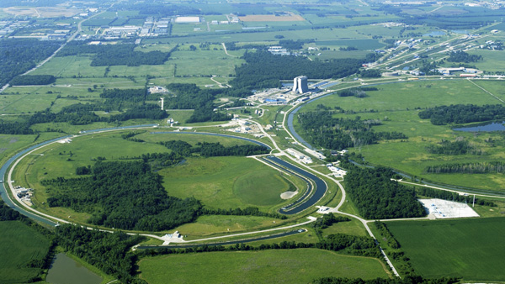
Advantages of 120 GeV Main Injector
The (very successful) past:
Fermilab E866/NuSea
Data in 1996-1997
¹H, ²H, and nuclear targets
800 GeV proton beam
The future:
Fermilab E906
First test run in 2011
¹H, ²H, and nuclear targets
120 GeV proton Beam
Cross section scales as 1/s
  7× that of 800 GeV beam
Backgrounds, primarily from J/ψ decays scale as s
  7× Luminosity for same detector rate as 800 GeV beam
50× statistics!!
at the same x_{t}, x_{b}
Fixed Target Beam lines
Tevatron 800 GeV
Main Injector 120 GeV

Slide 24
Drell-Yan Spectrometer Guiding Principles
Follow basic design of MEast spectrometer (don’t reinvent the wheel):
Where possible and practical, reuse elements of the E866 spectrometer.
  Tracking chamber electronics
  Hadron absorber, beam dump, muon ID walls
  Station 2 and 3 tracking chambers
  Hodoscope array PMT’s
  SM3 Magnet
Two magnet spectrometer | Hadron absorber within first magnet
Beam dump within first magnet | Muon-ID wall before final elements
New Elements
  1st magnet (different boost) Experiment shrinks from 60m to 26m
  Sta. 1 tracking (rates)
  Scintillator (age)
  Trigger (flexibility)

Slide 25
Fermilab E906/Drell-Yan Collaboration
Abilene Christian University
Donald Isenhower, Tyler Hague, Rusty Towell, Shon Watson
Academia Sinica
Wen-Chen Chang, Yen-Chu Chen, Shiu Shiuan-Hal,
Da-Shung Su
Argonne National Laboratory
John Arrington, Don Geesaman*, Kawtar Hafidi,
Roy Holt, Harold Jackson, David Potterveld,
Paul E. Reimer*
University of Colorado
Ed Kinney, J. Katich, Po-Ju Lin
Fermi National Accelerator Laboratory
Chuck Brown, Dave Christian, JinYuan Wu
University of Illinois
Bryan Dannowitz, Markus Diefenthaler, Bryan Kerns, Naomi C.R Makins, R. Evan McClellan, Jen-Chieh Peng
KEK
Shin'ya Sawada
Ling-Tung University
Ting-Hua Chang
*Co-Spokespersons
Los Alamos National Laboratory
Gerry Garvey, Mike Leitch, Han Liu, Ming Liu, Pat McGaughey, Joel Moss, Andrew Puckett
University of Maryland
Betsy Beise, Kazutaka Nakahara
University of Michigan
Christine Aidala, Wolfgang Lorenzon, Richard Raymond, Josh Rubin, Michael Stewart
National Kaohsiung Normal University
Rurngsheng Guo, Su-Yin Wang
RIKEN
Yoshinori Fukao, Yuji Goto, Atsushi Taketani, Manabu Togawa
Rutgers University
Lamiaa El Fassi, Ron Gilman, Ron Ransome, Brian Tice,
Ryan Thorpe, Yawei Zhang
Tokyo Tech
Shou Miyaska, Ken-ichi Nakano, Florian Sanftl,
Toshi-Aki Shibata
Yamagata University
Yoshiyuki Miyachi

Slide 26
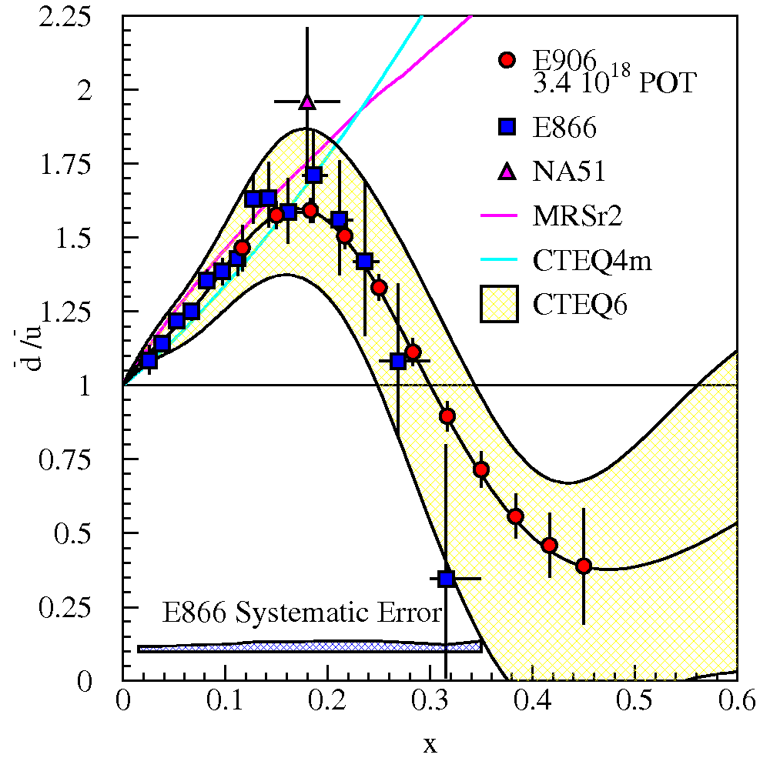
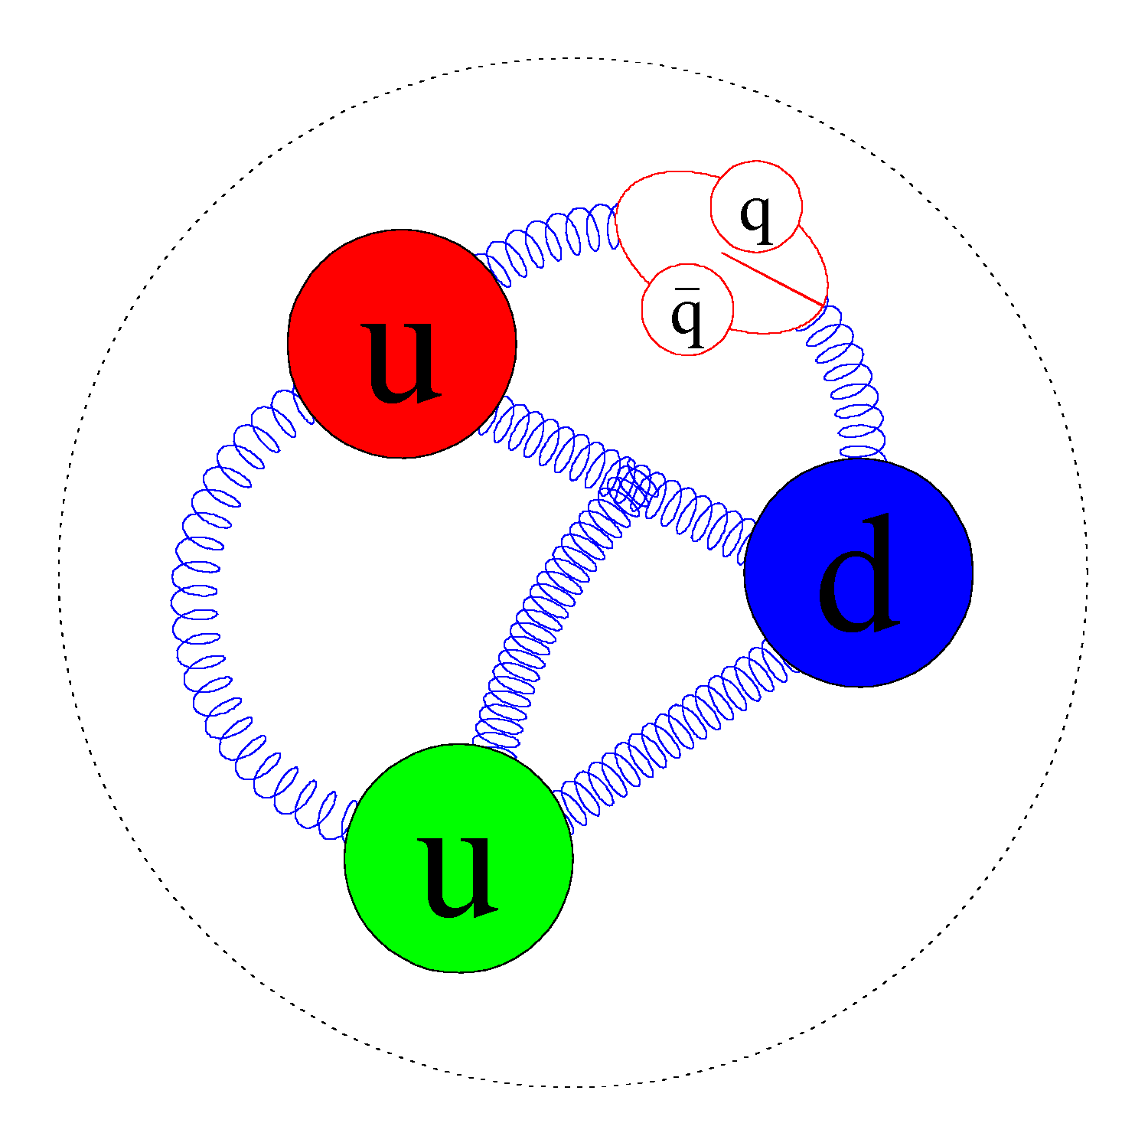
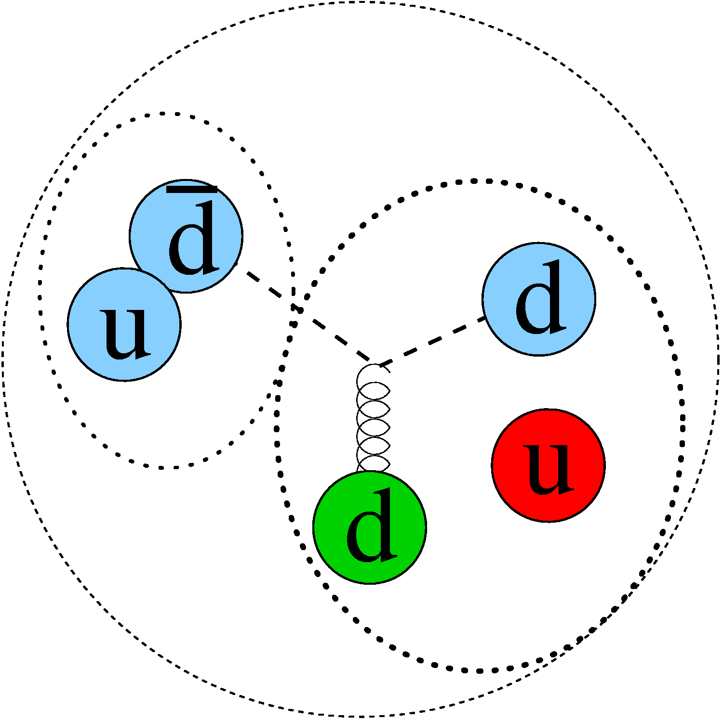
SeaQuest E-906 pp and pD physics
Non perturbative QCD models can explain excess d-bar quarks, but not return to symmetry or deficit of d-bar quarks
+
Proton

Slide 27
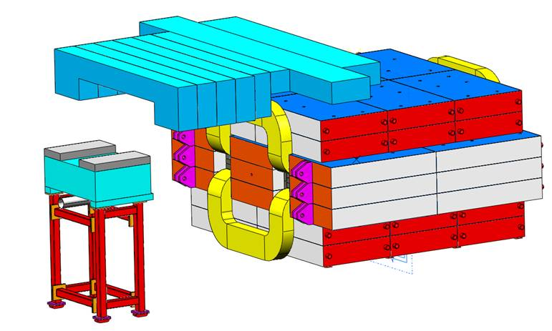
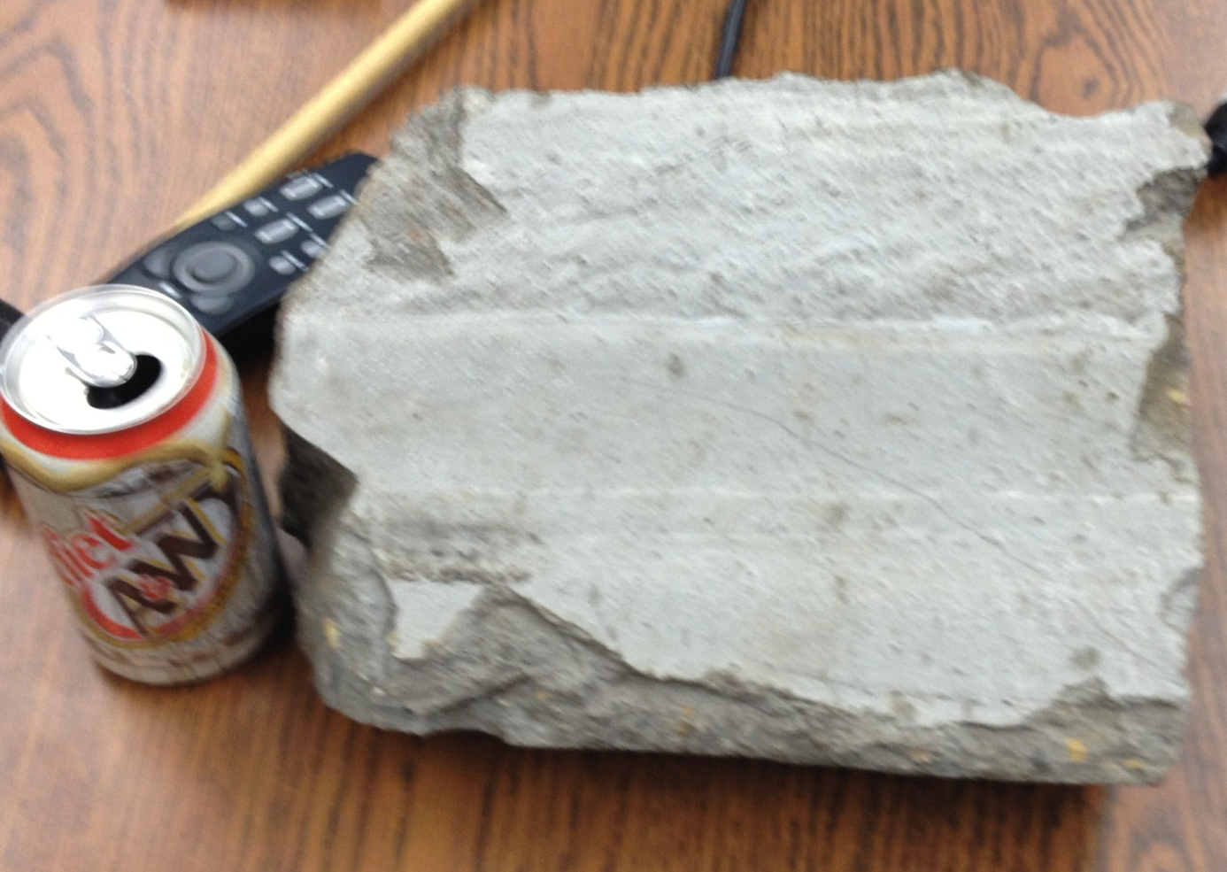
Time Line
1999 | 2000 | 2001 | 2002 | 2003 | 2004 | 2005 | 2006 | 2007 | 2008
Proposed to Fermilab |  | Approved w/conditions |  |  |  |  | Fermilab PAC reaffirms approval |  | Funding Approval
2008 | 2009 | 2010 | 2011 |  |  |  | 2012 |  |  |  | 2013
Funding Approval |  |  |  |  |  |  |  | Run 1 | Fermilab upgrade |  |  | Main Run
Spectrometer construction |  |  |  |  |  |  |  | Comission | upgrades
 |  |  | Beam Line Problems
 |  |  | Vacuum Leak | Filled w/concrete |  | Repairs |  |  | more repairs
 |  | Shielding additions
Additional radiation shielding required
500 tons of concrete and steel
14 tons of steel on movable cart

Slide 28
Eventually beam was delivered.
Our reaction:

Slide 29
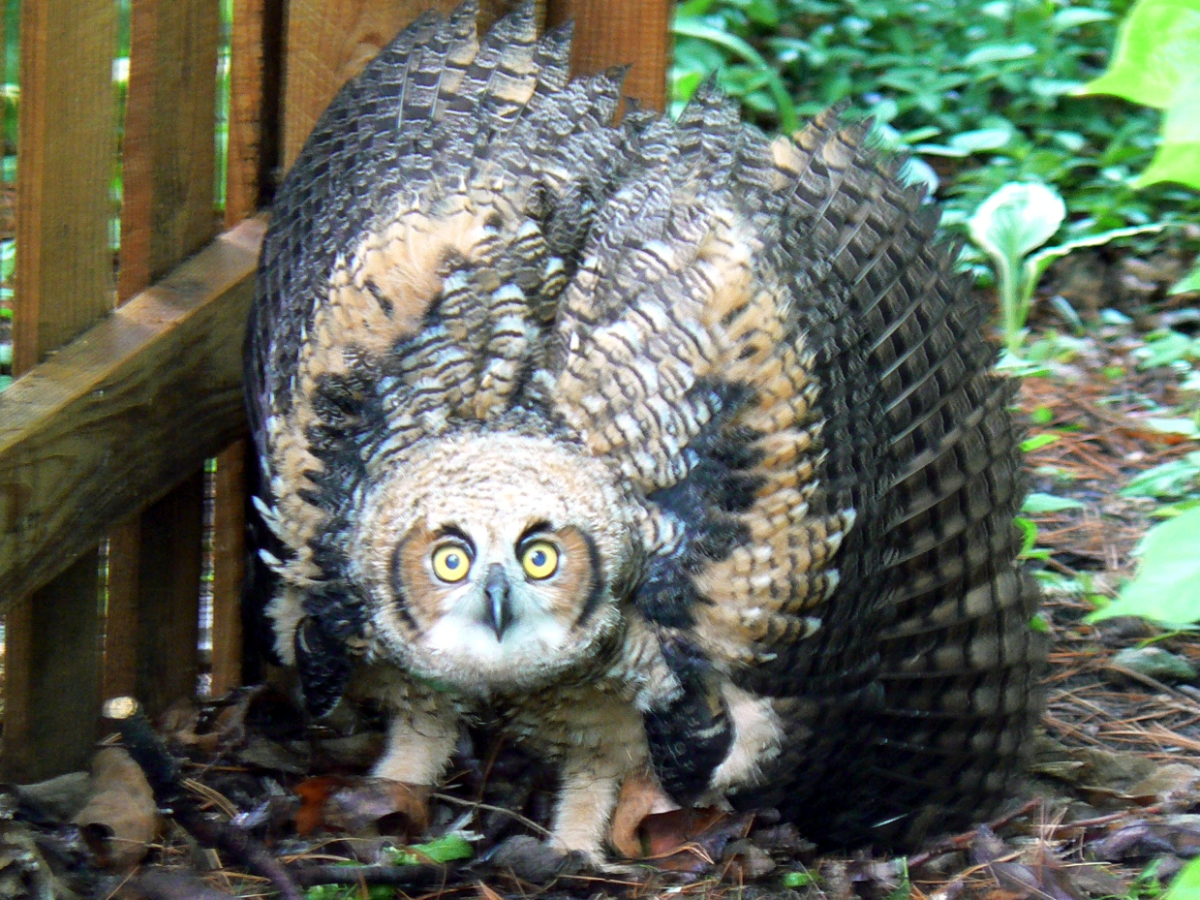
Eventually beam was delivered.
Our reaction:

Slide 30
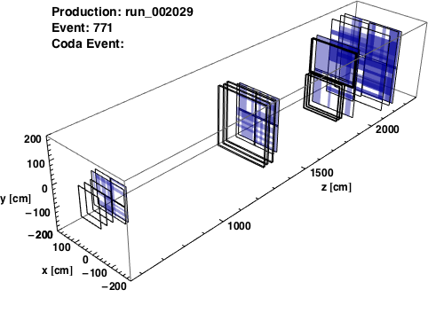
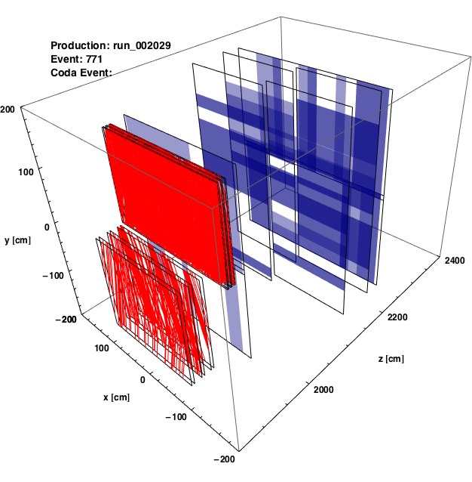
“Splat” Events
Symptoms and Clues:
Very large hit multiplicity for dimuon trigger events for both matrix and simple NIM triggers
All systems: hodoscopes, chambers, and prop. tubes swamped
Average intensity normal, measured by beamline instrumentation
full detector (hodoscope hits)
from Josh Rubin, U. Michigan
Stations 3+4 (all hits)

Slide 31
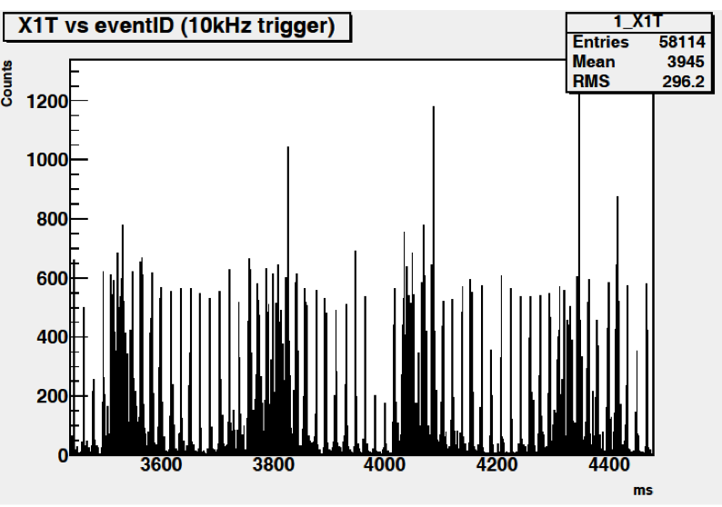
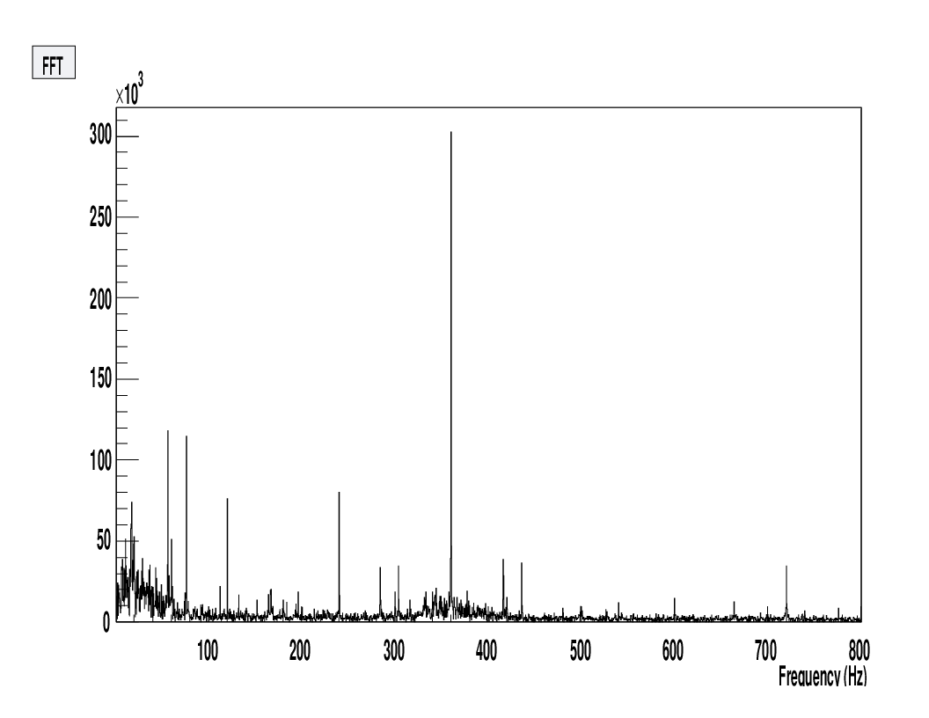
Understanding the Beam
Independent 10kHz pulsed DAQ read out raw hodoscope rates
Bins are integrated counts over 100µs (≈5000 RF buckets)
Large variation in Instantaneous intensity, duty factor very low.
Periodic structure
Frequency phase locked to AC line 60 Hz

Slide 32
The Splat-Block Card
A card was developed to keep a running average of the multiplicity over a 160 ns window (8 RF buckets).
If average multiplicity above threshold, raises a trigger veto
Luminosity greatly reduced, but trigger suppresses windows of time with large beam intensities.
from Josh Rubin, U. Michigan

Slide 33
Commissioning (beam line and spectrometer) Run (~two months)
First protons arrived March 8, 2012, Run ended April 30, 2012
All systems worked!
  Typical issues with mapping and timing resolved quickly
  Some challenges with TDC microcode – modules rolled-back to a prior software version, zero-suppression moved to VME CPUs→relatively long dead-times
Unexpectedly large hit multiplicities with dimuon trigger – termed “splat events”
Where do we go from here?
Better Beam Quality
  Fermilab is has gotten this message
  mistuned 720 Hz harmonic suppression (was suppressing 680)
  Better 60 Hz AC filtering on all power supplies
  Completely revamped control and feedback system
  Other improvements
Experimental Improvements
  TDC Micro code improvements—less dead time, pipelining?
  Cherenkov Beam monitor for better splat block
  New St. 1 and St. 3- for better rate capabilities
  Phototube bases optimized for rate rather than linearity

Slide 34
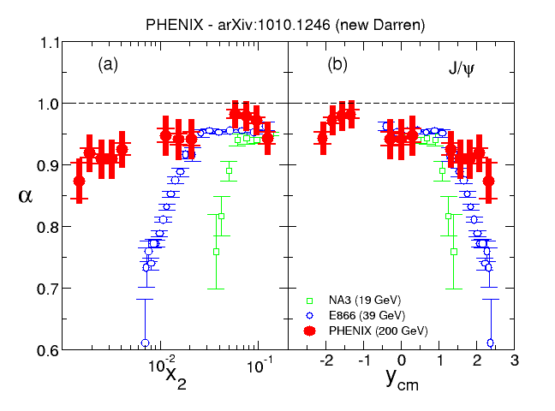
pA Drell-Yan at RHIC?
J/ψ
What about the J/ψ and ψ’?
  See talk by Mike Leitch in 1st session
  E906/SeaQuest does not have sufficient resolution to see the ψ’
200 GeV
J/ψ suppression doesn’t scale like shadowing
19 GeV
Possibly easier to select kinematical regions to emphasize quarks or antiquarks in proton or Nucleus.
di-leptons may be hard to see/separate from background
Use W± or Z⁰ instead of γ*
  Easy to identify
  Necessarily correlates x₁ x₂:
  For W±–difficult to reconstruct x₁ x₂ since ν is unseen
39 GeV
μ±
W±
ν

Slide 35
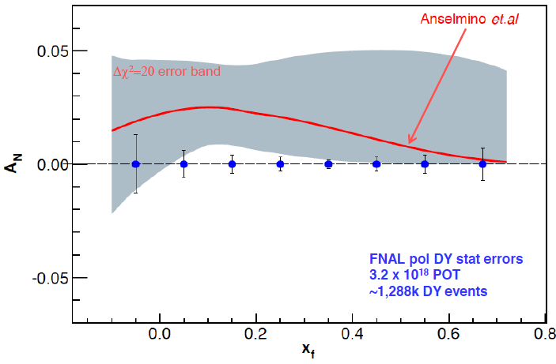
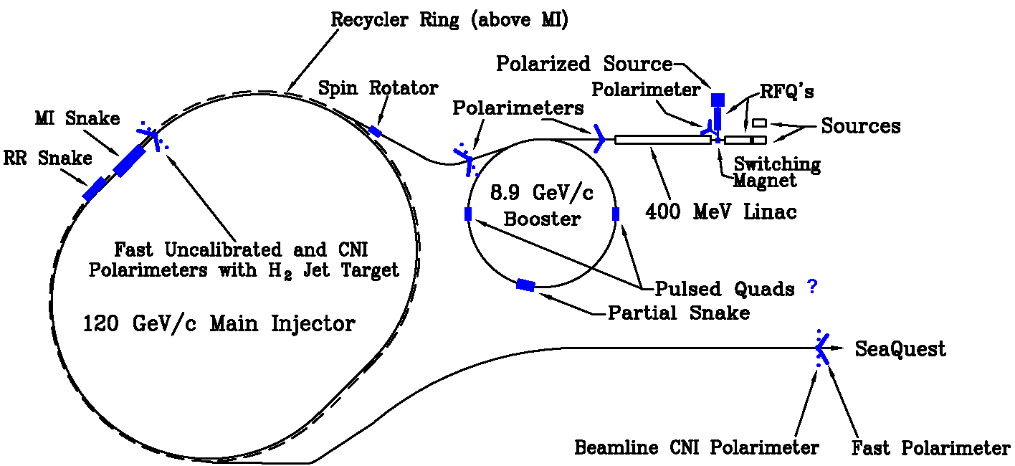
Polarized Drell-Yan@Fermilab Main Injector
Polarized beam
  Major advantage—the beam is a blow torch—Luminosity
  Major disadvantage—the beam polarization is presently virtual—only a proposal
Spectrometer:
  By 2014, spectrometer will be well understood, including angular acceptance
Exploring polarized target
sea quark Sivers’
SPIN@Fermi Collaboration

Slide 36
Conclusion—not yet
Unpolarized pA collisions can offer unique insight into
EMC Effect
Partonic Energy Loss
Fermilab E-906/SeaQuest spectrometer works, waiting for beam
Fermilab may also provide laboratory for pA physics
SPIN@Fermi Collaboration

