Slide 1
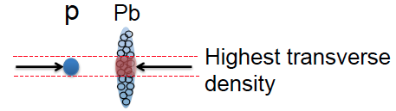
Collider p/d+A experiments: a new era in QCD at high parton densities
Raju Venugopalan
Brookhaven National Laboratory
Joint BNL-LANL-RBRC workshop, January 7-9, 2013

Slide 2
Exciting times !
LHC will start long awaited ~ 3 week p+A run at 5.02 TeV/n in a week !
4 hour “pilot” run past fall was extremely successful
Prospect of ⬆p+A collisions at RHIC – significant extension
of first collider studies – performed at RHIC - on light-heavy systems

Slide 3
Talk outline
Universal many-body parton dynamics at high energies
--- saturation from DIS to hadron-hadron collisions
Multiplicities and single inclusive distributions
Di-hadron correlations at RHIC – the ridge in p+p & p+A collisions
Initial state many-body parton dynamics in A+A collisions – the
IP-Glasma model

Slide 4
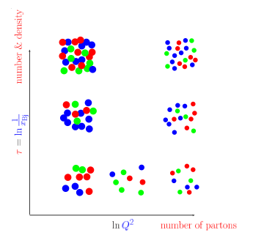
Many-body dynamics of universal gluonic matter
How does this happen ? What are
the right degrees of freedom ?
How do correlation functions of
these evolve ?
Is there a universal fixed point
for the RG evolution of d.o.f
Does the coupling run with Q_{s}² ?
How does saturation transition to
chiral symmetry breaking and
confinement
DGLAP+
higher twists
BFKL+
higher twists
ln(Λ_{QCD}²)

Slide 5
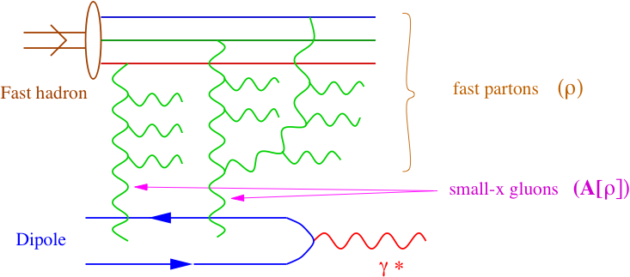
CGC Effective Theory: B-JIMWLK hierarchy of correlators
“time”
“diffusion coefficient”
At high energies, the d.o.f that describe the frozen many-body
gluon configurations are novel objects: dipoles, quadrupoles, …
Universal – appear in a number of processes in p+A and e+A;
how do these evolve with energy ?

Slide 6
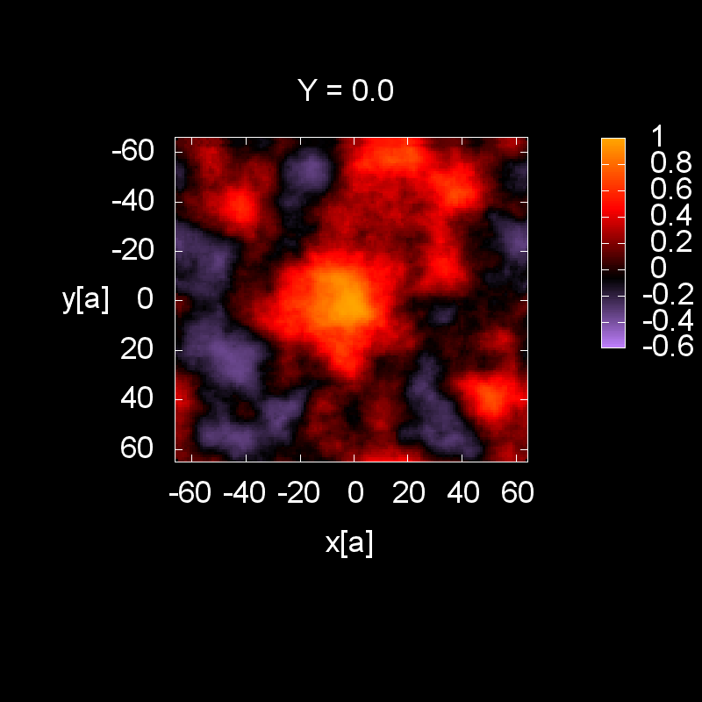
CGC Effective Theory: B-JIMWLK hierarchy of correlators
“time”
“diffusion coefficient”
Energy evolution of spatial distribution of gluons inside the proton
Rummukainen,Weigert (2003)
Dumitru,Jalilian-Marian,Lappi,
Schenke,RV, PLB706 (2011)219
Dipole correlator of Light-like Wilson lines Tr(V(0,0)V^dagger (x,y))
B-JIMWLK eqn. for dipole correlator – universal quantity whose (very good)
mean field solution is the BK equation

Slide 7
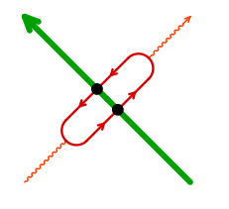
Inclusive DIS: dipole evolution
Photon wave function
Two dipole saturation models:
i) rcBK –higher twist corrections to pQCD BFKL small x evolution
ii) IP-Sat based on eikonalized treatment of DGLAP higher twists
– form same as MV model
Albacete,Kovchegov
Bartels,Golec-Biernat,Kowalski
Kowalski, Teaney;
Kowalski, Motyka, Watt

Slide 8
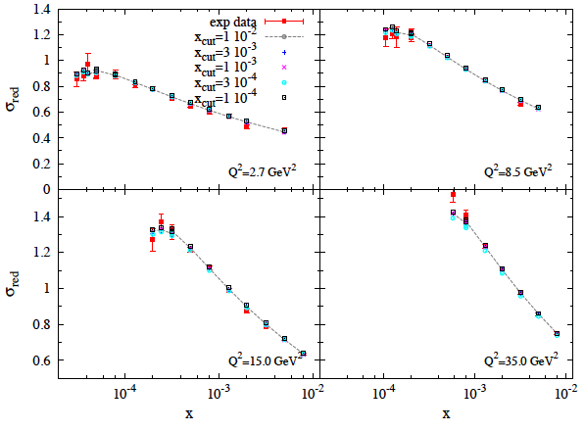
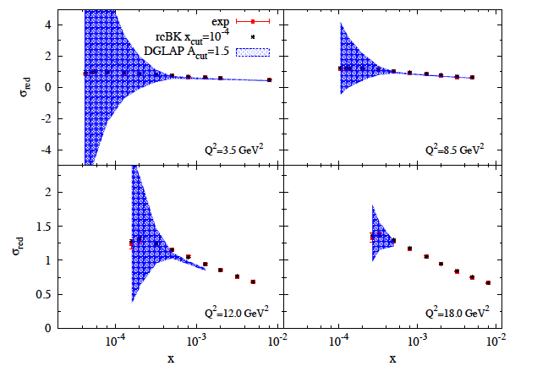
Inclusive DIS: dipole evolution a la BK
Comparison of running coupling
rcBK eqn. with precision
small x combined HERA data
Relative comparison of rc BK to
DGLAP fits-bands denote
pdf uncertainties
Albacete,Milhano,Quiroga-Arias,Rojo, arXiv:1203.1043

Slide 9
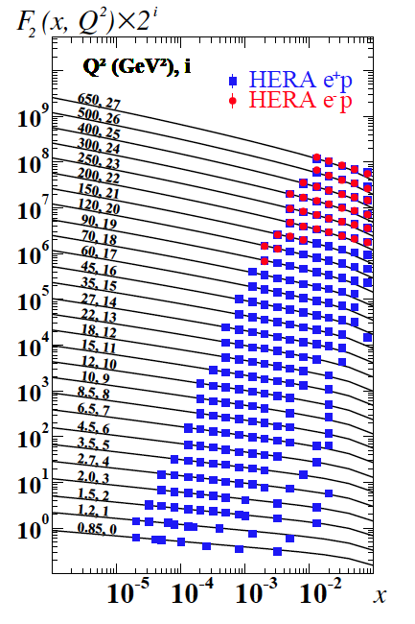
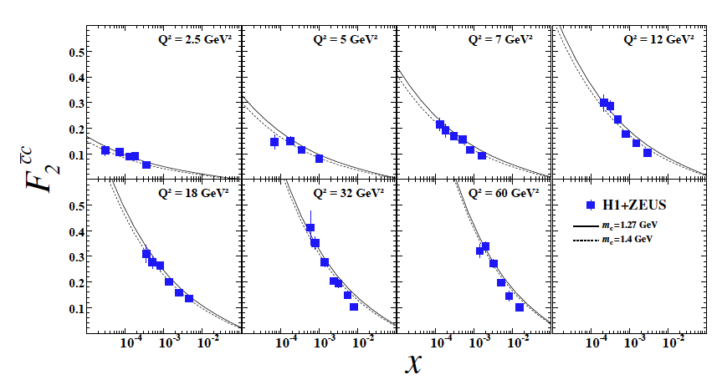
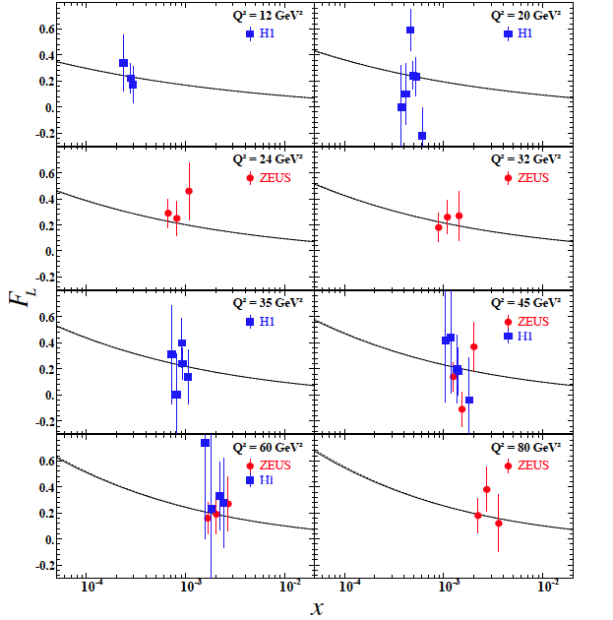
Inclusive DIS: dipole evolution a la IP-Sat
(Few) parameters fixed by χ-sq ~ 1
fit to combined (H1+Zeus)
reduced cross-section
Rezaiean,Siddikov,Van de Klundert,RV: 1212.2974

Slide 10
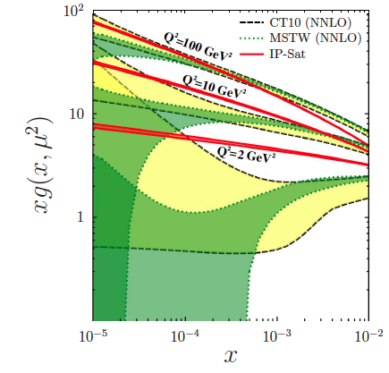
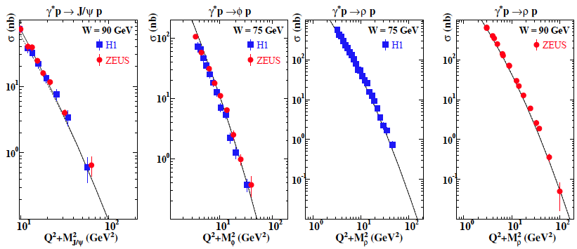
Inclusive DIS: dipole evolution a la IP-Sat
Rezaiean,Siddikov,Van de Klundert,RV: 1212.2974
More stable gluon
dist. at small x
relative to NNLO
pdf fits
Exclusive VM production:
Comparable quality
fits for energy (W)
and t-distributions

Slide 11
Saturation models: from HERA to RHIC & LHC
Unintegrated gluon dist. from dipole cross-section:
2
k_{T} factorization to compute gluon dist. at a given impact parameter:

Slide 12
Saturation models: from HERA to RHIC & LHC
k_{T} factorization is an approximation valid for Q_{S} < k_{T}
– in general need to solve classical Yang-Mills eqns when
parton densities in both projectile and target are large…
Gelis,Lappi,RV:0804.2630

Slide 13
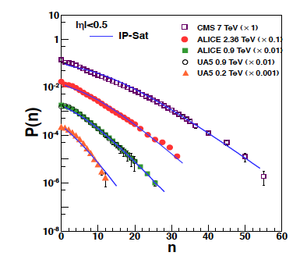
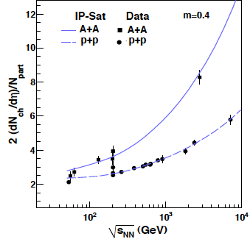
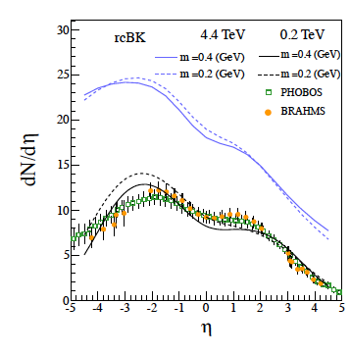
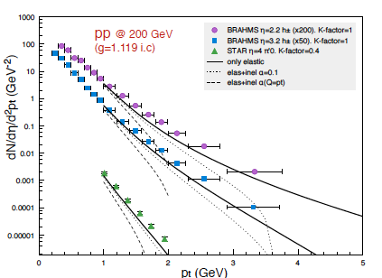
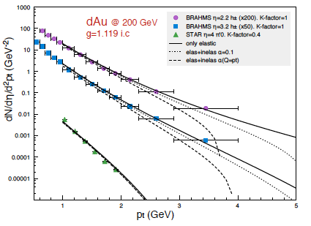
“Global analysis” of bulk distributions
Tribedy,RV, 1112.2445
p+p
d+Au
Albacete,Dumitru,Fujii,Nara,1209.2001

Slide 14
How do these models do with p+A at the LHC ?
In saturation models
Multiplicities have some
sensitivity to “infrared”
non-pert. physics/geometry
Compilation by A. Rezaiean
Other model comparisons, see arXiv:1210.3615
-likely in Helen’s talk…?

Slide 15
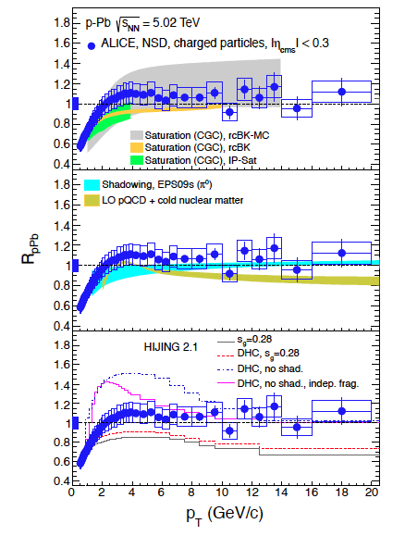
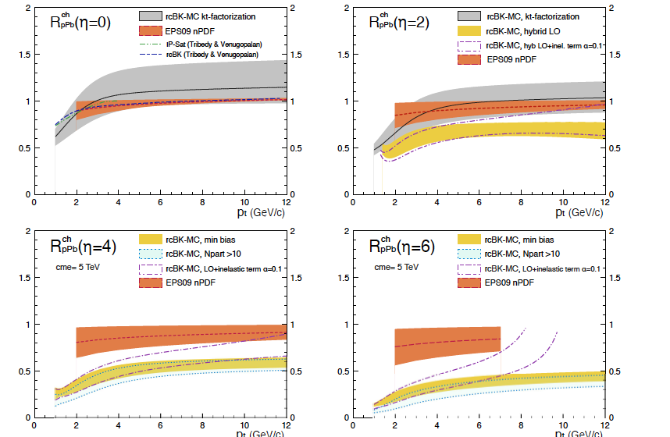
How do these models do with p+A at the LHC ?
ALICE, arXiv:1210.4520
Compilation from
Albacete et al 1209.2001
p+Pb run will add clarity

Slide 16
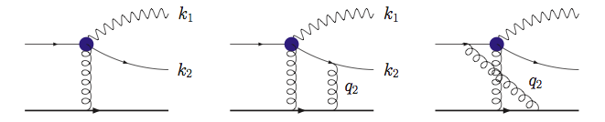
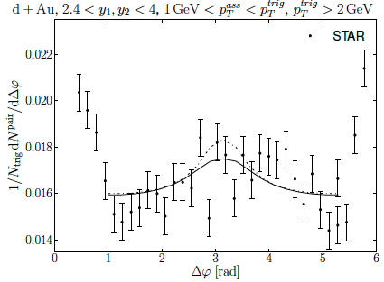
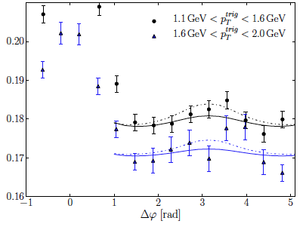
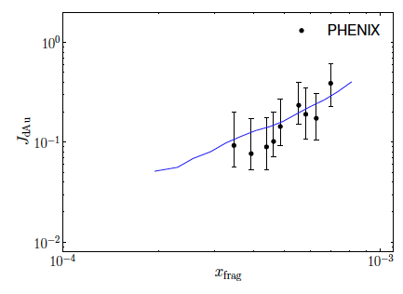
Di-hadrons in p/d-A collisions
Jalilian-Marian, Kovchegov (2004)
Marquet (2007), Tuchin (2010)
Dominguez,Marquet,Xiao,Yuan (2011)
Strikman,Vogelsang (2010)
Forward-forward di-hadrons sensitive to both dipole and quadrupole correlators
PHENIX
Lappi,Mäntysaari, 1209.2853
Recent computations (Stasto,Xiao,Yuan + Lappi,Mäntysaari) include Pedestal, Shadowing (color screening) and Broadening (multiple scattering) effects in CGC

Slide 17
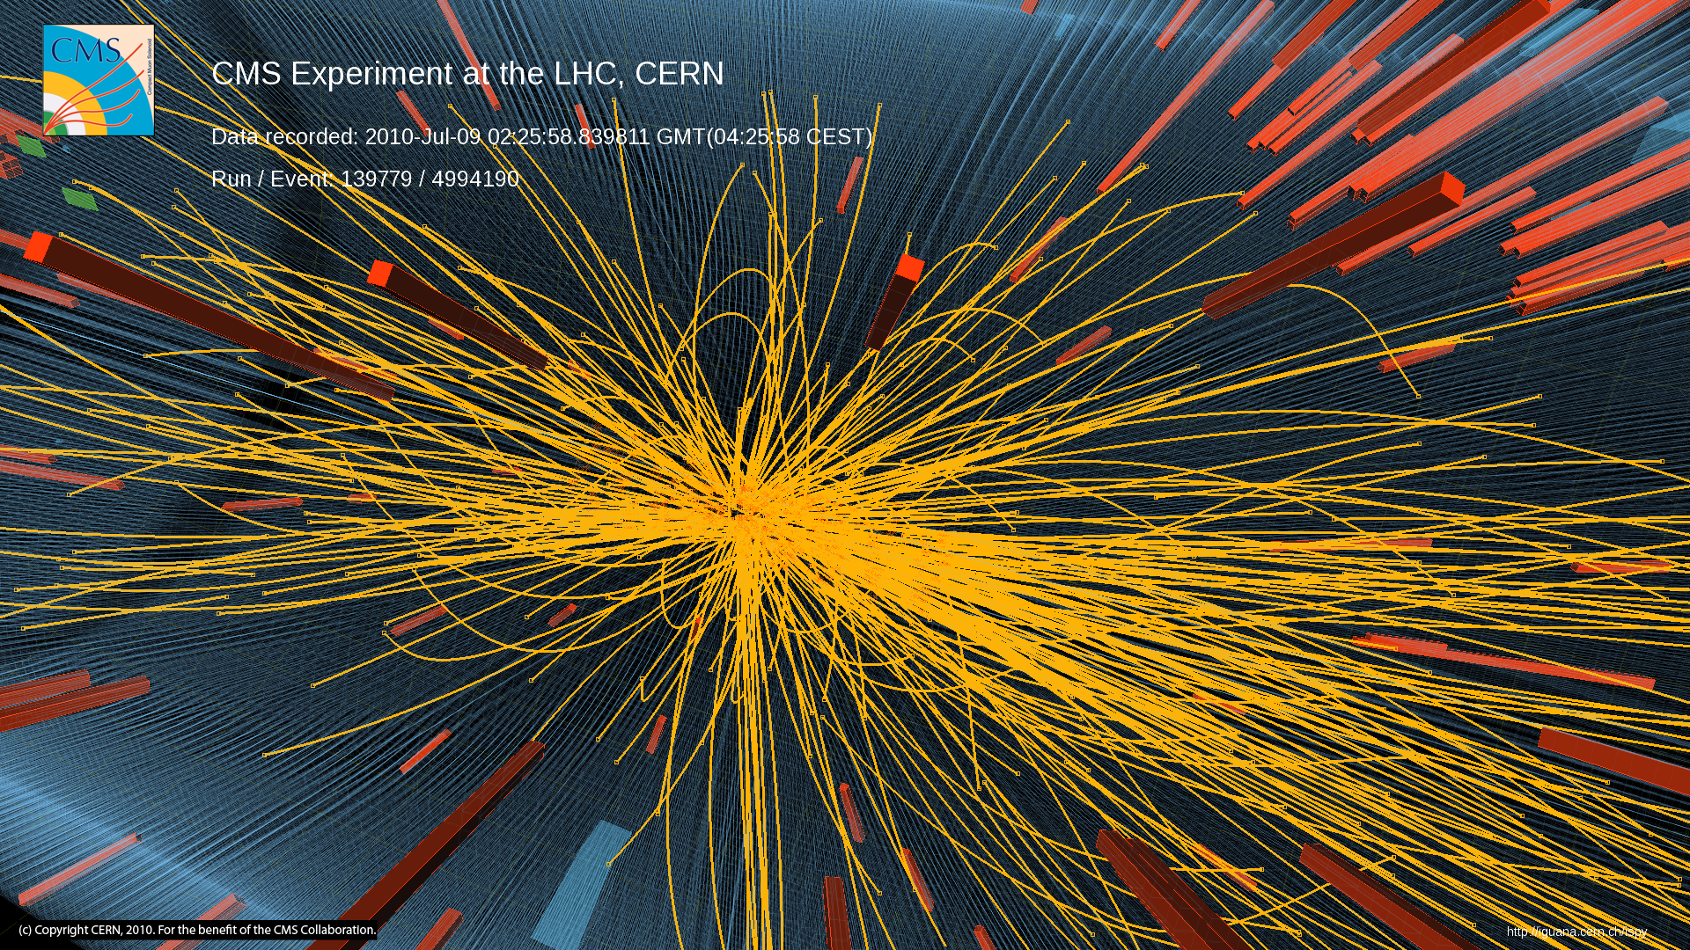
High Multiplicity pp collisions
Notes:
17

Slide 18
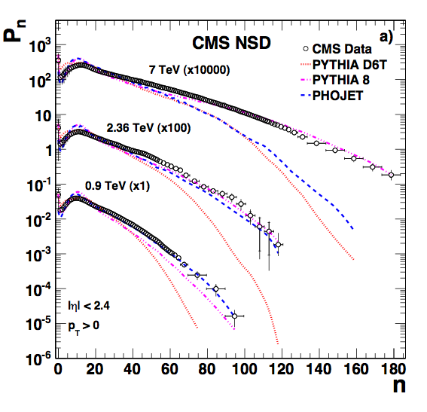
High Multiplicity pp collisions
High Multiplicity events are rare in nature
Very high particle density regime
Is there anything peculiar happening there?
Notes:
18

Slide 19
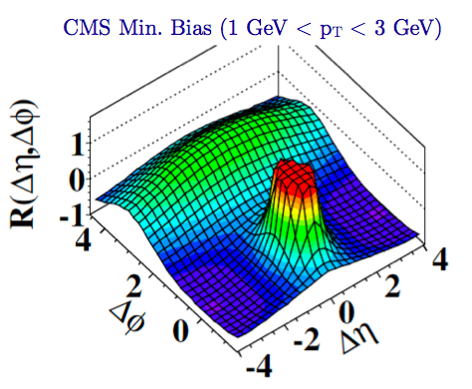
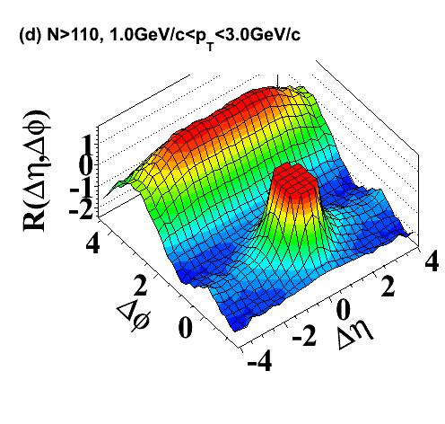

Two particle correlations in high mult. p+p
CMS 1009.4122
“Discovery”
Ridge: Distinct long range correlation in η collimated around ΔΦ≈ 0
for two hadrons in the intermediate 1 < p_{T}, q_{T} < 3 GeV

Slide 20
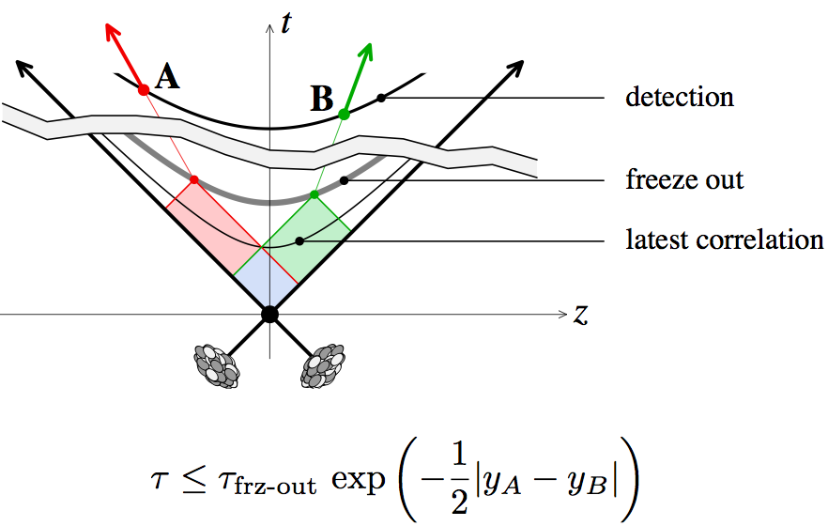
Long range rapidity correlations as a chronometer
Long range correlations sensitive to very early time (fractions of
a femtometer ~ 10⁻²⁴ seconds) dynamics in collisions

Slide 21
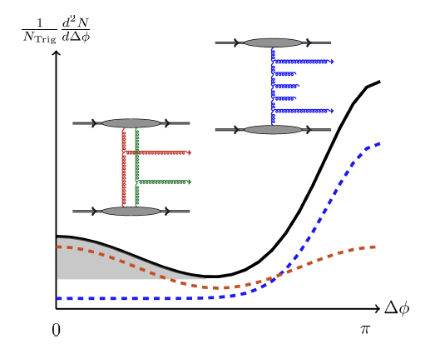
Anatomy of long range di-hadron collimation
BFKL
Mini-jet
Glasma graphs
Associated
Di-hadron
Yield

Slide 22
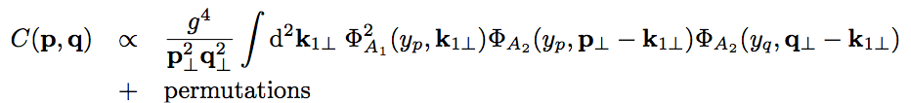
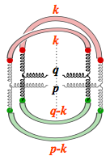
Long range di-hadron correlations
Dumitru,Dusling,Gelis,Jalilian-Marian,Lappi,RV, arXiv:1009.5295
RG evolution of two particle correlations C(p,q) expressed in terms of “unintegrated gluon distributions” in the proton
Proton 1
Proton 2
Contribution ~ α_{S}⁶/N_{c}² in min. bias, High mult. -> 1/α_{S}² N_{c}²
– enhancement of 1/α_{S}⁸ ~ factor of 10⁵ !

Slide 23
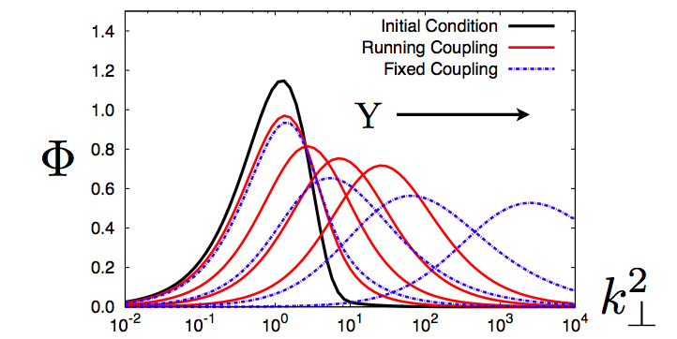
Collimated yield ?
From RG evolution
of BK equation
Q₀
Dominant contribution from
| p_{T}-k_{T}| ~ |q_{T}-k_{T}| ~ |k_{T}| ~ Q_{S}
This gives a collimation for ΔΦ ≈ 0 and π

Slide 24
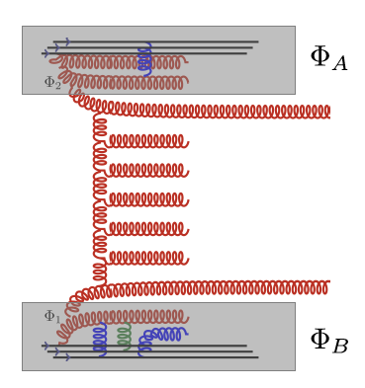
Angular structure from (mini-) Jet radiation
p
G_{BFKL}
q
Mini-jets: O (1) in high multiplicity events
- give an angular collimation, albeit only at ΔΦ≅π
LHC results also test the structure of bremsstrahlung radiation between jets

Slide 25
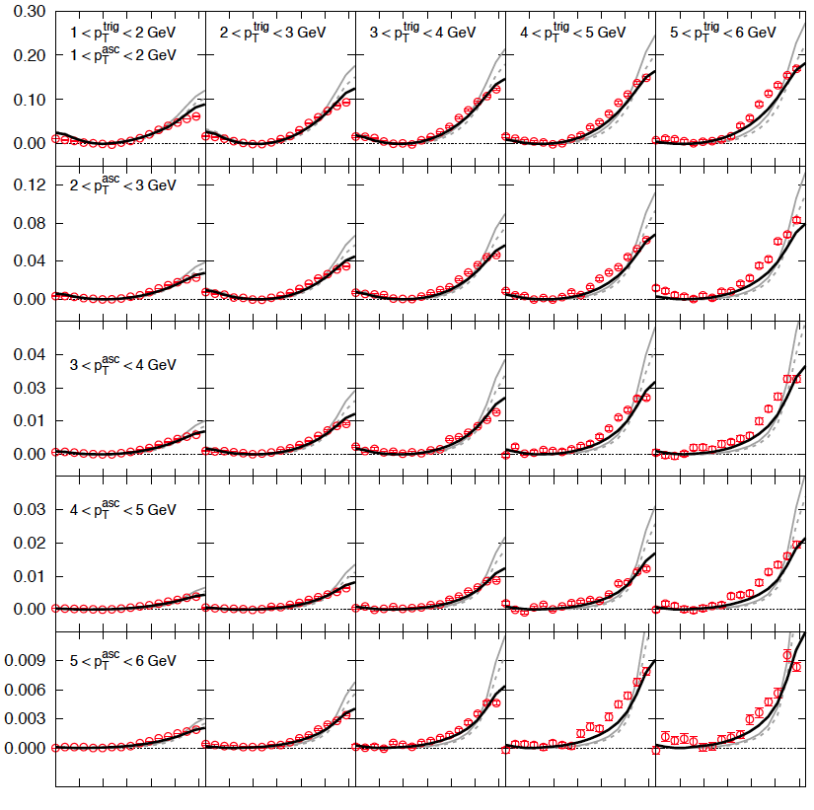
Dusling, RV: 1201.2658
1210.3890

Slide 26
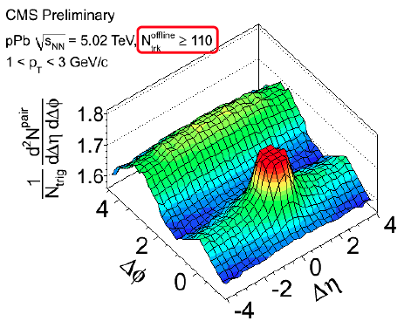
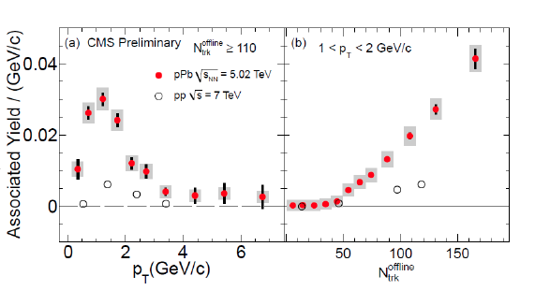
Exciting first results on proton lead collisions
CMS coll. arXiv:1210.5482, Phys. Lett. B
Key observation:
Ridge much bigger
than p+p for the
same multiplicity !

Slide 27
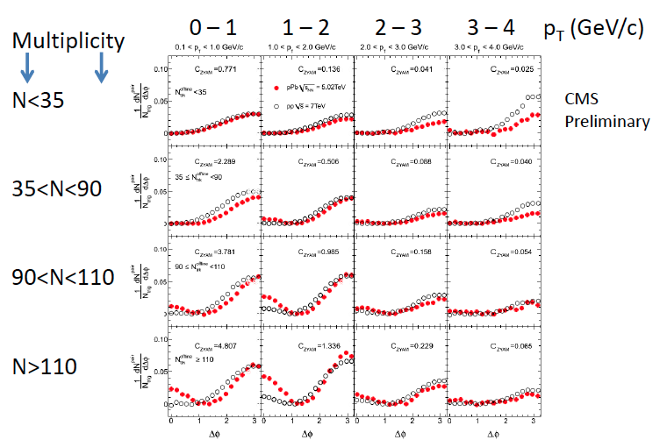
Exciting results on proton lead collisions

Slide 28
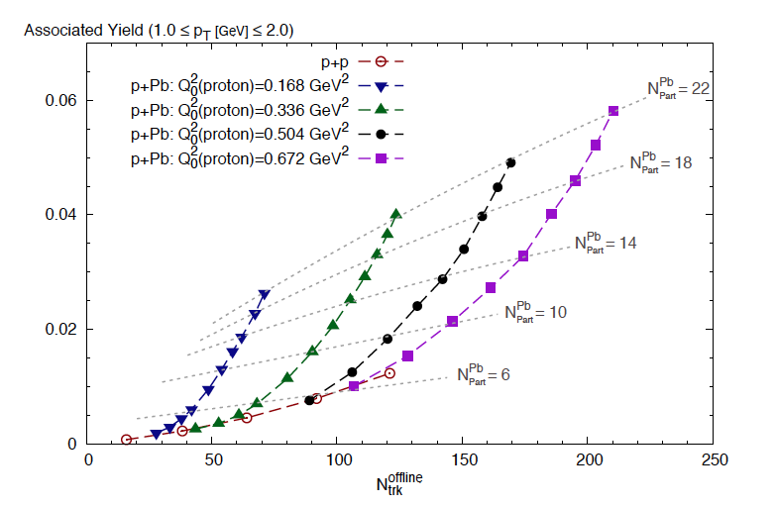
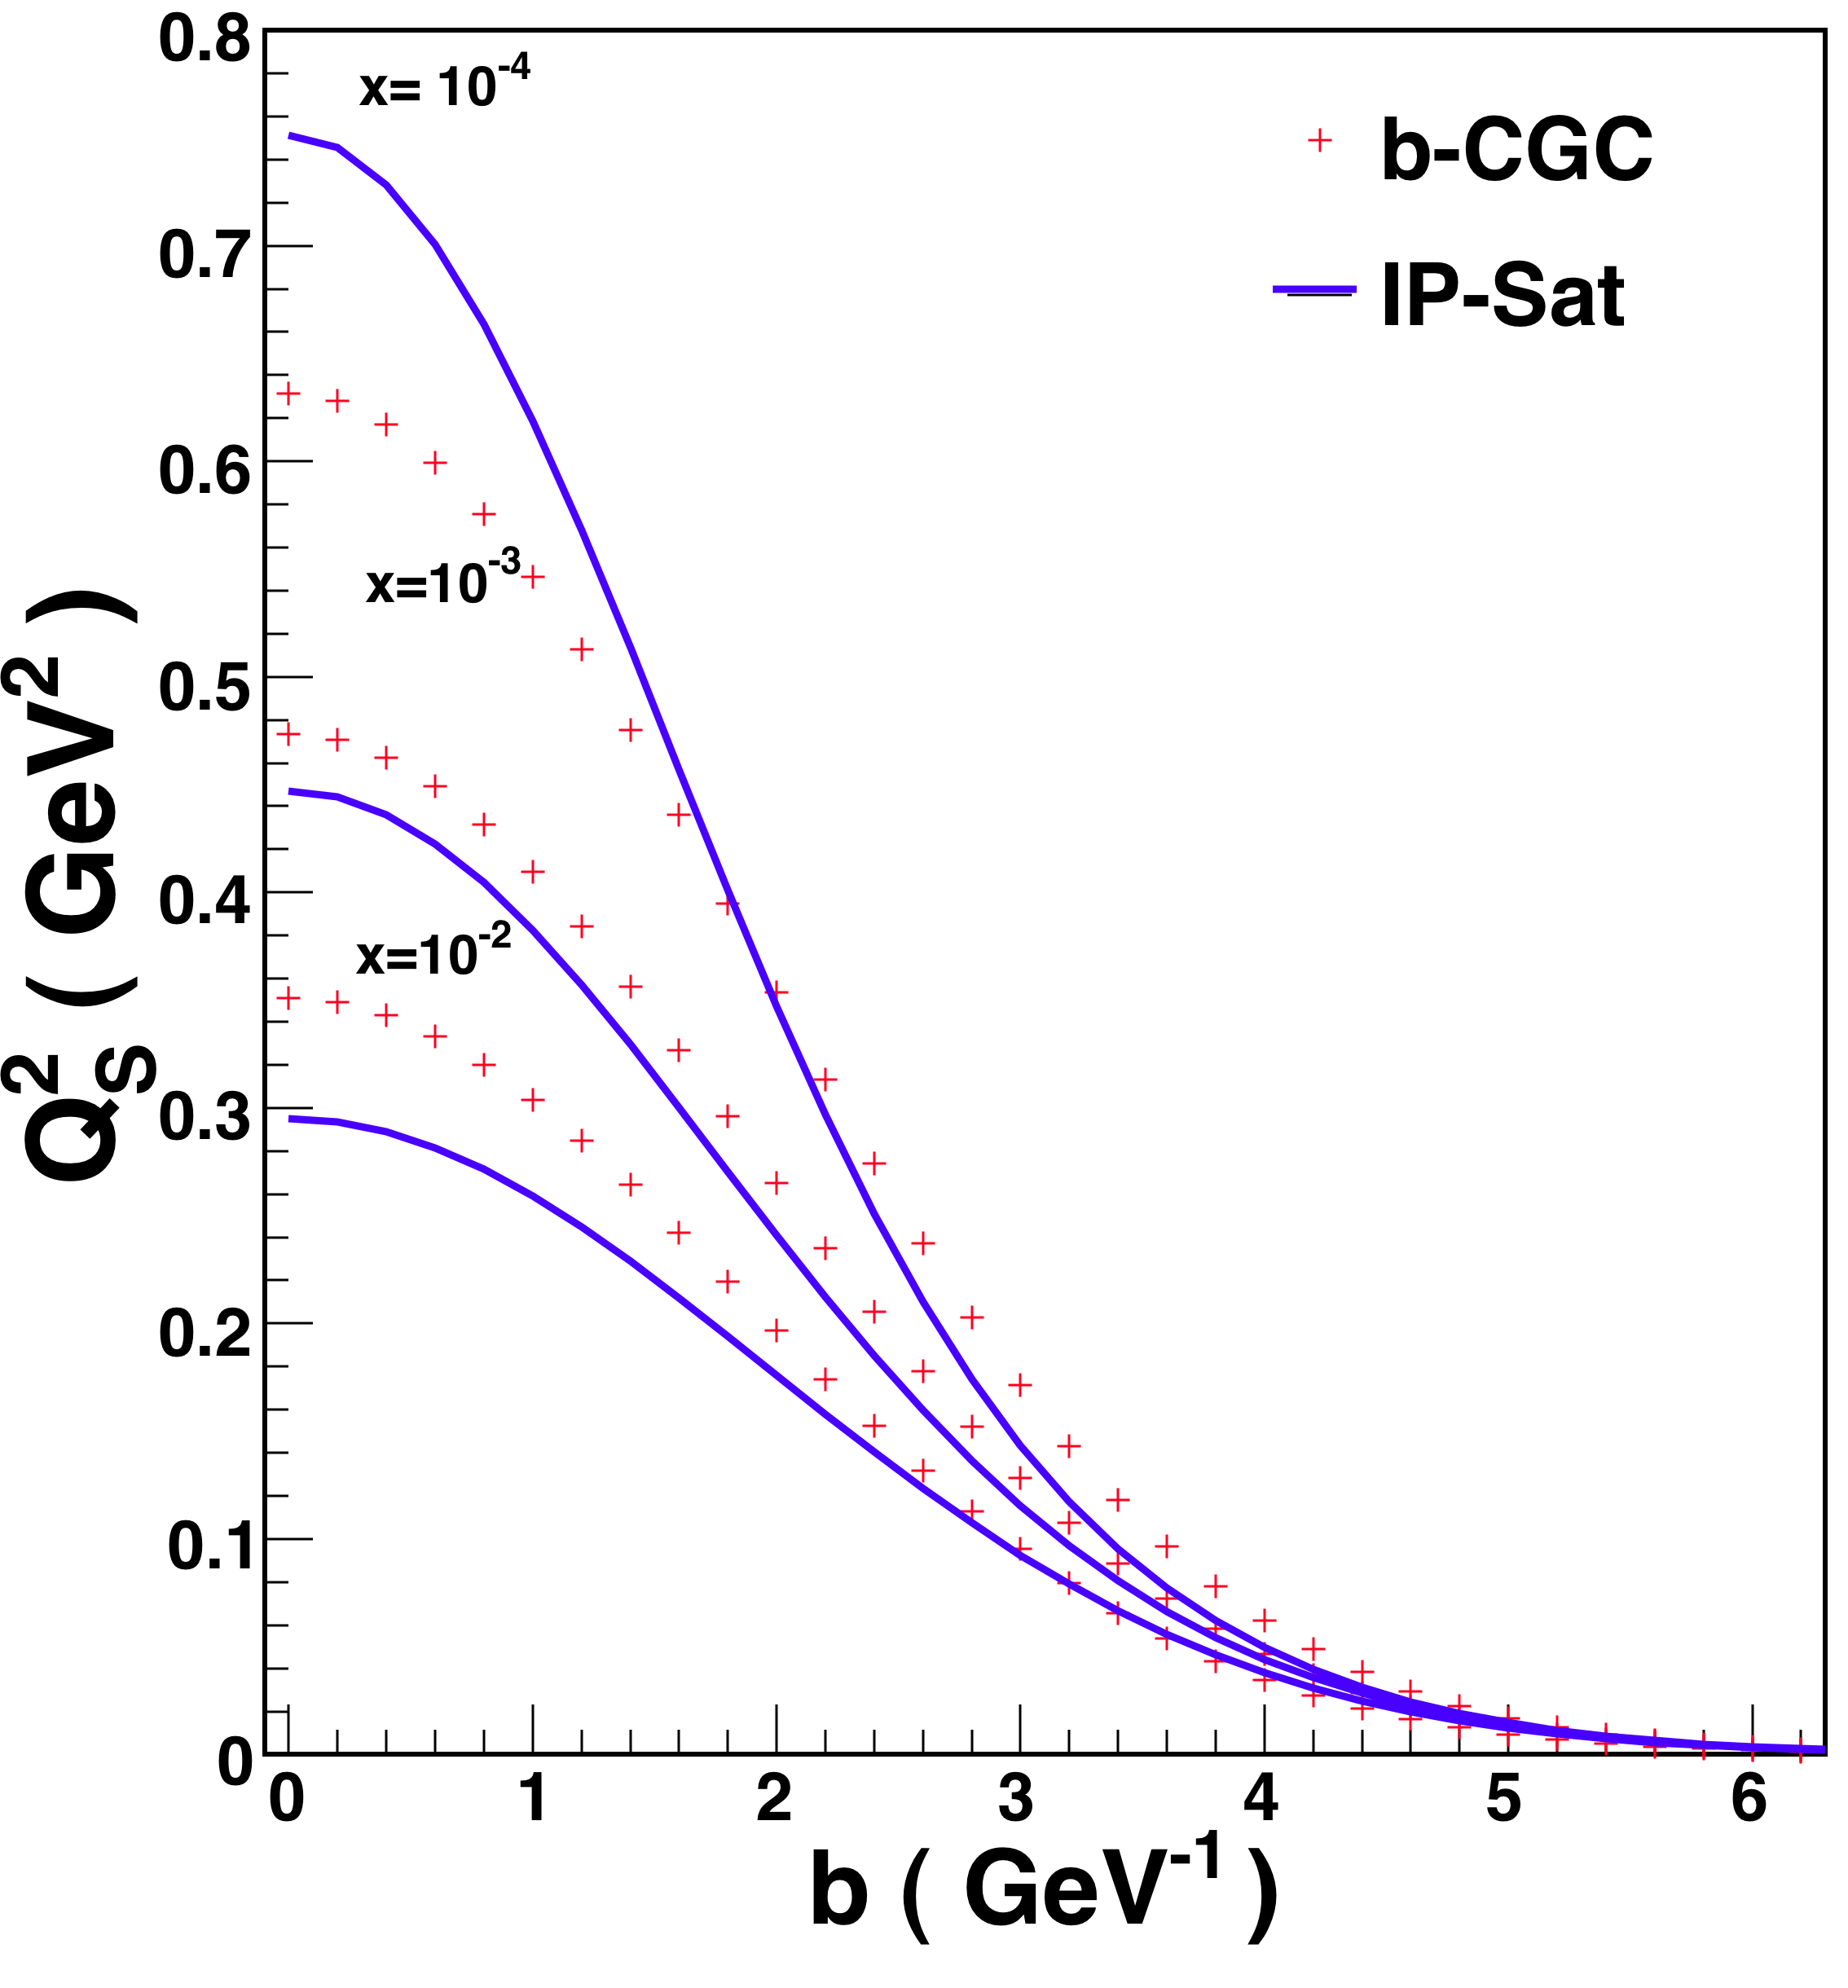
Systematics of p+Pb data explained
Dusling, RV: 1211.3701
Q₀²(lead)=N_{Part}^{Pb} * Q₀²(proton)
# of “wounded” nucleons in
Lead nucleus
Glasma signal is ~ N_{part} * N_{track}

Slide 29
p+Pb data explained
Dusling, RV: 1211.3701
Q₀²(lead)=N_{Part}^{Pb} * Q₀²(proton)
# of “wounded” nucleons in
Lead nucleus
Large “ridge” seen in Color Glass Condensate
by varying saturation scale in proton and
# of wounded nucleons

Slide 30
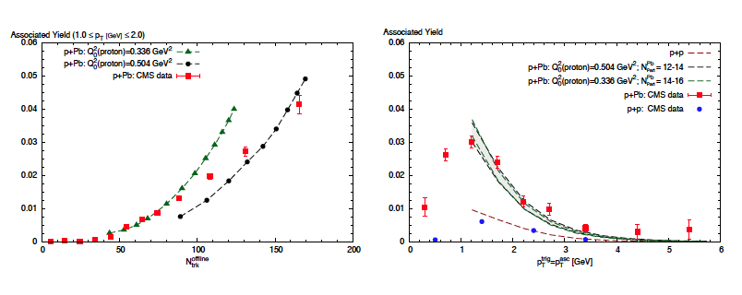
CMS p+Pb data explained
Dusling, RV: 1211.3701
Same parameters as in p+p
- gives larger ridge when saturation scales are varied

Slide 31
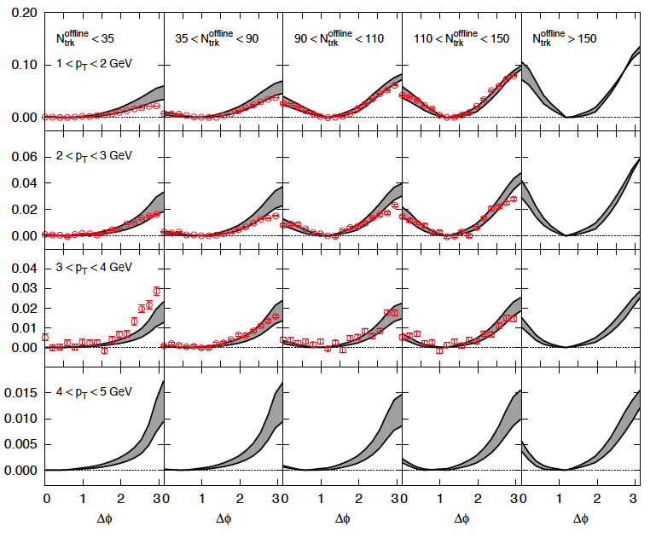
CMS p+Pb data explained
Dusling, RV: 1211.3701
Smoking gun for gluon saturation and BFKL dynamics ?

Slide 32
ALICE data on the p+Pb ridge
ALICE coll. arXiv:1212.2001
Different acceptance (|Δη| < 1.8) than CMS (2 < |η| < 4) and ATLAS (2 < |η| <5).
ALICE subtracts away-side “jet” contribution at 40-60%
centrality from most central events
–this gives dipole shape of correlation
Different analysis technique from
CMS/ATLAS
-- our fit here is with arbitrary
normalization

Slide 33
Comparison to ATLAS p+Pb ridge
ATLAS coll. arXiv: 1212.5198
ATLAS yields in asymmetric p_{T} windows compared to Glasma + BFKL:
K_{BFKL}=1 and K_{glasma}=4/3
Glasma graph contributions compared to ATLAS central – ATLAS peripheral

Slide 34
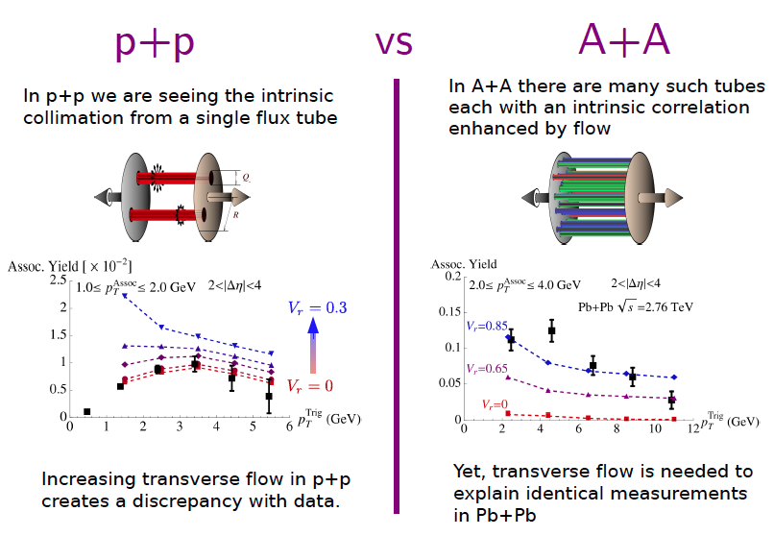
IP-Glasma + MUSIC model

Slide 35
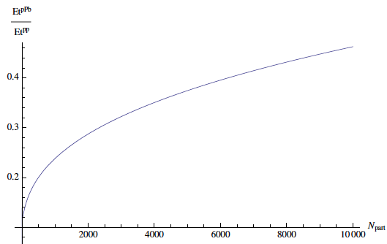
Can flow in p+A explain the ridge ?
In a thermal picture, for same transverse overlap area,
ε_{pp} ≈ ε_{pA} when N_{track}^{pp} = N_{track}^{pA}
For same energy densities, expect same flow dynamics but
pA yield is ~ 6 times larger than pp
In CGC picture, ε_{pA} < ε_{pp} for same N_{track} until very large N_{part}
Flow explanation unlikely
based on this simple argument
+
questions about applicability to
small size systems for large
transverse momenta

Slide 36
Summary
Have not covered many interesting channels: quarkonia, jets, photons that carry unique information about high parton densities
Exciting year for such studies and much to
look forward to @ RHIC ⬆pA and EIC

Slide 37
EXTRA SLIDES

Slide 38
MC rc BK LHC pseudo-rapidity dist. With different y -> η Jacobian
From A. Dumitru

Slide 39
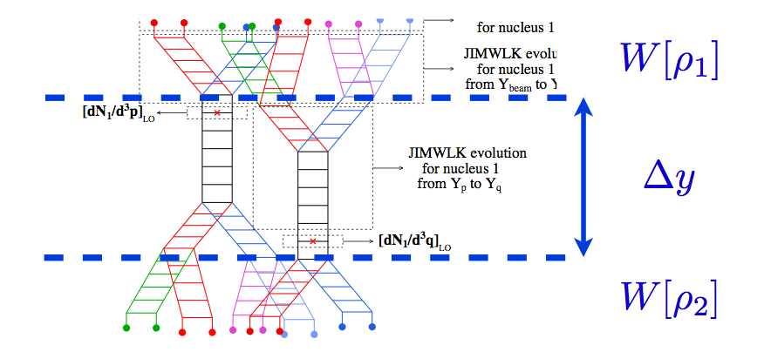
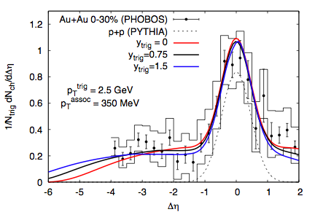
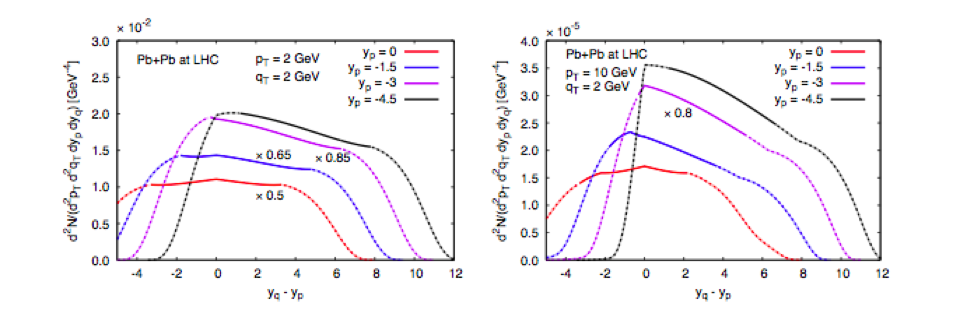
Long range di-hadron correlations
Gelis,Lappi,RV, arXiv:0810.4829
Dusling,Gelis,Lappi,RV, arXiv:0911.2720
LRC of Δy~10 can be studied at the LHC

Slide 40
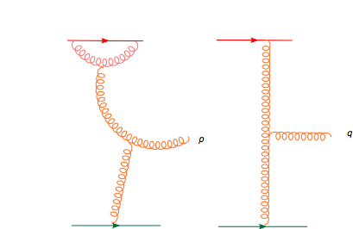
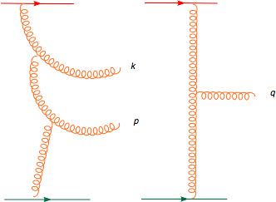

The saturated proton: Glasma graphs -I
RG evolution:
Gelis, Lappi, RV, arXiv: 0807.1306
+
+ …
Keeping leading logs to all orders (NLO+NNLO+…) 2-particle spectrum (for Δy < 1/α_{S})
= LO graph with evolved sources
avg. over sources in each event
and over all events gives correlation

Slide 41
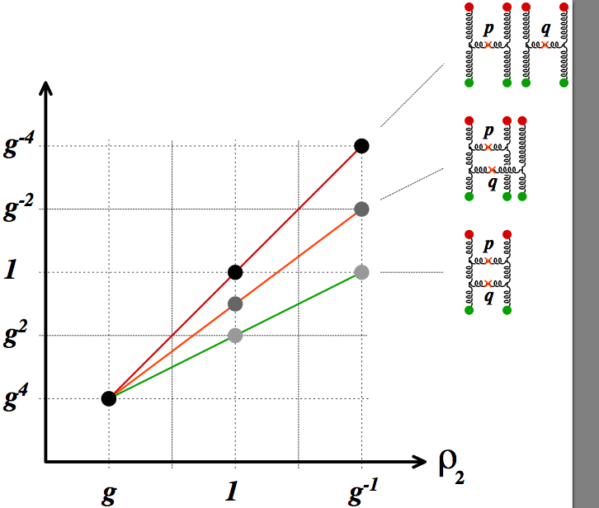


Power counting at high parton densities
CGC/Glasma
dN₂/d³p d³q
“pQCD”
When ρ₁, ρ₂ ~ g, “dilute limit”, CGC contribution is g¹² – power counting
changes from “dense limit” by α_{S}⁸ !

Slide 42
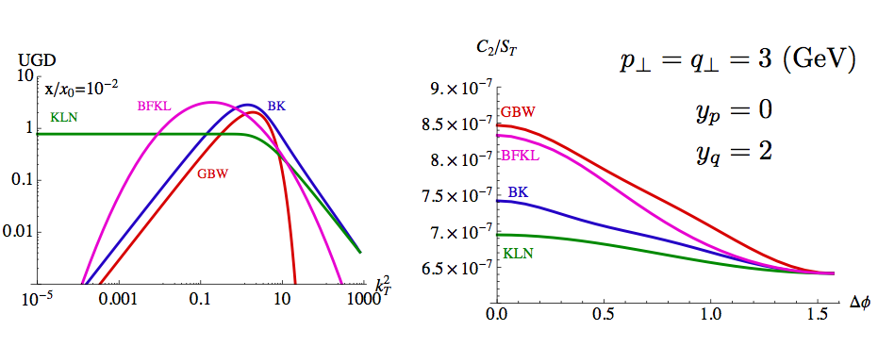
Physics underlying the ridge

Slide 43


Physics underlying the ridge
From previous discussion

Slide 44
Physics underlying systematics of the ridge
For Glasma graphs
For |p_{T}| = |q_{T}|, from the Cauchy-Schwarz inequality:
Equality implies no collimation; satisfied only iff
True only if Φ is flat in k_{T} - for above fns. Else, there must be a collimation

Slide 45



Physics underlying the ridge
Look at ratio of yield at Δφ_{pq} = 0 to Δφ_{pq}=π for |p_{T}|=|q_{T}|
As seen in the p+Pb data…

Slide 46

A+A initial state: saturated wave-functions
Incoming nuclei are Color Glass Condensates:
A Glasma / Quark-Gluon plasma is created.
Conjecture: matter produced is a nearly ideal perfect fluid with viscosity/entropy density, η/s ≥ 1 / 4π, a universal bound

Slide 47
IP-Glasma + vscous hydro model
Event-by-event flow distributions
Gale,Jeon,Schenke,Tribedy,RV, 1209.6330, PRL (in press)
v_{n} distributions track eccentricities ε_{n}
spatial fluctuations
efficiency => perfect fluidity
momentum anisotropies
+

Slide 48

From our paper
1210.3890v3
BFKL has very
weak centrality dependence
Subtracting 40-60%
gets rid of di-jet leaving only
dipole Glasma contribution
ALICE result consistent
with our expectations

Slide 49
rcBK vs IP-Sat evolution

Slide 50



Quantitative description of pp ridge
Dusling,RV, 1201.2658, PRL
Dependence on transverse
area cancels in ratio…
Subtracts any pedestal “phi-independent” correlation

