Slide 1
Hadronization and Color Transparency Studies at JLab
The Physics of pA Collisions at RHIC, BNL
Monday January 7th, 2013
Kawtar Hafidi

Slide 2
Part 1 - Hadronization

Slide 3
How do quarks transform “hadronize” into hadrons?
e
nucleon
Color neutral object
γ
g
g
g
e
Quark propagation
Hadron
Hadron propagation
Color charges cannot be separated by much more than 1 fm, since light
quarks easily pop up from the vacuum
Taking into account Lorentz dilation, the proper time scales for hadronization in the Lab frame become few fm
However our detectors are placed distances 10¹⁵ times further away from the origin compared to the hadronization length
Notes:
One of the challenges of modern nuclear physics is to understand how do energetic quarks ..

Slide 4
Hadronization in Nuclei
Nuclei provide a unique opportunity as detectors at a tiny distance within the range of hadronization process and perform direct measurements. These are the multiple scattering centers separated by only 1 – 2 fm
τ_{p}
τ_{f}^{h}
e
nucleon
γ
g
g
g
Hadron propagation
e
Quark propagation
Hadron
What is the interaction of the struck quark before it neutralizes its color?
What is the lifetime of an energetic free quark τ_{p} ?
How long does it take to form the color field of a hadron τ_{f} ?
What is the dynamic leading to color confinement?
Notes:
Nuclei or cold nuclear matter with known properties is the best detector to study hadron formation. Electron beam is perfect probe and we can tune kinematical variable to enhance or suppress processes.
In this talk I will be focusing on this part: color singlet formation, propagation and interaction

Slide 5
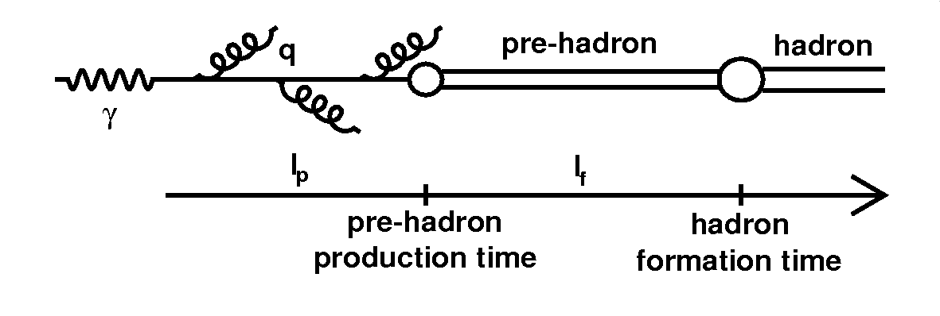
Motivation
Understand the Hadronization process by
  Measuring the characteristic times
  Measuring quark energy loss
  Measuring hadron attenuation
Characterization of the QCD medium
  Testing and calibrating theoretical tools used to determine the properties of Quark-Gluon Plasma
Reduce systematic effects when attenuation needs to be corrected for
  Neutrino experiments since they use nuclear targets
DIS
In Medium
Hadronization
DY
No In-Medium
Hadronization
Heavy ion collisions

Slide 6
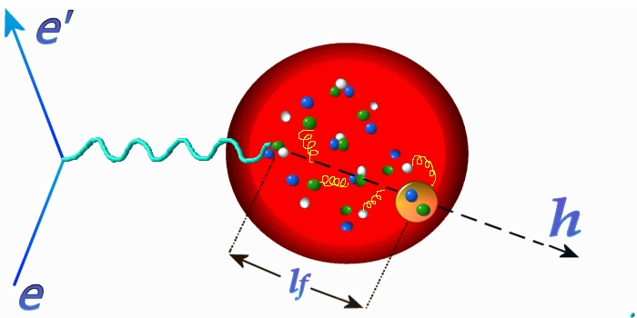
Experimental techniques
ν
z, p_{T}
Q²
E_{h}
Identify quark propagation phase by measuring p_{T} broadening
Identify hadron formation phase by measuring hadron attenuation
Extract characteristic times and reaction mechanisms using the variation of these observables with the nuclear size

Slide 7
Observables
Multiplicity ratio → Characterizes the attenuation (1- R)
Transverse momentum broadening → Characterizes the modification of the P_{t} spectrum
These are normalized to deuterium to reduce isospin effects
  → Other nuclei might be used for normalization as well

Slide 8
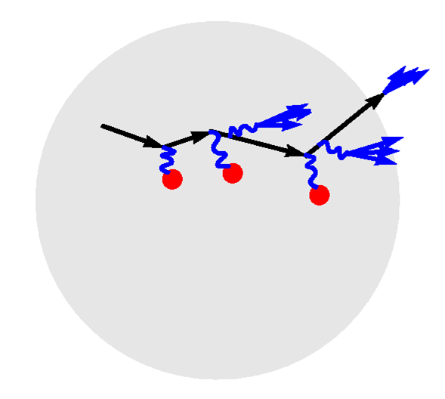
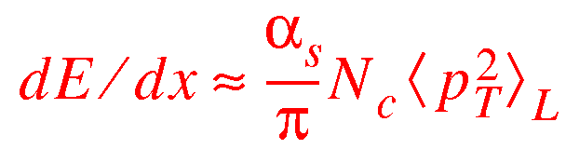
p_{T} Broadening and Quark Energy Loss
Quarks lose energy by gluon emission as they propagate
  In vacuum
  Even more within a medium
This energy loss is manifested by Δp_{T}²
Δp_{T}² is a signature of the production
time l_{p}
ΔE ~ L dominates in QED
ΔE ~ L² dominates in QCD?
propagating quark
gluons
quarks in nuclei
L
Medium-stimulated loss
calculation by BDMPS
nucleus
Notes:
Initial interaction point can be anywhere because interaction is weak.
QCD analog of LPM effect.
Proportional to gluon density in medium.
The calculation uses pQCD. Further work may be needed.
The vacuum energy loss : String -dE/dx prop 1 GeV/fm. The parton shares its energy with the produced hadrons. The rate should be constant.
If partons originate from hard scattering, gluon brems should be an additional or the main source of energy loss (pQCD is appropriate)
When you kick a quark hard, it shakes its gluon field depending on the hardness of the reaction (pQCD dE/dx prop -2*alpha*Q^2/3*pi). The energy loss has the same linear dependence as the string model because the gluons lose coherence with the source (they are radiated at different time intervals)
If one accelerates point-like charges, the main contribution should be brem and not coulomb forces (quark jet originating from QCD)
How many gluons are produced during time t ?
Only gluons with t<tc are considered (LPM QCD effect) the others are considered as a part of the color field of the quark
Subtracting pT for deuterium removes the effect of the intrinsic quark motion.
Virtual photon direction, = direction of momentum transfer

Slide 9
Experimental effort
  Semi-inclusive deep inelastic scattering on nuclei
    1970’s SLAC eA → e’Xh, energy transfer ~35-145 GeV
    1990’s CERN EMC μA → μ’Xh, energy transfer ~35-145 GeV
    1990’s WA21/59 (4- 64 GeV) ν beam on Ne target
    2000’s HERA HERMES e⁺A → e⁺’Xh, 12 and 26 GeV beam
    2000’s Jefferson Lab Hall C and CLAS, eA → e’Xh, 5 GeV beam
  Drell-Yan reaction
    1980’s CERN SPS NA-10 spectrometer: pA → Xμ⁺μ⁻, 140 and 280 GeV beam
    1990’s Fermilab pA → Xμ⁺μ⁻, 800 GeV beam
International, multi-institutional quest for 30 years, but most progress since 2000

Slide 10
Models
Which process dominates? Parton energy loss or Hadron absorption?
Are fragmentation functions modified in the nuclear medium?
Several models exists with different answers to these questions
  → Pure parton energy loss or hadron absorption models
  → Mixed models

Slide 11
Selected Models
Gluon Bremsstrahlung Model (B. Kopeliovich, J. Nemchik E. Predazzi, A. Hayashigaki)
Gluon radiation + hadronization model
Twist-4 pQCD Model (X.-N. Wang, E. Wang, X. Guo, J. Osborne)
Medium-induced gluon radiation only
Rescaling Models (A. Accardi, H. Pirner, V. Muccifora)
Gluon emission, partial deconfinement, nuclear absorption
PYTHIA-BUU Coupled Channel Model (T. Falter, W. Cassing, K. Gallmeister, U. Mosel)
Fundamental interaction + coupled channel nuclear final state interaction

Slide 12
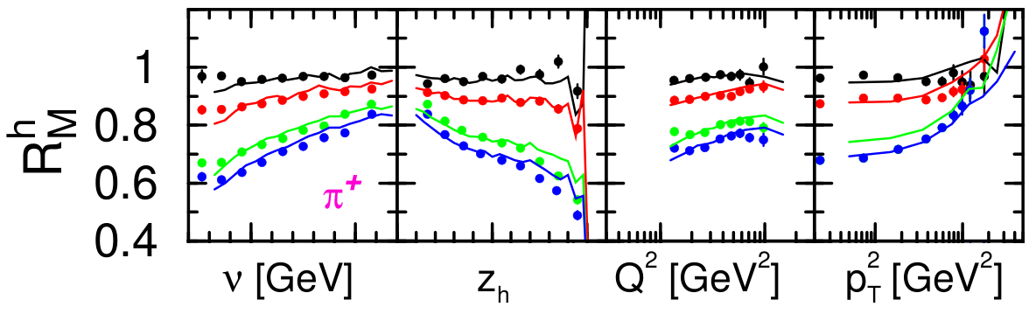
The general picture
HERMES Data compared to GIBUU model
He, Ne, Kr, Xe
Increase with ν
Decrease with z
Slight increase with Q²
Strong increase with P_{T}
Notes:
The ratio becomes larger than one for pt larger than 1 GeV. This was known in hadron-hadron collisions where it is attributed to initial state interaction leading to a broadening of the initial Partonic kt distributions.
He, Ne, Kr, Xe

Slide 13
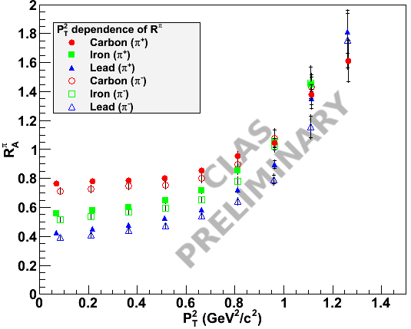
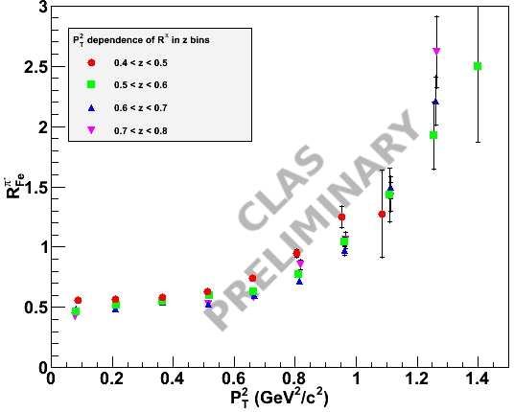
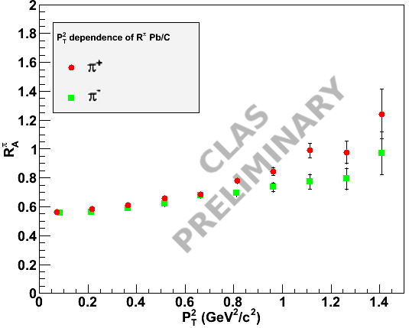
CLAS preliminary

Slide 14
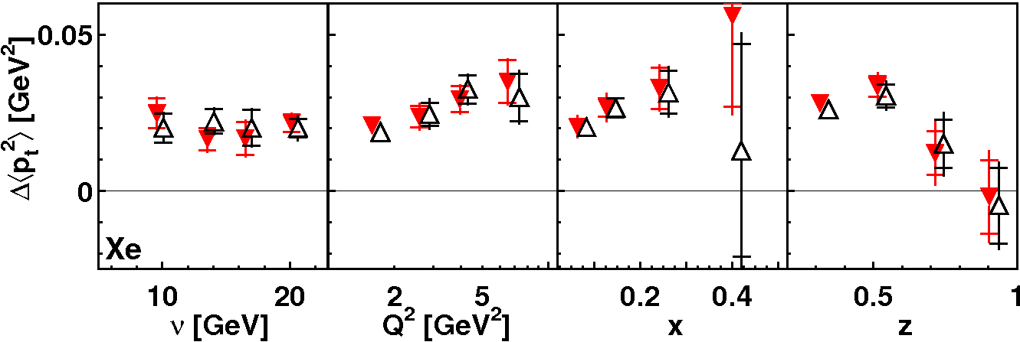
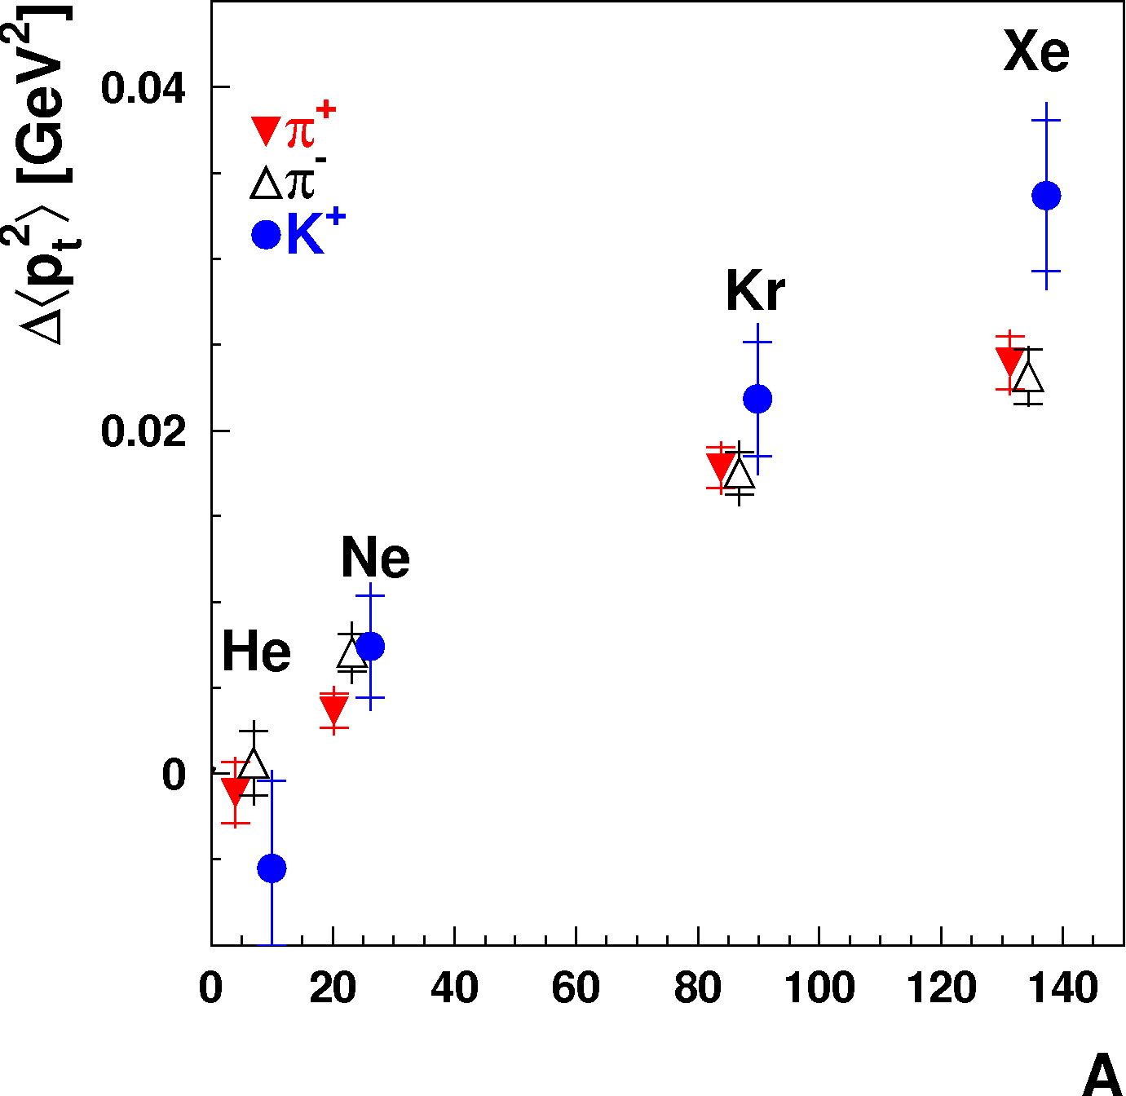
HERMES ΔP_{t}² Results
No broadening at high z
  → No effect at the partonic level
Increase with Q²
  → Predicted in the framework of parton energy loss
Dependence in A not conclusive
  → Compatible with A^{1/3} and A^{2/3}
Different behavior for kaons?
Notes:
High nu leads to important Lorentz boost at high energies- reduced attenuation (Formation outside the nucleus).
Shorter production time at high z and/or FF drops faster at high z
Small Q2 dependence, it could be a correlation with nu and/or parton energy loss.
Cronin effect, multiple soft scattering populating high pt2 region

Slide 15
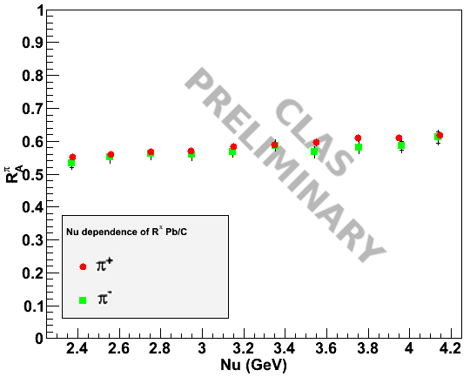
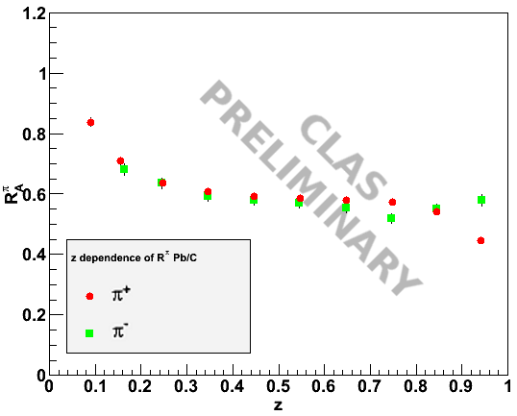
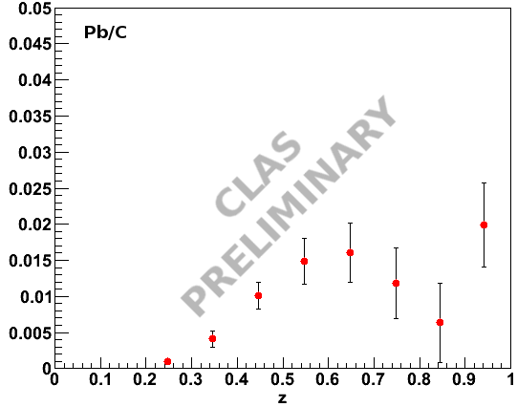
CLAS Preliminary Results: Pb/C
Δp_{t}²
Reproduce the ratios of HERMES
  → ν slope similar to HERMES
  → z Slope not as pronounced as in HERMES (?)
Results for Δp_{t}² compatible with HERMES

Slide 16
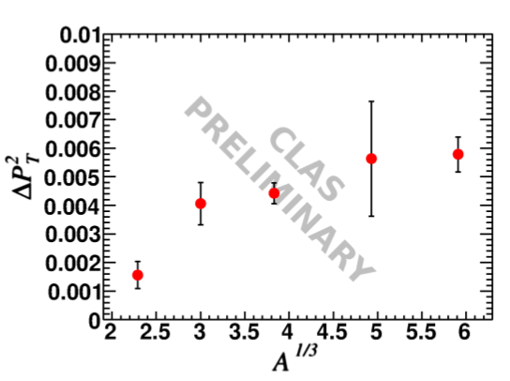
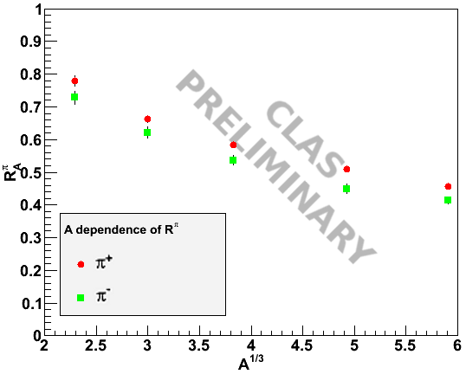
CLAS Preliminary Results : A Dependence
Nuclear effect saturates at high A – Does not follow A^{1/3} or A^{2/3}
  → Can be resolved within parton energy loss picture with small production time
Multiplicity ratio and P_{t} broadening follow the same trend
  → Originates from the same process ?
Notes:
C, Al, Fe, T, Sn, Pb
Saturation behavior is unexpected for most models since they all predicts A^alpha dependence with alpha>1/3
Production time smaller than nuclear radius, and attenuation is due to parton energy loss?

Slide 17
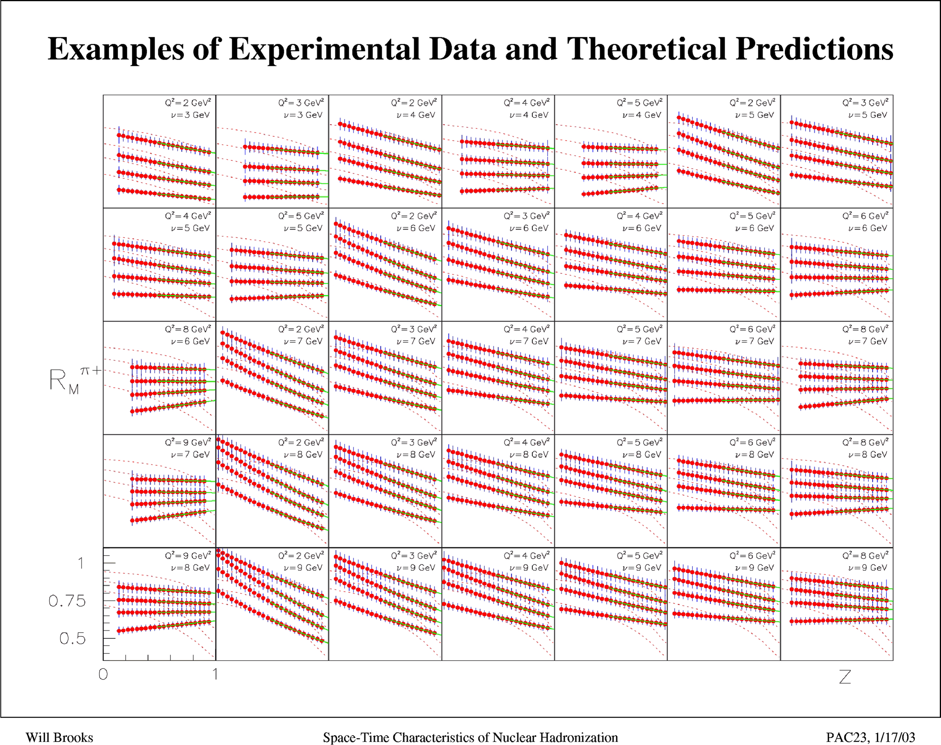
12 GeV Anticipated Data
E12-06-117
Notes:
Put reference to gluon bremsstrahlung model

Slide 18
Summary of Part 1
Hadronization is a fundamental process of QCD
  → Link between perturbative and non-perturbative domains
  → A way to probe nuclear media, either cold or hot
  → Helpful for other experiments
Past results gave the global picture of hadronization in medium
  → Effect of the various kinematic variables understood
  → Recent results provides multi-dimensional binning
Multi-dimensional analysis is crucial to constrain existing models → CLAS12 experiment (E-12-06-117) will provide such high statistics data in the right kinematic range

Slide 19
Future prospects for Hadronization studies
FNAL: E906 Drell-Yan at 120 GeV
  Lower energy run will significantly simplify dE/dx extraction and remove ambiguity between shadowing and energy loss
LHC Nuclear data
RHIC upgrades
JLab 12 GeV upgrade – CLAS12 in Hall B
  10 times more luminosity than CLAS and 1000 times more than HERMES
  Improved particle identification
  Access to higher masses
  Much larger kinematical range
Future electron-ion collider (Heavy quarks measurements)

Slide 20
Part 2 – Color Transparency

Slide 21
Color Transparency
Color neutral object
Pre-hadron
Mini-hadron
Small Size Configuration
Point Like Configuration
e
nucleon
.
Fully formed
hadron
e
G. Bertsch, S. Brodsky, A. Goldhaber & J. Gunion, PRL 47, 297 (1981)
A. Zamolodchikov, B. Kopeliovich and L. Lapidus, Pis’ma Zh.Teor. Fiz (1981);SPJETP Lett. (1981).
S. Brodsky & A. Mueller, Phys. Lett. B206, 685 (1988)
QCD predicts the existence of hadron-like configuration which under specific conditions, will pass through nuclear matter with dramatically reduced interaction
These configurations are of small size and their interactions with the nucleus are suppressed because of the small spatial extent of their color field
Notes:
Transparent medium to a particle means that the medium does not interact with it.
Color singlet and point-like configuration

Slide 22
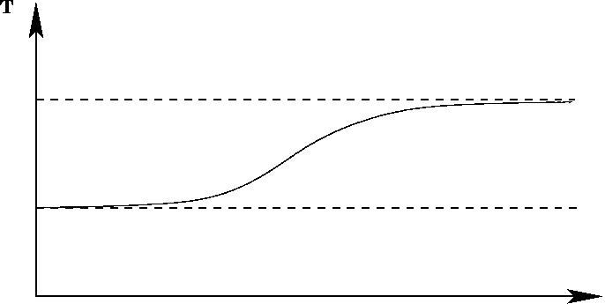
The 3 Pillars of Color Transparency “CT”
Creation of Small Size Configurations (SSC)
SSC experiences reduced interaction with the medium
SSC does not evolve rapidly as it propagates out of the nucleus
The signature of Color Transparency is the increase of the medium
“nuclear” Transparency T_{A} as a function of the momentum transfer
T_{A}
Complete transparency
1
σ_{N} is the free (nucleon) cross section
σ_{A} is the nuclear cross section
Glauber
Momentum Transfer

Slide 23
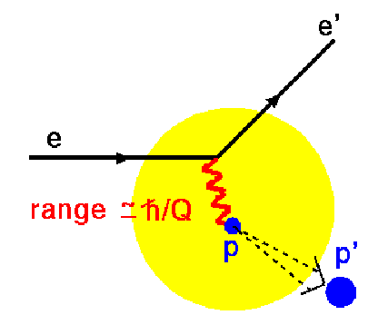
The power of hard exclusive reactions in CT studies
Hard exclusive processes play a key role in QCD
They allow the studies of quark and gluons scattering and their formation into hadrons at the amplitude level
They depend in detail on the composition of the hadron wave functions themselves
Lowest order elastic
Scattering shown in the
Breit frame where the
proton momentum is
changed in sign not
magnitude and no energy
is been exchanged
b
Q
For the reaction to be elastic, all partons in the proton wave function have to be located within the same transverse interval b ≤ 1/Q
At large Q², the transverse size of the ejectile can be much smaller than the equilibrium radius of the proton
Notes:
For Inclusive reactions, the underlying quark and gluon scattering processes lead directly to jet production. In leading order 1/Q2, cross sections and jet hadronization can be understood at the probabilistic level.

Slide 24

Pillar # 2: Color screening: the SSC experiences reduced attenuation
In QCD the color field of a color neutral object vanishes with decreasing size of the object
Consequence of charge screening in QED
were observed by Perkins in 1955
The ionization produced by the pair was small
near the decay point, increasing with distance
from vertex
It was quickly interpreted by Chudakov (1955)
in the framework of QED: A pair of oppositely
charged particles interacts in the medium
with a dipole cross-section proportional to b²
e⁺
b
γ
e⁻
π⁰
γ
200 GeV π⁰ produced in cosmic rays
In Perturbative QCD two-gluon exchange is believed to be the dominant scattering mechanism
The SSC-nucleon cross section is , R_{h} is the hadron radius

Slide 25
Pillar # 3: Lifetime of Small-Size-Configuration
Naïve parton model:
Quarks expand back to their usual separation at the speed of light
τ ≈ R_{h}/c (with time dilation it becomes E_{h}*τ/M_{h})
If the hadron is a nucleon R_{h}≈ 0.8 fm, probability of SSC escaping the
nucleus is significant even for modest values of Lorentz factor
More realistic “quantum diffusion” model:
the expansion takes a total time of 1/(E_{h*} - E_{h}), where E_{h*} is the energy of the typical intermediate state
The key point is that the SSC is not the ground state of the free hadron Hamiltonian

Slide 26


Medium Energy search for Color Transparency
Baryons
A(p, 2p) BNL
A(e, e’p) SLAC and JLab
Mesons
A(γ, πp) JLab
A(e, e’π) JLab
A(e, e’ρ) Fermilab, DESY and JLab
Notes:
Due to the difficulty of performing realistic QCD calculations at these energy scales, there is no theoretical consensus on either the Q2 scale at which the production of the PLC begin to dominate or the dominant mass scale of the PLC configuration. These values must be constrained by experimental searches for the onset of CT.

Slide 27
Color Transparency in C(p, 2p) reaction
A. Leksanov et al. PRL 2001
Elastic pp scattering
Glauber
The increase at low momentum cannot be taken as an unambiguous signal of CT
Results explained in terms of nuclear filtering (J. Ralston PRL 1988) or the
crossing of the open charm threshold (S. Brodsky PRL 1988)
Notes:
Free proton-proton cross section oscillates about s^-10 behavior predicted by PQCD constituent counting rule indicating the interference of soft processes with PQCD amplitude. If the soft process is suppressed in the nuclear medium, this would lead to the observed bump @9.5 GeV/c.

Slide 28
Search for Color Transparency in A(e, e’p) reaction
N. C. R. Makins et al. PRL 72, 1986 (1994)
G. Garino et al. PRC 45, 780 (1992)
D. Abbott et al. PRL 80, 5072 (1998)
K. Garrow et al. PRC 66, 044613 (2002)
Solid Pts – JLab
Open Pts -- other
Constant value fit for Q² > 2 (GeV/c)² has χ² /df ≈ 1
Conventional Nuclear Physics “Glauber” Calculation gives good** description
(V. Pandharipande and S. Pieper PRC 1992)

Slide 29
A(e, e’p) @ JLab 12 GeV

Slide 30
Search for
Color Transparency in A(e, e’π) reaction
B. Clasie et al. PRL 2007
Extensions of these
measurements to
Q² of about
10 (GeV/c)²
are planned for
JLab 12 GeV
upgrade
Notes:
The simple picture of CT, in which the probe “selects” the small size configuration of the struck particle, would naively only make sense when one looks at the longitudinal channel (sensitive to the virtual pion cloud)
R=σιγμα_{L}/σιγμα_{T} changes significantly vs. Q²

Slide 31
A(e, e’π) projections for JLab 12 GeV

Slide 32
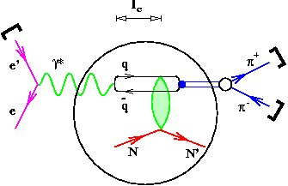
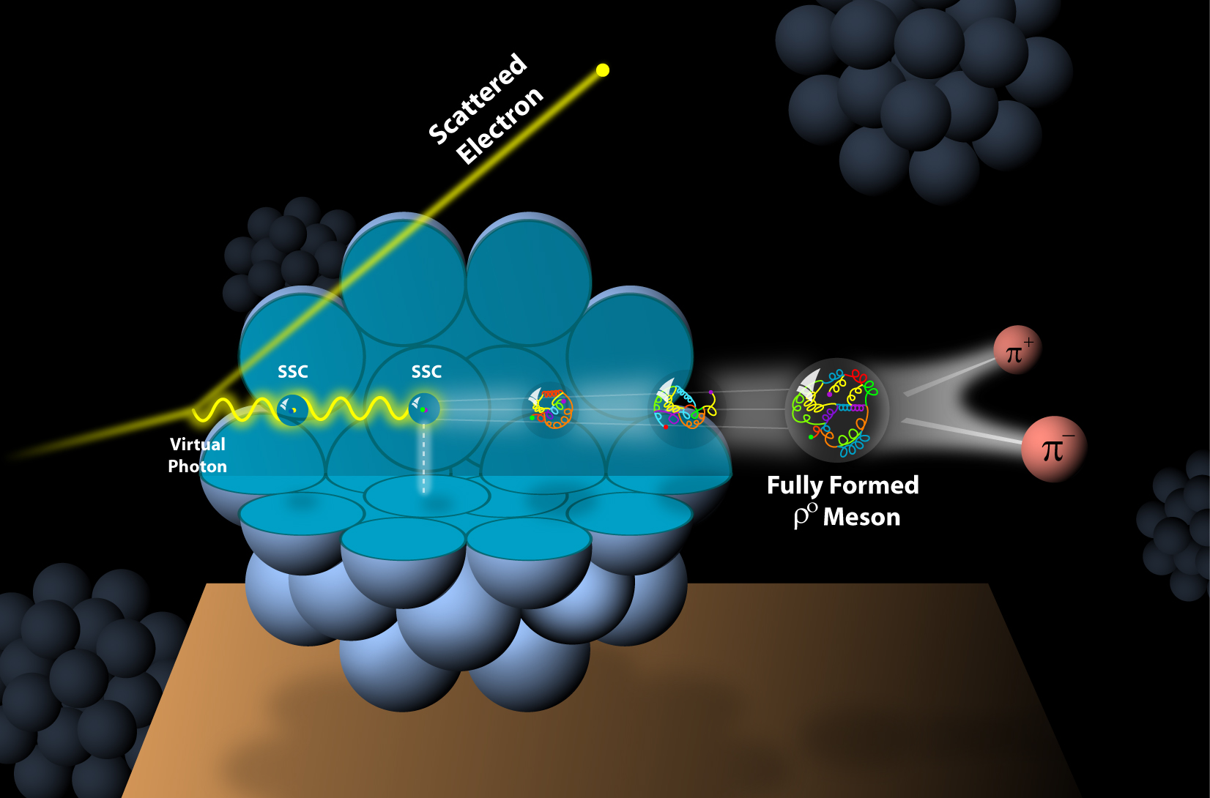
ρ⁰ electroproduction on nuclei
e + N → e’ + N + ρ⁰
Detected particles are :
Scattered electron and the
π⁺ and π⁻ from ρ⁰ decay
Finite propagation distance (lifetime) l_{c} for the (q q-bar) virtual state
l_{c} = 2ν/(M² + Q² )
M is the mass of the vector meson
ν is the energy transferred by the electron

Slide 33
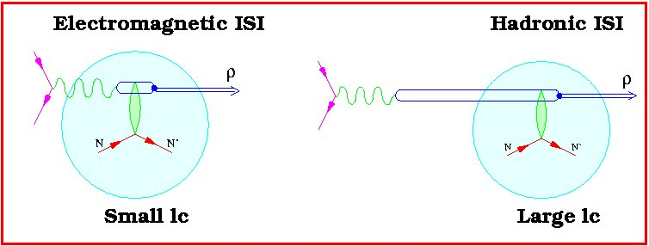
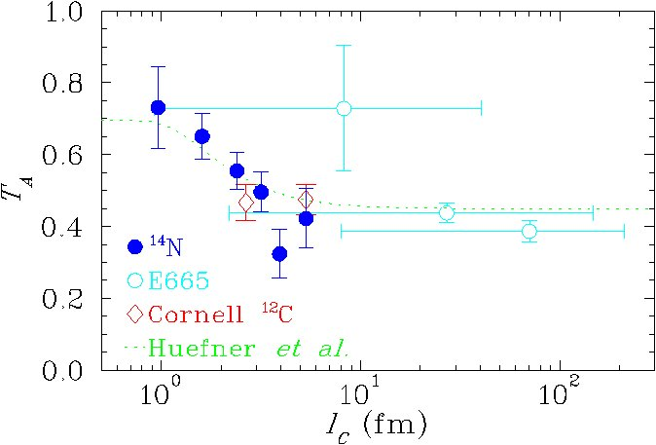
CT Signature is the rising of the nuclear transparency with Q². However …
HERMES
Coherence length
= 2ν/(M² + Q²)

Slide 34
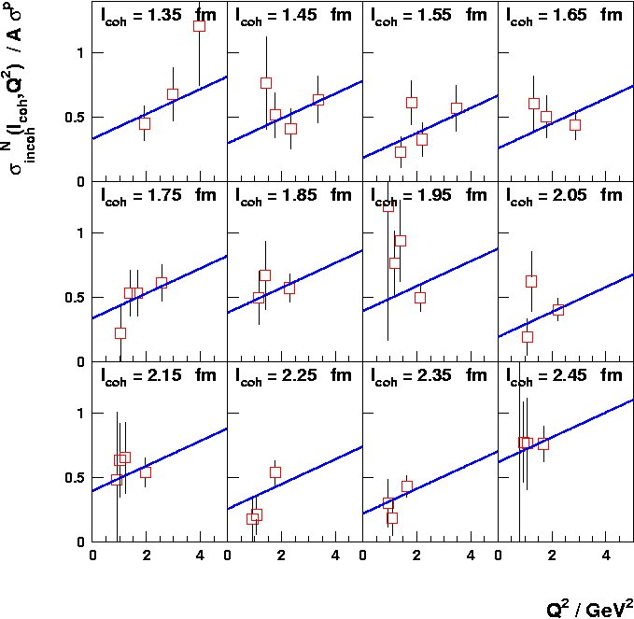
HERMES experiment at fixed coherence length
HERMES Nitrogen data : T_{A}=P₀ + P₂Q²
P₂ = (0.097 ± 0.048_{stat} ± 0.008_{syst}) GeV⁻²
Phys. Rev. Lett. 90 (2003) 052501
27 GeV positron beam

Slide 35
Nuclear Transparency vs. coherence length

Slide 36
Nuclear Transparency vs. Q²
FMS (Glauber Model): Frankfurt, Miller & Strikman, PRC 78, 015208 (2008)
GKM (Transport Model): Gallmeister, Kaskulov & Mosel, PRC 83, 015201 (2011)
KNS (LC QCD Model): Kopeliovich, Nemchik & Schmidt, PRC 76, 015205 (2007)
Notes:
A major difference between the two models is the ρ0 production mechanism. FMS model considers only ρ0 mesons produced diffractively. The GKM includes also those produced in deep-inelastic scattering, although the model assumes that the diffractive ρ0 mesons do not contribute to the color transparency effect. These may be reasons for the difference in the overall normalization.
The framework used is essentially a Glauber calculation, with the prehadronic interactions being described by the pQCD-inspired cross section of Farrar. In this model the prehadronic cross section consists of a 1/Q2 -dependent starting value; the cross section then increases linearly in time up to an expansion time where it reaches the full hadron-nucleon cross section. In FMS, the elementary cross section played no role as all produced rho can experience CT.

Slide 37
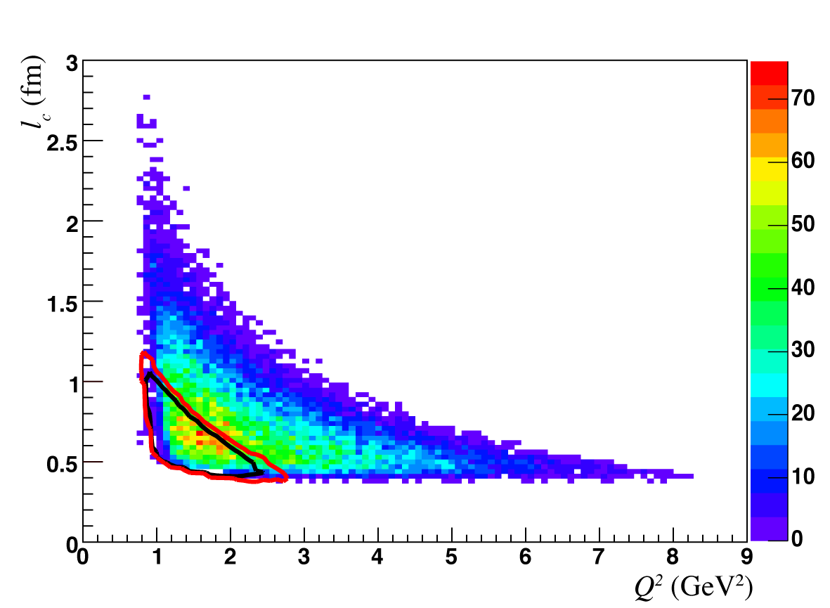
JLab 12 GeV ρ⁰ electroproduction measurements
C, Fe and Sn
E12-06-106

Slide 38
SSC vs. formation effects
Long l_{c} and fixed
Q² increases ⇒ T_{A} increases because the mean transverse separation of the {q,q-bar} fluctuation decreases
Coherence length
l_{c} = 2ν/(Q²+M(ρ)²)
Formation length
l_{f} = 2ν/(M(ρ’)² – M(ρ)²)
l_{c} small and fixed (@ low Q² l_{f} ∼ l_{c})
Q² increases ⇒ l_{f} increases
CT increases for two reasons:
transverse separation and l_{f} effects
Radius (C) = 2.7 fm
Radius (Fe) = 4.6 fm
Radius (Sn) = 5.7 fm

Slide 39
Summary part 2
Strong evidence for the onset of Color Transparency using ρ and pion electroproduction off nuclei at JLab (11 ± 2.3% decrease in the absorption of ρ in iron)
SSC expansion time with FMS model were found to be between 1.1 and 2.4 fm for ρ momenta between 2 and 4.3 GeV
At intermediate energies, CT provides unique probe of the space-time evolution of special configurations of the hadron wave function
Using the upgraded JLab 12 GeV, we plan to disentangle different CT effects (SSC creation, its formation and interaction with the nuclear medium)

