Slide 1
GEM Simulation

Slide 2
Monte Carlo
Gas ionization
  Ionization free path: exponential distribution
  Cluster size: a discrete distribution (Blum’s book)
Electron drift
  Drift each electron individually
  Add transverse and longitudinal diffusion
GEM amplification
  Amplify each electron individually
  Gain : exponential distribution
  No model for curve field line near GEM holes

Slide 3
Monte Carlo
Detection
  Electrons are sorted based on transverse position
  40ns peaking time 2nd order unipolar shaper
  Constant fraction discriminator
  Real field line and capacitive coupling not simulated
Reconstruction
  Least square fit with a straight line
  In 3D mode, fit two projections of the track

Slide 4
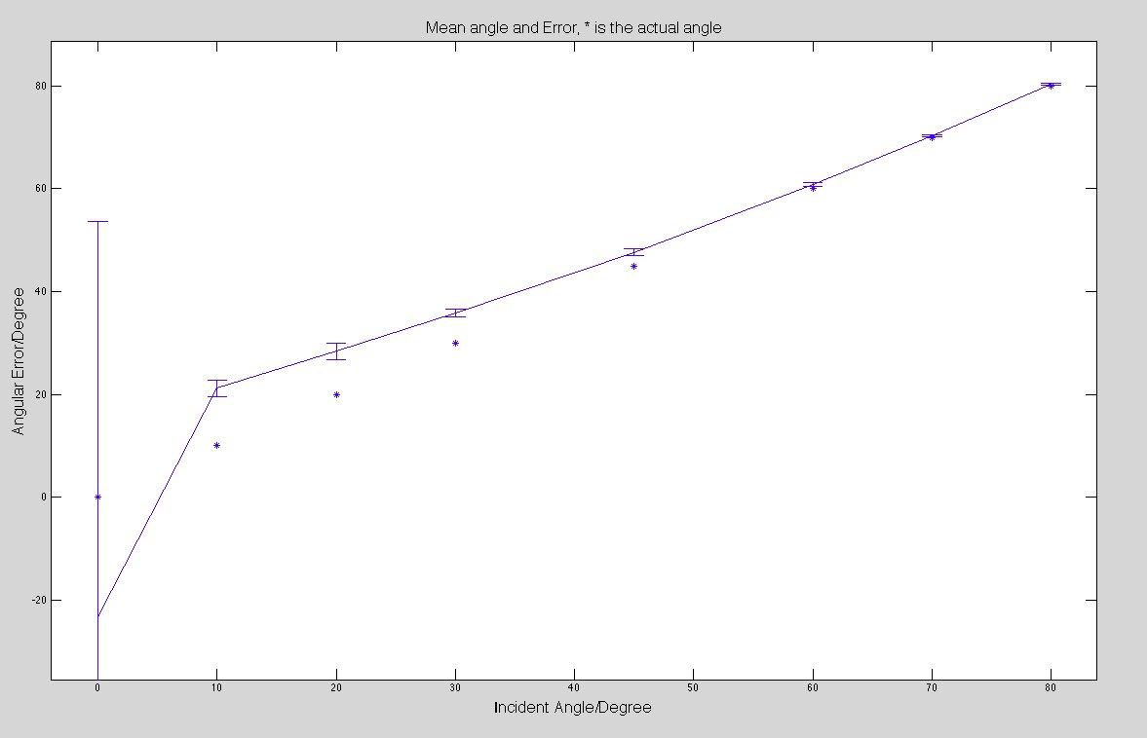
Result

Slide 5
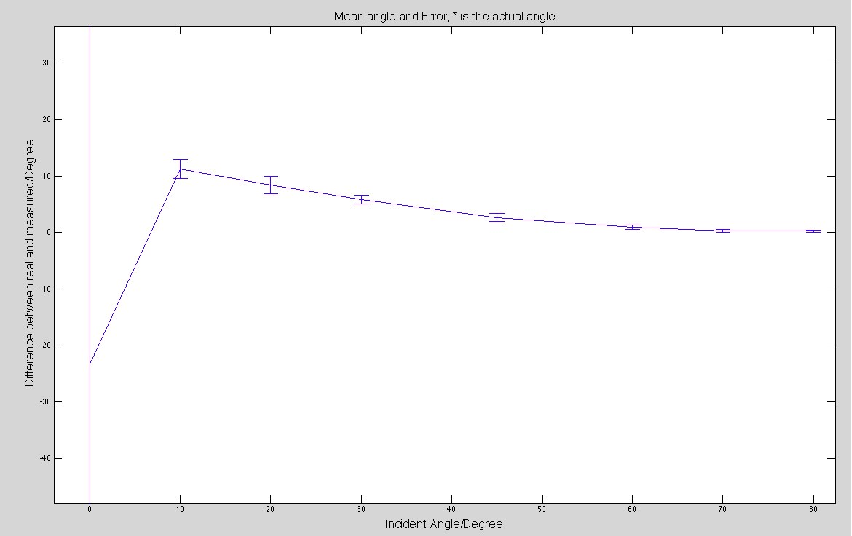
Result

Slide 6
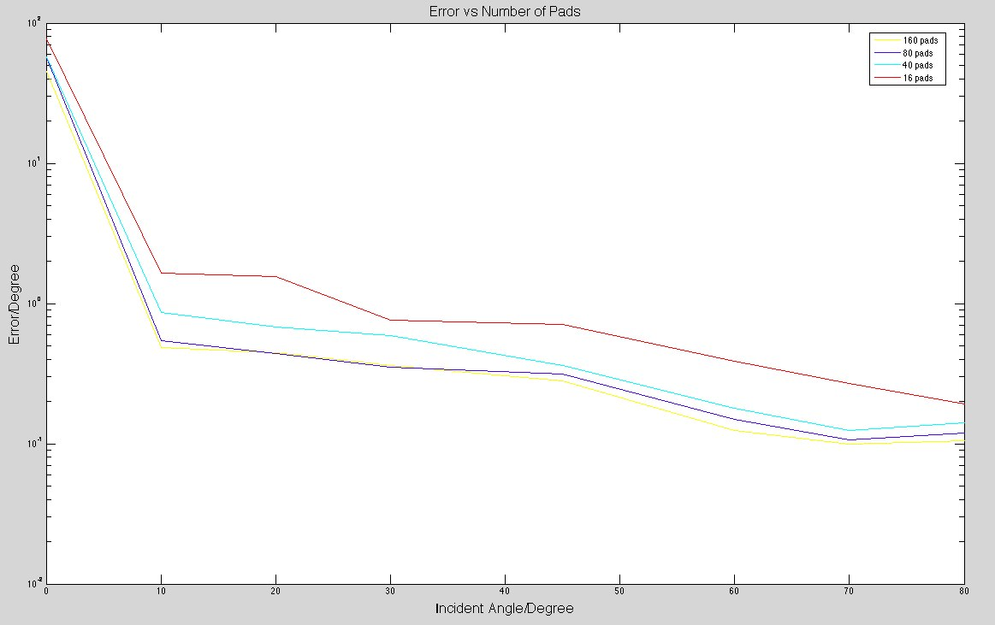
Result

Slide 7
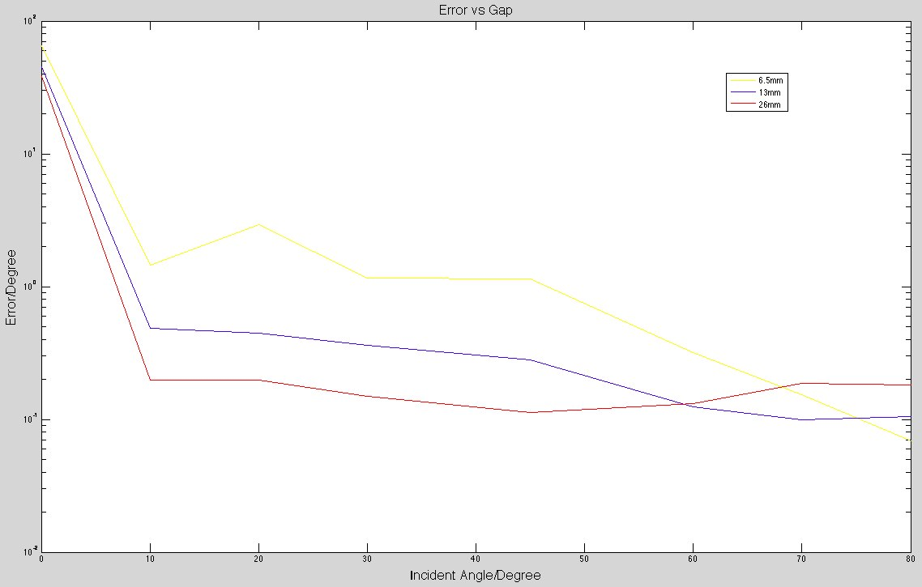
Result

Slide 8
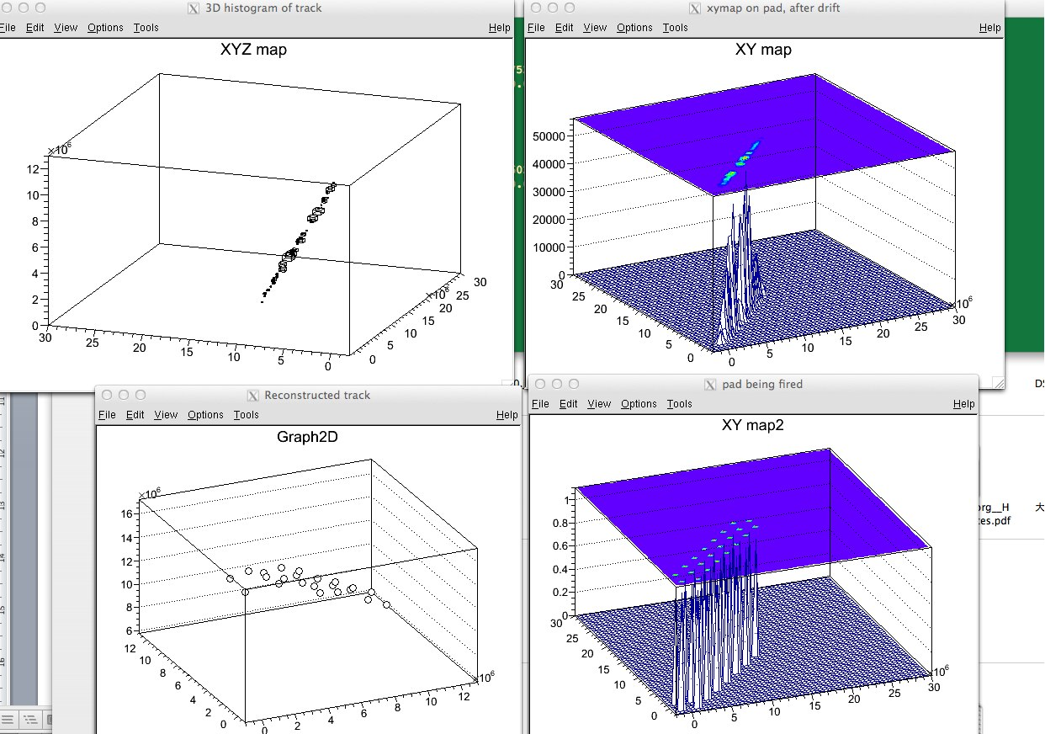
Result

