Slide 1

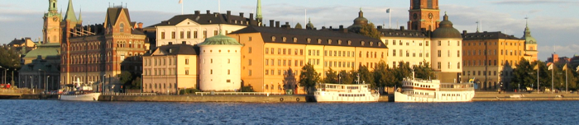
The Heavy-Ion Collider Era – from RHIC to the LHC
David Silvermyr, ORNL
NCNP 2011, Stockholm, 13-17 June
Notes:
Thank you very much. It’s a pleasure to be here.

Slide 2
Outline
Intro: high-energy heavy-ion physics; Relativistic Heavy Ion Collider (RHIC)
2) Selected highlights from first 10 years at RHIC
3) Few recent results from Large Hadron Collider (ATLAS + CMS)
Notes:
Here’s my outline for today. First I will start with an introduction/reminder what it is we are after in high-energy heavy-ion physics (this will be familiar after the talk by Jens Joergen earlier), then I will spend most of my time discussing some highlights from RHIC, and finish with some recent results from LHC.

Slide 3
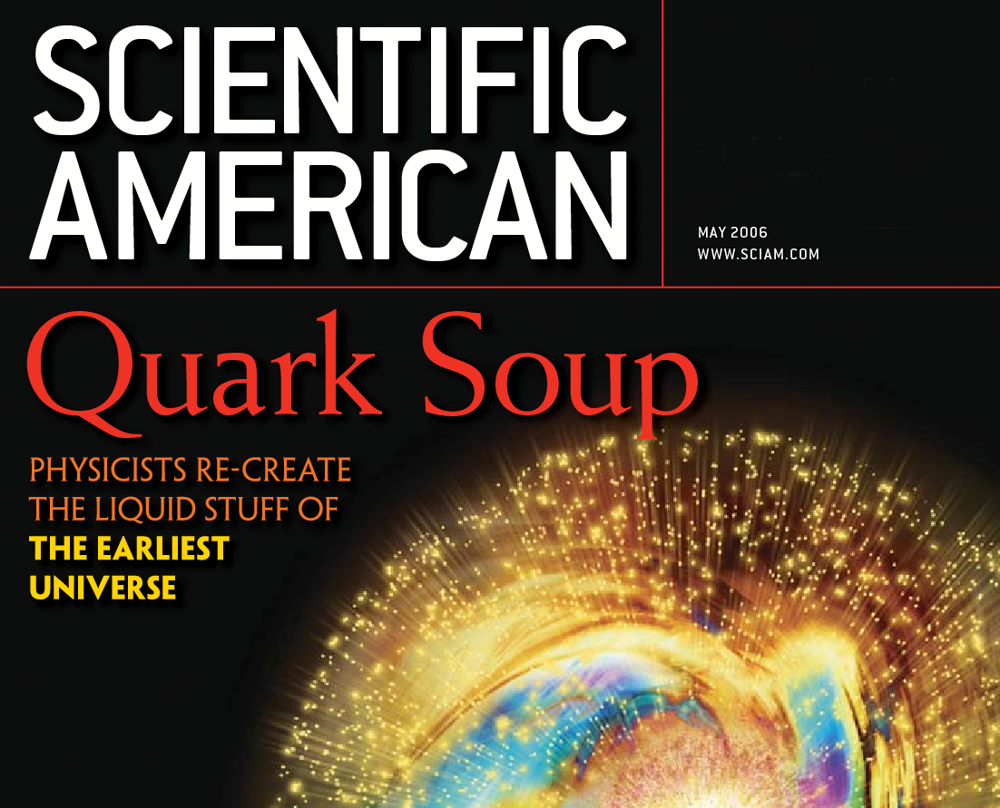

Hors d'œuvre
The Top Ten Physics Newsmakers of the (past) Decade (APS, 2010), include:
Large Hadron Collider
Quark Gluon Plasma
RHIC results top Physics story of the year in 2005
Notes:
As an appetizer, before we get really started, I just thought I’d mention that this sort of thing has received a lot of attention in the last decade. The topics Quark-Gluon Plasma and Large Hadron Collider were on the top ten list of newsmakers in the past decade, ranked recently by the American Physical Society, and results from RHIC ranked as the tops physics story of the year in the Physics year 2005 (all of physics, not just nuclear or particle physics)

Slide 4
The Physics of High-Energy Heavy-Ion Collisions
Create very high temperature and density matter
as existed some μsec after the Big Bang
inter-hadron distances comparable to that in neutron stars
collide heavy ions to achieve maximum volume
Study the hot, dense medium
do the nuclei dissolve into a quark gluon plasma?
Collide ions at high energy
√s = 200 GeV/nucleon pair w. Au+Au at RHIC
(max) 5.5 TeV/nucleon pair w. Pb+Pb at LHC
QGP definition : a new state of matter where the
fundamental degrees of freedom are not
color-neutral hadrons.
Perhaps later we will come up with a more exciting name !
Notes:
So, to the physics of High-Energy Heavy-Ion Collisions.. As you have heard from JJ, the goal is to create very high temperature and density matter, as existed in our universe a few micro-sec after the Big Bang. You can see here in this figure on the right the basic idea. In normal nuclear matter or at moderate temperature and densities we have our regular baryons or mesons. As we go up in temperature and density, at some critical temperature, the concepts of color neutral hadrons cease to exist and we reach a state commonly referred to as the quark-gluon plasma.
We use heavy-ions for this to have a larger volume and simply packing as many quarks and gluons and energy into our collision zone as possible.
The collision energy we can reach is up to 200 GeV per nucleon pair at RHIC and up to 5.5 TeV per nucleon pair at LHC.

Slide 5
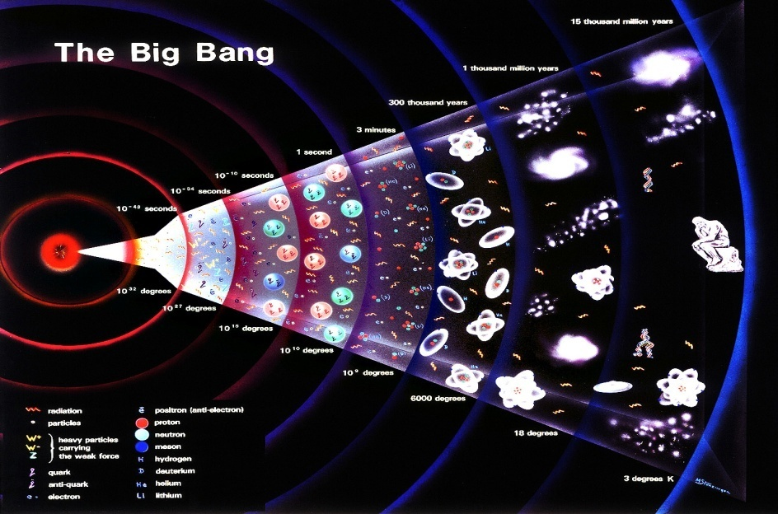
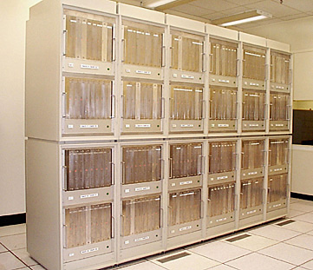
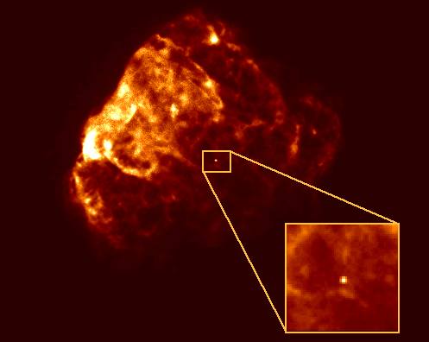
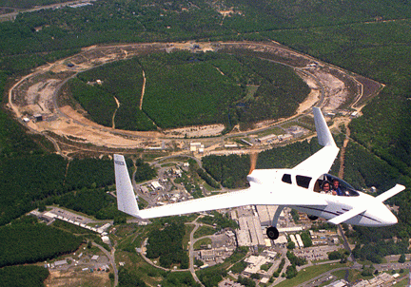
Where to Study Extreme QCD?
Big Bang
Only one chance…
Lattice QCD
Who wants to wait?…
RHIC (and LHC)
Neutron stars
Notes:
So, where can we do these studies of extreme QCD? Well, as far as we know, we had a chance a few micro-seconds after the big bang but that was only one event.. We can study the theory in lattice QCD calculations.
Furthermore, there could be a chance in the interior of neutron stars but for now, we are using the flagship accelerator facilities at Brookhaven and CERN.

Slide 6
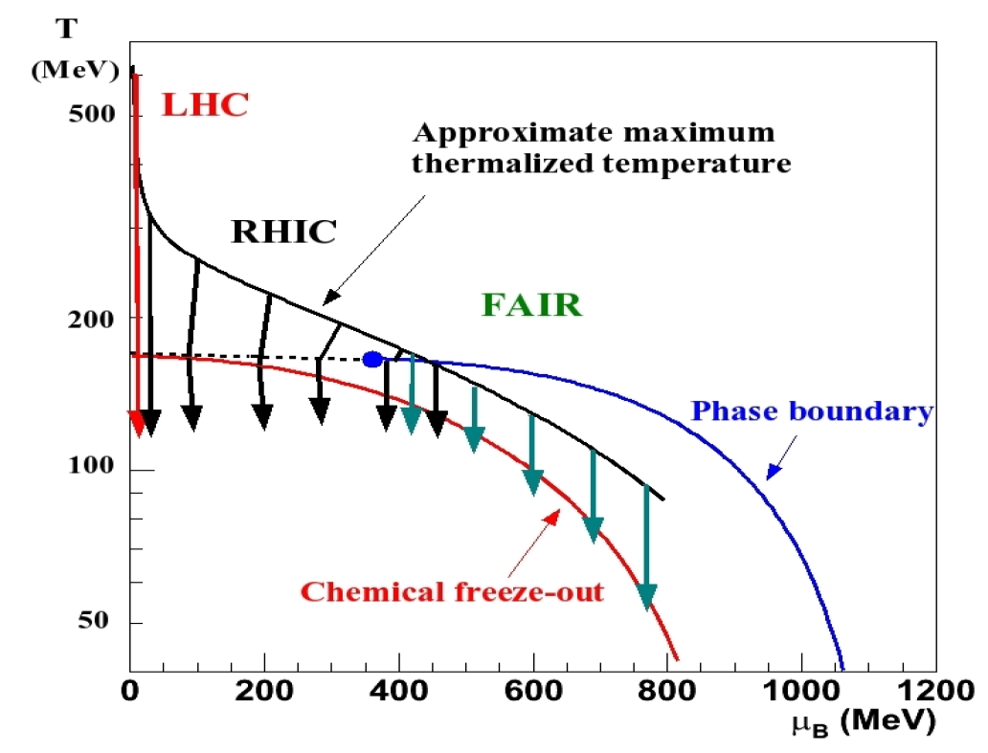
World Context
: 2010→
: 2000→RHIC II →
: 20XX→
Notes:
Here is a sketch of the so-called the phase diagram, with temperature and net-baryon chemical potential on the axes, and you can see the regions that can be reached with the current and future accelerators.
The plan is that RHIC will go through a luminosity upgrade and continue for many more years. Then we also have the new player on the field at lower energy FAIR, with particularly the CBM experiment that we heard a bit about yesterday.

Slide 7
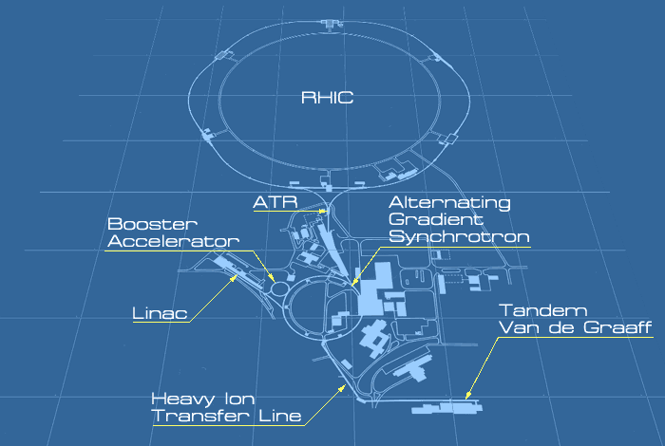
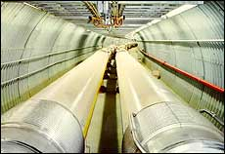
RHIC @ BNL
4 heavy ion experiments
BRAHMS
PHOBOS
PHENIX
9 GeV/u
Q = +79
STAR
3.84 km circumference
> 1700 magnets
106ns between beam crossings: 9.4 Mhz
Collision energies
√s_{NN} = 500 GeV for p-p
√s_{NN} = 200 GeV for Au-Au
Luminosity
Au-Au: 2 x 10²⁶ cm⁻² s⁻¹
p-p : 2 x 10³² cm⁻² s⁻¹
(polarized)
1 MeV/u
Q = +32
Notes:
Since I will start with the results from RHIC, let me just give some brief numbers regarding the RHIC facility. There are 4 experiments. The two big ones are called STAR and PHENIX, the two smaller ones who are no longer taking data are BRAHMS and PHOBOS.
RHIC is a very flexible machine and can accelerate pretty much everything from protons to gold and energies up to 500 GeV for polarized protons, and 200 GeV for Au+Au.

Slide 8
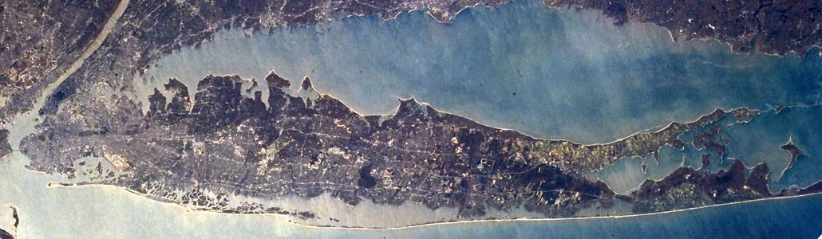
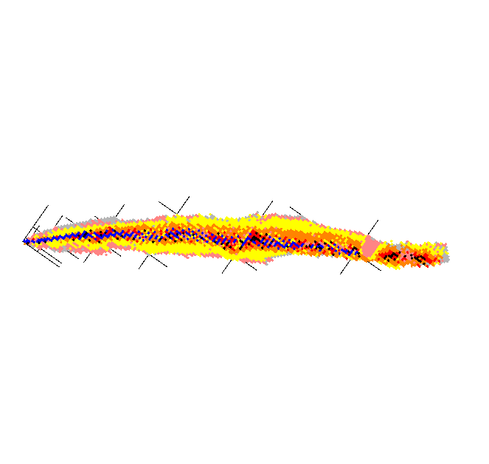
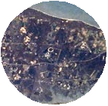
RHIC / Long Island
~ 100km [60 miles]
Manhattan
Au
RHIC/Brookhaven
Notes:
One way to remember what RHIC collides and where it is located is if you compare the geography of Long Island vs a tilted chart of the nuclides.. If you skip the North and South Forks, cut off at the Hamptons, there is some similarity between the location of gold and BNL.. :=)
The lines here BTW are the magic numbers as you probably realized. And you can actually see the RHIC ring quite nicely with Google maps or what not already on this scale.

Slide 9
Nordic High-Energy Heavy-Ion groups
Finland :
Jyvaskyla
PHENIX @ RHIC *
ALICE @ LHC *
Norway:
Bergen
Oslo
BRAHMS @ RHIC
ALICE @ LHC *
Alma Mater Hardware efforts:
Responsible for PHENIX
Pad Chambers (central tracking)
Contributions to ALICE TPC
electronics (central tracking)
Sweden :
Lund
PHENIX @ RHIC *
ALICE @ LHC *
Denmark:
Copenhagen
BRAHMS @ RHIC
ALICE @ LHC *
RHIC : Au+Au at 200 GeV/A
LHC: Pb+Pb at 2.76 TeV/A
* = experiments currently taking data
Notes:
Now, since this is a Nordic conference, I would just like to mention the groups involved in this research in the Nordic countries. All of them participate in the ALICE experiment at the LHC.
There are big groups in Denmark and Norway that also participated in BRAHMS at RHIC, and groups in Sweden and Finland that participate in the PHENIX experiment. The Lund group has been quite strong but has unfortunately shrunk significantly in recent years.

Slide 10
High-Energy Heavy-Ions Worldwide
From all time most cited experimental nuclear physics papers:http://www.slac.stanford.edu/spires/topcites/2010/eprints/to_nucl-ex_alltime.shtml :
- 4 out of top 10 from RHIC; other 6 from neutrino physics
- 36 out of top 50 (mostly from STAR and PHENIX)
[+ 11 from neutrinos; 3 from JLab]
In past decade more hadron-collider-physics citations for RHIC/heavy-ion physics than for Fermilab/particle physics..: http://sciencewatch.com/ana/st/hadron/
Very active time for the field and lots of interest in RHIC results!
PHENIX example:
  Have 100 published peer-reviewed papers! (54 PRL, 40+ PRC&PRD). Have >10,000 citations!
  120 PhD’s so far (6 from Lund)
Notes:
As my final public relations slide, I would also like to mention that in recent compilations of citations etc., high energy heavy ion physics is doing quite well. For instance 70% of the top 50 publications in experimental nuclear physics are from high-energy heavy-ion physics, and also if one compares with the particle physics folks, there are more citations for the results from RHIC than from any other hadron collider, for instance Fermilab.

Slide 11
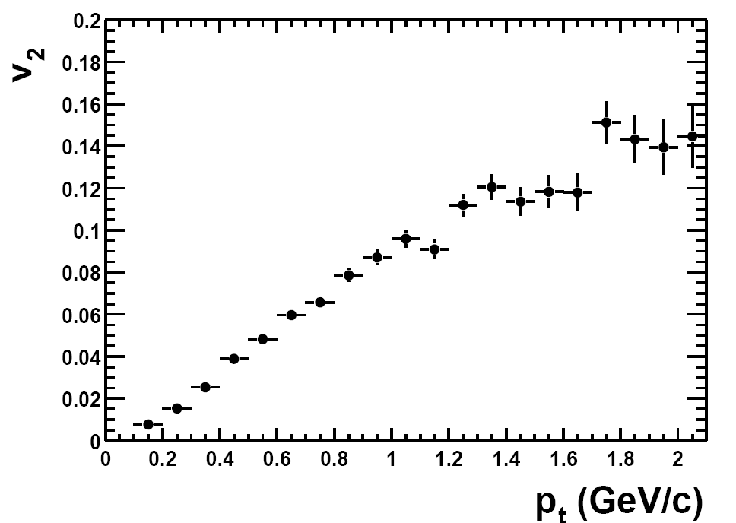
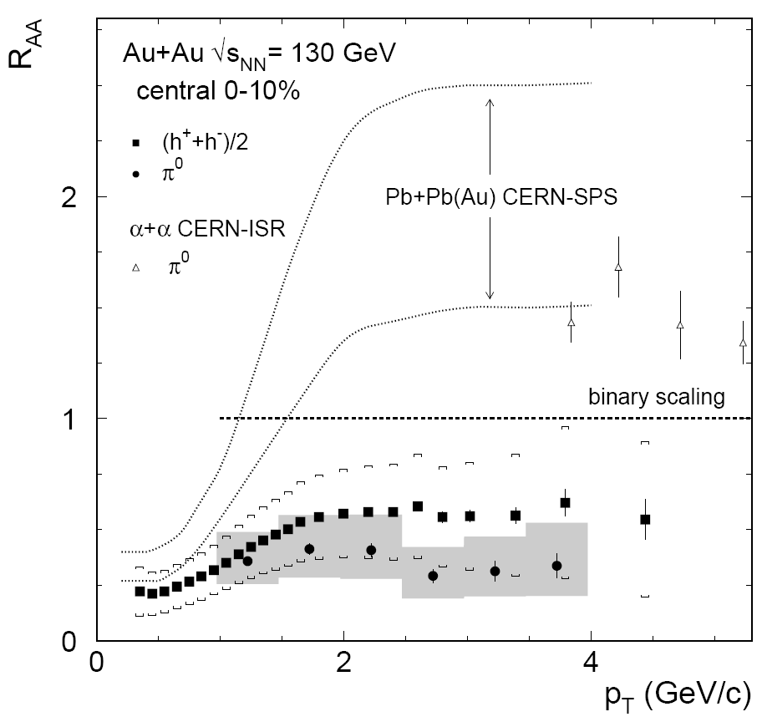
RHIC’s First Major Discoveries
Discovery of strong angle anisotropy, or “elliptic” flow, for produced particles:
  Elliptic flow in Au + Au collisions at √s_{NN}= 130 GeV,
  STAR Collaboration, (K.H. Ackermann et al.). Phys.Rev.Lett.86:402-407,2001
Discovery of
“jet quenching”
  Suppression of hadrons with large transverse momentum in central Au+Au collisions at √s_{NN} = 130 GeV,
  PHENIX Collaboration (K. Adcox et al.), Phys.Rev.Lett.88:022301,2002
  JJ discussed flow measurements, I will focus a bit more on ‘jet quenching’ related results from RHIC (LHC results in next talks)
Notes:
OK, that was the introduction.. Now we come to what I think are the two main discoveries at RHIC (and also seen at LHC), namely that we have measured a strong flow of particles, and also suppression of large momentum particles.
Jens Joergen described the results on flow in detail while I would like to focus on the item of jet quenching here.

Slide 12
Signal Example: How one would like to probe the Matter..
Matter we want to study
Calibrated
Light Meter
Calibrated
LASER
We have to use probes
produced in the medium!
Calibrated
Heat Source
Notes:
I start with a kind of trivial slide outlining the principle how one would ideally like to probe some matter under study and learn about its properties.
In general, if one has some matter one would like to study and e.g. see how it changes as one heats it up, you can shine light on it, and see what happens. The problem for us of course though is that we can not keep our fireball in some vessel or so, but have to use probes that are produced in the matter.
So, let me describe how that works..

Slide 13
History of Heavy Ion Collisions
Different particles carry info from different stages of the collision history
high ε, pressure builds up
γ, γ∗→ e⁺e⁻, μ+μ−
π, K, p, n, φ, Λ, Δ, Ξ, Ω, d,
Real and virtual photons from q scattering sensitive to the early stages. Probe also with q and g produced early, & passing through the medium on their way out.
Hadrons reflect medium properties when inelastic collisions stop (chemical freeze-out for particle mix, and kinetic freeze-out for momentum distributions).
Notes:
We can get information about different phases of the collisions by looking at different particles.
Let’s look at what happens during a heavy ion-collision. Here we have a time-line going from left to right. To the left where you have the early part of the collision, we try to get information from that by using penetrating probes like leptons and photons who don’t interact strongly.
And then for the later stage of the collision we look at the yield of different hadrons which should reflect the conditions (as the matter expands and cools down) at freeze-out.

Slide 14
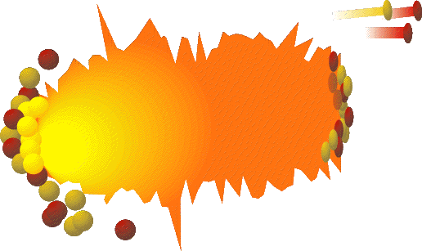
Probing the Medium
Sometimes a high energy photon is created in the collision. We expect it to pass through the plasma without pause.
Notes:
Let’s look at some examples and illustrations. First, here we have a photon being created in the collision. Our expectation is that this photon will pass undisturbed through the medium.

Slide 15
Color Probes of the Medium
Sometimes we produce a high energy quark or gluon.
If the plasma is dense enough we expect the quark or gluon to be “swallowed up” [scattered quarks radiate energy (~ GeV/fm)]
decreases their momentum (fewer high pT particles)
“kills” jet partner on other side
Notes:
Next, here we have instead a high energy quark or gluon being produced to start a jet. If this plasma or medium is dense enough we expect the jet to be swallowed up in the medium as the scattered quarks experience an energy loss. What we would expect to see would be fewer particles with large transverse momentum and also less of a correlation with back-to-back jets.

Slide 16
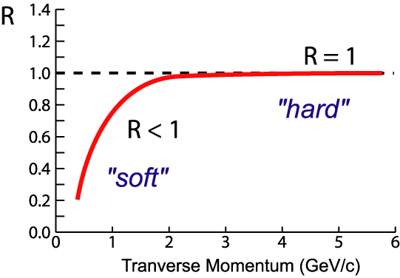
R_{AA} definition: Nuclear Modification Factor or Survival Probability
Study nuclear modification factor, R_{AA}
1. Compare Au+Au to p+p cross sections, scaled with N_{coll} to obtain R_{AA}.
2. If R_{AA}=1, then physics seems to be the same as in p+p collisions..
Notes:
What we look at here is the so-called nuclear modification factor, which is the ratio of what we see in Au+Au compared with what we see in proton-proton, scaled with the number of collisions in proton-proton. So, if Au+Au would be just like proton-proton we’d expect an R value of 1 as seen in the plot.

Slide 17
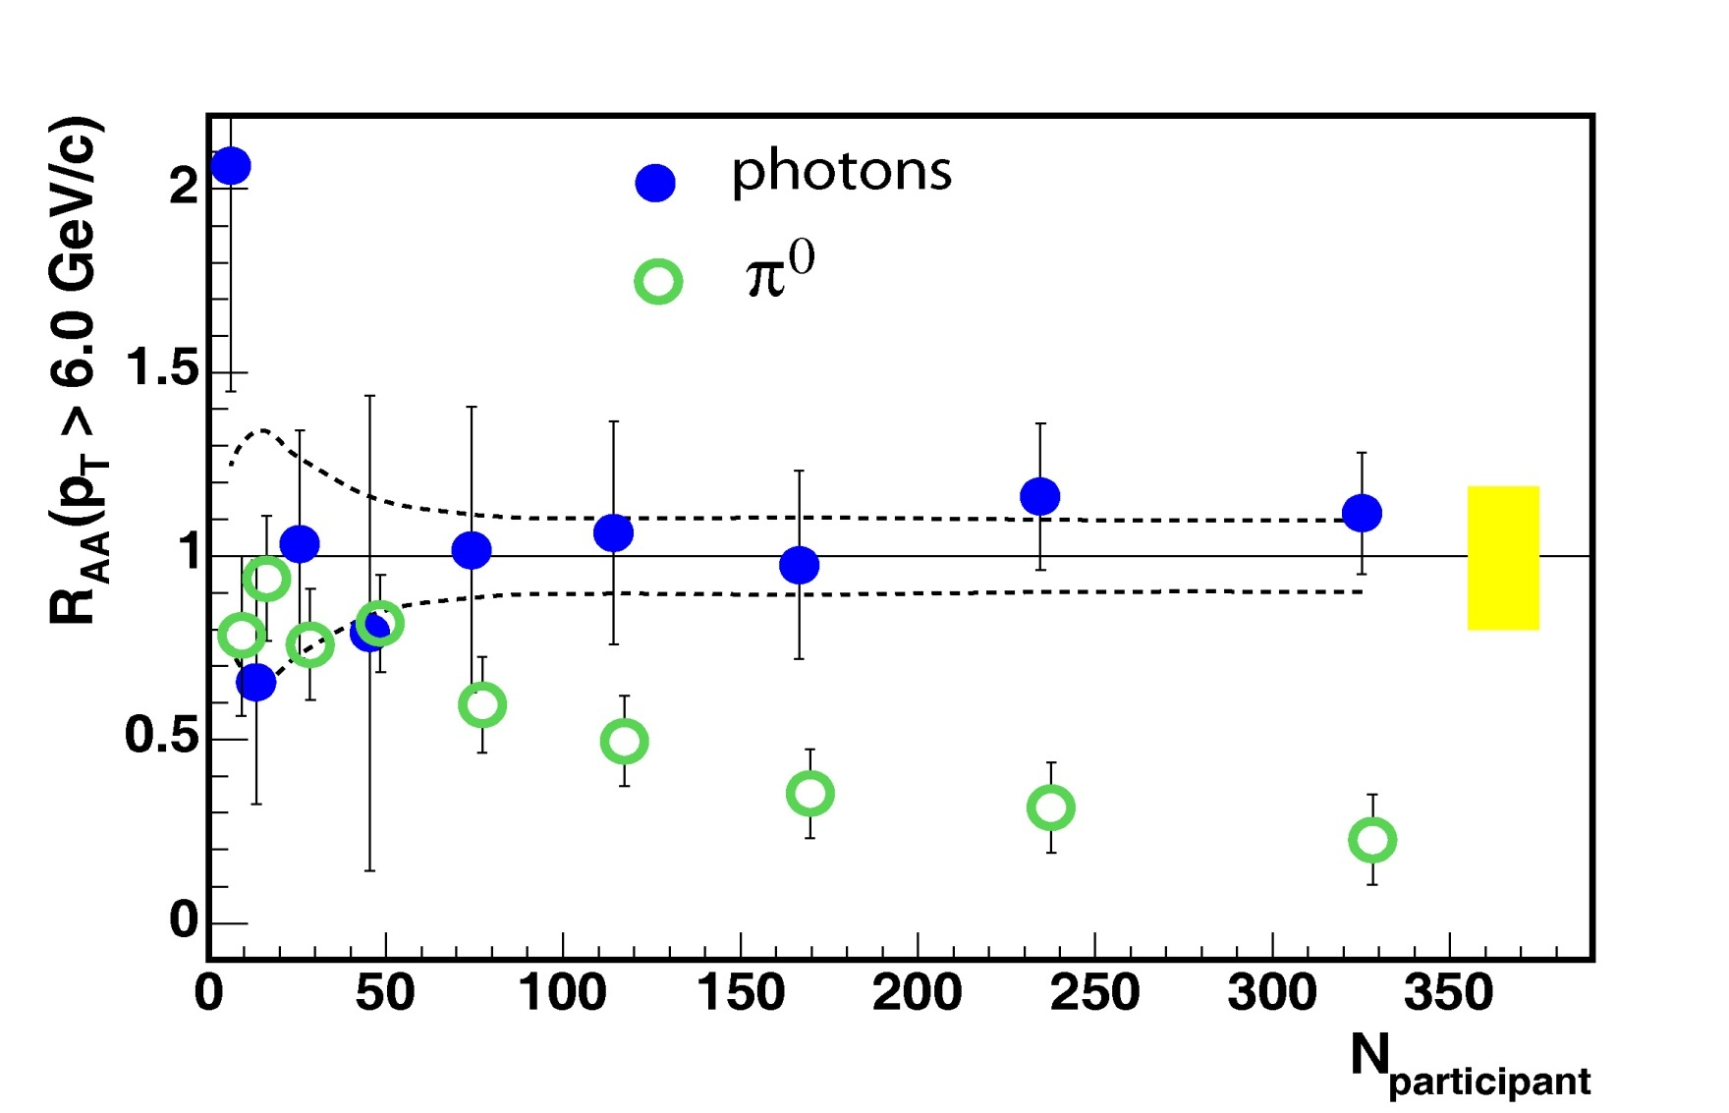
Experimental Results at RHIC
Scaling of photons shows excellent calibrated probe.
Quarks and gluons disappear into medium (except contributions consistent with surface emission)
(from quark and gluon jets)
Survival Probability
Size of Medium
Notes:
And here’s what we actually find in the data: if we look at relatively high momentum particles, more than 5 GeV or so, and compare what we find in AuAu collisions compared to pp (R_AA ratio you have heard about earlier..):
We see that our photon measurements show no change from peripheral to central collisions within errors, the yield looks the same. This then serves as our calibration, that we understand the yield as a function of centrality.
However, for our pion data from quark and gluon jets we see a dramatic loss and a suppression of about a factor 5 for more central collisions, where the high momentum particles get swallowed up by the medium.

Slide 18
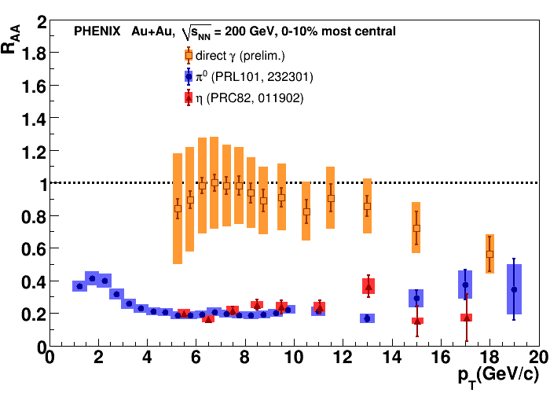
Overview of current R_{AA} results
R_{AA} results in various channels
“Survival probability” vs momentum for central collisions
The direct photon data are consistent with 1 up to about 14 GeV/c
π⁰ and η is suppressed
Notes:
18
Another way to look at this is for most central collisions: again the scaled ratio but now vs transverse momentum. Here you see that the ratio for photons is about 1, while for neutral pions and eta mesons we see a suppressions of about a factor 5.

Slide 19
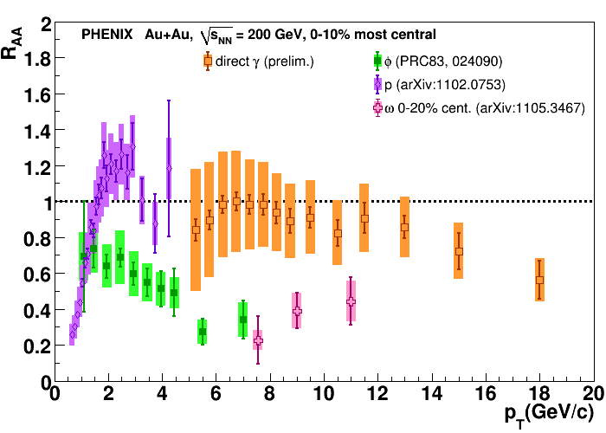
Proton, φ and ω
The proton is not suppressed
The φ behaves like a meson, not a baryon. It's not the mass that counts but the quark composition
Notes:
19
We can also look at other particles: here protons, phi and omega mesons. Protons do not appear to be suppressed, while phi, which has about the same mass, but behave more like the lighter mesons.

Slide 20
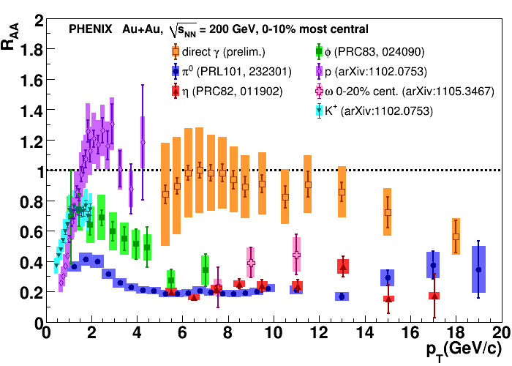
All together now
Summary of R_{AA} results in various channels, with references
Notes:
20
And here you see a compilation with all the particles together; and references for the measurements.

Slide 21
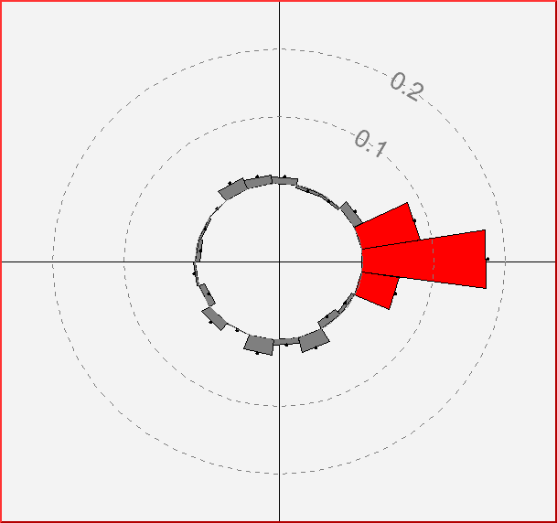
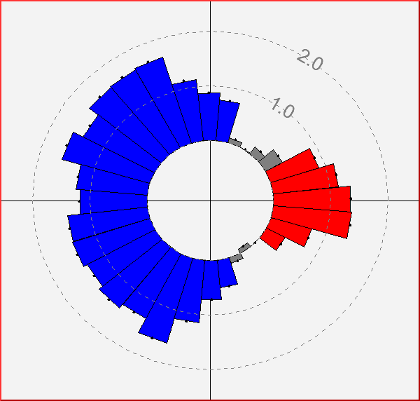
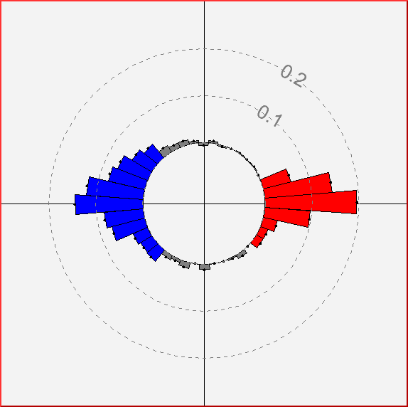

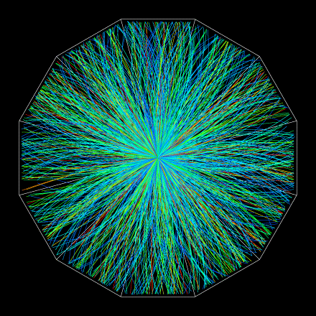
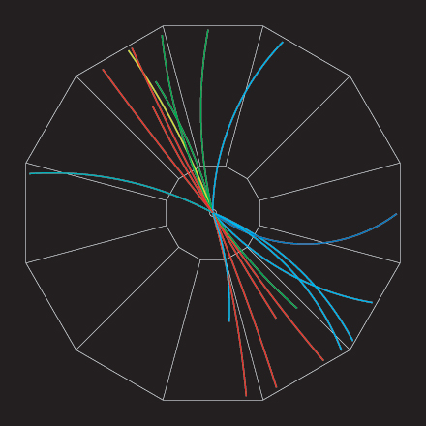
Jet Quenching!
Jet correlations in central Gold-Gold.
Away side jet disappears for particles p_{T} > 2 GeV
Jet correlations in central Gold-Gold.
Away side jet reappears for particles p_{T}>200 MeV
Jet correlations in proton-proton reactions.
Strong back-to-back peaks.
Azimuthal Angular Correlations
Notes:
Another way to look at jet quenching is via angular correlations.
Here you see first an event display showing the strong back-to-back correlations seen in p+p. Now, let’s on move on to central Au+Au, and there the back-to-back correlation disappears, when we use a certain momentum cut of 2 GeV/c.
So, let’s then use a lower momentum cut and then what happens is that a washed out correlation re-appears. Momentum obviously has to be conserved..
Conclusion is that the medium affects these correlations, and by how much energy is lost one can say something about the medium density.

Slide 22
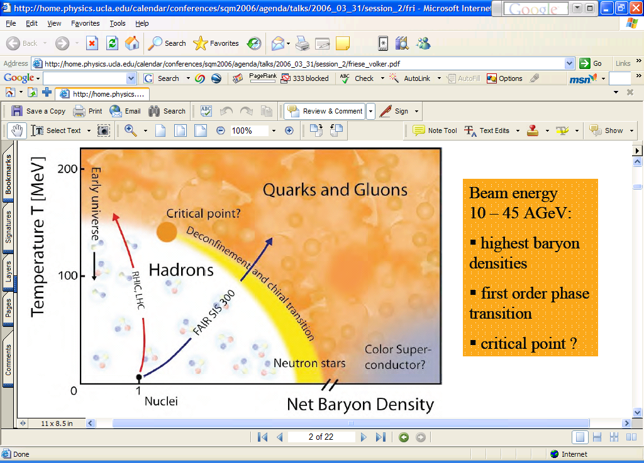
Measuring the Properties of the QGP
Conditions
Properties
μ ~ 0
Screening length
T_{i} =300-600 MeV
η/s→1/4π
CNM
effects
non-linear shadowing
low-x suppression
anti-shadowing?
dE/dx
Initial State
→Glauber
Can we pin down the energy loss per unit length through the produced matter?
Let’s compare data with models..
?
Notes:
OK, so based on various measurements we have determined some conditions that are reached in these collisions. As we try to determine the properties of the state of matter that is produced we can for instance ask us how much energy is lost per unit length?

Slide 23
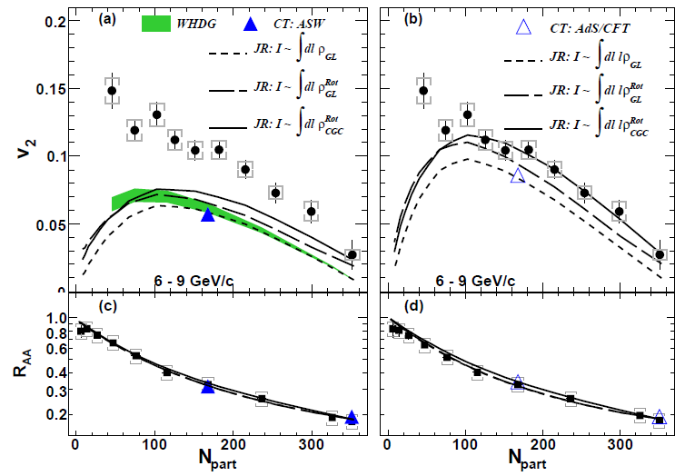
Path-length dependence of E loss
“Survival probability” vs centrality measure – could be described by several models (theory scenarios – details in references below)
pQCD+e.l.= perturbative QCD (standard) + energy loss parametrization
AdS/CFT = Anti-deSitter space/Conformal Field Theory correspondence (string gravity and gauge theory duality)
v₂ not explained
by pQCD
(even with
fluctuations &
saturation)
pQCD
PRL 105, 142301
pQCD + e.l.
AdS/CFT
Theory calculations:
Wicks et al., NPA784, 426
Marquet, Renk, PLB685, 270
Drees, Feng, Jia, PRC71, 034909
Jia, Wei, arXiv:1005.0645
R_{AA} explained by both models:
no clear message for dE/dx mechanism
Notes:
Here I again plot the scaled ratio or survival probability , but now vs centrality in the collision.
You see here a few different curves for various theory calculations, and both approaches, perturbative QCD as well as AdS/CFT can describe the data OK.

Slide 24
More model comparisons
Harder to describe both “Survival probability” and “Elliptic flow” at the same time though.. Ads/CFT seems to do better than pQCD example in this case
v₂ not explained
by pQCD
(even with
fluctuations &
saturation)
v₂ explained by
cubic path length
dependence
(like AdS/CFT)
AdS/CFT
Progress by confronting theory scenarios with multiple measurements..
pQCD
PRL 105, 142301
pQCD + e.l.
AdS/CFT
Theory calculations:
Wicks et al., NPA784, 426
Marquet, Renk, PLB685, 270
Drees, Feng, Jia, PRC71, 034909
Jia, Wei, arXiv:1005.0645
R_{AA} explained by both models
Notes:
When we ask the models to describe both the RAA and flow data though, we are able to discriminate better between the models. In this case the AdS/CFT scenario describes the data better than perturbative QCD. One should be careful to deduce too many things from this observation but I would just like to note that this is interesting.
I am not aware of that many predictions based on string theory that have been compared with data..

Slide 25
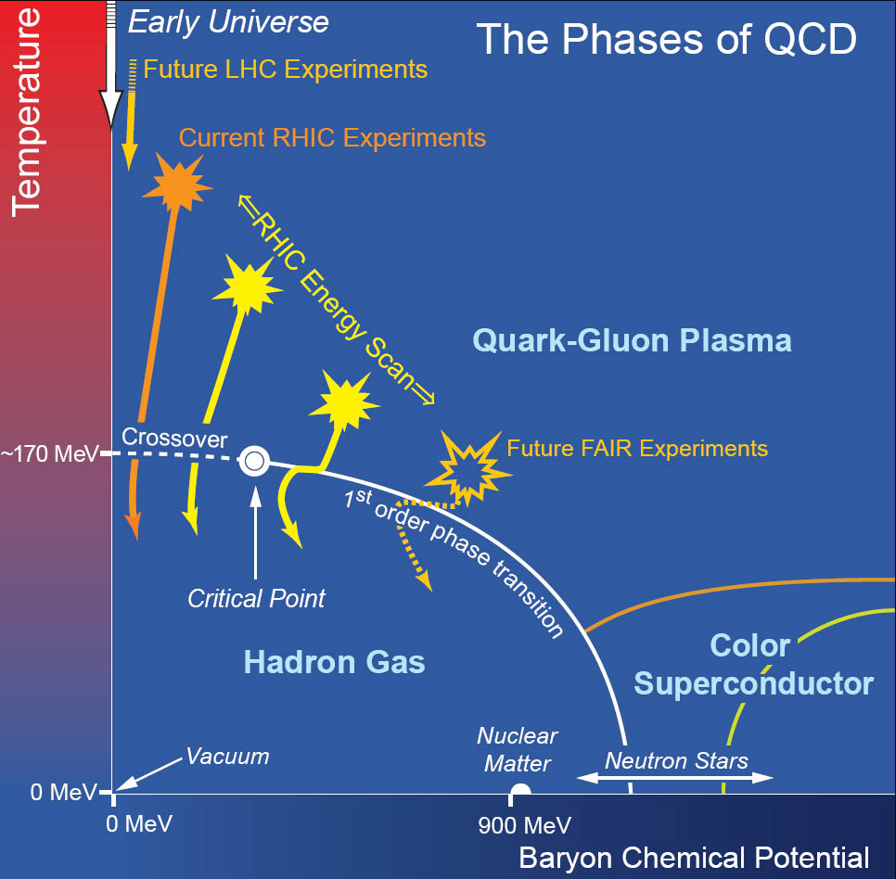
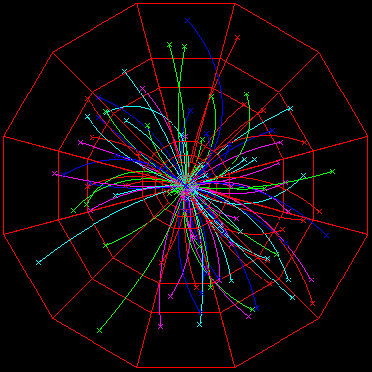
Other news: Beam Energy Scan at RHIC
History: Proposal in 2008
Demonstrating that RHIC/Experiments can operate also below injection energy..
Test runs from 2008 onwards
More info e.g. in:
STAR:PRC 81 (2010) 024911
QCD Phase Diagram (Hadrons -- Partons)
Theory and Experimental approaches
LHC experiments
http://drupal.star.bnl.gov/STAR/starnotes/public/sn0493
arXiv:1007.2613
Motivation:
Search for signals of phase boundary
Notes:
Switching gears a little bit to conclude the RHIC part: in the last few years RHIC has also started a low energy program, bridging the gap somewhat to the future FAIR experiments. What they have shown is that RHIC can also work as a decelerator, not only accelerator and collide heavy ions below injection energy.. Since I will be fairly brief on this topic I also point to some (STAR) references here.

Slide 26
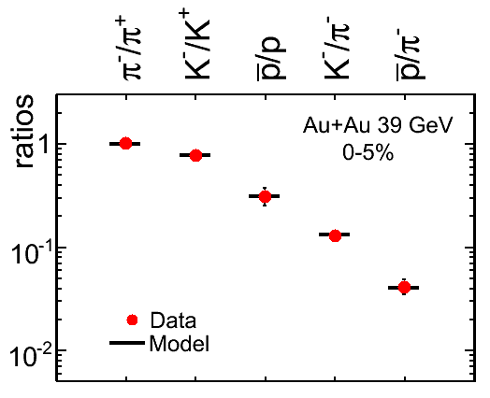
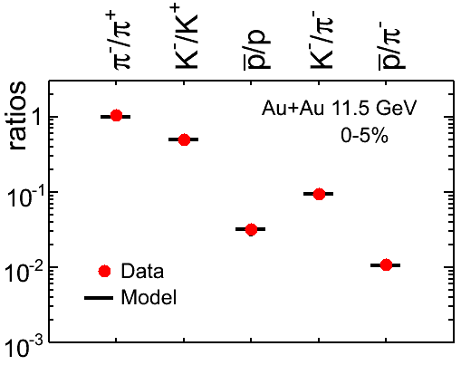
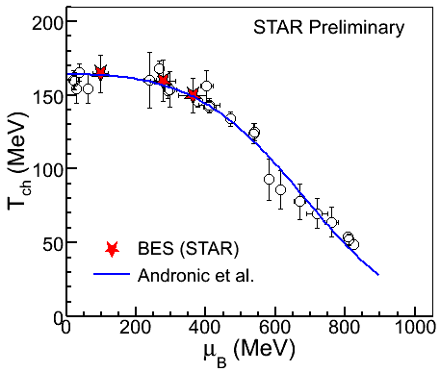
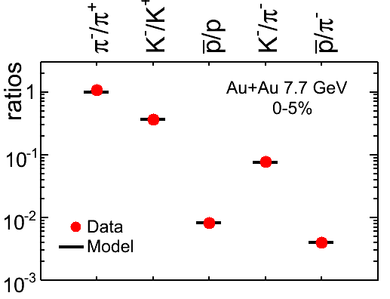
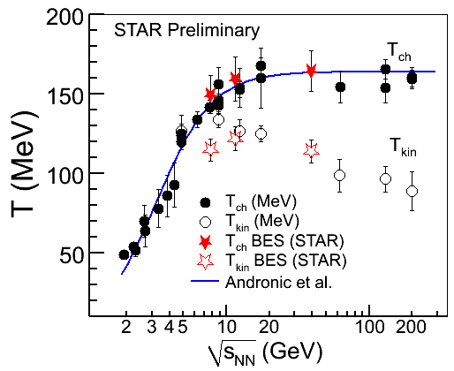
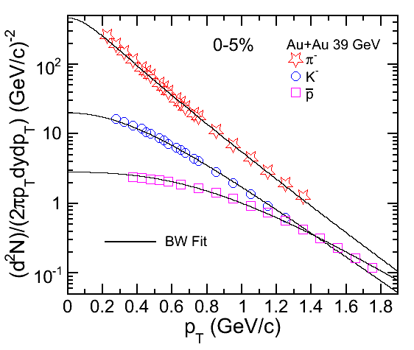
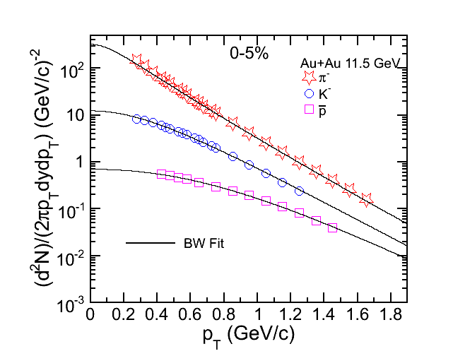
Freeze-out Conditions
11.5 GeV
STAR Preliminary
39 GeV
STAR Preliminary
Chemical freeze-out: Particle ratios
Andronic et al.,
NPA 834 (2010) 237
STAR Preliminary
7.7 GeV
39 GeV
11.5 GeV
STAR Preliminary
STAR Preliminary
Kinetic freeze-out : Momentum distributions (BlastWave fit)
Notes:
To establish where we are in the phase diagram in terms of temperature and chemical potential fits to particle ratios at different center-of-mass-energies are done (top left). Results are compiled in the top right plot.
One can also determine the kinetic freeze-out temperature from fits to the particle momentum distributions and one can see that the kinetic freeze-out is found to be a bit lower than the chemical freeze-out, as expected.

Slide 27
From RHIC to LHC
From results at RHIC: the top energies are well beyond the energies needed to produce a Quark-Gluon Plasma – studies of quantifying the properties of the produced state of matter are ongoing.
Research field still somewhat experiment/data-driven, but there are also many models and theory scenarios on the market. Interesting times..
At the higher energies at LHC we will be producing an even ‘purer’ QGP: hotter and longer-lived.
Notes:
This concludes what I wanted to say re. RHIC
The next step is then to go to the higher energies at the LHC where a purer quark-gluon plasma would be made, hotter and longer-lived.

Slide 28
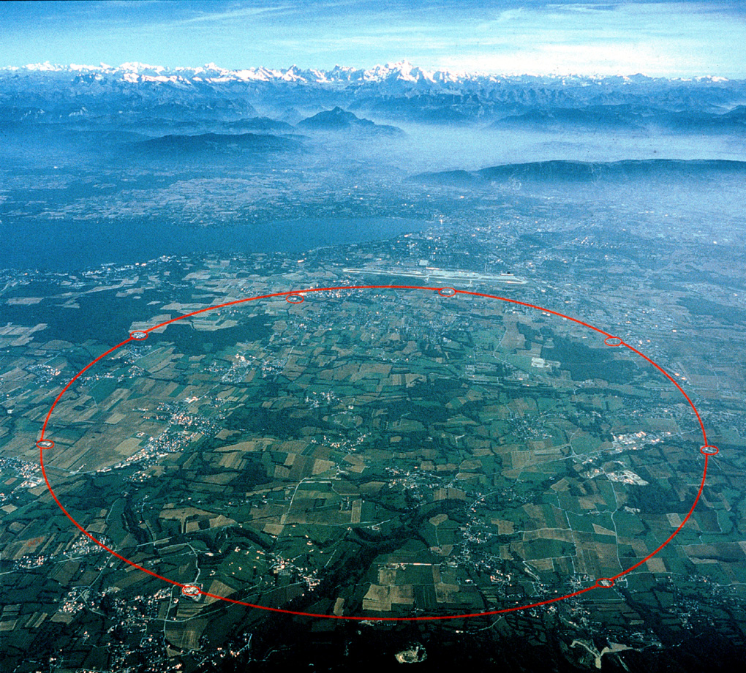





CERN Large Hadron Collider
4 large experiments
ALICE dedicated
to heavy-ion physics
(focus of other talks)
ATLAS & CMS also participate in heavy-ion running (few highlights/ examples next..).
8.6 km
LHC
LHC
Notes:
OK, you have heard about the LHC before. There are 4 large experiments at the LHC, and ALICE is the experiment dedicated to heavy-ion physics. The LHC results will be discussed in more detail in the following talks also, but I would just like to flash some results from ATLAS and CMS that are connected to the RHIC results I discussed earlier.

Slide 29
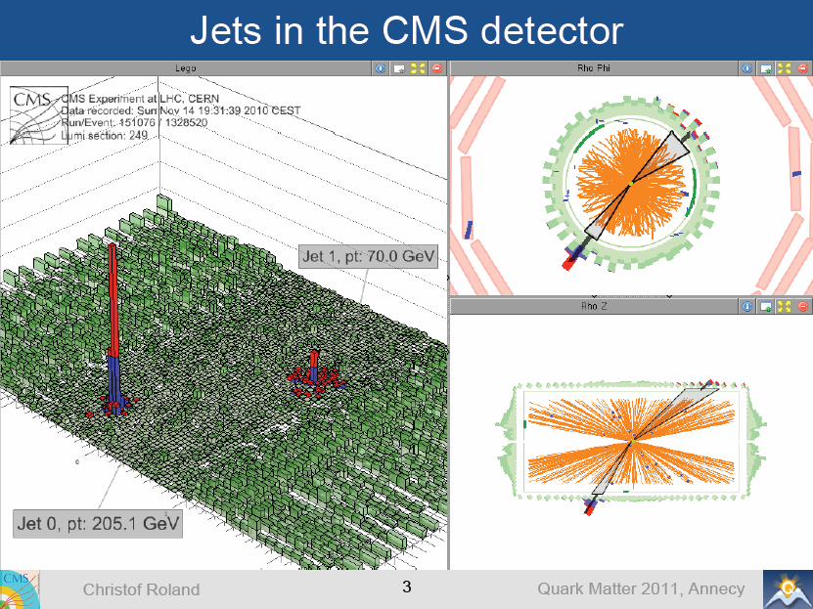
Jet Quenching seen on individual event basis!
(very large acceptance detectors)
Study angular correlations and jet asymmetries.
Notes:
Here you see an event display for a single event in the CMS detector. Just by eye you can see that you have a very large energy in one direction and a much smaller energy back-to-back. This is also similar to what was seen at RHIC on a statistical basis but at LHC with the large detectors we can really see it directly on an event-by-event level

Slide 30
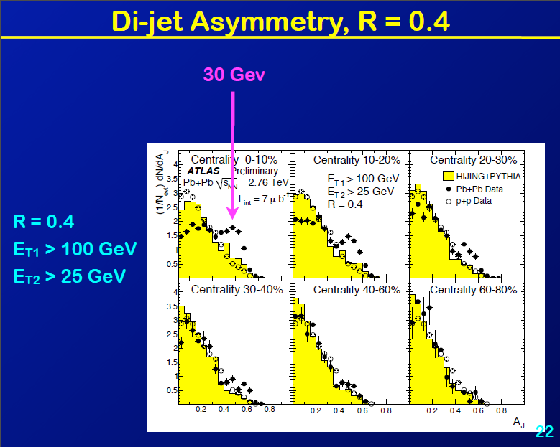
Jet asymmetry :
A_{J} = (E₁ – E₂)/(E₁+E₂)
N.B. !
ATLAS: Peripheral events like p+p & MC
Asymmetry deviations for central events!
Notes:
To quantify this discrepancy we here introduce a jet asymmetry measure: difference over the sum of the energies for the di-ject components. You can see that for peripheral events, the results agree well with p+p (open symbols) and MonteCarlo (yellow histogram), but not so for central events, where a clear discrepancy is seen for Pb+Pb data (closed symbols): the di-jet events become more asymmetric..

Slide 31
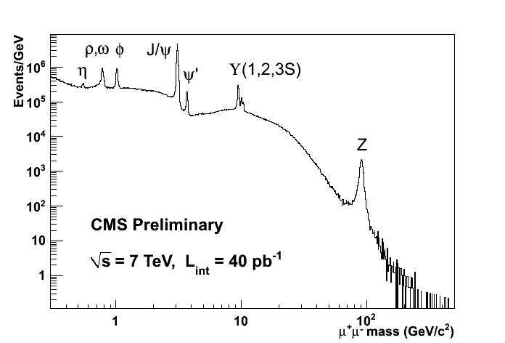
Di-muons from CMS
pp √s=7 TeV
Impressive resolution and acceptance together with larger cross sections enable many new interesting studies at LHC..
Notes:
The large acceptance and very good resolution also enable many interesting studies to be made..

Slide 32
Summary & Outlook
Golden era for High-Energy Heavy-Ion Physics: wealth of data from RHIC and LHC
- Expect exciting results for the next many years
Progress on quantitative studies towards properties of QGP, using excellent detectors, and studies of particles all the way from photons, electrons, muons, pions to quarkonia, high-energetic jets and Z..
Notes:
OK, so with that – let me conclude with a few take-away points.

Slide 33
EXTRA / BACKUP

Slide 34
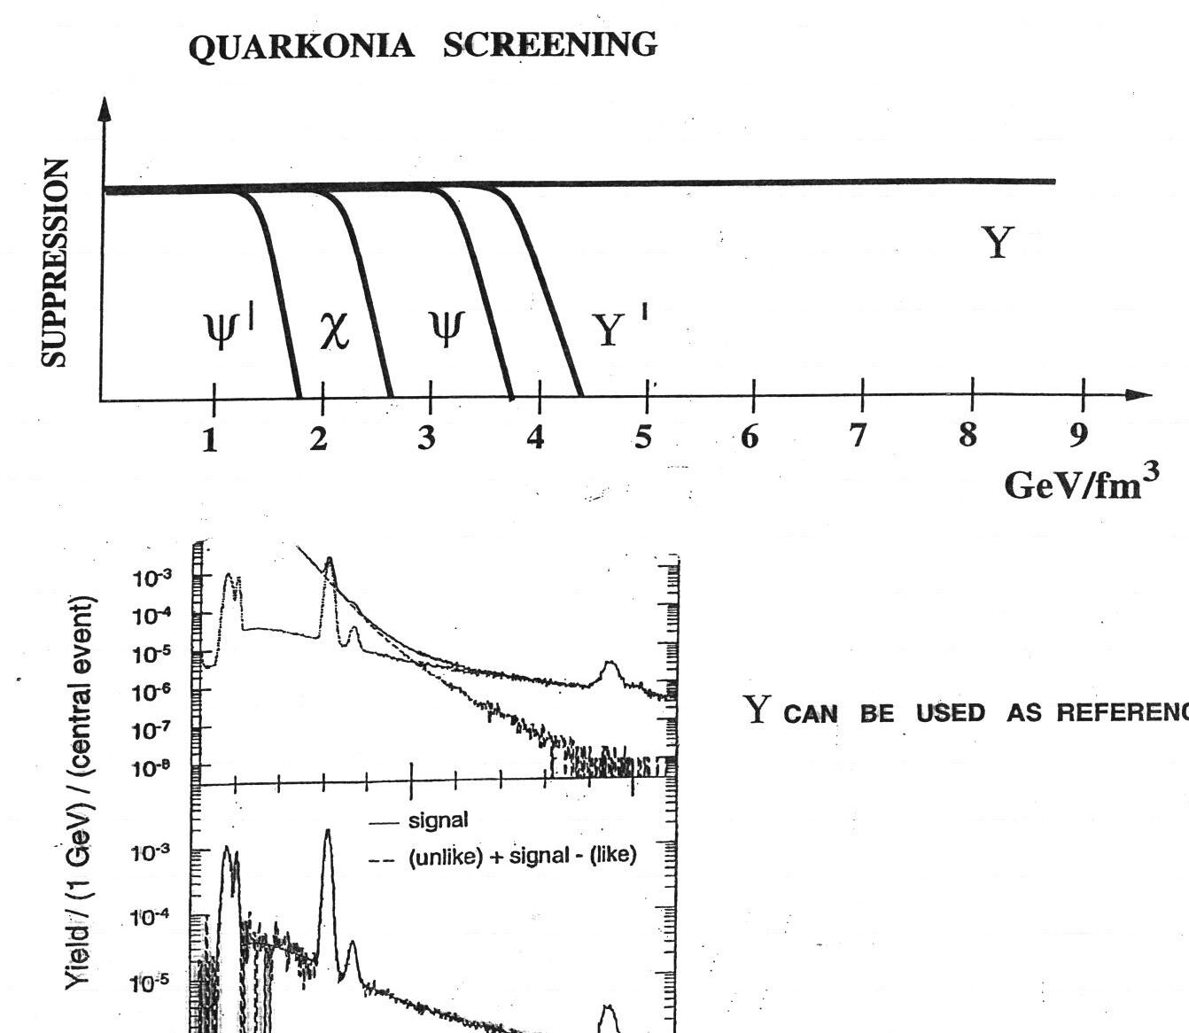
Quarkonia in Heavy Ion Collisions
Good candidates to probe the QGP in HIC
  Large masses and (dominantly) produced at the early stage of the collision via hard-scattering of gluons
  Strongly bound resonances
→
decreasing binding energy
Expectation:
(theory/lattice QCD)
Notes:
The final topic is the measurement of quarkonia in Heavy Ion collisions.
The idea is that as the energy density and temperature of the system increases, different quarkonia states will start to be suppressed.
The smaller the binding energy is, the easiest it is that the 2 quarks forming the resonance to have their potential screened by the colorful medium, leading to a suppression of the production of the state

Slide 35
ϒ(2S+3S) Suppression
PbPb
√s_{NN}=2.76 TeV
pp
PbPb
arXiv : 1105.4894
Submitted to PRL
p_{T} ^{μ} > 4 GeV/c
ϒ(2S+3S) production relative to ϒ(1S) in pp and PbPb
Compare pp and PbPb through a simultaneous fit
Notes:
Update right plot
in a one-tailed integral of a Gaussian distribution
Less than 1% prob being a downward fluctuation of the suppression
Measuring such a small number if the ratio is unity is of 1%
Make the point that things cancel in the double ratio
17% change of double ratio when letting the resolution free. But we believe our MC and reoslution pp and PbPb equal for jpsi
The probability to obtain the measured value, or lower,
if the true double ratio is unity, is calculated to be less than 1%.

Slide 36
ϒ(2S+3S) Suppression
PbPb
√s_{NN}=2.76 TeV
Pros of a double ratio
  Acceptance cancels
  Efficiency cancels
Potential differences
  Remaining systematics 9%, from line shapes
PbPb
arXiv : 1105.4894
Submitted to PRL
Hypothesis: no suppression ⇒ p-value 1%
Significance of the suppression 2.4 σ
Notes:
Update right plot
in a one-tailed integral of a Gaussian distribution
Less than 1% prob being a downward fluctuation of the suppression
Measuring such a small number if the ratio is unity is of 1%
Make the point that things cancel in the double ratio
17% change of double ratio when letting the resolution free. But we believe our MC and reoslution pp and PbPb equal for jpsi
he probability of a downward departure of the ratio
from unity of this significance or greater is 0.9\%, i.e. that
corresponding to 2.4 sigma for a one-tailed Gaussian distribution". The
last phrase is not really well stated, and would be better as "i.e. that
corresponding to 2.4 sigma in a one-tailed integral of a Gaussian
distribution".
The
probability to obtain our measured value or below if the double ratio is
unity is 0.9%
Finally, using an ensemble of one million pseudo-experiments, generated with the signal lineshape
obtained from the pp data (Fig. 1a), the background lineshapes from both data sets, and a
double ratio (Eq. 3) equal to unity within uncertainties, the probability of finding the measured
value of 0.31 or below is estimated to be 0.9%. In other words, in the absence of a suppression
due to physics mechanisms, the probability of a downward departure of the ratio from unity of
this significance or greater is 0.9%, i.e. that corresponding to 2.4 sigma in a one-tailed integral
of a Gaussian distribution.

Slide 37
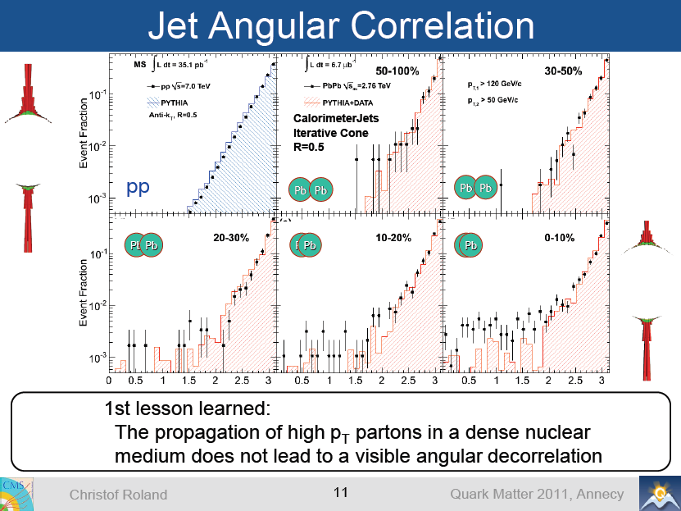

Slide 38
Quarkonia Production with CMS
First non-prompt J/ψ in HI
  b-quark energy loss
Prompt J/ψ
significantly suppressed
ϒ(2S)+ϒ(3S) excited states suppressed
  Consistent with 40% ϒ(1S) suppression
○ no p_{T} cut
p_{T}^{J/ψ}>6.5 GeV/c
PAS CMS HIN-10-006
arXiv : 1105.4894
Submitted to PRL
Sequential melting accessible with CMS resolution

Slide 39
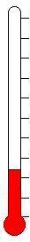
Freeing degrees of freedom: kT > ħω
T > 10³ °K: molecular dissociation
T > 10⁴ °K: atomic ionization, plasma formation
T > 10¹⁰ °K: nuclear reactions
T > 10¹² °K: proton ionization ? Quark-gluon plasma formation?
→ use a flame
→ get an arc-light
→ find a star
→buy a heavy-ion collider !

Slide 40
Transverse Momentum and Rapidity –
High energy jargon
Momentum transverse to the beam direction (z):
Rapidity (Boost-invariant), and Pseudo-rapidity (no PID):
η ~= 0.9 ⬄ θ = 45 deg
Notes:
Other variables that I will use later and that are standard for particle physics or high energy physics but could be somewhat of a jargon for you perhaps would be transverse momentum and rapidity.
Normally we always take our coordinate system with the z axis along the beam direction, i.e. to start with for a collision all the momentum is along the z axis. When we talk of momentum transverse to the beam this is then just the x and y parts added together.
The concept of rapidity is perhaps less straightforward although high-energy folks tend to get used to it fairly quickly.
It is a useful variable since when one moves between different Lorentz frames, this is just additative in rapidity.
(It is sort of related to an angle away from the beam direction.)

Slide 41
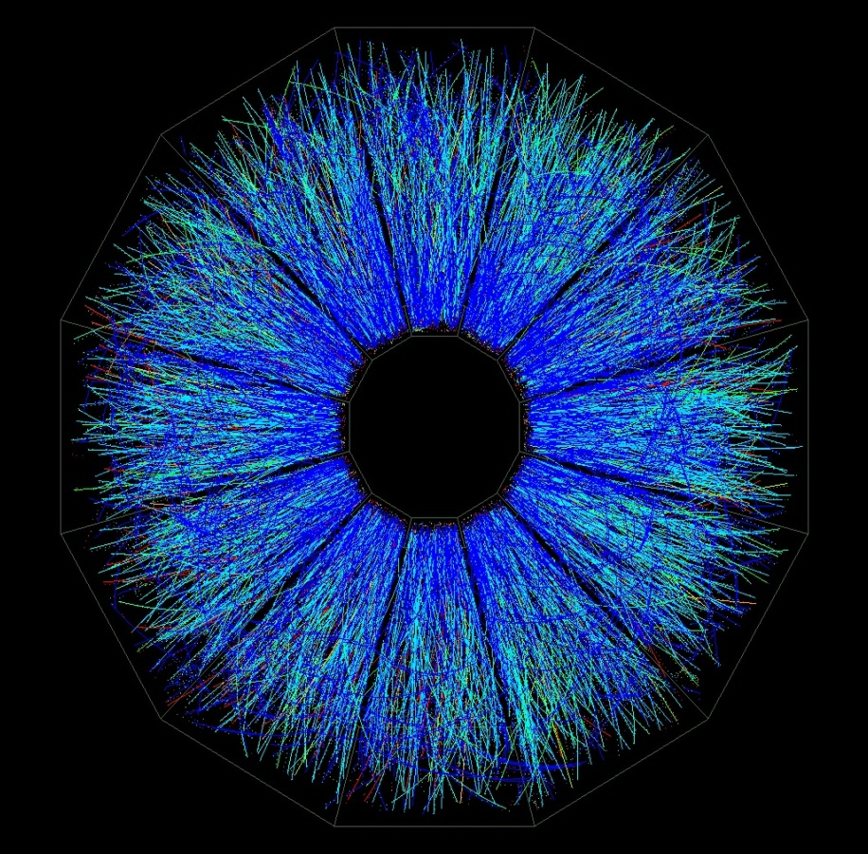

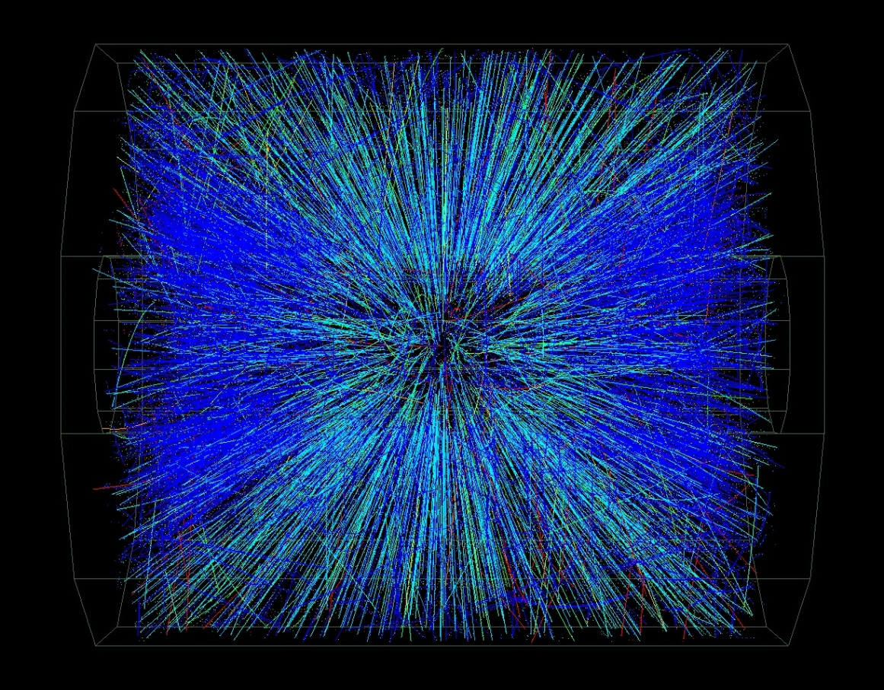
A RHIC Event
√s_{NN} = 200 GeV
Gold
  Thermalization? Particle spectra, yields
  Pressure developed? particle/energy flows
  Medium properties? effects upon probe particles
  Deconfinement? c and anti-c remain bound as J/Ψ?
Gold
Notes:
To set the scale a bit of the detector challenges etc. we face, have a look at this single event display. We are talking about many thousands of particles and tracks for just one event.
Then to get information on certain features, we look at different things, and I will get back to some of these later.
For instance, do we reach a state in some sort of thermal equilibrium? What is the temperature? Get info from these from particle spectra and particle ratios. For pressure and medium viscosity info, we look at the flow of particles and energy. For looking at what kind of medium we have created we rely on studies with probe particles.

Slide 42
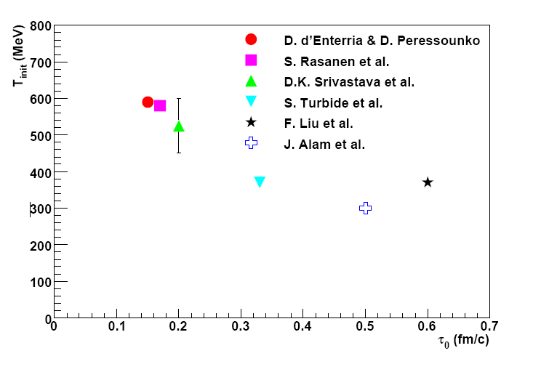
T_{i} from hydro
T_{i} from hydro
  300 . . . 600 MeV
  Depends on thermalization time, τ₀
  anti-correlation: T_{i} ⬄ τ₀
Phys. Rev. C 81, 034911 (2010)
Theory calculations:
d’Enterria, Peressounko, EPJ46, 451
Huovinen, Ruuskanen, Rasanen, PLB535, 109
Srivastava, Sinha, PRC 64, 034902
Turbide, Rapp, Gale, PRC69, 014903
Liu et al., PRC79, 014905
Alam et al., PRC63, 021901(R)

Slide 43
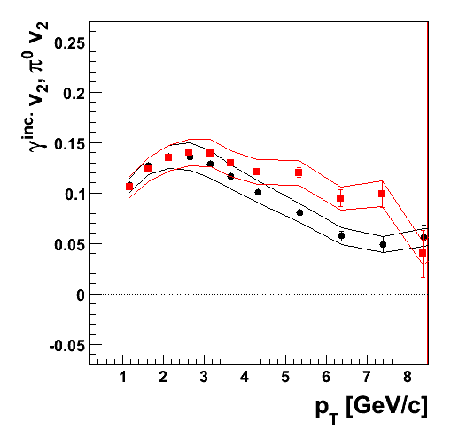
Direct Photon v₂
Au+Au@200 GeV
minimum bias
π⁰ v₂ similar to inclusive photon v₂
Two possibilities
  A: there are no direct photons
  B: direct photon v₂ similar to inclusive photon v₂
Key: precise measurement of direct photon excess
preliminary
π⁰ v₂
inclusive photon v₂

Slide 44
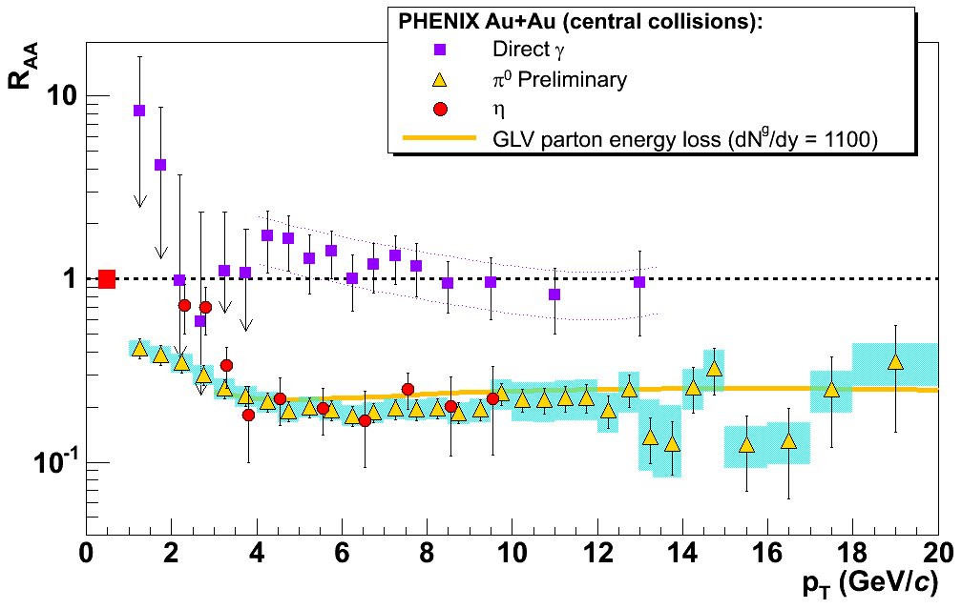
Very Opaque Medium
Scaling of photons shows excellent calibrated probe.
Quarks and gluons disappear into medium, except consistent with surface emission.
Survival Probability
Photons
π⁰, η from quark and gluon jets
Notes:
We can then compare this with what we get when we look at photons which we think should be more or less un-affected by the medium. And indeed we get a good description with binary collision scaling for central collisions for them. While for pions etc from jets we see this large suppression going out to 20 GeV/c. This is from our largest data-set so far from 2004.
Also shown as the yellow line is a calculation of the parton energy loss using a certain gluon density.

Slide 45
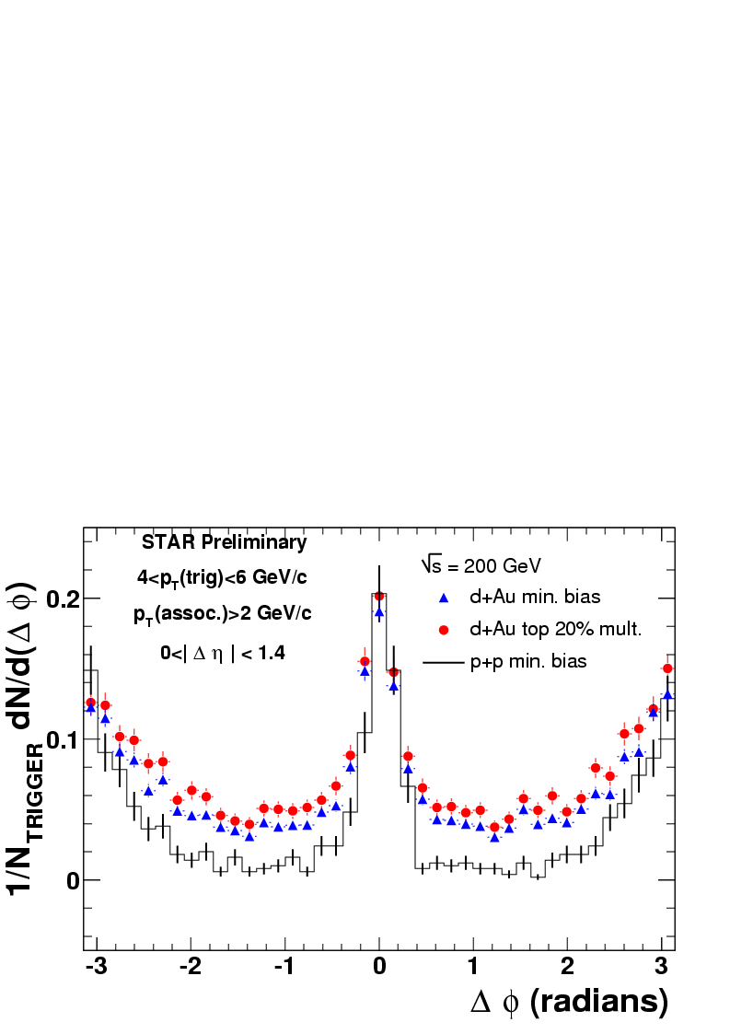
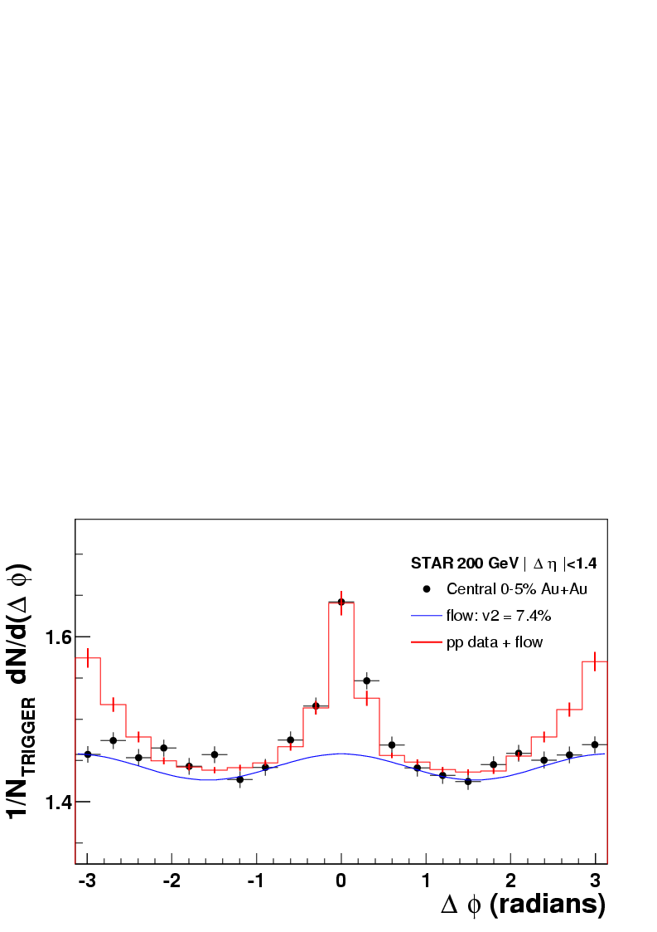
Back-to-back jets observed in d+Au;
- not in Au+Au
p+p, d + Au
jet pair production in d+Au also looks independent of N_{coll}
Observe no (big) suppression of back-to-back jets as in central Au-Au!
Central Au + Au
Notes:
So, now I have shown you the decrease of particles at high pT. Another thing I mentioned earlier was back-to-back jets. So, let’s look at the data. What these plots show are the angular correlations between a trigger particle and associated particles. For p+p and d+Au one sees both a near-side peak and also an away-side peak. However for central Au+Au shown on the bottom, only the near-side peak is there, and the away-side back-to-back correlation is gone. Due to momentum conservation the jet has to go somewhere so let’s look at this in a different representation.

Slide 46

CERN Large Hadron Collider
1232 dipole magnets:
- 15 m each
- ~ 1 MCHF each
- 9 T field
superconducting,
operated at 1.9 K
p – design luminosity: 10³⁴ cm⁻²s⁻¹
2808 bunches with 10¹¹ protons each → I = 0.5 A
E_{tot} = 3 x 10¹⁴ x 7 TeV ~= 300 MJ → > 60 ton truck moving with 200 mph!
(or ~takeoff mid-size jet airliner)
Notes:
Before I get to the ALICE experiment, here is some basic info for this new collider at CERN: the machine ring has more than 1000 large dipoles. At the full energy and luminosity, which it will take a few years to reach, there is then about 3000 bunches with 10^11 protons in each. That is a lot of stored energy. It is in fact more than the kinetic energy of a 60 ton truck moving at 200 mph.. Or a mid-size jet at take-off or landing.

Slide 47

ALICE
Central Detectors:
Inner Tracking System 100%
Time Projection Chamber 100%
Time-of-Flight 100%
Transition Radiation Detector* 39%
Spectrometers:
RICH 100%
Photon Multiplicity 100%
Forward Multiplicity 100%
Photon Spectrometer 60%
Muon Spectrometer 100%
Calorimeters:
Zero Degree Calorimeter 100%
EM Calorimeter* 36%
Trigger:
Trigger Detectors 100%
pp High-Level-Trigger 100%
*upgrade to the original setup
Notes:
OK, here is then an overview of ALICE. You see persons next to the large magnet to set the scale.
You also see the installation status for the various subsystems here, divided into central detectors, spectrometers etc. As you can see, most subsystems are complete, except for the TRD – transition radiation detector, and PHOS and EMCAL, use for photon and jet measurements.

Slide 48

The ALICE Collaboration
~1000 | Members 63% from CERN member states
~30 | Countries
~100 | Institutes
~150 | MCHF capital cost (+magnet)
US ALICE
11 Institutions 53 members (inc. 12 grad. Students)
Cal. St. U. –San Luis Obispo, Creighton University,University of Houston, Lawrence Berkeley Nat. Lab,Lawrence Livermore Nat. Lab, Oak Ridge Nat. Lab,Ohio State University, Purdue University, University of Tennessee, Wayne State University,Yale University
Notes:
Here you see info on the collaboration. I suspect this is the largest nuclear-physics experiment in the world with about 1000 collaborators. It used to be that one could list the names of all the collaborators on one slide, then the institutions, and I guess now we are at the stage where can only list the involved countries.
Here I also list the institutes from the US that are involved.

Slide 49

49
Oct 2008 Split J. Schukraft
Notes:
Here you see a photo of approx. a quarter of the collaboration in front of the closed large central magnet (which I BTW think has more steel in it than the Eiffel tower).

Slide 50

Raimond Snellings – ALICE

Slide 51

The PHENIX detector
Central arms:
hadrons, photons, electrons
p > 0.2 GeV/c
|y| < 0.35
[70 < θ < 110 deg.]
Δφ = π
Muon arms:
muons at forward rapidity
p > 2GeV/c
1.2 < |y| < 2.4
[11 < θ < 33 deg.]
Δφ = 2π
Centrality measurement:
We use beam beam counters together with zero degree calorimeters
Notes:
Now, before I get to any results, let me briefly introduce the PHENIX detector. It has two central detector arms around mid-rapidity and two muon arms at forward and backward-rapidity. The strength of PHENIX is its lepton and photon program but we of course also reconstruct plenty of hadrons.
For measurements of the centrality of the collision we use PMT detectors and calorimeters close to the beam.

Slide 52

PHENIX/STAR Citation history
Explosion of HEHI citations after the start of RHIC/the collider era!
NB: STAR has ~ 20 more papers; cite count ~same as PHENIX

