Slide 1




Global Observables* Measurements at RHIC and LHC
(* = biased towards N_{ch} & E_{T})
David Silvermyr
Oak Ridge National Laboratory

Slide 2
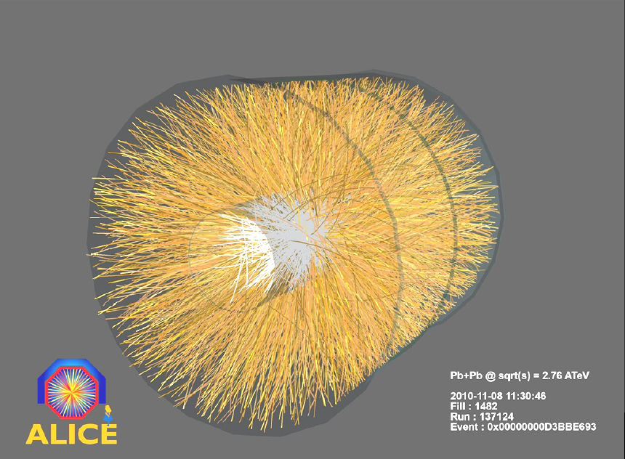
Outline
Introduction
Bulk properties of QGP Previous Results (Memory Lane Revisited)..
Recent Experimental Results
(mainly PHENIX & ALICE)
dN_{ch}/dη at mid-rapidity
dE_{T}/dη at mid-rapidity Energy density
Discussion
Comparison to models
Comparison of results from AGS, SPS, RHIC, LHC
[Next speaker will present CMS results]

Slide 3
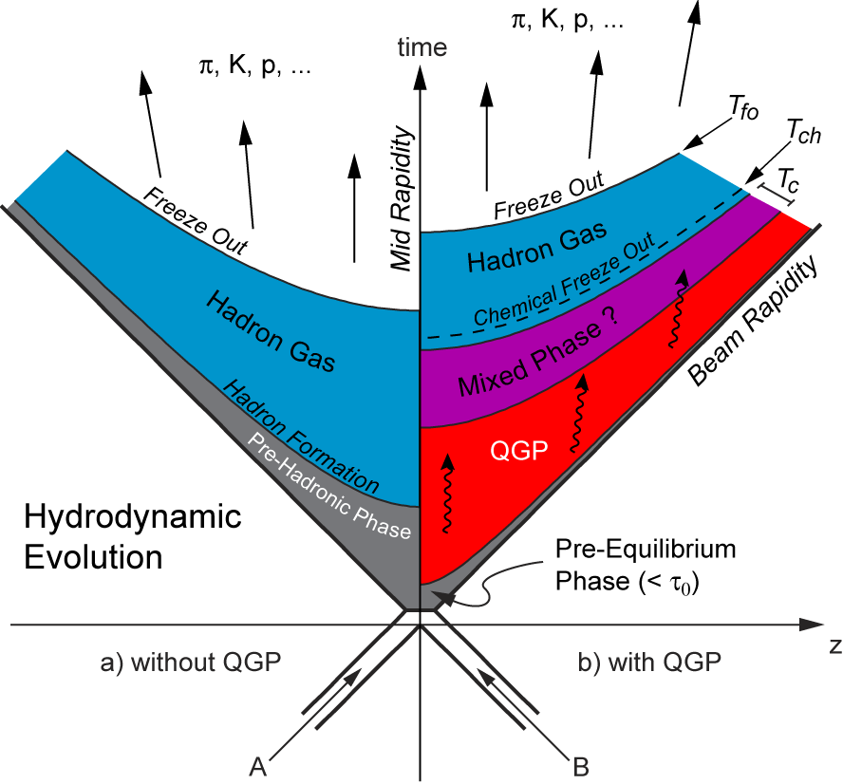
The Bulk of Hadronic Collisions
Charged particle multiplicity and transverse energy
  Global observables that can be used to characterize an A+A event. Information about initial conditions and dynamics of nucleus-nucleus collisions:
  - energy density of the system
  - mechanisms of particle production; comparing how much energy comes out as a function of what was put in..
Soft light hadrons; particle ratios
  Characterize the freeze out
  - Chemical: T_{ch} ≤ T_{c} inelastic scattering ceases
  - Kinetic: T_{fo} ≤ T_{ch}: elastic scattering ceases
and other global observables: Elliptic Flow, Femtoscopy, Net-charge Fluctuations, ..
[not covered in this talk..]

Slide 4
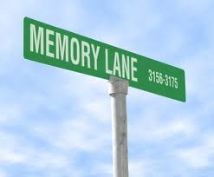

Memory Lane : Theme
Quick review of what was known before the start of LHC;
two examples of RHIC summaries:
A) QM09 talk by W. Busza (“Lessons from PHOBOS”; arXiv:0907.4719)
[Several global observables “lessons”/highlights from RHIC:
3. Energy and system dependences factorize
5. The production process shows signs of significant saturation during the early stages of the collision (limiting fragmentation)]
B) Info from PHENIX mid-rapidity compilation paper:
PRC 71, 034908 (2005)
Will be plotting e.g. dN_{ch}/dη (often /Npart) vs Npart or available energy or η..

Slide 5
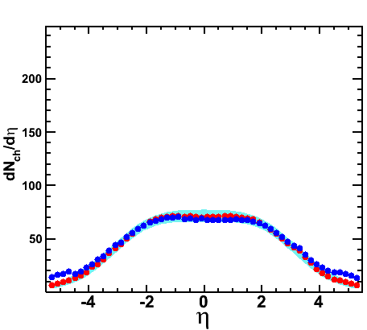
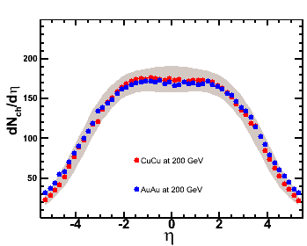
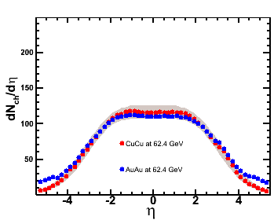
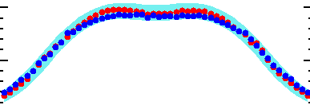
System Size or Species Type?
Au+Au: 35-40% N_{part} = 98
Cu+Cu: 3-6%, N_{part} = 96
Au+Au: 45-50% N_{part} = 62
Cu+Cu: 15-25%, N_{part} = 60
Au+Au: 35-40% N_{part} = 99
Cu+Cu: 3-6%, N_{part} = 100
Au+Au: 45-55% N_{part} = 56
Cu+Cu: 15-25%, N_{part} = 61
Cu+Cu Preliminary at 62.4 GeV
Cu+Cu Preliminary at 200 GeV
G. Roland for PHOBOS @ QM05
Au+Au & Cu+Cu look very similar as soon as N_{part} values are the same.
I.e. system size matters (species don’t)

Slide 6
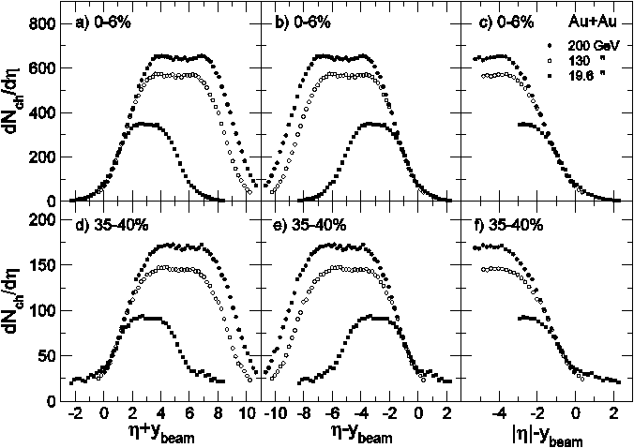
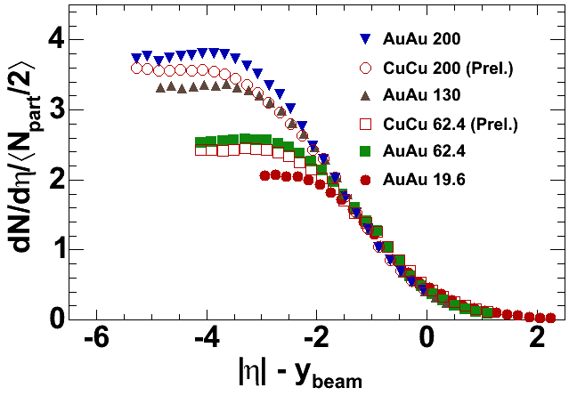
Shape: Limiting Fragmentation Region
PHOBOS PRL 91, 052303 (2003) / NPA757, 28 (2005)
PHOBOS PRL 102:142301,2009
Limiting fragmentation:
In the rest frame of the nuclei the longitudinal scaling appears to be independent of the colliding nuclei over a large range of |η|-y_{beam}
Au+Au & Cu+Cu distributions (relative to beam rapidity) for different energies look very similar..

Slide 7
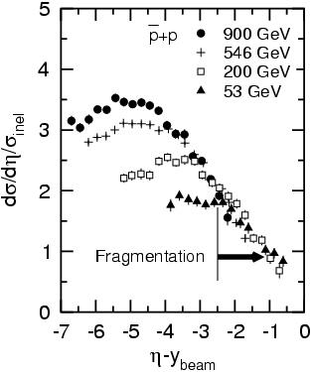
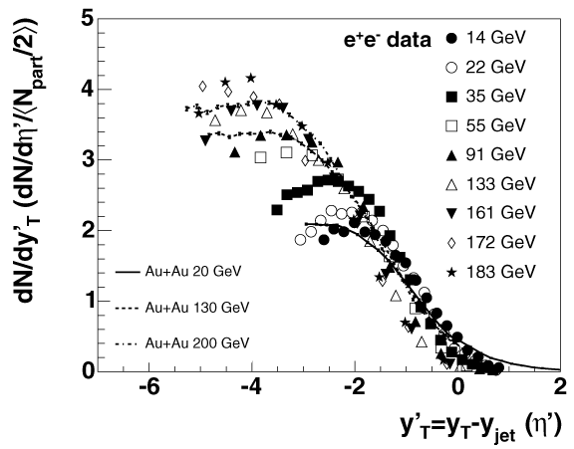
Limiting Fragmentation : Other Systems
R.Noucier for PHOBOS PANIC05
Limiting fragmentation behavior is a universal phenomenon:
It is seen not only in the A+A systems, but in many other symmetric collision systems.
P.Steinberg JoP c.s. 9(2005) 280-285
and ref. therein
UA5, Z.Phys.C33, 1 (1986)
p+p
e⁺e⁻

Slide 8
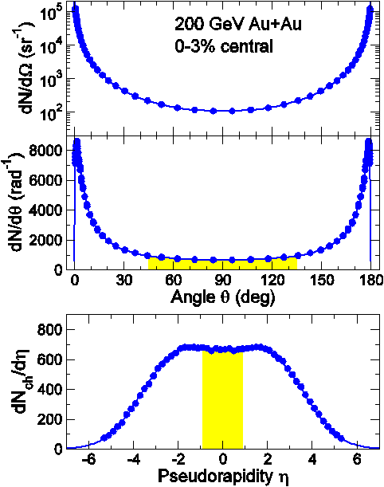
Where do the particles go?
y = 0.5ln(E+p_{z})/(E-p_{z})
y_{beam} = ln(√s/m_{p})
sinh(η) = m_{T}/p_{T} sinh(y)
Only ~22% of all emitted particles have p_{T} > p_{L}
Measurements at mid-rapidity carry information about the most dense region in the collision
=> Let’s focus on this region next..
PHOBOS
22%
Notes:
Keeping in mind that pseudorapidity distributions REALLY are just angular distributions if the emitted particles.
So what does a typical pseudorapidity distributions, such as the one for 200 GeV Au+Au look like in real angular coordinates.
Well, that’s what we see here.
Note that the mid-rapidity plateau turns into a minumum in both the dN/dθ and the dN/dΩ representations.
The highest density of particles in real space is really seen at very forward/backward angles

Slide 9
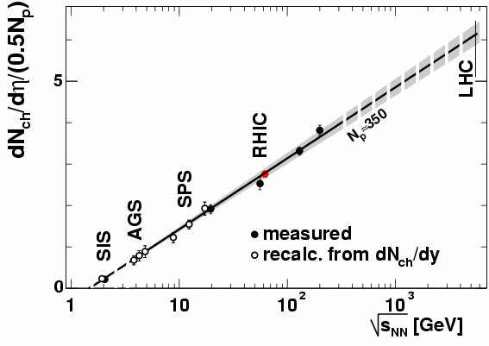
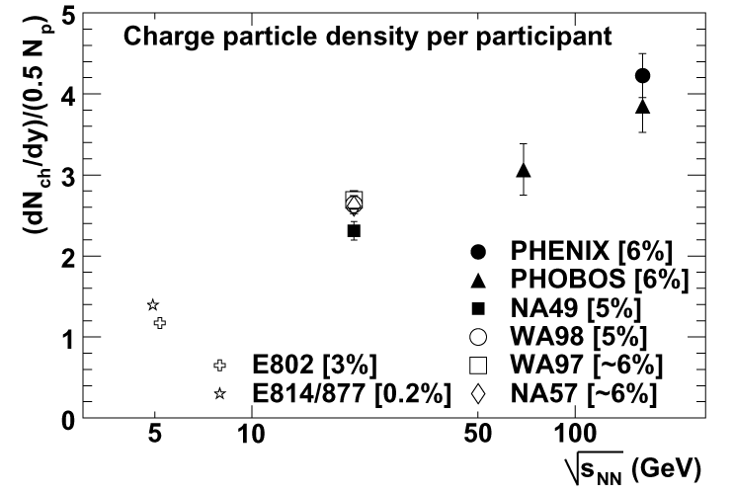
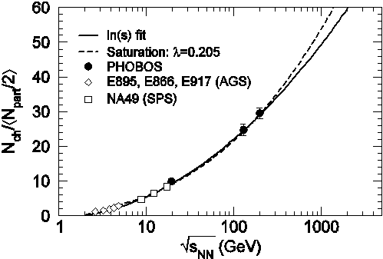
Energy Dependence
PHENIX @ QM01
Nucl. Phys. A698, 171 (2002).
dN_{ch}/dη ~ ln(√s)
PHENIX (PRC 71, 034908 (2005))
dN_{ch}/dη = (½N_{part}·A)ln(√s_{NN}/√s₀)
A = 0.74±0.01
√s₀ = 1.48±0.02 GeV
LHC prediction, based on data trend for 350 participants:
dN_{ch}/dη @ η=0: 1100
Total N_{ch} : 13000
PHOBOS PRL 91,52303 (2003)

Slide 10
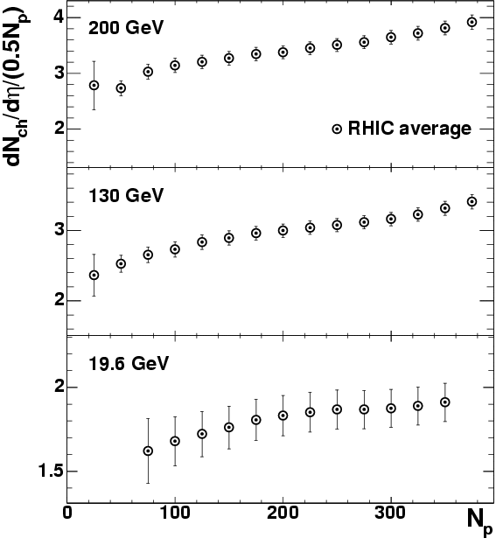
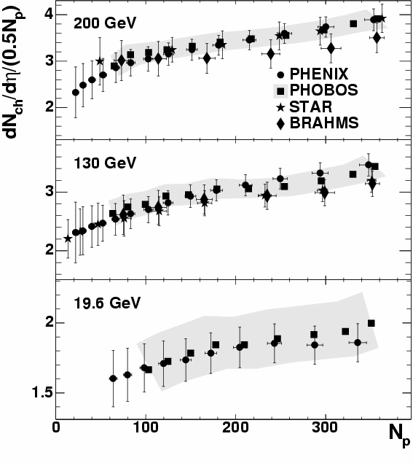
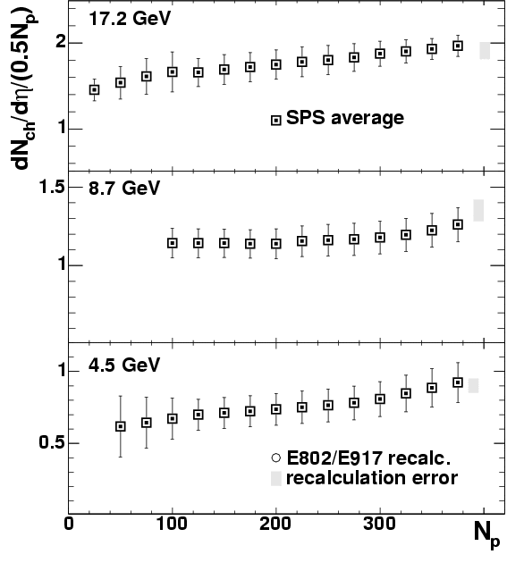
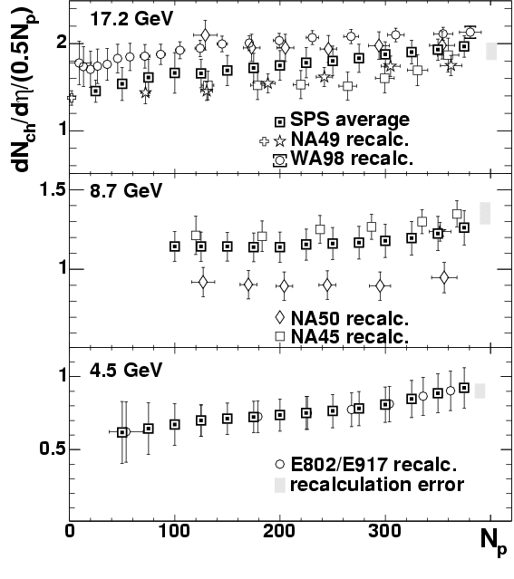
RHIC, SPS, AGS All Together
Spectacular agreement between 4 RHIC experiments. All measurements are independent, except for similar approaches of using Glauber model calculations.
Plots from PHENIX PRC 71, 034908 (2005)
BRAHMS: Si + Scintillators
PHENIX: PC at 2.5m and 5m, no field
PHOBOS: Si detectors
STAR: Tracking in the field

Slide 11
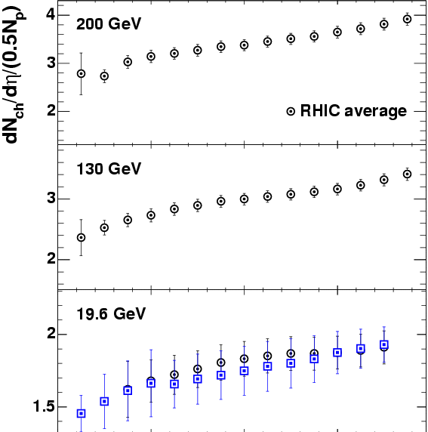
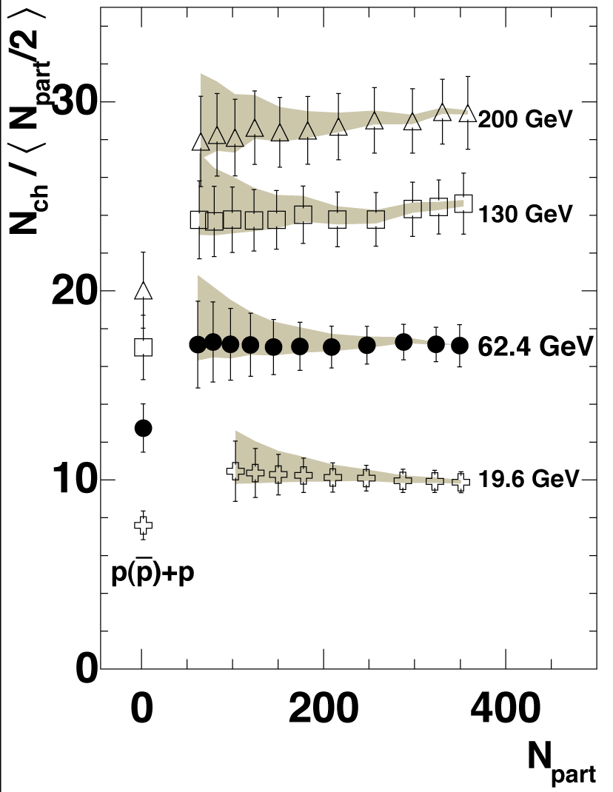
RHIC, SPS, AGS All Together
Averaged SPS data at 17.2 GeV is in good agreement to averaged RHIC data at 19.6 GeV (expected difference ~4%)
There is a continuous set of measurements from AGS to RHIC energies.
The centrality shape at η=0 scales with √s_{NN}
Total particle yields per participant are flat in centrality..
=> Mid-rapidity centrality dependence seems like just distr. narrowing..
PHOBOS nucl-ex/0509034
p+p is ~30%-40% lower

Slide 12
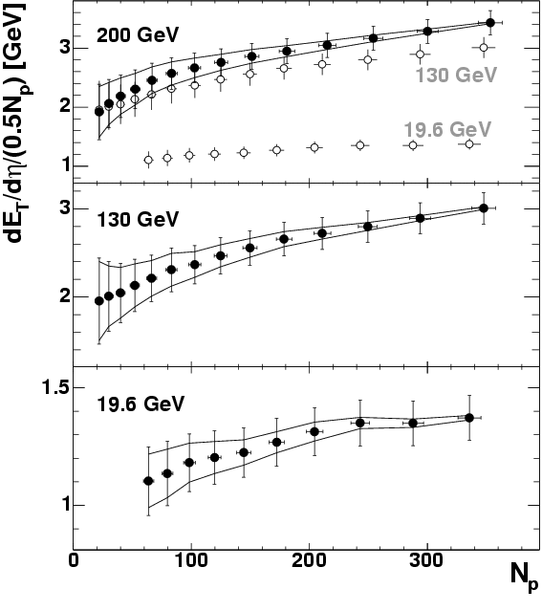
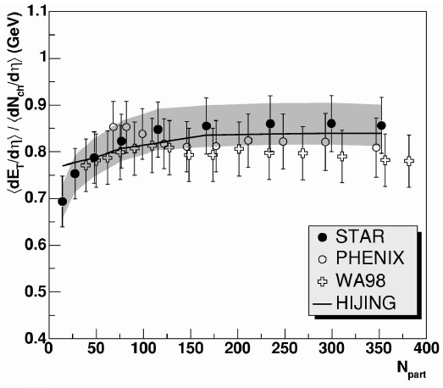
E_{T} Measurements
STAR (PRC 70, 054907 (2004))
STAR:TPC + calorimetry
PHENIX: calorimetry only
PHENIX PRC 71, 034908 (2005)
Centrality shape scales with incident beam energy
Steady rise from peripheral to central a la N_{ch}

Slide 13
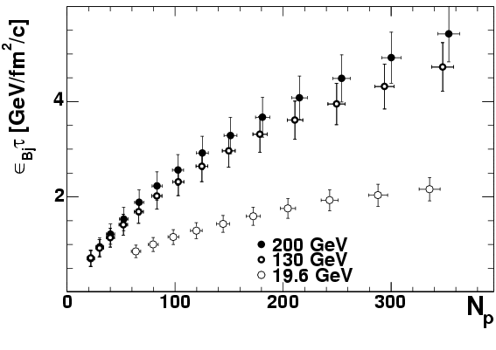
Bjorken Energy Density Estimate
PHENIX PRC 71, 034908 (2005)
ε_{BJ}=(A_{T}τ)⁻¹dE_{T}/dy
  √s_{NN} = 200GeV (0%-5%) & τ =1fm/c; ε_{BJ} = 5.4 ± 0.6GeV/fm³
What about “τ”?
  Limiting: τ = 1/(2Rγ) 0.15 fm/c
  Formation: τ = h/m_{T} ≈ 0.6E_{T}/N_{ch} 0.3 fm/c

Slide 14
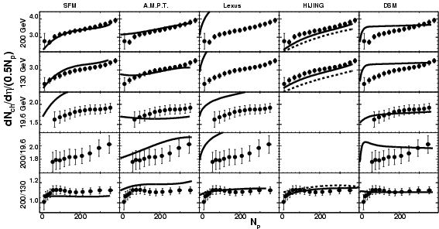
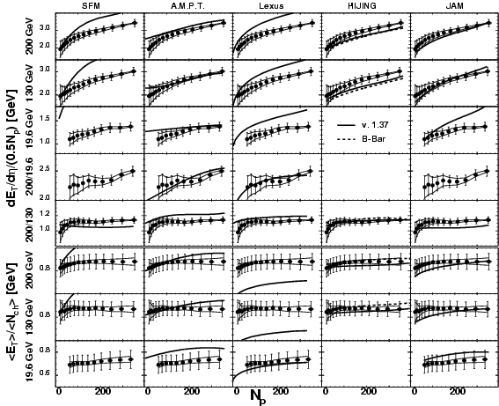
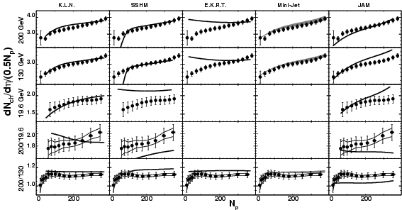
“Early RHIC” Model Survey
Lots of data available:
PHENIX PRC 71, 034908 (2005)
Reproduce most of data: A.M.P.T., HIJING N_{ch} only: K.L.N., Mini-jet
Compared as many models as we could find to data..

Slide 15
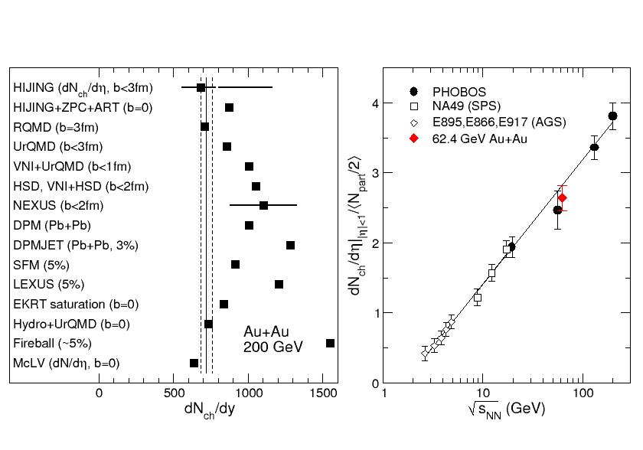
From RHIC to LHC
Pre-RHIC theoretical predictions:
Seems straightforward to extrapolate to LHC, right..?
PHOBOS, Nucl. Phys. A747, 28 (2003)
Notes:
First a quick look back in the history.
Before RHIC turned on there was a large number of theoretical predictions for the multiplicity of particles emitted at mid-rapidity in 200 GeV Au+Au collisions.
The predictions varied by up to a factor of two as illustrated here.
In retrospect we see that the experimental value for 200 GeV lies in in the lower range of the predictions.
In fact, the increase in charged particle multiplicity at eta=0 with energy turns out to be only logarithmic as shown in the right panel.

Slide 16
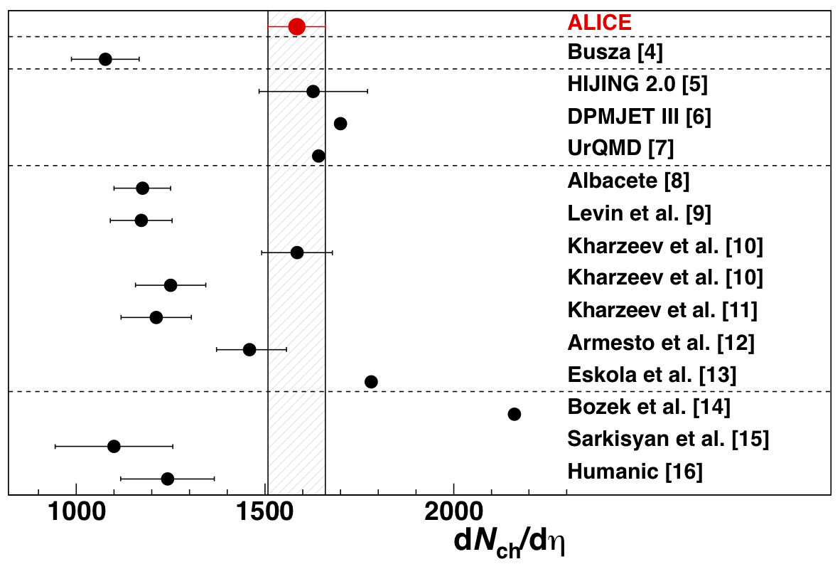
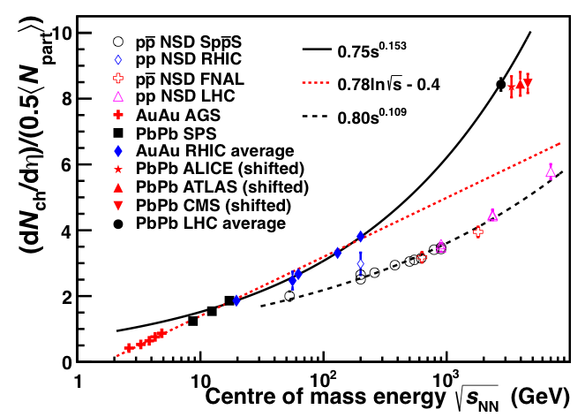
First LHC HI Results:
Charged Particle Multiplicity
5% most central events:
dN_{ch}/dη = 1584 ±4(stat)±76(sys)
Predictions more spread around result (on high side of expectations) than at start of RHIC
Excellent agreement also between LHC experiments!
Pb-Pb(√s_{NN}= 2.76 TeV)
→ 1.9 x p-p(√s_{NN}= 2.36 TeV)
→ nuclear amplification!
→ 2.1 x RHIC (Au-Au√s_{NN}= 0.2 TeV)
Plot: arXiv:1202.3233

Slide 17
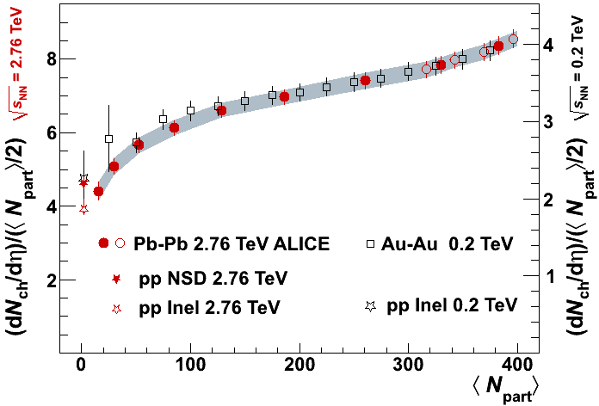
Multiplicity vs centrality
Measurement based on tracklet reconstruction in SPD
LHC scale
RHIC scale
From RHIC to LHC
  dN_{ch}/dη ~1600 for 0-5%: ~2.1 increase
  Similar centrality dependence at 0.2 and 2.76 TeV for N_{part}>100 (RHIC average)
  Good “matching” to the pp point
|η|<0.5
PRL106, 032301(2011)
PRC71, 034908 (2005)
Interpolations between
2.36 and 7 TeV pp
PRC83, 024913 (2011)

Slide 18
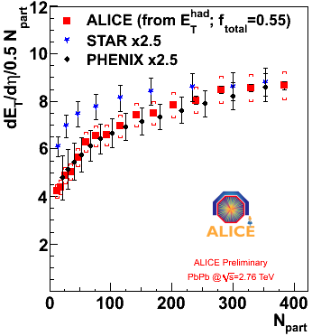


Transverse Energy
E_{T}^{had} from charged hadrons directly measured by the tracking detectors
f_{total} from MC to convert into total E_{T}
From RHIC to LHC
  ~2.5 increase in
  dE_{T}/dη/ (0.5*N_{part})
Energy density (Bjorken)
ετ ~ 15 GeV/(fm²c)
RHIC: ετ =5.4±0.6 GeV/(fm²c)
(GeV)
PRC71:034908 (2005)
PRC70:054907 (2004)
Centrality dependence similar to RHIC (PHENIX)

Slide 19
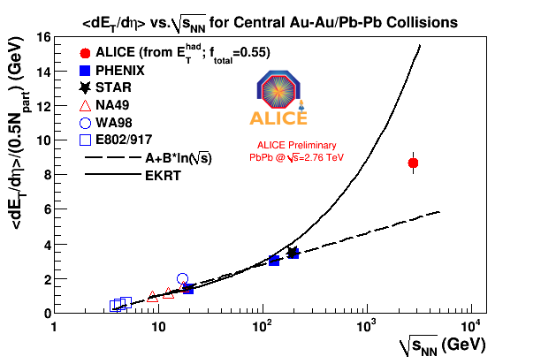
√s dependence: N_{ch} & E_{T}
dN_{ch}/dη/(0.5*N_{part}) ~ 8
2.1 x RHIC
1.9 x pp (NSD) at 2.36 TeV
growth with √s faster in AA than pp
dE_{T}/dη/(0.5*N_{part}) ~ 9 in 0-5%
Also increase of N_{part} (353 →383)
→ 2.7 x RHIC for dE_{T}/dη (consistent with ~20% increase of <p_{T}>, and expectations from spectra)
Grows with power of CM energy faster than
simple logarithmic scaling extrapolated from lower energy
Plot: arXiv:1202.3233

Slide 20
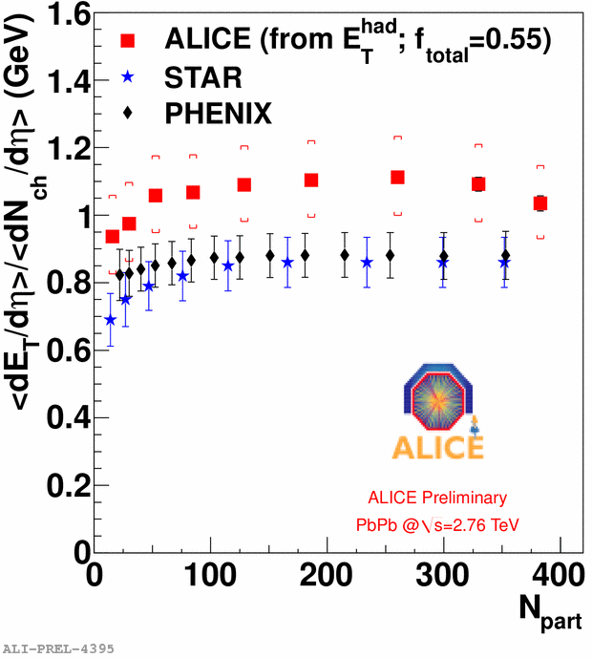
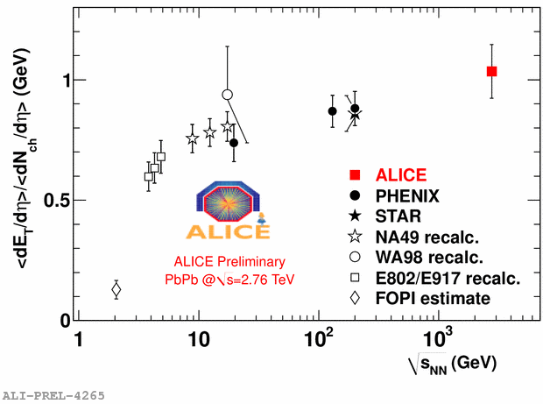
E_{T}/N_{ch}
Consistent behavior for E_{T} and N_{ch}
- Both increase with energy
Both show steady rise from peripheral to central
E_{T}/N_{ch} ~ independent of centrality
E_{T}/N_{ch} increases with energy
PRC71:034908,2005
PRC70:054907,2004
PRC71:034908,2005

Slide 21
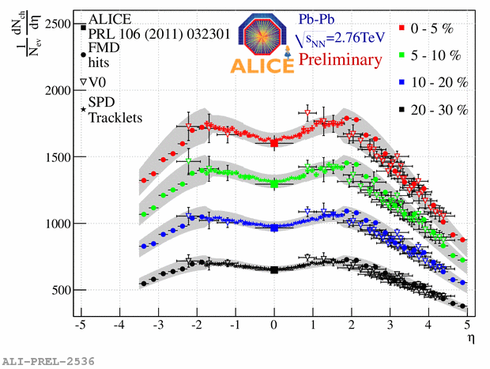
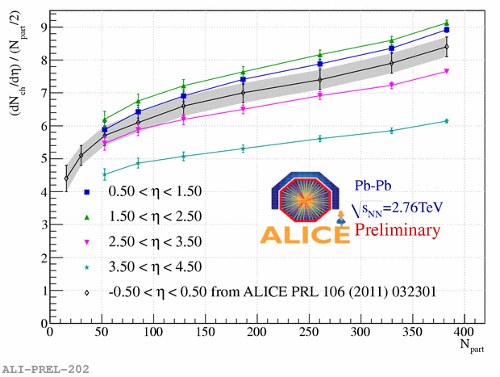
Observables at high rapidity
Phenomena at high rapidity
  properties of initial state (e.g. Color Glass condensate, gluon density, ...)
  energy and baryon stopping
dN_{ch}/dη at forward rapidity
  SPD: mid rapidity
  VZERO, FMD
similar trend for measured η bins
Note: suppressed y-scale..

Slide 22
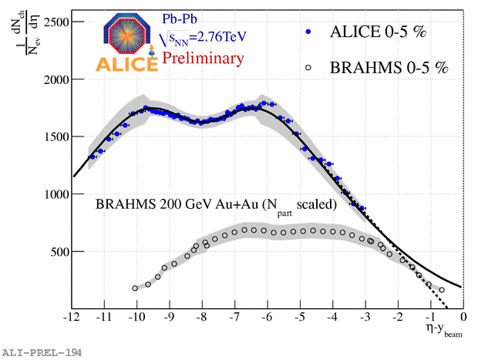
Extended longitudinal scaling
Yields at high rapidity are energy-independent, when viewed in rest-frame of one of colliding nuclei
longitudinal
scaling could be
present also for
Pb+Pb at 2.76 TeV
Works also for dN/dη
because
y≈ η + ln (p_{T}/m_{T}) ≈ η
BRAHMS PRL 88:202301,2001
BRAHMS data scaled by N_{part}(ALICE)/N_{part}(BRAHMS)
η-y_{beam} > -3: extrapolations
  (double-Gaussian, linear)

Slide 23
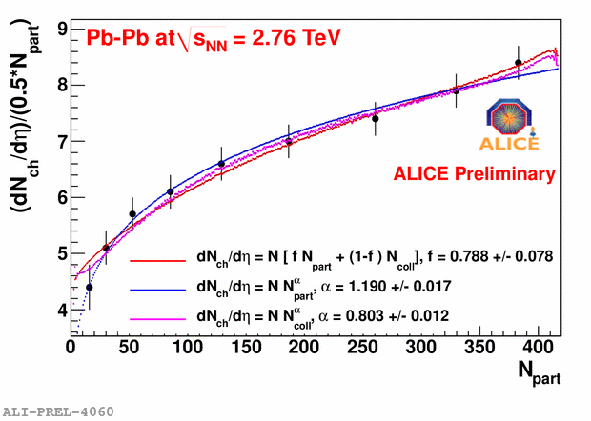
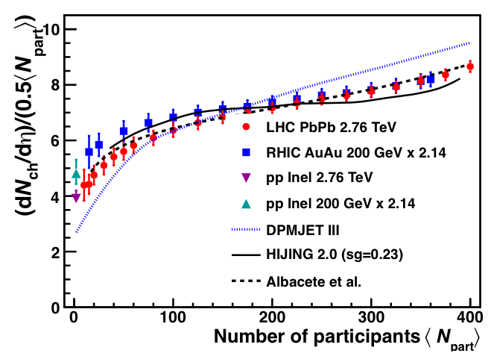
Mid-rapidity dN_{ch}/dη vs centrality
Plot: arXiv:1202.3233
Multiplicity scaling with centrality:
Stronger than N_{part}
Different possible scalings (2 component, power laws) reproduce data
Glauber fits not sensitive to choice of parameterization
Scaling similar to RHIC:
Contribution of hard processes (N_{coll} scaling) the same as at lower energies..? Just geometry?

Slide 24
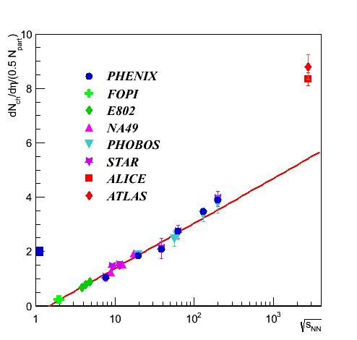
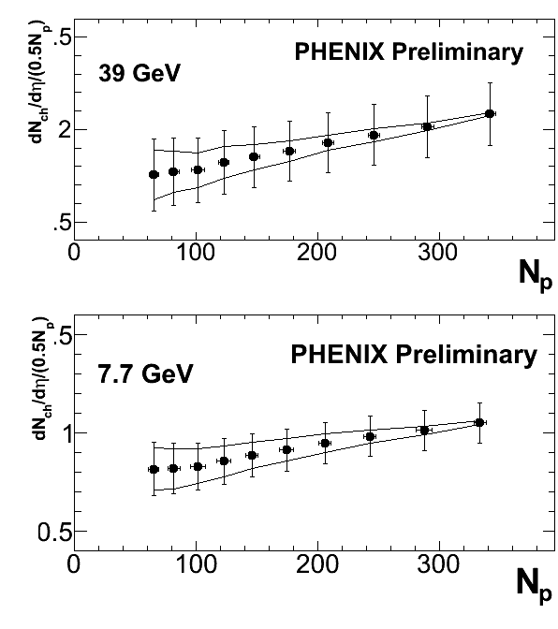
News: RHIC Energy Scan Results
Adding new data: coverage all the way down to √s_{NN} = 7.7 GeV

Slide 25
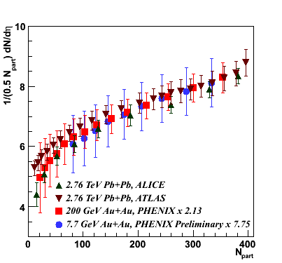
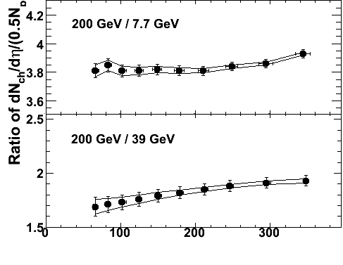
dN_{ch}/dη
N.B.: Approx. same centrality dependence at 7.7 GeV as at 2.76 TeV!
[note: no RHIC average here, just PHENIX..]

Slide 26
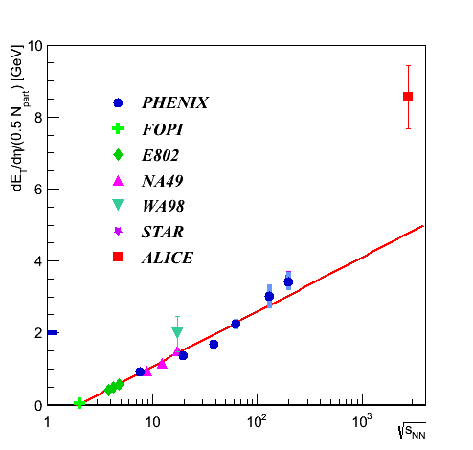
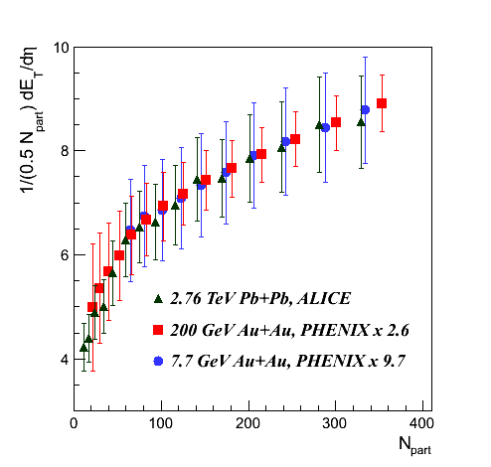
dE_{T}/dη
Also for transverse energy:
Approx. same centrality dependence at 7.7 GeV as at 2.76 TeV!

Slide 27
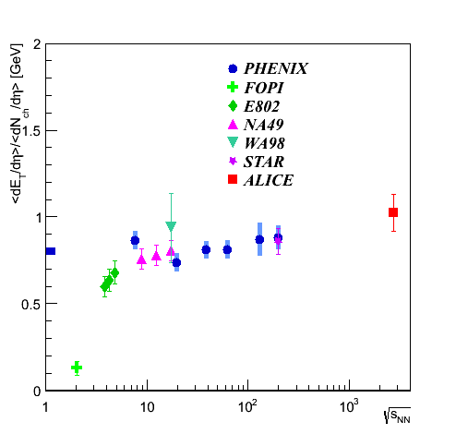
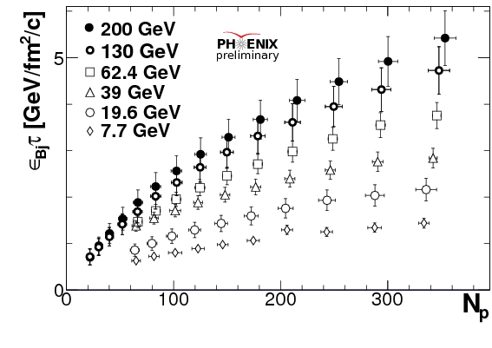
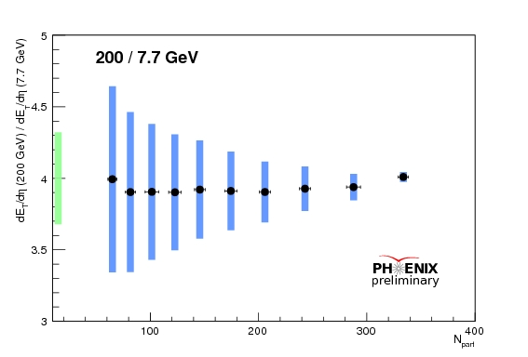
E_{T} and Bjorken Energy Density
Smooth scaling throughout RHIC energy range

Slide 28
Summary
The bulk properties of the system show a smooth transition throughout RHIC energy range and on to LHC energies
LHC multiplicity (many predictions) and transverse energy (fewer comparisons) values higher than many predictions based on RHIC data
Centrality dependence very similar from lowest RHIC to highest LHC √s (PHENIX & ALICE): “just” rapidity distribution narrowing/geometry?
LHC Energy density > 15 GeV/fm³→ ~>3x RHIC
Thanks to A. Milov, A. Toia, M. Floris, C. Nattrass, J. Mitchell for input/slides..

Slide 29
EXTRA / BACKUP

Slide 30
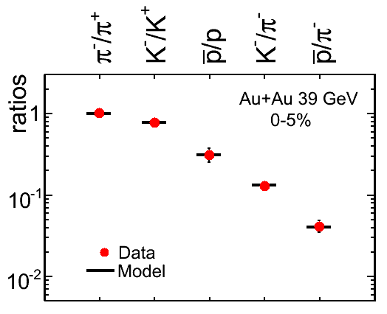






Energy Scan: Freeze-out Conditions
11.5 GeV
STAR Preliminary
39 GeV
STAR Preliminary
Chemical freeze-out: Particle ratios
Andronic et al.,
NPA 834 (2010) 237
STAR Preliminary
7.7 GeV
39 GeV
11.5 GeV
STAR Preliminary
STAR Preliminary
Kinetic freeze-out : Momentum distributions (BlastWave fit)
Notes:
To establish where we are in the phase diagram in terms of temperature and chemical potential fits to particle ratios at different center-of-mass-energies are done (top left). Results are compiled in the top right plot.
One can also determine the kinetic freeze-out temperature from fits to the particle momentum distributions and one can see that the kinetic freeze-out is found to be a bit lower than the chemical freeze-out, as expected.

Slide 31


LHC Data & Thermal Models
S. Wheaton, J. Cleymans and M. Hauer,
Comput. Phys. Commun. 180 (2009) 84-106.
A. Andronic et al.,
Phys.Lett.B673:142-145,2009
nice agreement of kaon and multi-strange production with thermal-model predictions T_{ch} = 160-164 MeV
ad hoc tuning of freeze-out temperature T_{ch} = 148-149 MeV:
→ helps for kaons and protons
→ multi-strange underestimated

Slide 32


Comparison to models
Should we expect to see a growing influence of hard scattering (N_{coll}) going from 0.2 to 2.76 TeV ?
pQCD-inspired models
(HIJING, DPMJET, AMPT, ...)
  strong centrality dependence
  moderated by gluon shadowing
  → 2-component
  (soft~N_{part}, hard~N_{coll})
PRL106, 032301(2011)
Saturation models (CGC, EKRT, ...)
  At fixed scale parton phase space density saturates → limits parton production
  Factorization of N_{ch}
    Growth in energy: power law
    Growth in centrality: power law/logarithmic
Different versions of the same model!

Slide 33

CMS: dE_{T}/dη
Fig. 1 from
arxiv:1205.2488

Slide 34

CMS: dE_{T}/dη
Fig. 2 from
arxiv:1205.2488

Slide 35

CMS: dE_{T}/dη
Fig. 3 from
arxiv:1205.2488
Central value ~X sigma above ALICE prelim(?)
[CMS: cut-off at 900 MeV, and calorimetry-only measurement
ALICE: agrees with expectations from spectra]

Slide 36


LHC: Particle Ratios
STAR, PRC 79, 034909 (2009)
PHENIX, PRC 69, 03409 (2004)
BRAHMS, PRC 72, 014908 (2005)

Slide 37

<E_{T}>/<N_{ch}> Ratios
Ratio <E_{T}>/<N_{ch}> increases by ~20% from 19.6 GeV to 200 GeV and stays the same between 200 GeV and 130 GeV
  Consistent with the average particle momentum increase between those two energies.
Ratio <E_{T}>/<N_{ch}> is rather independent of centrality: puzzling?
  Same freeze-out conditions?
  Since trigger and centrality related uncertainties cancel out, the flatness of the curves is a rather precise statement.
PHENIX PRC 71, 034908 (2005)

Slide 38


What happens to <m_{T}>?
At low √s_{NN}:
  E_{T} is “produced” energy only.
  N_{ch} can benefit from pre-existing particles (baryons).
At higher √s_{NN}:
  Critical temperature T_{c}=0.17GeV.
  Assuming:
  <E_{kin}>=3/2T_{c} ≈ 0.26 GeV
  <m₀> ≈ 0.25 GeV
  <m_{T}> = <E_{kin}> + <m₀>
  ≈ 0.51 GeV
  <E_{T}>/<N_{ch}> ≈ 1.6 <m_{T}>
  ≈ 0.82 GeV
RHIC measured 0.88 GeV (with flow)
Prediction for LHC: 0.93±0.04 GeV
H. Satz, Rep. Prog. Phys. 63, 1511 (2000)

Slide 39

N_{total}
Total charged particle multiplicity N_{tot} measured with extrapolations in η-y_{beam} > -3 (linear and double Gaussian)
N_{tot} almost linear with N_{part}
pseudorapidity distribution
gets more narrow
for central events
Width * Height ~ constant
→ increased particle
production occurs at
mid-rapidity
At RHIC: N_{ch}=4630 in |η|<4.7

Slide 40

World Context
: 2010→
: 2000→RHIC II →
: 20XX→
Notes:
Here is a sketch of the so-called the phase diagram, with temperature and net-baryon chemical potential on the axes, and you can see the regions that can be reached with the current and future accelerators.
The plan is that RHIC will go through a luminosity upgrade and continue for many more years.

Slide 41


Size of a system or type of species?
A long standing question: Is N_{part} a valid characteristics?
From the N_{part} point of view Cu+Cu is the same as in the first 1/3 of Au+Au.
B.Back for PHOBOS @
Lake Louise Workshop 2006

Slide 42

ALICE
Central Detectors:
Inner Tracking System 100%
Time Projection Chamber 100%
Time-of-Flight 100%
Transition Radiation Detector* 39%
Spectrometers:
RICH 100%
Photon Multiplicity 100%
Forward Multiplicity 100%
Photon Spectrometer 60%
Muon Spectrometer 100%
Calorimeters:
Zero Degree Calorimeter 100%
EM Calorimeter* 36%
Trigger:
Trigger Detectors 100%
pp High-Level-Trigger 100%
*upgrade to the original setup
Notes:
OK, here is then an overview of ALICE. You see persons next to the large magnet to set the scale.
You also see the installation status for the various subsystems here, divided into central detectors, spectrometers etc. As you can see, most subsystems are complete, except for the TRD – transition radiation detector, and PHOS and EMCAL, use for photon and jet measurements.

Slide 43

The PHENIX detector
Central arms:
hadrons, photons, electrons
p > 0.2 GeV/c
|y| < 0.35
[70 < θ < 110 deg.]
Δφ = π
Muon arms:
muons at forward rapidity
p > 2GeV/c
1.2 < |y| < 2.4
[11 < θ < 33 deg.]
Δφ = 2π
Centrality measurement:
We use beam beam counters together with zero degree calorimeters
Notes:
Now, before I get to any results, let me briefly introduce the PHENIX detector. It has two central detector arms around mid-rapidity and two muon arms at forward and backward-rapidity. The strength of PHENIX is its lepton and photon program but we of course also reconstruct plenty of hadrons.
For measurements of the centrality of the collision we use PMT detectors and calorimeters close to the beam.

