Slide 1
RHIC Status
Spin Collaboration 2/20/15
Regular stores for physics
Ramp losses fixed, moving from 1.4e11/bunch -> 1.6e11/bunch
Yellow e-lens commissioning with beam (not colliding yet)
Blue e-lens commissioning delayed by cathode short
  Replaced, baking out, access Monday to end bakeout and reconnect
  Days of cathode conditioning before first e-beam

Slide 2
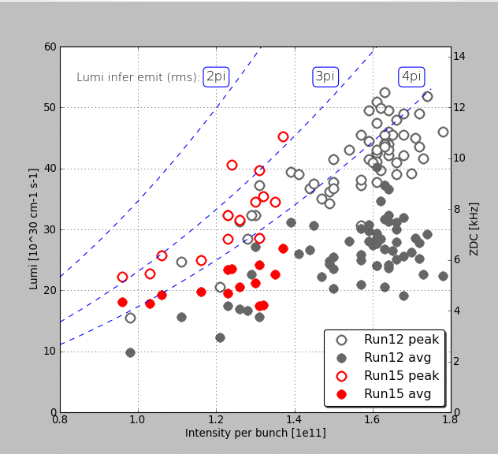
Luminosity by fill (up to 18684, 2/17)

Slide 3
