Slide 1
AGS pp Status
Haixin Huang
Feb. 20, 2015
RSC Meeting

Slide 2
Status
Source polarization has been up lately, the average of past one week is about 82%. The vertical emittance at AGS flattop has been reduced with several optical changes (two tunes closer to each other around 200ms, reduce vertical chromaticity after 350ms). The reported vertical normalized rms emittance is about 3.2pi (was 5pi) at flattop with 2*10¹¹ intensity.
A new set of JQ timing has been put into use and an overall timing scan has been done. This new set of timing coincides with the -0.5ms shift in the later part of ramp, so it seems the mysterious shift of -0.5ms is gone. With smaller emittance, higher source polarization and new timing, we get above 70% polarization with 2*10¹¹ intensity.
We have set up a faster ramp on user2. The ramp is shortened by about 50ms (out of 430ms). It is faster in the early part. The motivation is to preserve emittance(such as space charge near injection), and secondary effect is to cross the early depolarizing resonances faster. The polarization with JQ off is in the middle of 60% with 2*10¹¹.

Slide 3
Booster Setup
Booster injection tune setup study: compare the near half integer setting vs. 4.9 setting. It showed that the near half integer setting is better but the vertical tune needs to be pushed further away from half integer, due to higher intensity.
The benefit of higher input intensity from linac: the stop band tuning is easier, as the effect is visible with higher input. We set up stop band correction with much higher input and then lower intensity for operation.
We have set up a faster Booster user on Booster user8. The motivation is to reduce emittance, but we still need machine time to judge if it works.

Slide 4
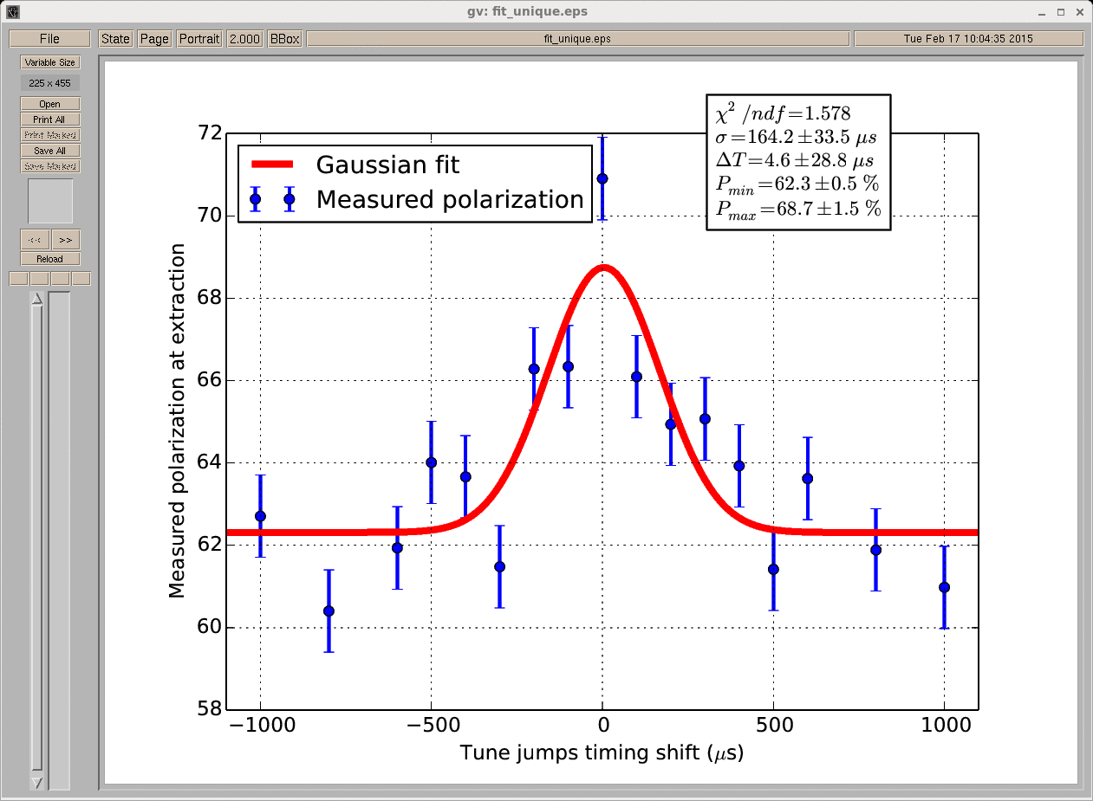
Overall JQ Timing Scan (2/14-16)
(fitted by Yann)
Not a good Gaussian shape, but good polarization at expect timing.

Slide 5
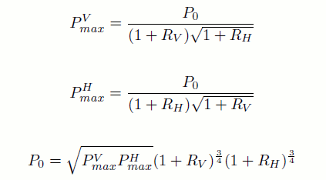
AGS Polarization Profile at Flattop
P₀ is the polarization with zero emittance or source polarization. P^{v}_{max} equivalent to fixed target measurement done with vertical target.
Date P^{V}_{max} R_{H} P^{H}_{max} R_{V} P_{0_mea} P_{200MeV}-> P₀
1/12 72.2 0.7 0.054 0.016 74.6 0.8 0.093 0.016 81.6 1.4 82.5 80.8
1/16 69.2 0.8 0.139 0.018 69.4 0.7 0.061 0.015 79.9 1.4 80.1 78.5
2/2 67.4 0.9 0.112 0.018 66.3 0.5 0.080 0.011 76.7 1.2 80.5 78.9
2/5 68.7 0.7 0.112 0.017 66.1 0.8 0.121 0.018 79.5 1.5 80.1 78.5
2/17 72.6 0.6 0.057 0.014 69.6 1.0 0.086 0.021 78.9 1.5 82.0 80.3
The measured and expected P₀ agreement is reasonable.
The recent gain of polarization is seen in the reduction of polarization profiles.
5
Haixin Huang

Slide 6
How Sensitive Are the Parameters?
Date P^{V}_{max} R_{H} P^{H}_{max} R_{V} P_{0_mea} P_{200MeV}-> P₀
2/17 72.6 0.6 0.057 0.014 69.6 1.0 0.086 0.021 78.9 1.5 82.0 80.3
72.6 0.6 0.080 0.014 69.6 1.0 0.12 0.021 82.0 1.6 82.0 80.3
65.0 0.6 0.057 0.014 65.0 1.0 0.086 0.021 72.1 1.4 82.0 80.3
72.6 0.6 0.040 0.014 69.6 1.0 0.040 0.021 75.4 1.5 82.0 80.3
77.0 0.6 0.040 0.014 74.0 1.0 0.040 0.021 80.1 1.6 82.0 80.3
The measured and expected P₀ agreement is more sensitive to P_{max} than to R value. Unless we assume we significantly overestimate the R value and P_{max}(the last row), we could not get good agreement.
From RHIC measurements in the past, the R value is around 0.06-0.07 at injection, which set a constraint on how far we can change the R value.
6
Haixin Huang

Slide 7
RHIC Polarization and R values
Store Injection
Ring P R P R
Y1 64.9 0.3 0.09 0.01 60.6 0.5 0.04 0.01
Y2 62.1 0.3 0.09 0.01 60.0 0.4 0.04 0.01
B1 64.0 0.2 0.07 0.01 65.0 0.5 0.02 0.02
B2 63.1 0.3 0.06 0.01 64.0 0.4 0.02 0.01
These are offline measurements for all measurements. Horizontal and vertical targets are mixed.
If we used same R value for both planes, the P₀ is below 70% for all of them. If we assume all polarization loss is emittance related, then the polarization loss should be reflected in R values. P₀ should be near the value from AGS, just a few percent lower due to spin mismatch at injection (0.96 for blue and 0.99 for yellow).
7
Haixin Huang

Slide 8
Near Term Job List
Reduce the emittance in the AGS (faster Booster and AGS ramps).
Evaluate the jump quad timing derivation with averaged frequency meter data.
Beta function measurement at IPM (vertical E15 has been studied so far) and eIPM.
eIPM setup. Gas leak of horizontal eIPM is fixed.
Setup various flattops for emittance and polarization measurements. Start from 40.5, then 31.5, 22.5, 13.5 and 7.5 if time allowed.

Slide 9
Backup Slides

Slide 10
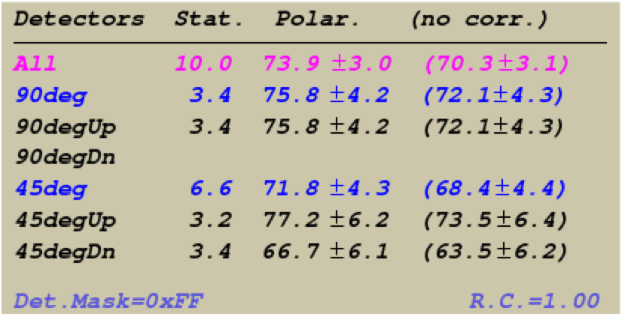
AGS Polarization Rate Correction
The correction effect is small: relatively 5%.
10
Haixin Huang

