Slide 1
RHIC Status and E-lens 101
Spin Collaboration Meeting
V. Schoefer
2/6/2015

Slide 2
RHIC Status
As of today, past the installation milestones
DX moves at IP2,4
Roman pot installation
Dump window upgrade
Abort kicker cooling upgrade
Final e-lens bakeout today
X-arc transformer failure (two day repair ends today)
Slow going so far because of daily access
56x56 1.3e11/bunch through the rotator ramp
Need rebucketing
Store setup, overnight stores Saturday evening(?)

Slide 3
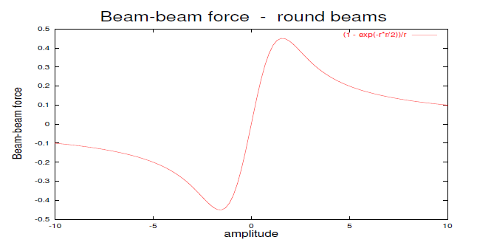
Beam-Beam Effect
In collision, on-coming beam looks like a non-linear lens
Like charge means defocusing
which lowers the tune
Beam-beam foce [arb]
Amplitude [beam sigma]
Linear beam-beam parameter
N = per bunch intensity
r0 = classical radius of partical
= Relativistic gamma
ε = emittance

Slide 4
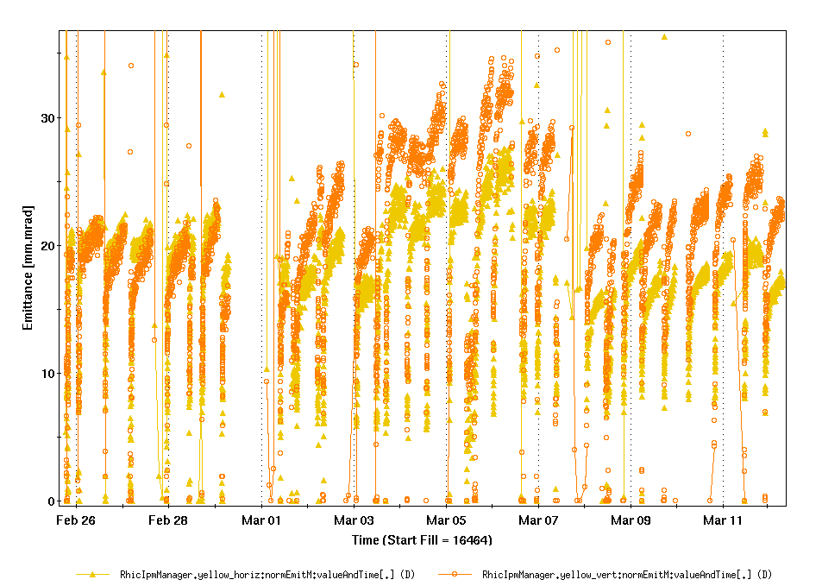
Beam-beam Emittance Blowup
Vertical Beam Transfer Function
Longitudinal scraping being used to reduce beam loss during rebucketing at 100 GeV.
Moving to a vertical-only scraping scheme increased beam-beam tune spread, ΔQ_{bb}
Ran into the beam-beam limit:
Transverse emittance blowup
Increase in polarization decay
>2%/hr, compared to ~1%/hr nominal
2/3
7/10
1.3 ΔQ_{bb}
Vertical
Horizontal
Yellow IPM Emittances
Diminishing tune spread from beam-beam is exactly the goal of the electron lens

Slide 5
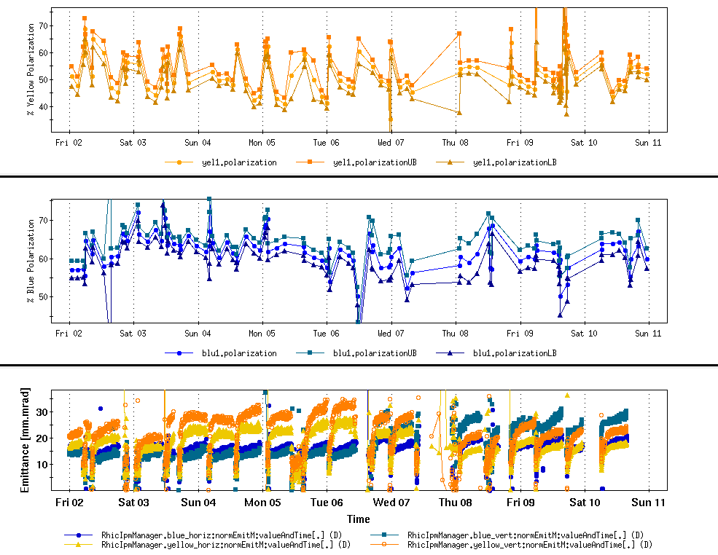
Beam-beam Emittance Blowup
Yellow emittance blowup at store coincides with removing longitudinal scraping in the Booster
Yellow polarization decay goes to 1.9%/hr during this period

Slide 6
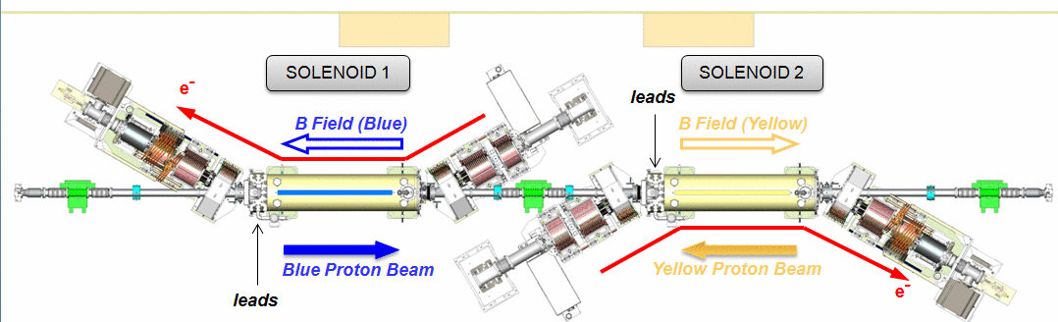
E-Lenses at IP 10
EBIS Spare
SOLENOID 1
Images from X. Gu

Slide 7
Slide courtesy of W. Fischer

Slide 8
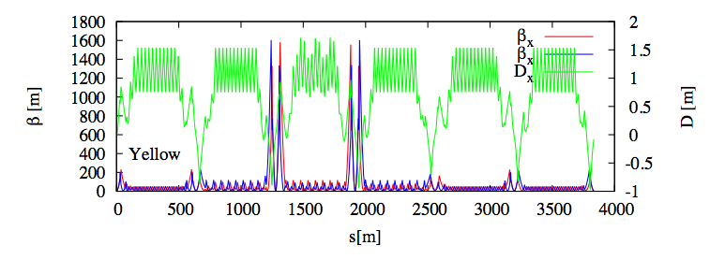
Run 15 Store Optics
ΔΦ =π
Β* = 0.85m
Β = 20 m
The π phase advance between IP8 (or 6) and the e-lens is what makes it an ‘e-lens’ lattice.

Slide 9
E-lens and transverse stability
E-lens presents a substantial impedance to the beam* , “transverse mode coupling instability” (think head-tail instability)
Primary stabilizing force is the solenoidal field at the e-lens (pins the electrons)
Additional stabilizing (against all coherent instabilities, including e-lens) to be provided by the transverse BBB damper.
B_{th} = min solenoid field for stability
r = beam radius (controlled via β*)
ΔQ = |Qx – Qy| (assumed to be 0.01, could be a problem)
*Burov et al, “Transverse beam stability with an ‘electron lens’” Phys. Rev. E, Vol 59, Num 3 (1999)

Slide 10
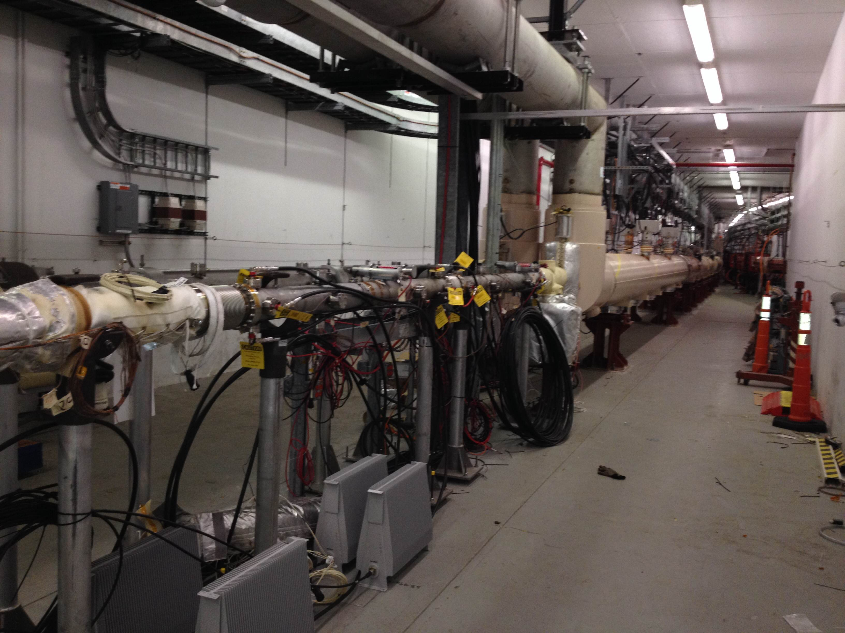
BBB Damper
Hardware (pickups and kickers in the injection area)
Blue BBB kicker
Yel beam
Y-arc
Yellow BBB kicker
PUE can be chosen between Q11 and Q15 (depends on lattice)

Slide 11
E-lens Commissioning
Final bakeout today, hi-pot tests
Cathode conditioning over the weekend
Electron beams some time next week
Initially end of store
Integration into standard ramp sequence after initial tests
Initial operational setup is to bring all beams into collision (p-p and p-e) simultaneously at end of ramp.

