Slide 1
AGS pp Status
Haixin Huang
Feb. 6, 2015
RSC Meeting

Slide 2
Tasks
To preserve polarization, following things have to be done: orbit harmonic correction in the Booster (Gγ=3,4); high vertical tune in the AGS with both snake on; horizontal tune jump quads(JQ) on with right jump timing.
To further reduce the polarization loss in the AGS, preserve emittance is the way to go. We need good measurement of emittance throughout the accelerator chain: end of LINAC (LPM), Booster to AGS transfer line (MW006), AGS IPM (and new device eIPM). As cross checks, the emittance measurments in the AtR line (flags) and RHIC (IPM).
The source polarization in past runs was as high as 82%. It is expected to have some small gain this year but the upgraded source can provide more intensity. If Booster scraping can scrape the beam to give a brighter beam (smaller emittance), we win.
Our remaining jobs are: find ways to benefit from the higher input intensity, reliable emittance measurement, accurate JQ timing determination.

Slide 3
Plan on Emittance Front
We need reliable emittance measurement to get emittance evolution in the AGS. The ion collecting IPM has space charge effect. We can mitigate the effect by turning off RF, but this is only possible at flattop (without acceleration). We plan to take these measurements at various energies.
The electron collecting IPM (eIPM) does not have space charge effect, as electron travels very fast. We have installed them into AGS, but the vertical one has issues (non-symmetric profile, large profile). We are working on to improve that.
The upgraded source can deliver much more intensity now (typically 8-9*10¹¹). But with the small emittance and higher intensity, space charge could be a problem at Booster injection. Space charge force is proportional to the peak current. One way to reduce the effect is to reduce the peak current. Dual harmonic RF cavity can do it.

Slide 4
Status
Dual harmonic RF setup has been tested in the Booster. With the h=2 cavity on for longer time (120ms), the beam seems brighter at extraction (same beam size, but more intensity). It has been used since 1/9.
Several JQ timing files have been tried. It seems that the timing needs to be earlier by 0.5ms from the timing derived from energy and tune measurements.
Polarization is in the range of high 60% to low 70% with 2*10¹¹ intensity.
Benefit of JQ is seen: JQ on: 73.54+-1.26; JQ off 67.79+-1.19; ratio: 1.085+-0.024. Intensity was 1.5*10¹¹.
Many polarization profile measurements are done.
Intensity scan was also done.

Slide 5
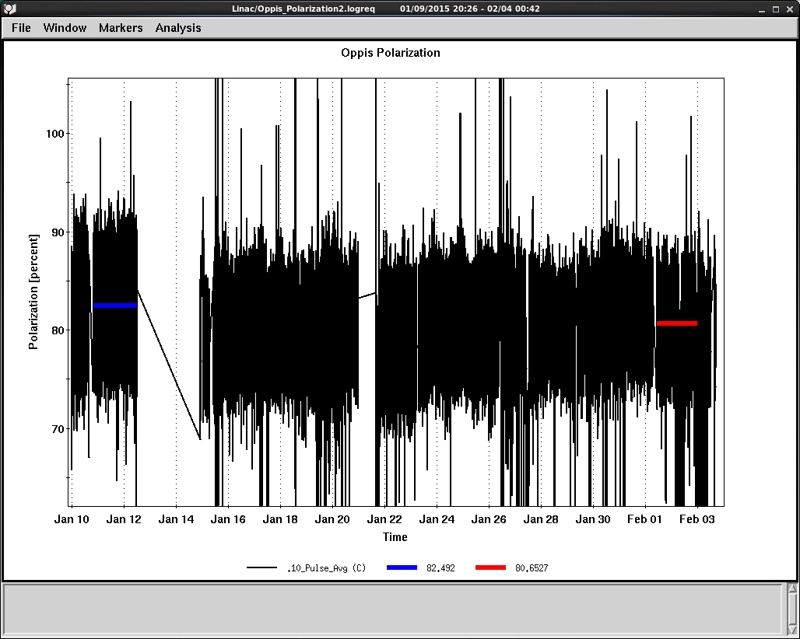
Source Polarization History

Slide 6
Booster Bunch with Different Harmonics
The study last year showed that the emittance did not go down with Booster input intensity above 6*10¹¹. This could be due to space charge.
The solution is to use dual RF harmonics in the Booster (has been used for high intensity operation a decade ago).
(Simulation by Kip)

Slide 7
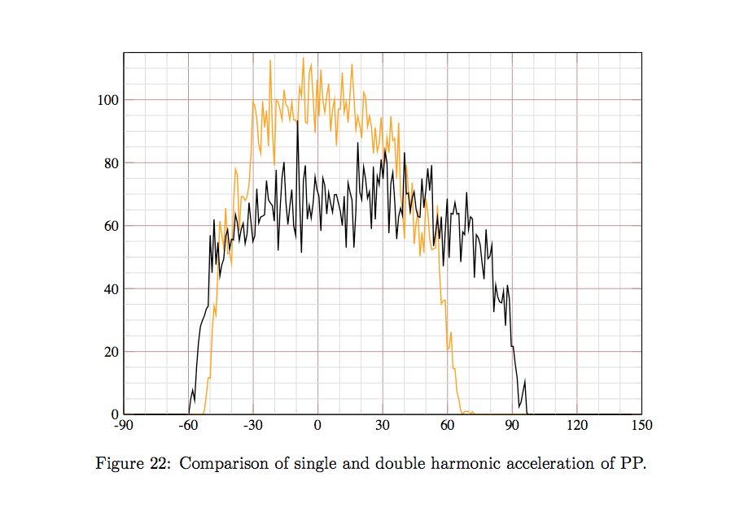
The Reduction in Peak Current is 25-30%
(done by Kip)

Slide 8
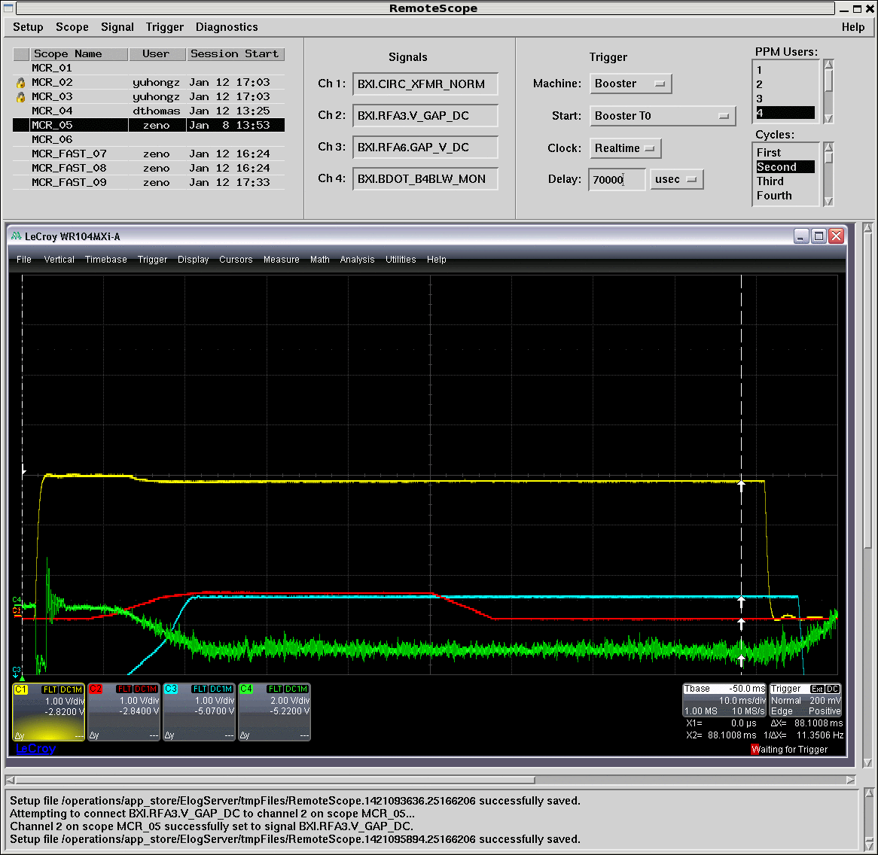
Booster Dual Harmonic RF Cavity
Almost no loss with h=2 on.
Yellow: Intensity
Red: h=2 voltage

Slide 9
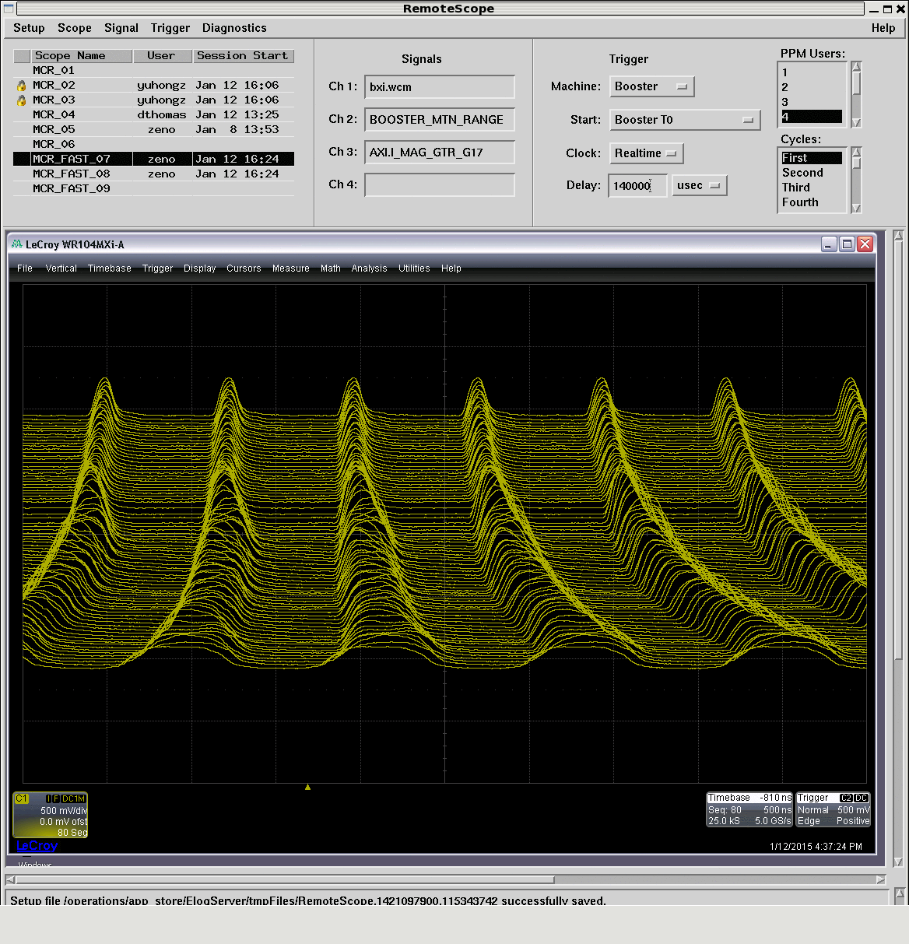
Booster Mountain Range
H=2 is off

Slide 10
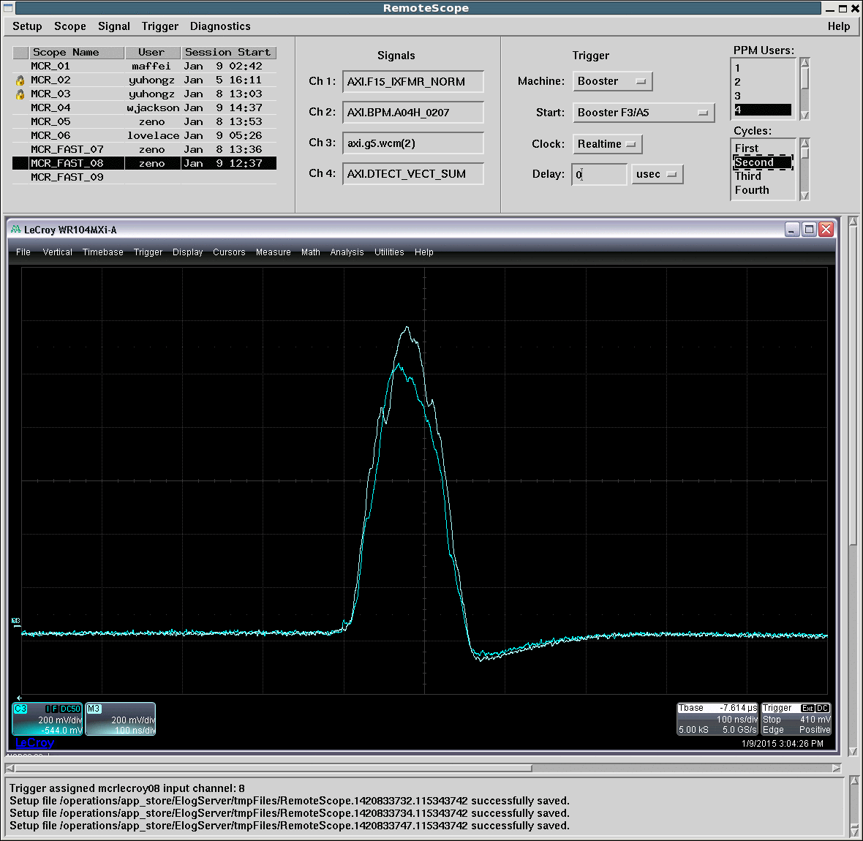
AGS First Turn Bunch Shape
The higher peak is with h=2 on.

Slide 11
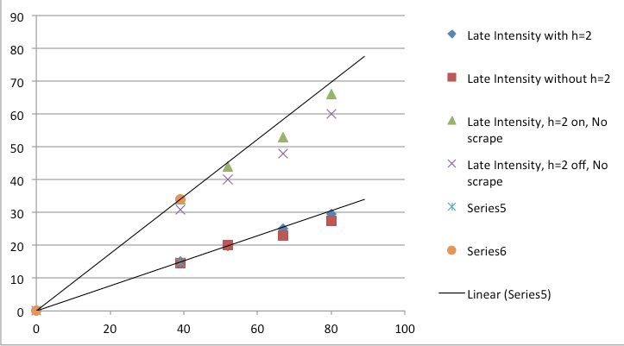
Booster Late Intensity with and without Scraping
(done by Keith)

Slide 12
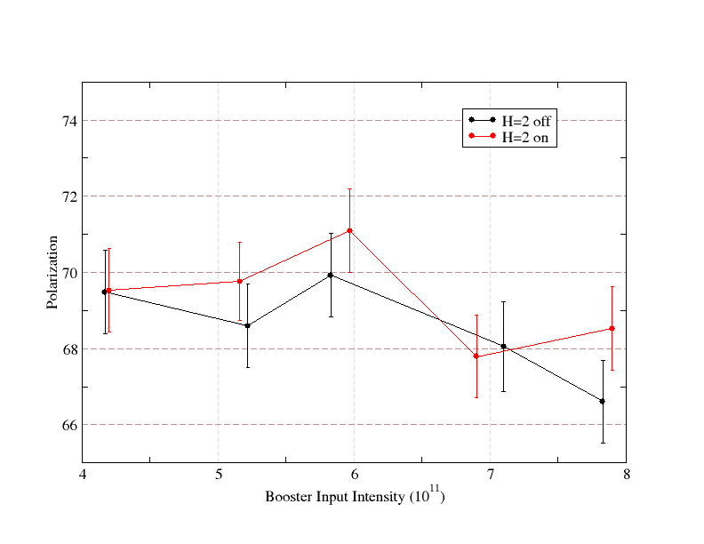
AGS Polarization vs. Booster Input Intensity
AGS intensity was at 2*10¹¹. No gain in polarization with higher Booster input (heavier scraping)

Slide 13
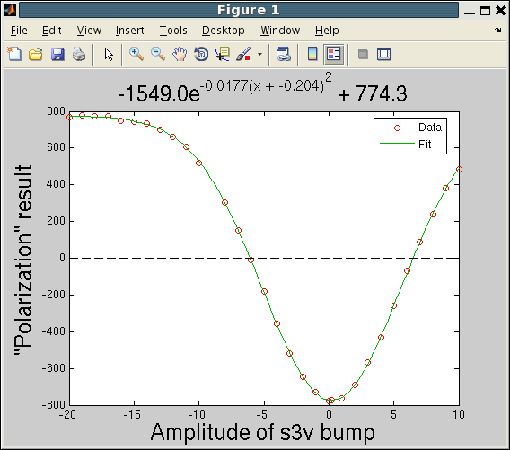
Booster sin3v Scan (1/24)
(done by Phil)
New Setting

Slide 14
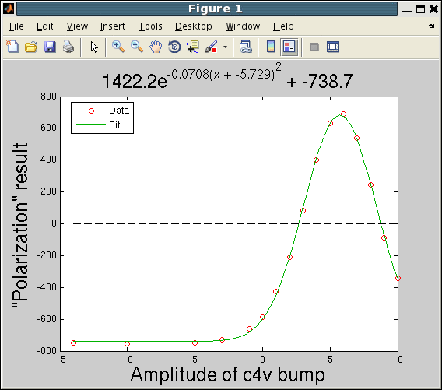
Booster cos4v Scan (1/24)
(done by Phil)
Setting
Probably -10A is enough

Slide 15
Comment on Booster Harmonic Scans
Step size of 1A is needed to pinpoint the optimal harmonic current.
Cos4v does not need to be at -14A, -10A is enough. Full spin flip is observed.
The scan moved the sin3v from 1A to 0.2A, a relative gain of 1.5% is seen.
This is the first time we can get full spin flip for sin3v curve, after PS group upgraded the power supply. Can we operate at the spin flip mode? It should be more stable, but requires higher current. Since it introduces extra spin flip, the spin sign for RHIC has to be changed.
The scan moved the cos3v from -5.6A to -6A, not much change in polarization due to shallower curvature.
The absolute value of the peak asymmetry changed a lot for two different RF settings. One can’t use the asymmetry value to judge input polarization. Only harmonic scan can tell if there is polarization loss in the Booster.

Slide 16
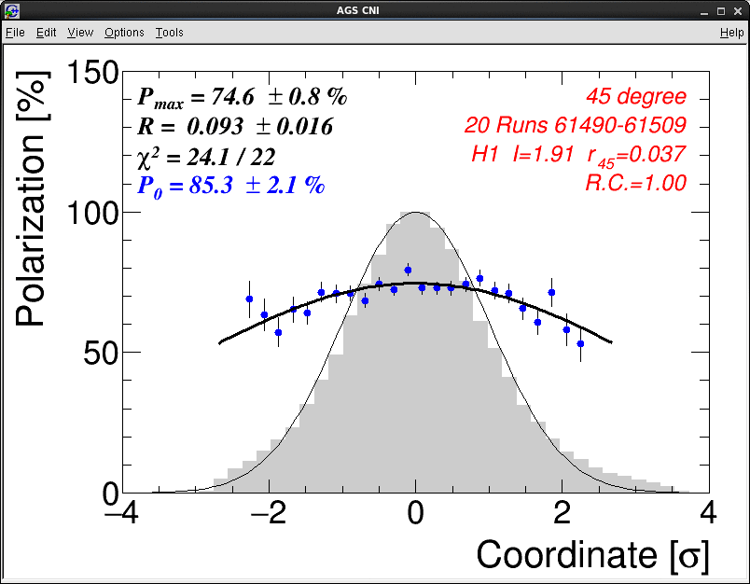
AGS Flattop Vertical Polarization Profile

Slide 17
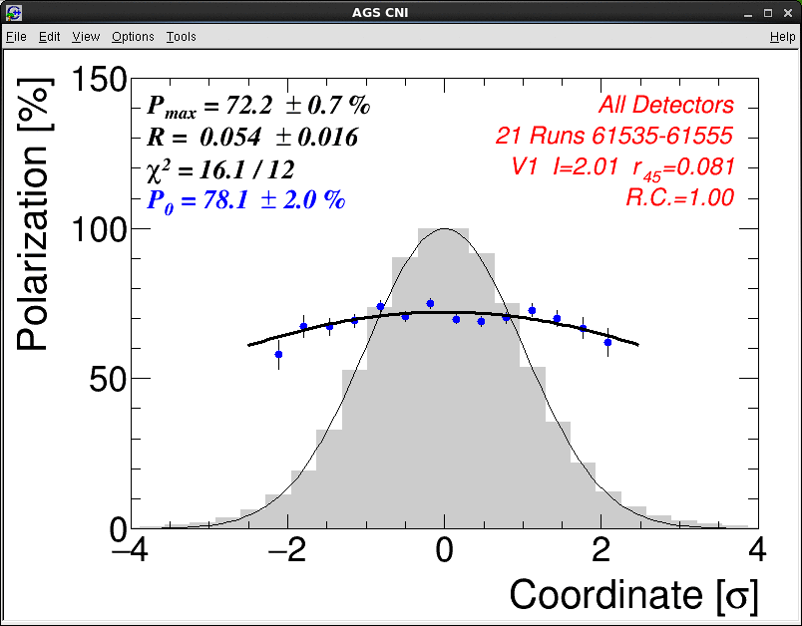
AGS Flattop Horizontal Polarization Profile

Slide 18
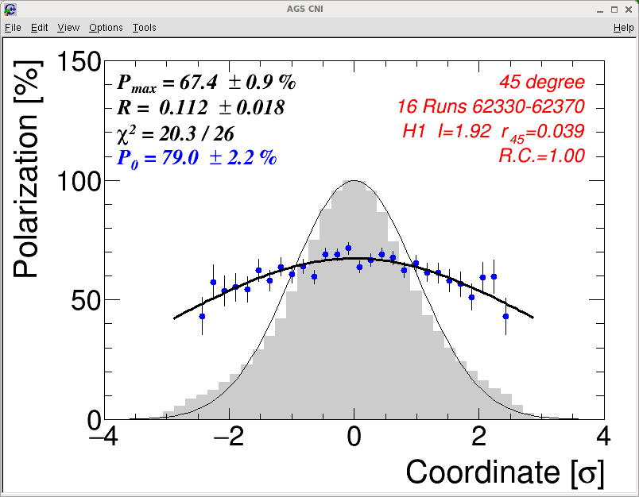
AGS Flattop Vertical Polarization Profile (2/2)

Slide 19
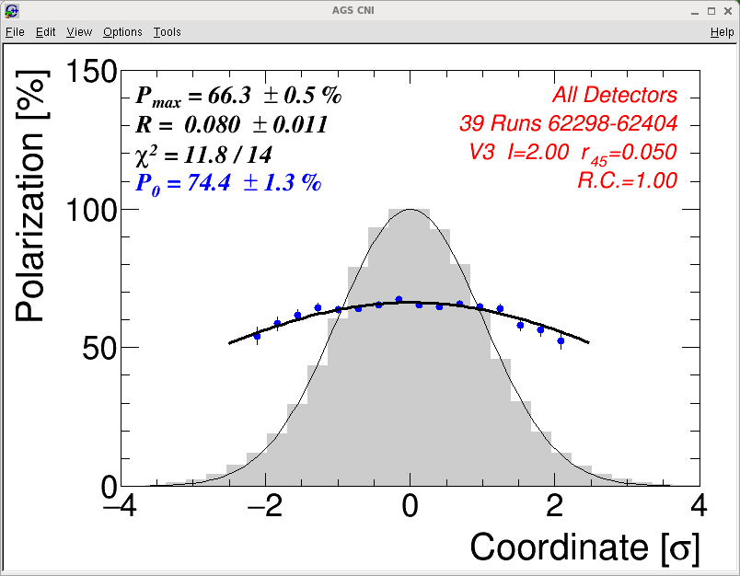
AGS Flattop Horizontal Polarization Profile (2/2)

Slide 20
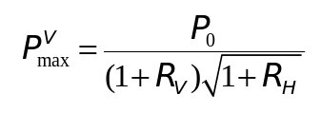
AGS Polarization Profile at Flattop
P₀ is the polarization with zero emittance or source polarization. P^{v}_{max} equivalent to fixed target measurement done with vertical target.
Date P^{V}_{max} R_{H} P^{H}_{max} R_{V} P_{0_mea} P_{200MeV}-> P₀
1/12 72.2 0.7 0.054 0.016 74.6 0.8 0.093 0.016 81.6 1.4 82.5 80.8 1/16 69.2 0.8 0.139 0.018 69.4 0.7 0.061 0.015 79.9 1.4 80.1 78.5
2/2 67.4 0.9 0.112 0.018 66.3 0.5 0.080 0.011 76.7 1.2 80.5 78.9 2/5 68.7 0.7 0.112 0.017 66.1 0.8 0.121 0.018 79.5 1.5 80.1 78.5
The measured and expected P₀ agreement is reasonable.
If the lower P₀ for 2/2 is due to the high tune at Booster injection (put in use since 1/29), as the results of larger emittance, the R values should be larger, but they are about the same.
For the same P₀, we expect larger P_{max} to be associated with smaller R value. We did not see that.
20
Haixin Huang

Slide 21
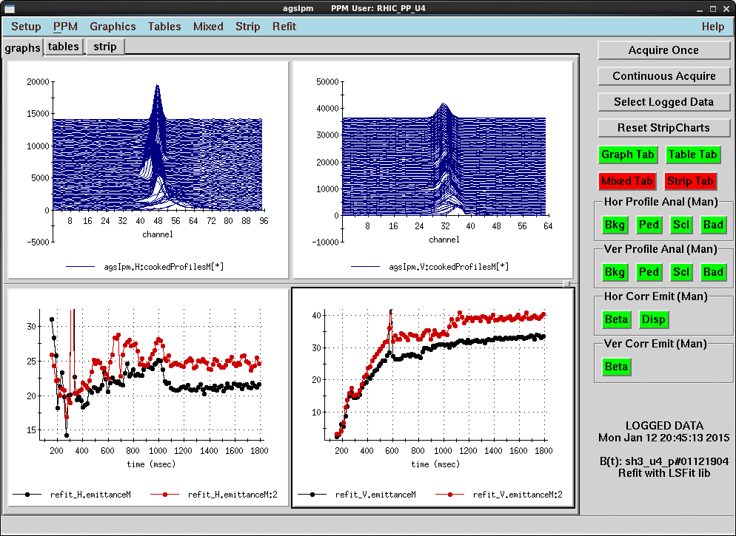
AGS Emittance Comparison
01/12/15 20:45:13 (black) vs.02/06/15 02:05:44 (red). Vertical difference started around 360ms, after transition.

Slide 22
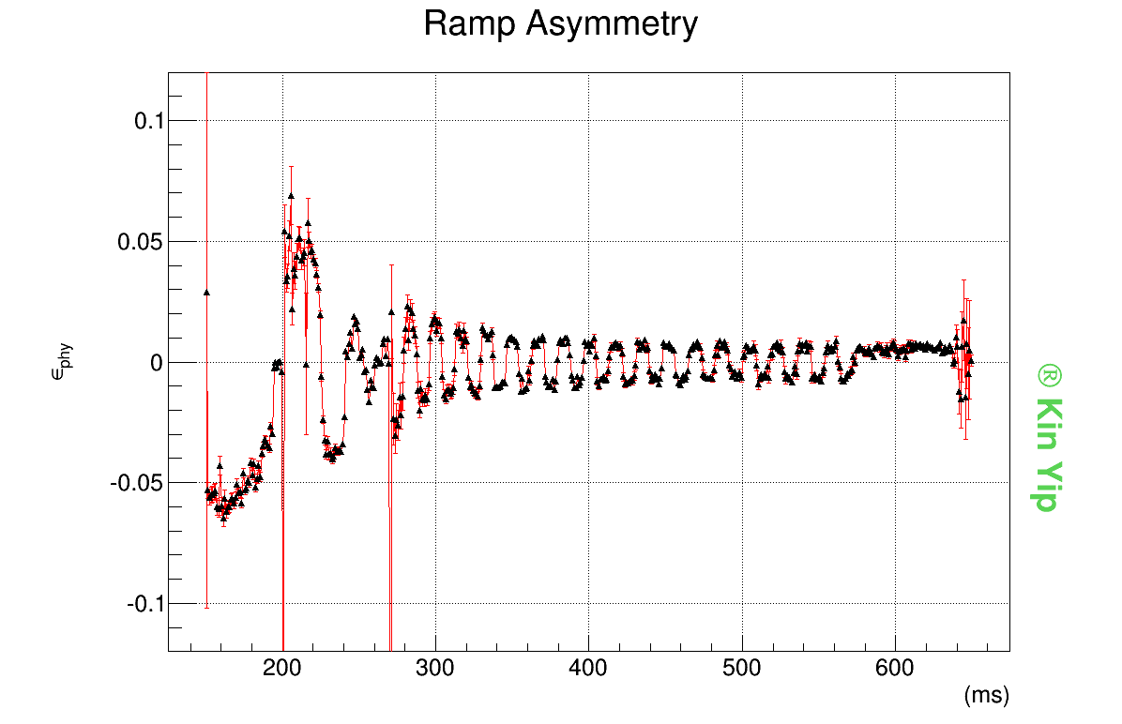
AGS Polarization Ramp Measurement (1/18)

Slide 23
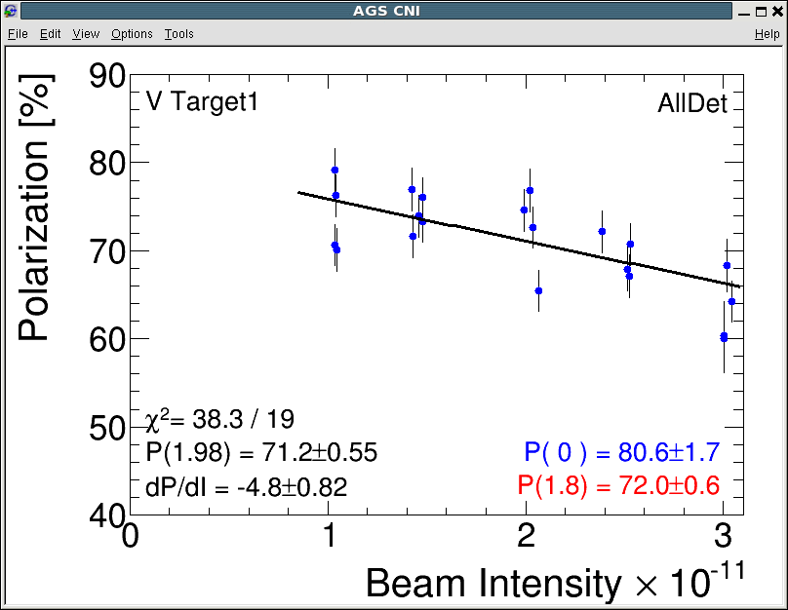
AGS Polarization Intensity Scan
We did not scan to 3*10¹¹ in run13. At 3*10¹¹, extrapolation from run13 (up to 2.2*10¹¹) is 62%.

Slide 24
Near Term Job List
Reduce the emittance in the AGS.
Jump quad timing setup.
Beta function measurement at IPM (vertical E15 has been studied so far) and eIPM.
eIPM setup. Currently, gas leak of horizontal eIPM is one problem. It can be fixed with parts arrived next week. Vertical one does not give reasonable sigma.
Setup various flattops for emittance and polarization measurements. Start from 40.5, then 31.5, 22.5, 13.5 and 7.5 if time allowed.
Booster injection tune setup study: compare the near half integer setting vs. 4.9 setting.

