Slide 1
AGS/Booster PP Status
Haixin Huang
April 5, 2013
RSC Meeting

Slide 2
Status
Emittance at AGS extraction is smaller now and comparable to last run. The Booster scraping was tuned to produce similar results as last run. AGS damper has been adjusted to reduce remittance at flattop.
We did not see much difference in the emittance and polarization in the AGS with various source temperatures but same output intensity. Currently fill RHIC with 90F.
A new IPM has been installed tomorrow in the AGS. This will provide another measurement for horizontal emittance.
We have done JQ on/off ramp measurements and polarization profile measurements.
We tested h=2 in the Booster (two 10¹¹ bunches). The AAGS extraction polarization of 10¹¹ bunch is around 70%. However, bunch merge at flattop is not an easy job.

Slide 3
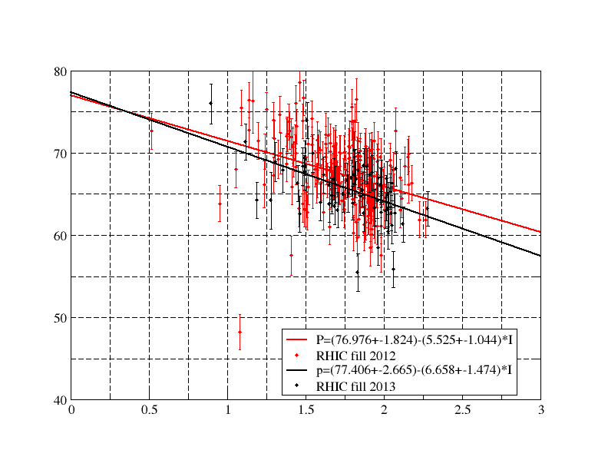
Run12-13 255GeV Run AGS Polarization

Slide 4
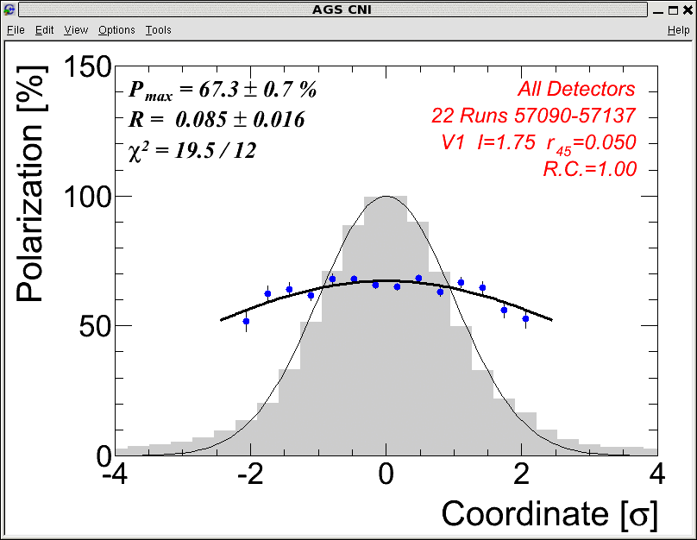
Horizontal Polarization Profile

Slide 5
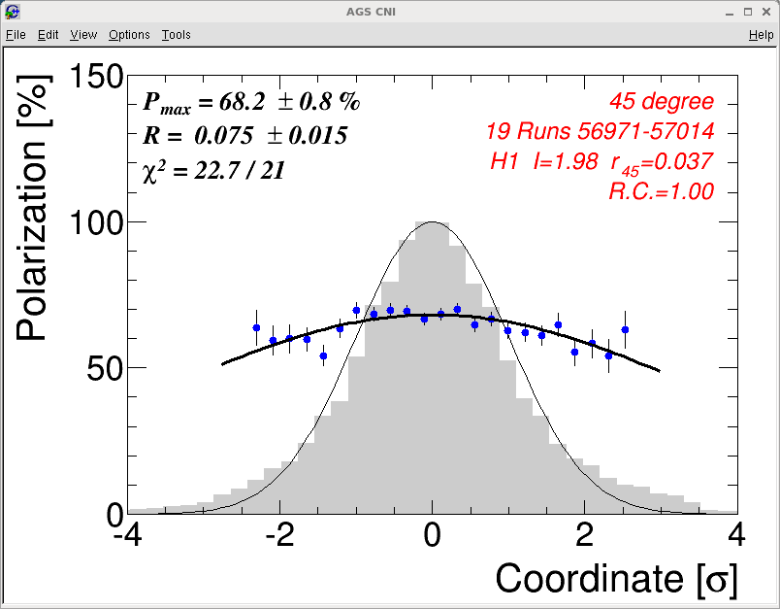
Vertical Polarization Profile

Slide 6
Plan for Near Future
Continue to reduce emittance in the AGS.
Over time, the radius has drifted a little bit, this may affect the jump quad efficiency. We will check the JQ timing again.
Do serious comparison between the Fast and slow ramps. Use the higher polarization one for RHIC.

