Slide 1
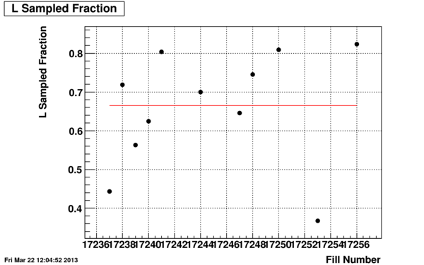
Update on the Current STAR Status
RSC mtg.
March 22, 2013
Bill Christie
Brief Status:
Up and running a suite of production physics triggers
All W triggers, Inclusive Jet triggers, B &E EMC HT Triggers
L0 Di-Jet Triggers are being checked, and plan is to try and elevate to Physics Trigger IDs by this evening.
MTD (Muon system) trigger firmware still to come.
FMS Commissioning still in progress.
Early Days. Will be working on our efficiency to Sample the delivered luminosity.
Plot includes both detector “uptime” and system “deadtime”, hence value plotted in L__{samp}/L__{del}

Slide 2
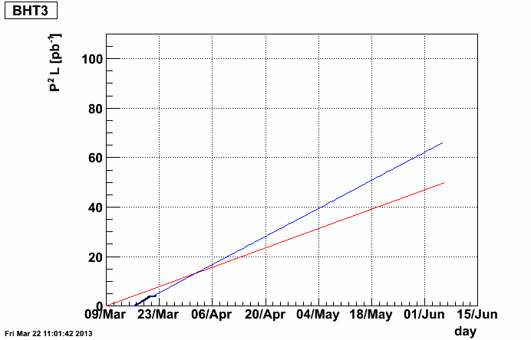
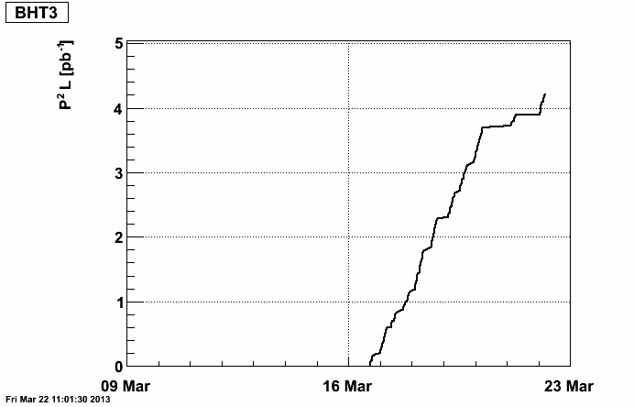
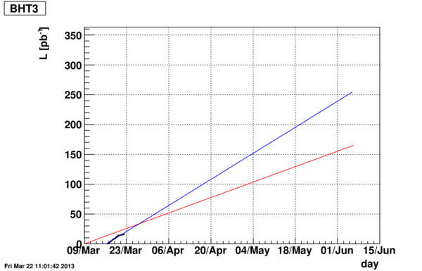
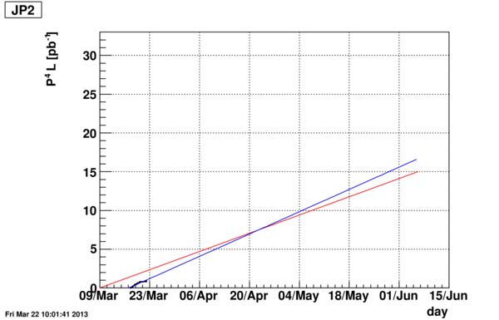
Some Projection plots current as of noon today
With Projection
Base for BEMC W trigger
Without Projection
Inclusive Jet trigger
Part of double spin program
Integrated Luminosity the last few days is low. Better Projections hopefully by Monday.

