Slide 1
AGS/Booster PP Setup Status
Haixin Huang
March 22, 2013
RSC Meeting

Slide 2
What is Different This Year?
We have a new source which has stronger polarization dependence on intensity. As the result, we are scraping less in the Booster to reach same intensity in the AGS. We tested (3 times) higher Booster input with stronger scraping but did not result higher polarization.
We use a faster round up magnet cycle in the AGS, which alomost equivalent to extraction-on-the-fly. But, AGS polarization is around 65% with 2*10^11 intensity. We have set up AGS user1 with the slower ramp and will do serious comparison between the two states. Right now, it seems that we don’t get as high polarization as the slower ramp, by about 2 percent.
The emittance seems larger at AGS extraction compared to last year. We also use less Booster input intensity this year as we have a new source.

Slide 3
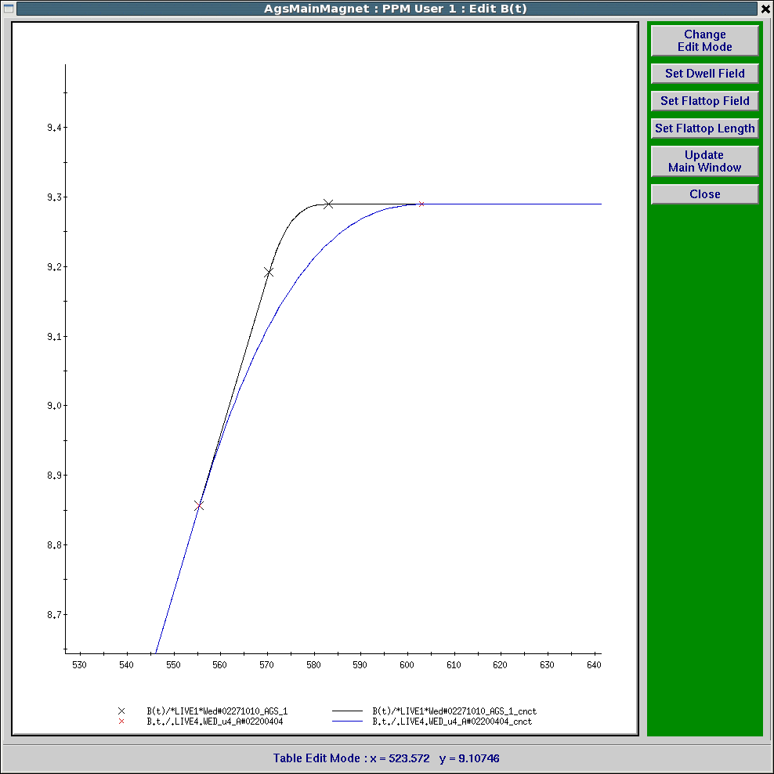
Faster Ramp Near the End

Slide 4
How Well Is AGS Running This Year?
RHIC polarization at injection for run12:100GeV as 59.2%; 255GeV as55.6%. This Run: 55.0+-0.2% for yellow1 and 54.7+-0.3% for blue1.
AGS polarization for RHIC fill in run12: 67.6%. This run: 66.1%. These are vertical fixed target measurements. Taking into account horizontal polarization profiles, this should convert to about 63% for RHIC comparison.
From the intensity scan shown earlier, there is not much difference so far from last year.

Slide 5
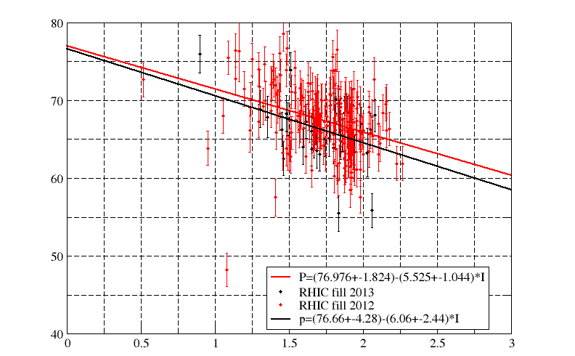
Run12-13 255GeV Run AGS Polarization

Slide 6
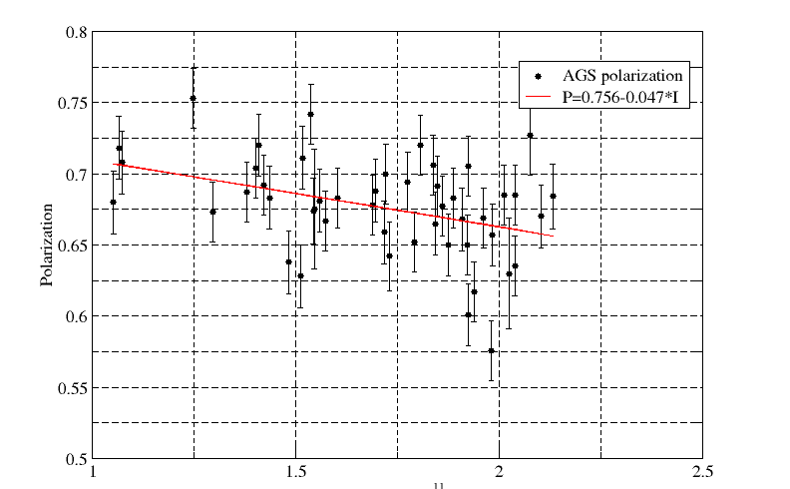
Run12 255GeV Run AGS Polarization

Slide 7
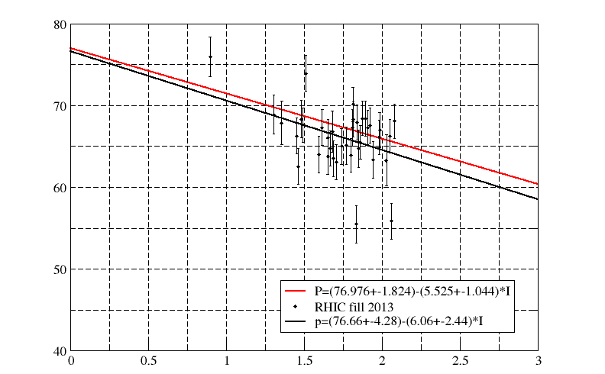
Run13 255GeV Run AGS Polarization

Slide 8
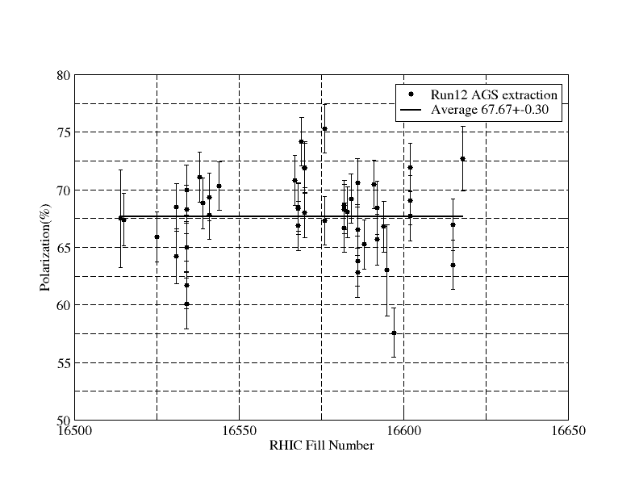
Polarization at AGS Extraction for Run12

Slide 9
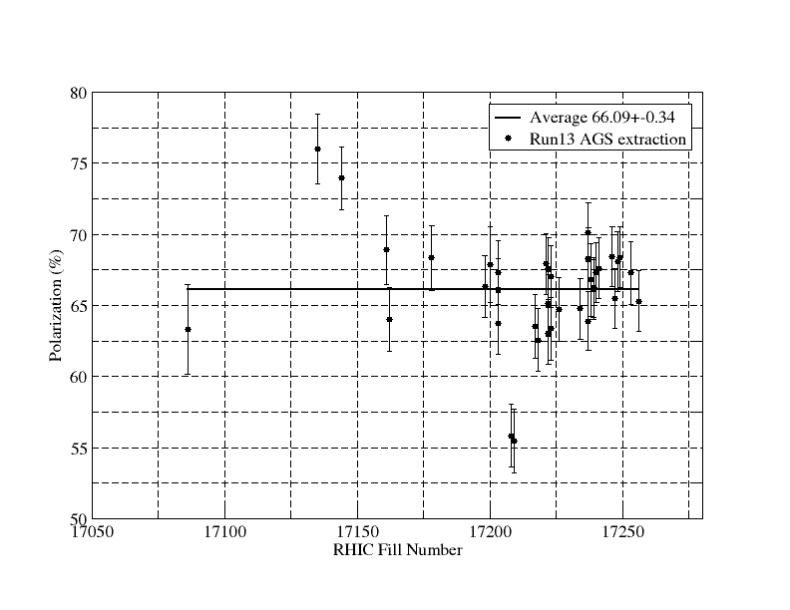
Polarization at AGS Extraction for Run13

Slide 10
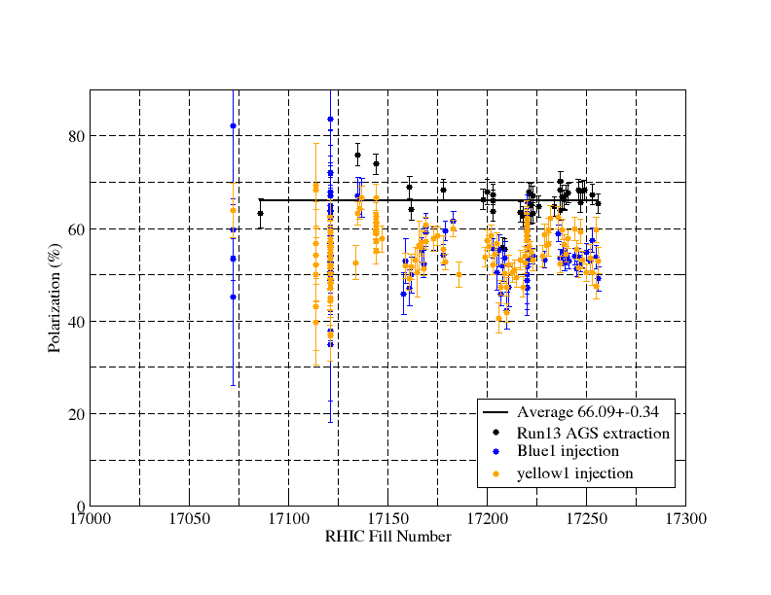
Polarization at AGS Extraction and RHIC Injection
Blue and yellow are offline data and store scale factor is used. Both averages are close to 55%.

Slide 11
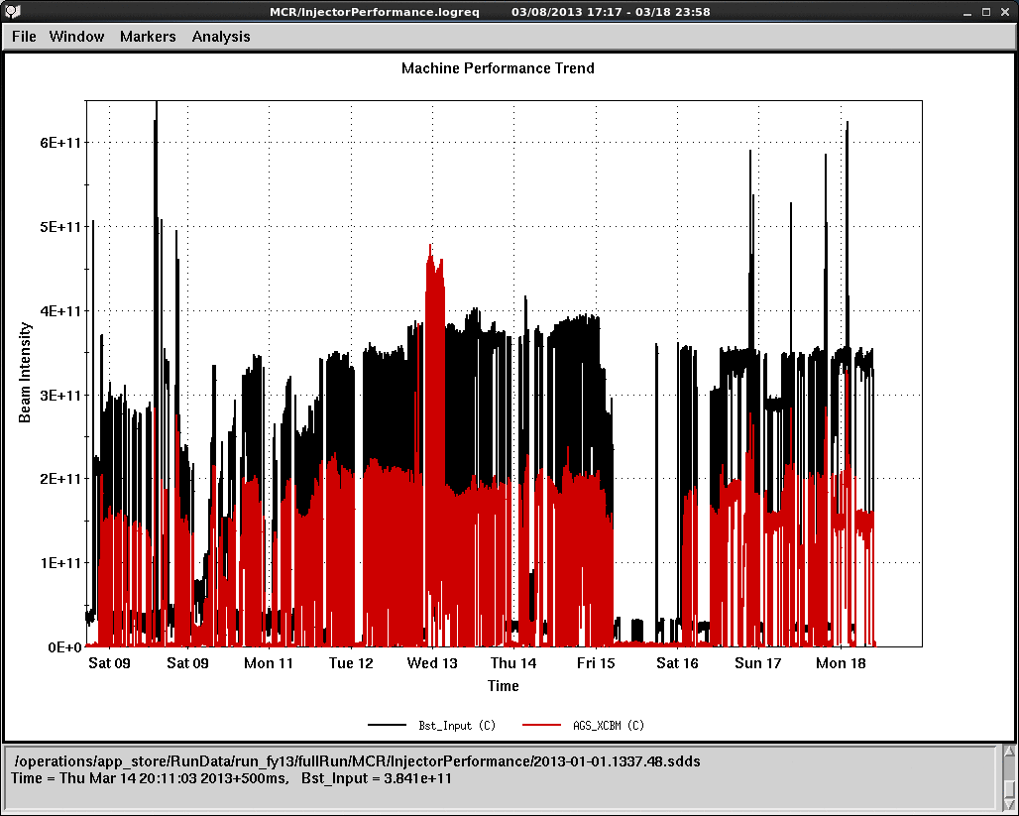
Run13 Booster Scraping

Slide 12
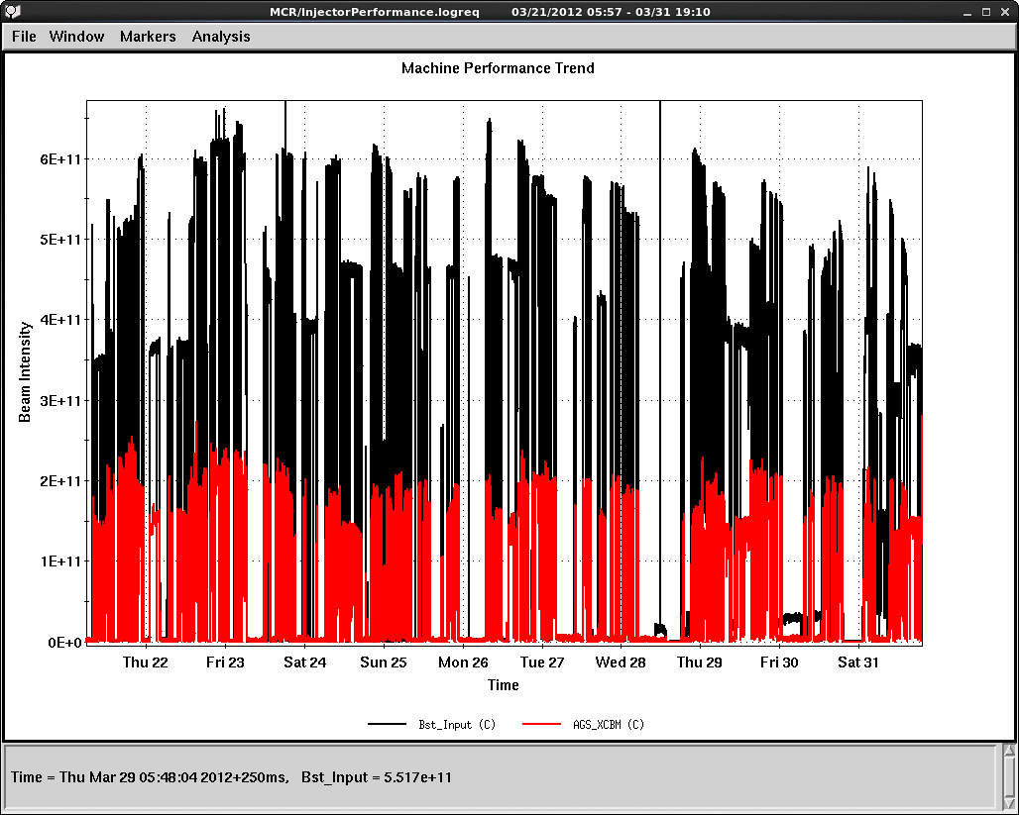
Run12 Booster Scraping

Slide 13
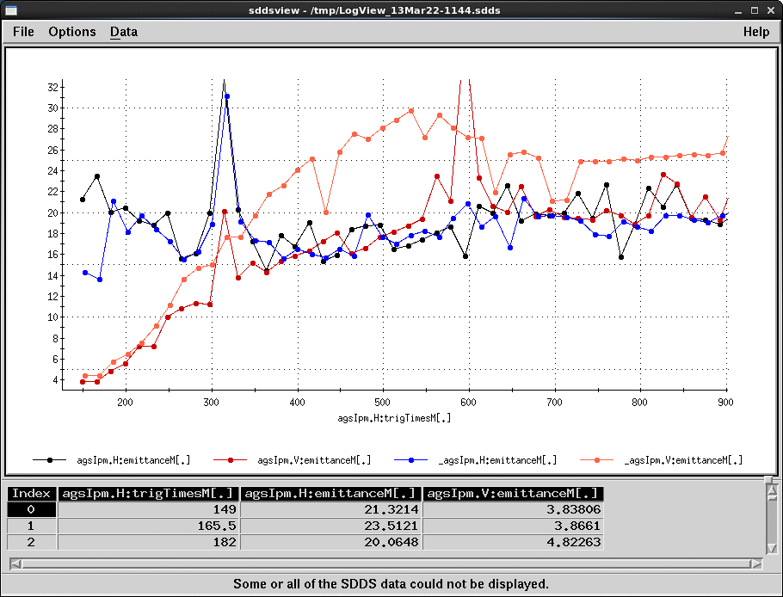
Emittance on the Ramp (12 vs. 13)
Black: H, run12
Blue: H, run12
Red: V, run13
Pink:V, run13
Intensity was 2*10^11. Beta function is not right at injection; there is space charge effect on the ramp. So use the numbers in relative sense. Vertical growth seems more this year.

Slide 14
Plan for Near Future
Find ways to reduce emittance in the AGS.
Do serious comparison between the two states. Use the higher polarization one for RHIC.

