Slide 1
PHENIX Plan for Run13
Kieran Boyle

Slide 2
Outline
Run 13: Who’s who
Primary physics goals
  W->mu
  W->e
  A_{LL} of forward clusters
Readiness
  Muon Trigger
  RPC
  FVTX
Issues
  Spin/bunch pattern
  Relative luminosity
  Local Polarimetry
  Vernier Scans

Slide 3

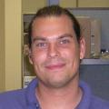
Who’s who in Run13
Run Coordinator: Hubert van Hecke (LANL)
Spin Coordinator: Ralf Seidl (RIKEN)

Slide 4
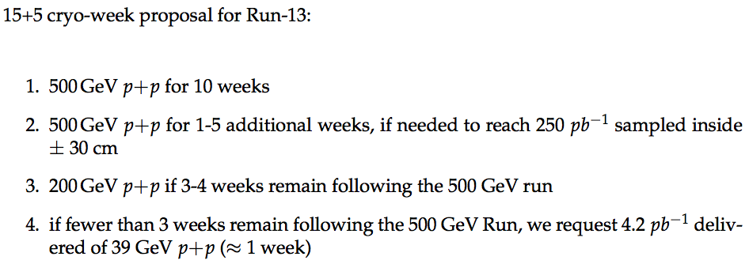
Physics goals
PHENIX BUP request

Slide 5
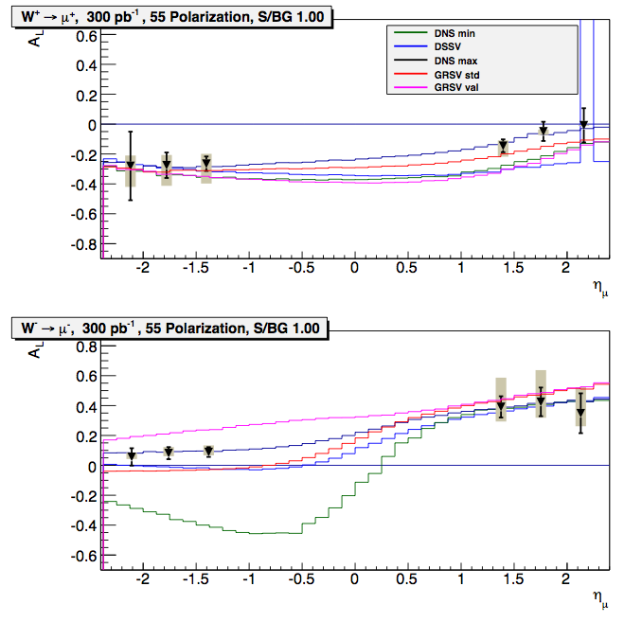
W→mu
Plot shows expectations for full luminosity expected for W→mu program
S/B=1, which is achievable has been demostrated
Additional understanding of background from VTX will help us reduce both the S/B and its systematic uncertainty.

Slide 6
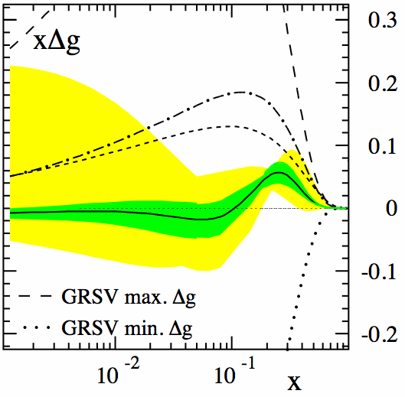
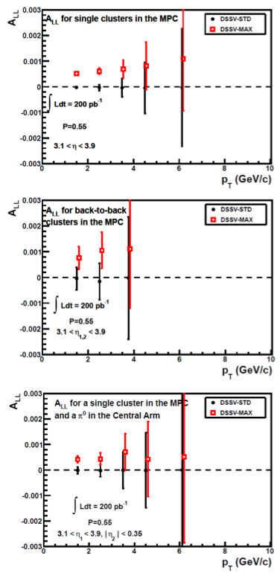
A_{LL}
Will continue A_{LL} measurements in central arm
With new electronics installed before Run12, expect significant statistics for forward MPC cluster, which samples low x gluon distribution
A_{LL} measurements will require small Relative Luminosity systematic uncertainty.

Slide 7
Detector readiness

Slide 8
MuTrig-FEE Readiness
Acceptance
Fixed 6 Masked MuTrig-FEE boards during Shutdown period. Now all boards are functioning and there is no dead region.
SG1 Rejection Power
For more rejection power:
  Completed Recap (minor effect on RP)
  Fine tuning threshold
    Update thresholds
    Higher thresholds to noisy octants
Run11
Run12

Slide 9
Noise Hit Rates
There are a few octants in North Station-3 had been noisier by factor of 2~4 thru Run12.
By applying higher thresholds to these octants, the rejection power is expected to be improved by factor of 1.5 to 2.
Trade off
Noise Hit Rates [Hz]
A few % loss in trigger efficiencies in these octants
Particularly Noisy Octants
Run12 Run number

Slide 10
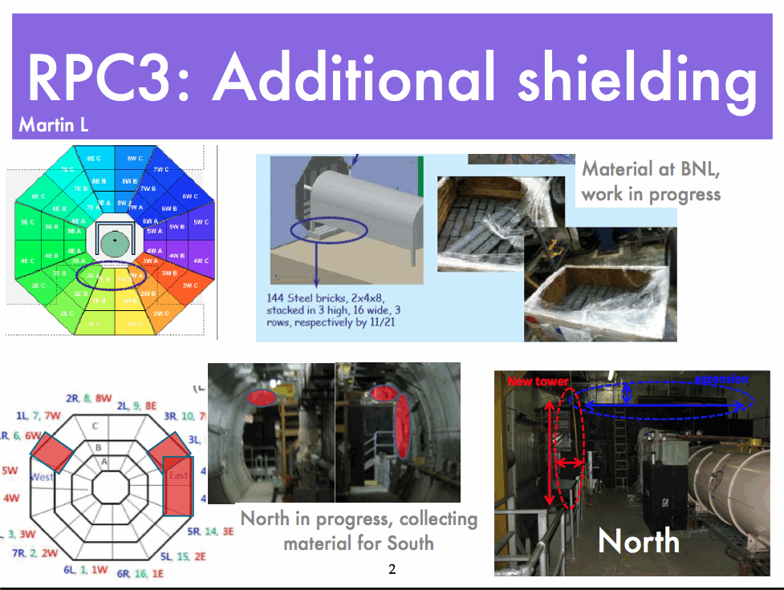
RPC
RPC1 is ready and fully in trigger.

Slide 11
FVTX
Needed for background rejection and determination for W→mu
Successfully commissioned in Run12 p+p 200 GeV
  Was in data taking for 500 GeV p+p and HI portion of run
VTX cooling leak
  East arm was removed and is in Chemistry
  VTX is removed, and East FVTX be installed in IR next week
  West VTX Barrel is still in IR; will likely not be powered during Run13
  Expect to be on schedule for Feb 11 cooldown.
  Will reduce amount of time for cosmics running
    Plan to try to get these during run when possible
New FPGA code allows for each wedge to act as luminosity monitor

Slide 12
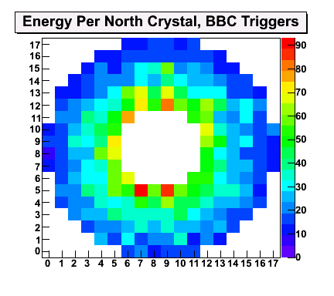
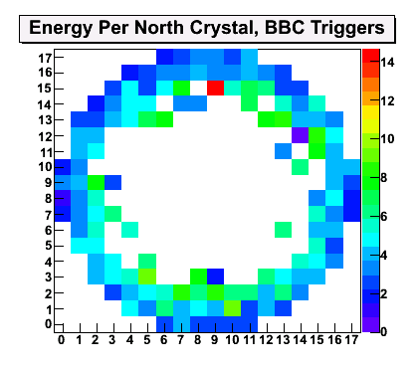
MPC
Severe Damage last year during HI running when abort kicker prefire occured
Detector repaired over shutdown, but were not able to ensure against such beam dumps in future
Angelika is looking if it is possible to use collimators to prevent such damage, but seems unlikely
As this detector is very important for our A_{LL} measurements, a similar event would severly impact our physics output in Run13
Before
After

Slide 13
Detector readiness

Slide 14
Bunch/Spin Pattern
Two changes for Run13:
  To speed up time at injection, CAD wants to inject pairs of bunches with the same polarization direction
  Therefore, several possibilities:
    1 : + + - - + + - -
    3a: + + - - - - + + → s s s s o o o o
    3b: + - - + + - - + → s o s o s o s o
    3c: + + + + - - - - → s s o o s s o o
  3b does not work for PHENIX central arm ERT events, due to differing trigger circuits in even and odd crossings, as it does not allow for A_{LL} analysis in even and odd crossings separately
  To understand impact on Rel lumi, it would be good to try early in Run13 3a and 3c.
  As in previous years, we would like to cycle polarizations patterns each fill.
s = same helicity
o = opposite

Slide 15
Bunch Structure at IP8
Still unclear what bunch structure will be at IP8
Initially, expected that for e lense commisioning, needed abort gaps to align at IP10.
  Would mean ~10% lower luminosity for PHENIX
  Recently, told that as only blue beam will be commissioned, can have abort gaps aligned at IP8
  Would need a few additional bunches empty
    Question: What would the filled/empty bunch structure be at IP8
  It is useful to have a few empty-filled crossings for each beam as in previous years.
  Ralf will be in next week, and hopefully we can sit with Vahid then to clarify and settle this issue

Slide 16
Polarization Measurements
Will need to lower HV on RPCs
This works well if we do three pol. measurements during fill:
  1 before HV turned
  1 at midpoint of fill (with advanced notice so we can turn down to standby—~1-2 minutes)
  1 after end of fill declared

Slide 17
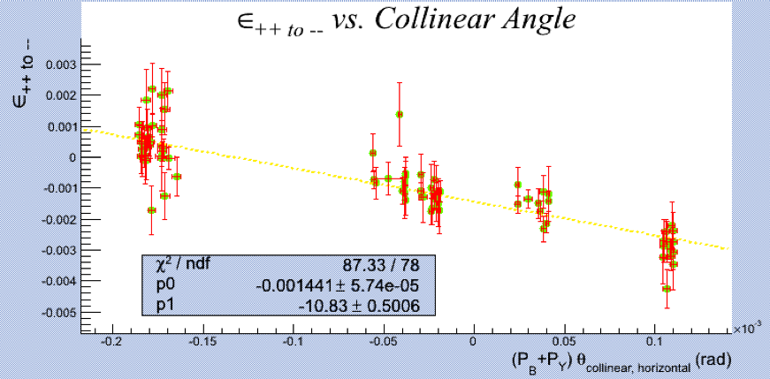
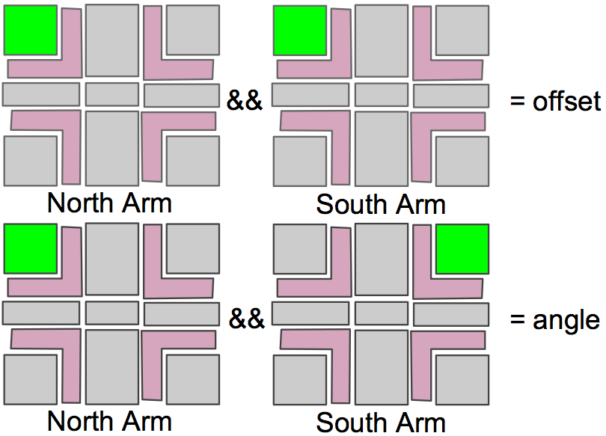
Relative Luminosity
Last year, performed angle scan to study source of false asymmetries
  Clear ++ vs. -- asymmetry seen when beams angled through IR
This year, passing SMD signals to STAR Scaler board to be able to fake angles and offsets in all fills
Additional luminosity monitors will be added:
  FVTX, using each wedge to count rates independently in FPGA
  RPC1 ring B in north and south for different η coverage
  ERT W and E low energy trigger for additional cross checks

Slide 18
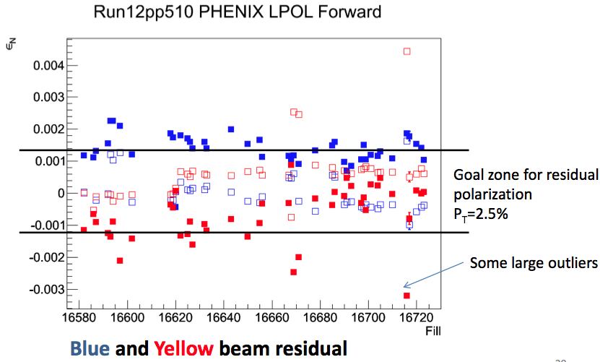
Local Polarimetry
Local Polarimetry
  Need to ensure that remaining transverse component is small
  Successful set up last year, with C. Gal at CAD during rotator commissioning for very quick feed back.
When changes to Snakes and/or rotators are done, Ralf and Hubert need to know ahead of time, so they can ensure there are no issues.

Slide 19
Vernier Scans
Want at least 3 good scans
As in past years, these work best when planned in advance so experts can be at both PHENIX and CAD to ensure smooth operations
  Communication is key

Slide 20
Conclusions
Expect to make a lot of progress towards our ultimate W goal in Run13
Detector will be ready for Feb 11 cool down
  W trigger is ready for Run13
  FVTX will be installed fully for Run13
  MPC repaired after serious damage from beam loss event
Need good communication to ensure best quality data is taken

Slide 21
Backups

Slide 22
