Slide 1
AGS/Booster PP Setup Plan
Jan. 11, 2013
RSC Meeting
Haixin Huang

Slide 2
Running Scenario
AGS pp setup starts on Jan. 22.
The Siemens generator will be ready in the 1st week of February (2/3 as deliver date and several days to setup).
The AGS cold snake will be available after Jan. 26.
Use the 1st week for Booster, AGS LLRF and Westinghouse setup.
Given that we have two weeks with Westinghouse, we will plan to run jump quads with Westinghouse for 5 sec. duty cycle.
Higher source intensity (a factor 2).
Setup Booster with h=2 and AGS h=8=>smaller longitudinal emittance and faster RHIC filling (two bunches).
We will flip spin at Gγ=3 in the Booster.
Faster duty cycle: 3.3 seconds (down from 4 seconds). We can shave off the AGS flattop length by 200ms without affecting polarization measurement time.
New jump quad timing (with correction of Gγ vs. spin tune).

Slide 3
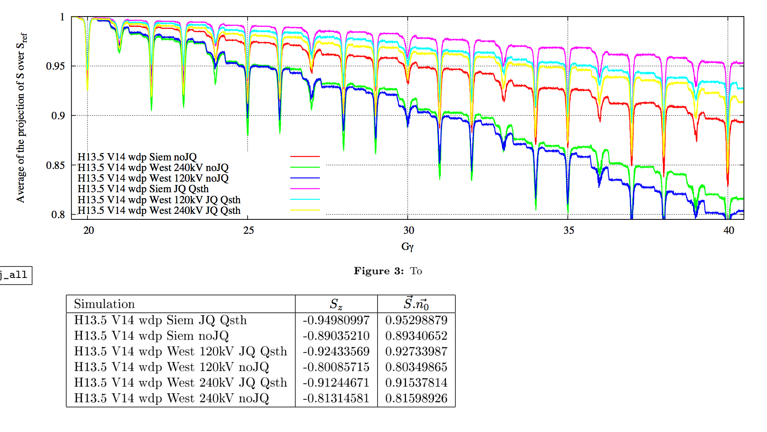
Spin Simulation done with ZGOUBI
Expected ratio of Westinghouse vs. Siemens is 0.927/0.953=0.973, the factor of extra polarization loss due to slower ramp rate.
(simulation done by Yann)

Slide 4
Jump Quads with Westinghouse
Ramp rate is slower but the depolarization effect would be more visible between JQ on and off.
The purposes of these exercise are: 1. to see how well we can overcome horizontal resonances with slower ramp rate; 2. to demonstrate the JQ effect for academic reason.
Take new betatron tune measurements and develop a new JQ timing function for Westinghouse.
Simple JQ on/off comparison.
JQ timing scan with Westinghouse for the whole ramp; last three resonances.
Polarization profiles (both H &V) with JQ on/off.
We will take ramp polarization measurements with Westinghouse and JQ on/off, if time allowed.

Slide 5
Booster Setup and AGS Injection(Before Siemens)
Setup Booster first with h=1 and put beam into AGS with Westinghouse generator. Check beam emittances in the BtA and AGS injection (including bunch length).
Setup Booster with h=2. Check beam emittances in the BtA and AGS injection.
To make switch between h=1 and 2 easy, we want to have two Booster users for pp.
We will flip spin at Gγ=3 in the Booster. Harmonic scan at Gγ=3 and 4 will be done to make sure full spin flips in both energies.
With additional spin flip, we have odd spin flips in the injector chain (AGS and the Booster). The source spin sign has to change its timing sequence.
Measure beta functions at IPM with cold snake on/off.

Slide 6
New Tests for This Run
Test radial jump for the last horizontal resonance.
Extraction-on-the-fly as combined with JQ on. But it will be hard to schedule the test if it has to be done after RHIC setup done with regular extraction from AGS. The switch is less than a shift.
If we can’t get time for RHIC, we can test EOTF in the AGS by dumping beam in W dump and using the ramp measurements as proof it will benefit polarization.
Ramp measurements with flattop at Gγ=45.5 and 48.5(Siemens, JQ off). This is a missing piece to confirm that extraction-on-the-fly will benefit polarization. It probably requires a couple of overnight shifts.
To see the jump quads on/off effect more decisively, we will run stronger partial snake on a different AGS user (not for regular RHIC injection). The cold snake will be tested at higher current (282A).

Slide 7
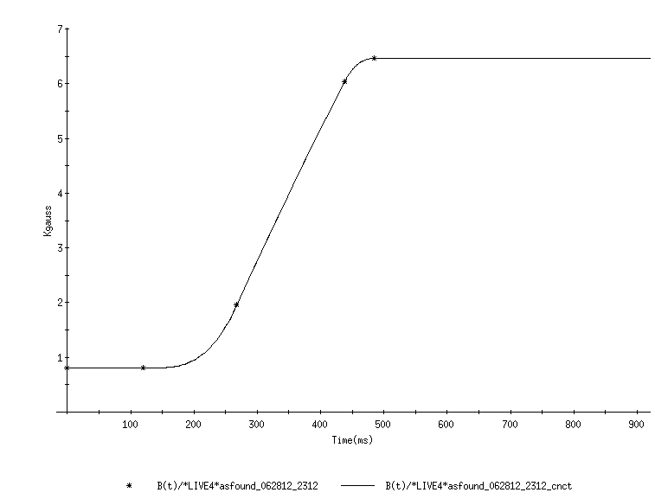
Extraction on the Fly
Principle: Don’t roll over and extract during the acceleration ramp
Gamma(t) proposed
Extract here ‘on the fly’
Gamma(t) now
Extraction now

Slide 8
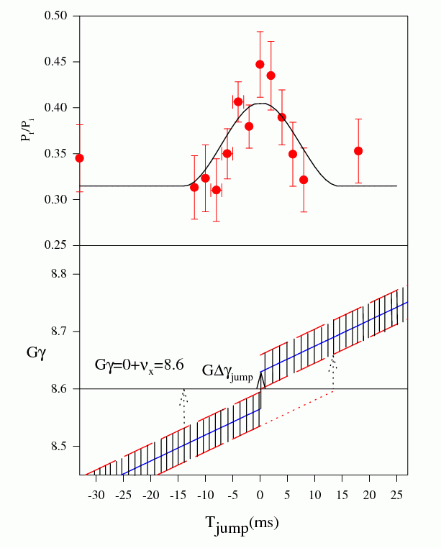
Polarization Gain with Radial Jump in 1996
It was done with solenoidal partial snake in the AGS, quite strong coupling.
5% of regular ramp rate to induce full spin flip at 0+ν_{y}.
The extremely slow ramp rate magnified the the polarization loss at 0+ν_{x}. Radial jump at 0+ν_{x} showed benefit. Solid line is the prediction based on the momentum spread and the ramp rate.
It probably is suitable for the weak resonances such as the horizontal resonances. However, it has the same limitation as jump quad scheme: not all particles will benefit from the jump due to the momentum spread.

Slide 9
Summary
The AGS Siemens generator repair and cold snake delay complicate the AGS pp setup.
We will use the waiting time for Booster setup, AGS LLRF setup and Westinghouse test (how much polarization we can have with Westinghouse generator).
H=2 will be used in the Booster in the hope to reduce longitudinal emittance and to remove the intensity limit at rebucketing.
Faster AGS cycle (4s->3.3s) will be used to speed up RHIC fill.
Two new schemes to mitigate polarization loss at the end of AGS ramp will be tested: Radial jump and extraction-on-the-fly.
It will be a busy year.

