Slide 1
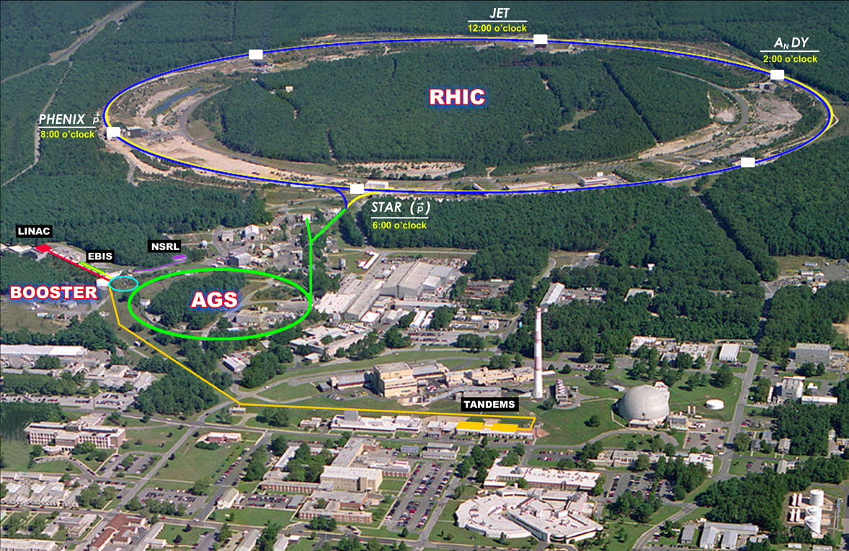
Polarized proton projections Wolfram Fischer
11 May 2012
RHIC Spin Collaboration Meeting BNL
Notes:
9 August 2011, 14:30, 25+5min

Slide 2
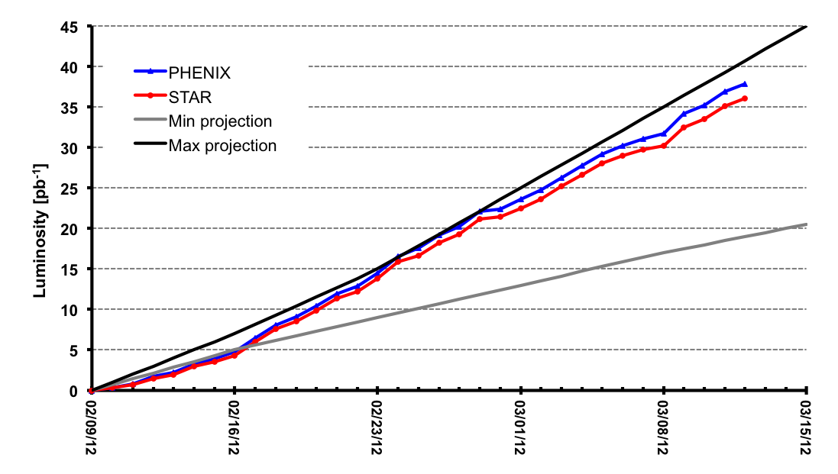
Run-12 100 GeV polarized protons
Polarization (H-jet, i.e. intensity and time averaged)
Blue 56g61.8% Yellow 57g56.6% (2009g2012)

Slide 3
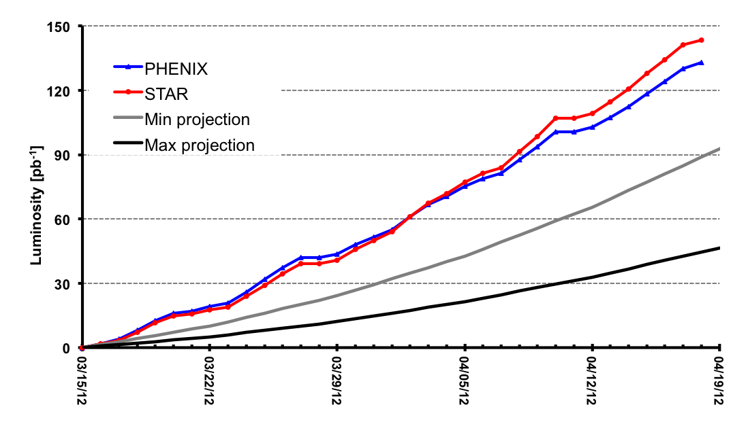
Run-12 255 GeV polarized protons
Polarization (H-jet, i.e. intensity and time averaged)
Blue 48g50.3% Yellow 48g53.5% (2011g2012)

Slide 4
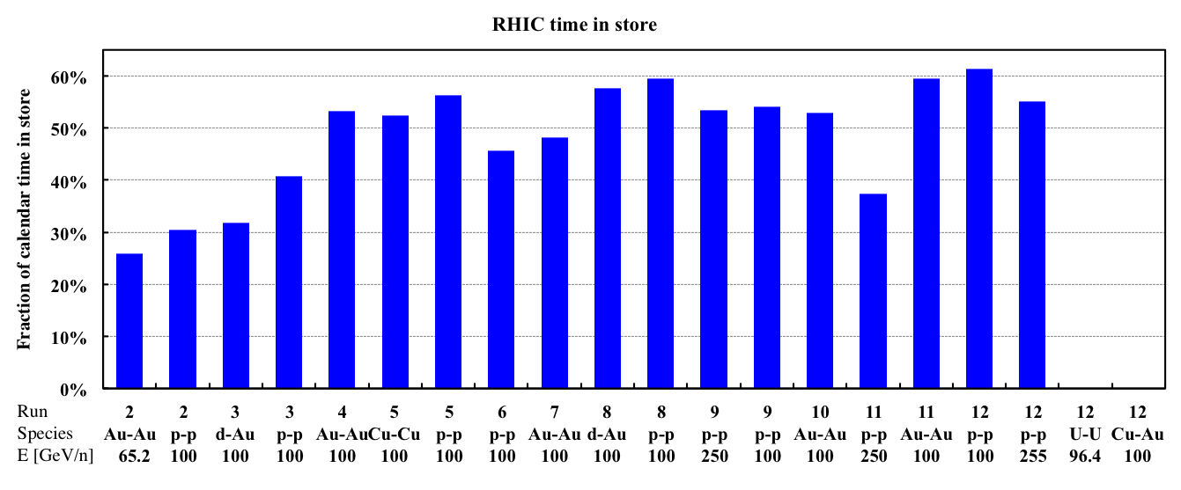
RHIC time-in-store
Low failure rates of all systems, even at raised energy.

Slide 5
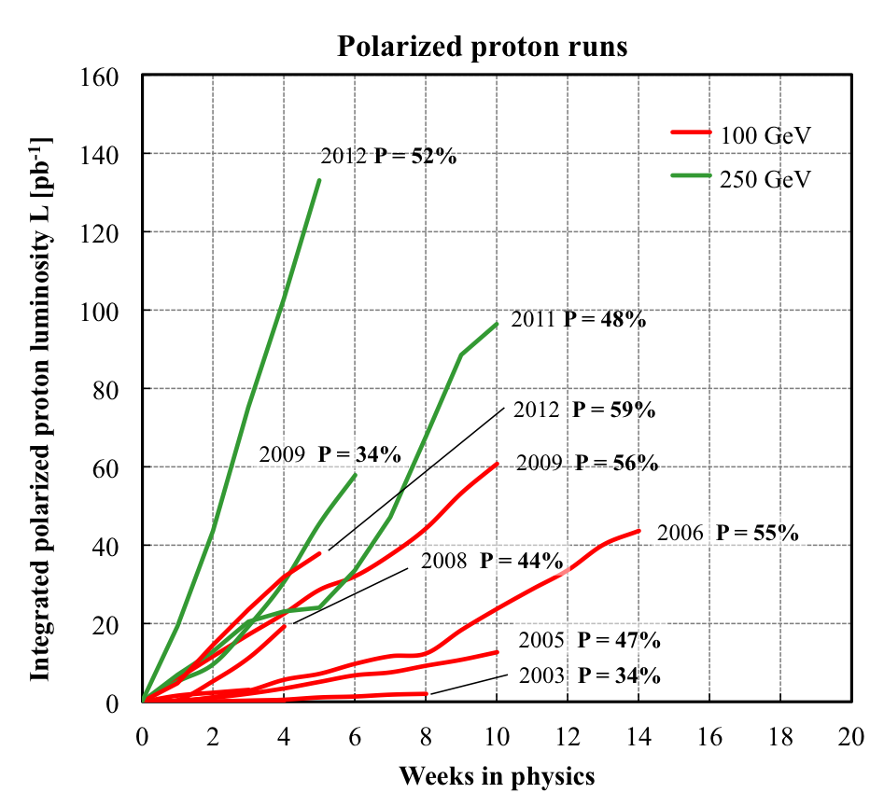
RHIC polarized protons – luminosity and polarization
At 255 GeV in 2012
L_{avg} = 105x10³⁰cm⁻²s⁻¹
P_{avg} = 52%
L_{avg} +15% relative to 2011
P_{avg} +8% relative to 2011
FOM = LP² (single spin experiments)
FOM = LP⁴ (double spin experiments)

Slide 6
New in Run-12 Run Coordinator: V. Schoeffer
100 GeV
2 new Landau cavities installed
Yellow primary collimator inspected (no sign of damage – concern for high intensity)
AGS horizontal alignment
9 MHz system upgraded
AGS horizontal tune jump system timing improved
Operation from new MCR
Down ramps do not stop at park, park to injection 2x faster
255 GeV
Increased store energy
Snake ramps between 100 GeV and 255 GeV
Scans of snake spin rotation axis angle and rotation angle
Test of longitudinal injection damper, Landau phase error compensation
Test of short AGS cycle
Test of Blue vertical phase shifter power supply (for electron lenses)

Slide 7
Polarization in Run-12
Difference between Blue and Yellow not understood (100 GeV P_{B} > P_{Y}, 255 GeV P_{B <} P_{Y})
Expect only small further gains in ramp transmission
Polarization lifetime at store cannot be easily eliminated
Further P gains likely to come from source upgrade: larger initial polarization, and ability to reduce emittance

Slide 8
Preparation for Run-13 pp
OPPIS upgrade
Electron lens installation
Also requires a new lattice (phase advance between IP8 and IP10 – phase shifters)
Polarimeter improvement
RF properties of pC polarimeter
Targets
RF
9 MHz modification
Longitudinal injection damping
Landau phase compensation

Slide 9
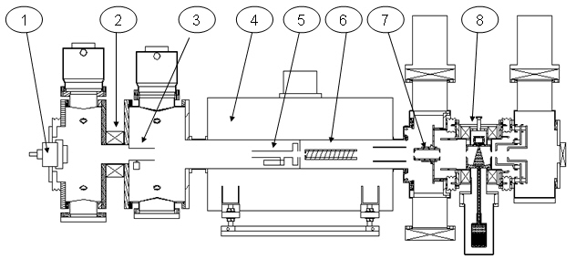
Optically Pumped Polarized H– source (OPPIS) – A. Zelenski
Upgraded OPPIS (2013)
Goals: 1. H⁻ beam current increase to 10mA (order of magnitude) 2. Polarization to 85-90% (~5% increase)
Upgrade components:
1. Atomic hydrogen injector (collaboration with BINP Novosibirsk)
2. Superconducting solenoid (3 T)
3. Beam diagnostics and polarimetry
Source Neutralizer Ionizer Rb-cell Sona Na-jet (H⁺) (H⁰) (H⁺) (H⁰) (H⁻)
sc solenoid
10x intensity increase was demonstrated in a pulsed operation by using a very high-brightness Fast Atomic Beam Source instead of the ECR source

Slide 10
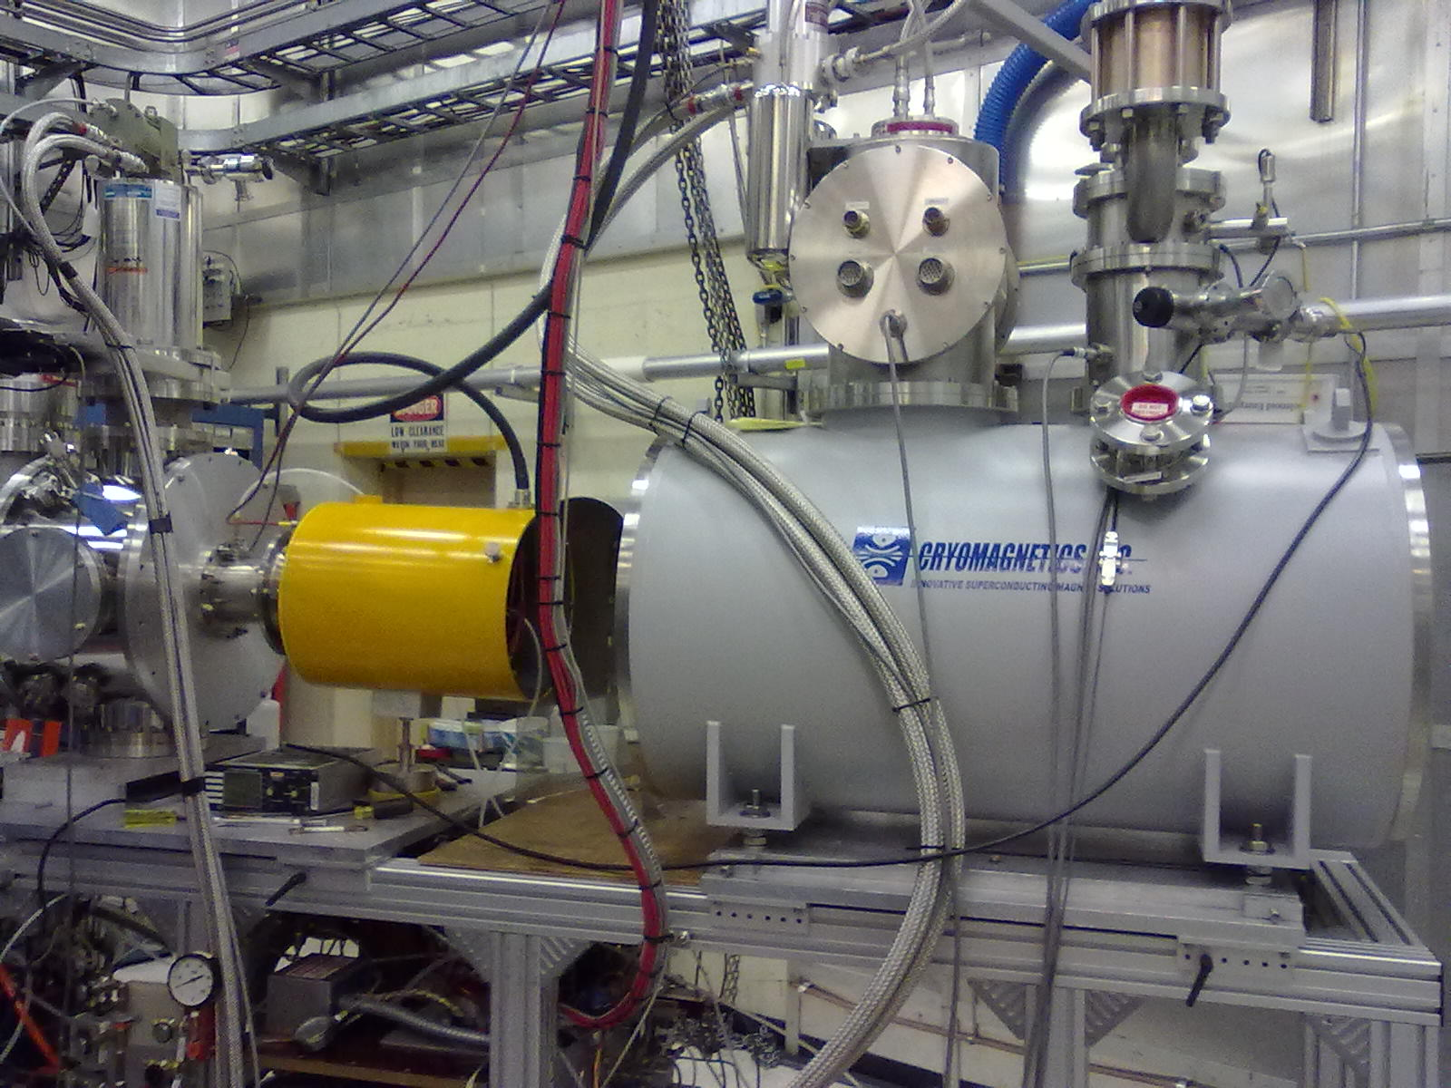
OPPIS location 05/10/12
New Atomic Beam Source (ABS)
New superconducting solenoid

Slide 11
RHIC electron lenses Motivation
Bunch intensity in 2012 polarized proton physics store
Goal:
Compensate for 1 of 2 beam-beam interactions with electron lenses
Then increase bunch intensity and luminosity (up to 2×)
Need with new polarized proton source − under construction, A. Zelenski
bunches with 1 collision
bunches with 2 collisions

Slide 12
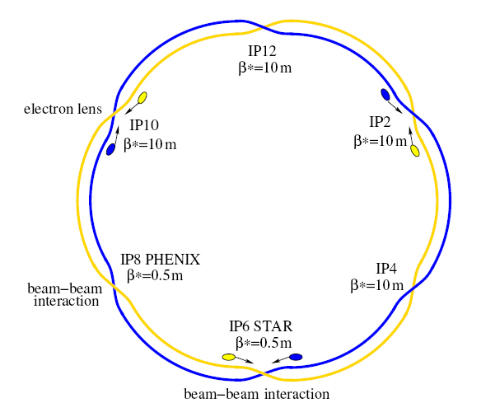
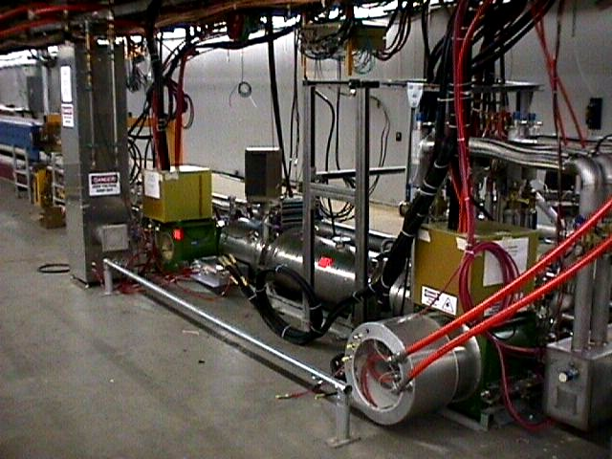
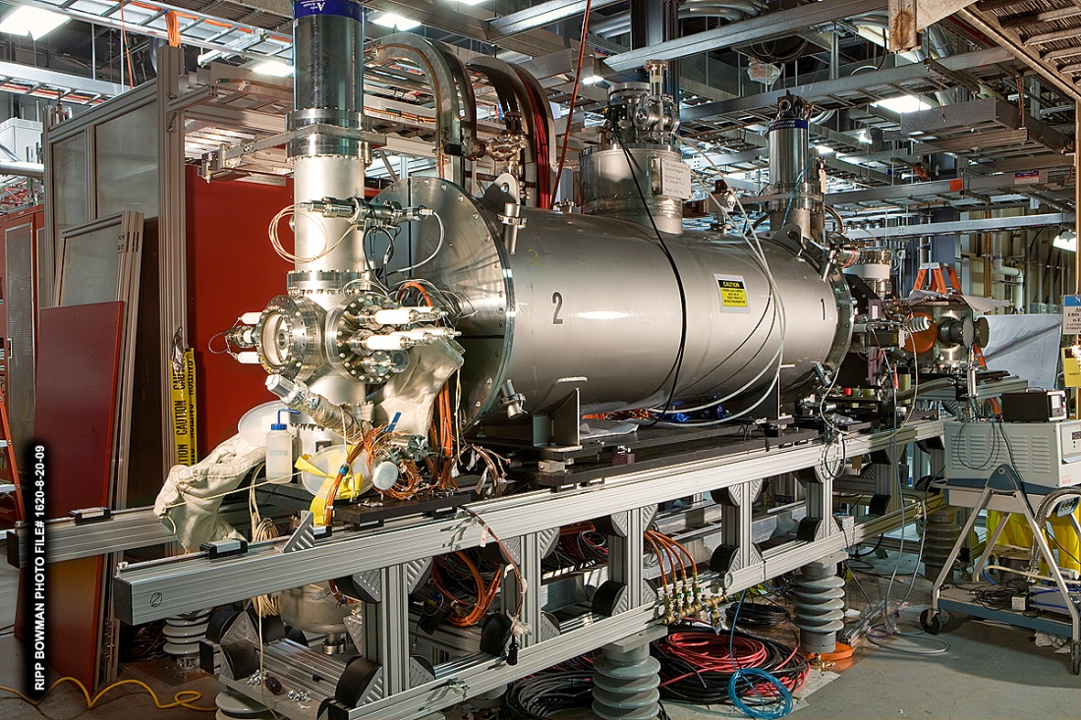
RHIC electron lenses Compensation overview
Basic idea: In addition to 2 beam-beam collisions with positively charged beam have another collision with a negatively charged beam with the same amplitude dependence – and electron lens.
Exact compensation for:
short bunches
Δψ_{x,y} = kπ between p-p and p-e collision
no nonlinearities between p-p and p-e
same amplitude dependent kick from p-p, p-e
only approximate realization possible
Deviations from ideal were extensively studied in simulations: Y. Luo et al. – accepted for publication PRST-AB
FNAL - TEL
Build on experience with Tevatron electron lenses V. Shiltsev, A. Burov, A. Valishev, G. Stancari, X.-L. Zhang, …
BNL Electron Beam Ion Source (EBIS) J. Alessi, E. Beebe, M. Okamura, A. Pikin, D. Raparia, …
BNL - EBIS

Slide 13
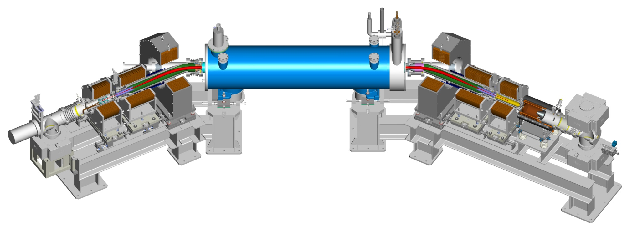
RHIC electron lenses Compensation overview
GS1 warm solenoid B = 0.8 T, I = 1200 A, P = 58 kW
SC main solenoid B = 6 T, I = 440 A + 16 more magnets
CSB = GSB
GS2 warm solenoid B = 0.5 T, I = 730 A, P = 25 kW
CS2 = GS2
GSB warm solenoid B = 0.3 T, I = 770 A, P = 45 kW
CS1 = GS1
p
p
GSX/Y
CSX/Y = GSX/Y
Electron gun Modes: DC, 100 Hz (setup), 80 kHz (1/turn)
V_{max} = 10 kV, I_{max} = 1.5 A, P = 2×10⁻⁶ AV^{-3/2}… Cathodes: LaB₆ and IrCe (from Budker), 4.1 mm radius, Gaussian profile (2.8 σ)
Electron collector ρ_{P} < 50 W/cm², T < 125 °C

Slide 14
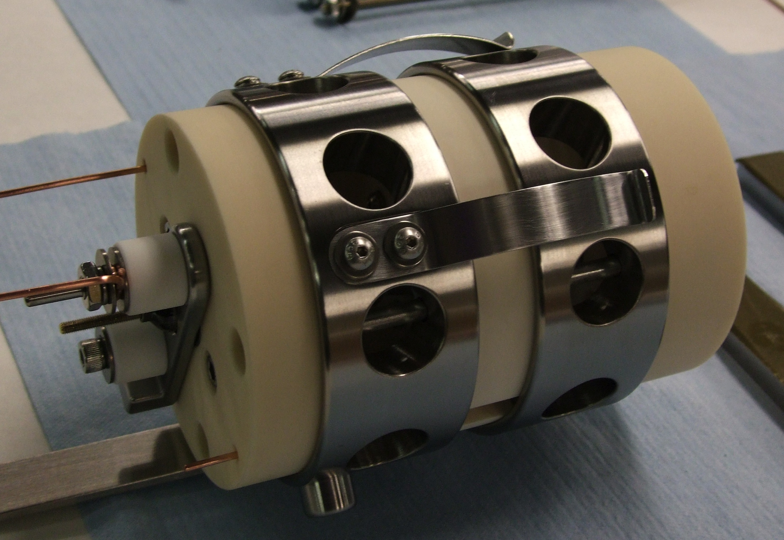
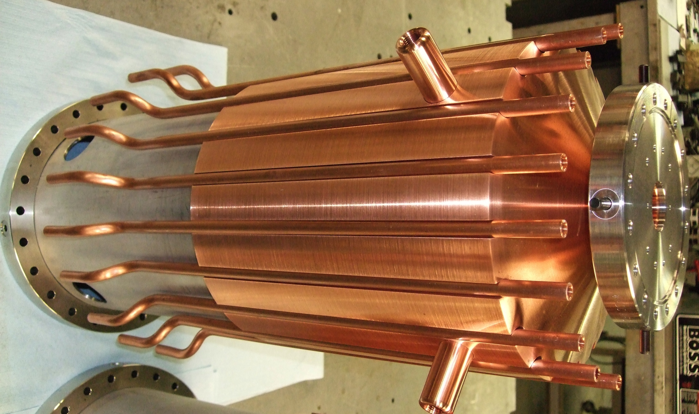
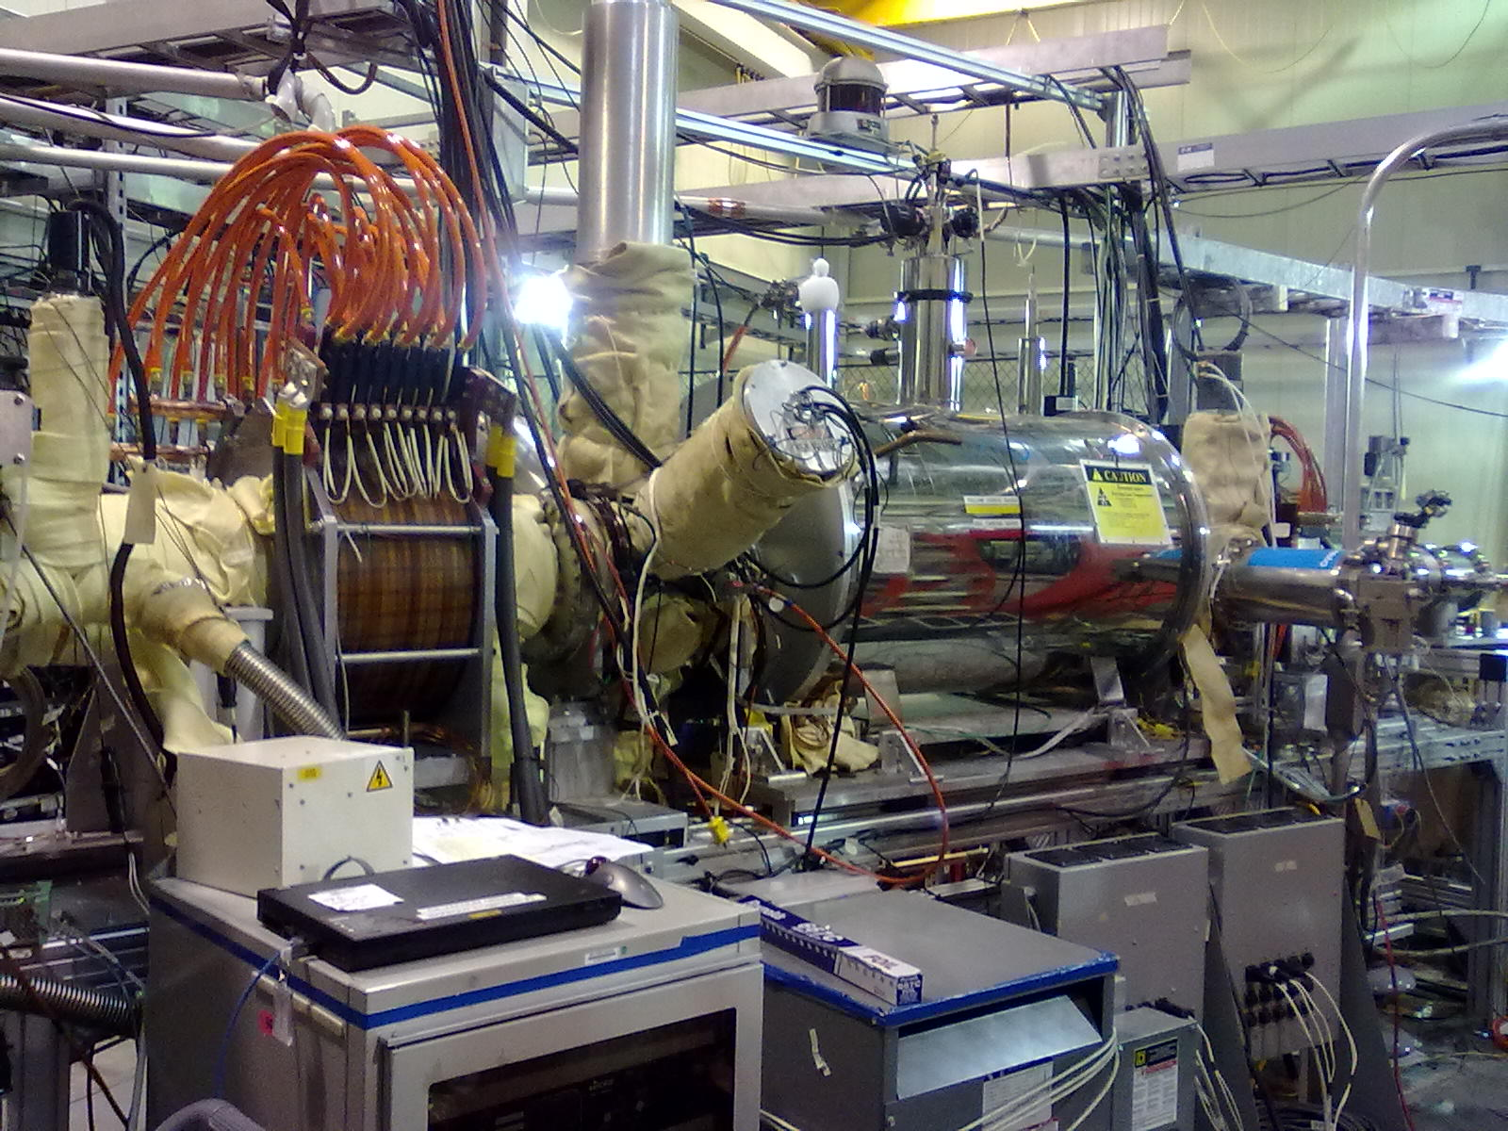
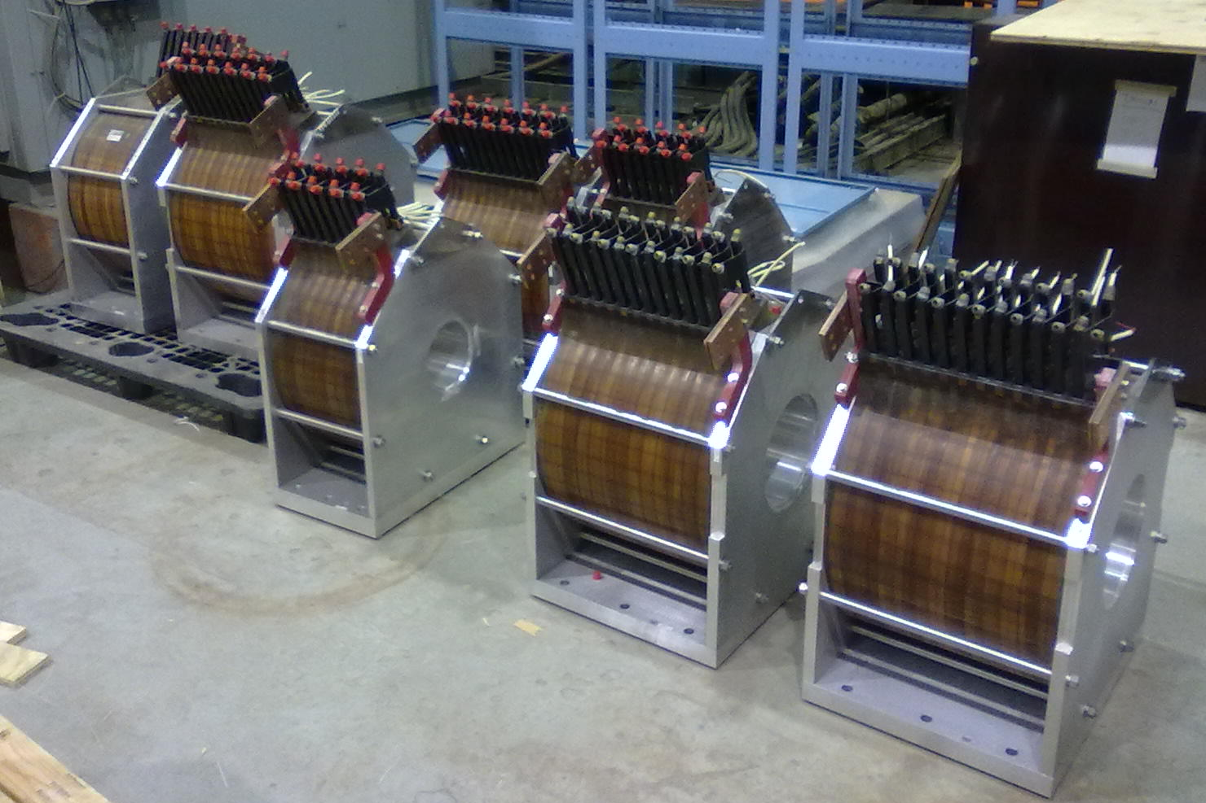
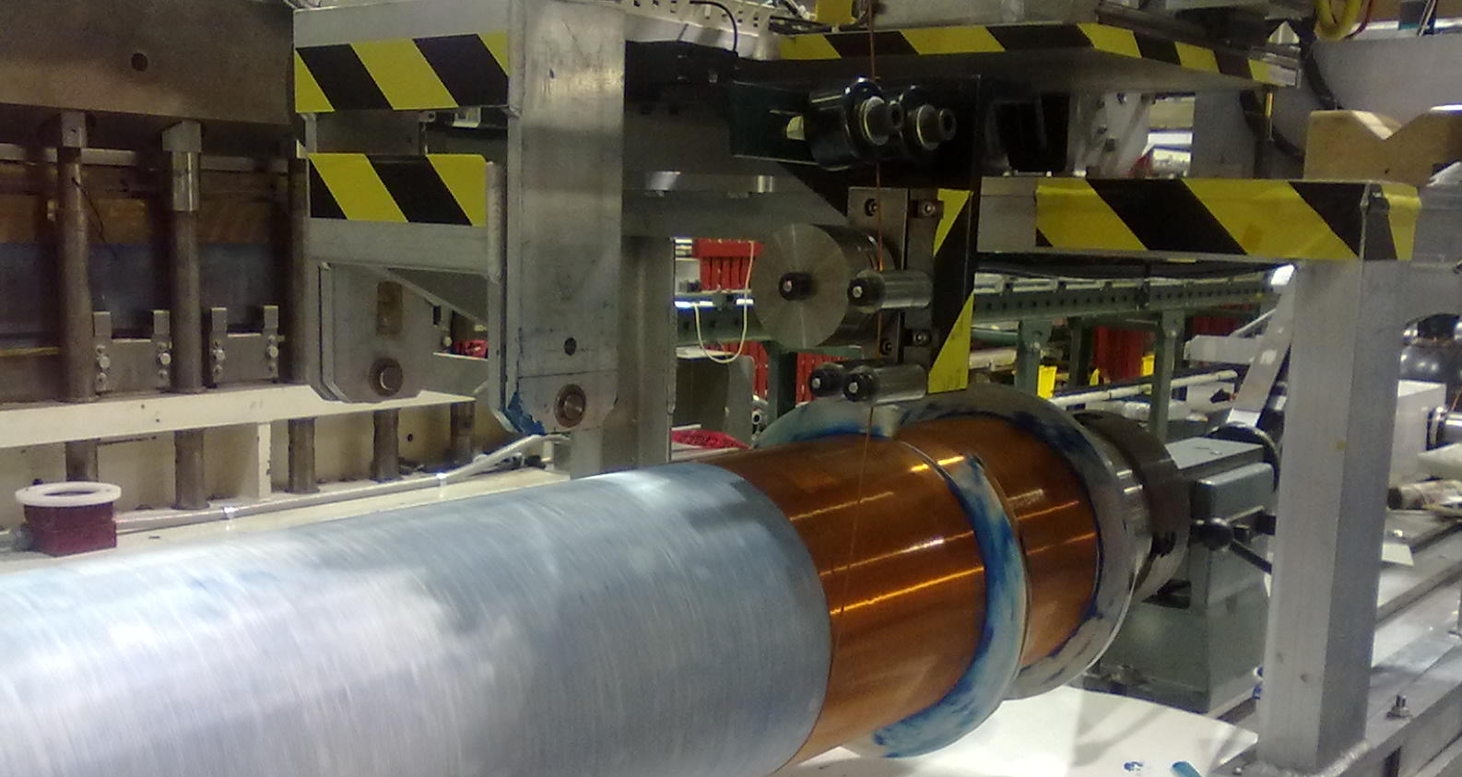
Electron lenses some hardware

Slide 15
Luminosity and Polarization Goals
Parameter | unit | Achieved | With 3D stoch. cooling and 56 MHz SRF
Au-Au operation |  | 2011 | ≥ 2014
Energy | GeV/nucleon | 100 | 100
No of bunches | … | 111 | 111
Bunch intensity | 10⁹ | 1.3 | 1.1
Average Luminosity | 10²⁶ cm⁻² s⁻¹ | 30 | 40
p↑- p↑ operation |  | 2012 | ≥ 2013 | ≥ 2014
Energy | GeV | 100 / 255 | 100 / 250 | 250
No of bunches | … | 109 | 109 | 109
Bunch intensity | 10¹¹ | 1.6 / 1.7 | 1.6 / 2.0 | 2.2
Average Luminosity | 10³⁰ cm⁻² s⁻¹ | 33 / 105 | 30 / 150 | 300
Polarization | % | 58 / 52 | 60 | 70

Slide 16
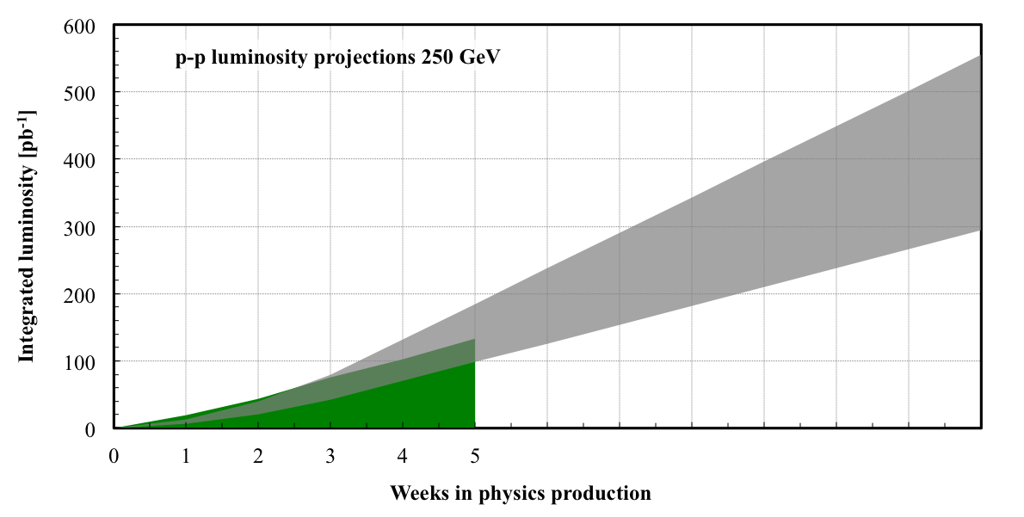
Luminosity projections for Run-13
Polarization: 50-60% (depends largely on OPPIS progress)
Luminosity: electron lens commissioning, expect limited gains

Slide 17
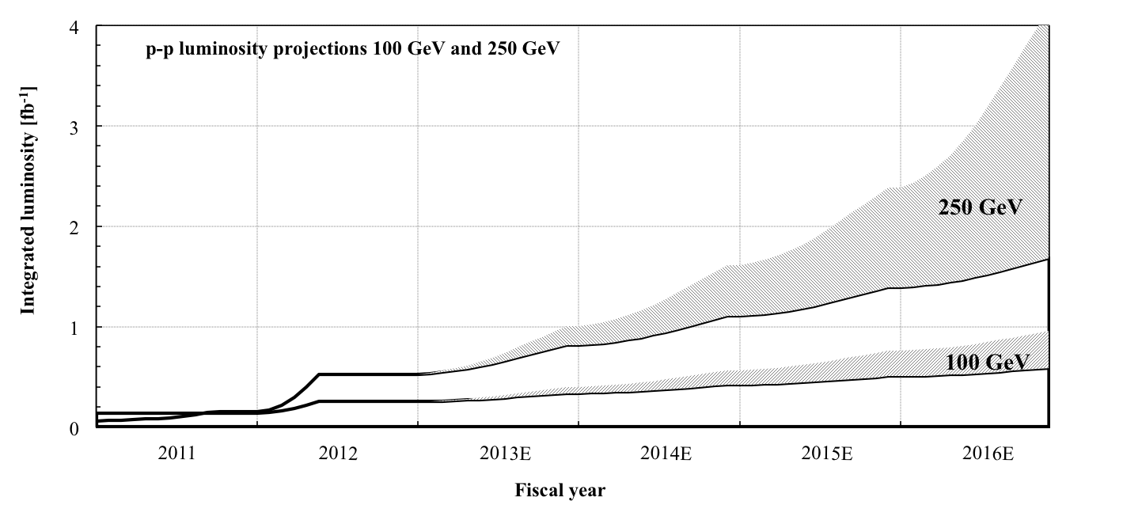
Projections for p⌃-p⌃
incremental changes
polarized source upgrade electron lens commissioning
incremental changes (ε_{x,y}, ε_{s}, ΔE_{store}, δβ/β…)
[Note: assume 12 weeks of physics, 8 weeks of ramp-up, start at ¼ of max]

Slide 18
Polarized proton projections – summary
Have transformed Run-11 developments into operation in Run-12
Polarization
Further gains likely require source upgrade
Difference between Blue and Yellow not yet understood (both 100 GeV and 255 GeV)
Upgrades
OPPIS (expect gains in polarization and/or luminosity in Run-13)
Electron lenses (commissioning in Run-13, expect limited gains)
Longitudinal emittance
Polarimetry

