Slide 1
PHENIX Run12 Spin
John Koster
RBRC
RSC Meeting
2012/05/11

Slide 2
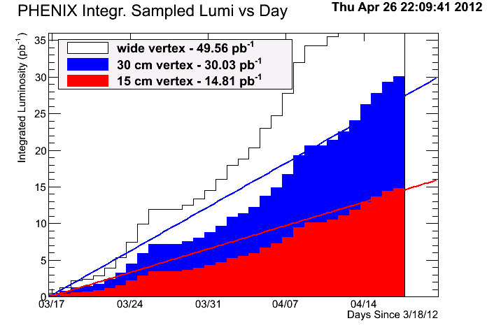
PHENIX Integrated Luminosity

Slide 3
Achievements
Precision/low-x ∆G measurements
  New forward EM calorimeter electronics installed
    Better triggering
  Several special fills for studying systematic errors
W→μ
  RPC1 installed
    Offline data readout commissioned
    Online trigger is in fine-tuning stage
  Trigger is in fine-tuning stage
VTX/FVTX installed and commissioned
    FVTX is a new detector for this year
Increased use of online polarimetry.

Slide 4
Muon Trigger Rejection
Slide from Yoshi-mitsu Imazu

Slide 5
Muon Trigger Turn-on Curve
Slide from Yoshi-mitsu Imazu

Slide 6
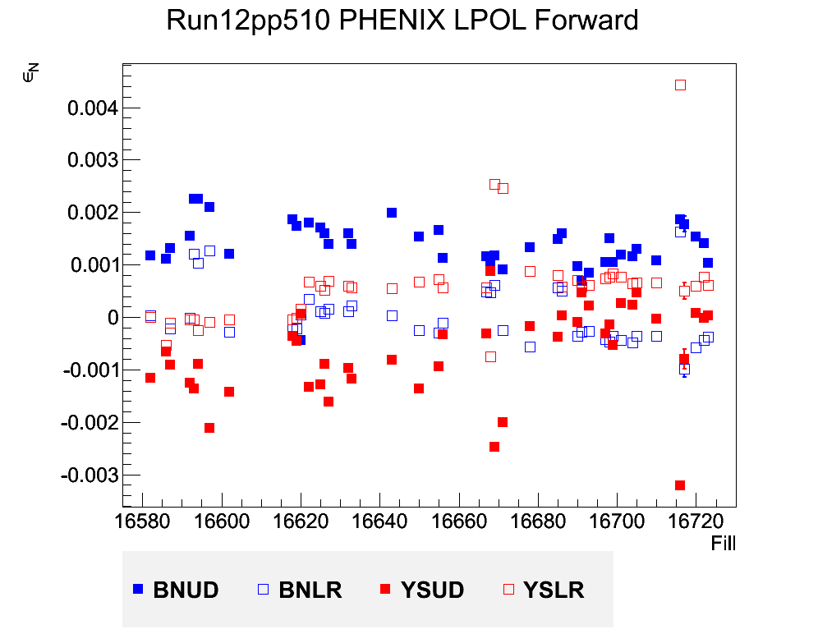
Local Polarimetry
Goal zone for residual polarization
Some large outliers
LPOL team: Ciprian Gal, Sanghwa Park, Josh Perry

Slide 7
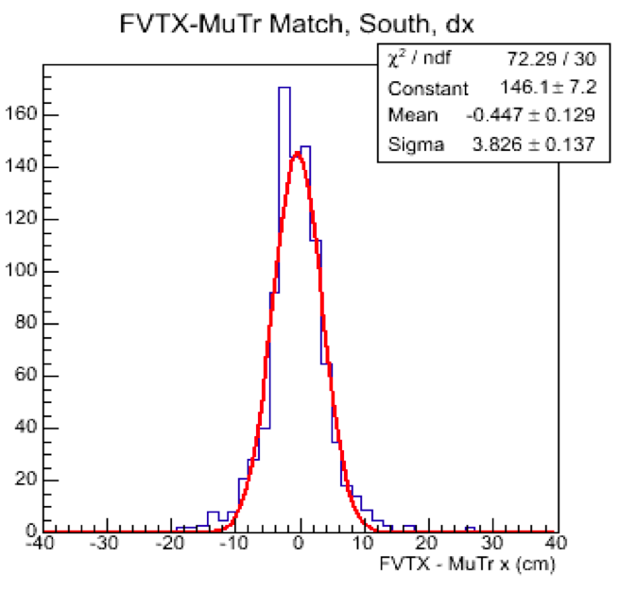
FVTX and MuTr Matching
Absorber
MuTr
FVTX-MuTr Match, dx
x
FVTX
x
(dx, dy)
x
South
X
x
x
x
Loop over MuTr tracks and look for matched FVTX tracks.
Best matching tracks peaks at 0.
We expect a few cm window due to the multiple scattering in absorber. Simulations use 3cm windows for matching.
It will be improved once we finish the detector alignment. (FVTX alignment and global alignment)
dx (cm)
Slide by Xiaorong Wang and Jin Huang

Slide 8
For next year
I expect less commissioning time → better data-taking efficiency at the beginning of the run.
Would be great to continue taking 1 polarization measurement half-way through the fill.
Will work on data-taking efficiency during the CuAu run
  Would be great to improve this number.

