Slide 1
AGS/RHIC Polarized Proton Run 12 Summary
V. Schoefer, H. Huang
RHIC Spin Collaboration Meeting
5/11/12

Slide 2
Jump Quad Timing
Two errors found in jump quad timing
Slow accumulation of error in requested jump time throughout the cycle
Up to 300 us near the end of the cycle
Mismatch between the timing of the jump between the quads ~18 us.
Diagnosis of both problems aided by local scope
No apparent effect of either improvement on polarization (200 us error), or emittance (18 us error)

Slide 3
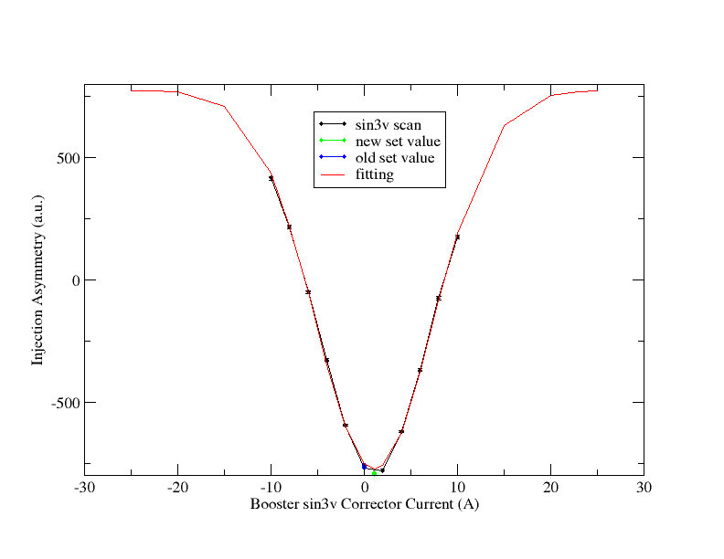
AGS Injection Asymmetry Measurements
Routine, precise measurement of asymmetry at AGS injection
Improvement of Ggamma= 3 imperfection resonance compensation.
~ 4% (abs) improvement in polarization

Slide 4
Emittances of Run11 and Run12
AGS Emittance
Left: Run12; right: Run11
Horizontal
Horizontal
Vertical
Vertical
Increased Booster input (as high as 6e11) allowed for additional scraping
Reduction in the growth in the AGS (vertical in particular) relative to Run 11 still unexplained, seems unrelated to jump quads.

Slide 5
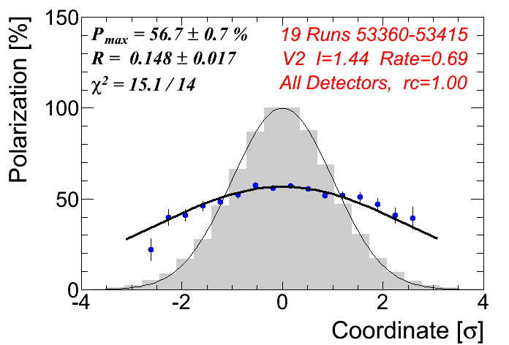
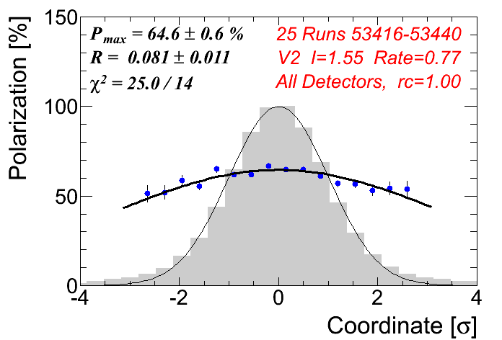
AGS Sweep pC Measurements
Jump quads OFF
(horizontal)
Jump quads ON
(horizontal)
‘Sweep’ mode allows for better measurement of polarization profile
These results are consistent with Run 11

Slide 6
Polarization for RHIC Fills
Better polarization in Run 12 at routinely higher intensity
Some improvement from Booster
Remainder from emittance?
Same Analysis process for both runs (with rate correction)

Slide 7
Problems
AGS vertical orbit ‘lurch’
Still not solved, almost certainly still present with ions (we are just less sensitive)
Diagnostics in place to locate the source
pC target position jump
Jump quad timing mysteries
New timing calculated using updates tune/energy measurements yields lower polarization
Not clear which input is incorrect
Last three (of 41) pulses seem to be disproportionately beneficial to polarization (suspected last year, multiple measurements made in Run 11 and Run 12, they don’t converge on a consistent conclusion)

Slide 8
RHIC Performance: 100 GeV
Luminosity
Relative to Run 9
Increased β* 0.7 -> 0.85 m
Increased intensity 1.35 ->1.65e11/bunch
Above two approximately cancel to get same peak lumi of ~50e30 cm-2s-1
Lumi lifetime
Average ~16 hours, compared to 7 hours in Run 9 and 12 in Run 8 (even at 1 m β*)
Run 12: First 100 GeV p^ run to use tune/orbit feedback for all physics stores
Improved integrated lumi mostly due to a combination of good uptime and lumi lifetime
Run | β* [m] | Lumi Lifetime [h]
Run 8 | 1.0 | 12
Run 9 | 0.7 | 7
Run 12 | 0.85 | 16

Slide 9
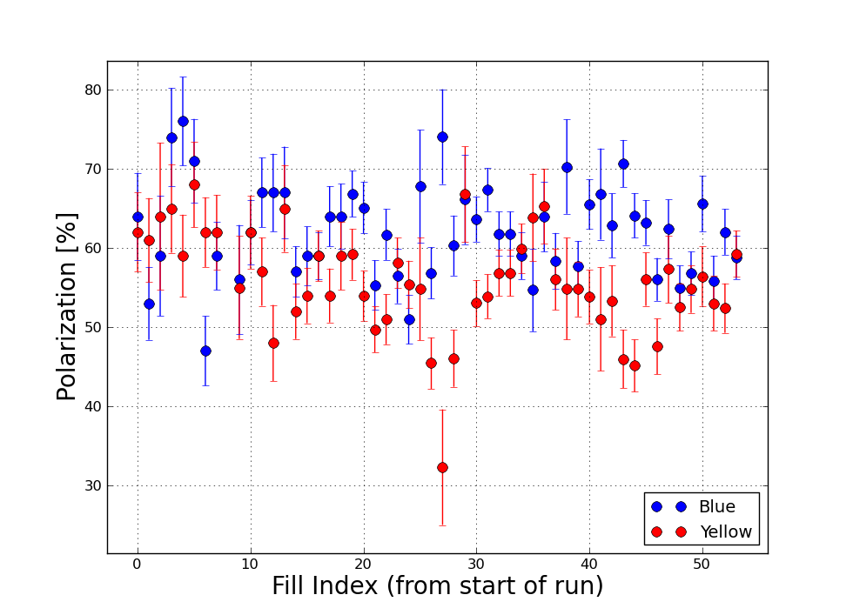
Polarization: 100 GeV
Polarization averages
(B,Y) ~ (61%, 55%)
Yellow slightly higher (57%) when omitting ‘split tune’ fills and a the emittance blowup period
Polarization lifetime varies over the run, but is typically 0.5%/hr or less in blue and ~1%/hr in yellow

Slide 10
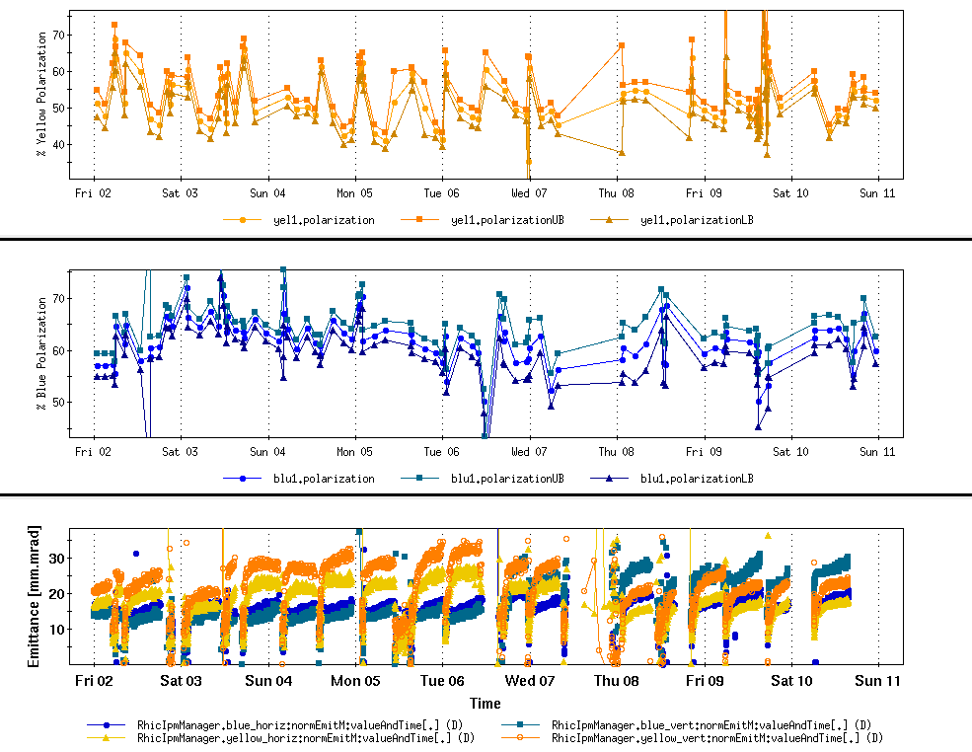
Beam-beam Blowup
Yellow emittance blowup at store coincides with removing longitudinal scraping in the Booster
Yellow polarization decay goes to 1.9%/hr during this period
Further analysis needed to deconvolve straight beam-beam effects from operational lowering of tunes (which helps later in the store, but is a disaster at onset of collisions)
Were we really pushing the beam-beam limit, or just badly configured to handle a slightly increased beam-beam tune spread?

Slide 11
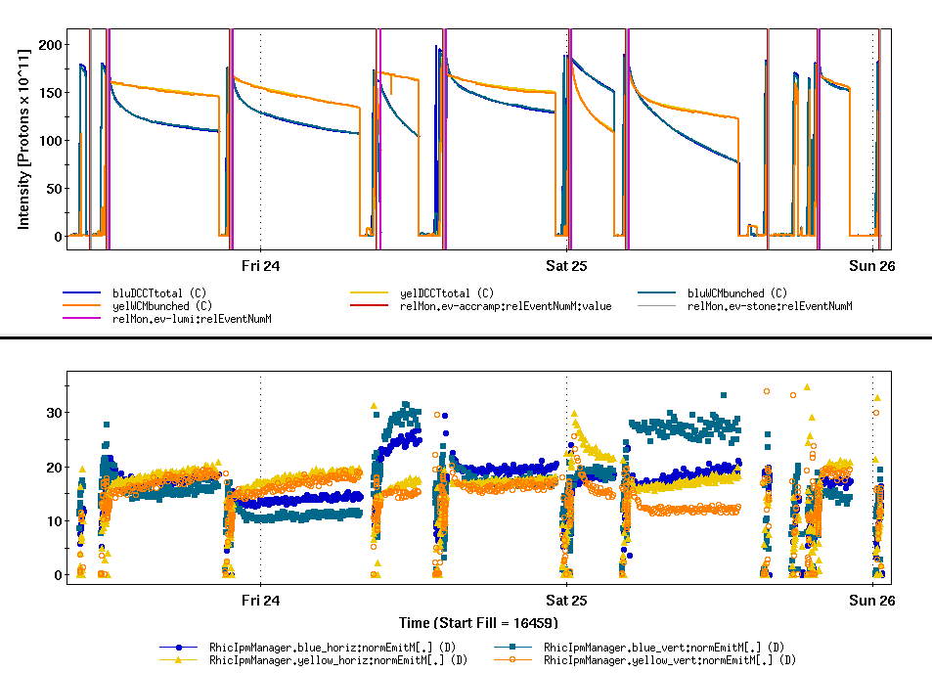
Split Tunes
Yellow tune above 0.7
Successully suppresses coherent modes, but…
Decreased yellow polarization lifetime (~2%/hr)
Blue (nominally unchanged settings) has emittance blowup in two of the four fills
Four ‘split tune’ fills

Slide 12
RHIC Performance: 255 GeV
Integrated Lumi by Week
Luminosity
Peak lumi ~25% higher than Run 11
Smaller emittance
Source intensity + scraping
Less growth in AGS
Integrated lumi
Same in week 1 of Run 12 as best week (8,9) or Run 11
No major failures
No 9 MHz commissioning
Changeover from 100 GeV, 3.5 days, (with maintenance)
Average Lumi by Fill

Slide 13
Polarization: 255 GeV
Run 11 ~48% (Jet, both rings)
Run 12 Blue 50%, Yellow ~55% (after snake change?)
No explanation for B-Y discrepancy
If Yellow improvement comes from snake change, then why not blue?
What is the impact of intensity lifetime?
Needs a full accounting (ramp transmission, polarization lifetime, comparison to AGS). The data are available.
No obvious improvement from +5 GeV
Snake scans
The immediate conclusion: polarization is largely insensitive to changes in the snake axis and rotation angles. (This contradicts the statement that the improvement in yellow is from the snake current change)

Slide 14
Longitudinal Emittance
Longitudinal emittance puts a limit on peak lumi at both 100 and 255 GeV
100 GeV: Momentum aperture at store (rebucketing)
255 GeV: Acceleration losses at max acceleration rate
Attempts at cure:
Shorten AGS cycle: less time at injection, smaller growth
Would have helped: the AGS jump quads need modification to handle the rep rate
Landau phase loops: minimize jitter of bunch relative to 197 MHz cavity while injecting/ramping
Did not improve growth rate
Bunch-by-bunch damping: minimize/eliminate Landau voltage at injection, reduce impact of Booster cycles
Much learned during the run, needs further development over the shutdown
Increase Landau voltage on the ramp to increase bucket area
Cavity has to be tuned at higher voltage to be compatible with rebucketing (doable next run)

Slide 15
Additional efforts
Local coupling correction
Simultaneous global coupling and vertical dispersion correction
Beam-based alignment
Phase shifter commissioning (and E-lens prerequisite)
LLRF commissioning (AC coupled phase loops)
Vertical 2/3 resonance correction (helped rotator ramp losses at 255 GeV, might have helped 100 GeV rebucketing woes, did not help lumi lifetime)

