Slide 1
RHIC Status
RSC Meeting 4/6/12
V. Schoefer
Typical fill: 107 bunches, 1.8e11 injected
  Limited by acceleration losses, but those have improved since we sit for less time at injection (no polarization measurements)
Polarization
  Yellow improvement seems to come from the earliest snake change, changing the snake on the ramp to account for energy dependence of rotation
  Blue did not see the same improvement
    Measuring spin tune
  Currently running with calculated optimum snake currents for (inj-100 GeV) and (100 GeV-255 GeV)
  Ramp scans are limited in range owing to power supply limits

Slide 2
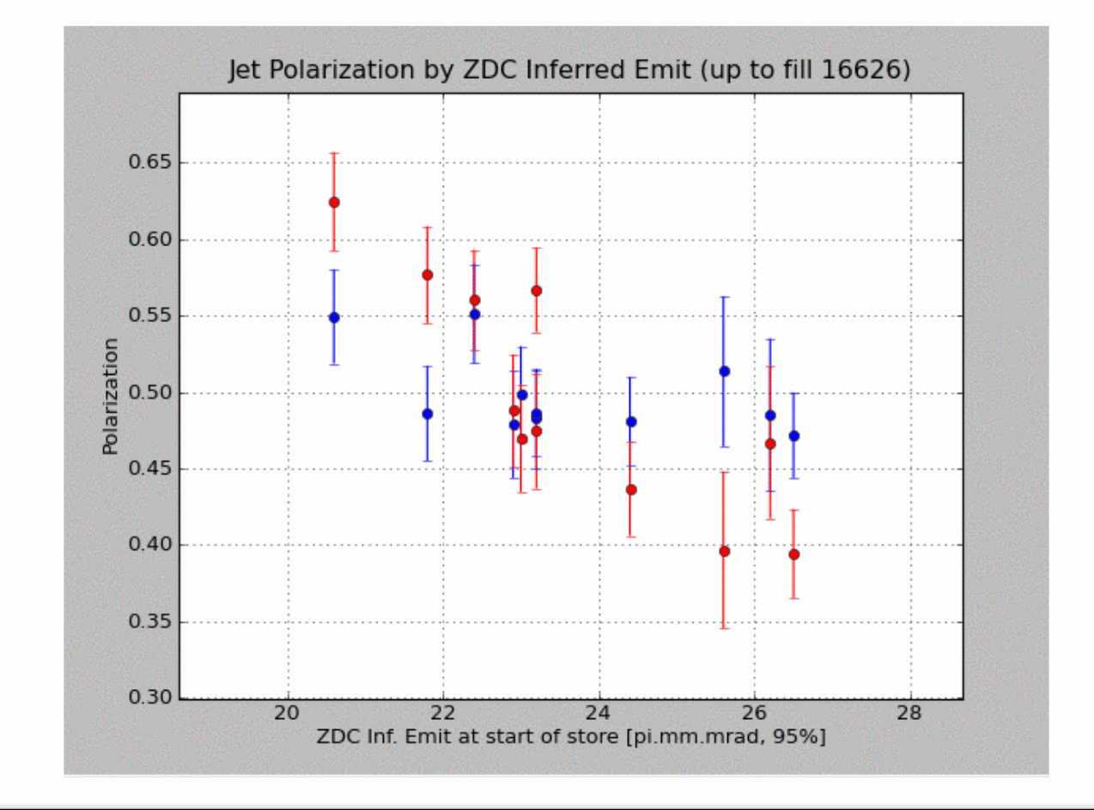

Slide 3
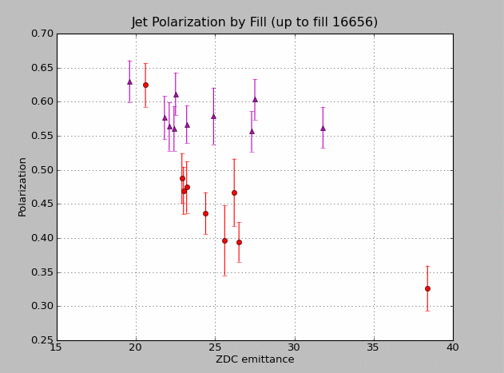
Ramp snakes after 100 GeV
Change in spin parameters is small
Spin tune shift: 6e-4
Imperfection strength change: 0.055
Constant snakes

Slide 4
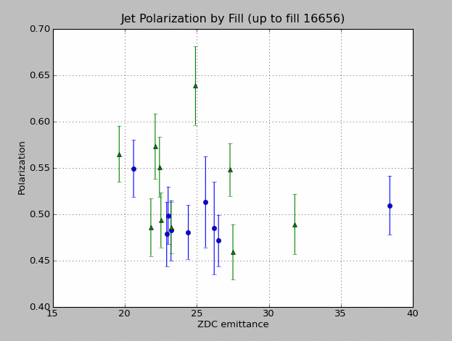
Ramp snakes after 100 GeV
Constant snakes

Slide 5
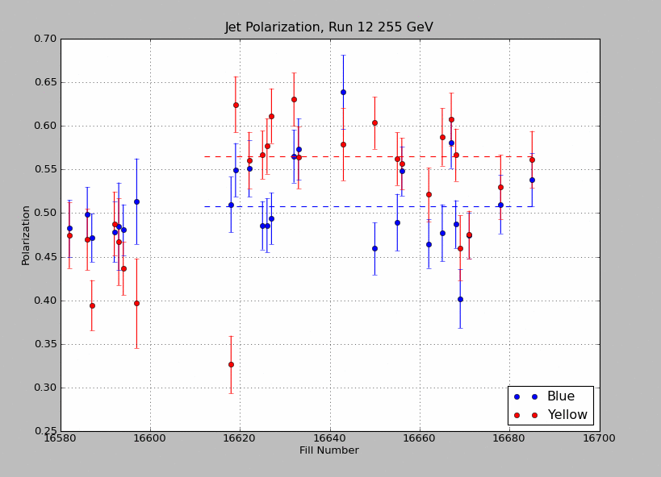
Recalculated snakes
-5 yellow μ at store

Slide 6
Plan
Run with the newly calculated optimum currents for a few fills to establish a baseline
Try measuring spin tune in blue
Cycle through blue snake current settings
  Phi angle (if supported by spin tune measurement)
  Mu changes on ramp (necessarily small, partial scan already)

