Slide 1
Run12pp510 Updates
John Koster RBRC RSC
2012/04/06

Slide 2
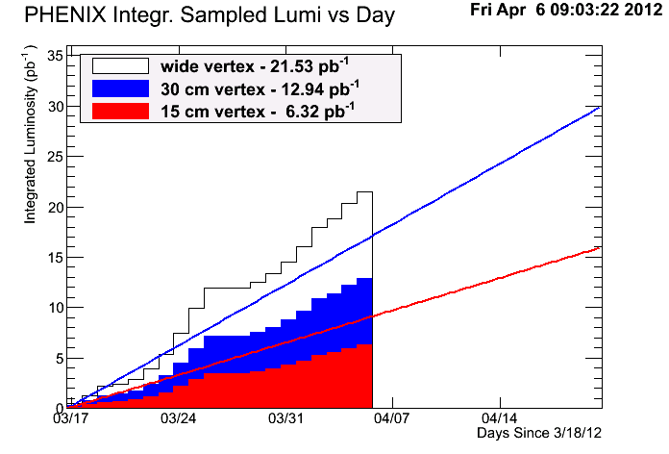
PHENIX Sampled Luminosity

Slide 3
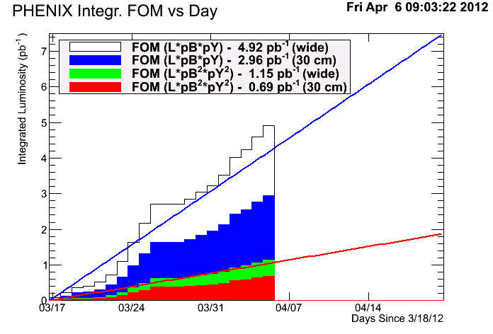
PHENIX FoM

Slide 4
Polarization measurements during fills
Stop:
Stop DAQ
Bring RPC detectors to standby (9.5kV→8kV). Needed for forward W measurement (500 GeV).
Ramps down VTX bias. Needed for heavy flavor (200 GeV).
Give go-ahead on polarization measurement
Pol. Measurement
Start:
Bring up bias
Start DAQ
Total is ~20-30 minutes not taking forward W’s per measurement
Can we put pC measurements only at the beginning and end of fills? Keep # of measurements the same, but move them to beginning or end of store.
We can see how well this scheme works

Slide 5
Determining Dump Conditions
Bill C. brought this up earlier in the week.
We should look into it.
I haven’t had a chance to look at optimal store length given mean time between stores
Maybe Wolfram or Vincent has already looked it this.
Maybe base on luminosity rather than on time since injection?

