Slide 1
PHENIX Run12pp510
Status
John Koster
RBRC
RSC Meeting
2012/03/23

Slide 2
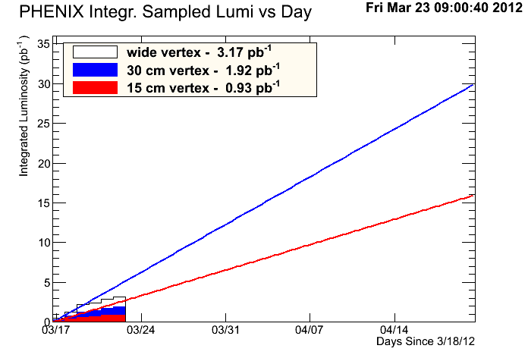
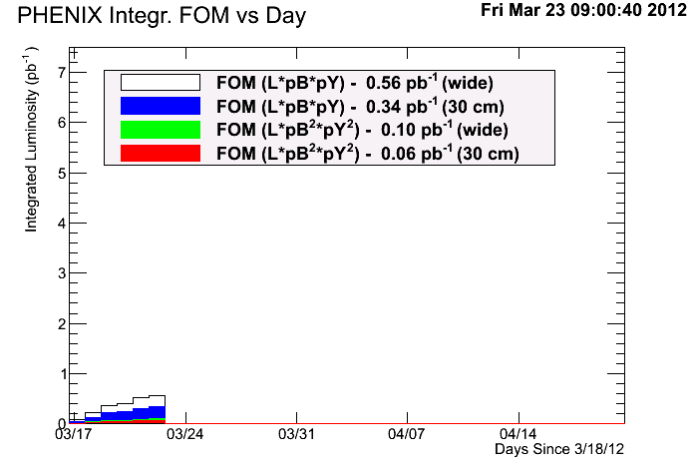
510 GeV FoM/Luminosity
P²L FoM Goal: ~7.5pb⁻¹
* pol. Numbers are taken from CNI

Slide 3
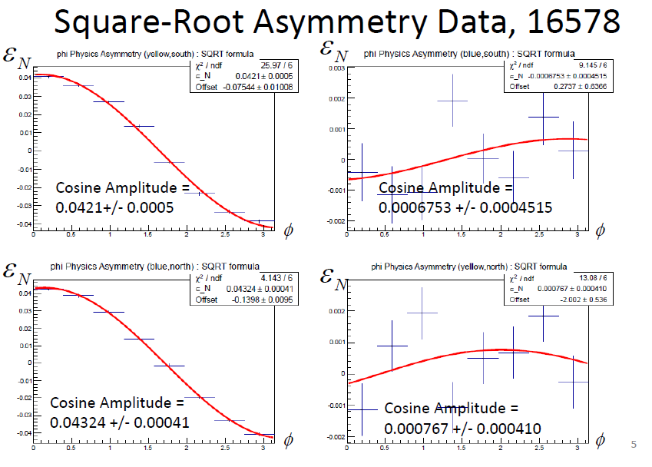
510 GeV Offline Local Polarimetry
Slide by Ciprian Gal, Sanghwa Park, Josh Perry
Residual:
Transverse Pol. / Total Pol. (P_{T}/P)
2.9% Yellow
4.3% Blue
errors +/- ~1%
Transverse fill Longitudinal Fill
Fill-Beam | Raw Asym. | Pol. (Hjet)
Transverse-Blue | 0.04324 +- 0.00041 | 61.1% +- 6.6%
Transverse-Yellow | 0.0421 +- 0.0005 | 69.3% +- 7.3%
Longitudinal-Blue | 0.0009952 +- 0.000203 | 48.3% +- 3.3%
Longitudinal-Yellow | 0.001263 +- 0.000217 | 47.5% +- 3.8%

Slide 4
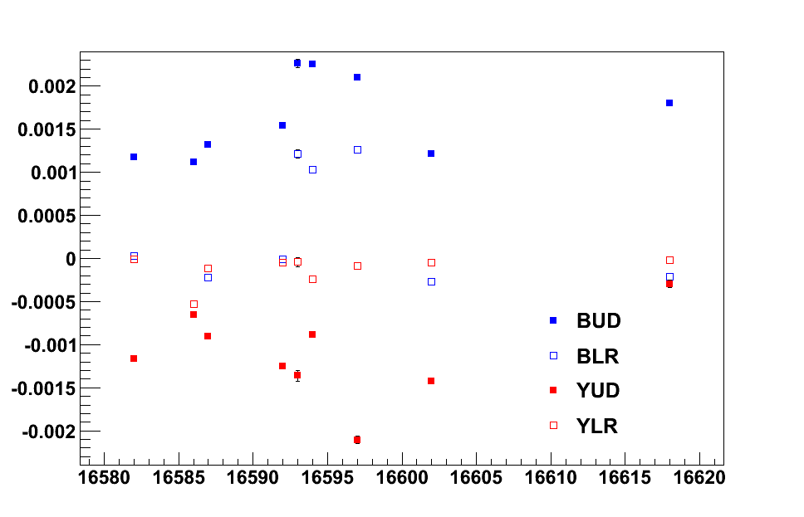
510 GeV Online Local Polarimetry
Plot by Ciprian Gal, Sanghwa Park, Josh Perry
Raw Asymmetry
Fill Number
Just after initial tuning by Vahid finished
Star rotators adjusted
Blue rotators adjusted
Yellow
rotators adjusted

Slide 5
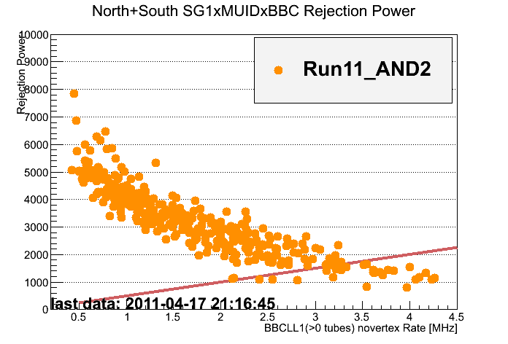
Muon Trigger Rejections, 510 GeV
Rejection
Slide by Itaru Nakagawa
Muon Trigger: Achieves sufficient rejection!
RPC3 timing cuts are not finalized yet.
Rejection will improve.
RPC1 will be implemented for additional rejection and acceptance.
Run12:
SG1xRPCxBBC
AND2, 95%
Run12:
SG1xMUIDxBBC
AND2, 97%
Run12:
SG1xRPC
OR, 97%
2kHz Band Width Limit
PHENIX W→muon trigger can handle high luminosity

Slide 6
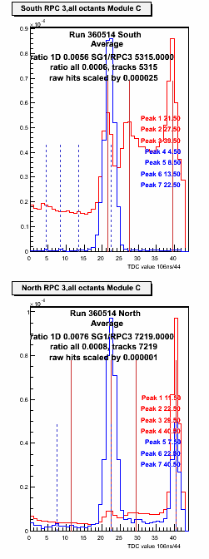
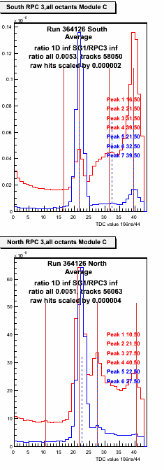
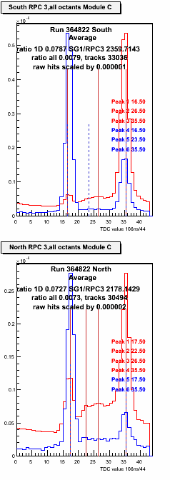
Overall RPC timing and BG
Slide by Ralf Seidl
200 GeV
510 GeV
Outer RPC3s in the tunnel most sensitive to incoming BG
Blue (North) sees more background at 510 GeV
However beam conditions change very much – study Collimator and Vernier scan data
Incoming Background
Collision related
Muon arm track related hits
(different scale)

Slide 7

Things in the works…
These are not proposals, but may become one in the future
Single colliding bunch high intensity fill
  Useful for studying cross talk in the MuTr
  120 minutes total data-taking
Transverse beam polarization + offset beam positions
  Continuation of studies done with angled beams during 200 GeV running.
My worry:
introduce too many requests from detectors before getting high pol. and lumi.
PHENIX requests will go through that filter before being proposed.

Slide 8
backup

Slide 9
Last 13 stores of Run11pp500
Fill# | Start time | End time
15431 | Sun Apr 10 13:16:23 EDT 2011 | Sun Apr 10 15:37:11 EDT 2011
15435 | Mon Apr 11 00:48:14 EDT 2011 | Mon Apr 11 06:46:51 EDT 2011
15436 | Mon Apr 11 10:03:36 EDT 2011 | Mon Apr 11 19:08:05 EDT 2011
15438 | Mon Apr 11 21:21:23 EDT 2011 | Tue Apr 12 00:30:19 EDT 2011
15442 | Tue Apr 12 13:52:37 EDT 2011 | Tue Apr 12 14:04:13 EDT 2011
15443 | Tue Apr 12 16:15:24 EDT 2011 | Wed Apr 13 00:37:10 EDT 2011
15444 | Wed Apr 13 02:10:47 EDT 2011 | Wed Apr 13 07:59:24 EDT 2011
15452 | Wed Apr 13 23:57:24 EDT 2011 | Thu Apr 14 05:56:29 EDT 2011
15457 | Thu Apr 14 19:58:11 EDT 2011 | Fri Apr 15 05:18:37 EDT 2011
15466 | Sat Apr 16 06:06:58 EDT 2011 | Sat Apr 16 19:19:58 EDT 2011
15467 | Sat Apr 16 20:37:25 EDT 2011 | Sun Apr 17 07:09:05 EDT 2011
15470 | Sun Apr 17 12:47:02 EDT 2011 | Sun Apr 17 21:23:21 EDT 2011
15472 | Mon Apr 18 00:07:07 EDT 2011 | Mon Apr 18 07:41:59 EDT 2011
* Start and end time are based on ev_lumi_on and ev_lumi_off in cad db.
Caveat there is some sort of UTC offset to the times listed here and the ones root gave me on my plot.

Slide 10
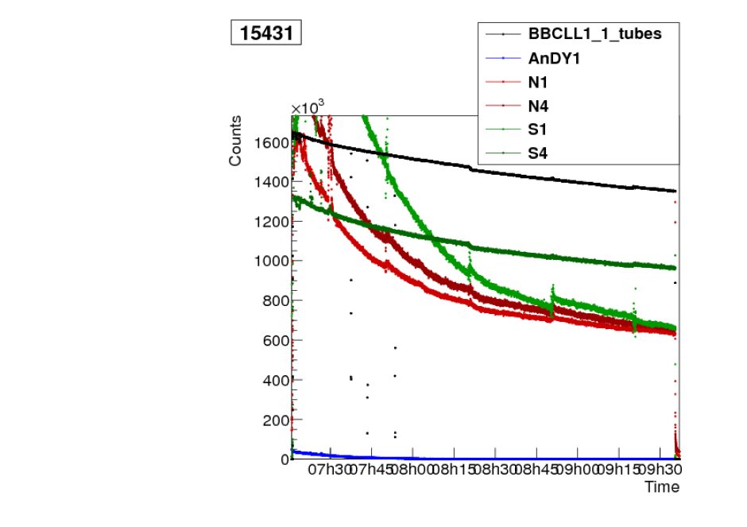

Slide 13
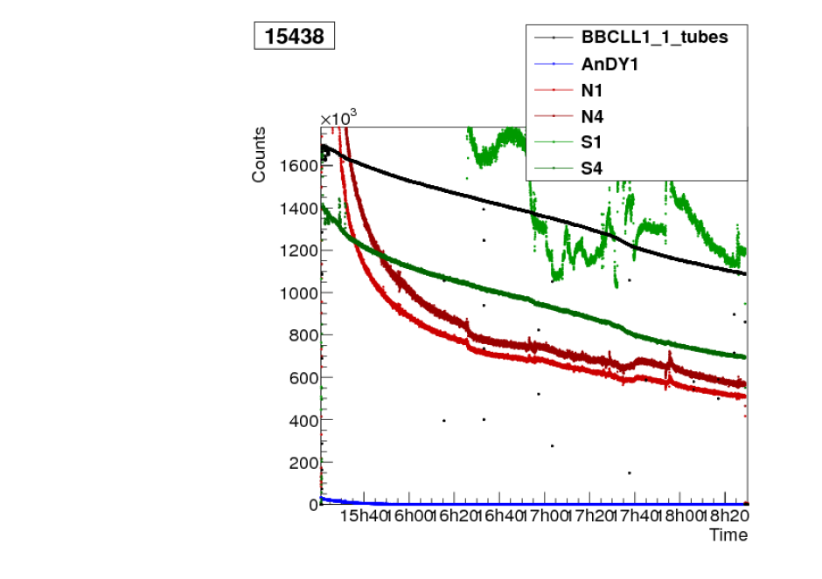

Slide 17
