Slide 1
A summary on Polarisation in Run-12
100GeV and first results for 250 geV
E.C. Aschenauer
presenting the work done by Alan, anders, Bill and Dima

Slide 2
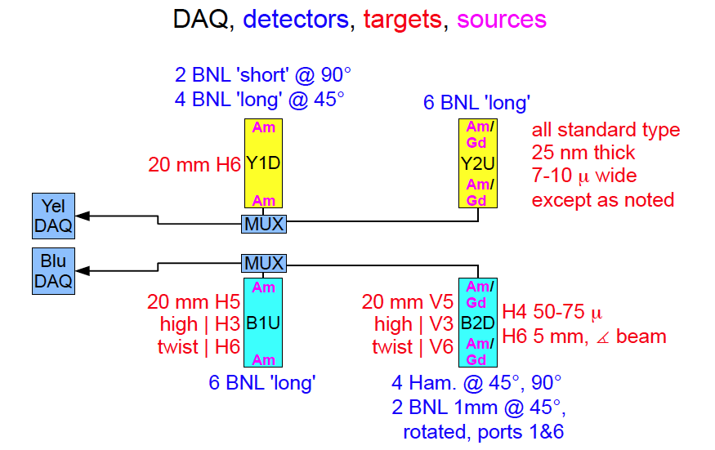
Run 12 pC polarimeters

Slide 3
Run 12 pC polarimeters
Known complications:
  100 GeV:
    noise due to pickup especially at injection less significant at flat top
      method to correct for it was developed by Dima and Bill and implemented
      shown data have this correction included
      noise was correlated to stochastic cooling sitting before / after the polarimeters
    B2D is an experimental polarimeter → new detector types
  255 GeV
    noise is gone → most likely due to grounding improvements and removing of antennas at the polarimeters and the stochastic cooling
    polarimeters not yet normalized to jet, need 10 long fills at least
      normalization is polarimeter dependent
      ratios like Y1D to Y2U need not to be 1 at the moment

Slide 4
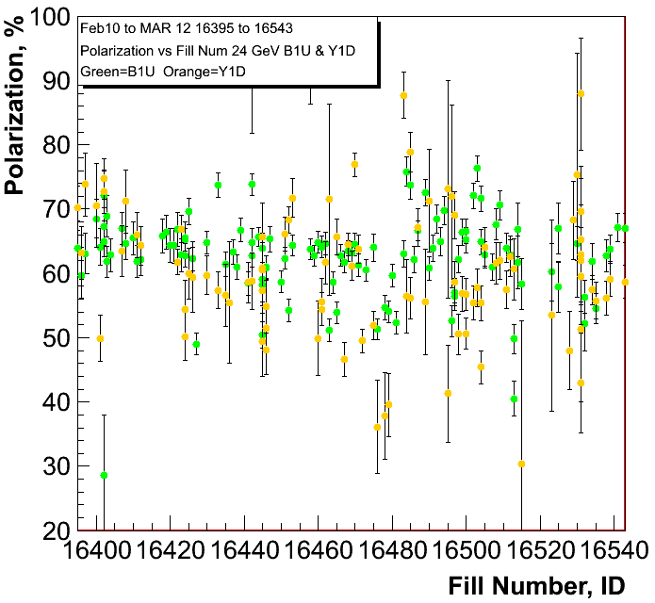
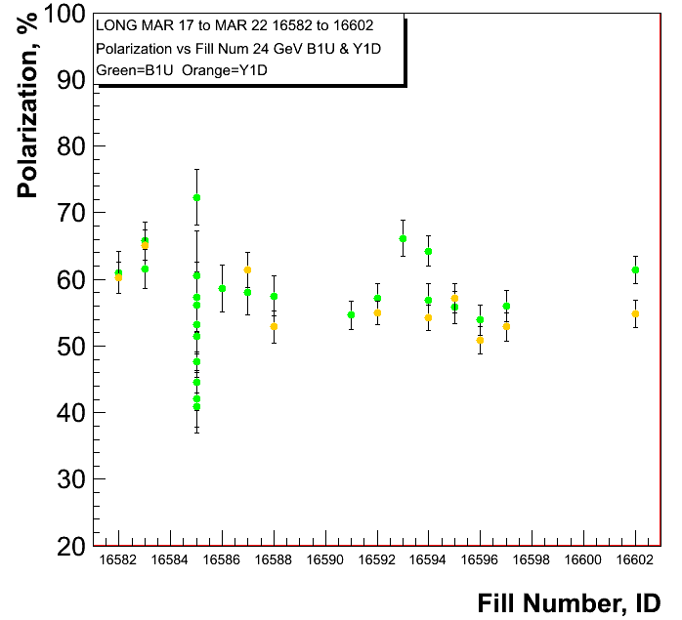
255 GeV Results
injections for 100 GeV
injections for 255 GeV
polarisation at injection
Blue and Yellow
Caveat:
pC numbers not normalized
to jet

Slide 5
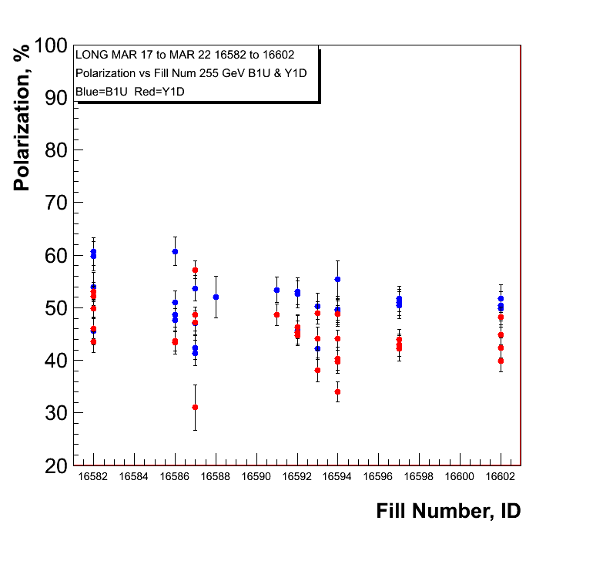
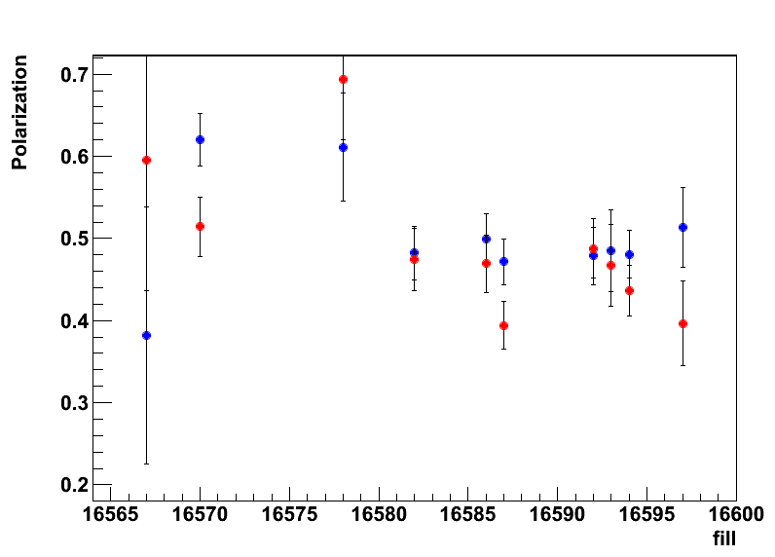
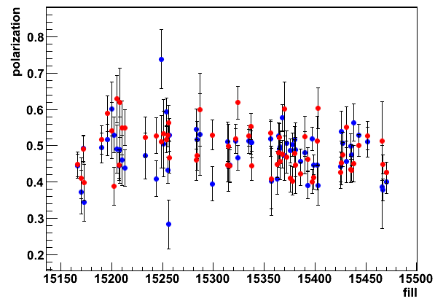
255 GeV Results
polarisation at flat top
Blue and Yellow
H-Jet
H-Jet Run-11
→ longitudinal

Slide 6
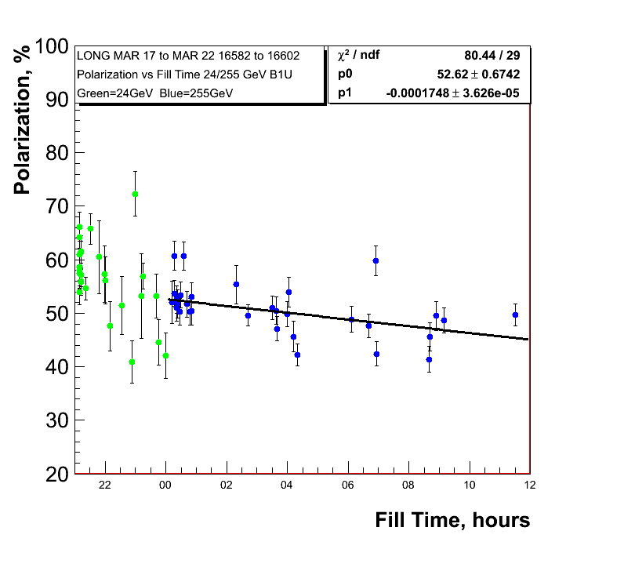
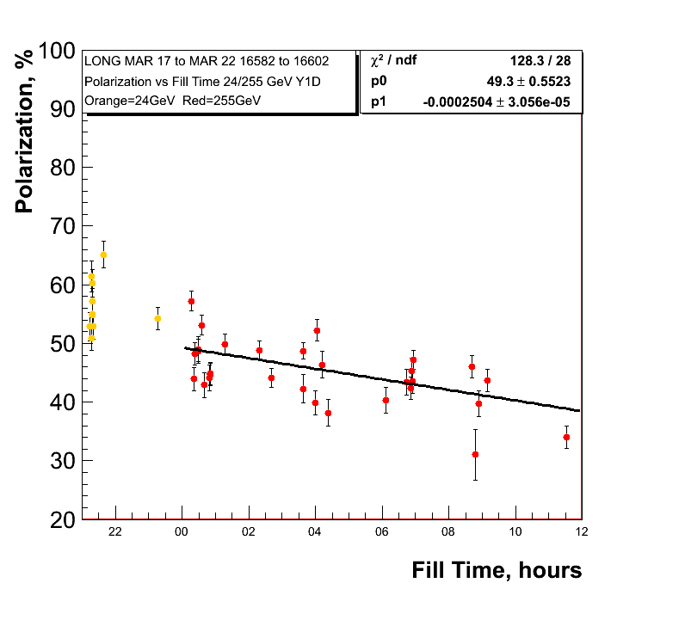
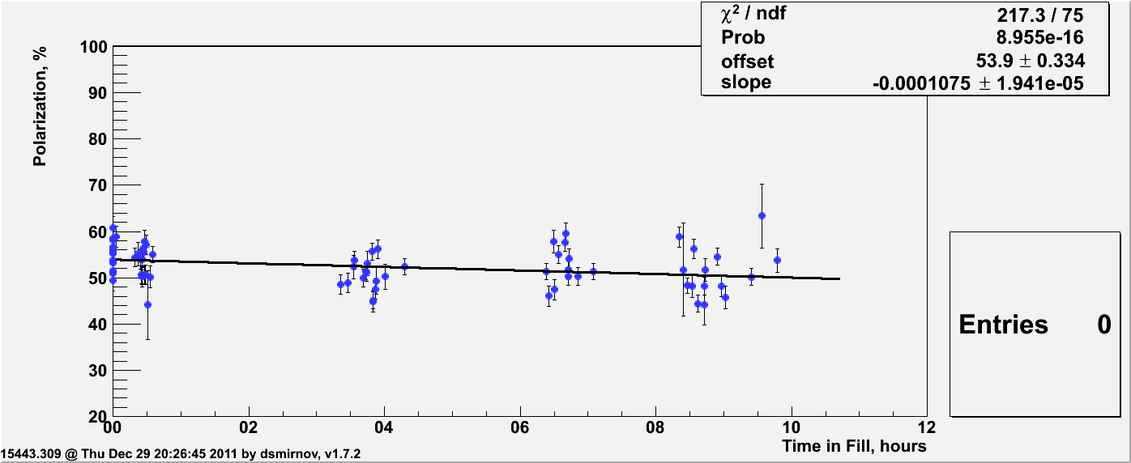
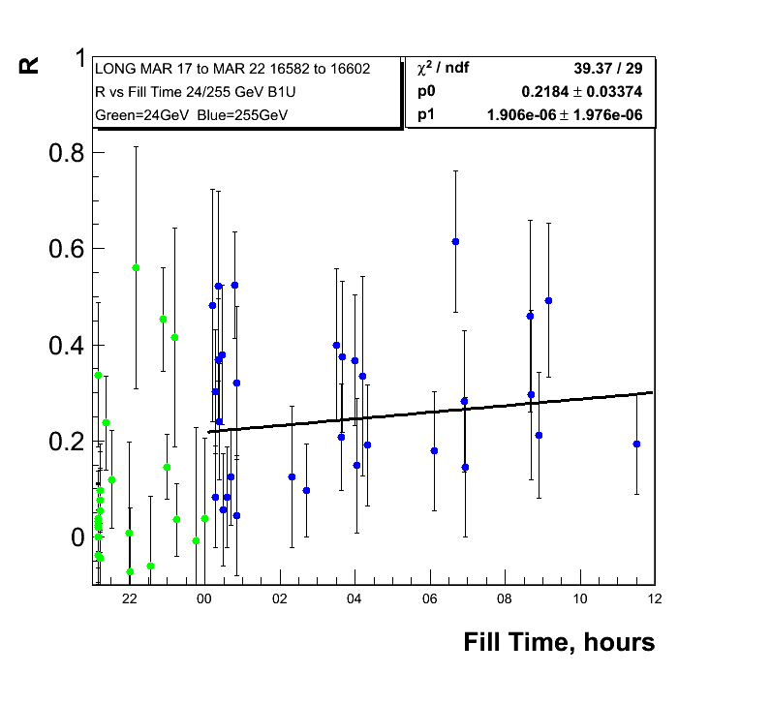
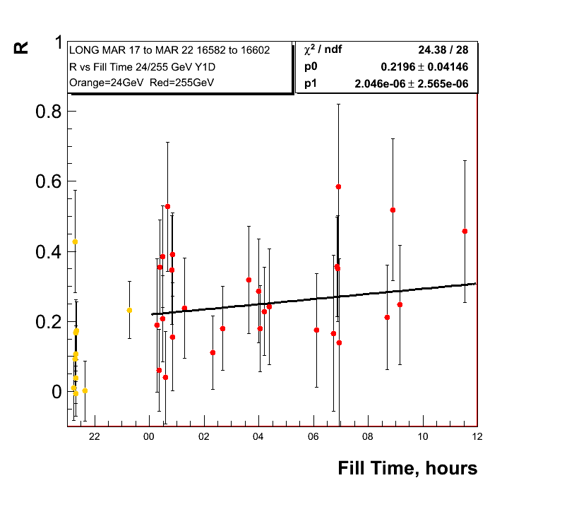
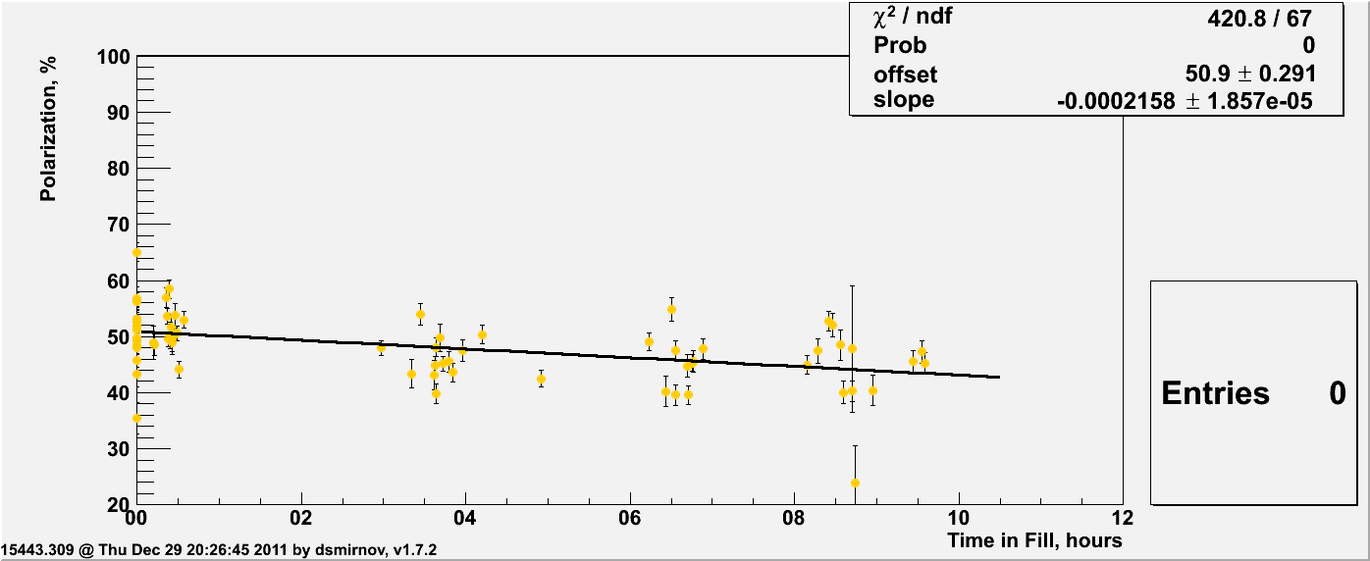
255 GeV Results
0.62%±0.13/hour
0.9%±0.11/hour
Polarisation
lifetime very
similar run-11
and run-12 so
255 GeV did not
do the trick
Run-11
0.39%±0.07/hour
Run-11
0.78%±0.07/hour

Slide 7
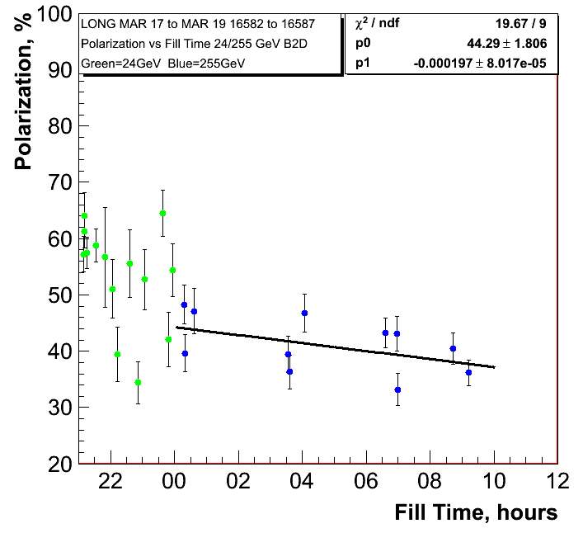
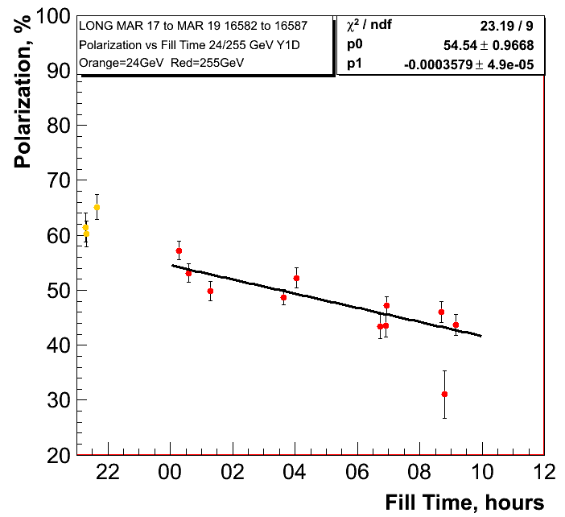
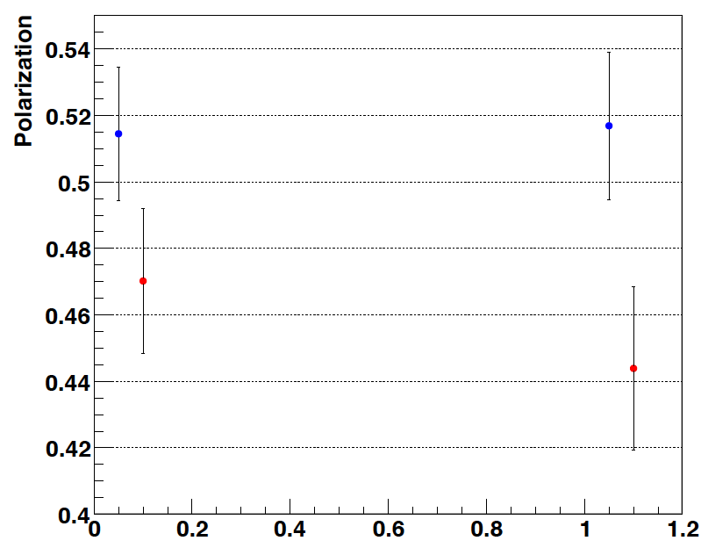
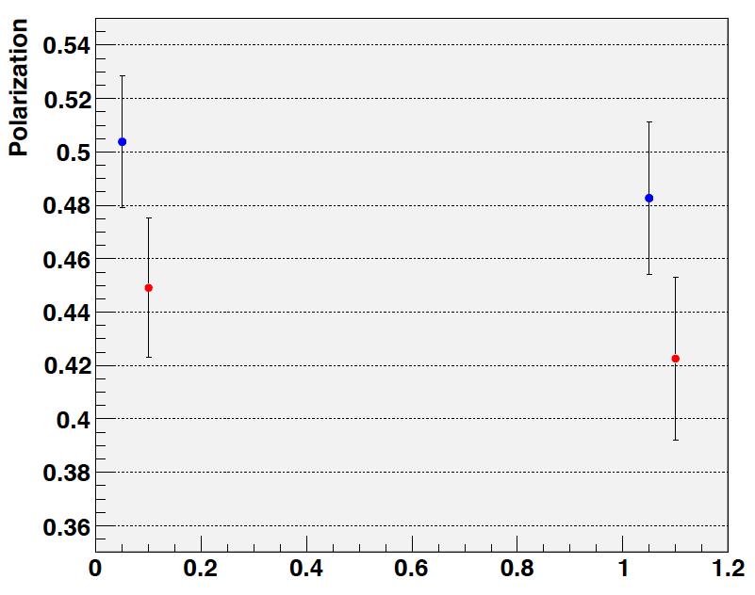
255 GeV Results
0.71%±0.28/hour
1.288%±0.18/hour
H-Jet:
Fills: 16570-16592
trans + longitudinal
H-Jet:
Fills: 16586-16592
longitudinal

Slide 8
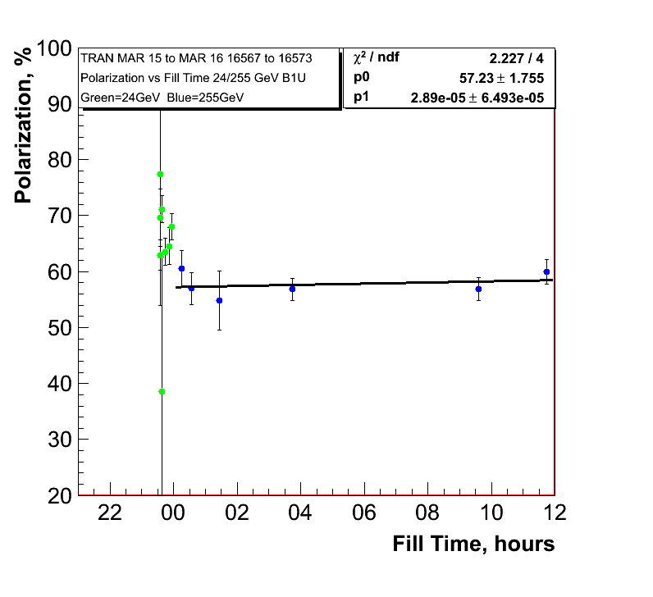
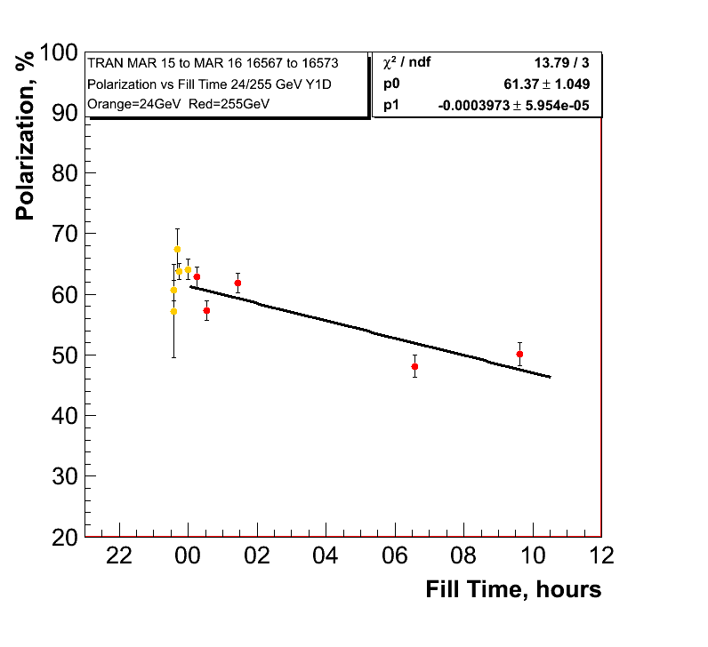
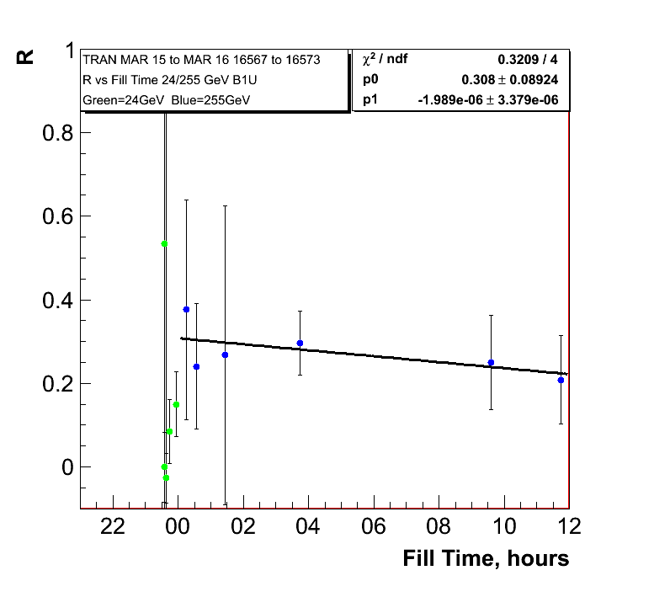
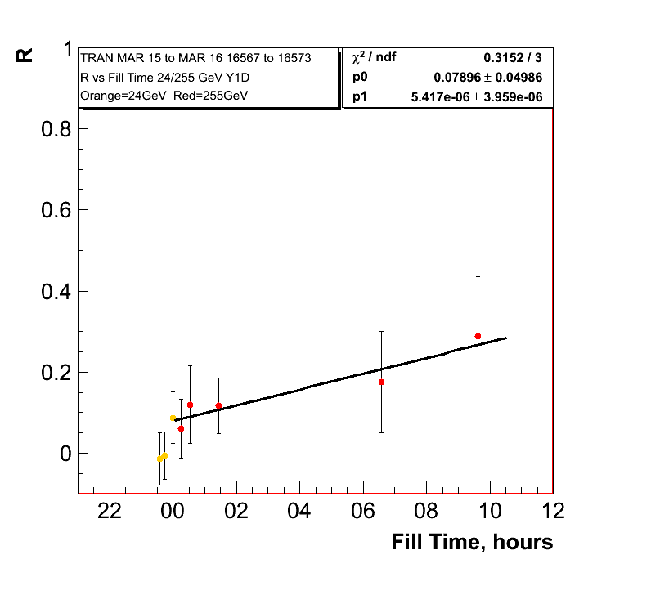
255 GeV Results Transverse Fills
0.10%±0.23/hour
Polarisation
lifetime in
yellow very
similar to
longitudinal
255 GeV fills
1.4%±0.21/hour

Slide 9
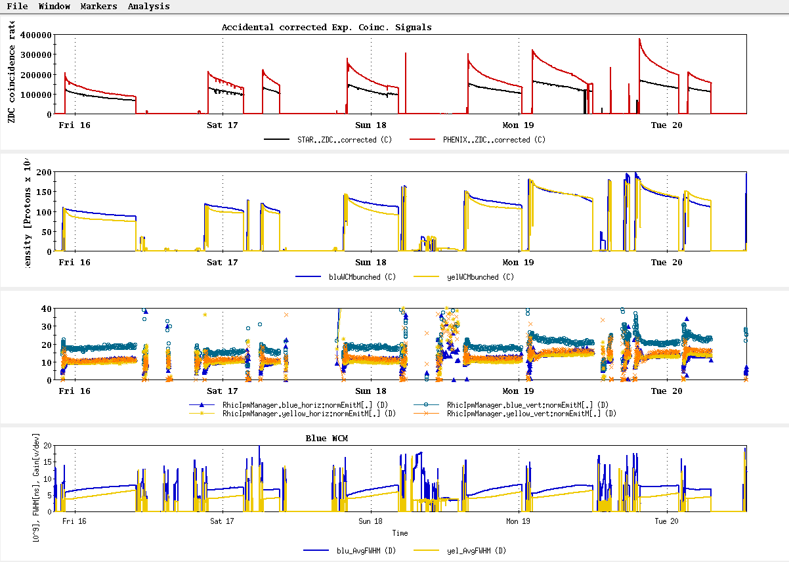
History
~L_{store avg} Goal

Slide 10
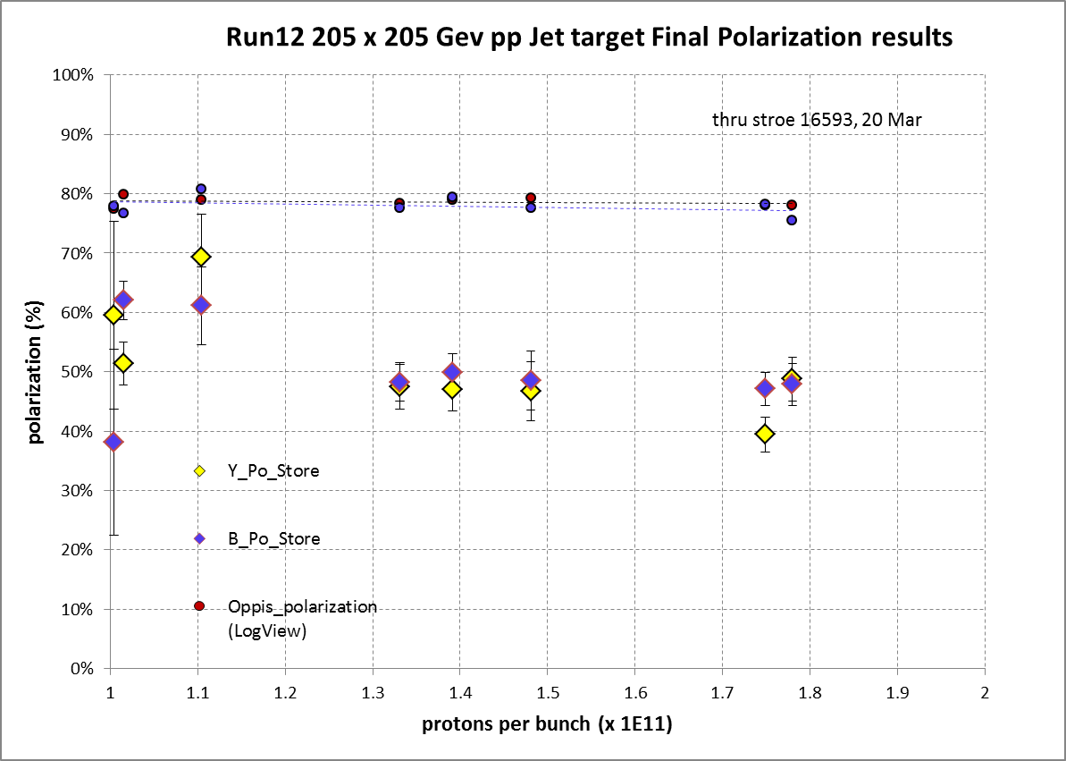
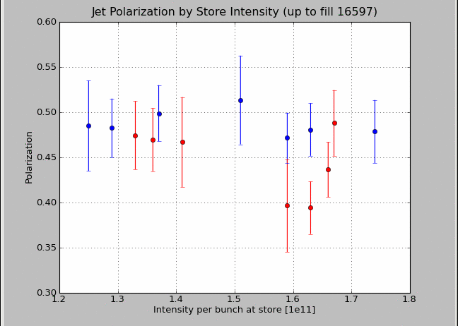
Intensity Dependence of Polarisation
transverse
longitudinal
longitudinal

Slide 11
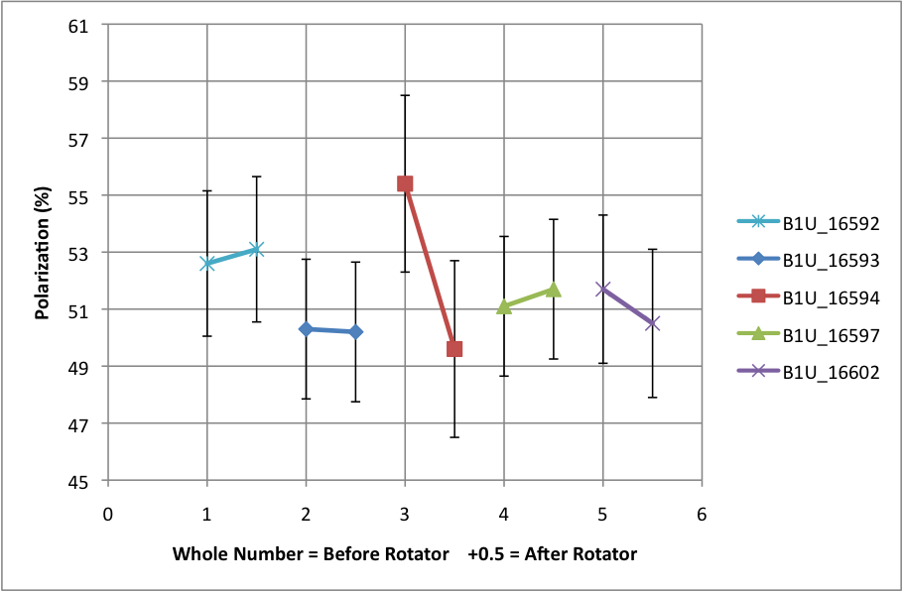
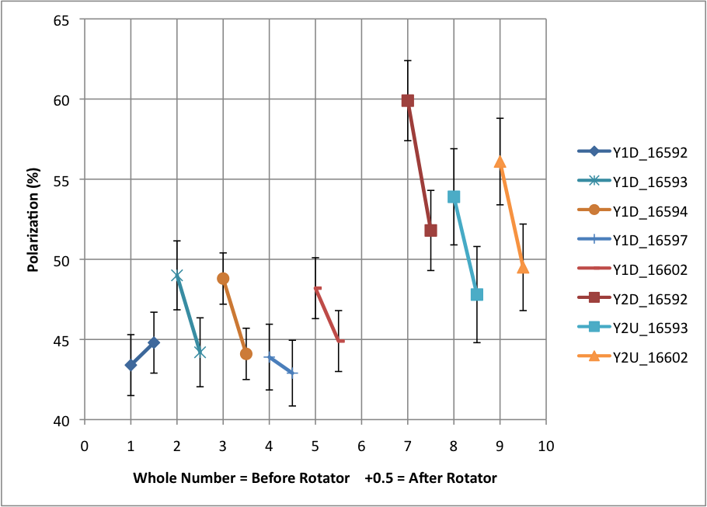
Polarisation loss through rotator ramp
Blue Beam
Shown are the polarisation
measurements before and
after the rotator ramp
at 255 GeV
Yellow Beam

Slide 12
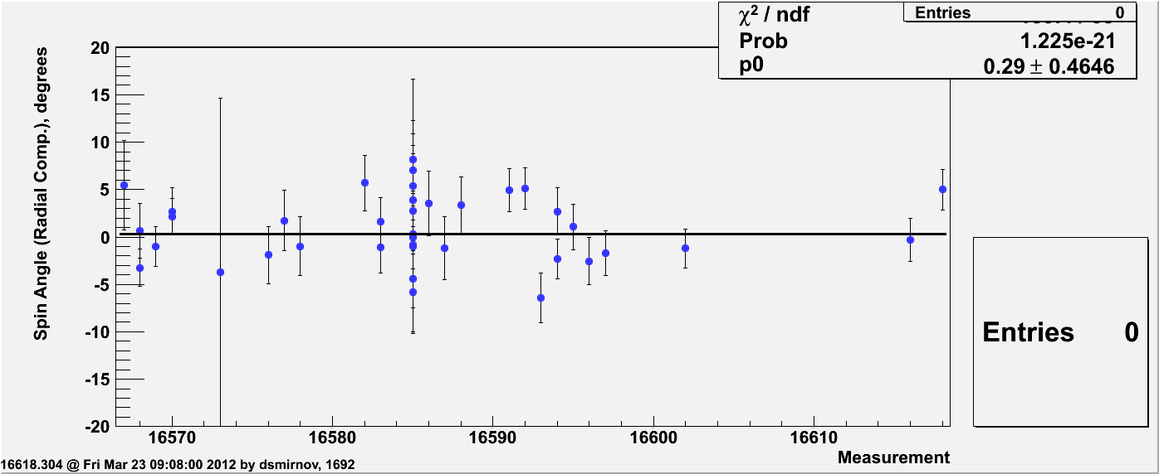
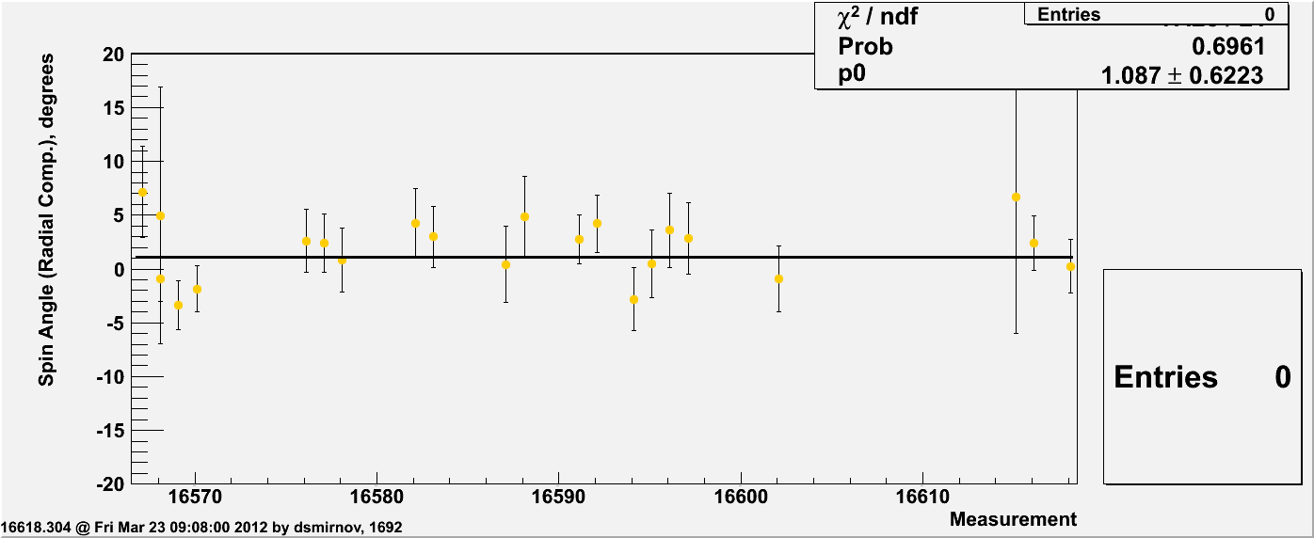
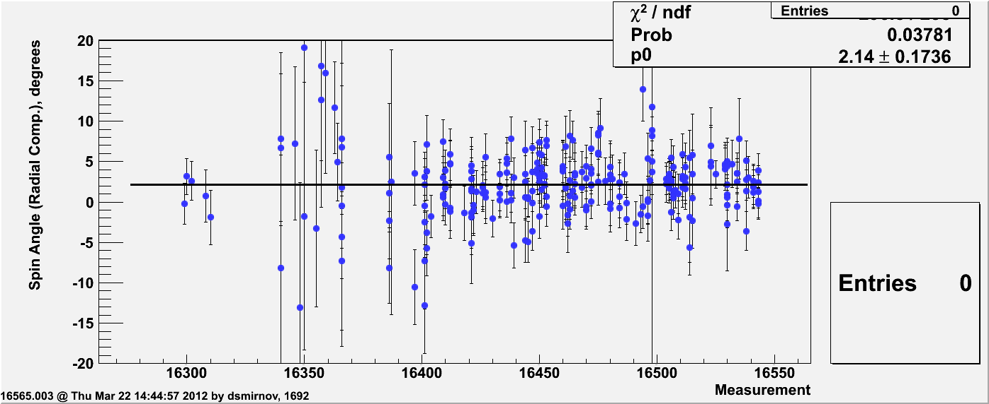
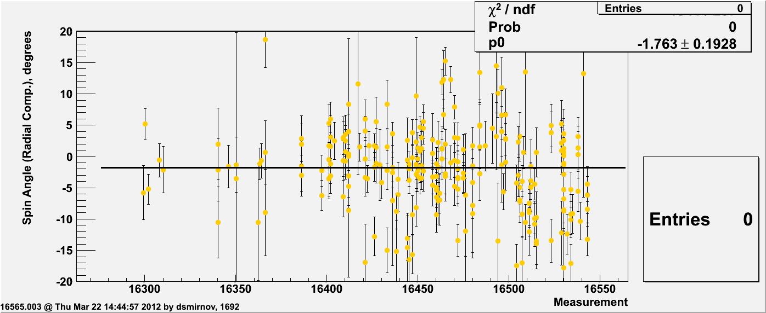
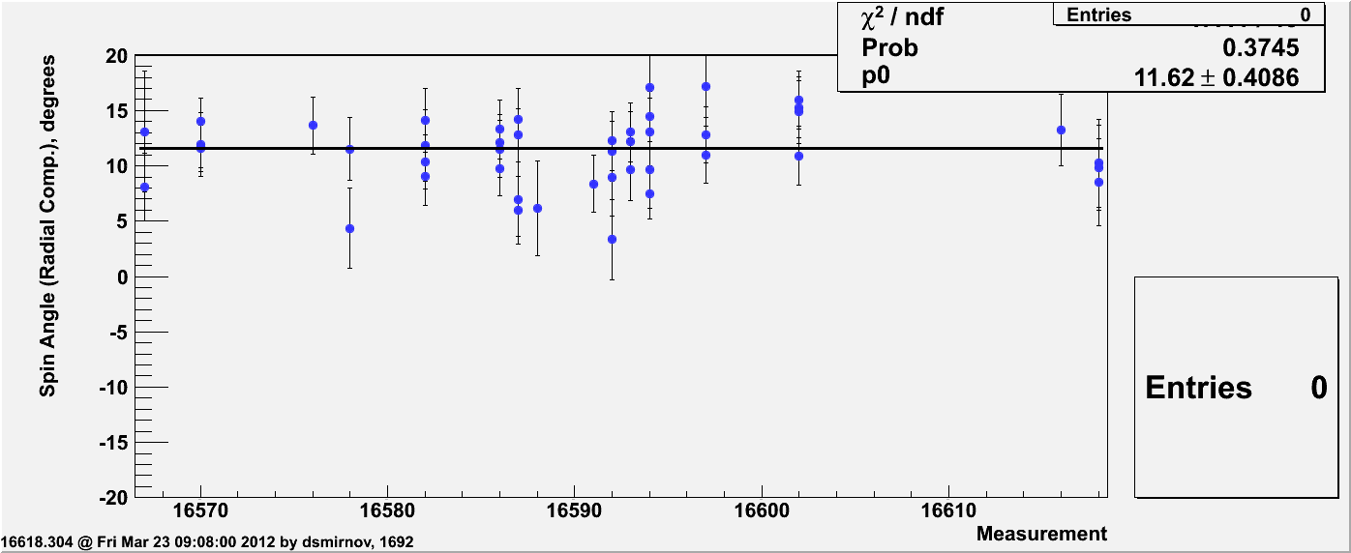
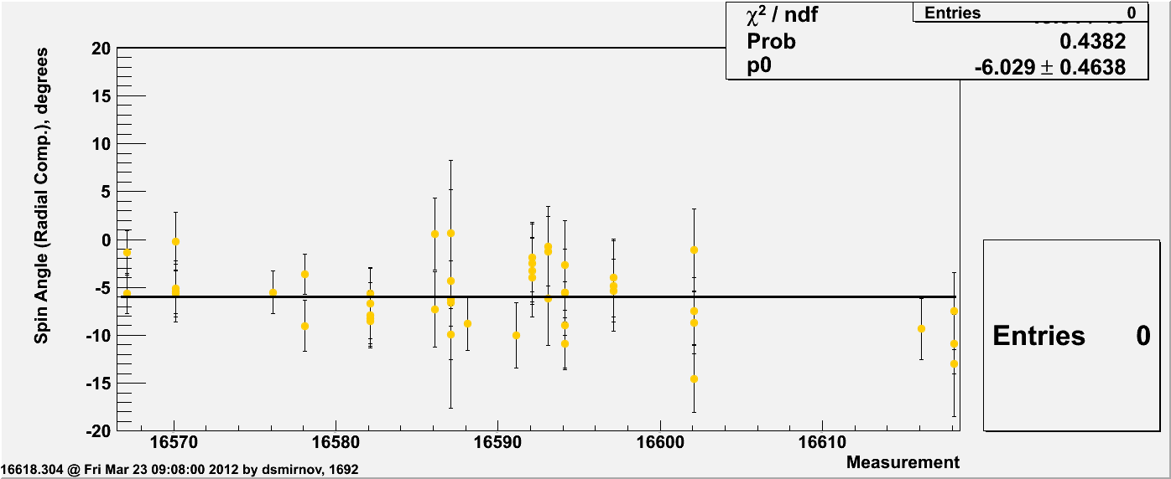
Radial SPIN Angle Measured by pC
24 GeV
100 GeV
255 GeV

Slide 13
Questions which Come to the Mind of a naïve experimentalist
Can we recover the loss of polarisation at injection
Do we understand the difference in flat top polarisation for the transverse vs. the longitudinal stores at 255 GeV
  could this point to an intensity dependence
  is the ramp procedure for a transverse and longitudinal store the same?
  would a transverse fill help to understand this difference ?
Could we do something about the loss in polarisation in yellow ~5% during the rotator ramp
There was some time ago talk about an energy scan could this help the polarisation at flat top
Do we understand why the transverse spin component changes without changes in the rotator setting

Slide 14
100 geV Results
polarisation at injection
Blue and Yellow
Caveat:
only first round of cleaning
up noise in polarimeters
was done
pC numbers not normalized
to jet

Slide 15
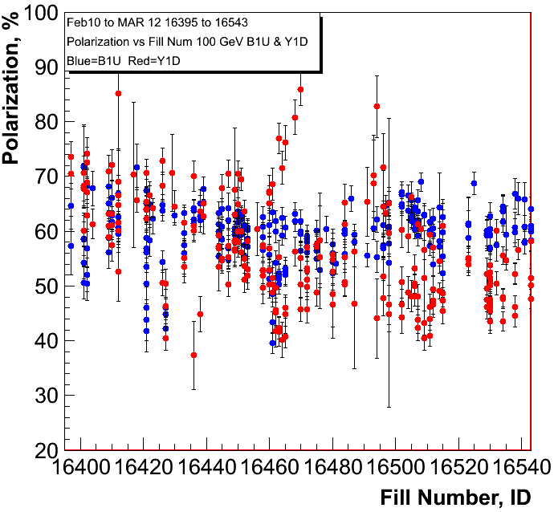
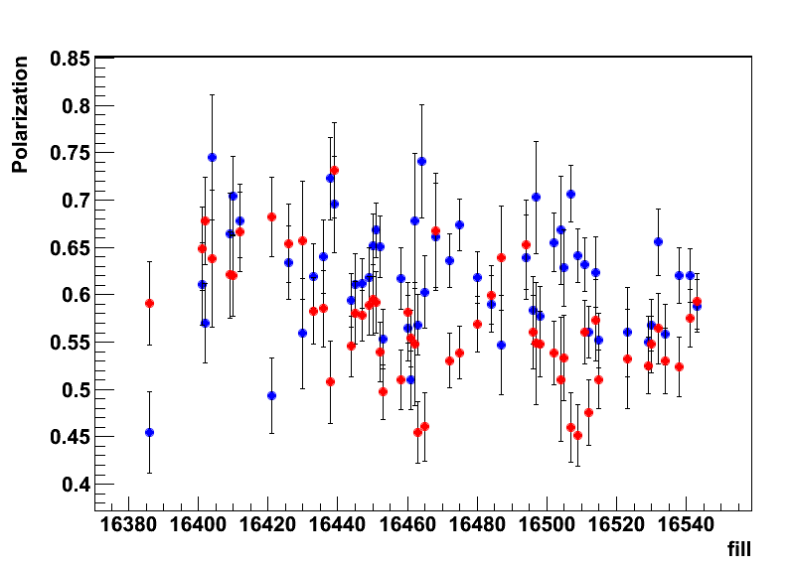
100 geV Results
polarisation at flat top
Blue and Yellow
H-JET

Slide 16
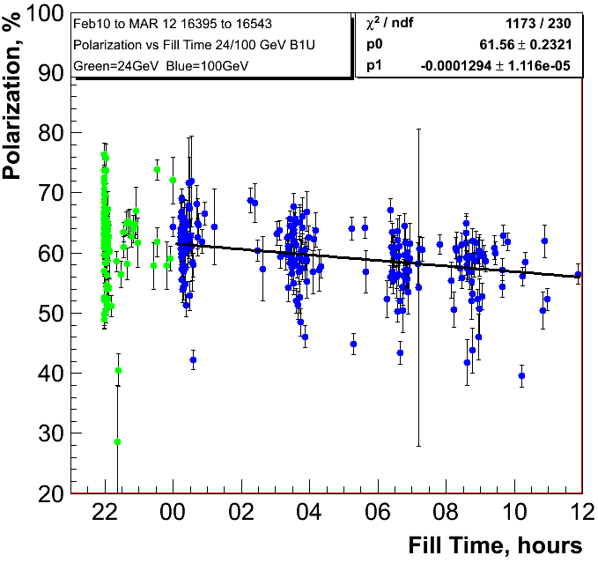
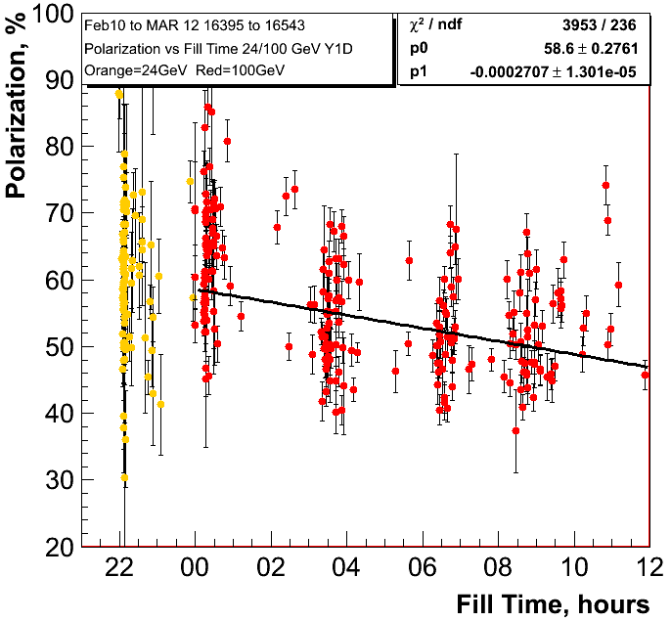
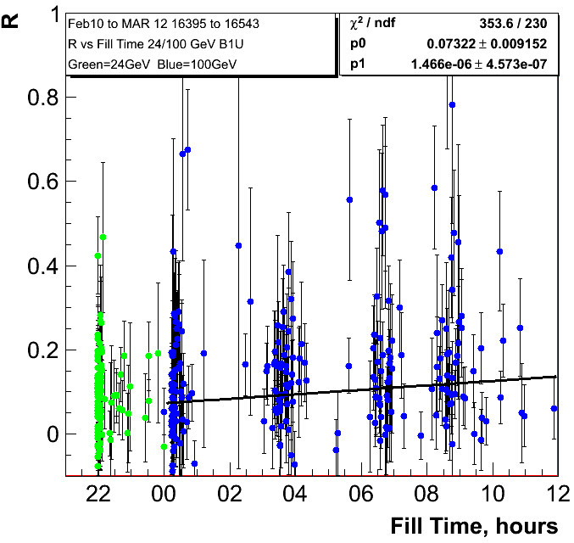
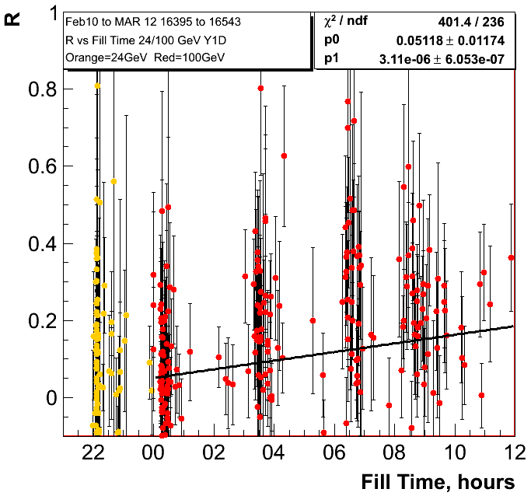
0.47%±0.040/hour
0.97%±0.047/hour

Slide 17
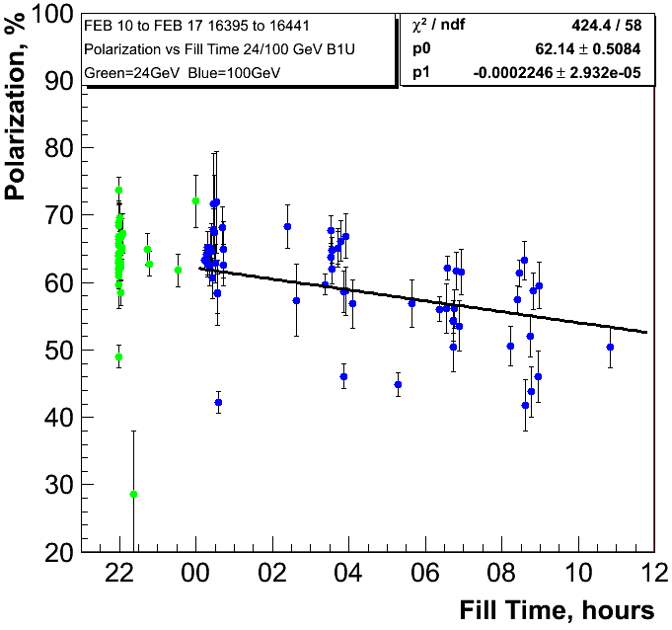
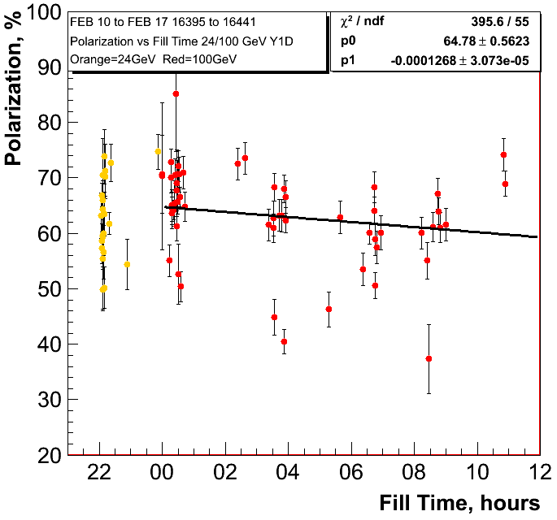
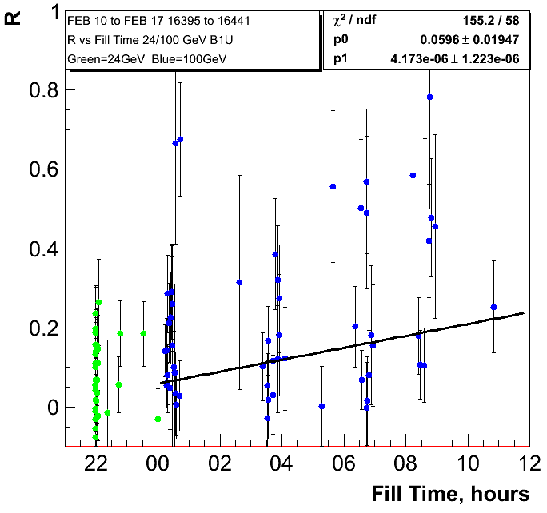
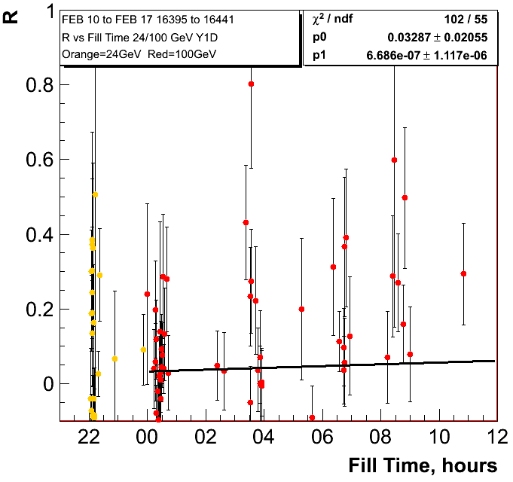
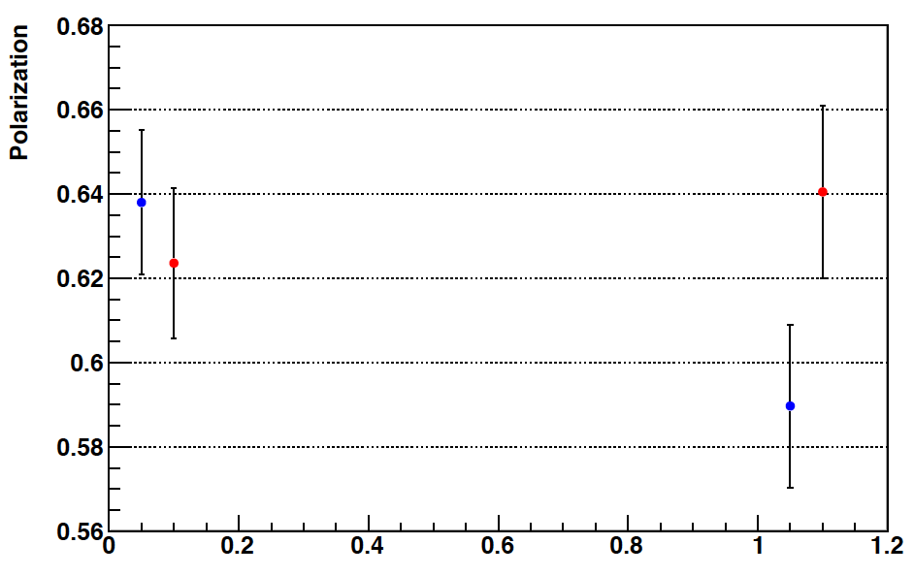
0.80%±0.11/hour
0.46%±0.11/hour
H-Jet
Fills: 16386-16439

Slide 18
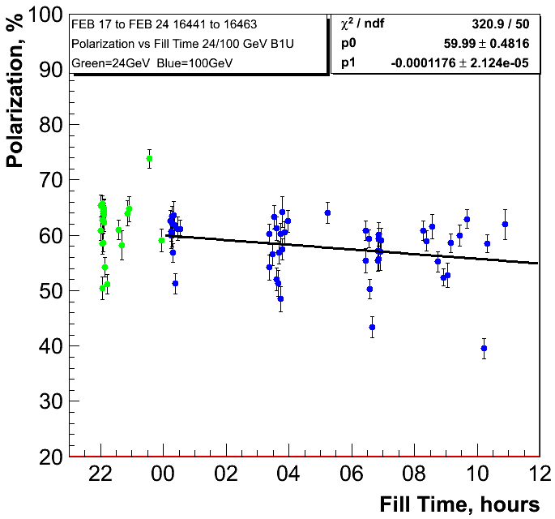
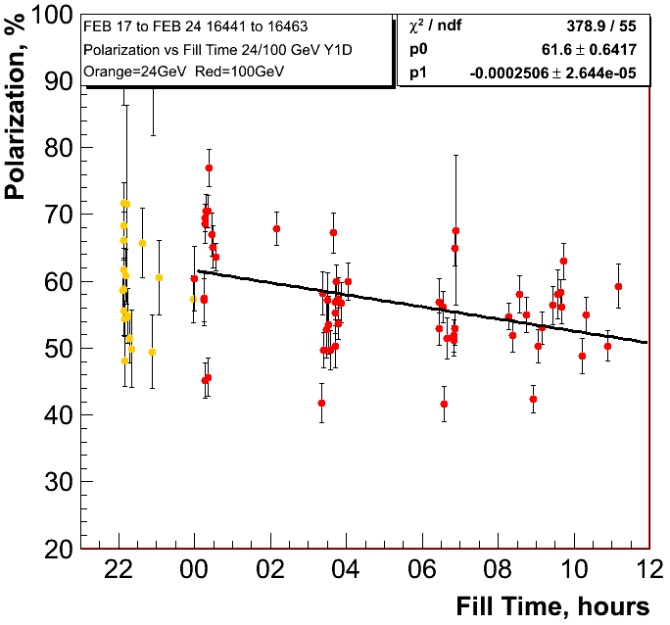
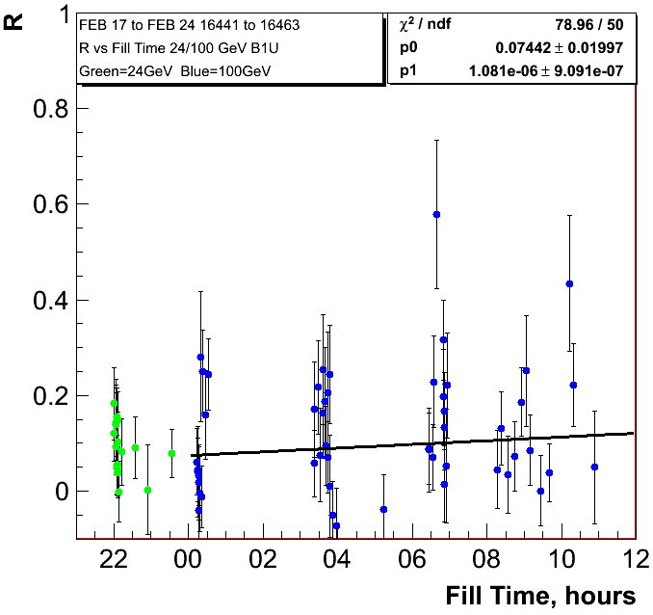
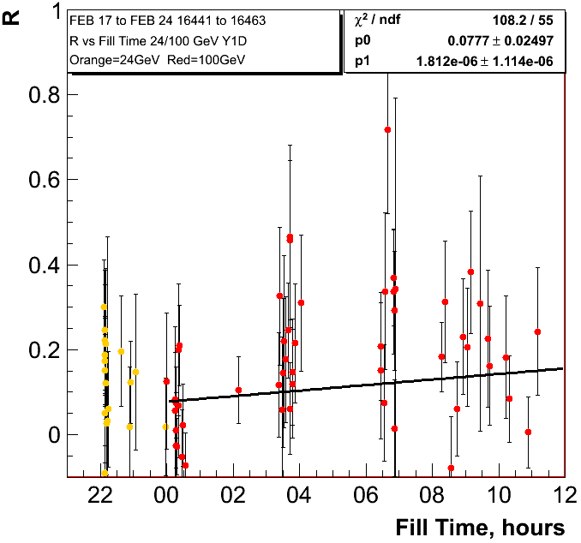
0.42%±0.08/hour
0.90%±0.095/hour

Slide 19
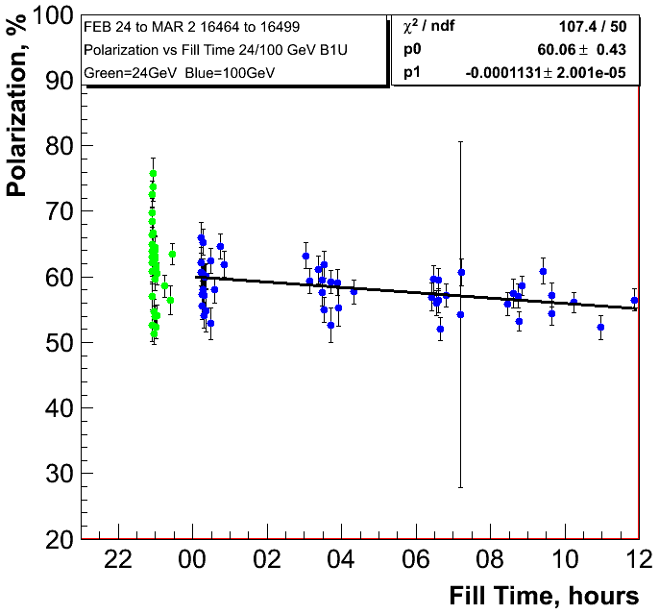
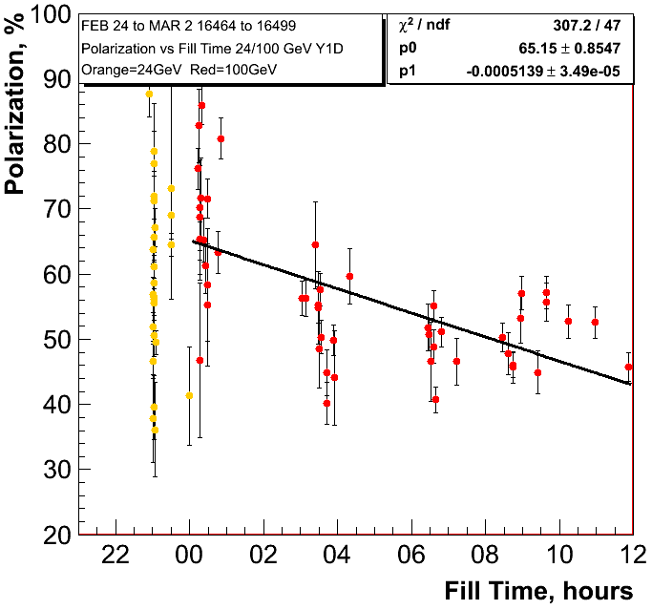
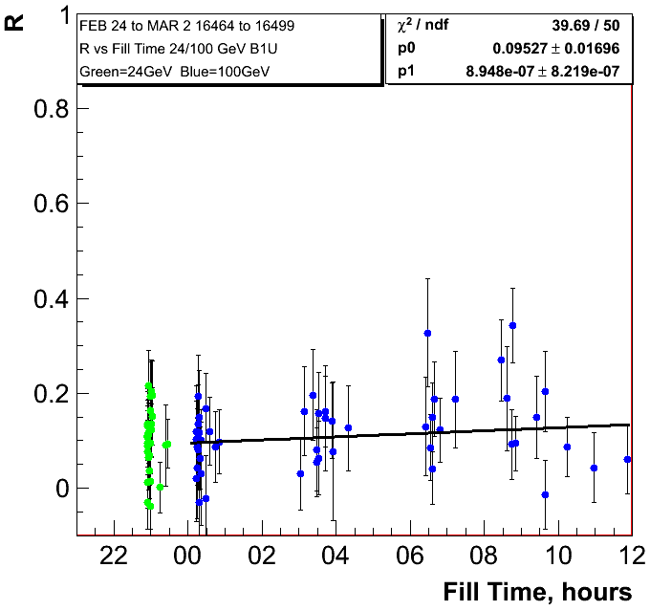
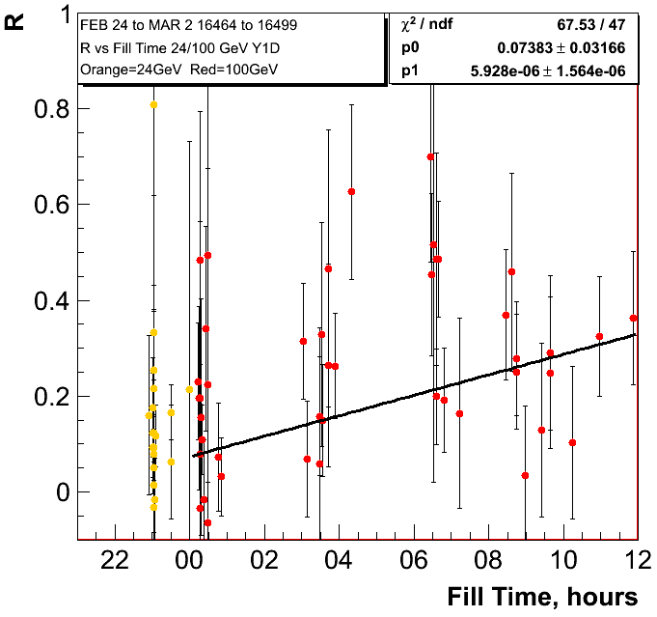
0.41%±0.07/hour
1.85%±0.13/hour

Slide 20





0.18%±0.118/hour
1.77%±0.17/hour
H-Jet
Fills: 16502-16511

Slide 21




0.35%±0.11/hour
0.76%±0.08/hour

Slide 22
Summary
100 GeV:
  main loss in polarisation through decay in fill
  polarisation decay varies from week to week for the two beams
  jet and pC polarimeters consistent observing the same trends
  could this nice data set be used to correlate it to machine parameters → improve polarisation at 255 GeV
255 GeV:
  the polarisation loss is through ramp to full energy, through rotator ramp and polarisation lifetime
  jet and pC polarimeters consistent observing the same trends
  current flat store polarisation consistent with 2011 average
  polarisation decay in fill “comparable” to 2011
  Is there any possibility to go back to the polarisation at 255 GeV transverse fills

Slide 23




1.08%±0.1
1.4%±0.21
Fills
16453-16461
before
split tunes

Slide 24




0.83%±0.15
2.16%±0.2
Split Tune Fills
16462-16465

Slide 25




0.23%±0.11
1.85%±0.19
Fills
16468-16478
after
split tunes

