Slide 1
RHIC Status
RHIC Spin Collaboration
V. Schoefer
3/9/12

Slide 2
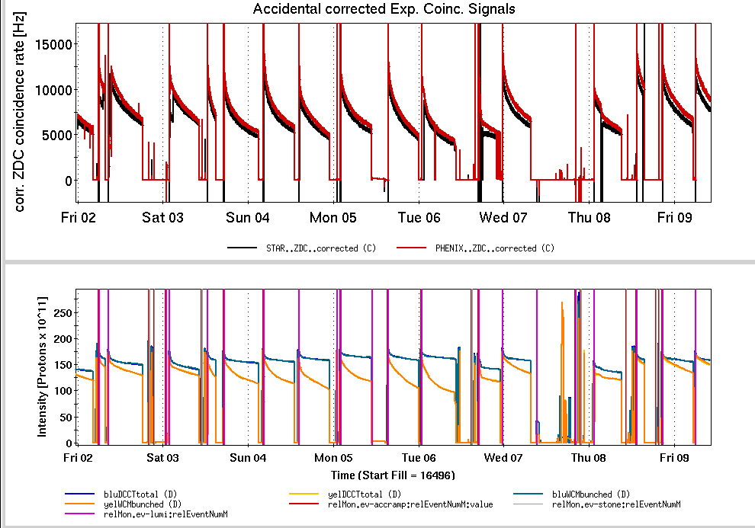
Status: 100 GeV
Ran into beam-beam limitation
Strong vertical scraping in Booster results in higher beam-beam parameter, yellow emittance blows up
Open questions:
Why is yellow emittance more sensitive to tune? (2/3 resonance strength?)
Is yellow polarization lifetime more sensitive to emittance than blue? (Pending re-analysis with calibrated IPM)
Yellow emittance blowup
Blowup from fill number 16506-16514

Slide 3
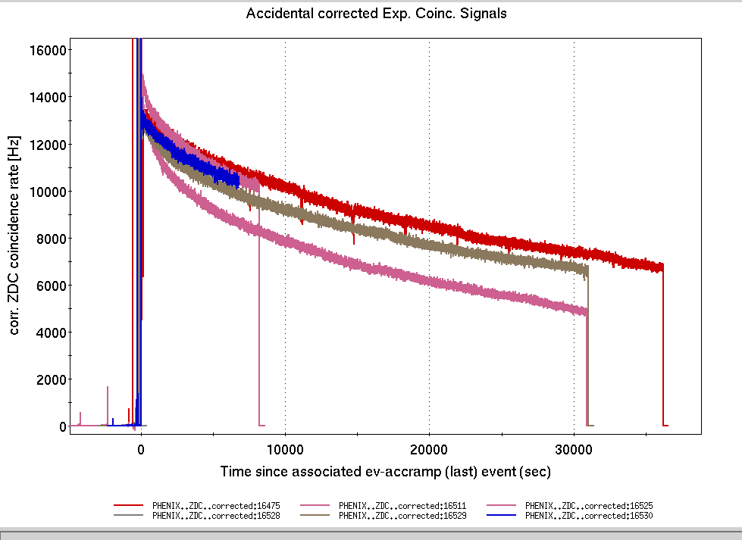
Three recent stores
Best integrated lumi
Sample ‘blow-up’ store

Slide 4
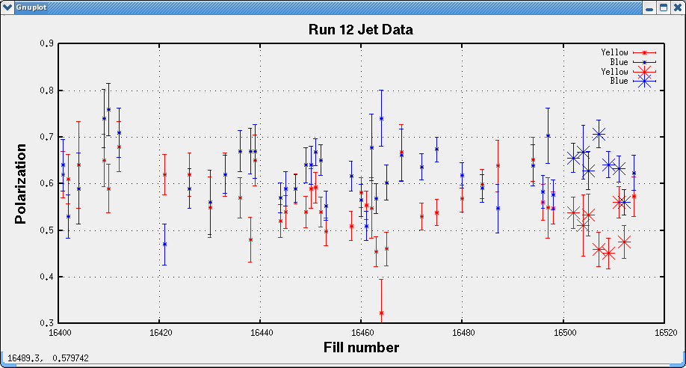

Slide 5
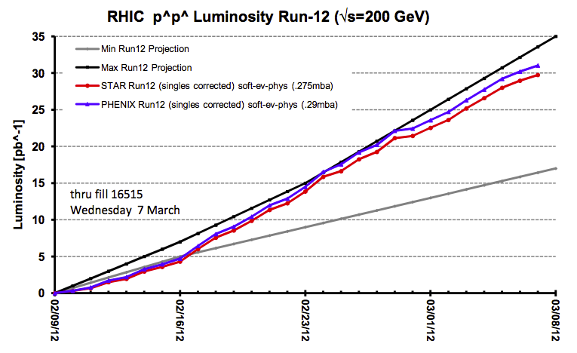

Slide 6
Planning for 255 GeV
DX magnets already trained to zero crossing angle at 255 GeV at IP6, 8 and 12
  IP2 to be trained to zero crossing angle during Mar 14 maintenance
Beta* = 0.6 m at IP6, 8
  IP2 at 2 m
Will begin at 255 GeV

Slide 7
Polarized Proton: 100 GeV to 250 GeV Changeover Schedule (Run 12)
 | 12-Mar | 13-Mar | 14-Mar | 15-Mar | 16-Mar | 17-Mar | 18-Mar
 | Mon | Tues | Wed | Thur | Fri | Sat | Sun
OWL | 100 Gev Physics | Energy ramp increasing bunch number/intensity | Ramp dev. (Trans. Store?) | Ramp dev., Long. Store conditions | 255 GeV physics
DAY | p.s. setup 5-6 hours, Begin 255 GeV Ramp Development | Rebucketing setup (maybe <1 shift) | MAINT. | Finish standard optics measurements, transition to. Stores | Contingency
EVE | Energy ramp development | Rotator ramp dev. | MAINT.+ Recovery and ramp devel. | Transition to 255 Gev physics (trans. store?) | 255 GeV physics

