Slide 1
AGS PP Progress
Haixin Huang
RSC Meeting
February 24, 2012

Slide 2
Progress in Last Two Weeks
Jump quad overall timing scan is done.
Jump quads timing scan on last pulse is done.
Another set of Ggamma=3,4 harmonic scan is done at AGS injection with CNI polarimeter. The cos3v peak moved by 1A or relative 2%. The corrector current was set as high as 22A, not full spin flip yet. Power Supply group give green light to run the P/S at 25A. We will do when we have beam available at injection. They also modified one P/S to run at 30A. Will need to develop an algorithm to use this one to get higher harmonic component.
AGS CNI Polarimeter has switched to the fast analysis. 180s->6s analysis time. Andrei updated the intensity correction factor (about 50% of the one he used for last run). The 1.1 correction factor is removed. In the end, the polarization value reported at 1.5-1.7*10^11 intensity does not change much from previous numbers. But it showed less intensity dependence now.
First intensity scan is done with smallest horizontal target (less rate). We are going to do more intensity scan with different targets to confirm that the rate correction we put in makes sense.
Polarization profile measurement through sweep measurement has been done with both horizontal and vertical targets. The profile have been derived, but no rate correction considered. The correct one will have the rate correction included.

Slide 3
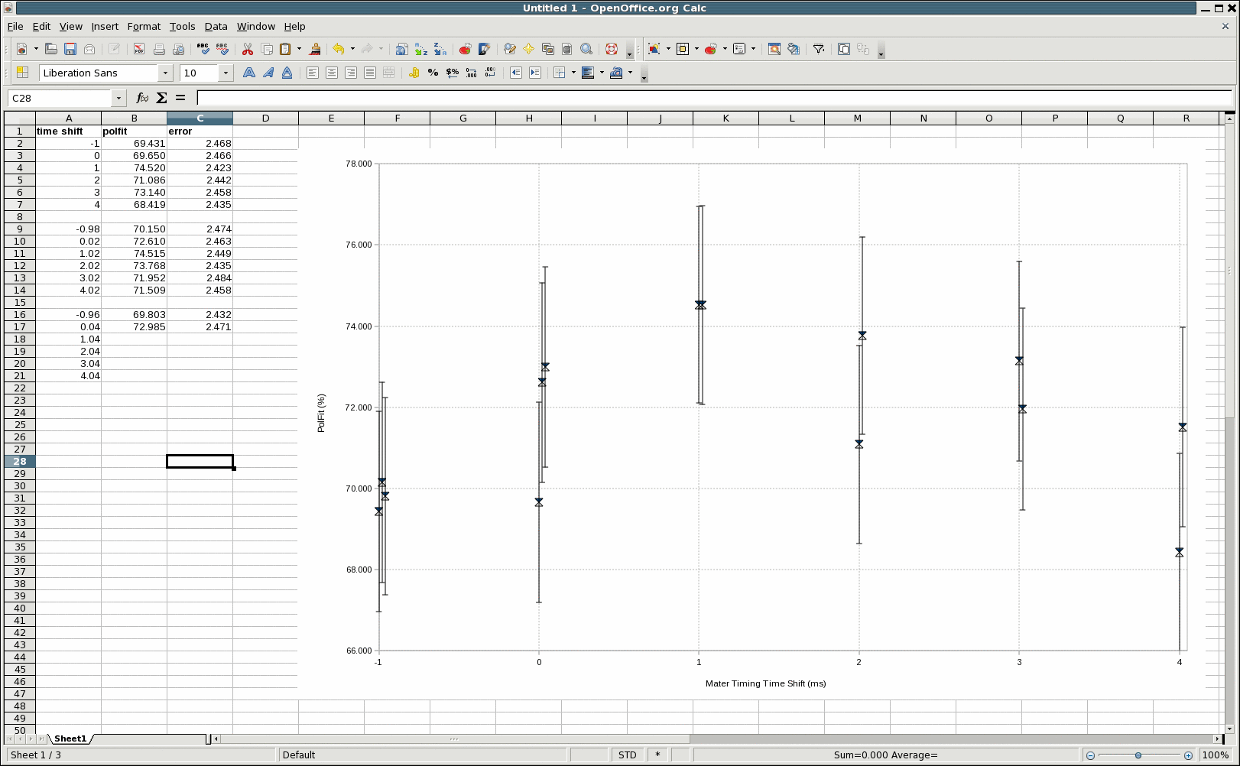
Timing Scan for Last JQ Pulse
Note: this is effect from one resonance crossing, so it is significant if it is true.

Slide 4
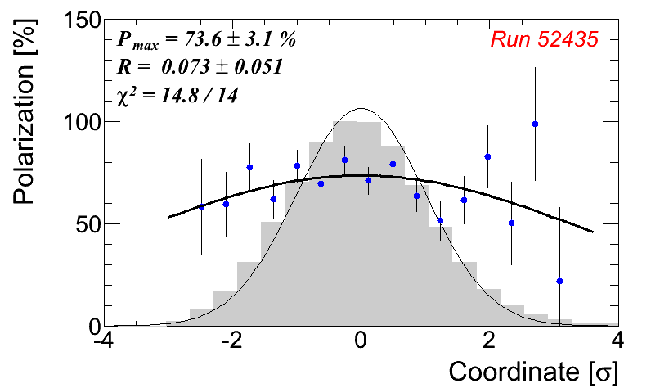
Example of One Run
Analyzed by Andrei, no rate correction yet

Slide 5
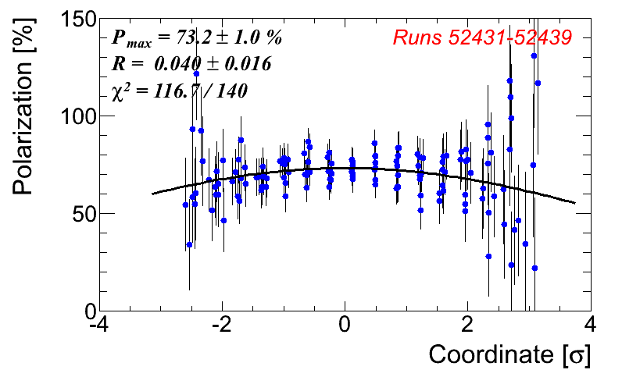
Horizontal Polarization Profile
Analyzed by Andrei, not complete data set, no rate correction yet

Slide 6
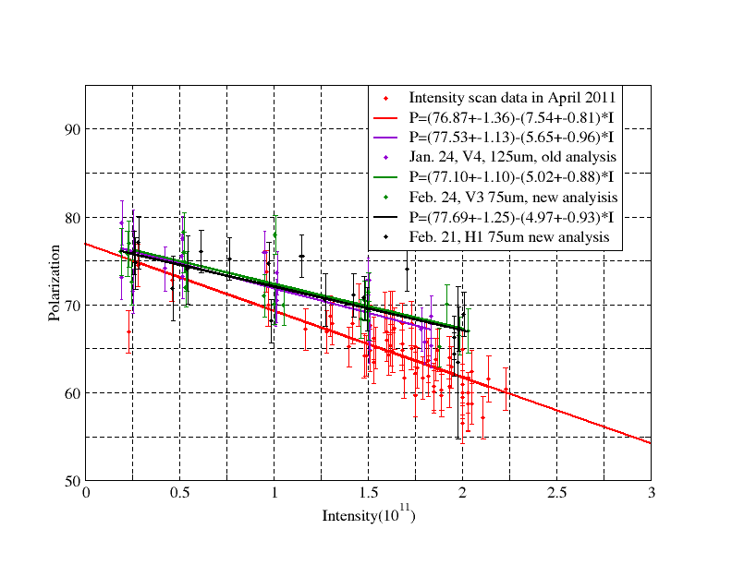
Latest Intensity Scan with New & Old Analyses
Rates are very different for H1 and V3 due to beta functions.

Slide 7
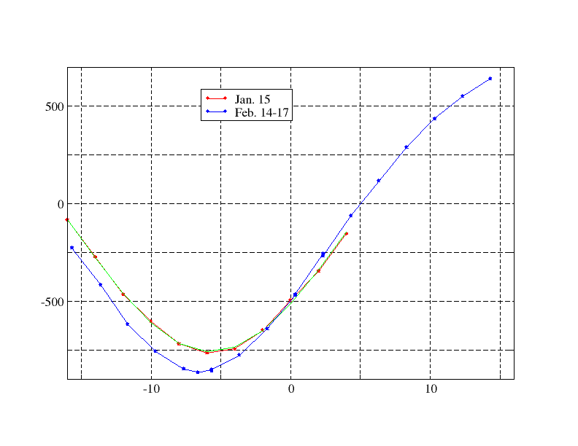
Cos3V Scans over a Month apart
The change of optimal current is believed due to the sine and cosine knobs are not orthogonal to each other.

