Slide 1
RHIC Status: Startup Run 12
V. Schoefer
RHIC Spin Collaboration Meeting
1/13/12

Slide 2
Outline
Startup schedule
Improvements for Run 12
Further LLRF commissioning
9 MHz
Luminosity
Slight reduction in beta* (100 GeV)
Emittance measurement, reduction and maintenance
Polarization
Source improvements (Einzel lens + suppression tune)
Store energy change (250 GeV polarization lifetime)
Emittance improvements
Possible ramp transmission improvements (100->250 GeV)
Lattices and projection

Slide 3
Start Up Outline
Jan 3-9: Successful, addressing outstanding items now
Jan 17 : Start of final cooldown
Jan 21: Earliest injection into blue
Followed by 9 MHz capture
Instrumentation setup
Jan 24: Yellow injection
Followed by 9 MHz capture
Instrumentation setup
Sat Jan 28: Power supplies ready for ramp
Actual readiness for ramp depends on LLRF progress
Beam-to-flattop time expected to be short (~ 1 ramp)
by Friday Feb 3: Midnight shift collisions (day/eve still development)
week of Feb 6: Final ramp up and into production with 100 GeV

Slide 4
RF: Low-level
Addresses problems from last year: reliability, emittance growth
9 Mhz bouncer feedback loops improved for less noise
‘bunch-gating’: will allow bunch-to-bucket phase feedback during injection, preserves emittance while sitting at injection
Independent control of AGS extraction energy for extraction to blue/yellow
9 MHz matching very sensitive to energy error
I expect this to be the pacing item for startup

Slide 5
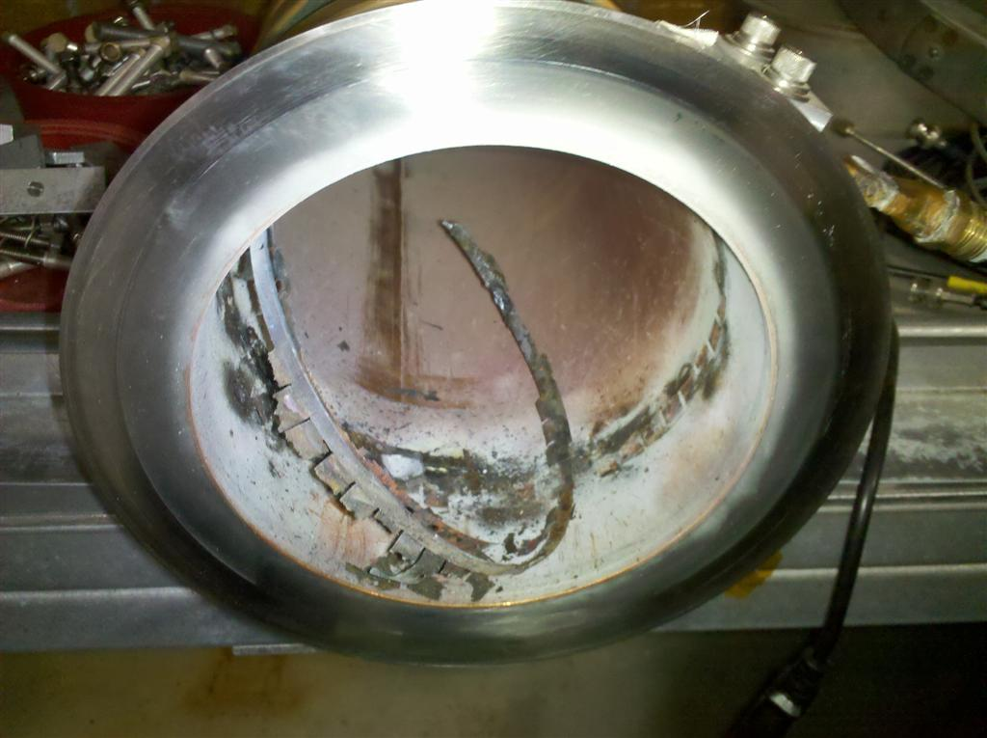
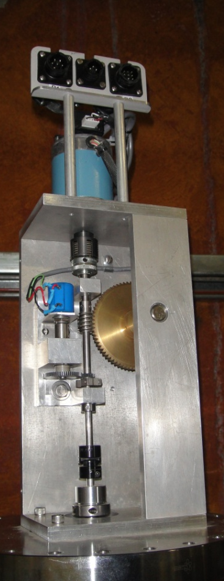
RF: High level - 9 MHz Cavity
Two source of downtime in Run 11:
Mechanical linkage in the tuning servo of the 9 MHz cavity was loose. This was very hard to trouble shoot
High-level rf failure (spring fingers)
Loose linkage slowed the startup/ramp
Burned RF spring fingers caused the version to 28 MHz ramps in the last week of the run
Both issues resolved. RF shield redesigned to eliminate hot spot
We will start Run 12 with the 9MHz cavity
Rebucketing to 28 MHz at store and squeeze with 197 MHz
Burned up spring fingers
Loose linkage in tuning servo

Slide 6
Emittance Monitoring
Vertical emittance in AGS is difficult to measure/maintain (near integer)
New dipole installed to measure the (rapidly changing) optics immediately at the IPM through the cycle
Can better quantify growth at injection
Maybe can identify growth on the ramp
Similar method available for optics measurement in RHIC
New flags installed in AtR for precision measurement of transfer optics
Addresses discrepancy between blue and yellow transmission and possible emittance dilution at RHIC injection

Slide 7
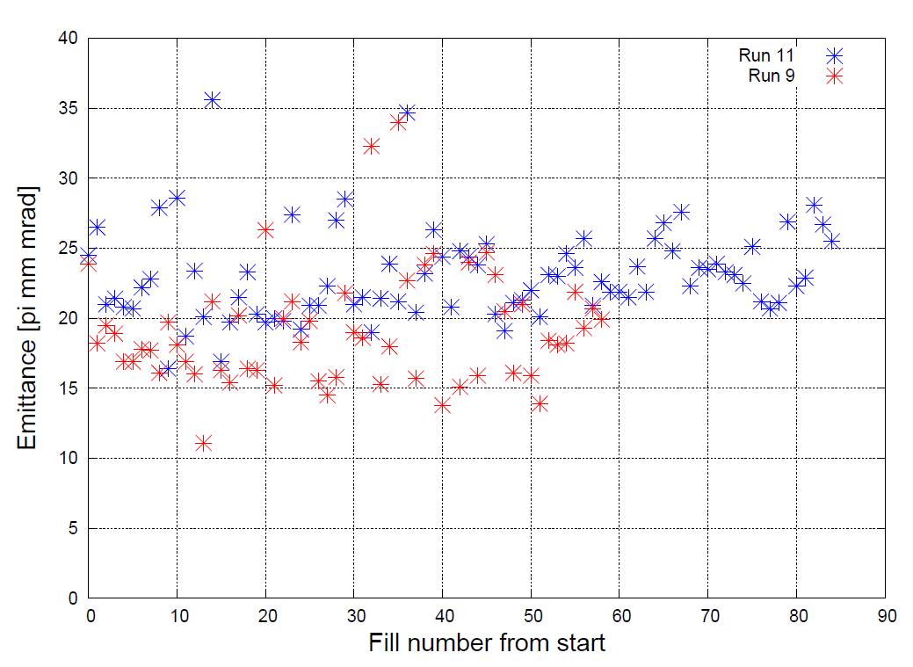
Emittance: Consistency
If the Run 11 ZDC calculated emittances were capped at their MEDIAN value, that is a 10 % decrease in average emittance.
20 % increase in luminosity, just from consistently meeting a relatively weak constraint.
More precise measurement and monitoring will help
(from lumi)

Slide 8
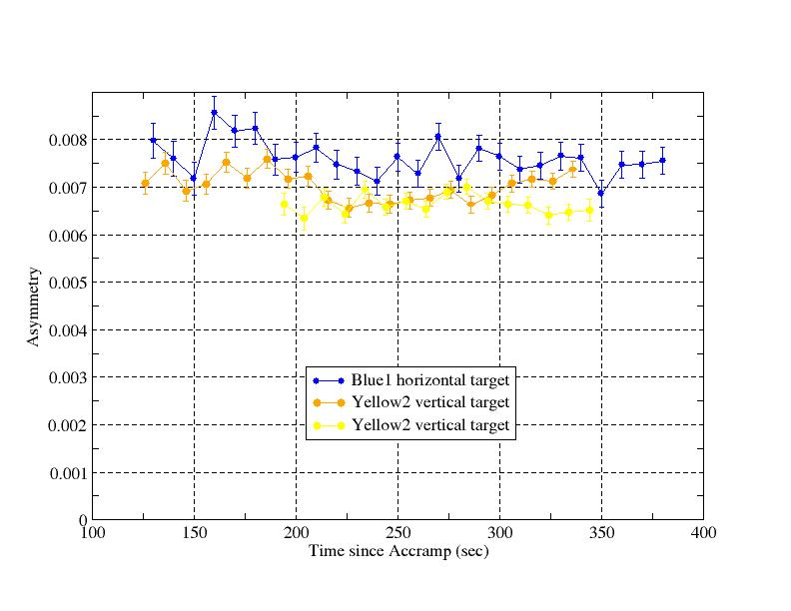
Polarization Transmission in RHIC
Acceleration of beam from
100 GeV to 250 GeV and back to 100 GeV suggests 10 % (absolute) polarization loss between 100 and 250 GeV.
The mechanism for the remaining loss is not well-understood and continues to be studied with tracking.
Not a clear step down at the location of an identifiable resonance

Slide 9
Possible RHIC Polarization Loss Mechanisms
Sub-optimal store energy: polarization lifetime (loss of 5%, absolute, during 250 GeV store)
Transverse coupling during the ramp
Global coupling appears well-corrected
Fast local coupling measurement for Run 12
10 Hz orbit oscillations
Feedback on the ramp demonstrated with Au in Run 11
Vertical dispersion
Primary source is our own coupling correction, new correction algorithm to be tested in Run 12

Slide 10
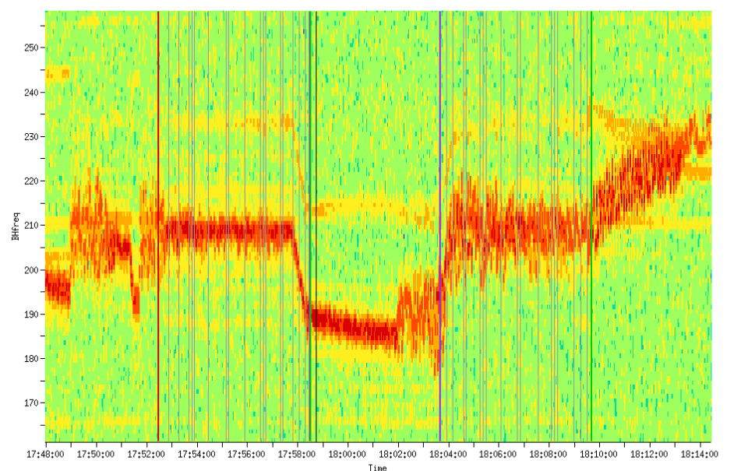
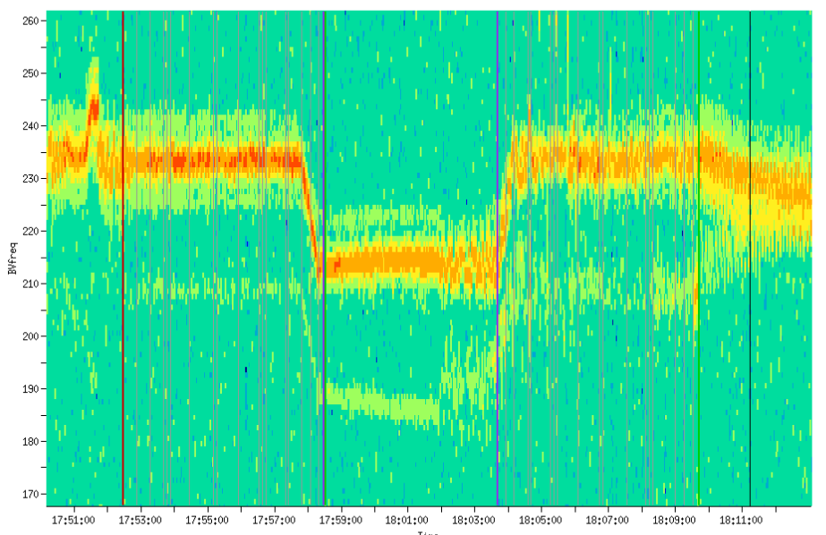
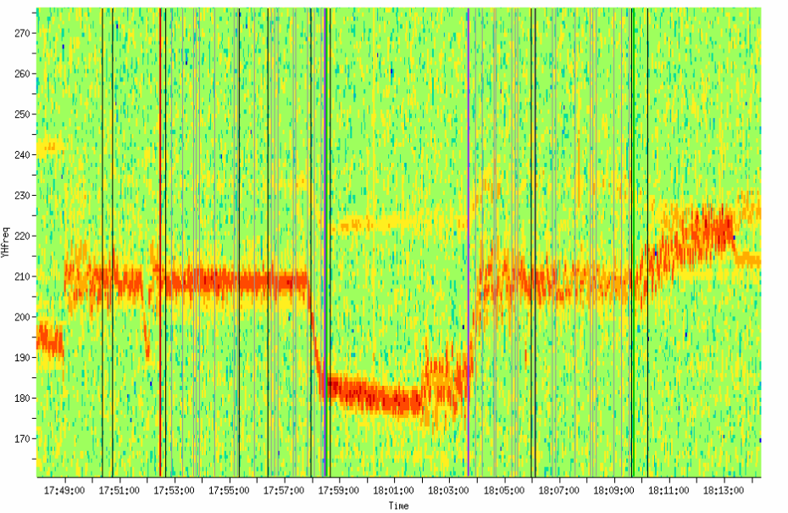
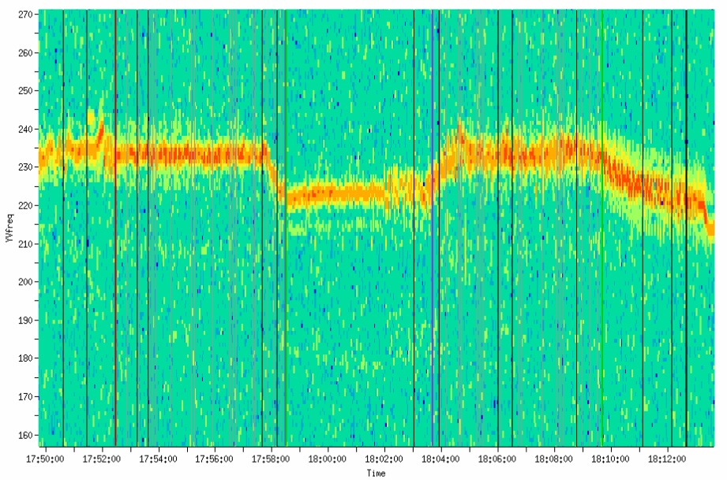
Ramp coupling
Blue
Yellow
Horizontal
Betatron frequency
Vertical
100 250 100
100 250 100
GeV
GeV

Slide 11
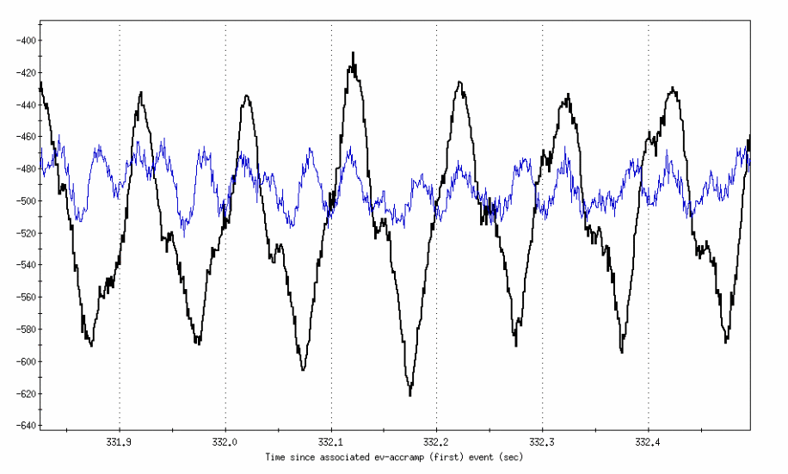
Orbit oscillations at 10 Hz
Mechanical vibration of triplet quads causes transverse position oscillations. Horizontal change is of order 2-3 mm, but 200 um (peak-to-peak) in vertical
--- Feedback off
--- Feedback on
Feedback routinely used at store through Run 11, demonstrated effective on the ramp only at the end of Run 11 during the heavy ion run.
Vertical position (um)
Time since ramp start (s)

Slide 12
RHIC 100 GeV Polarized Proton Parameters
Parameters | Run 12 Goal
Interaction points | 6 8
β* in blue [m] | 0.85 0.85
β* in yellow [m] | 0.85 0.85
Working points (ramp and store) | 28.695, 29.685
Luminosity/Week | 10 pb⁻¹ (max)
Polarization (Jet) | 60-65%
Peak bunch intensity | 1.35 × 10¹¹
Peak luminosity | 0.5 × 10³² cm⁻²s⁻¹
Down from 1 m in Run 9
No tune swing

Slide 13
RHIC 250 GeV Polarized Proton Parameters
Parameters | Run 11 Achieved | Run 12 Goal
Interaction points | 6 8 (AnDY test at 2) | 6 8
β* in blue [m] | 0.8 0.6 | 0.65 0.65
β* in yellow [m] | 0.65 0.63 | 0.65 0.65
Working points | Ramp: (28.680, 29.673) Store: (28.69, 29.68) | Ramp: (28.680, 29.673) Store: (28.69, 29.68)
Luminosity/Week | 25.4 pb⁻¹ (the best, 4/5-12) | 40 pb⁻¹ (max)
Polarization (Jet) | 46%* | ~50%
Peak bunch intensity | 1.65 × 10¹¹ | 1.65 × 10¹¹
Peak luminosity | 1.6 × 10³² cm⁻²s⁻¹ | 2.0 × 10³² cm⁻²s⁻¹
*Average of jet polarization is 46% for both rings. Taking into account for the polarization profile correction factor (R=0.2), The polarization seen by experimenters is boosted by Sqrt(1+R)=> 50%.
Notes:
Peak luminosity goal nearly achieved, but at higher intensity than anticipated.
Higher intensity is a product of the 9 MHz cavity commissioning.
Problem is the emittance.

