Slide 1
PHENIX Run 12
John Koster
RBRC
RSC Meeting
2012/01/13

Slide 2
Outline
Physics expectations
Upgrades/Accomplishments during 2011 shutdown
Commissioning plans
News from spin service tasks
  Local polarimetery
  Relative luminosity (special plans/runs for run12)
  Vernier scan

Slide 3
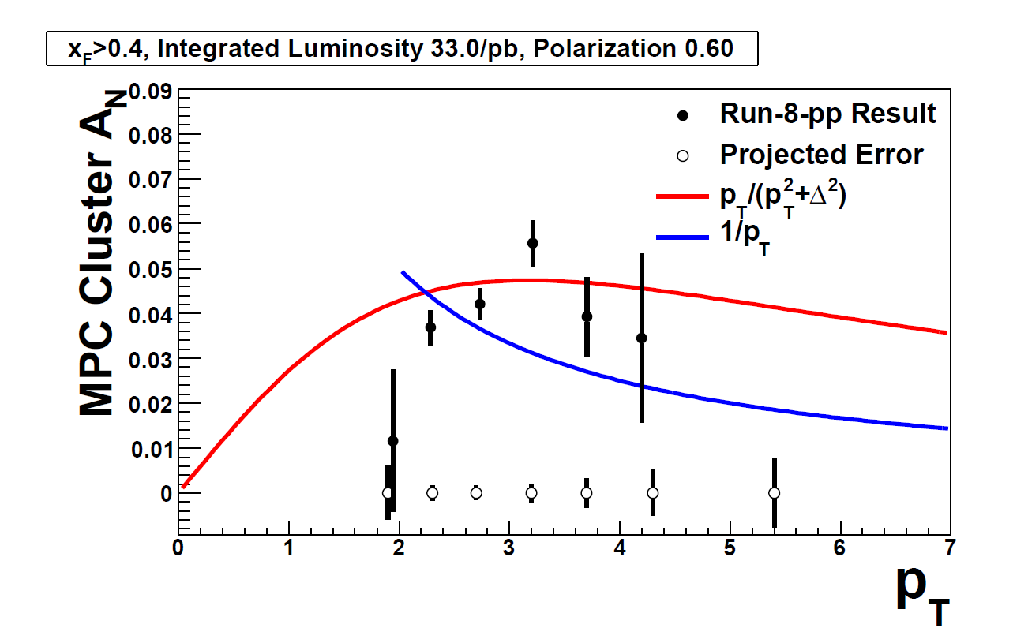
High p_{T} Neutral Pion A_{N}
200 GeV pp Transverse
Motivation:
Search for expected falloff of A_{N} at large p_{T}
Run 12 goal:
Reduce statistical errors
Measurement will be enhanced by improved MPC electronics
PHENIX preliminary data

Slide 4
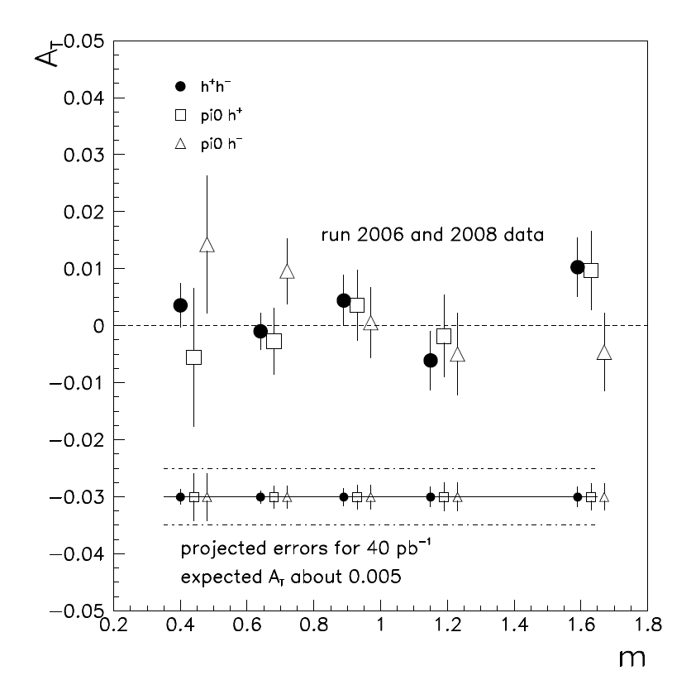
Probing the Transversity Distribution
200 GeV pp Transverse
Motivation: extract the transversity distribution using Interference FF
Run 12 goal: reduce statistical errors on our existing measurement.
PHENIX preliminary data
m_{Pair} (GeV/c²)

Slide 5
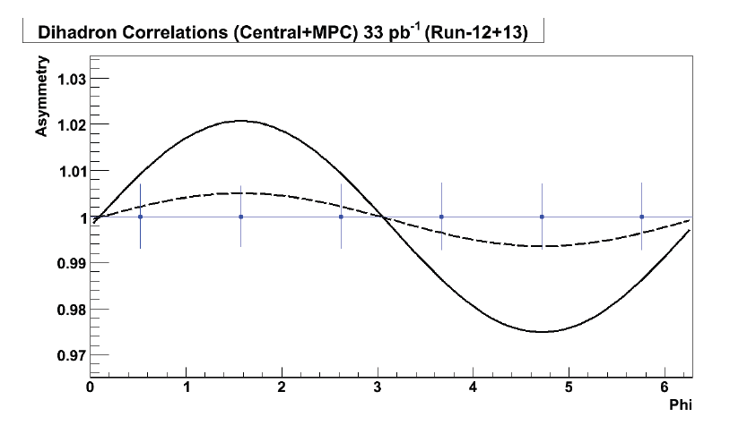
Probing the Transversity Distribution (2)
200 GeV pp Transverse
Motivation:
Extract transversity distribution using Collins FF
What is magnitude of expected asymmetries?
Transversity tuned to produce:
25% of PHENIX forward A_{N}
100% of PHENIX forward A_{N}
Simulations by Joshua Perry and John Lajoie

Slide 6
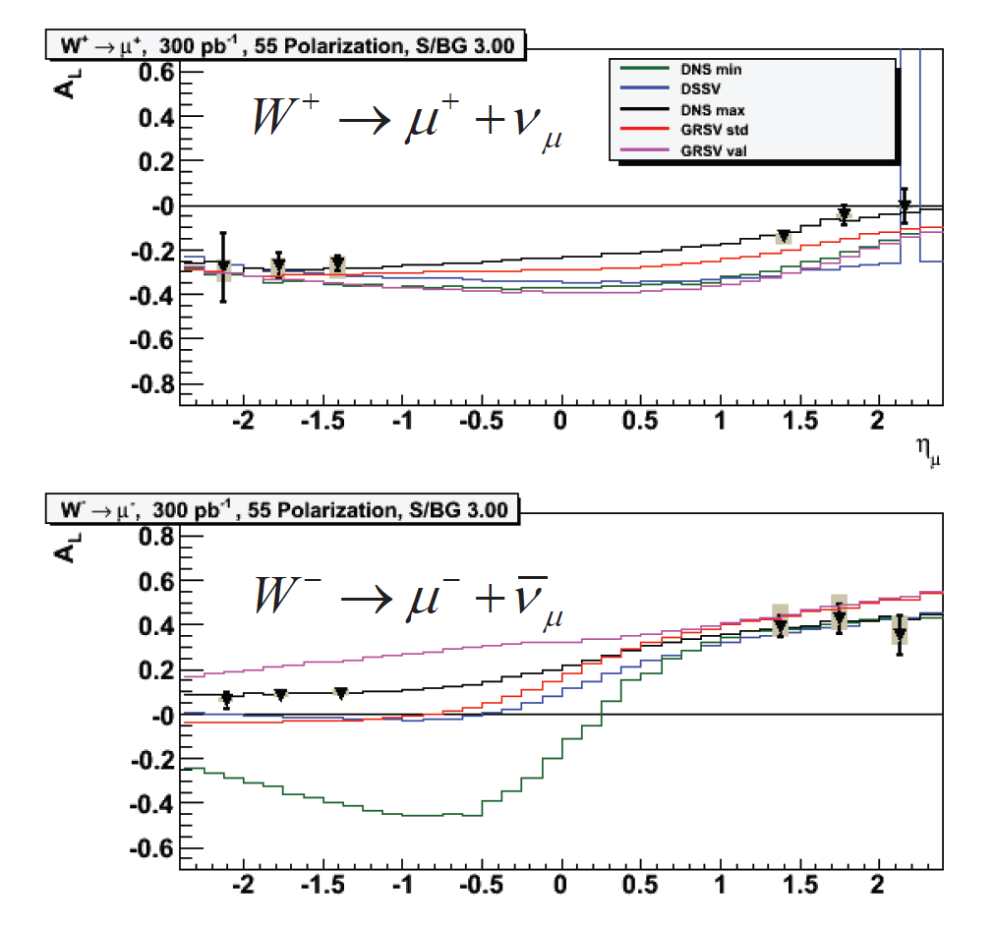
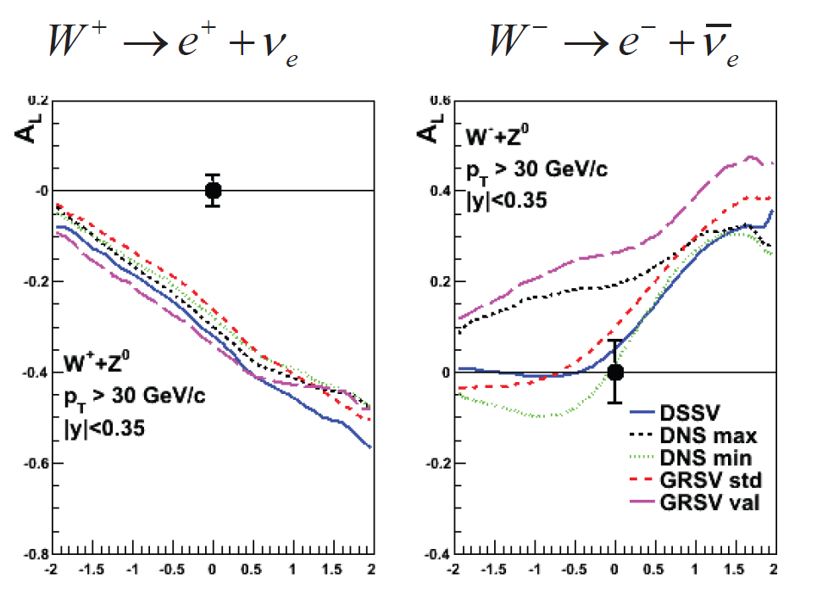
Accessing the sea quark polarization
500 GeV pp Longitudinal
Projections based on 300 pb⁻¹ at 55% polarization
Important that we get as much luminosity and polarization as possible this year
Hardware for efficient triggering is now in place for forward muons

Slide 7
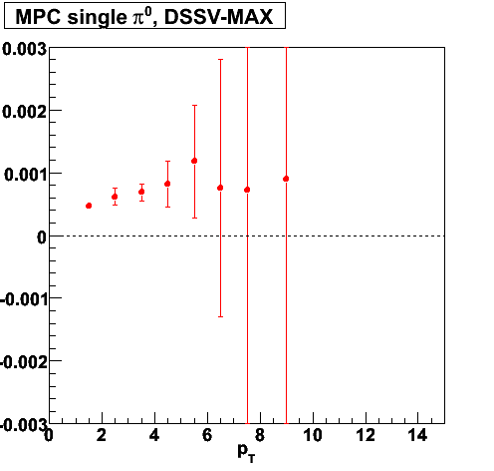
Measuring the low-x gluon helicity distribution
500 GeV pp Longitudinal
Projected A_{LL} for neutral pions at forward rapidity assuming
DSSV: ∆χ²/χ² = +2%
Probes the low-x region
Will take advantage of large projected luminosity but requires reduction of PHENIX’s relative luminosity errors
  Our plan is briefly discussed at the end of the talk
  Will be topic of dedicated RSC meeting
Measurement will be improved by upgraded MPC electronics
Projected asymmetry and statistcal errors
300 pb⁻¹
55% polarization
Current PHENIX sys. errors
3.1<|ƞ|<3.7
Simulations by Cameron McKinney

Slide 8
2012 Upgrades/Commissioning

Slide 9
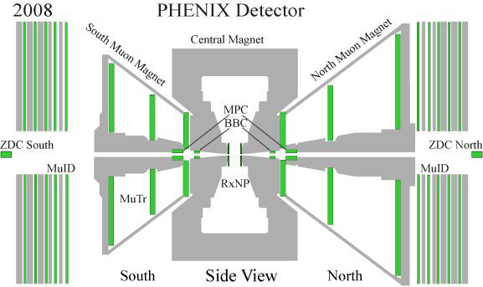
Forward Muon Trigger Upgrade
Hadron absorber
MuTr FEE Upgrade
RPC Stations 1 and 3 Station 1 installed this year
Background shielding Additional shielding installed this year
Additional shielding may be needed in the tunnel area. It will be studied with Run 12 data.

Slide 10
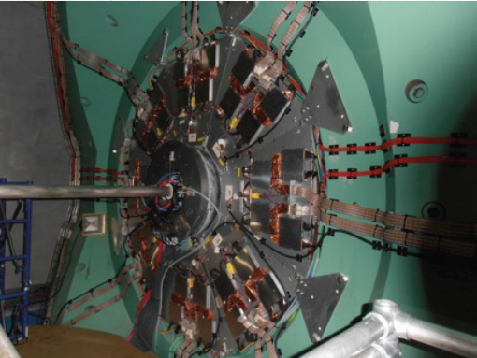
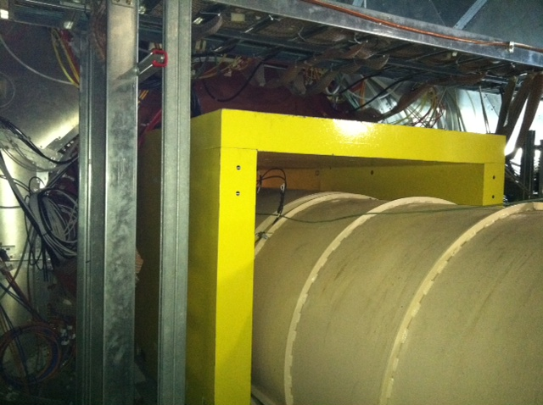
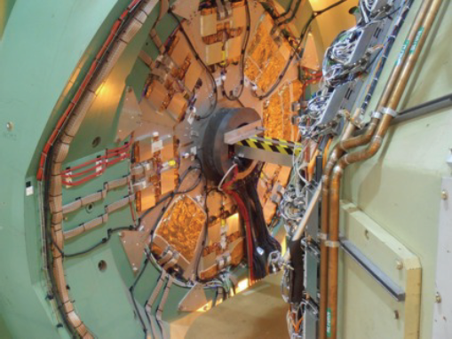
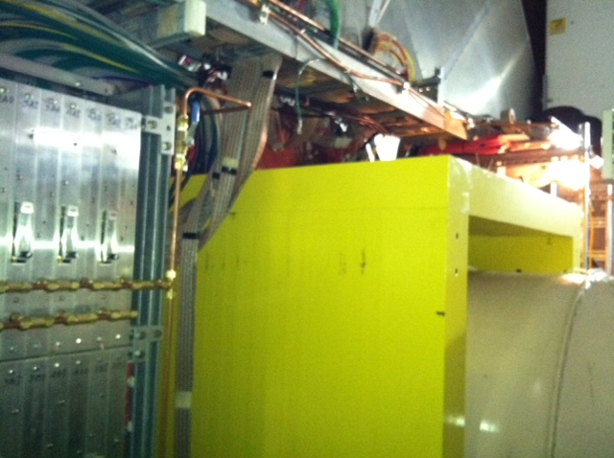
Run12 New Muon Trigger Hardware
South RPC Station 1
South Tunnel Shielding
North RPC Station 1
NorthTunnel Shielding
Many thanks to CAD and Dave Phillips for the new shielding!

Slide 11
Muon Trigger Commissioning Plans
1/11
Shifts have start at PHENIX
1/20
Target start of comic data-taking
Cosmics are needed to understand momentum smearing, charge-sign efficiency, trigger turn-on, backgrounds, etc.
  Plan to start with commissioning work and then go to collection mode. Would like to collect 3 weeks of cosmics.
  Cosmic runs can be squeezed into (hopefully small) periods of accelerator downtime during physics mode.
  We would like to take advantage of these periods as much as possible
    If we don’t accumulate sufficient statistics during Run12, may ask for additional time in June.
1/31
2 week ramp-up with 8 hours/night for experiments
  Allows us time to do commissioning with beams.

Slide 12
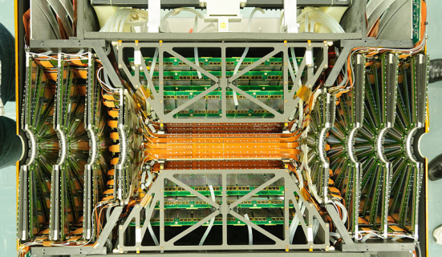
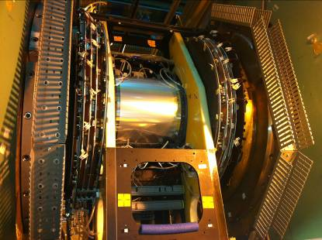
VTX/FVTX
VTX/FVTX in laboratory
FVTX detector integrated into VTX detector.
Now installed in IR
Cabling/cooling work finishing up
Next week: verify all signal/power cable connections and start commissioning
VTX/FVTX in IR

Slide 13
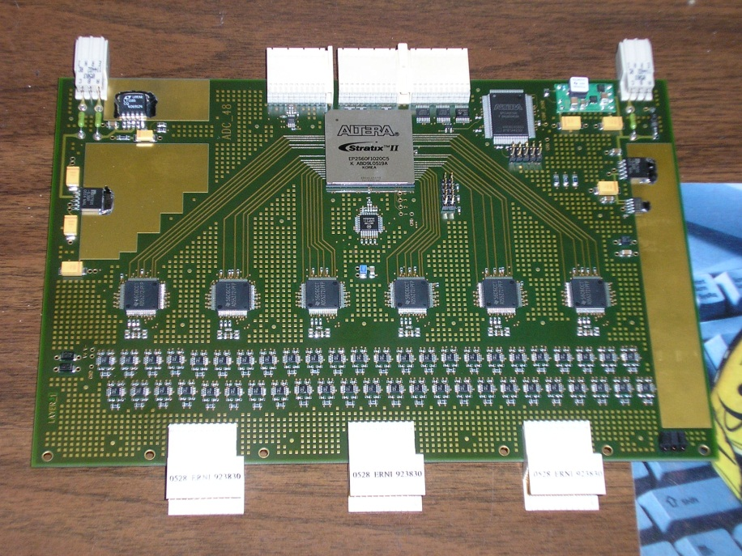
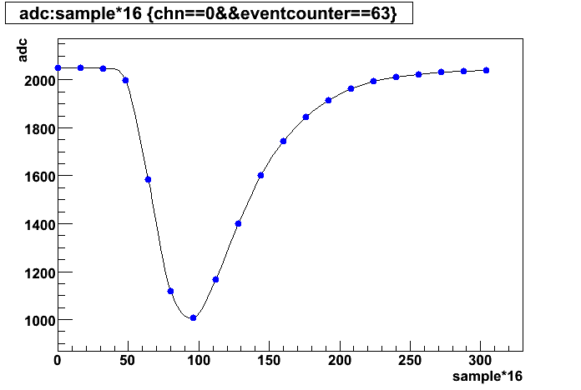
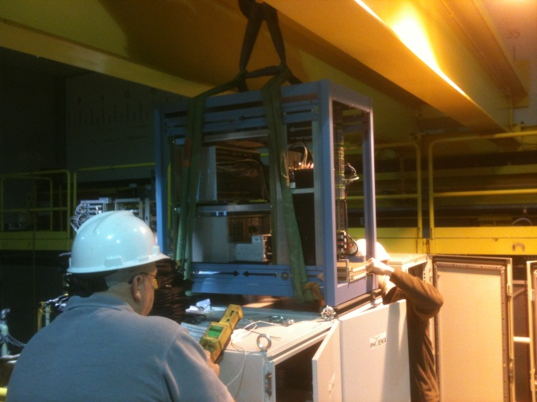
MPC Electronics
New MPC electronics (reuse HBD waveform digitizers) will be installed for the South MPC
  Will allow for improved energy resolution, improved handling of high rates, sharper trigger turn-on curve, and p_{T} (rather than energy) based trigger.
  Useful for A_{N}, Collins and A_{LL} measurements
  North MPC initially keeps old electronics, i.e. we can do physics while South is being commissioned
Cosmic data
New SMPC Electronics Rack being installed
13

Slide 14
Spin Service Tasks
Vernier Scans
  PHENIX should coordinate with Angelika before the run on step sizes/lengths, etc.
  Prefer 1 scan / week, preferably starting with low luminosity.
Local polarimetry
  This year plan to use the ZDC/SMD scalers to perform analysis in real-time.
  We would like to monitor the analysis outputs from MCR and perform a faster rotator commissioning at √s=500 GeV
  We plan to test the new system at √s=200 GeV.
    Will coordinate with Vincent on the details.
Relative Luminosity
  See next slide

Slide 15
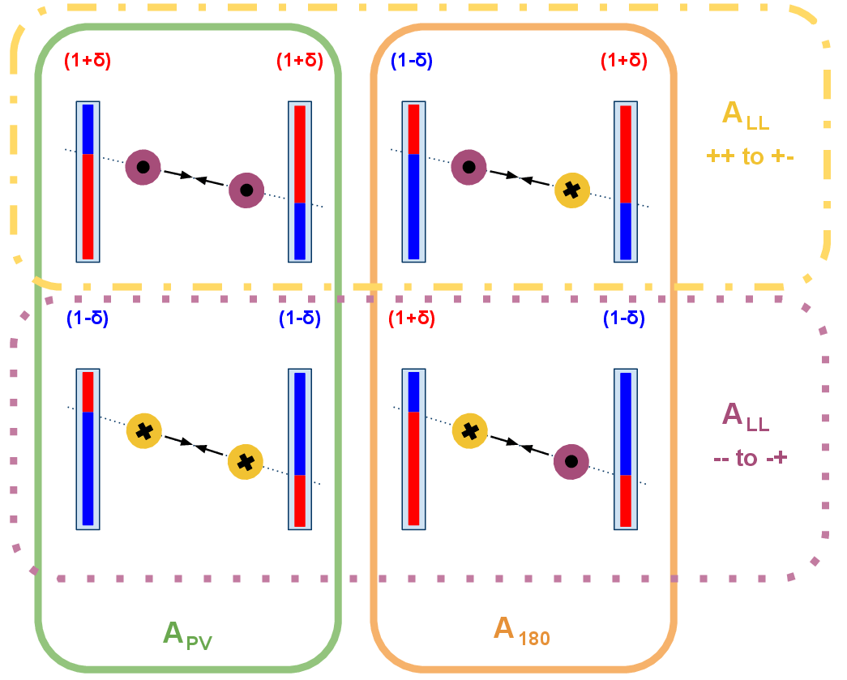
Relative Luminosity
Idea: the neutron A_{N} observed at zero angle is producing false double spin asymmetries in the ZDC because the beams have a small misalignments w.r.t. the detectors
Still working to finalize our beam request
Will be between 5 and 10 fills with angled/offset beams
Kieran Boyle and Andrew Manion, who have developed this idea, will present more details and the final request at the next RSC meeting.

Slide 16
Backup

Slide 17
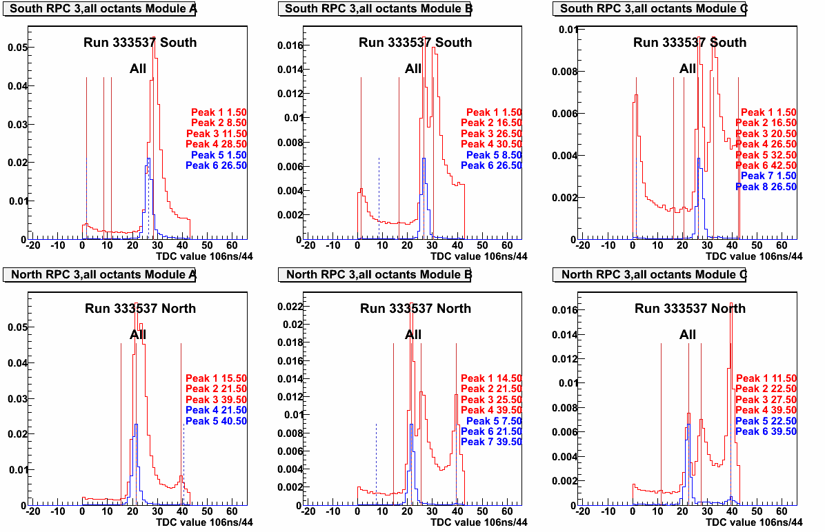
Importance of RPC Shielding
RPC inclusive TDC spectra
RPC TDC spectra muon coincidence
Run11 Data
Incoming beam
Background coming in slightly after muons from collision
Collision related, i.e. muons
Modules A, B are C are close, middle and outer from the beampipe.
Note that the two collision-related peaks merge as you get closer to the beamline
Detailed analysis by Ralf Seidl and Martin Leitgab

Slide 18
Importance of RPC Shielding
Collision related secondary is in-time with the muons! Poses a problem for the trigger!
Where is it coming from?

Slide 19
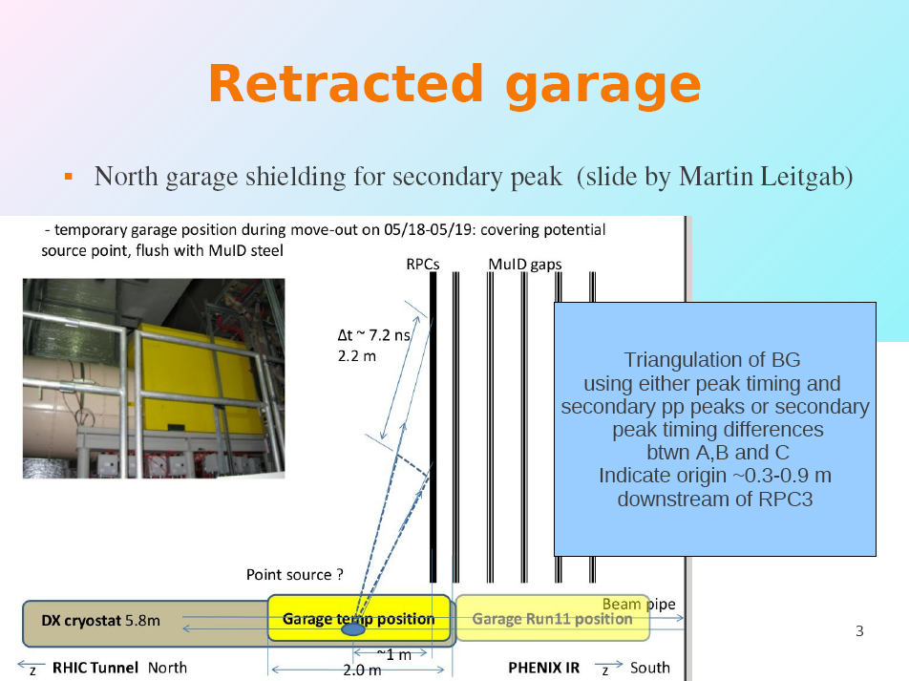
Slide from Ralf Seidl

Slide 20
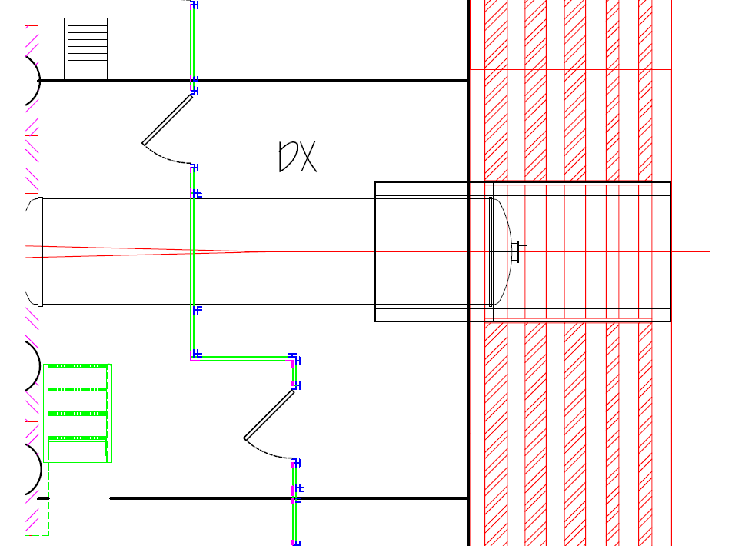
DX shielding
Slide from Ralf Seidl
DX Shielding has been added to PHENIX for Run12
Plan:
  Extend rail
  Extend Garage 5’ - 6’ out from last MuID steel (similar thickness as existing garage)
  Look whether something can be put below rail (lesser priority)
New Steel would cost ~50-60k, but
Old steel from AGS experiment available in ~6” thick sheets

Slide 21
Q3 Shielding
Additional shielding may be needed farther away from the RPC’s
Not an issue for the trigger because this background is in time with the incoming beam
But it will help reduce our background levels
  Lets us turn on the RPC’s sooner in a fill → Acquire more luminosity!
  Reduces currents in chambers

Slide 22
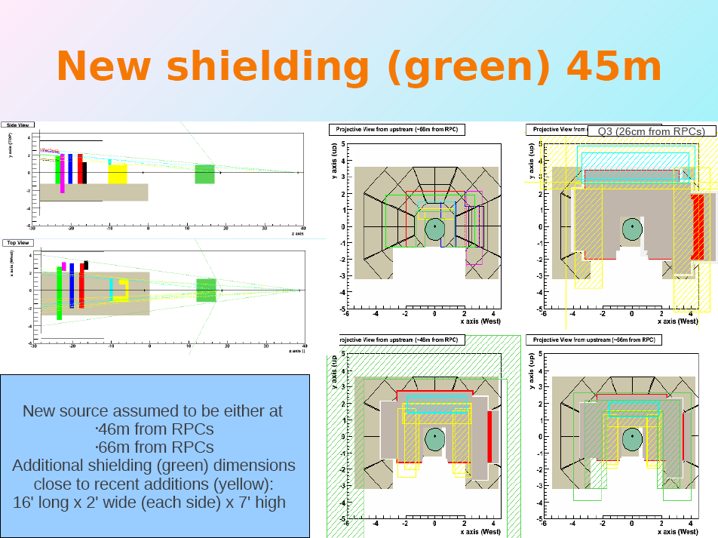
Slide from Ralf Seidl

Slide 23
Incoming BGs
Slide from Ralf Seidl
Lacking good idea of actual origin of the remaining BG
➔no dedicated (a la Q3) shielding possible
➔need to change strategy to tunnel cross section shielding to catch most of the origin positions
Add some shielding in the vicinity of the existing Q3 shielding
Possibility of not enough material for Q3 shielding (especially on top)
➔Beef up top shielding plate lengths

Slide 24
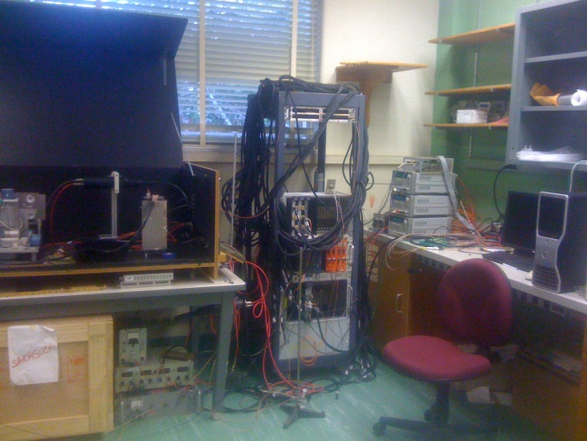
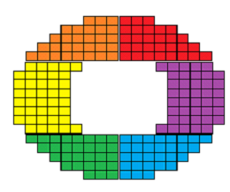
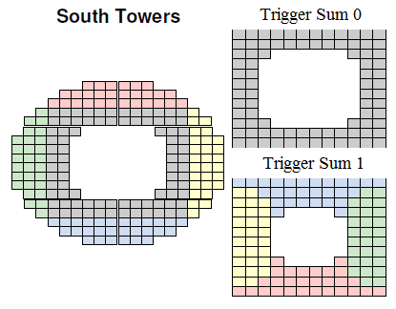
MPC Trigger Upgrade: Hadrons+Di-Hadrons
Slide from Scott Wolin
Current Trigger Calculation
  Wrong topology for di-jet trigger
  Lower rejection power
  Have to prescale
New Trigger Calculation
  6 Azimuthal trigger sums
  Can trigger on coincidence high p_{T} jets in opposite hemispheres
Beam
Beam
Scintillators
HBD ADC
PHENIX DAQ

Slide 25
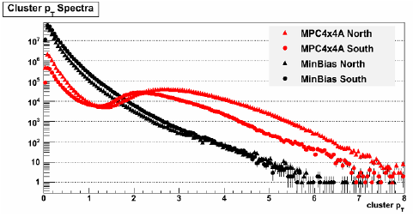
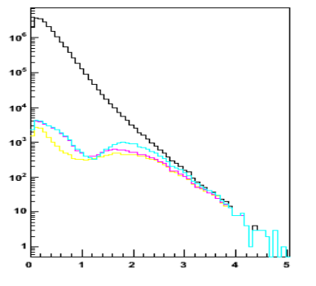
Comparison of Trigger Turn-On Curves
Slide from Scott Wolin
Run 9 Data: Analog Sum
Run 9 Simulation: Digital Sum
Turn on width
~ 1 GeV/c
Turn on width
~ 0.6 GeV/c
Yellow: 2x2 realistic gain, gain corrected, sums only within module, ½ threshold on joining edges
Magenta: 2x2 realistic gain, gain corrected, pt threshold, sums only within module, ½ threshold on joining edges
LightBlue: 2x2 realistic gain, overflow bit (ie, map 0-1024 ADC to 5 trigger bits, rather than the full 2048 possible), sums only within module, ½ threshold on joining edges

Slide 26
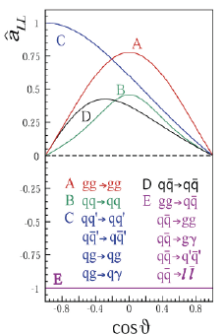
A_{LL} projections from simulation
LO QCD
A_{LL} is determined in pythia via event-by-event calculation of asymmetry weights
DSSV w/modified Δg(x) (see next slide)
(cancel event-by-event)
CTEQ PDFs
Slide from Cameron McKinney

Slide 27
A_{LL} projections from simulation: modified Δg(x)
Δg(x)’s from DSSV
x*Δg(x)
x
DSSV-Standard(ΔG ≈ 0)
DSSV-Min (negative ΔG ≈ -0.3)
DSSV-Max (large ΔG ≈ 0.7)
Also scale model Δg(x)’s to give different total ΔG’s
Slide from Cameron McKinney
27

Slide 28
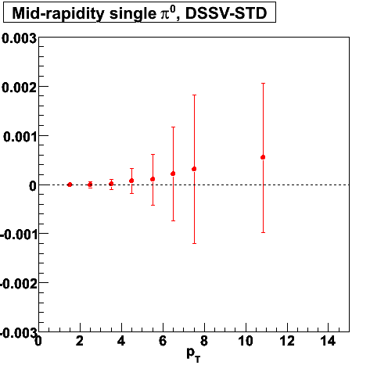
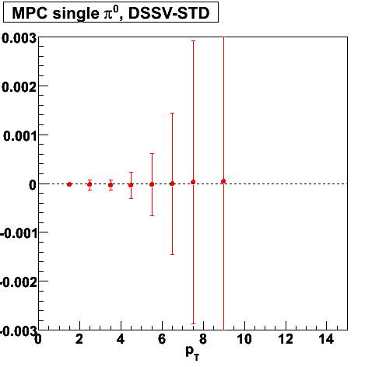
A_{LL} projections from simulation
Δg(x) = DSSV-STD (ΔG≈0)
A
π
0
A
π
0
LL
LL
= assumed systematic uncertainty of 10⁻⁴
(GeV/c)
(GeV/c)
Small ΔG→Small asymmetries
Slide from Cameron McKinney
Notes:
Which projections?

Slide 29
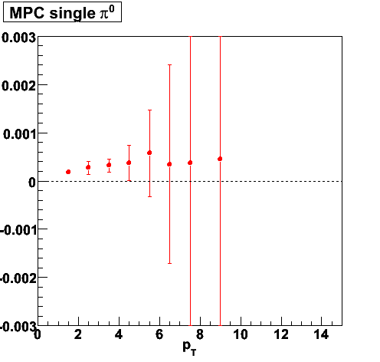
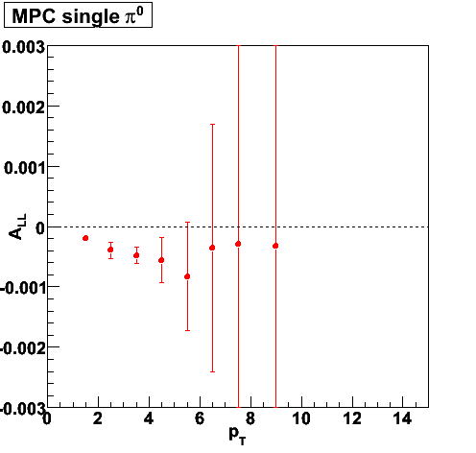
A_{LL} projections from simulation—MPC Single π⁰
DSSV-MAX scaled to ΔG=0.35
A
π
0
LL
DSSV-MAX * -1
(sensitive to sign of ΔG)
Cranking up ΔG leads to non-zero A_{LL}
Slide from Cameron McKinney
Notes:
Change scale on lower left plot

