Slide 1
AGS PP Progress
Haixin Huang
RSC Meeting
January, 13, 2012

Slide 2
Status
70+ AGS magnets have been moved during summer shut down aiming at better orbit. Horizontal orbit definitely changed. Still evaluate the impact.
Linac running with Einzel lens for user4 and user5. Polarization is around 78-79%.
Emittance is smaller than last run at flattop as reported by IPM: 13pi for 1.5*10^11.
Tune scan at various intrinsic resonances are done, but more detail scan will follow.
B Field scan done and showing that the setting is at optimized location.
Jump quads on/off have been done several times, the polarization gain is relatively 10%.
The vertical tune at 36+ can be pushed to 8.993 and resulted higher polarization.
With vertical damper on, the polarization is about 61% for 1.7*10^11.
Injection polarization measurement done with CNI polarimeter for the first time.

Slide 3
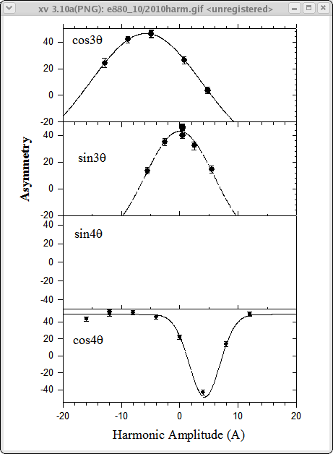
Booster Harmonics Scan
2010

Slide 4
Booster Harmonic Scan
2010 2012
Cos 3v -5.80 -5.76
Sin3v -0.03 0.83
Cos4v 4.63 3.34*
*(not enough points)

Slide 5
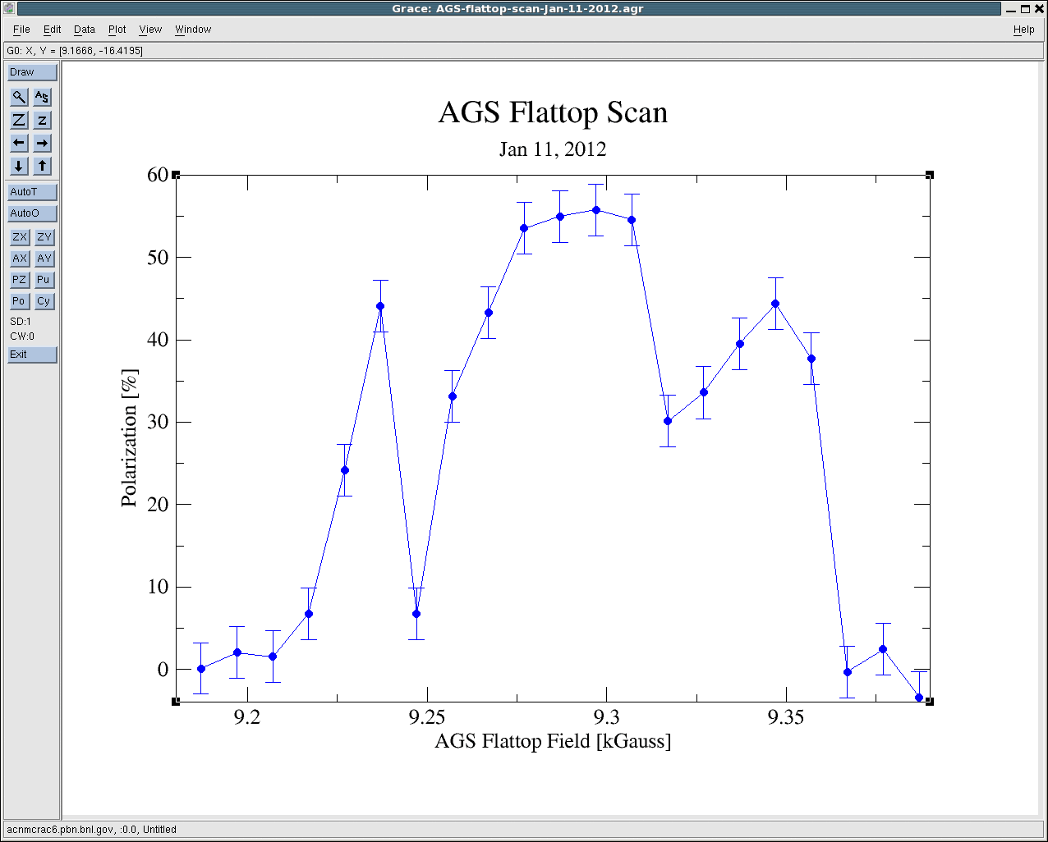
B Field Scan
Qy=8.68 at flattop, the two dips should be apart by 72G. There is no surprise on this plot.

Slide 6
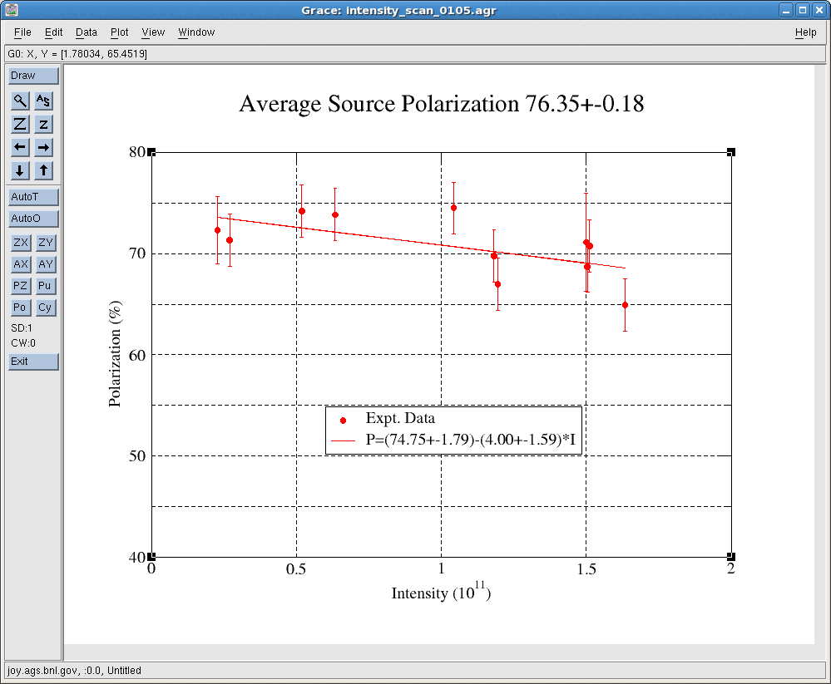
First Intensity Scan
Not too different from April 2011

Slide 7
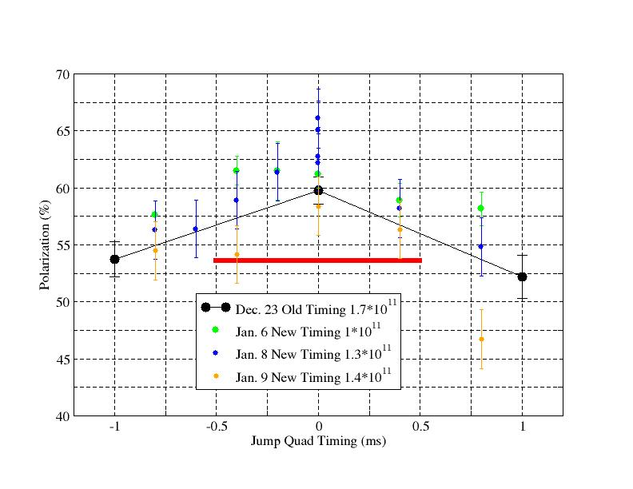
JQ Timing Scan
The data from last night is not so good.

Slide 8
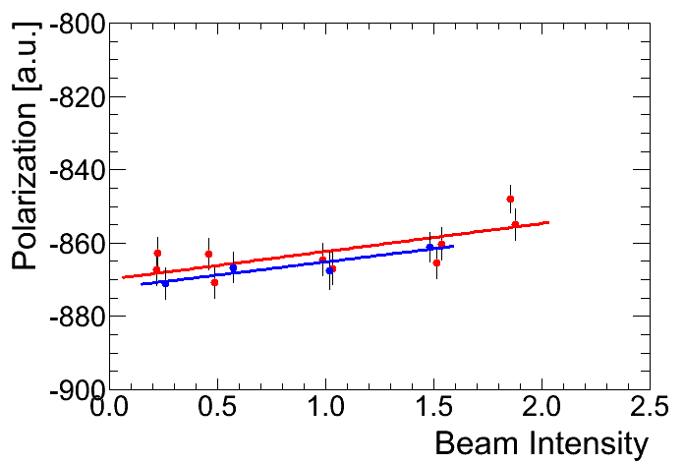
Injection Polarization Intensity Scan
(Fit by Andrei)
51397-51407 -869.9+-2.6 +7.6+-2.25 1421-51425 -872.3+-4.4 +7.2+-4.5
The slope is much less than at flattop: 0.9% vs. 5%.

Slide 9
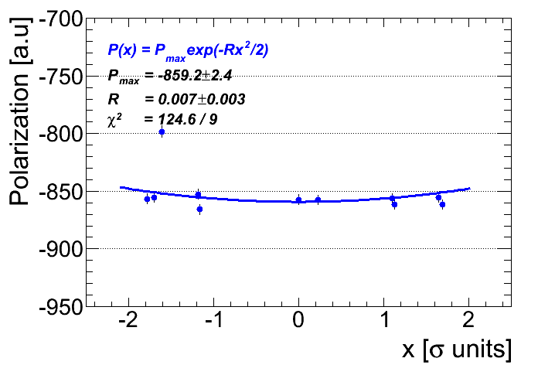
Injection Polarization Horizontal Profile
Arbitrary unit for the asymmetry.
(Fit by Andrei)

Slide 10
Remaining Job List
Scan the important parameters (Qy and possibly Qx, harmonic orbit) for polarization.
Vertical damper on and push vertical tune higher.
Load the jump quad timing for early part of ramp (before transition) to see if it give us additional gain of polarization. First test is to make sure P/S can take it.
Fine tuning the pulse shape for each pulse..
Injection matching tuning (with tunemeter spectrum as monitor)
Modeling work with bare AGS on user3.
Extraction setup.

