Slide 1
RHIC Status
Haixin Huang
April 8, 2011
RSC Meeting

Slide 2
Status
Peak luminosity reached new record of 150* 10^30 cm^-2 s^-1.
Bunch intensity is typically 1.8*10^11 and as high as 1.9*10^11. We have seen no indication of limit from 9MHz cavity.
Collimator on the ramp has been put into use since last Friday.
Vertical tune at store has been raised to improve beam life time.
Horizontal tune on the ramp (tune swing part) has been lowered by 0.003, not much effect seen on polarization.
We will keep Booster scraping in while maintain intensity at 1.7-1.8*10^11 level. Using other means (source temperature, AGS setup, AtR tuning) to maintain the intensity.
Down ramp development yesterday and successful chromaticity feedback with proton beam.

Slide 3
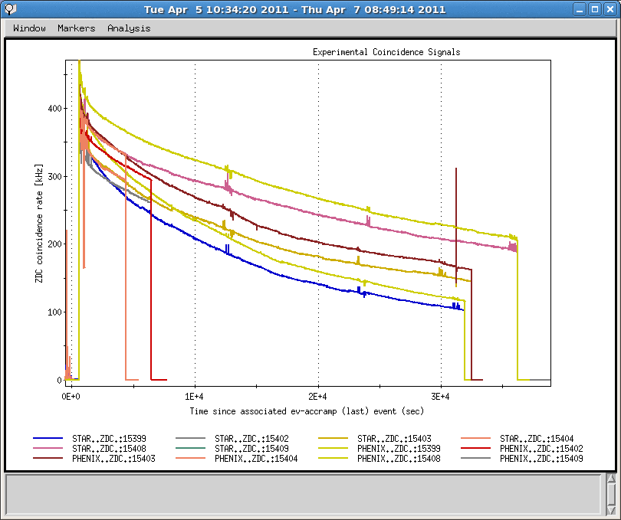
Luminosities in Last a Few Stores

Slide 4
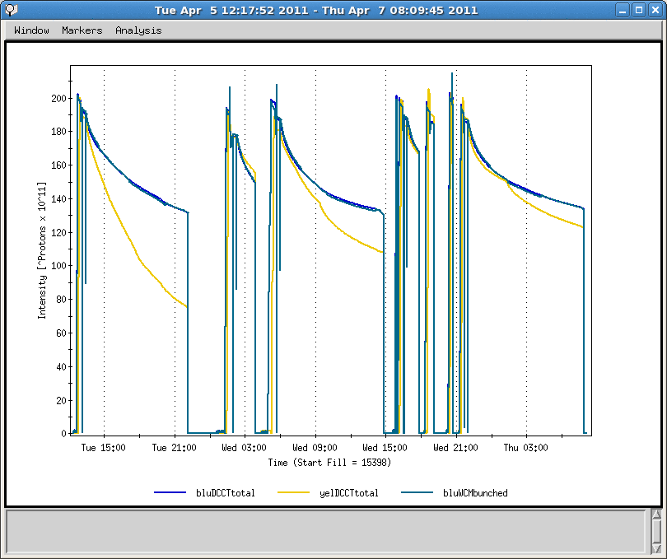
Intensity

Slide 5
Polarization Sensitivity Tests So Far
  We scanned snake current +-5A (+-150mirco-rad), no change of polarization transmission efficiency. But we plan to do more.
  We scan the vertical tune on the ramp and it stays at a plateau. Tune control on the ramp is also very good.
  We greatly improved the rms orbit this run through orbit feedback. The BPM offset sign reversal and realignment of vertical should improve the orbit, too.
  Vertical chromaticity is in the 2-3 range over the sensitive range (100-250GeV).
  Possible sources of polarization loss on the ramp: misalignment between magnets and BPMs; coupling at later part of ramp; and horizontal tune/chromaticity because of coupling.

Slide 6
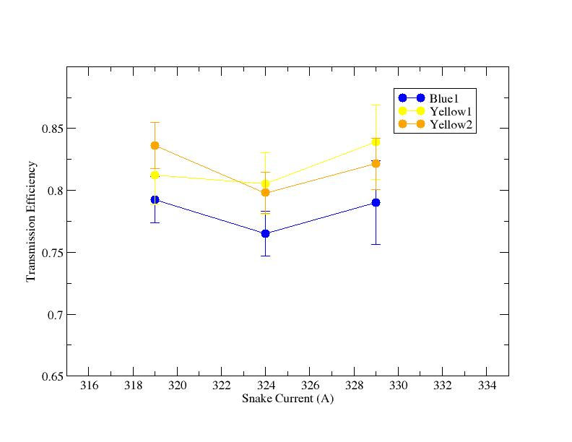
Inner Snake Current Scan
snake current +-5A (+-150mirco-rad)

Slide 7
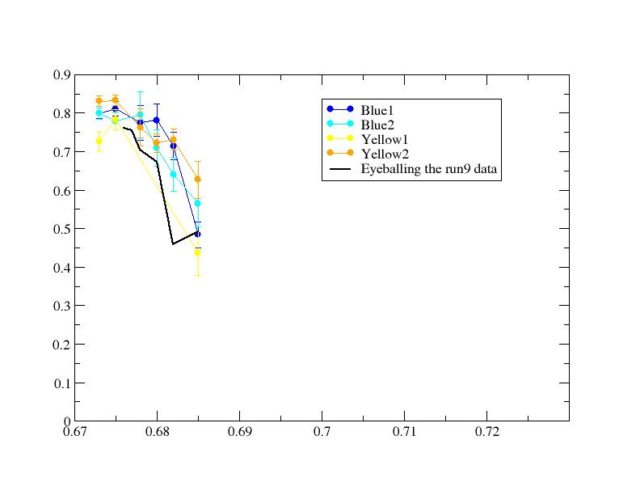
Vertical Tune Current Scan

Slide 8
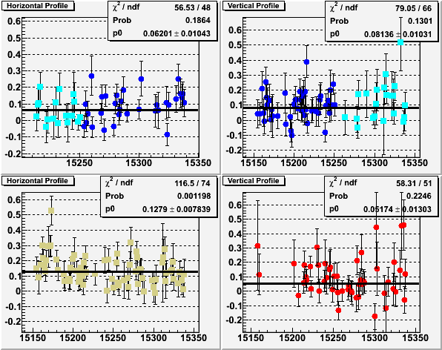
Polarization Profiles @injection

Slide 9
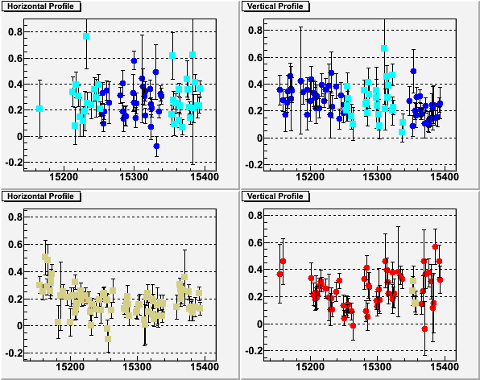
Polarization Profiles @250GeV
0.2 lately
0.25
0.2
Overall they are better than run9, but the profiles are steeper than injection.

Slide 10
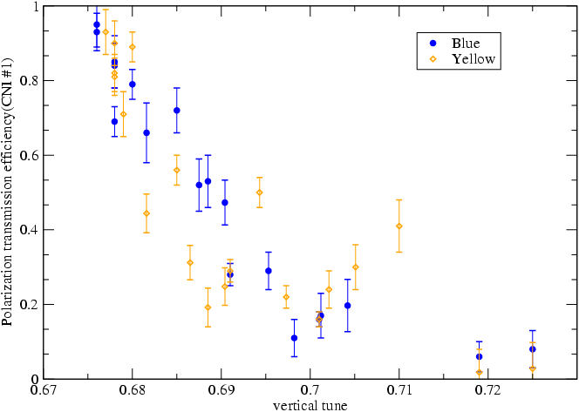
RHIC Polarization Transmission to 250GeV
The relative gain of polarization by moving Q_{y} from .68 to .676 is 1.12. The actual efficiency is about 80% instead of 93% (based on jet calibration). The hope is that the close orbit error reduction gives additional gain.
From online polarization measurements
11/16 resonance
7/10 resonance
3/4 resonance
New Working pt 0.673
Working pt for 250GeV run

Slide 11
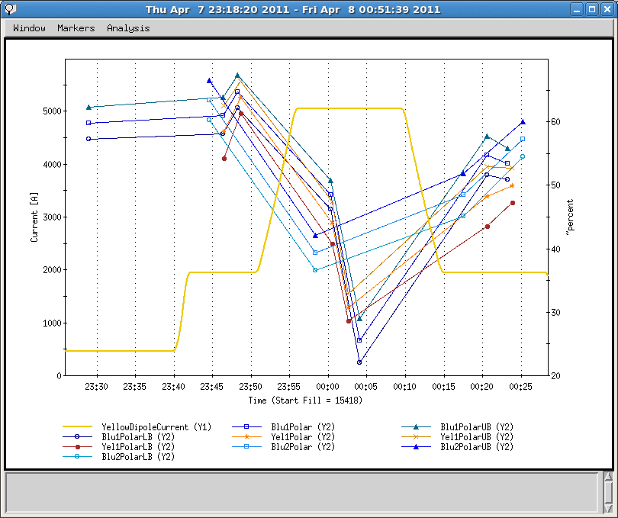
Ramp Measurements
Preliminary ratio of three ramps:
100->100:0.777+-0.025
100->250:0.727+-0.016
The ramp is a factor slower. So any depolarization effect should be stronger than the regular ramp.

Slide 12
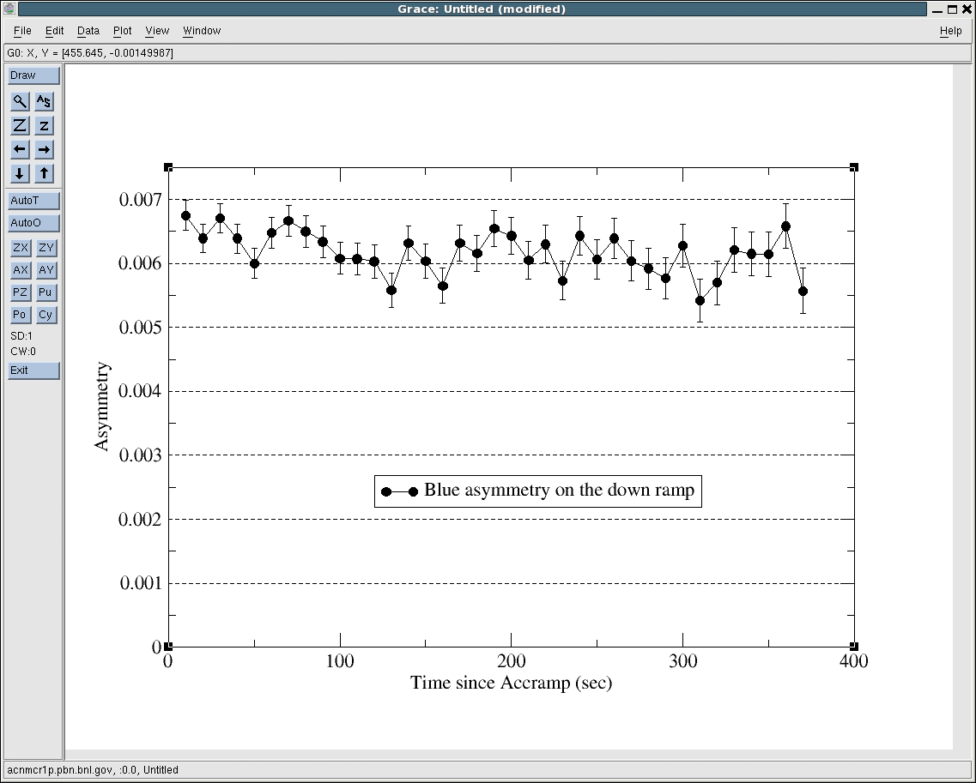
Asymmetry on the Down Ramp

Slide 13
Possible Study List (14-30 hrs)
Ramps with vertical tune at 0.71 and 0.72. Bunch intensity of 1.3-1.4*10^11. Two ramps. The purpose is to see if higher polarization can be reached this year after all the effort to reduce orbit errors. We measured close to zero polarization last run. 3-4 hours.
Ramp with vertical tune at 0.671 to see if we indeed reach transmission efficiency plateau. The last attempt was lost during ramp, but passed the low tune part. May need two ramps. 3 hours.
12 bunch ramp and stay at store for half hour to check e-cloud effect on emittance growth. 1hr.
109x109 2.5 to 3e11/bunch acceleration (requires ½ hr tunnel access). 2 hrs.
Emittance growth at store without collision (expect to see no emittance growth in store). 1hr at store +1 hr setup.
Test of the new configuration of the llrf loops for the 9 MHz mode. The goal of the new loops is to achieve lower longitudinal emittance and shorter bunches at store. 2 hours at injection and possible 6-bunch ramp.
Near integer working point 16 hours.

Slide 14
Plan
  Parasitic parameter scans (snake current).
  Parasitic moving parameters in steps over many stores (horizontal tune, horizontal chromaticity).
  Follow the prioritized study list to do beam study.
  To identify the source of possible polarization loss, we need polarization profile information during store (combine the profiles from different stores to gain statistics).
  Also need modeling the up and down ramps with different ramp speed.
  Most importantly, provide physics stores.

Slide 15
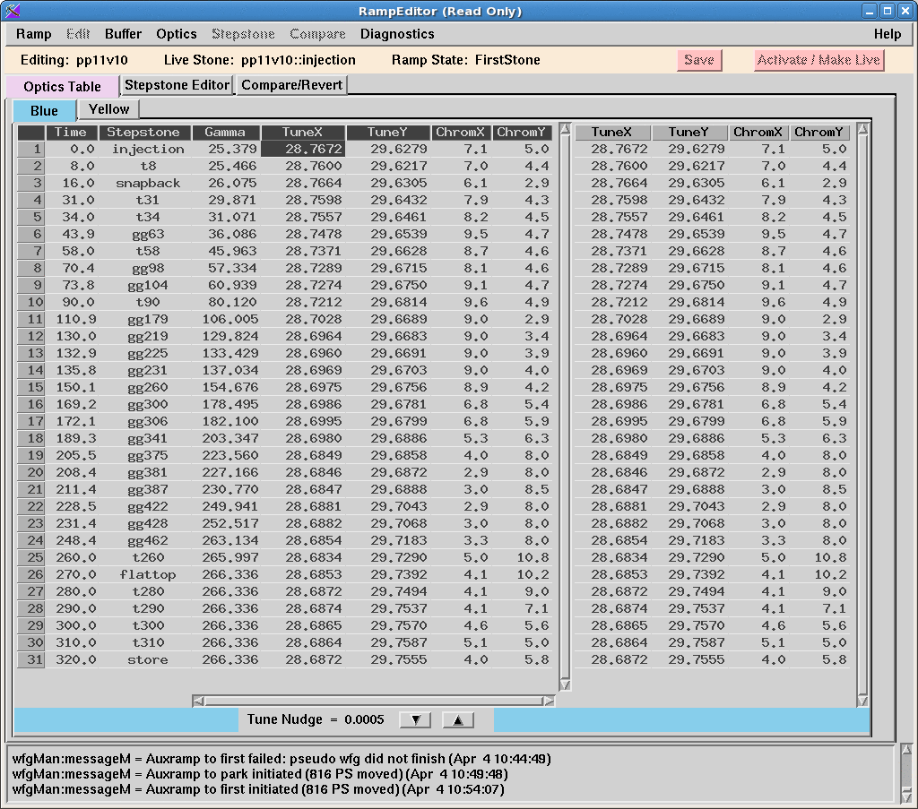

Slide 16
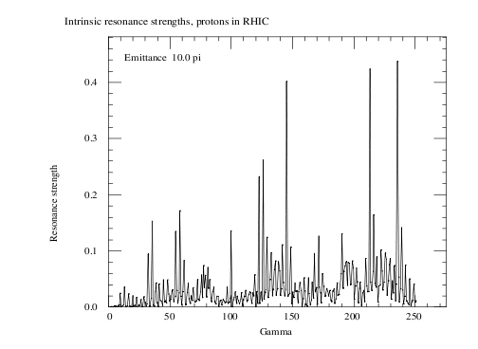
Vertical Intrinsic Resonance Spectrum in RHIC

Slide 17
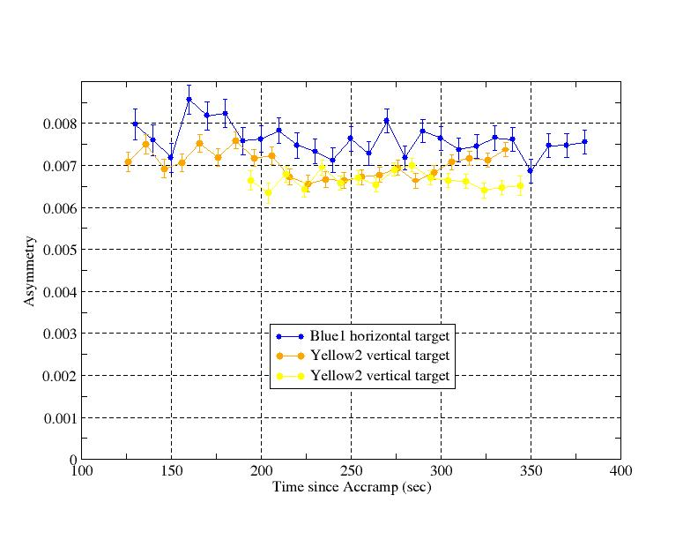
Ramp Measurements
110s: 100GeV; 270s: 250GeV; 320s: done beta squeeze
Seen flat asymmetry over the range. But if assuming analyzing power dependence on energy, polarization drop shown around 200sec.

