Slide 1
RHIC Status
Haixin Huang
March 25, 2011
RSC Meeting

Slide 2
Status
  Intensity has been pushed to 1.4*10^11/bunch at beginning of store. Polarization seems not affected as measured by jet.
  Lowered vertical chromaticity on the ramp. Started vertical tune (on the ramp) scan over stores. So far only two points: 0.675, 0.673.
  Optics correction was put in for blue (to reduce beta beat). It improved collision rate at PHENIX, but made STAR one worse.
  Working point adjustment (raise vertical tune) in blue improved blue lifetime. Now yellow lifetime is worse than blue.

Slide 3
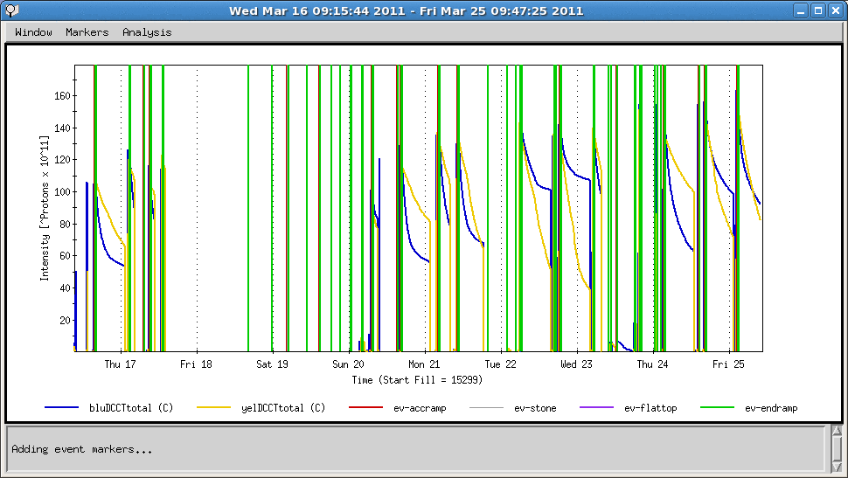
Beam Intensity of Past Ten Days

Slide 4
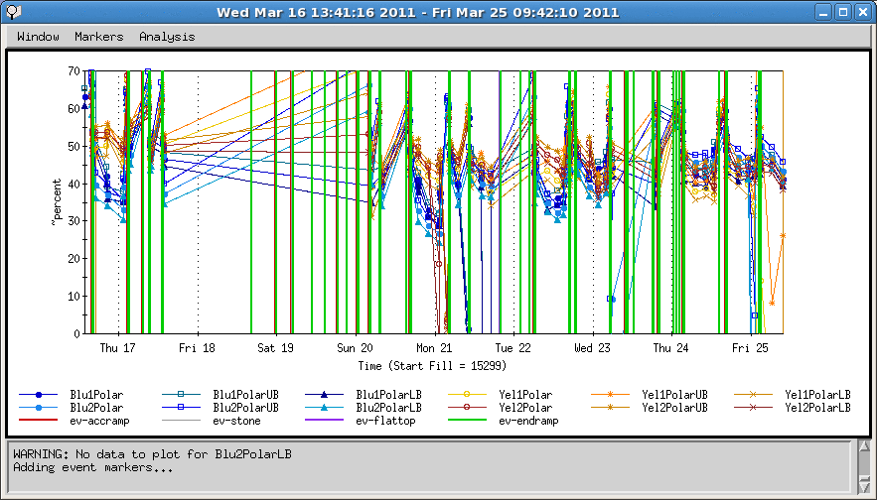
Polarization in Past Ten Days

Slide 5
Plan
  Optics correction in today’s machine development.
  Finish the tune scan (0.671, 0.678, 0.68).
  Increase bunch intensity. AGS can deliver 2.2*10^11, we have been using 1.8*10^11 so far. We need to look the AtR matching.
  To identify the source of possible polarization loss, we need polarization profile information for all fills (vertical and horizontal, injection and store), as soon as possible.
  To confirm the polarization loss, polarization measurements on the up and down ramps are needed.

