Slide 1
RHIC Status
Haixin Huang
March 4, 2011
RSC Meeting

Slide 2
Status
  Started seen de-bunching problem on Monday with 9MHz cavity in blue. Added diagnostics on Monday. The phenomenon disappeared after maintenance day. There are glitches with 9MHz cavity running in past one week: phase jump; blue emittance sensitive to noise; tuner clutch mechanical problem.
  Measured chromaticity with 9MHz cavity on the ramp for the first time in machine development. A minor adjustment for vertical chromaticity in the vertical tune swing part was done.
  Working point has been pushed lower to achieve better lifetime. The blue polarization transmission efficiency seems improved a little bit.
  The yellow intensity has been pushed higher: 1.3*10^11 at flattop.

Slide 3
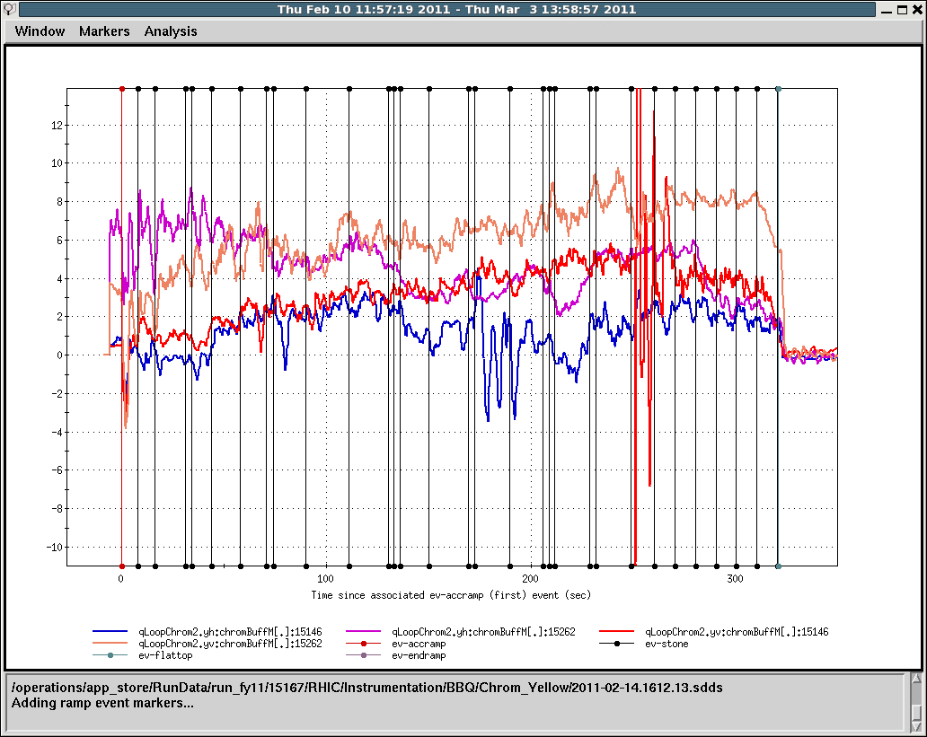
Yellow Chromaticity on the Ramp

Slide 4
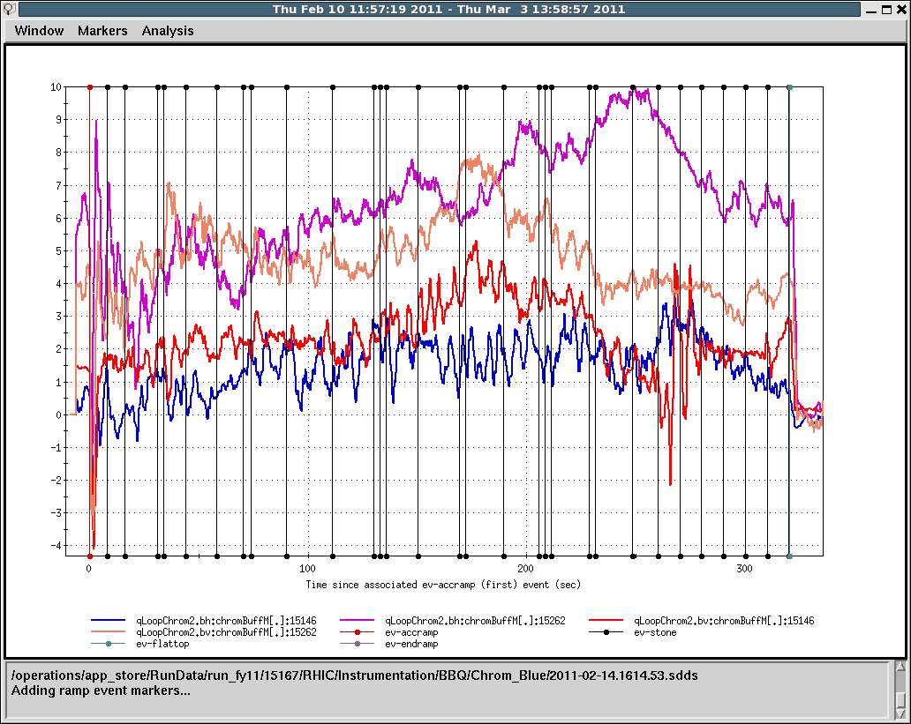
Blue Chromaticity on the Ramp

Slide 5
Toward Higher luminosity and Polarization
  Increase bunch intensity gradually.
  Need snake current scan to set spin tune close to 0.5. This will be done over many stores. We will start in the overnight store.
  Poor lifetime at beginning of store. Change working point for blue. APEX session next week will continue this.

