Slide 1
RHIC Status
Haixin Huang
Feb 25, 2011
RSC Meeting

Slide 2
Status
  9MHz cavity commissioning was successful and it is in operational last night.
  With dp/p cut in half, we have more room to push chromaticity. Raised set values by 2 units (was aronud 2) on the ramp.
  10Hz orbit feedback has been put into use at beginning of store, which reduced the luminosity oscillation and improved lifetime.
  Vertical tune swing has been moved earlier by 30s on the ramp to cover a strong resonance below 100GeV. Not much change in the polarization transmission efficiency seen. Left it in operation.
  Several round PHENIX rotator setting changes. Dial in the best guess last night during store.

Slide 3
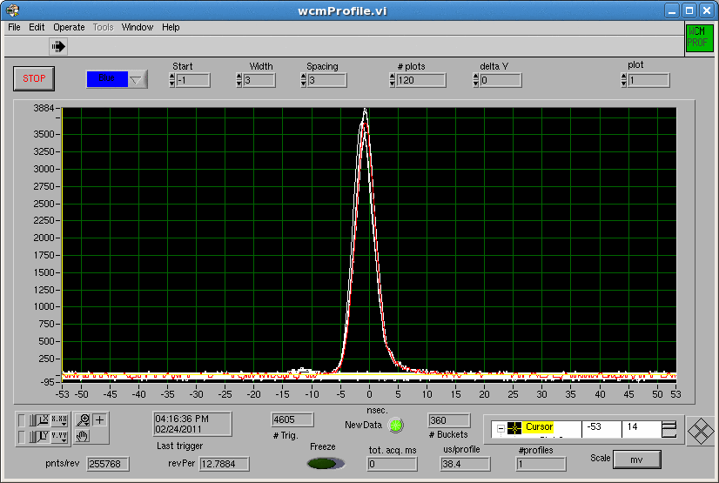
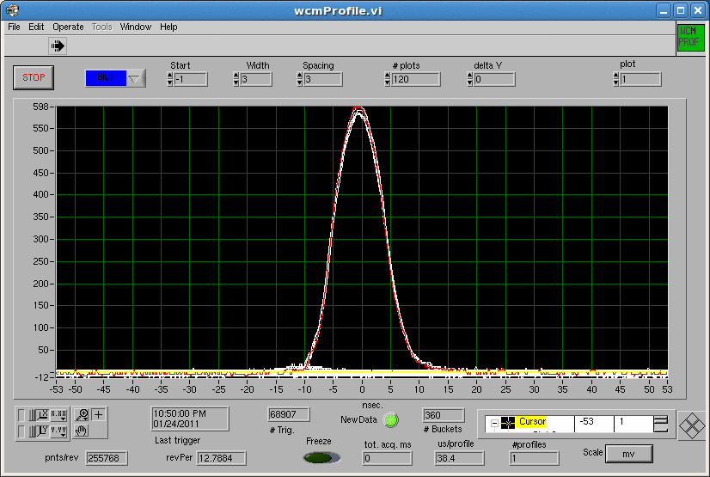
Bunch Shape after 9MHz and 28MHz Ramps
9MHz/197MHz
28MHz

Slide 4
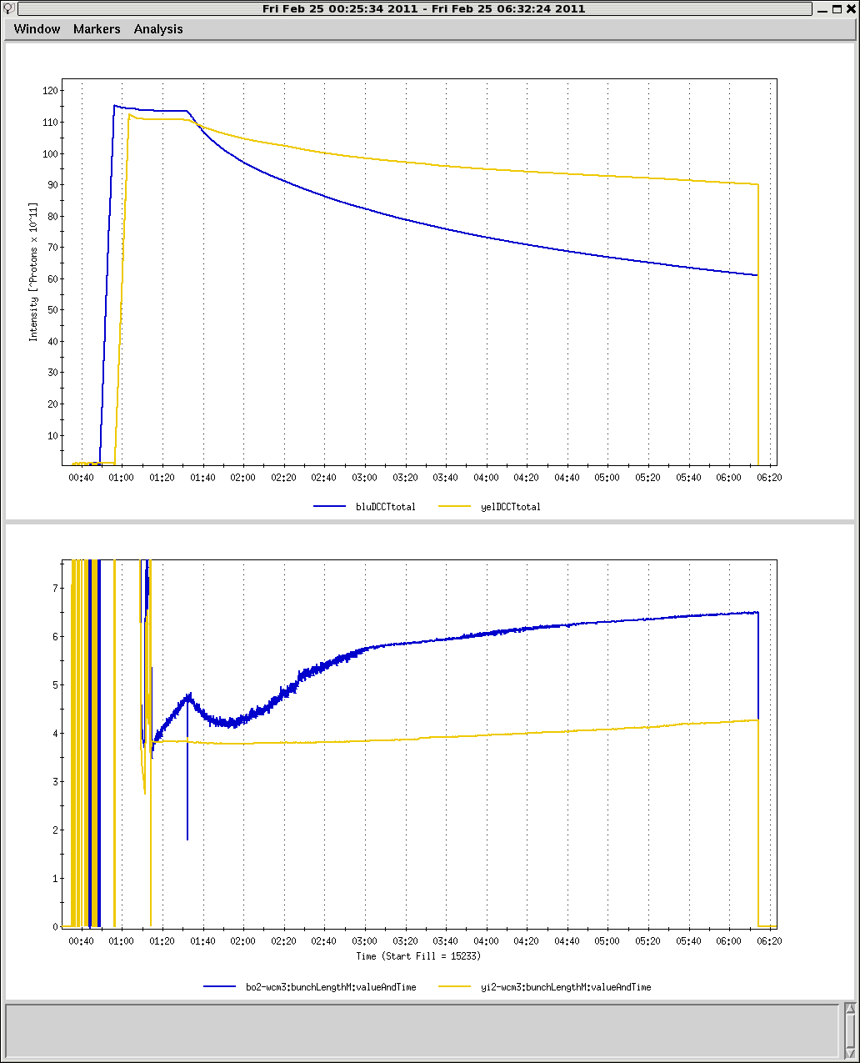
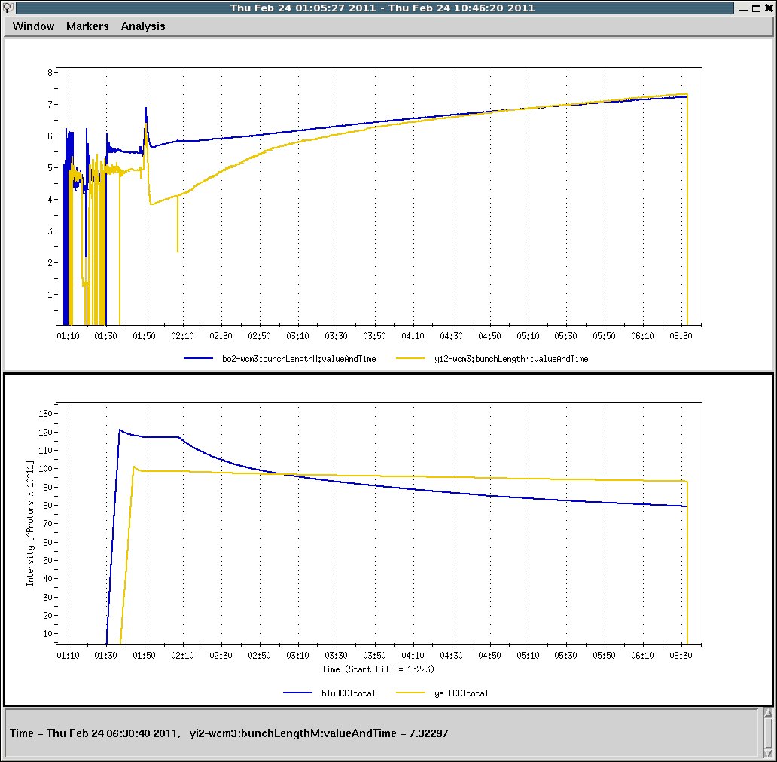
Bunch Length after 9MHz and 28MHz Ramps
The phase has been adjusted for blue after this store
28MHz
9MHz/197MHz

Slide 5
New Ramp (Moving Tune Swing Earlier by 30 seconds)
New ramp
Injection Store ratio Injection Store ratio
Blue Yellow 68.7 2.3 63.2 2.4 0.92 0.05 65.4 2.9 64.9 2.2 0.99 0.05 63.7 2.6 60.7 2.3 0.95 0.05 65.9 2.3 63.2 1.7 0.96 0.04
Old ramp
Injection Store ratio Injection Store ratio
Blue Yellow 61.2 2.2 56.2 2.1 0.92 0.05 62.8 2.0 60.5 1.9 0.96 0.04 62.5 2.1 57.6 1.9 0.92 0.04 63.1 1.4 60.5 2.5 0.96 0.03
The store values are based on run4 100GeV A_N (the one used since run4).

Slide 6
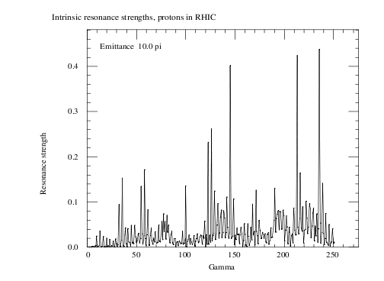
Resonance Spectrum
Old ramp tune swing when reach .675
New ramp tune swing when reach .675

Slide 7
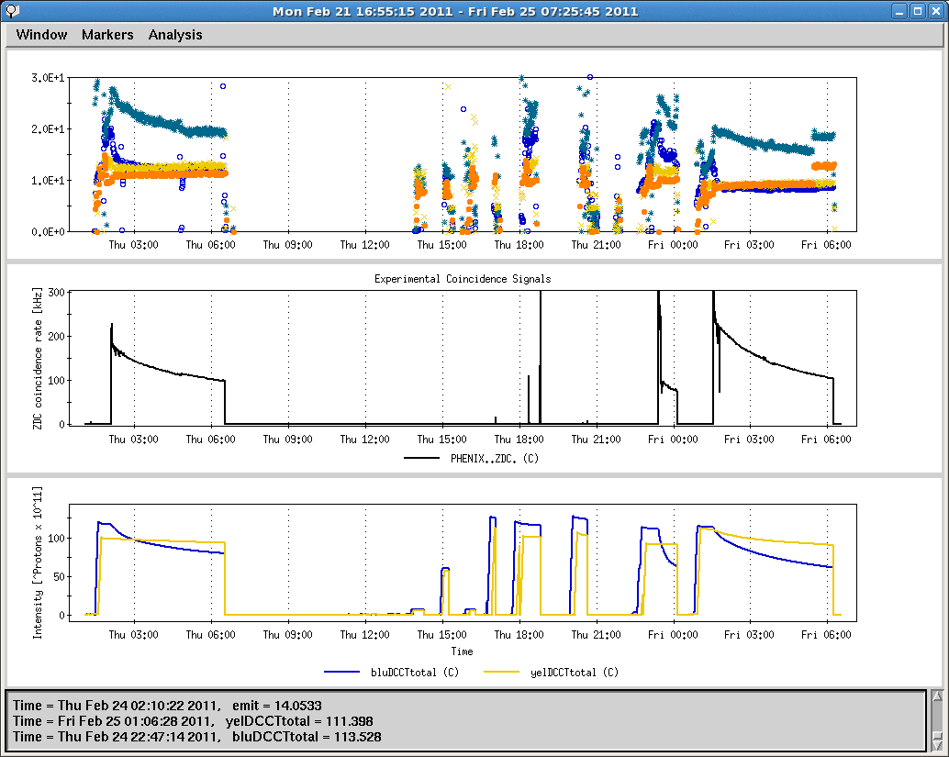
Emittance and Luminosity

Slide 8
Toward Higher luminosity and Polarization
  Injection/AtR efficiency for yellow. Yellow injection kicker timing adjustment seems helpful, but did not stay. Missing some bunches last night is a new thing with 9MHz cavity. RF group is aware of it.
  Injection drift compensation, need chromaticity measurement for this compensation. Without a good setting, we lose beam at injection due to poor lifetime.
  Increase bunch intensity gradually.
  Need snake current scan to set spin tune close to 0.5. This will be done over many stores. We will start after settled on PHENIX rotator current settings.
  Poor lifetime at beginning of store. Change working point for blue.

Slide 9
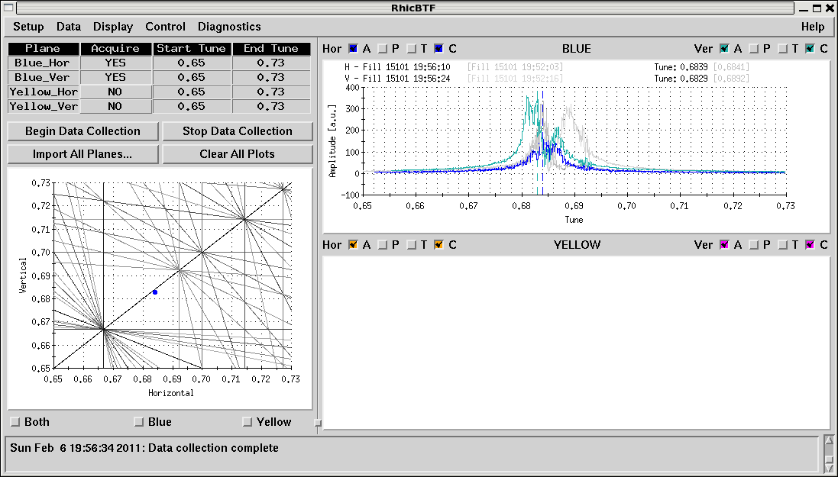
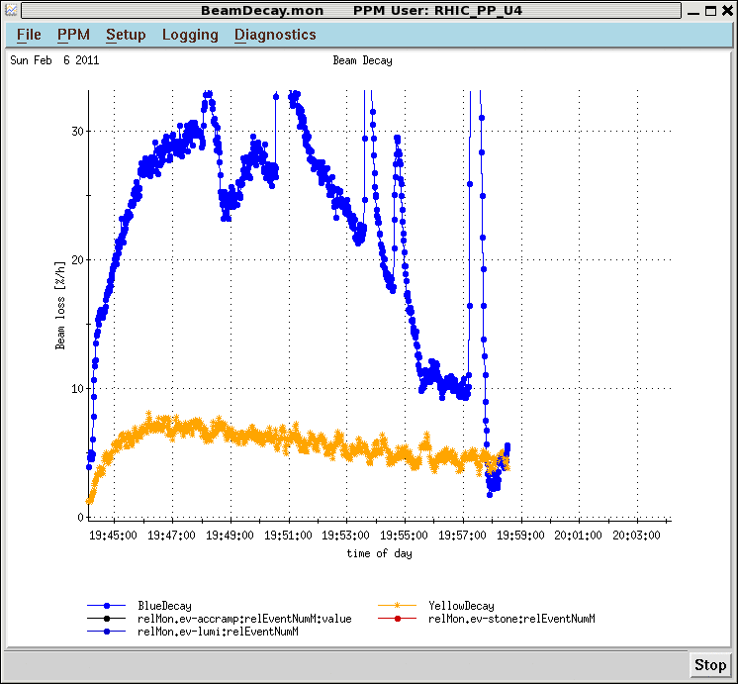
Blue Lifetime with Different Working Point
On Feb. 6, in Yun’s shift, good lifetime with tunes moved to (.683,.682). We will try that when machine is back.

